Slide 1
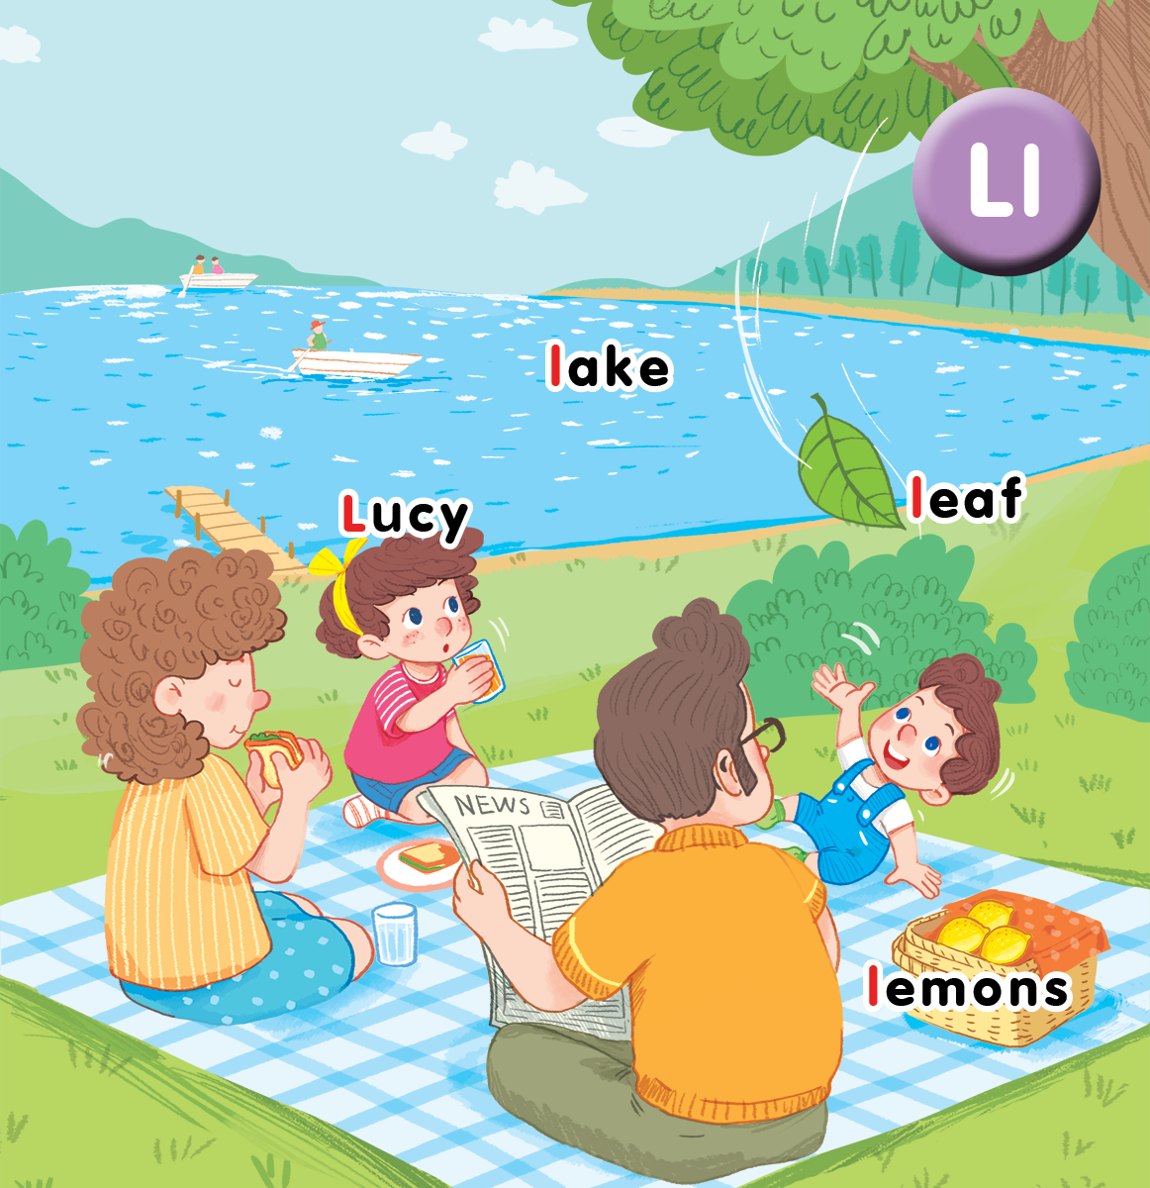
Unit 12 At the lake Lesson 3
Notes:
By the end of the lesson, pupils will be able to:
- introduce a thing with the structure “That’s a/my____” .
- sing along the unit song.

Slide 2
Warm-up
Notes:
Word making
Goal: Warm up and revise the words.
Time: 3 minutes
Give each group a set of letters.
In 2 minutes, pupils will stick on board words that they can make from letters.
Group with most correct words will be the winner.
Have pupils read in chorus all the correct words.

Slide 3
Listen and repeat
Notes:
Listen and repeat is divided in to 2 steps.
Step 1
Goal: Pupils will be able to understand the meaning of the imperative: Look at…
Time: 5 mins
Point to the picture of mango and say Look at the mango.
Repeat 3 times and have pupils repeat the sentence.
Do the same with the picture of leaf.
Explain the meaning of the structure if needed.
Step 2
Goal: Pupils will be able to practice listen and repeat task in textbook.
Time 2 mins
Have pupil open the book and practice listen and repeat in chorus, in groups then individuals.
Step 3
Goal: People will be able to practice more the new structure.
Time: 2 mins
Stick around the class wall with some flashcards.
Say Look at… and pupils will look at the picture that teacher mentioned.
Next turn, 1 pupil says and the others do.

Slide 4
Look at
the lemons

Slide 5
Look at
the leaf

Slide 6
Look at
the lake

Slide 7
Let’s talk
Notes:
Let’s talk is divided into 2 steps.
Step 1
Goal: Practice speaking the structure Look at… in the text book, task 7.
Time: 3 mins
Point to the picture of Lucy and say Look at Lucy.
Have pupils point and say.
Point to the picture of lemon and say Look at the lemon.
Have people point and say.
Pupils work in pair, point and say, using the structure and picture of task 7.
Step 2
Goal: Practice the structure “Look at_____” in real life.
Time: 5 minutes
Have pupils choose one flashcard/thing and say the structure “Look at_____”.
After that, ask the whole class if it is Yes or No.
Have the whole class repeat that sentence in chorus.

Slide 8
Let’s talk.
Notes:
File sách mềm chưa cập nhật

Slide 9
Let’s sing
Notes:
Let’s sing is divided into 3 steps.
Step 1
Goal: Pupils will be able to read the song lyrics.
Time: 3 minutes
Have pupils read the song lyrics in chorus then in groups.
Step 2:
Goal: Pupils will be able to sing a long the song
Have pupils listen and sing along the song in chorus then in groups.
Step 3
Goal: Pupils will be able to sing the song with TPR.
Have groups create their own TPR for the song then present.
Finish the song with the TRP for high five and fist bump.

Slide 10
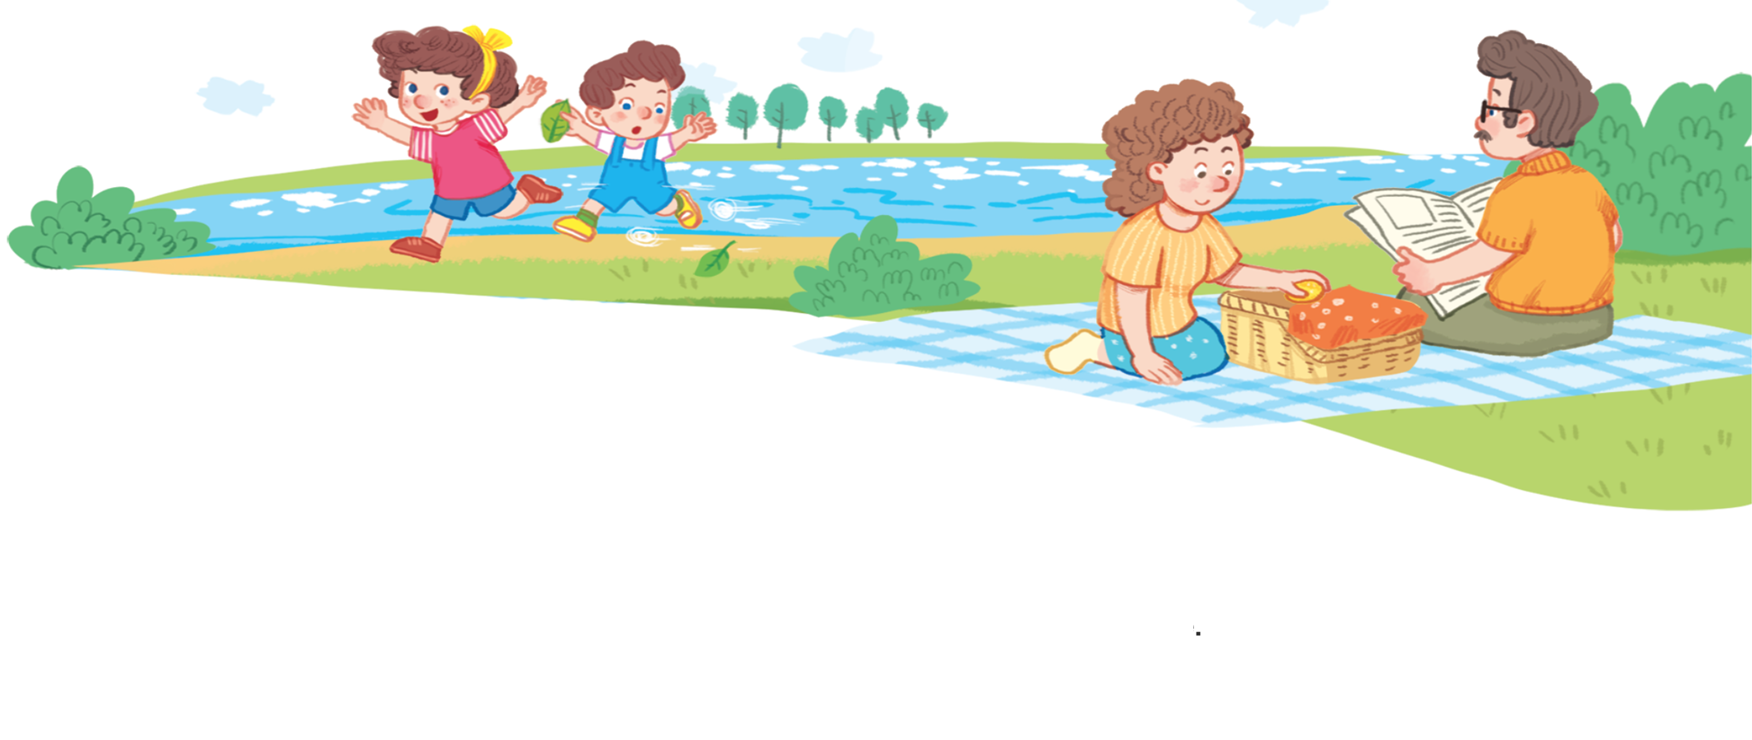
Let’s sing!
Look at Lucy. Look at Lucy.
Look at Lucy. She’s running round the lake.
Look at the leaf. Look at the leaf.
Look at the leaf. It’s falling to the ground.

Slide 11
Game
Notes:
Musical Chair Game
Goal: Review the unit keywords, the song and the chant.
Time: 5 minutes
Revise the words and play the game.
Each group has 1 presentative.
Put one flashcard in each chair.
Say 1 word.
Pupils have to find the flashcard and sit on the chair that has this flashcard. Then hold the flashcard and say Look at____.
The group has 1 point if their presentative is the fastest and says the correct sentence.

Slide 12
Musical chair game

Slide 13
Goodbye
Notes:
Say goodbye Lucy in chorus.

Slide 14
Goodbye
Notes:
Say goodbye lake in chorus.

Slide 15
Goodbye
Notes:
Say goodbye leaf in chorus.

Slide 16
Goodbye
Notes:
Say goodbye lemon in chorus.

Slide 17
Website: hoclieu.vn
Fanpage: facebook.com/www.tienganhglobalsuccess.vn

