Slide 1



Slide 2




11
My family
LESSON 3 – PERIOD 6

Slide 3

My family
Let’s write.
Project
Read and complete.
Warm-up
and review
Fun corner
and wrap up

Slide 4






Warm-up
and review
Funny sums
0
1
2
3
4
5
6
7
8
0
9
1
2
3
4
5
6
7
8
0
9
1
2
3
4
5
6
7
8
GIRLS
9
A
B
C
D
0
1
2
3
4
5
6
7
8
0
9
E
1
2
3
4
5
6
7
8
BOYS
0
9
F
G
H
1
2
3
4
5
6
7
8
9
Notes:
- Divide the class into 2 teams to play “Funny Sums”.
- Each team chooses one letter to go to the question.
- Have pupils look, read and do the sums.
- Back to the menu for pupils another question.
- Pupils continue their turns until there are not any letters.
- The team that gets most points is the winner.

Slide 5



What’s the Number?
Eight plus four is…..
20 pts
twelve

Slide 6
What’s the Number?
nine plus two is ….
10 pts
eleven

Slide 7
What’s the Number?
Eight plus five is ….
20 pts
thirteen

Slide 8
What’s the Number?
ten plus four is ….
10 pts
fourteen

Slide 9
What’s the Number?
six plus nine is ….
20 pts
fifteen

Slide 10
What’s the Number?
Eight plus eight is ….
10 pts
sixteen

Slide 11
What’s the Number?
Eight plus ten is ….
20 pts
eighteen

Slide 12
What’s the Number?
twelve plus eight is ….
10 pts
twenty

Slide 13
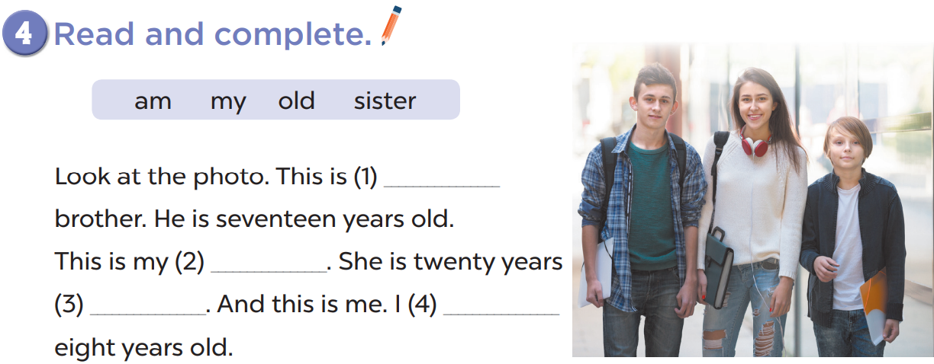
my
sister
old
am

Slide 14
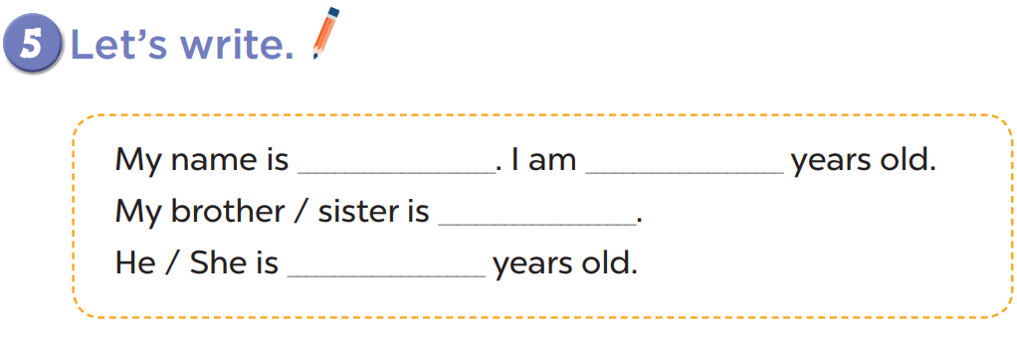

Slide 15

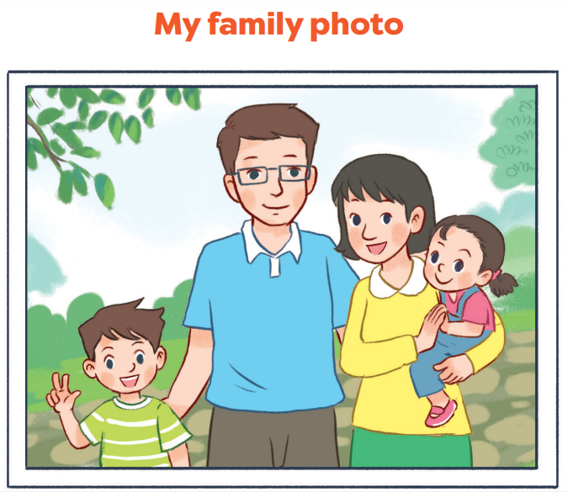

Slide 16





TREASURE HUNT
A
Fun corner
and wrap up
This is
is
sixteen
twelve
twenty
B
My
brother
10
80
40
70
I’m/ me
30
70
60
90
My
sister
30
60
60
80
My friend
20
30
50
50
Notes:
- Divide the class into 2 teams.
- Have pupils choose a square and make a sentence base on cue words.
- Back to the menu for another question.
- Pupils continue their turn until there are not any letters.
- The team that gets the most points is the winner.

Slide 17

Website: hoclieu.vn
Fanpage: facebook.com/www.tienganhglobalsuccess.vn

