Slide 2

OUR SPECIAL DAYS
Lesson 1 - Period 2

Slide 3
Table of contents
1
2
3
4
Warm-up
Activity 1
Listen and tick or cross.
Activity 2
Read and complete.
Activity 3
Listen, complete and sing.
Fun corner
5
Look, read and choose.

Slide 4
01
Warm-up

Slide 5
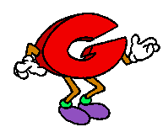
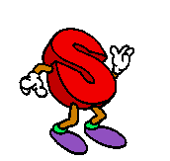
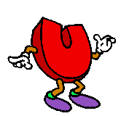

Can you?

Slide 6
Look and guess the occasions
1 picture open: 3 points
2 pictures open: 2 points
All pictures open: 1 point

Slide 7

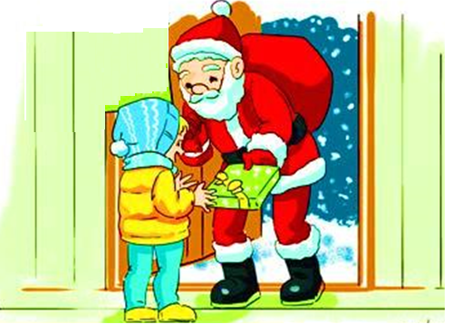


Christmas Day

Slide 8
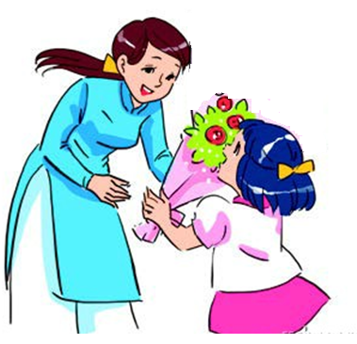


Teachers’ Day

Slide 9
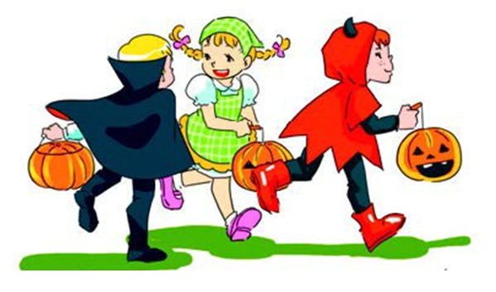


Halloween Day

Slide 10
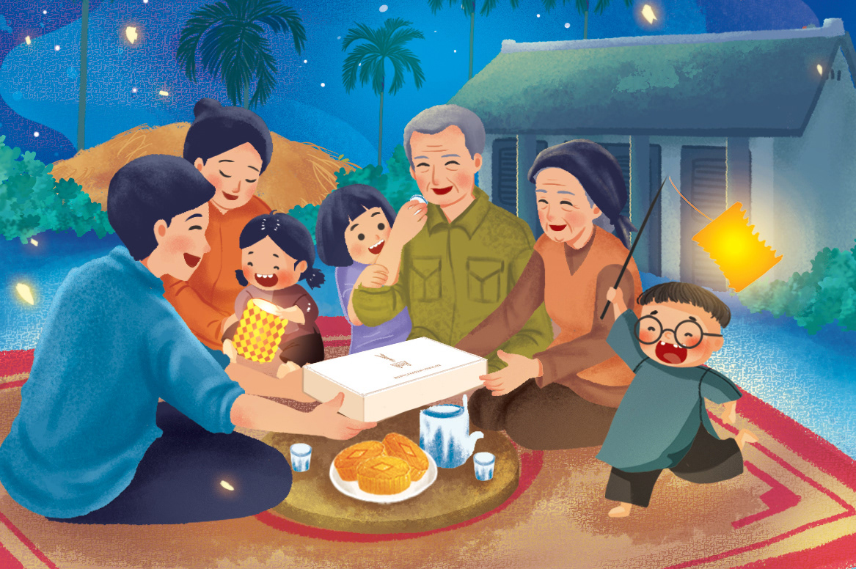


Mid-Autumn Festival

Slide 11
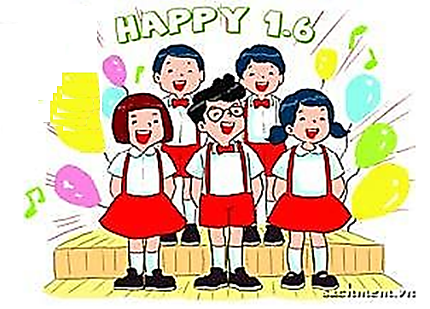

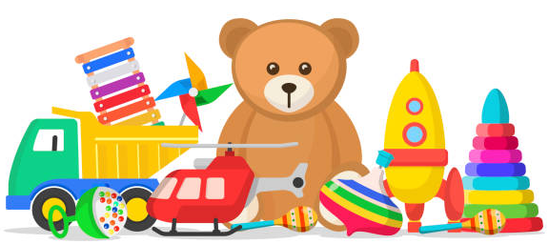
Children’s Day

Slide 12
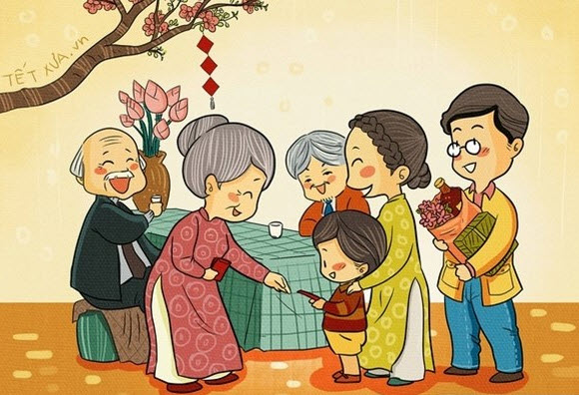


Tet

Slide 13
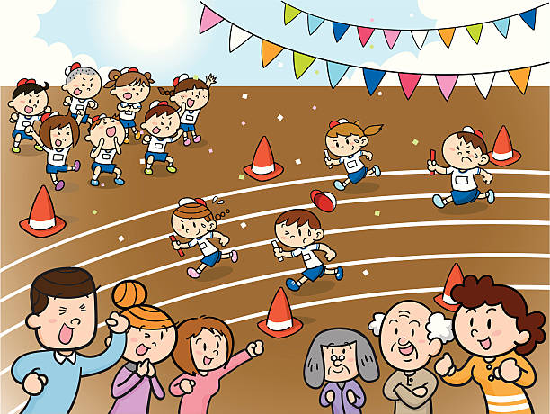
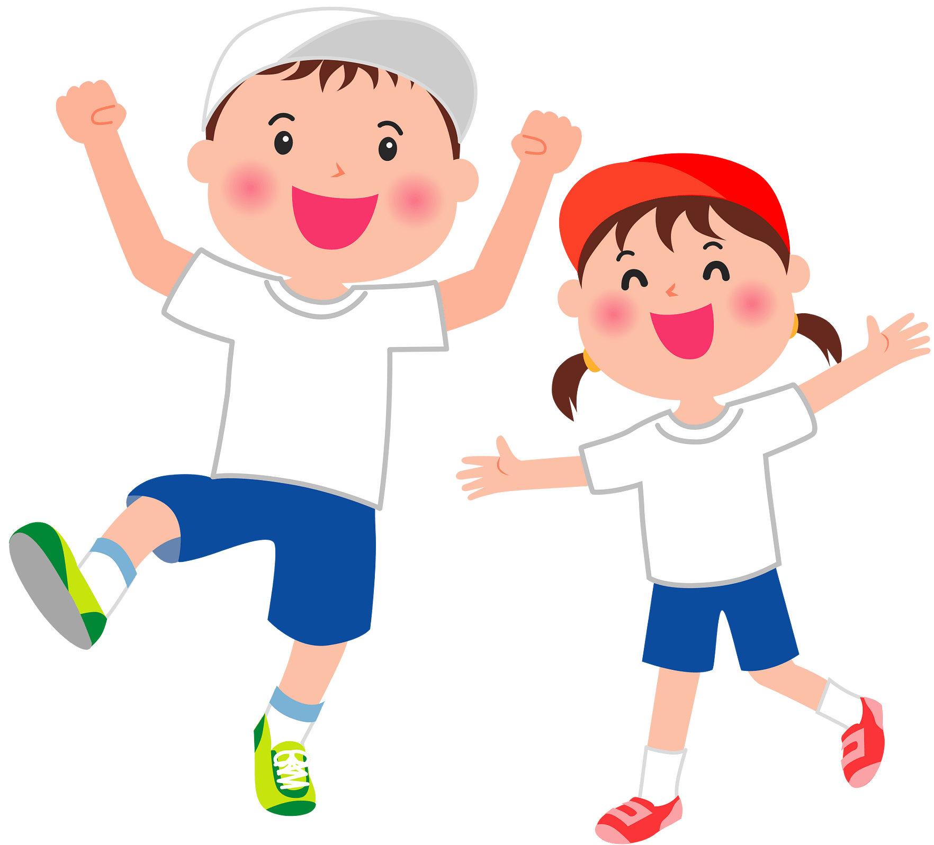

Sports Day

Slide 14

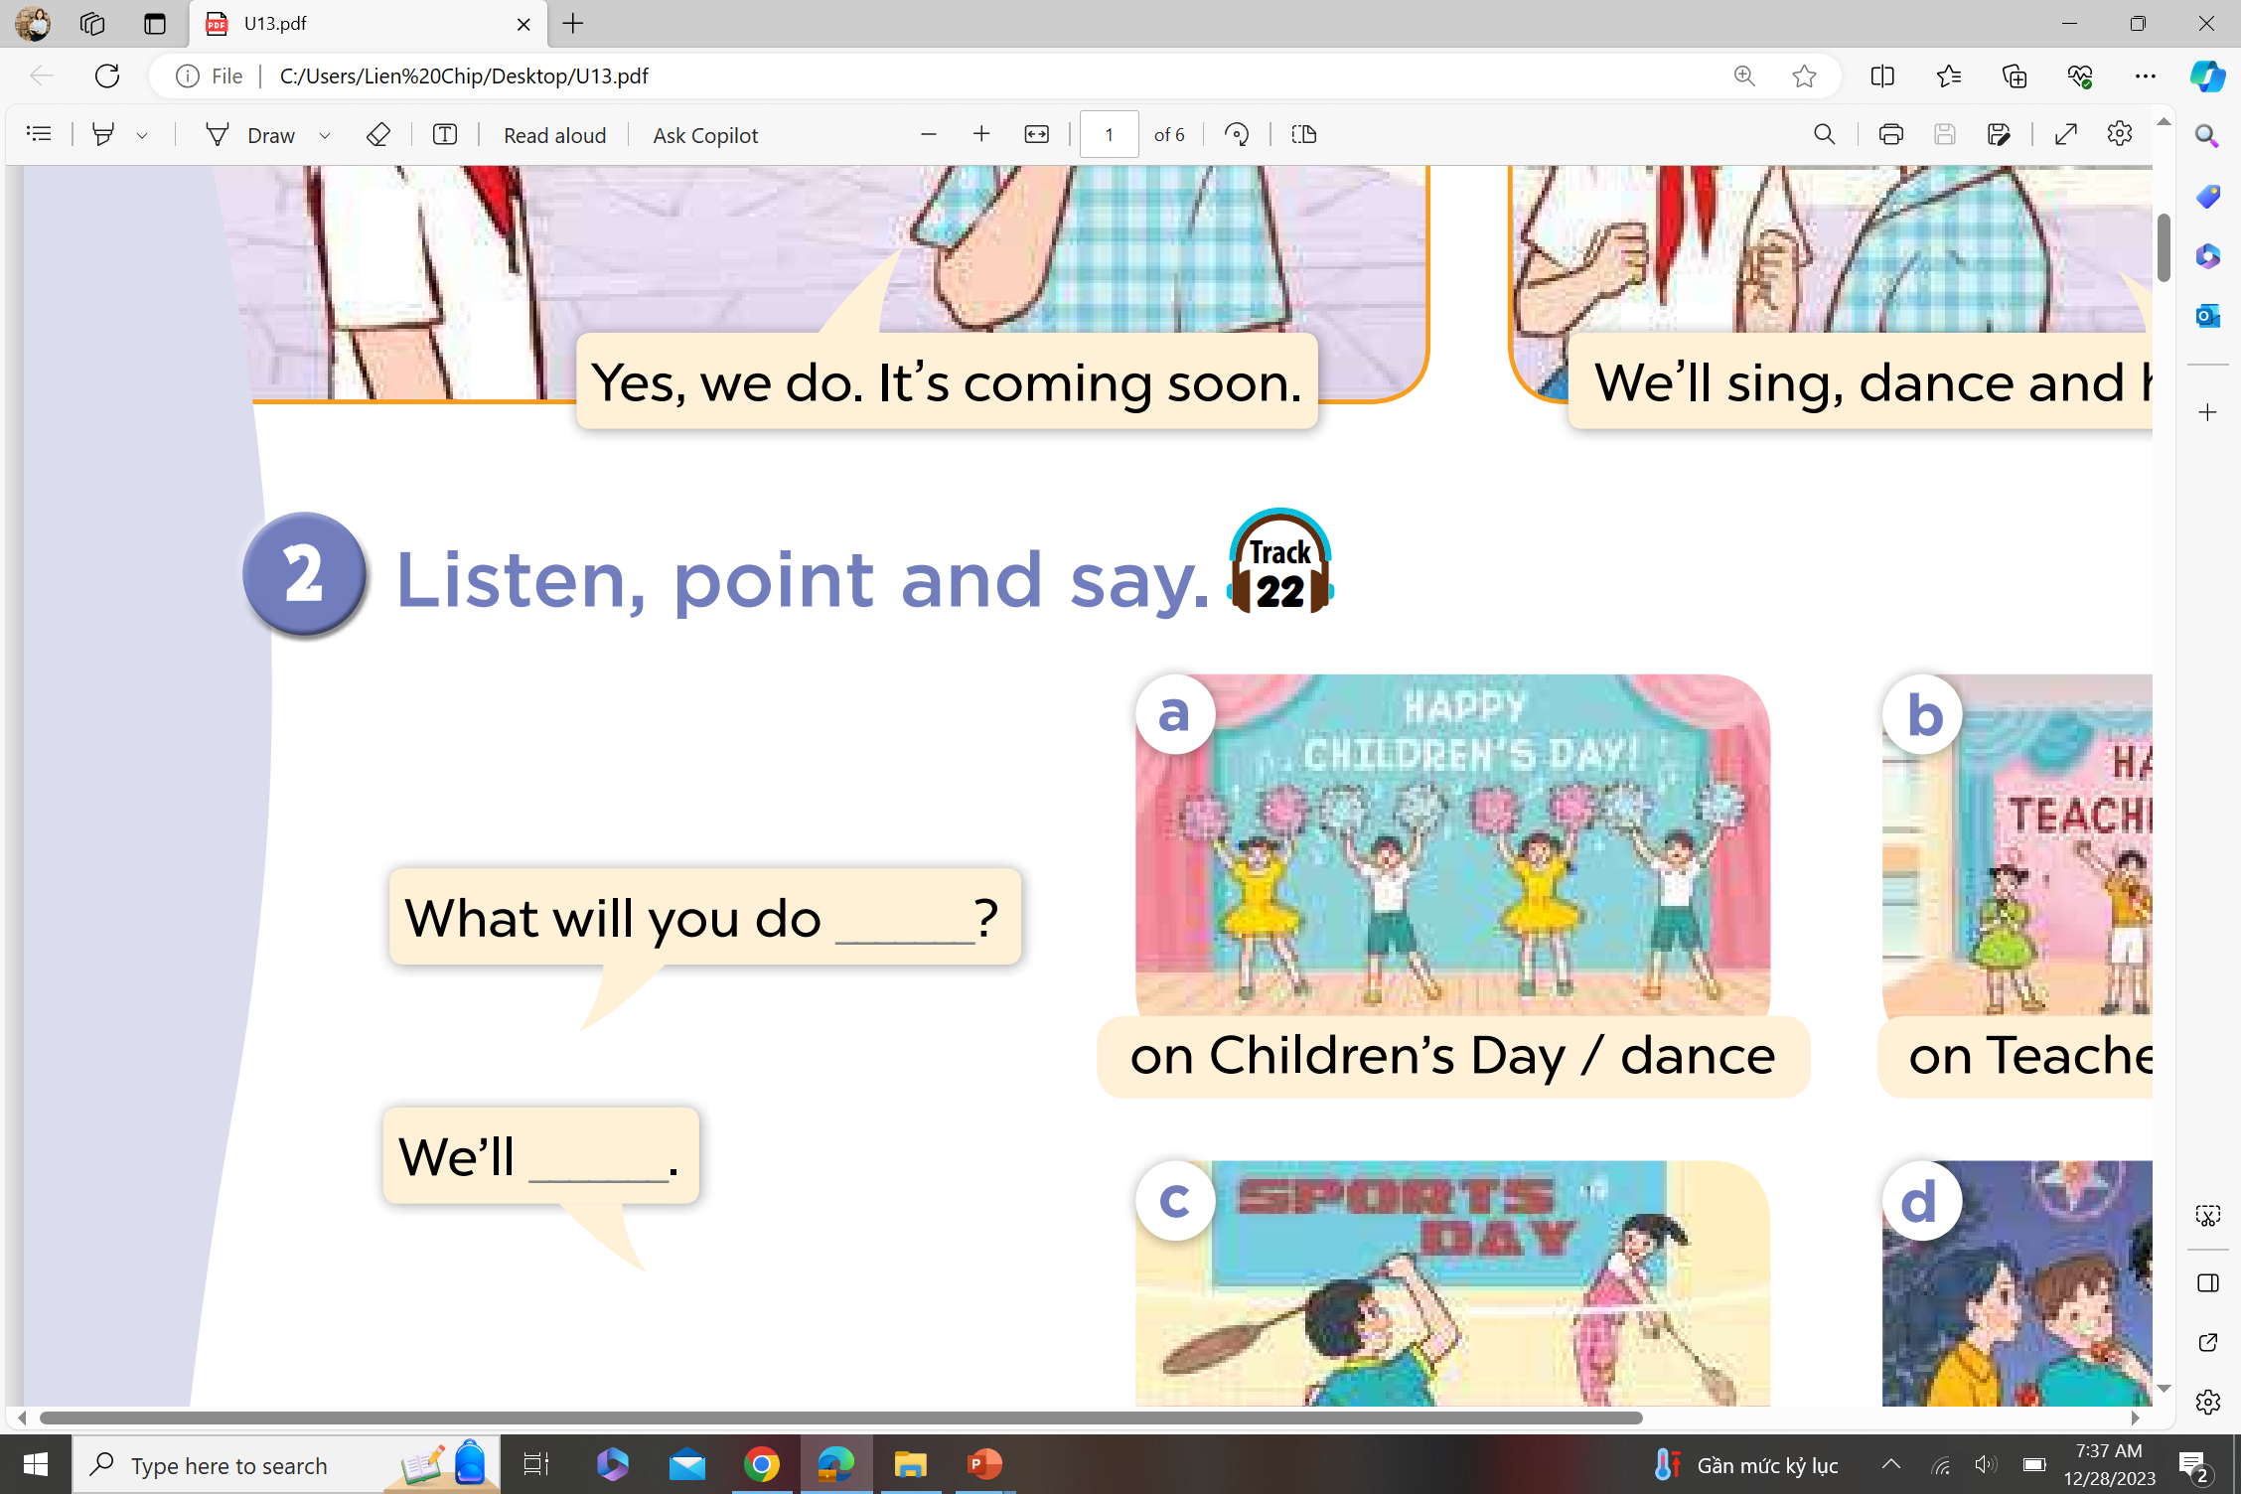
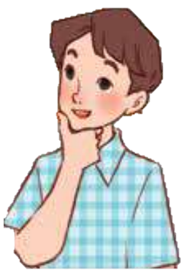
Ask and answer.

Slide 15
02
Activity 1
Listen and tick or cross.

Slide 16
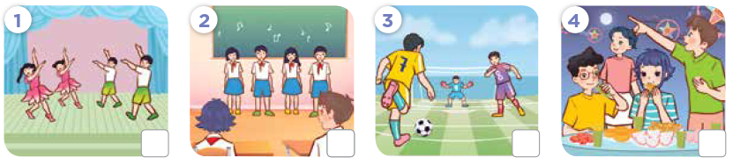
Look! What will they do?

Slide 17


Listen and tick or cross.

Slide 18
Listen and repeat.

Slide 19
03
Activity 2
Read and complete.

Slide 20
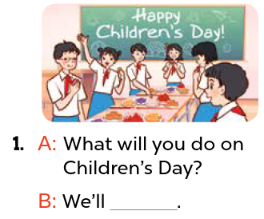
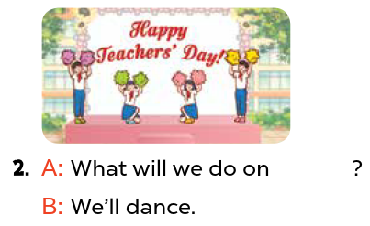
Read and complete.
Teachers’ Day
have a party

Slide 21
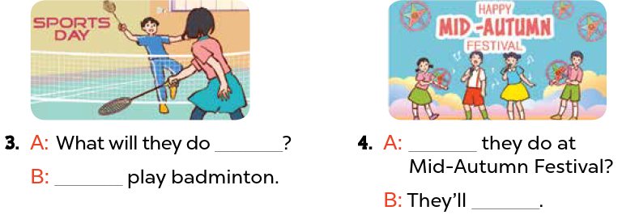
Read and complete.
on Sports Day
What will
We’ll
sing and dance

Slide 22
Activity 3
04
Listen, complete and sing.

Slide 23
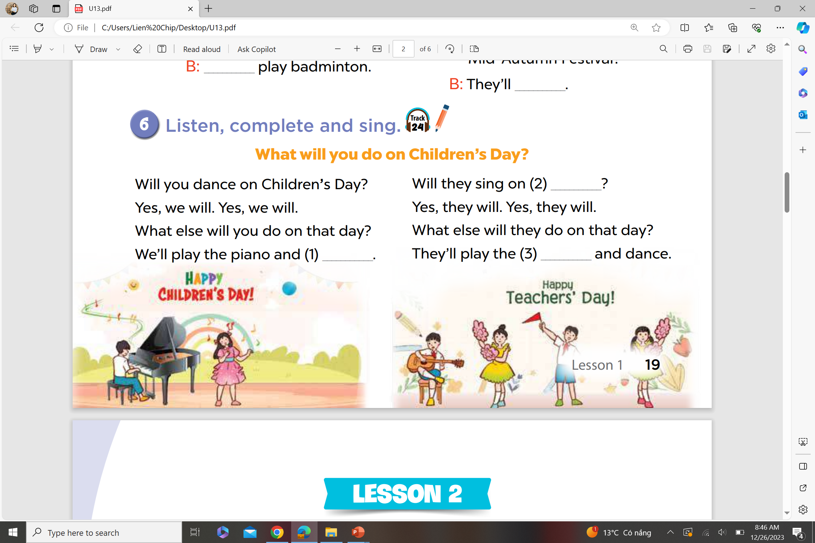
Listen, complete and sing.
Teachers’ Day
sing
guitar

Slide 24
Fun Corner
05
Look, read and choose.

Slide 25


.................. will you do on
Christmas Day?
What
A. When
B. What
C. Who

Slide 26
What .................. you do on
Children’s Day?
will
A. are
B. do
C. will

Slide 27
What will you do at Mid–Autumn Festival? – We’ll .................. a party.
have
A. have
B. has
C. to have

Slide 28
What will you do ..................
Mid–Autumn Festival?
at
A. at
B. on
C. in

Slide 29
What will you do ..................
Halloween Day?
on
A. in
B. on
C. at

Slide 30
What will you do on Sports Day?
- We’ll .................. badminton.
play
A. to play
B. plays
C. play

Slide 31
What will you do on Teachers’ Day?
- We’ll ...................
sing
A. sings
B. singing
C. sing

Slide 32
Website: hoclieu.vn
Fanpage: https://www.facebook.com/tienganhglobalsuccess.vn/

