Slide 2



Unit 12
Our Tet holiday
Lesson 3 - Period 6

Slide 3
Table of contents
1
2
3
Activity
Activity
4
5
Project
Fun corner
Warm-up
Read and complete.
Look and write.
Our Tet activities
Hit the clay pot

Slide 4
1
Warm-up
Let’s chant.

Slide 5
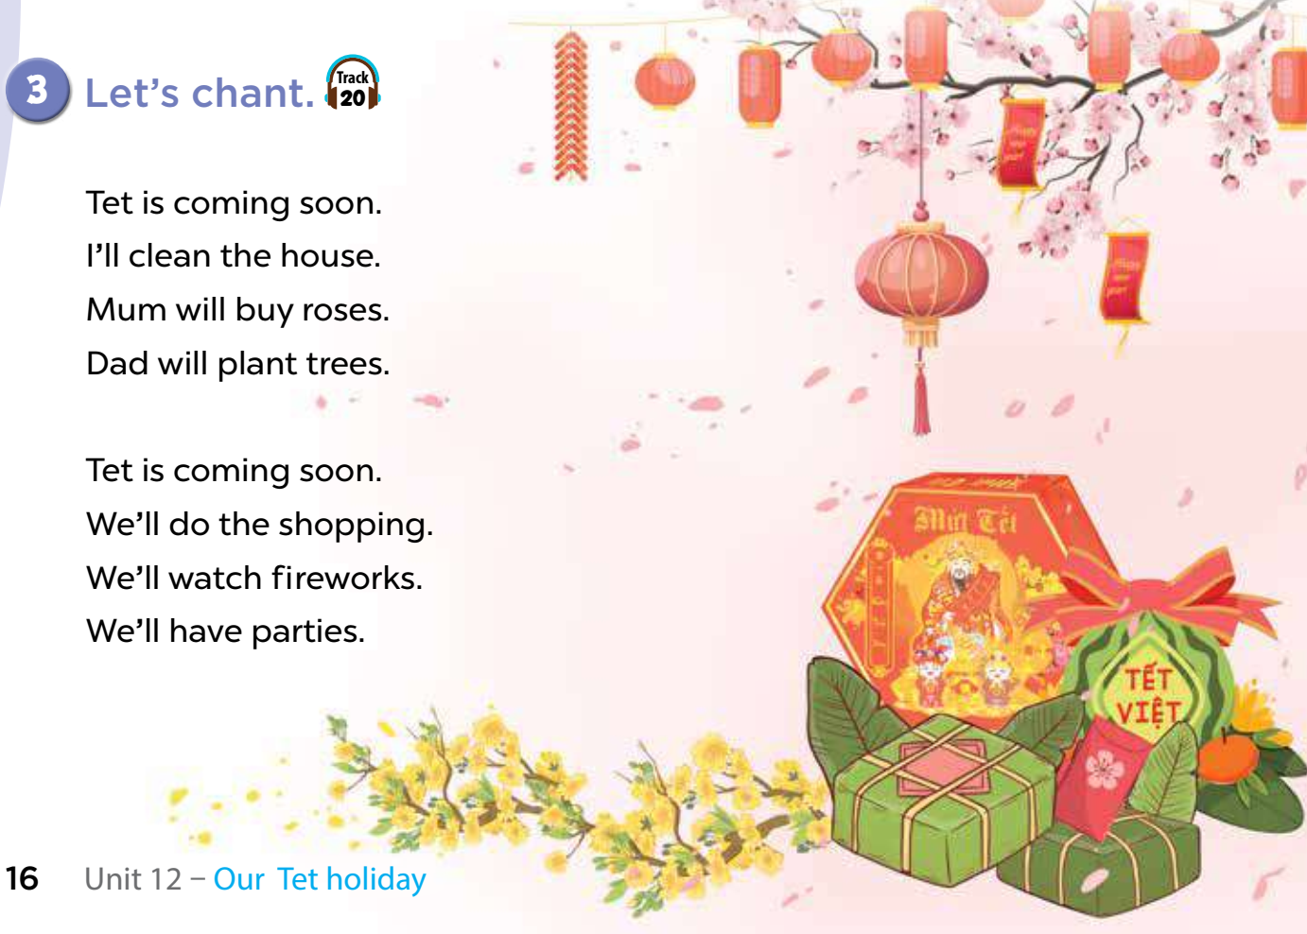


Slide 6
2
Read and complete.
Activity 4

Slide 7
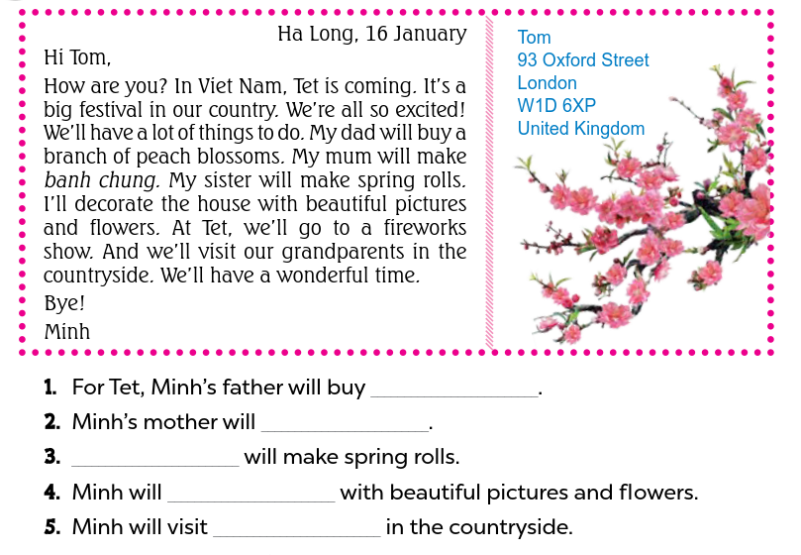
peach blossoms
make banh chung
Minh’s sister
decorate the house
their grandparents

Slide 8
3
Look and write.
Activity 5

Slide 9
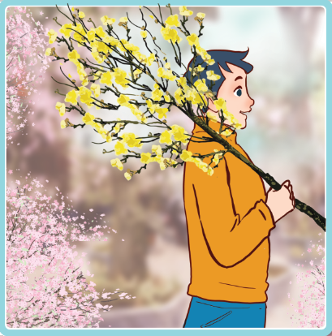
buy a branch of peach blossoms
Look and say.
For Tet, I’ll buy a branch of peach blossoms with my father.

Slide 10
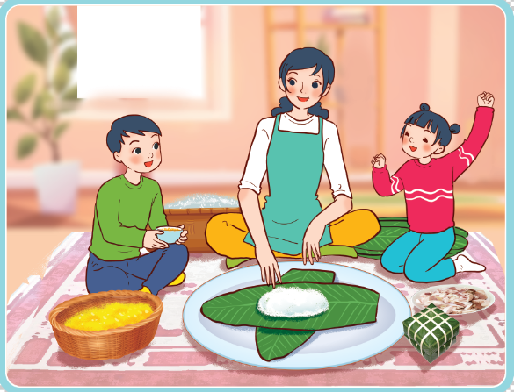
make banh chung
Look and say.
At Tet, I’ll make banh chung with my mother.

Slide 11
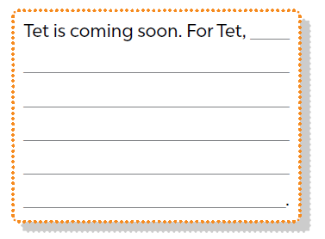
Look and write.

Slide 12
Suggested answer:
My Tet
Tet is coming soon. For Tet, I’ll buy a branch of peach blossoms with my father. I’ll make banh chung with my mother. At Tet, I’ll go to a fireworks show with my sister. Our family will have a New Year party.

Slide 13
Let’s share your awesome work!

Slide 14
Project
4
Our Tet activities

Slide 15
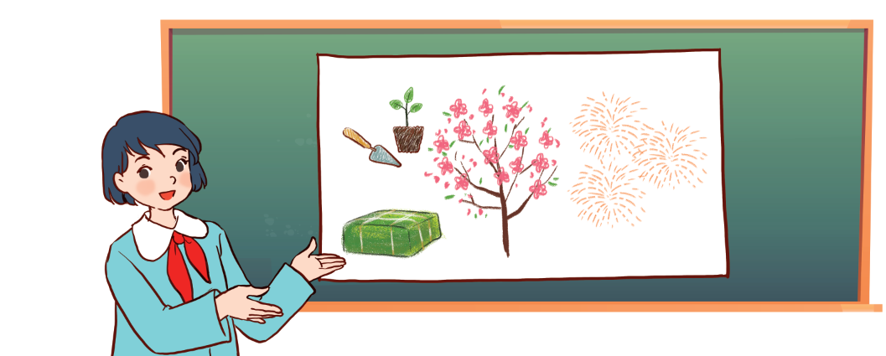
Our Tet activities
I will plant a tree. _______

Slide 16
V.
Fun corner
Hit the clay pot

Slide 17

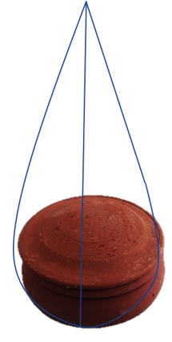
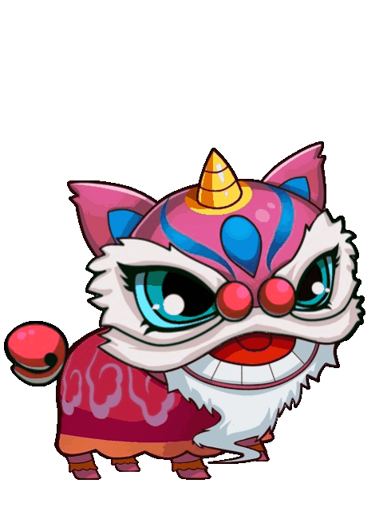


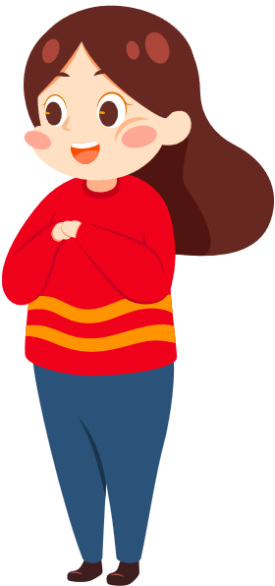
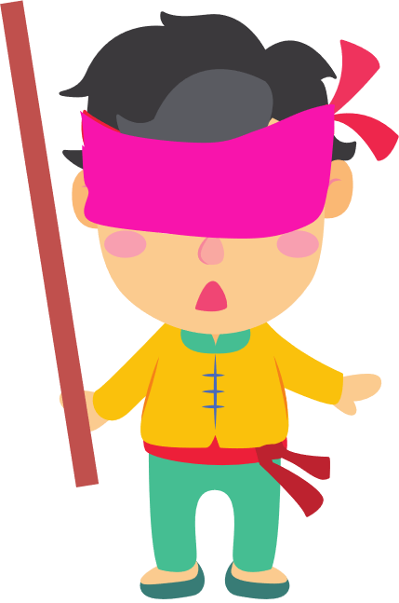
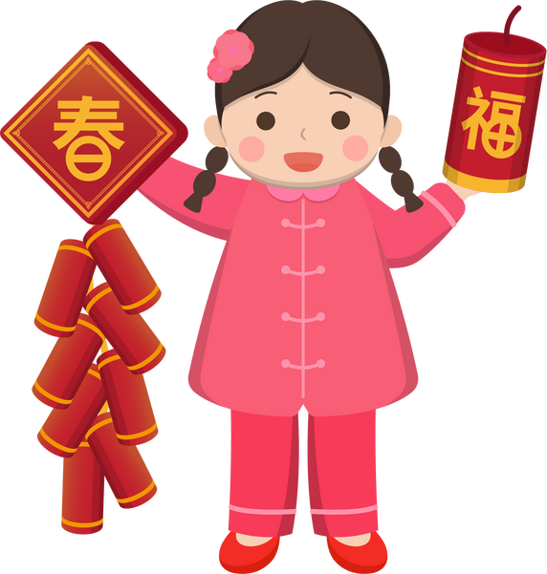
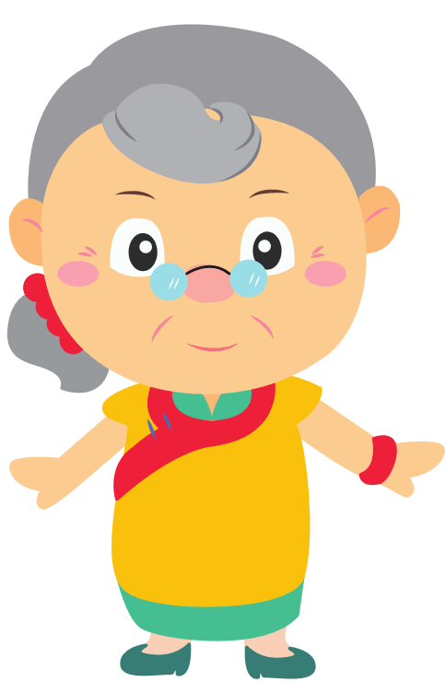

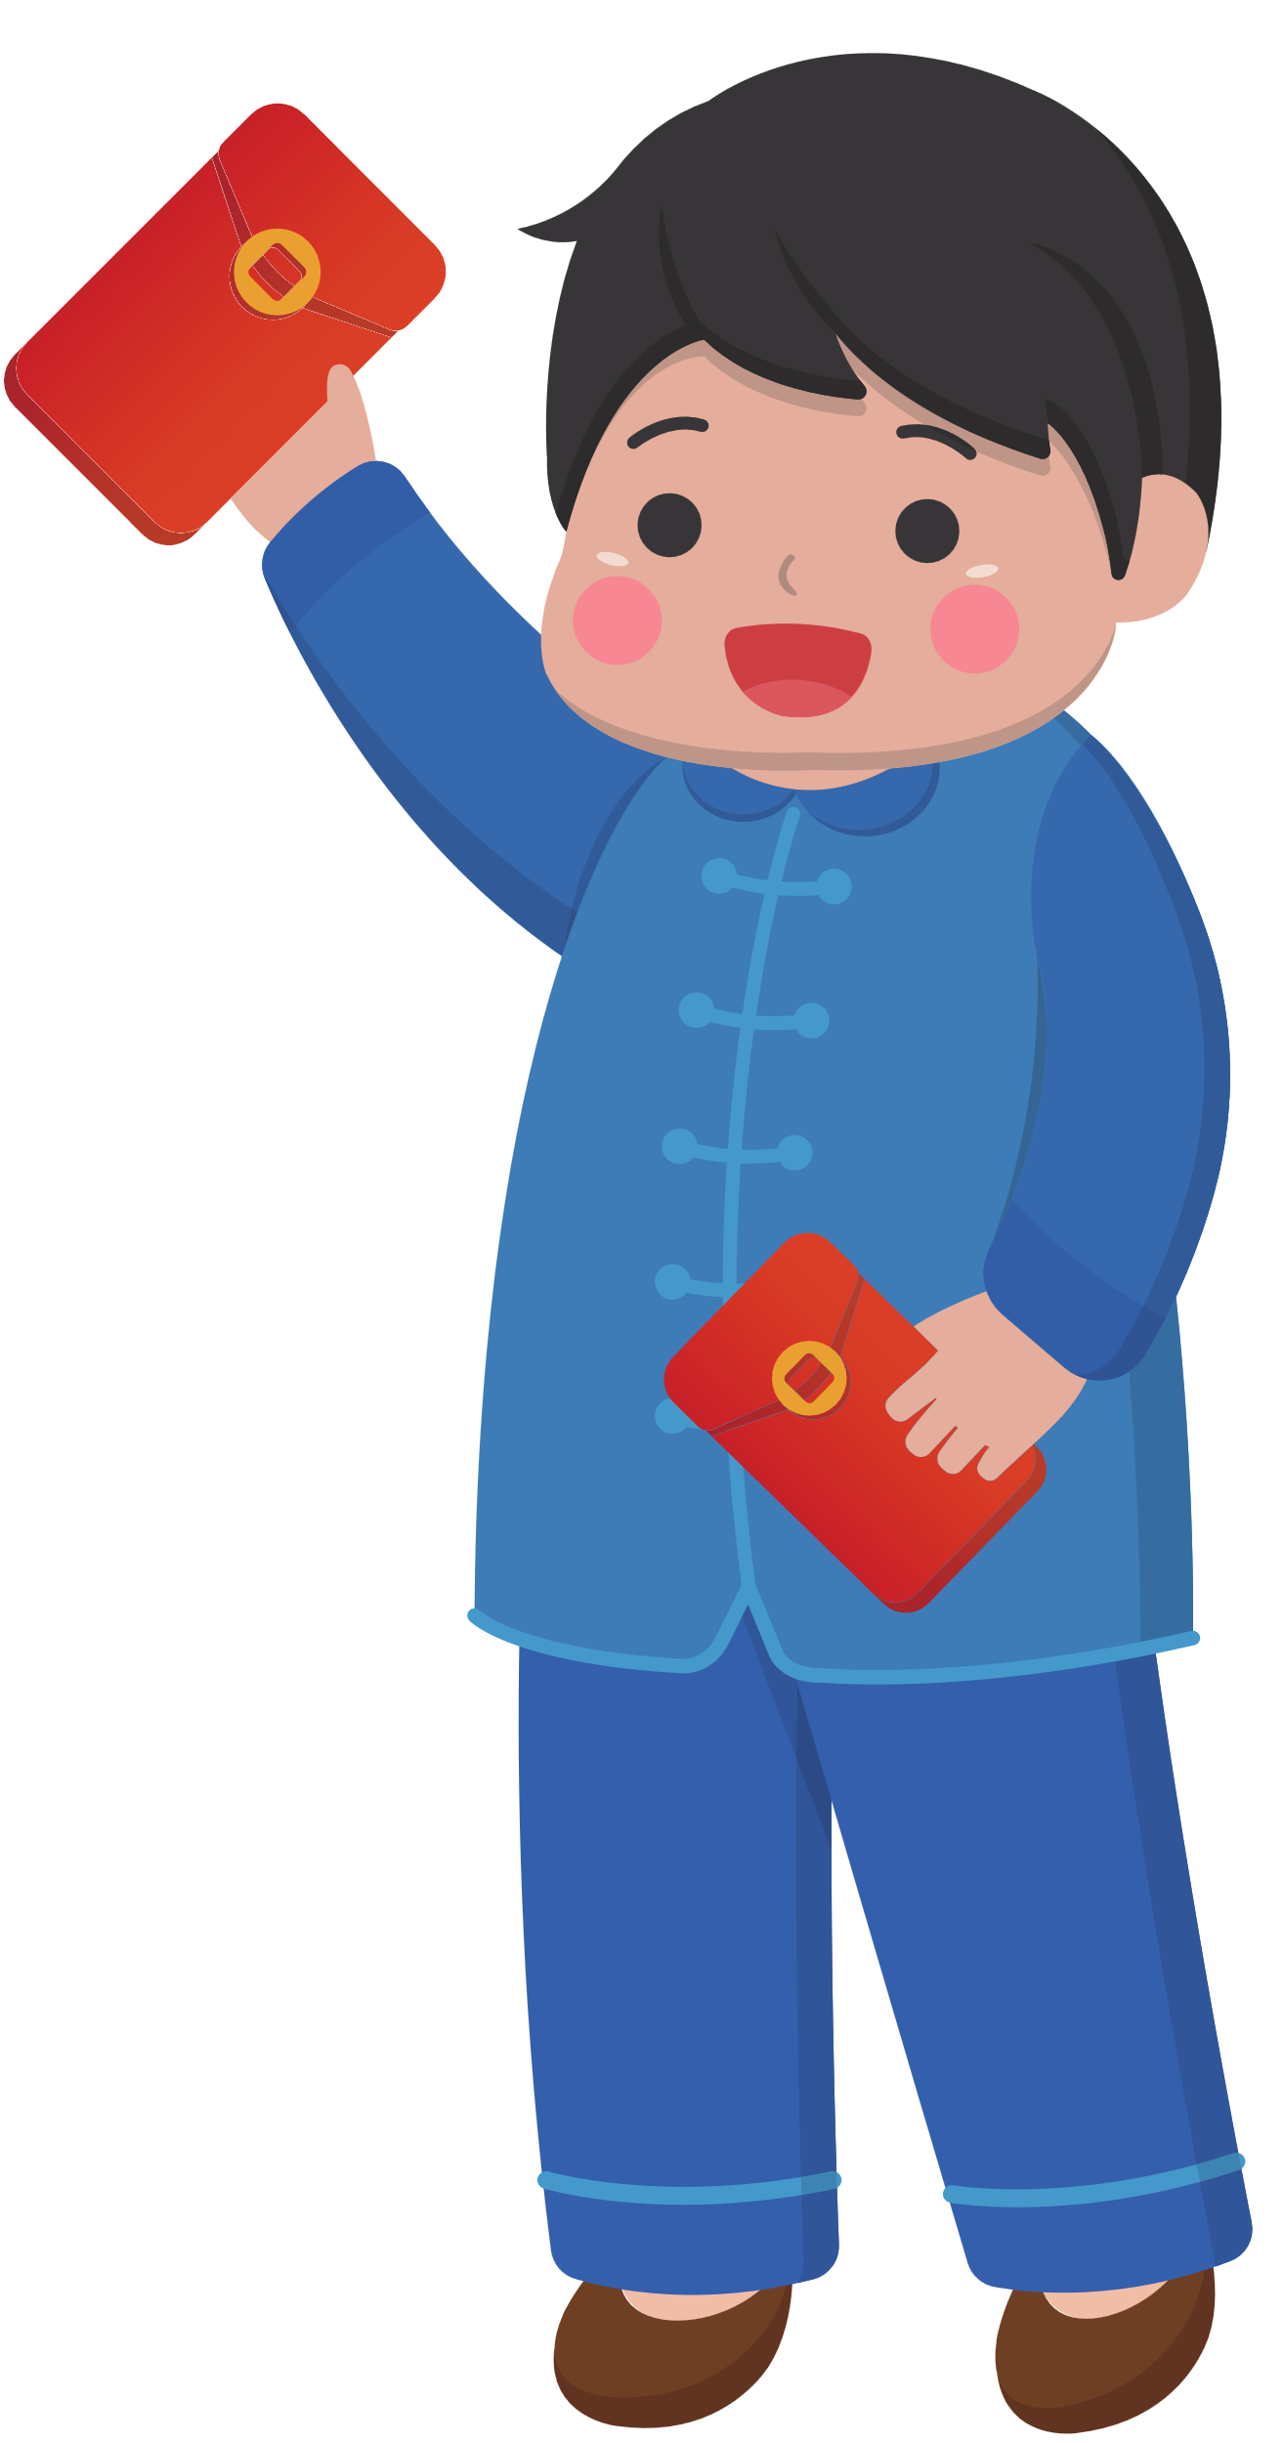
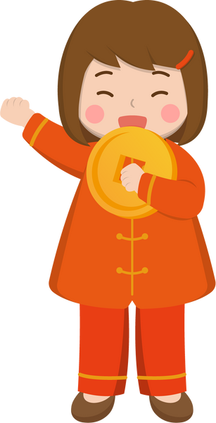
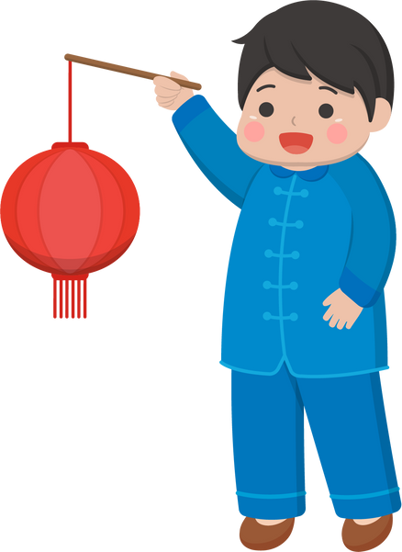
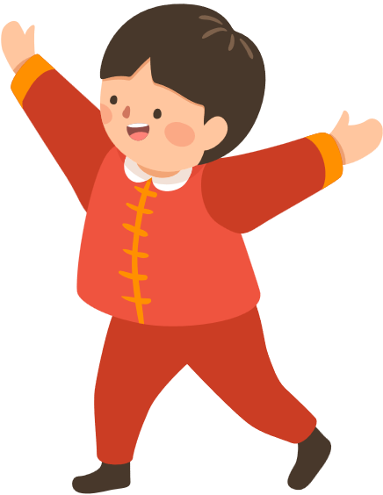
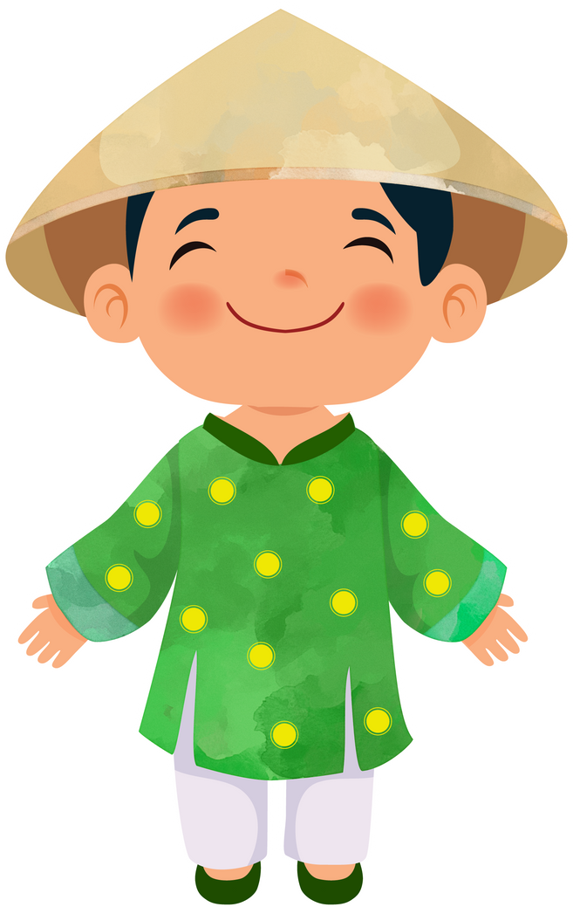
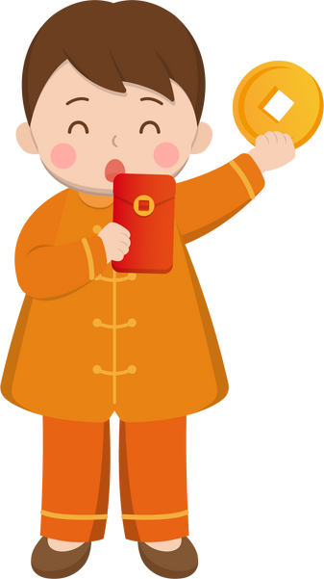
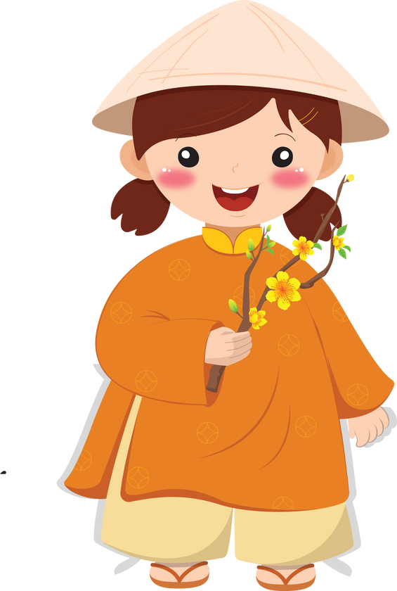

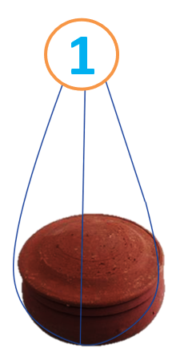
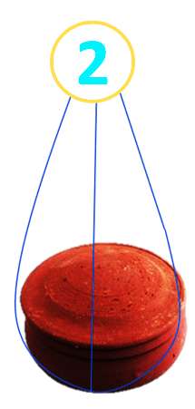
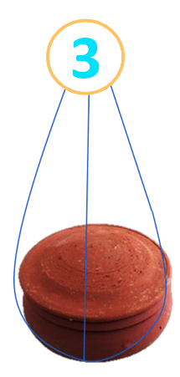
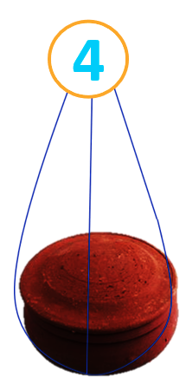
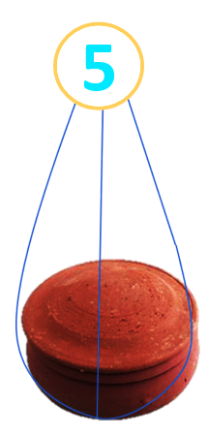
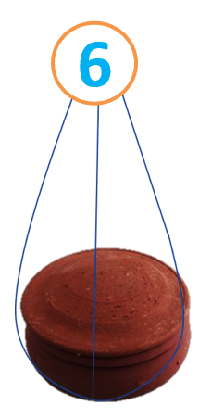

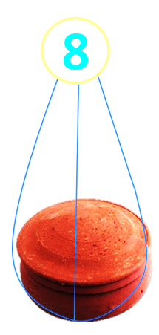
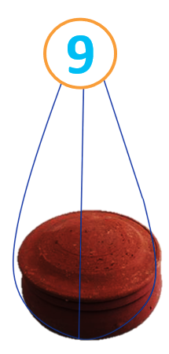
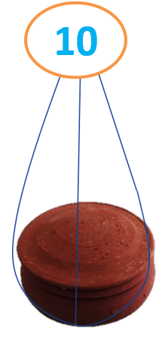



10
1
2
3
4
5
6
7
8
9
0
1
2
3
4
5
6
7
8
9
0
1
2
3
4
5
6
7
8
9
1
0
2
3
4
5
6
7
8
9
0
1
8
4
20
2
5
10
15
6
3
Notes:
Ấn lần thứ nhất vào các niêu đất để di chuyển cậu bé
Ấn lần thứ 2 vào các niêu để đập niêu và nhận lì xì

Slide 18



1
2
3
4
5
Happy New Year
6
7
8
9
10

Slide 19

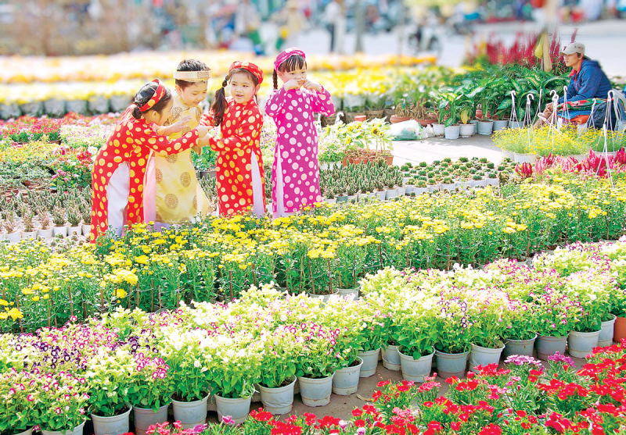



- Where will you go at Tet?
- I’ll go to …………. .
A. a New Year party
B. a flower festival
C. a fireworks show

Slide 20
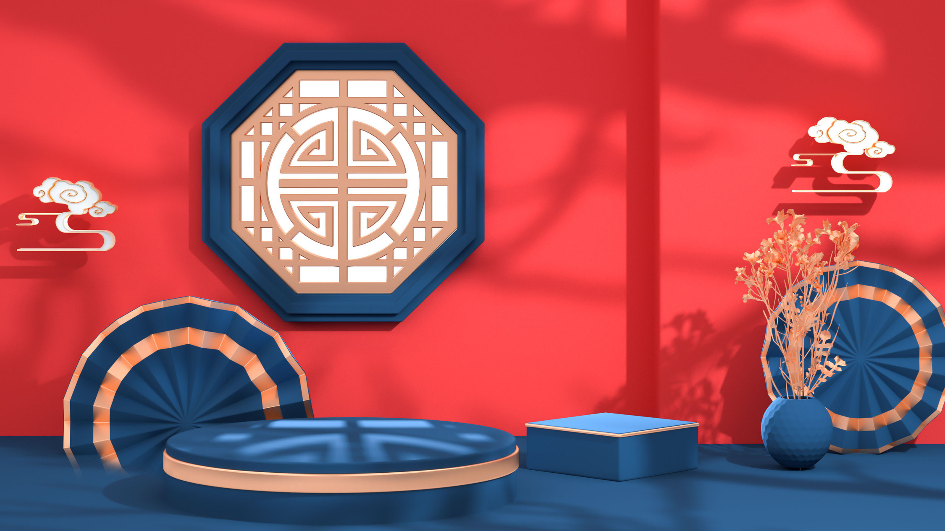
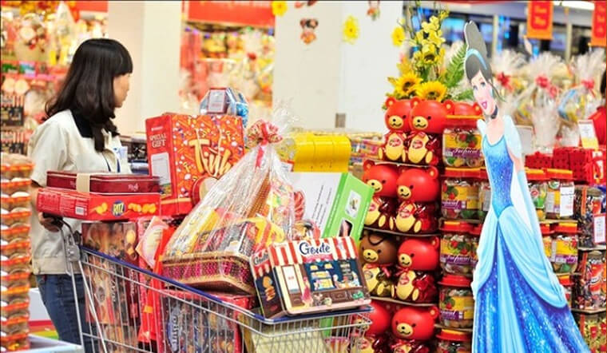
Will you do the shopping for Tet?
A. Yes, I will.
B. Yes, I won’t.
C. No, I will.

Slide 21
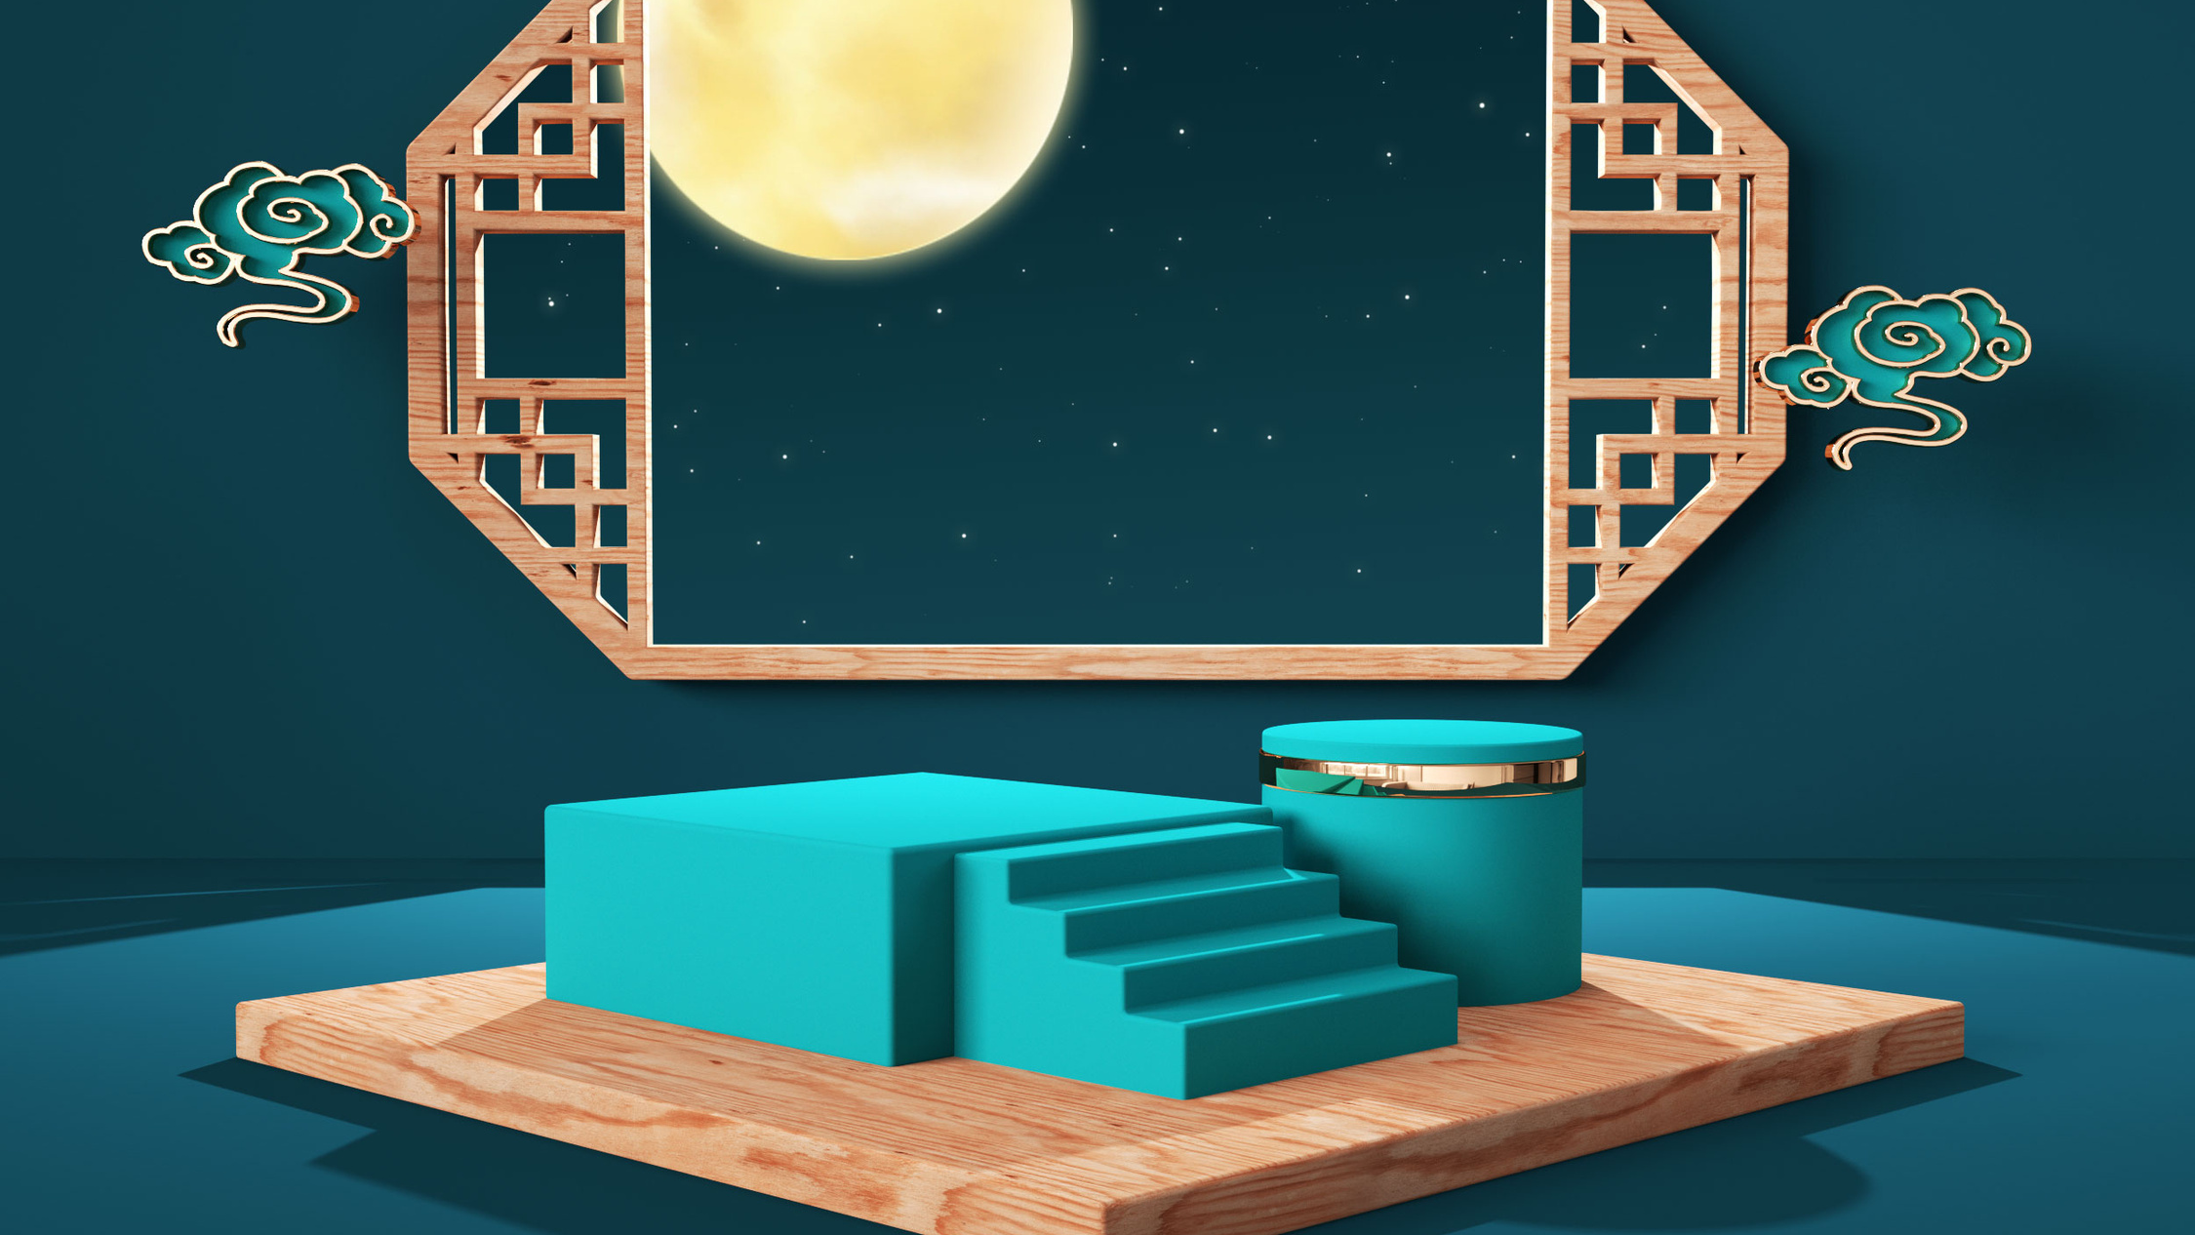
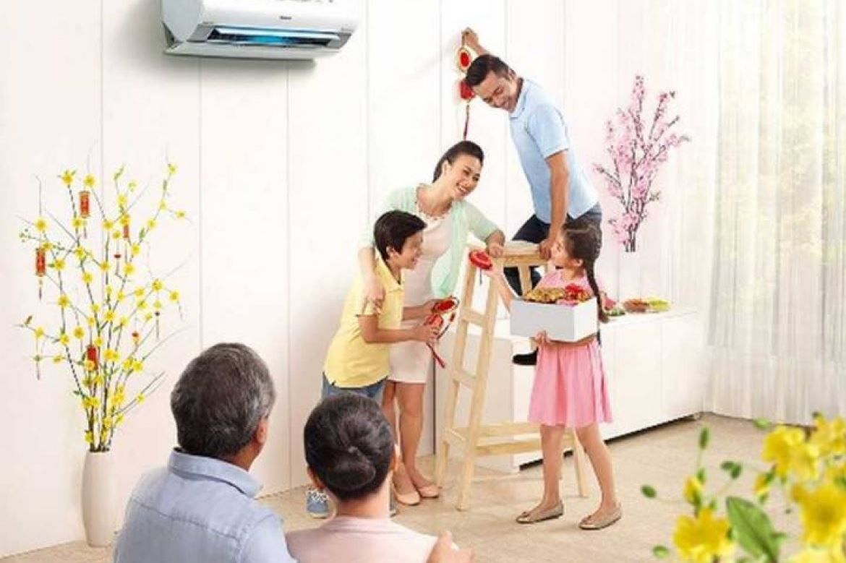
Will you decorate the house for Tet ?
A. Yes, I won’t.
B. No, I will.
C. Yes, I will.

Slide 22
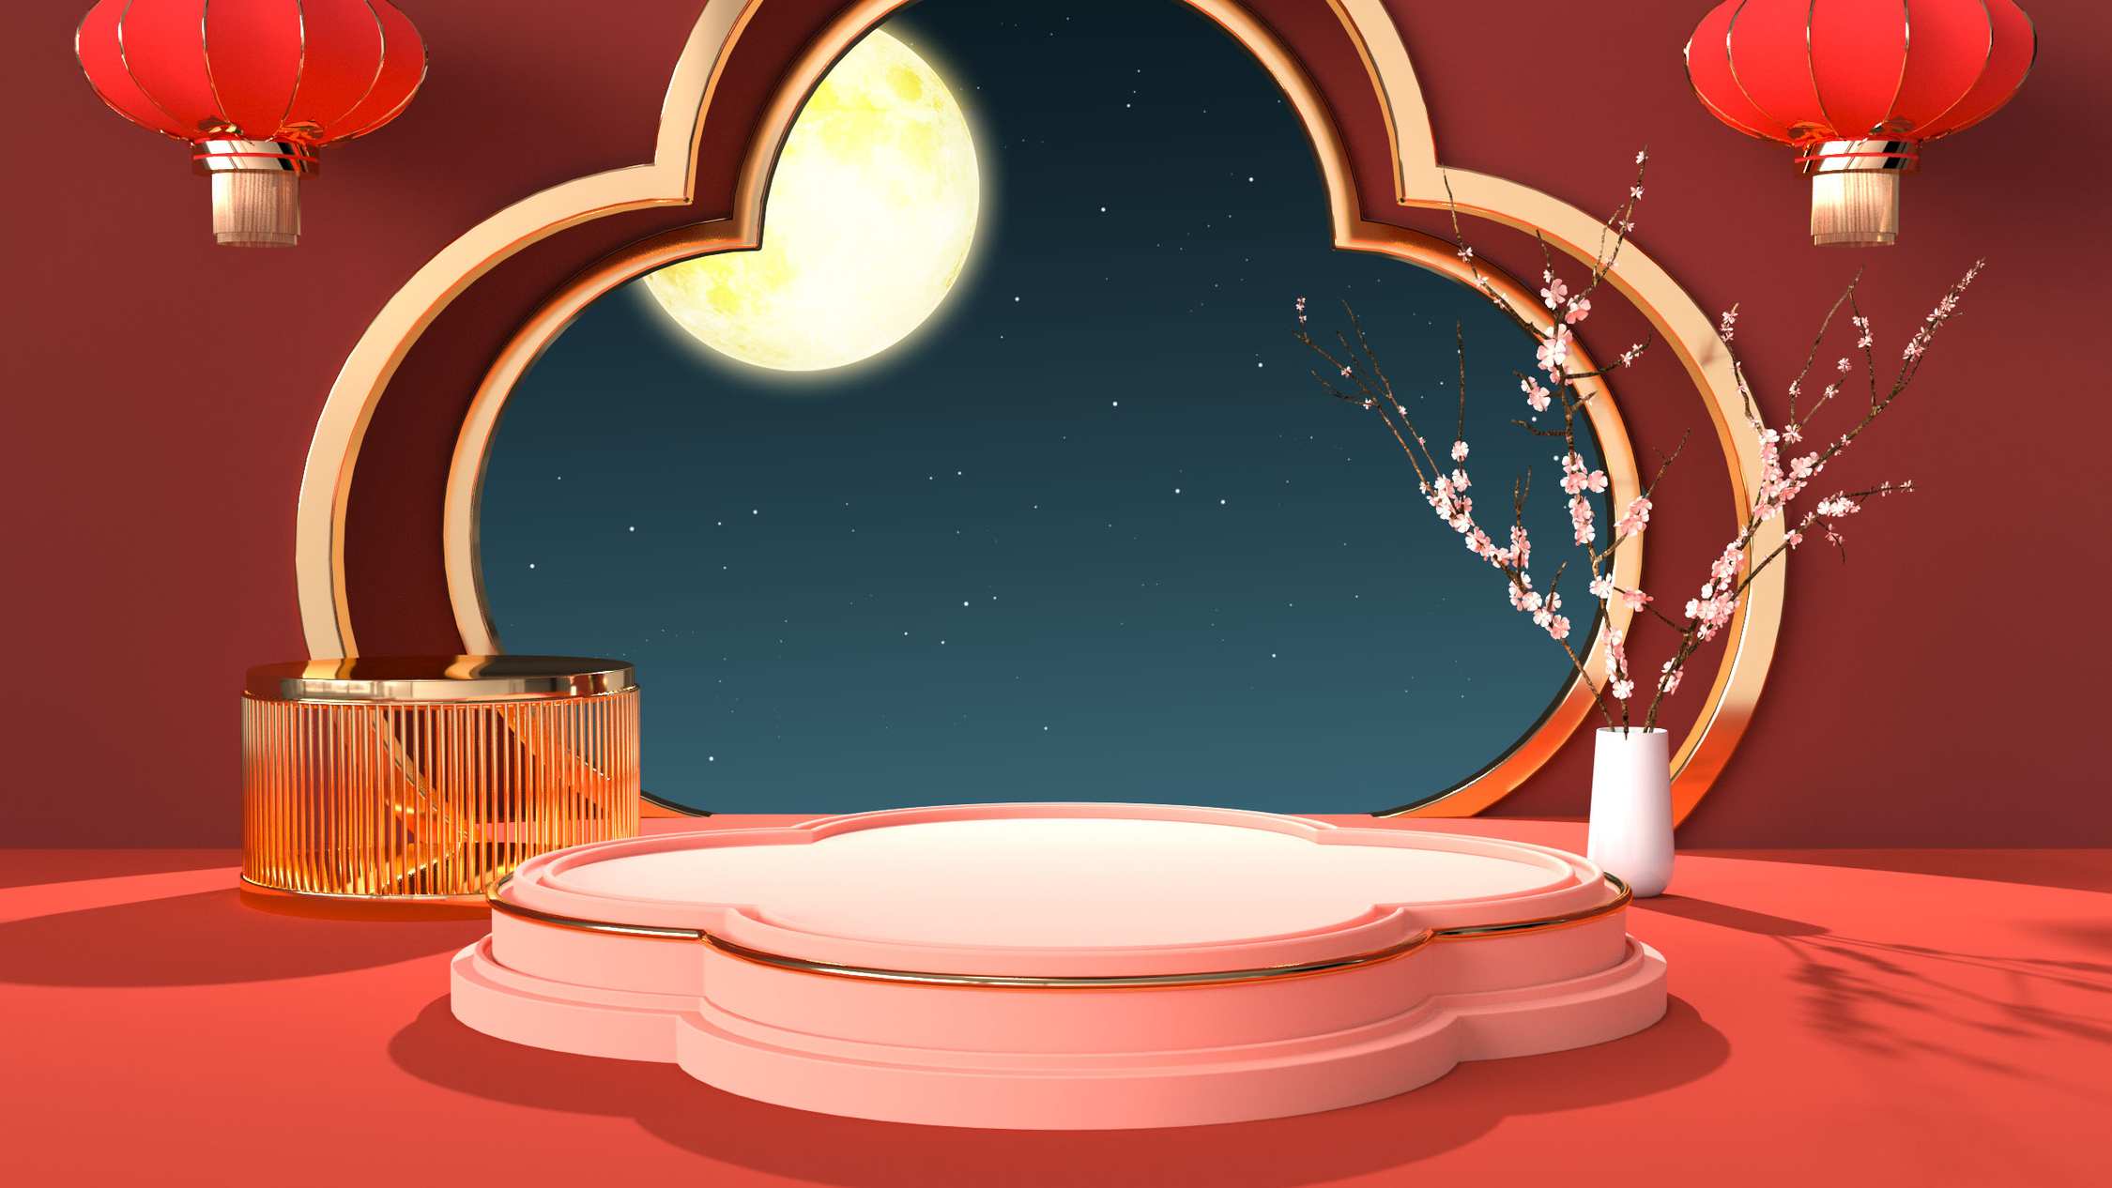
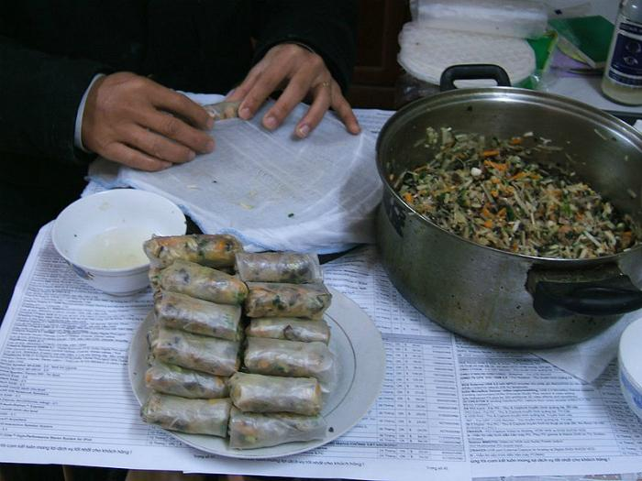
Will you make banh chung ?
A. Yes, I won’t.
B. Yes, I will.
C. No, I won’t.

Slide 23

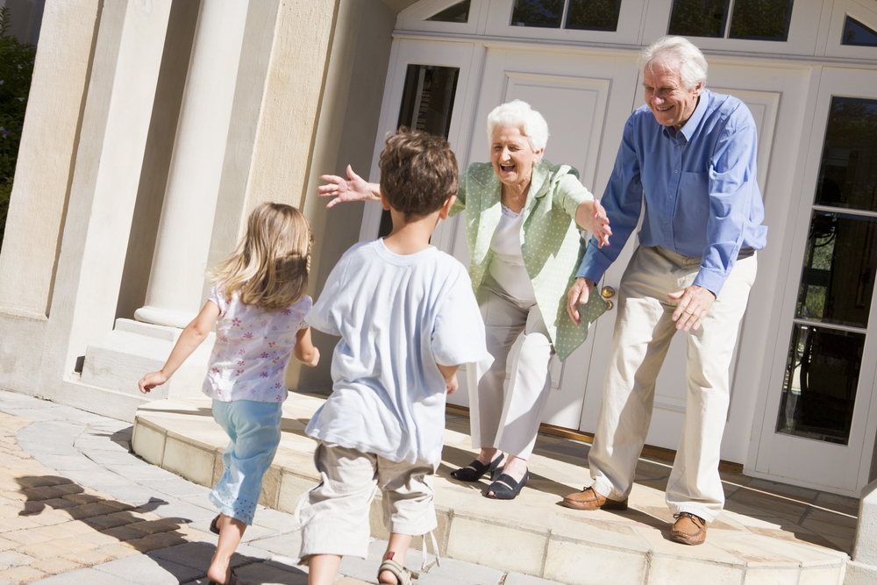

- Where will you go at Tet?
- I’ll go to …………. .
A. a fireworks show
B. my grandparents’ house
C. a New Year party

Slide 24

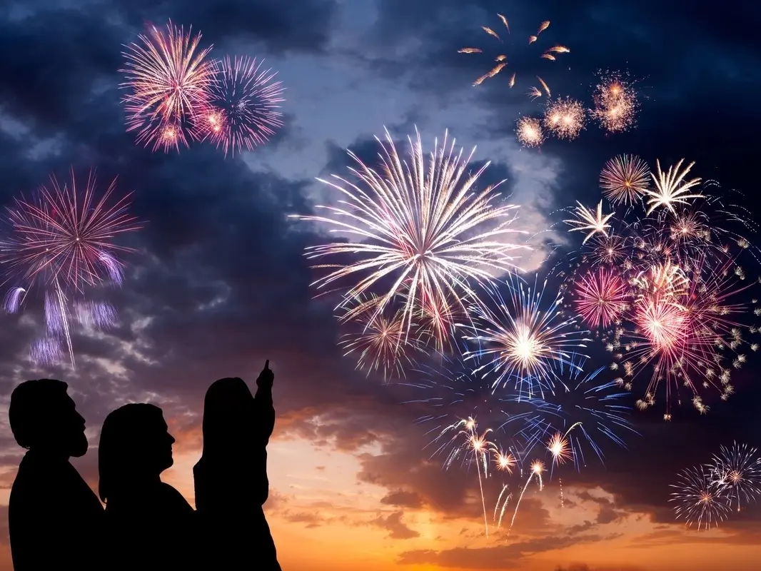
We will ………………………….
A. watch a fireworks show
B. wear new clothes
C. go to a flower festival

Slide 25






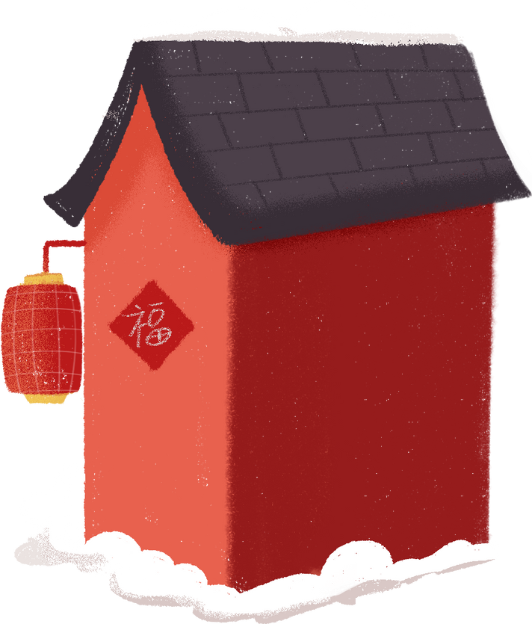
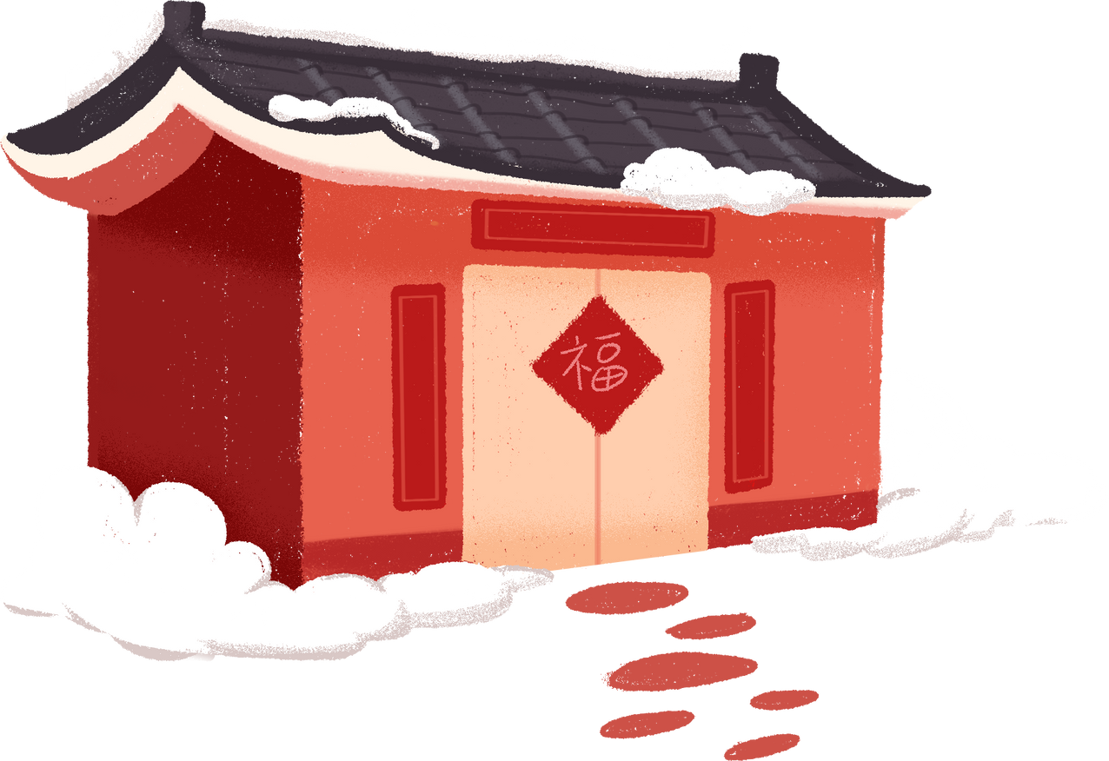
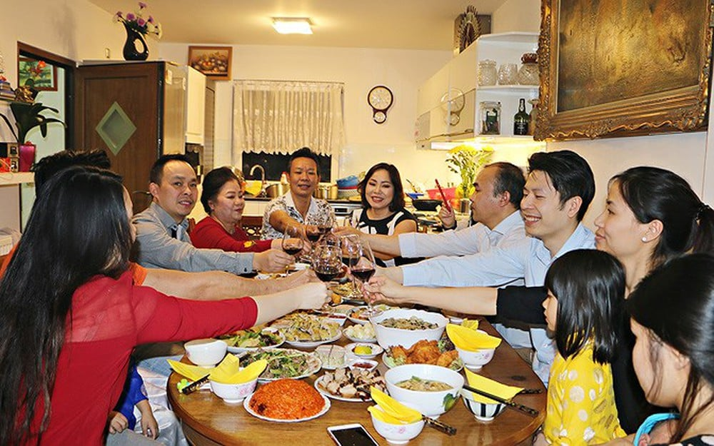
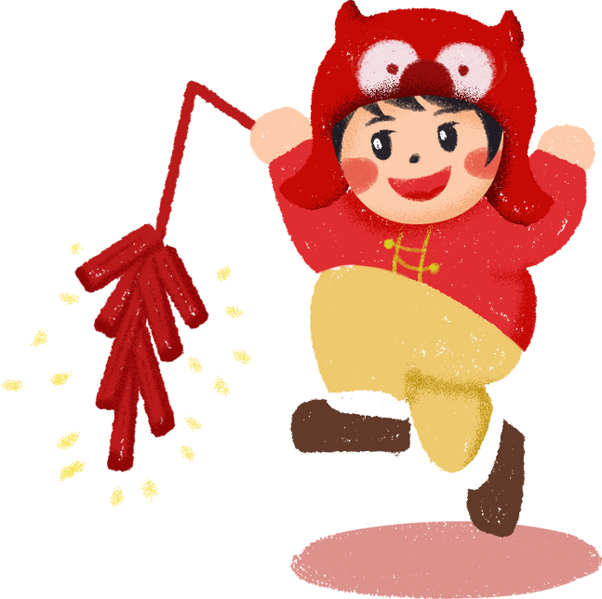

We will ……….. at Tet.
Happy
Lunar New Year
A. have a New Year party
B. go to the countryside
C. decorate the house

Slide 26




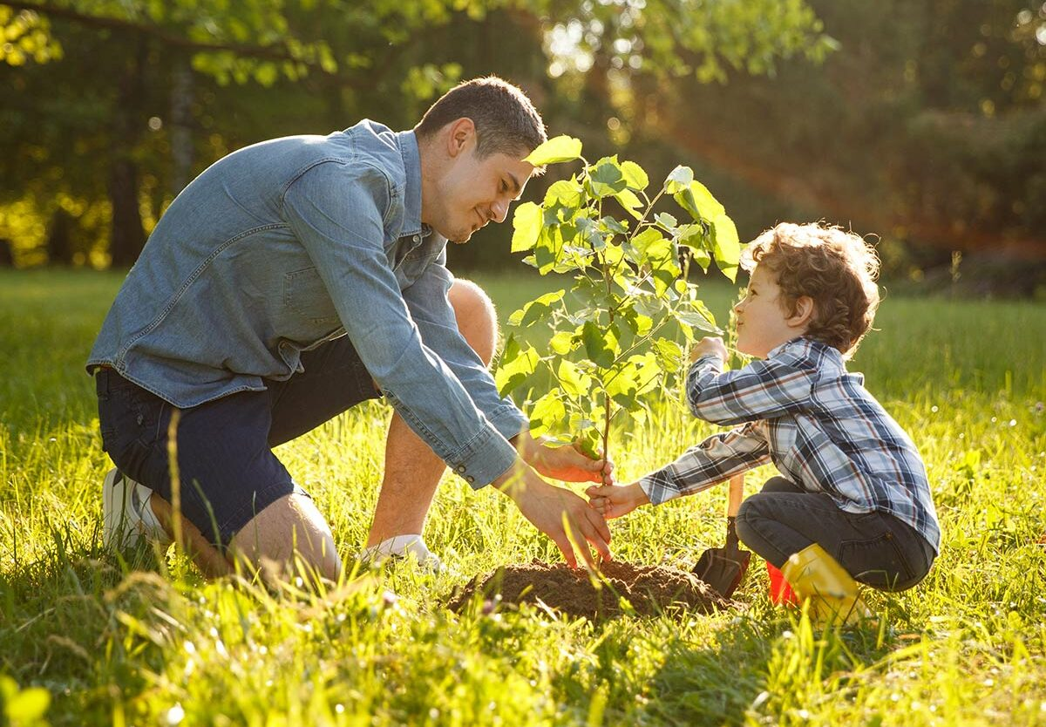
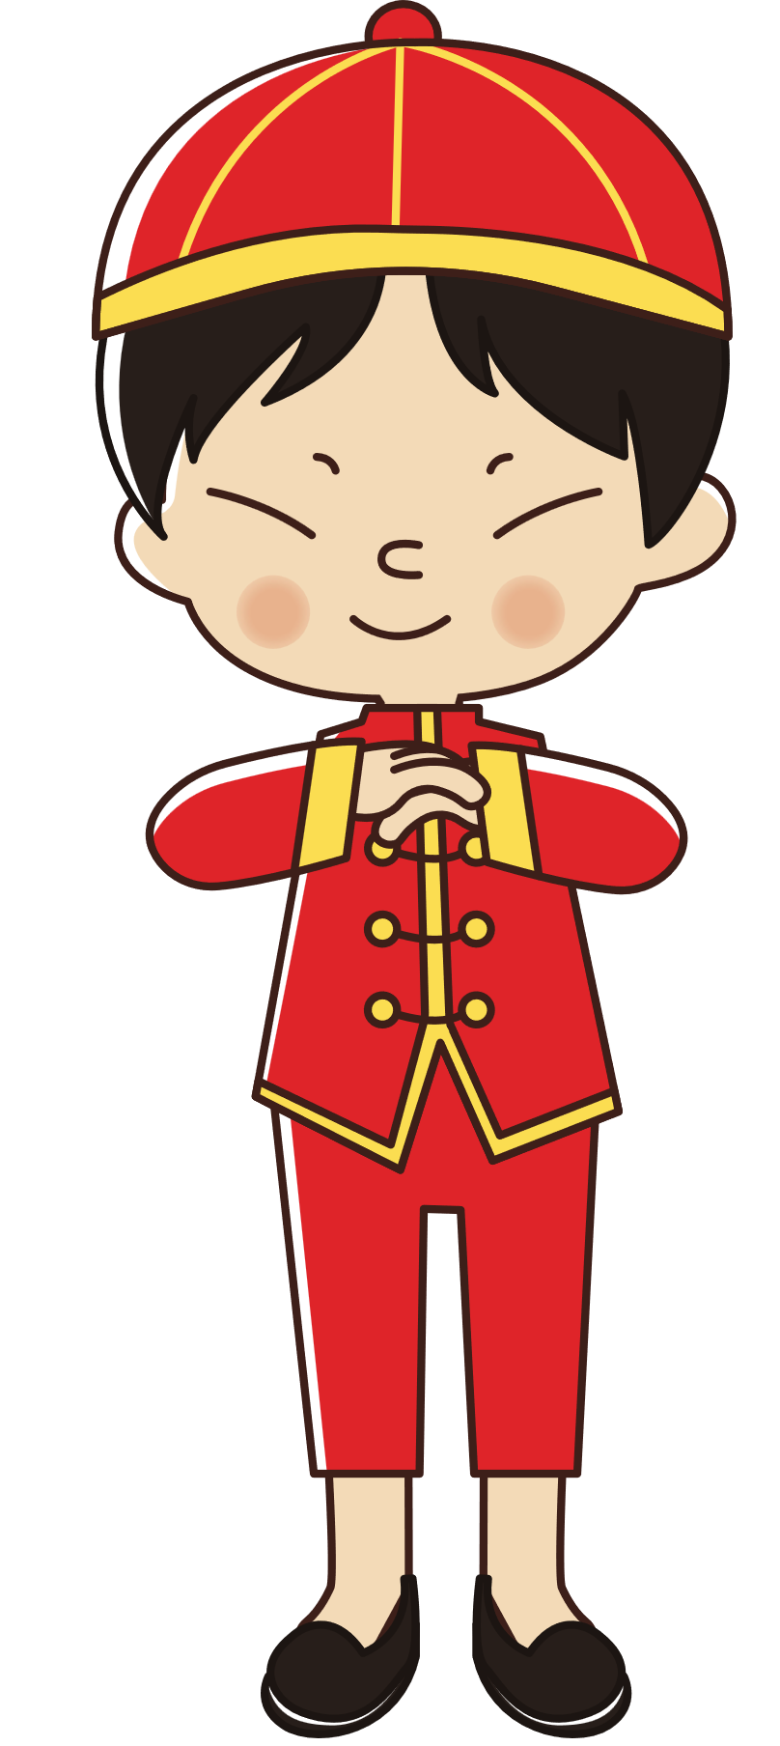
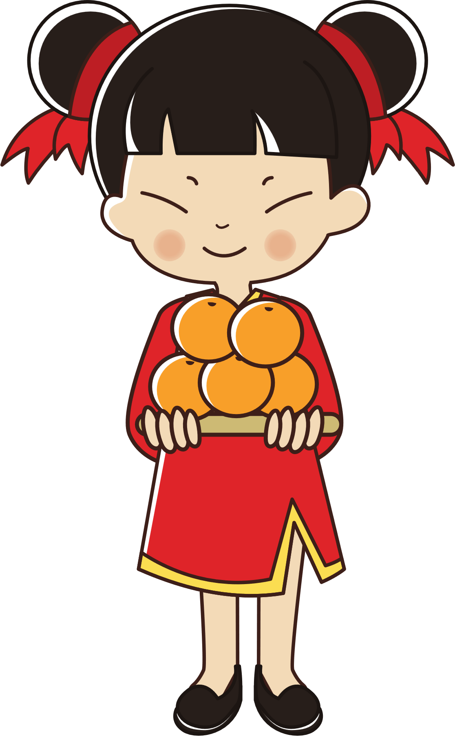
For Tet, Dad will ………………. .
A. eat spring rolls
B. have a big party
C. plant trees

Slide 27


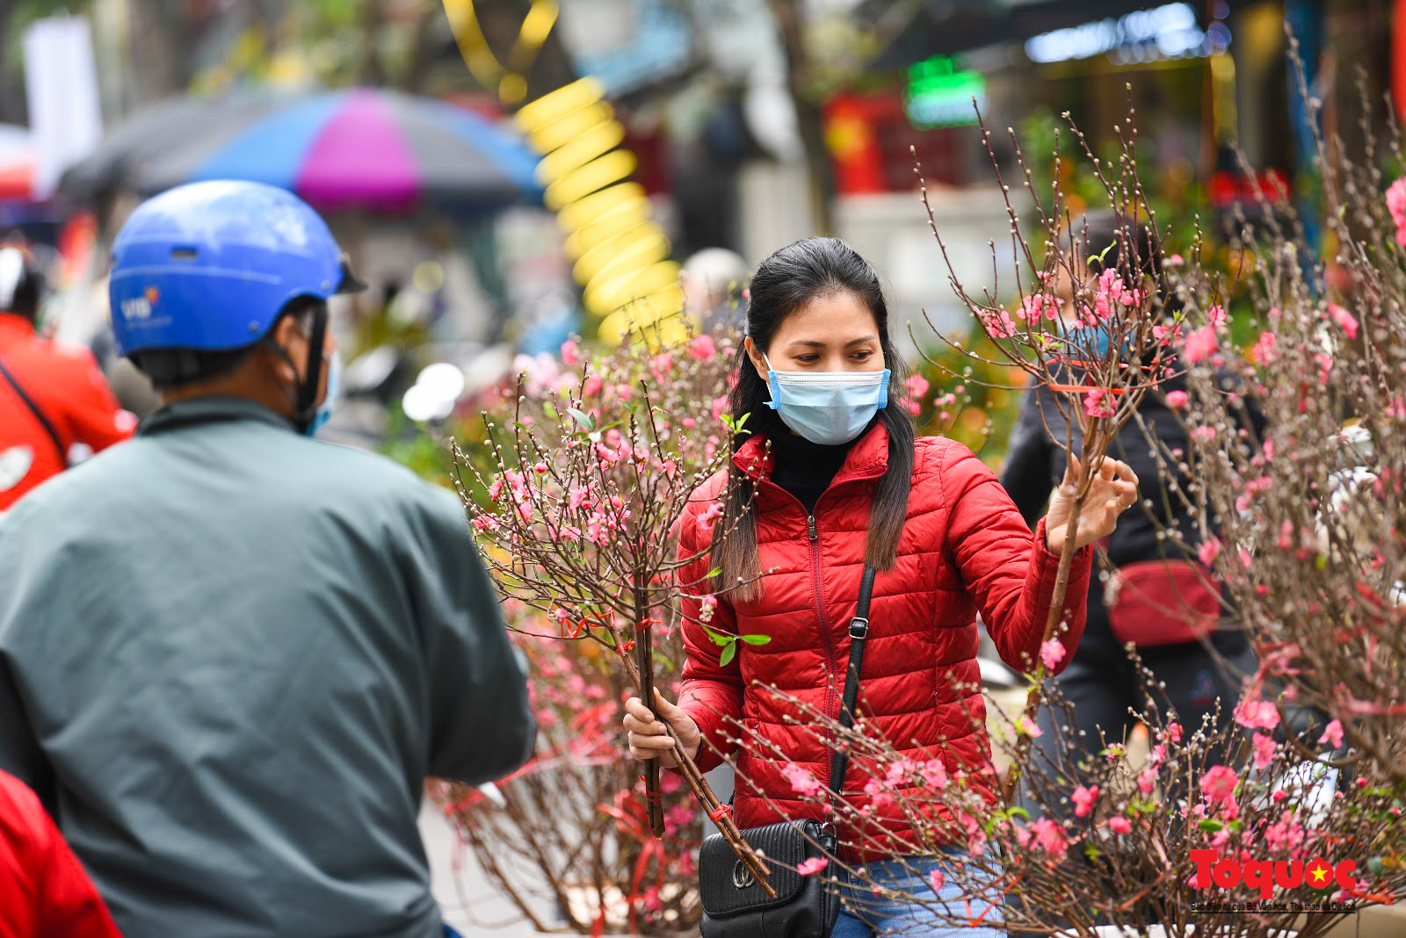

She will …………… for Tet.
A. eat banh chung
B. buy flowers
C. clean the house

Slide 28
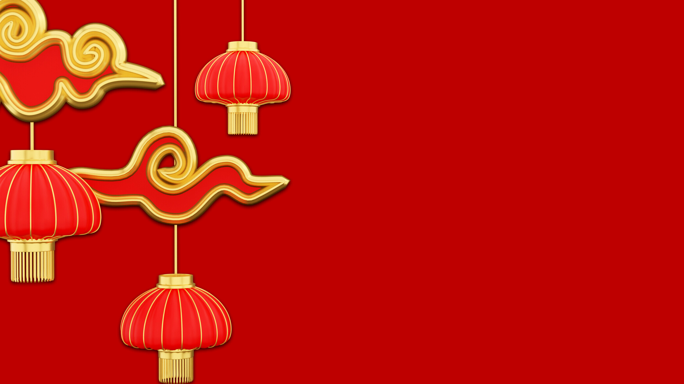

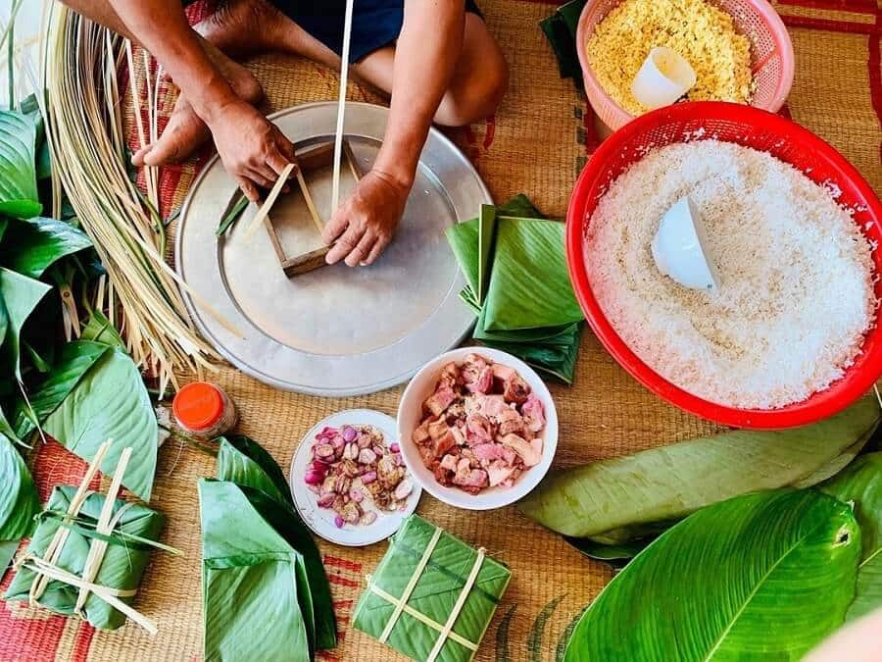
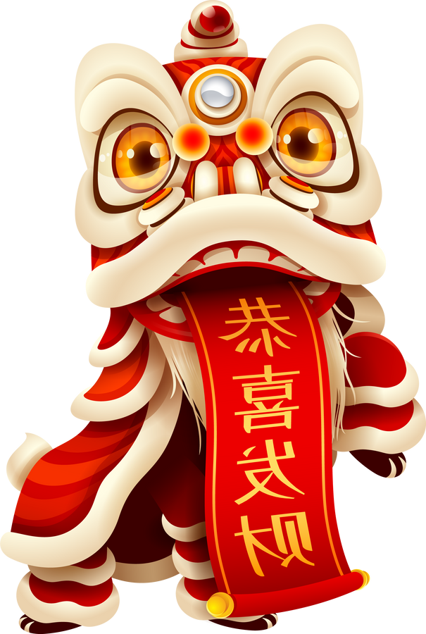
Will you make banh chung for Tet ?
A. No, I won’t.
B. Yes, I won’t.
C. Yes, I will.

Slide 29

Happy Tet Holiday

Slide 30
Website: hoclieu.vn
Fanpage: https://www.facebook.com/tienganhglobalsuccess.vn/

