Slide 1



Slide 2




14
My bedroom
Lesson 1 – Period 1

Slide 3




①
Warm-up and review
②
Look, listen and repeat.
③
Listen, point and say.
④
Let’s talk.
⑤
Fun corner and wrap-up

Slide 4



Lesson 1
Period 1
①
Warm-up and review

Slide 5

Game: What room is this?
Look and guess
Notes:
Open the coloured squares and guess the room behind.

Slide 6

living room
SHOW

Slide 7

bathroom
SHOW

Slide 8
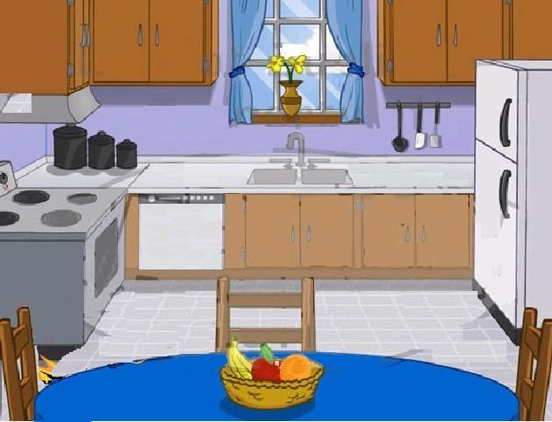
kitchen
SHOW

Slide 9

bedroom
SHOW

Slide 10
Lesson 1
Period 1
②
Look, listen and repeat.

Slide 11

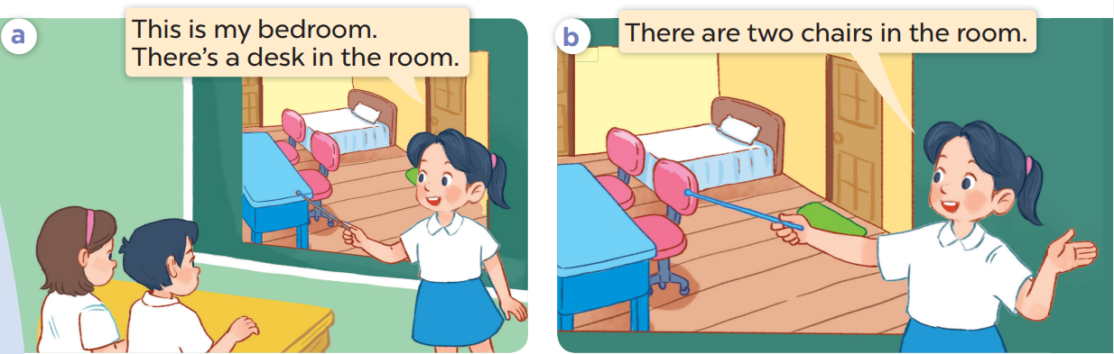

Slide 13
Lesson 1
Period 1
③
Listen, point and say.

Slide 14
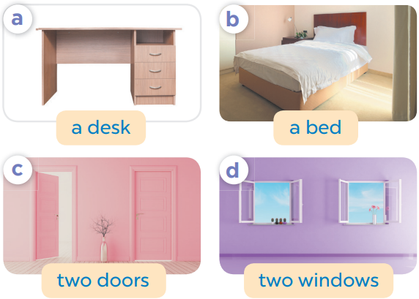
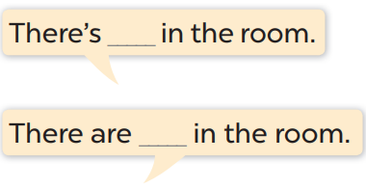

Slide 15


Slide 16
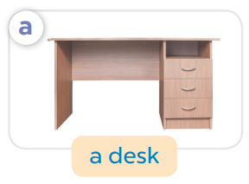
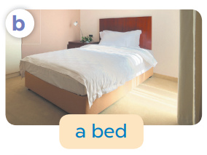

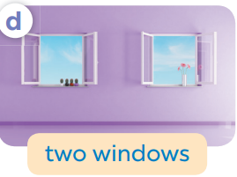
Game: What’s missing?
Notes:
Game: What’s missing?
T divides the class into 2 teams: BOYS and GIRLS.
T shows 4 pictures on the board. Take out 1, then 2 pictures then ask pupils to find out what is/ are missing.
Members of each team try to say out loud the missing room as fast as possible.

Slide 17
What’s missing?

Slide 18
What’s missing?

Slide 19
What’s missing?

Slide 20
What’s missing?

Slide 21
What’s missing?
What’s missing?

Slide 22
What’s missing?
What’s missing?

Slide 23
What’s missing?
What’s missing?

Slide 24
What’s missing?
What’s missing?

Slide 25
What’s missing?
What’s missing?

Slide 26
What’s missing?
What’s missing?

Slide 27
Lesson 1
Period 1
④
Let’s talk.

Slide 28
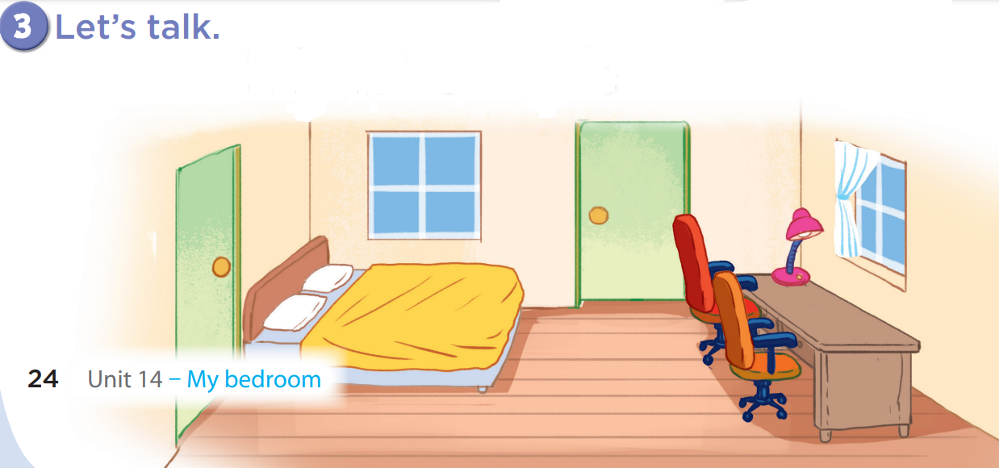
There are
two windows.
There is a bed.

Slide 29
There are
two doors.
There is a desk.

Slide 30
There are
two chairs.
There is a lamp.

Slide 31
Game: Look and say!
Notes:
Game: Look and say
- Divide the class into 2-4 teams.
- Have the pupils look at the arrows and say the sentences.

Slide 32

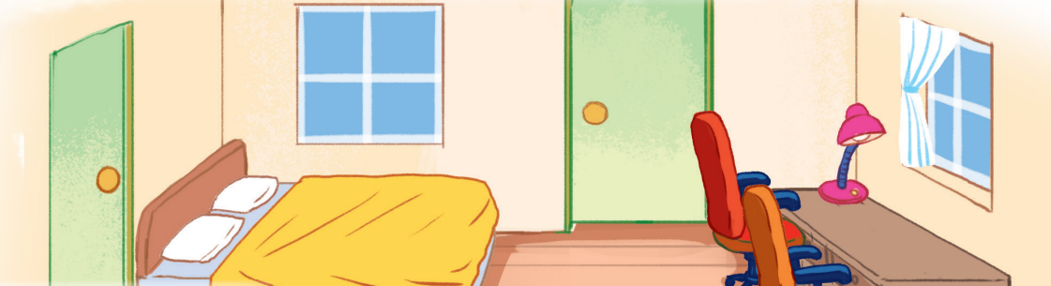
There are two windows.
5

Slide 33
There are two doors.
3

Slide 34
There is a bed.
2

Slide 35
There is a desk.
3

Slide 36

There are two doors.
5

Slide 37

There is a bed.
2

Slide 38
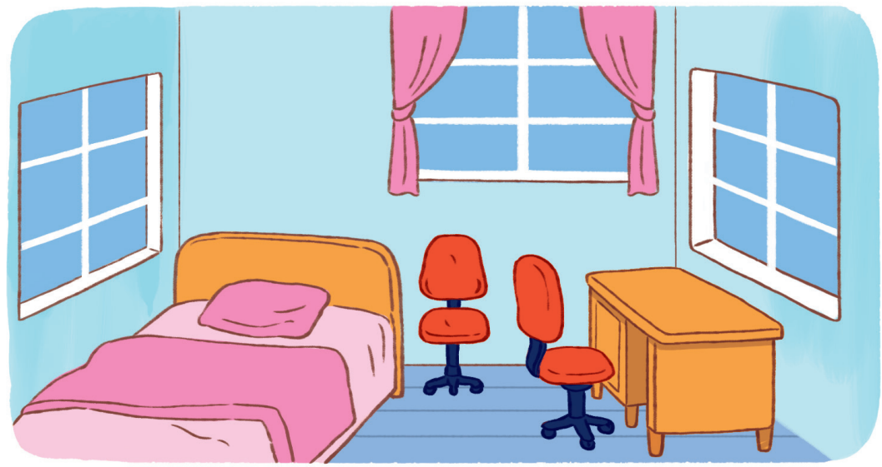
There is a desk.
3

Slide 39
There are three windows.
3

Slide 40
There are two chairs.
3

Slide 41
Lesson 1
Period 1
⑤
Fun corner and wrap-up

Slide 42
What can you see in the room?
Notes:
Teacher asks pupils some questions about the picture and has them answer, e.g.:
+ What can you see in the picture?
+ How many…..?

Slide 43
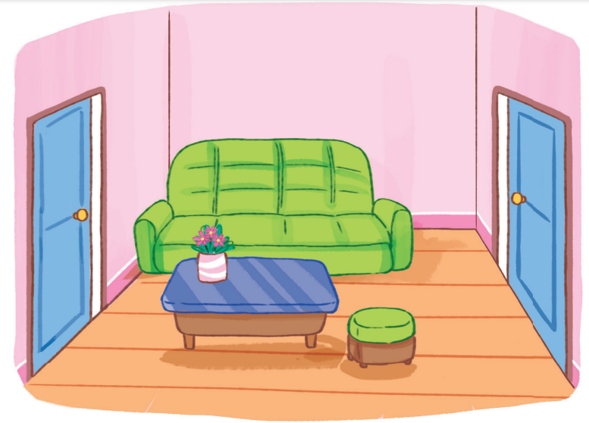
What can you see in the room?

Slide 44
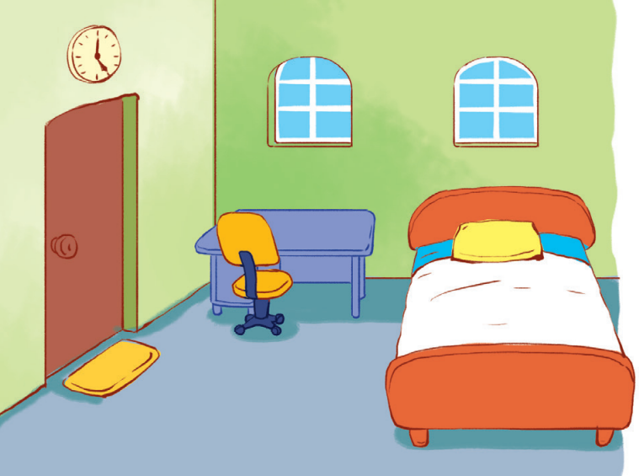
What can you see in the room?

Slide 45

Website: hoclieu.vn
Fanpage: https://www.facebook.com/tienganhglobalsuccess.vn/

