Slide 1



Slide 2




11
My family
LESSON 3 – PERIOD 5

Slide 3

My family
Listen and circle.
Let’s chant.
Listen
and repeat.
Warm-up
and review
Fun corner
and wrap up

Slide 4

Warm-up
and review
WORD SEARCH PUZZLE
SEVEN
EIGHT
NINE
ELEVEN
TWELVE
SIXTEEN
TWENTY
WHO
FATHER
BROTHER
T
W
E
L
V
E
F
F
T
W
E
L
V
E
F
F
W
H
O
N
R
A
I
A
W
H
O
I
A
E
L
E
V
E
N
F
T
E
L
E
V
E
N
F
T
N
E
E
I
G
H
T
H
N
E
I
G
H
T
H
T
N
I
N
E
D
E
E
T
N
I
N
E
E
E
y
B
R
O
T
H
E
R
Y
B
R
O
T
H
E
R
Y
A
S
E
V
E
N
O
S
E
V
E
N
S
I
X
T
E
E
N
E
S
I
X
T
E
E
N
Notes:
Have the whole class play “Word search puzzle”.
Have pupils find out the words about numbers and family members.
This game is just for fun not for competition.

Slide 5
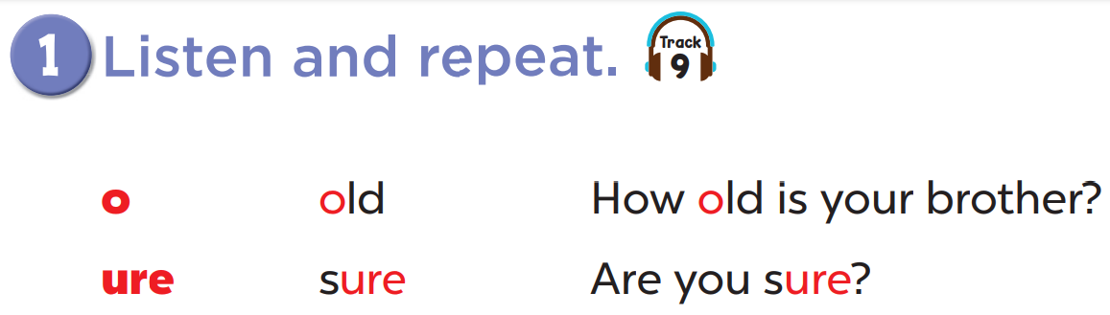


Slide 6
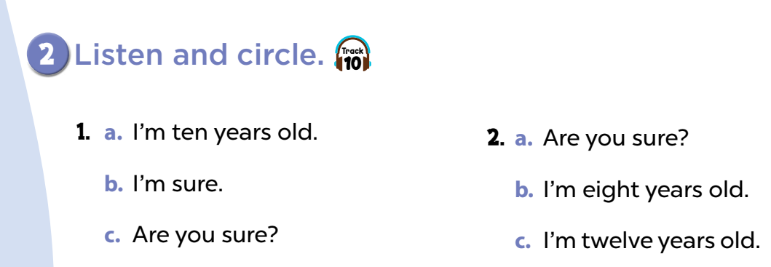

Slide 7
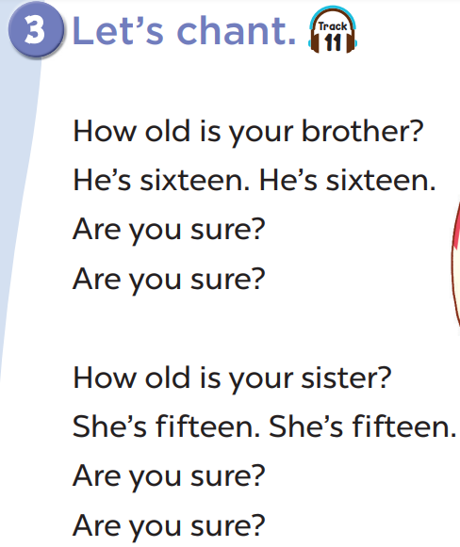
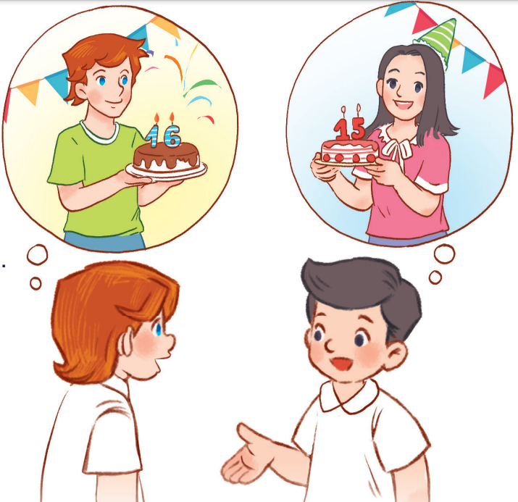

Slide 8
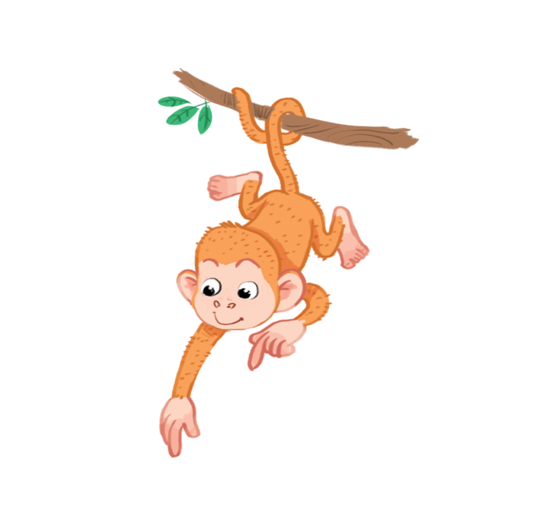
Fun corner
and wrap up
A
B
eleven
twelve
O /əʊ/
ure /ʊə(r)/
thirteen
fourteen
fifteen
sixteen
Notes:
- Divide the class into 2 teams to play “Fabulous sounds”.
- Each team choose one number to go to the question.
- Have pupils look, read and choose the right words that match the sounds.
- Back to the menu for pupils to choose another question.
- Pupils continue their turns until there are not any numbers.
- The team who gets the most points is the winner.

Slide 9



close
about
hot
50
O /əʊ/
Notes:
- Click on the home button to go back.

Slide 10
out
come
open
40
O /əʊ/
Notes:
- Click on the home button to go back.

Slide 11
old
school
book
30
O /əʊ/
Notes:
- Click on the home button to go back.

Slide 12
go
come
about
20
O /əʊ/
Notes:
- Click on the home button to go back.

Slide 13
picture
eraser
sure
30
ure /ʊə(r)/
Notes:
- Click on the home button to go back.

Slide 14
sure
black
blue
20
ure /ʊə(r)/
Notes:
- Click on the home button to go back.

Slide 15

Website: hoclieu.vn
Fanpage: facebook.com/www.tienganhglobalsuccess.vn

