Slide 1
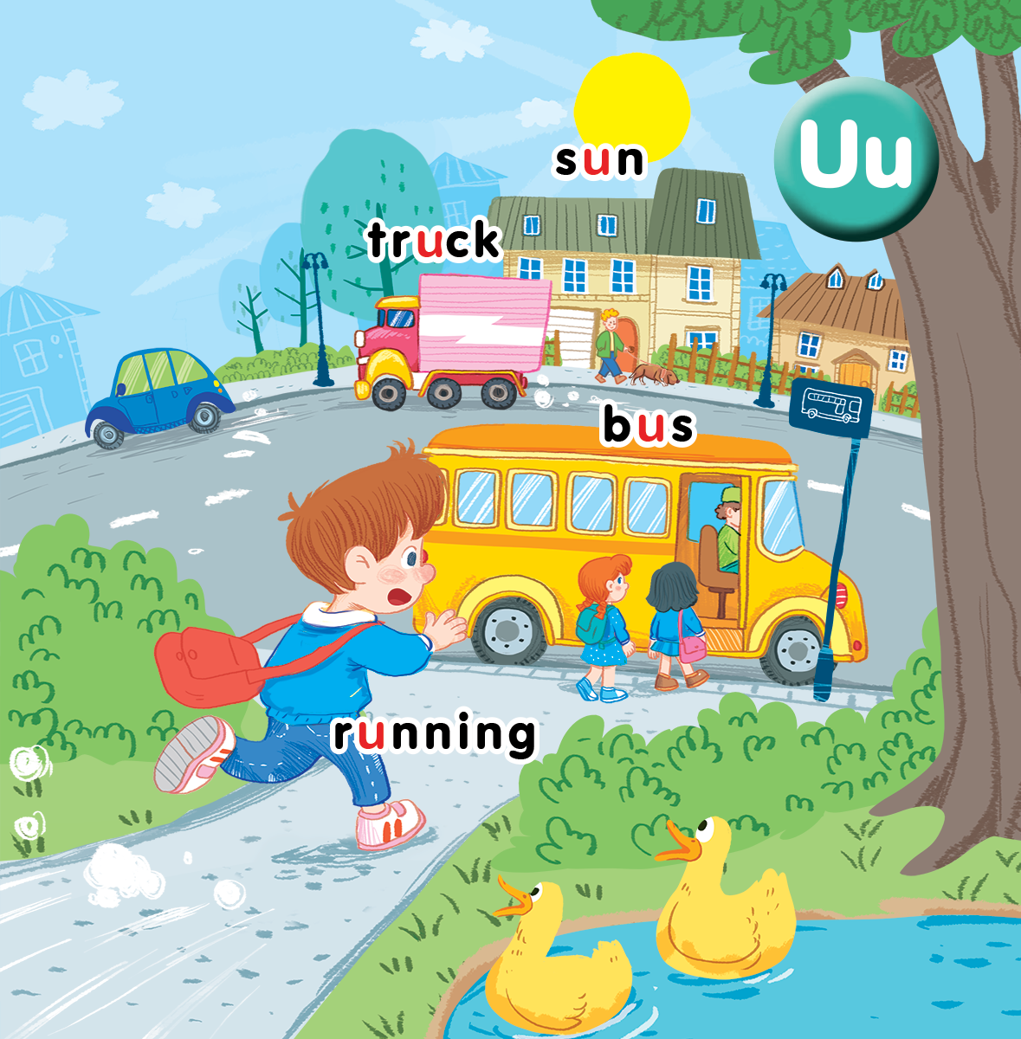
Unit 11 At the bus stop Lesson 3
Notes:
Goals:
- Pupils will be able to listen and repeat the sentences ”He’s running.”, ”She’s running.”
- Pupils will be able to say what each of the pupils (in the pictures) is doing, using ”____’s running.”
- Pupils will be able to sing a song with the structures ”It’s a ____.” and ”The boy is ____.”

Slide 2
Warm-up
Notes:
Goal: Warm up and revise the chant.
Time: 3 minutes
Play the chant.
Have pupils listen and chant 2-3 times.

Slide 3
Chant!

Slide 4
Listen and repeat
Notes:
Listen and repeat is divided in to 2 steps.
Step 1
Goal: Pupils will be able to listen to the structure He/She’s/They’re running.
Time: 5 minutes.
Introduce the structure and have pupils listen and repeat.
Hold up a flashcard for a boy and stick the flashcard on the board.
Say He’s running.
Do the same with a flashcard for a girl.
Play the recording, and have pupils listen and repeat.

Slide 5
He’s running.

Slide 6
She’s running.

Slide 7
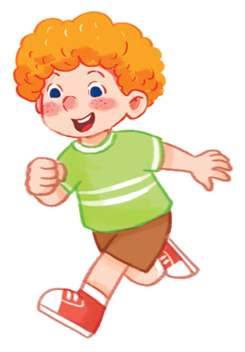
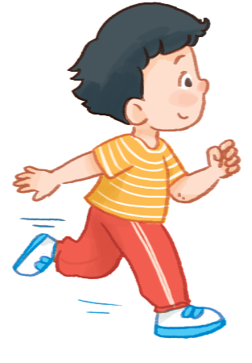
………….’s running.
Notes:
Step 2
Goal: Pupils will be able to recognize and repeat the structure He’s running/ She’s running.
Time: 3 minutes.
Have pupils open the book, listen and repeat.

Slide 8
Let’s talk
Notes:
Let’s talk is divided into 2 steps.
Step 1.
Goal: Practice the structure in the Let’s talk activity
Time: 3 minutes
Make a model sentence.
Have pupils say the structure ”____’s running.” in chorus.
Have pupils say the sentences in Let’s talk activity in groups of 4.
Step 2:
Goal: Practice more freely the structure ”____’s running.”
Time: 5 minutes
Have pupils choose one flashcard and say the structure ”____’s running.”
After that, ask the whole class if it is Yes or No.
Have the whole class repeat that sentence in chorus.

Slide 9
Let’s talk

Slide 10
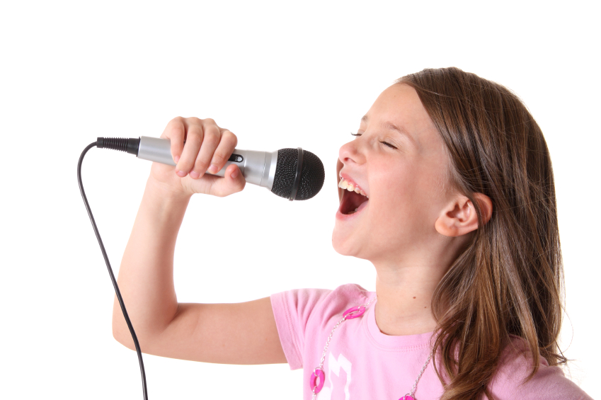
Let’s sing
Notes:
Let’s sing is divided into 3 steps.
Step 1
Goal: Pupils will be able to read the song lyrics.
Time: 3 minutes
Have pupils read the song lyrics in chorus then in groups.
Step 2:
Gold: Pupils will be able to sing a long the song.
Have pupils listen and sing along the song in chorus then in groups
Step 3
Goal: Pupils will be able to sing the song with TPR.
Have groups create their own TPR for the song then present.
Finish the song with the TRP for high five and fist bump.

Slide 11
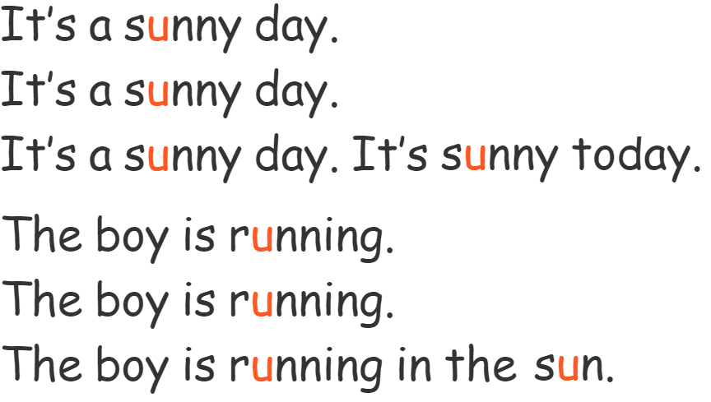
Let’s sing!

Slide 12
Game
Notes:
Goal: Review the unit keywords, the song and the chant.
Time: 5 minutes
Revise the words and play the game.
Play the game in groups.
Group 1, 2, 3 4
Choose the card one by one in each group and each member has to do with TPR action and the representative will say “_____’s running”. “That’s a____”.
The team with the highest points is the winner.

Slide 13
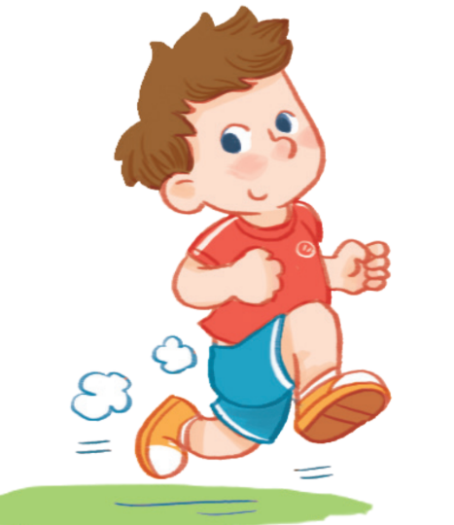

Slide 17
Goodbye
Notes:
Repeat the words with rhythm and say goodbye.

Slide 18
Goodbye

Slide 19
Goodbye

Slide 20
Goodbye

Slide 21
Website: hoclieu.vn
Fanpage: facebook.com/www.tienganhglobalsuccess.vn

