Slide 1
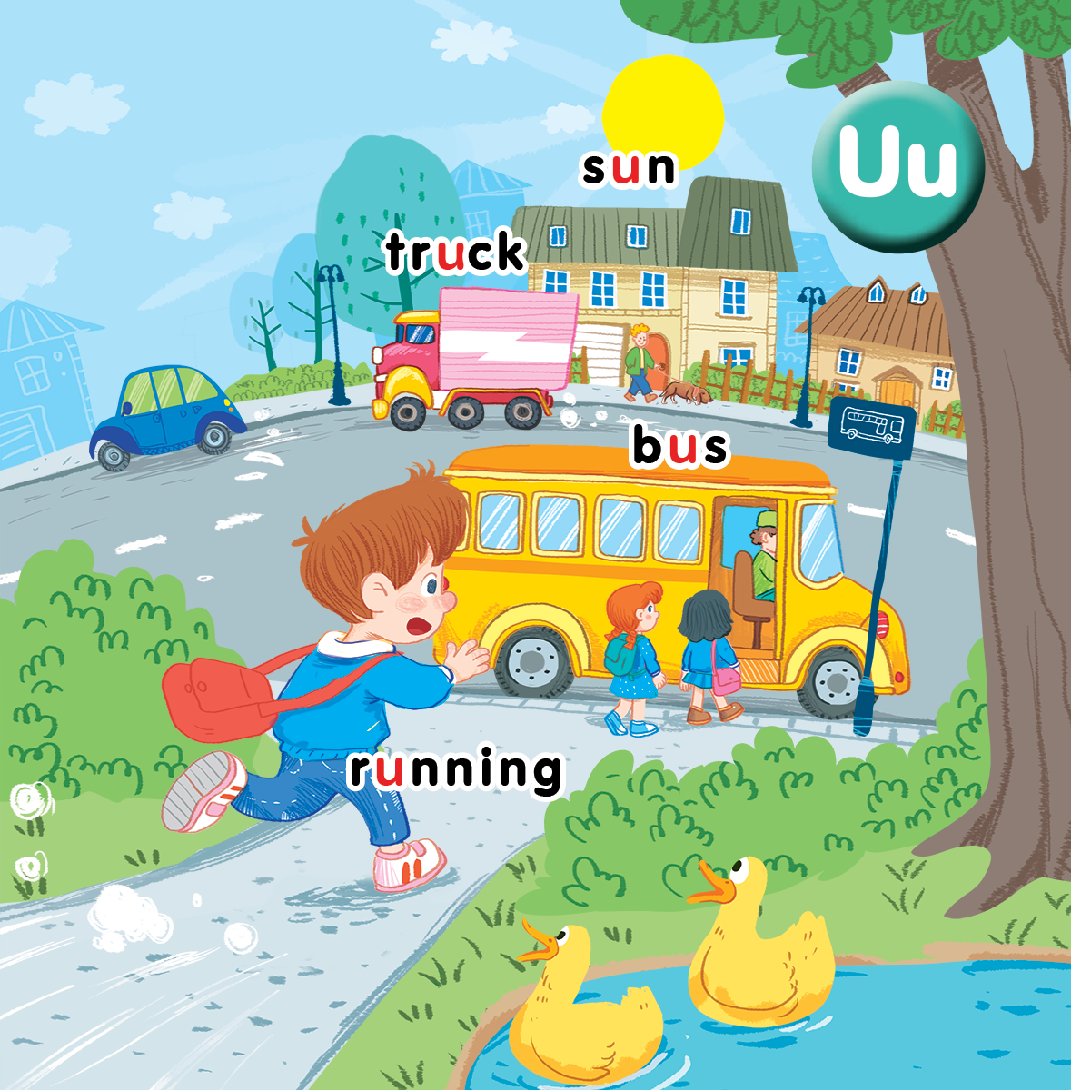
Unit 11
At the bus stop
Lesson 1
Notes:
By the end of the unit, pupils will be able to:
- pronounce the sound of the letter U/u in isolation and in the words sun, truck, bus and running correctly.
- say the sound of the letter U/u and the words sun, truck, bus, running in a chant.
- recognize the words in different situations when listening.
- use “___’s running.” to talk about what someone is doing at the moment.
- trace the letter U/u and complete the words s__n, tr__ck, b__s, r__nning.
sing a song with the structures “It’s a ____.” and “The boy is ____.”
Lesson 1
By the end of the lesson, pupils will be able to:
- pronounce the sound of the letter U/u in isolation and in the words sun, truck, bus and running correctly.
- listen and recognize the words sun, truck, bus, running in a chant.
- recognize and say the words in different situations when listening.

Slide 2

Warm-up
Notes:
Goal: Revise the previous unit vocabulary: mouse, mother, mango, monkey
Time: 5 minutes
Show each slide with a part of the picture.
Pupil says the word.
Do TPR with each word respectively.

Slide 3


Slide 4


Slide 5


Slide 6


Slide 7



Notes:
Listen and repeat is divided into 4 steps.
Step 1
Goal: Listen and repeat the sound u and introduce the context
Time: 3 minutes
Say Open your book! with a TPR action. Have pupils open the book, Unit 11 At the bus stop. Teacher opens the digital book.
Stick the card with letter u and say the sound.
Play the recording or say and have pupils listen and repeat in chorus then in groups.
Say Today we will learn four words having the sound u.
Introduce the context of the picture by eliciting from pupils.

Slide 8

u

Slide 9


running
bus
Notes:
Step 2
Goal: Pupils will be able to listen and repeat the unit keywords bus and running.
Recognize and say the words with flashcards.
Time: 3 minutes
Show each slide with two words: bus, running
Do TPR with each word respectively.
Note: Ask pupils to listen, repeat and do actions 3 times.

Slide 10

f
Notes:
Bus or Running?
Ask pupils to guess.

Slide 11


sun
truck
Notes:
Step 3
Goal: Pupils will be able to listen and repeat the unit keywords truck and sun.
Recognize and say the words with flashcards.
Time: 3 minutes
Do the same with step 2.

Slide 12
Notes:
Truck or sun?
Ask pupils to guess.

Slide 13
u
Notes:
Step 4
Goal: Pupils will be able to practice listen and repeat again the sound u and all four words
- Have pupils listen and repeat the sound u and the words
- Pupils repeat in chorus, group

Slide 14



Notes:
Point and say is divided into 3 main steps.
Step 1
Goal: Pupils will be able to listen and repeat the words.
Time: 3 minutes
Have pupils listen and repeat the words once again but vary the speed to have fun.
Step 2.
Goal: Pupils will be able to listen and point to the pictures.
Time: 3 minutes
Have pupils listen and point to the pictures in the book.
Teacher can ask some pupils to read then others point.
Step 3
Goal: Pupils will be able to point and say to the pictures.
Time: 5 minutes
Point to the word truck and say truck.
Point to other words and have pupils say.
Have pupils work in pair, 1 points and the other says.

Slide 15
Point and say

Slide 16
Game
Notes:
Who’s faster?
Goal: Pupils will be able to recognize the unit words through pictures, meaning.
Time: 5 minutes
Show the slides to pupils.
Tell the pupils that when they see a picture, they have to say; when they see a word, they have to act.
The faster the winner.

Slide 17

Notes:
WHO IS FASTER?
Goal: Revise Unit Vocabulary.
Time: 5 minutes
Play in group
Round 1
Each group is given 4 cards with the images of bus, running, sun, truck and 4 cards with the spellings of the 4 above words.
Pupils have to arrange words with images.
Round 2:
Teacher shows 8 slides of 4 words and 4 images
Group who gives the fastest and correct answer will be given 1 point.

Slide 19
bus

Slide 22
truck

Slide 23


Slide 24
sun

Slide 25
running

Slide 26
Goodbye
Notes:
Repeat the words with rhythm and say goodbye.

Slide 27

Goodbye

Slide 28
Goodbye

Slide 29
Goodbye

Slide 30
Website: hoclieu.vn
Fanpage: facebook.com/www.tienganhglobalsuccess.vn

