Slide 2

FUN TIME 3
Period 1

Slide 3

Table of contents
01
Warm-up and Review
Activity 1.Trace and colour.
Then point and say.
02
03
Activity 2. Let’s play.
04
Fun corner and Wrap-up

Slide 4


01
Warm-up and Review

Slide 5


HIDDEN PICTURES
GAME

Slide 6


What’s this picture?
clock

Slide 7

What’s this picture?
mop

Slide 8

What’s this picture?
pot

Slide 9

What’s this picture?
mango

Slide 10

What’s this picture?
monkey

Slide 11
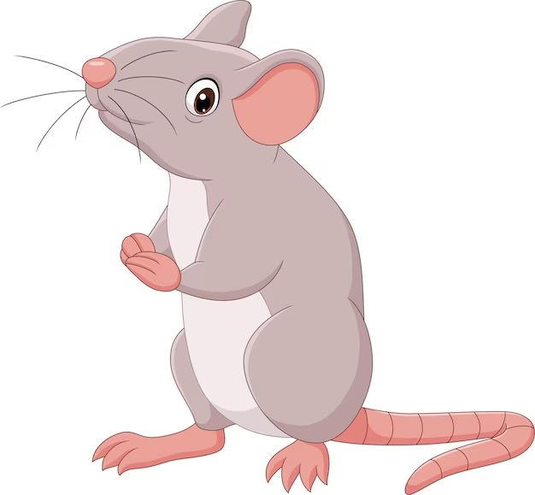
What’s this picture?
mouse

Slide 12


Very Good!

Slide 13
02
Activity 1. Trace and colour.
Then point and say.

Slide 14

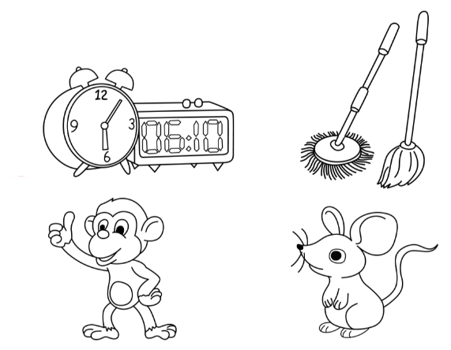
Trace and colour. Then point and say.
1
2
3
4

Slide 15
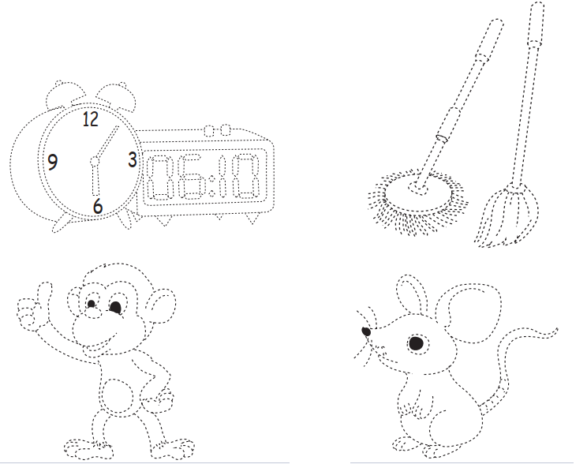







































Trace and colour. Then point and say.
1
clocks

Slide 16











Trace and colour. Then point and say.
2
mops

Slide 17

























Trace and colour. Then point and say.
3
monkey

Slide 18

















Trace and colour. Then point and say.
4
mouse

Slide 19

1
2
clocks
mops
3
4
monkey
mouse

Slide 20
03
Activity 2. Let’s play.

Slide 21
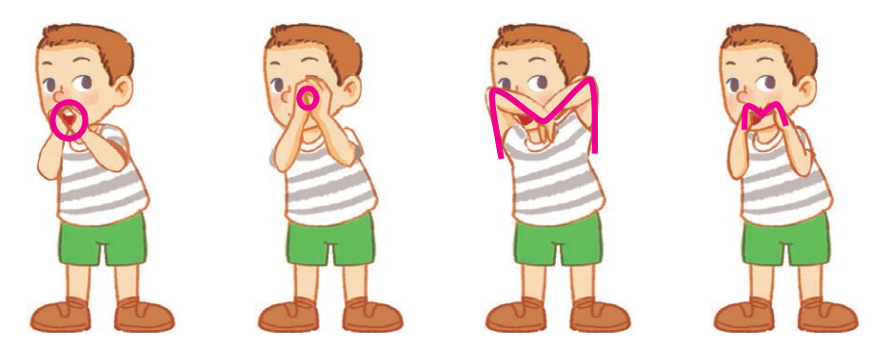
Let’s play.
Simon says

Slide 22

Let’s play.
Simon says

Slide 23

Let’s play.
Simon says

Slide 24

Let’s play.
Simon says

Slide 25

Let’s play.
Simon says

Slide 26
Let’s play.
Simon says

Slide 27
04
Fun corner and wrap-up

Slide 28
Wrap-up
m
/m/
o
/ɒ/

Slide 29


Slide 30

Pass the ball!
That’s a __.
That’s a __.

Slide 31
Website: hoclieu.vn
Fanpage: https://www.facebook.com/tienganhglobalsuccess.vn/

