Slide 1
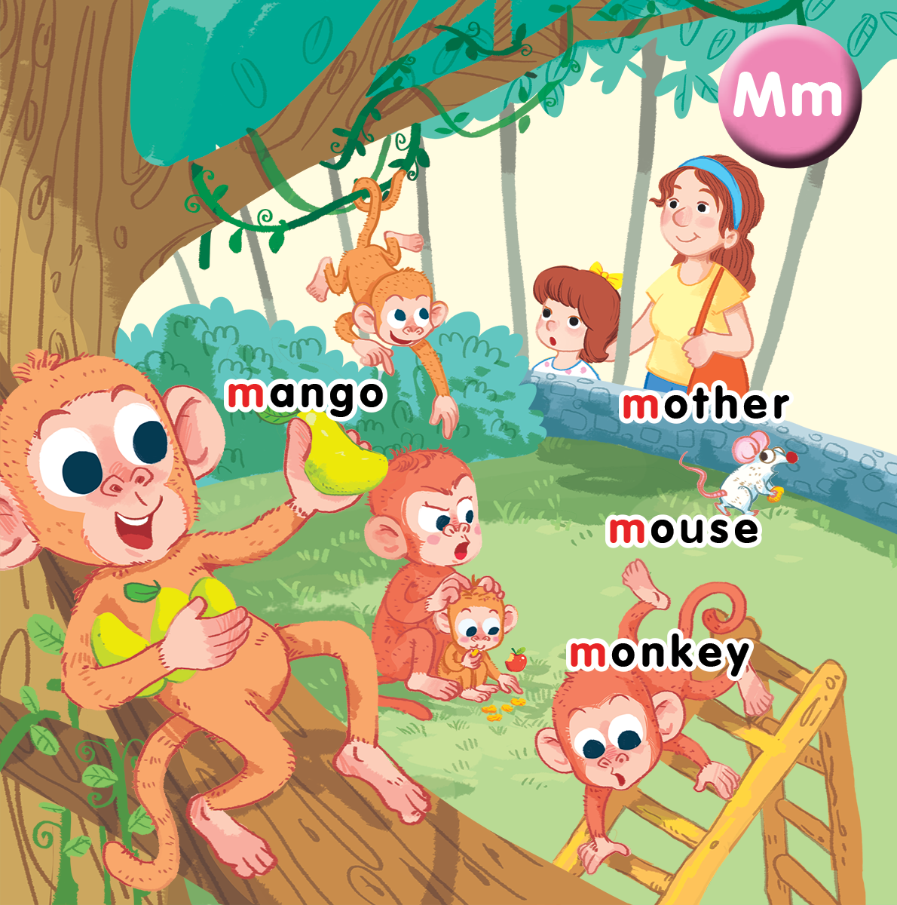
Unit 10 At the zoo Lesson 3
Notes:
By the end of the lesson, pupils will be able to:
- introduce a thing with the structure “That’s a/my____” .
- sing along the unit song.

Slide 2
Warm-up
Notes:
Who’s faster?
Goal: Warm up and revise the previous lesson.
Time: 2 minutes
Teacher shows the slide
In 1 minute, have pupils find how many letters M.

Slide 3
How many letters…M?
A | M | H | M | B
G | B | D | 0 | M
A | E | M | C | P
M | I | Q | R | U
C | M | S | D | Y
F | R | O | E | M
B | L | M | N | Q
V | X | Z | R | E

Slide 4
8
A | M | H | M | B
G | B | D | 0 | M
A | E | M | C | P
M | I | Q | R | U
C | M | S | D | Y
F | R | O | E | M
B | L | M | N | Q
V | X | Z | R | E

Slide 5
Listen and repeat
Notes:
Listen and repeat is divided in to 2 steps.
Step 1
Goal: Introduce the sound and the meaning of the structure That’s_____?
Time: 5 minutes.
Introduce the structure and have pupils listen.
Point to a flash card for mother and say That’s a mother. Repeat the sentence many times.
Do the same with other words.
Ask pupils if they understand the sentence and explain in mother tongue if it is needed.
Step 2
Goal: Pupils will be able to repeat the structure That’s a…
Time: 3 minutes.
Have pupils open the book, listen and repeat in chorus, group and in pairs.

Slide 6
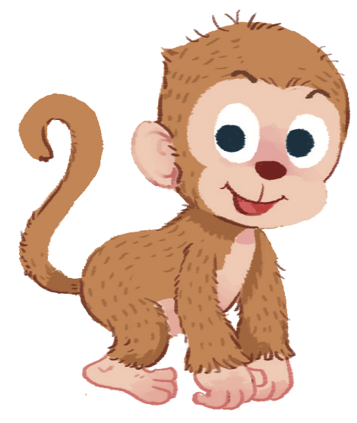
That’s
a monkey

Slide 7
That’s
a mother

Slide 8
That’s
a mouse

Slide 9
That’s
a mango

Slide 10
Let’s talk
Notes:
Let’s talk is divided into 2 steps.

Slide 11
Let’s talk.
Notes:
Step 1.
Goal: Pupils will practice speaking the structure That’s a… in groups.
Time: 5 minutes
Make a model with 1 pupil then have pupils work in group of 4 to do the task on Let’s talk.
Pupil will take turn to say the sentence.

Slide 12
Notes:
Step 2
Lucky numbers
Goal: Pupils will practice more in a game
Time: 4 minutes
Have pupils look at the slide and choose the number and practice saying the structure “That’s a______.”

Slide 13
1
2
3
4
5
6
7
8

Slide 14
That’s a monkey.

Slide 16
That’s a mouse.

Slide 18
That’s a mango.

Slide 20
That’s a mother.

Slide 22
Let’s sing
Notes:
Let’s sing is divided into 3 steps.
Step 1
Goal: Pupils will be able to read the song lyrics.
Time: 3 minutes
Have pupils read the song lyrics in chorus then in groups.
Step 2:
Goal: Pupils will be able to sing a long the song.
Time: 3 minutes
Have pupils listen and sing along the song in chorus then in groups.
Step 3
Goal: Pupils will be able to sing the song with TPR.
Time: 3 minutes
Have groups create their own TPR for the song then present.
Finish the song with the TRP for high five and fist bump.

Slide 23
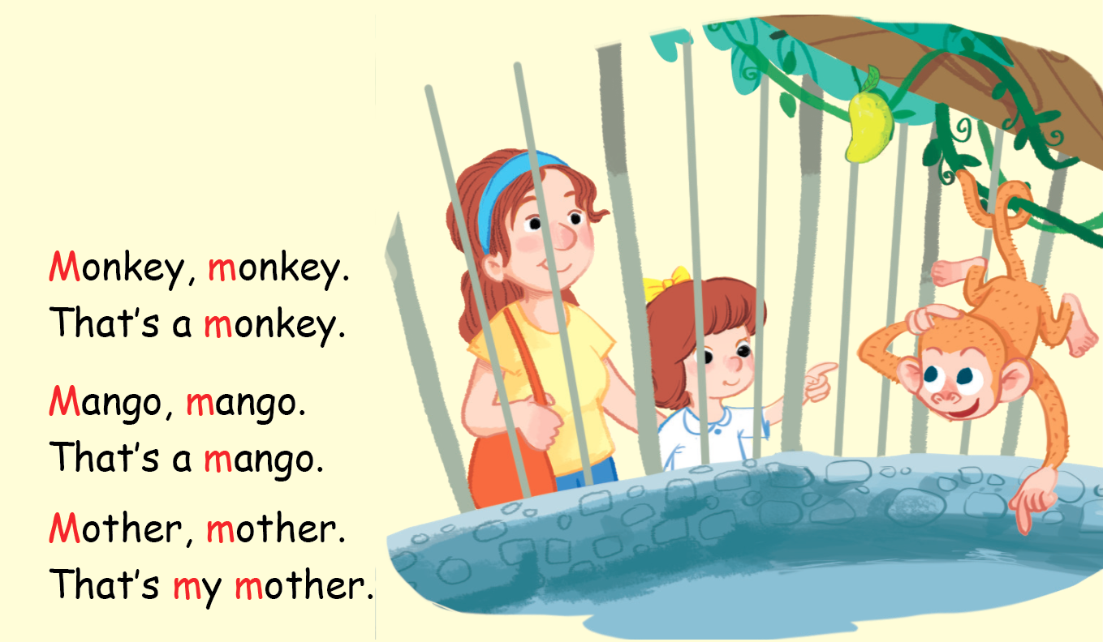
Let’s sing!

Slide 24
Game
Notes:
Guessing game
Goal: Review the unit keywords and structure.
Time: 5 minutes
Play the game in groups.
Pupils take turn in each group to do TPR action and the others guess and say “That’s____”.

Slide 25
Goodbye
Notes:
Goodbye
Time: 2 minutes
Repeat the words with rhythm and say goodbye.

Slide 26
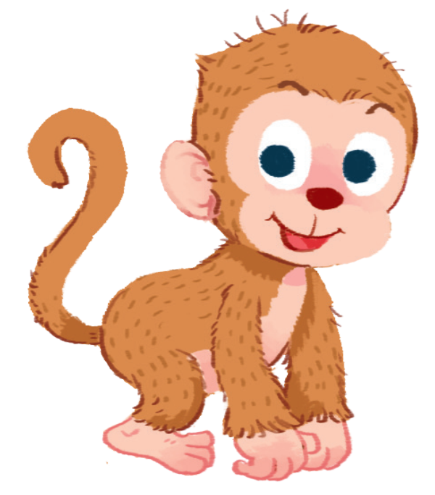
Goodbye

Slide 27
Goodbye

Slide 28
Goodbye

Slide 29
Website: hoclieu.vn
Fanpage: facebook.com/www.tienganhglobalsuccess.vn

