Slide 2








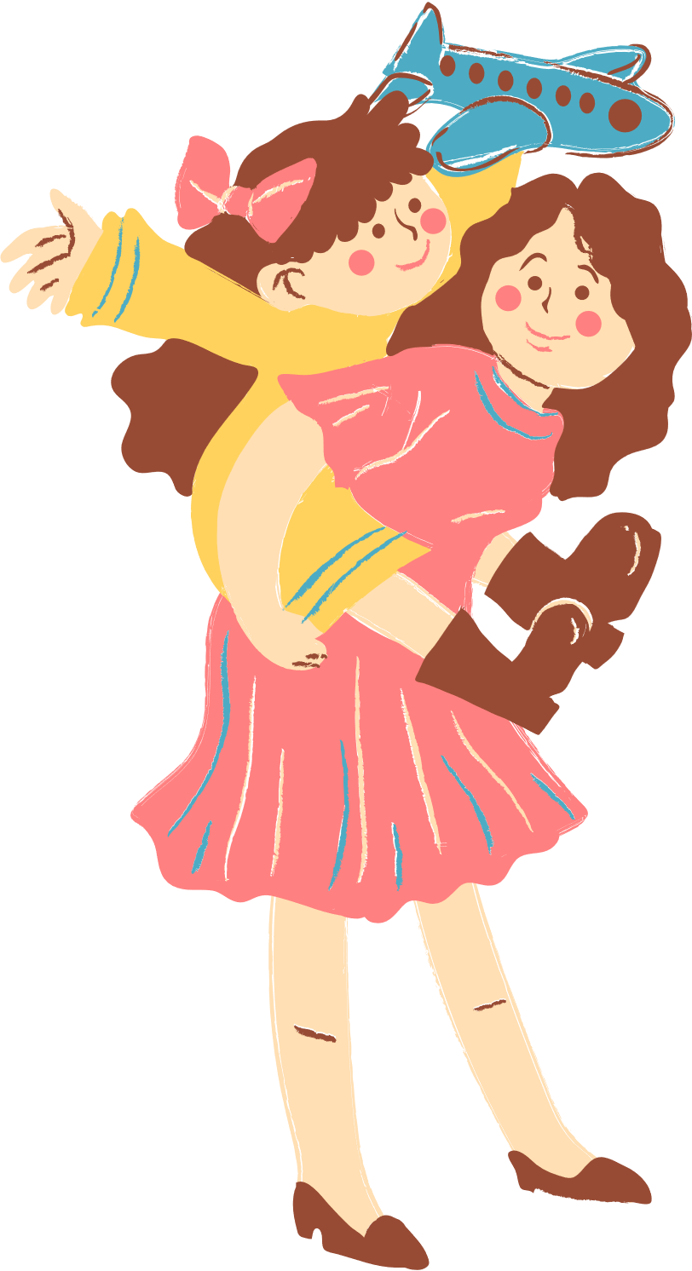
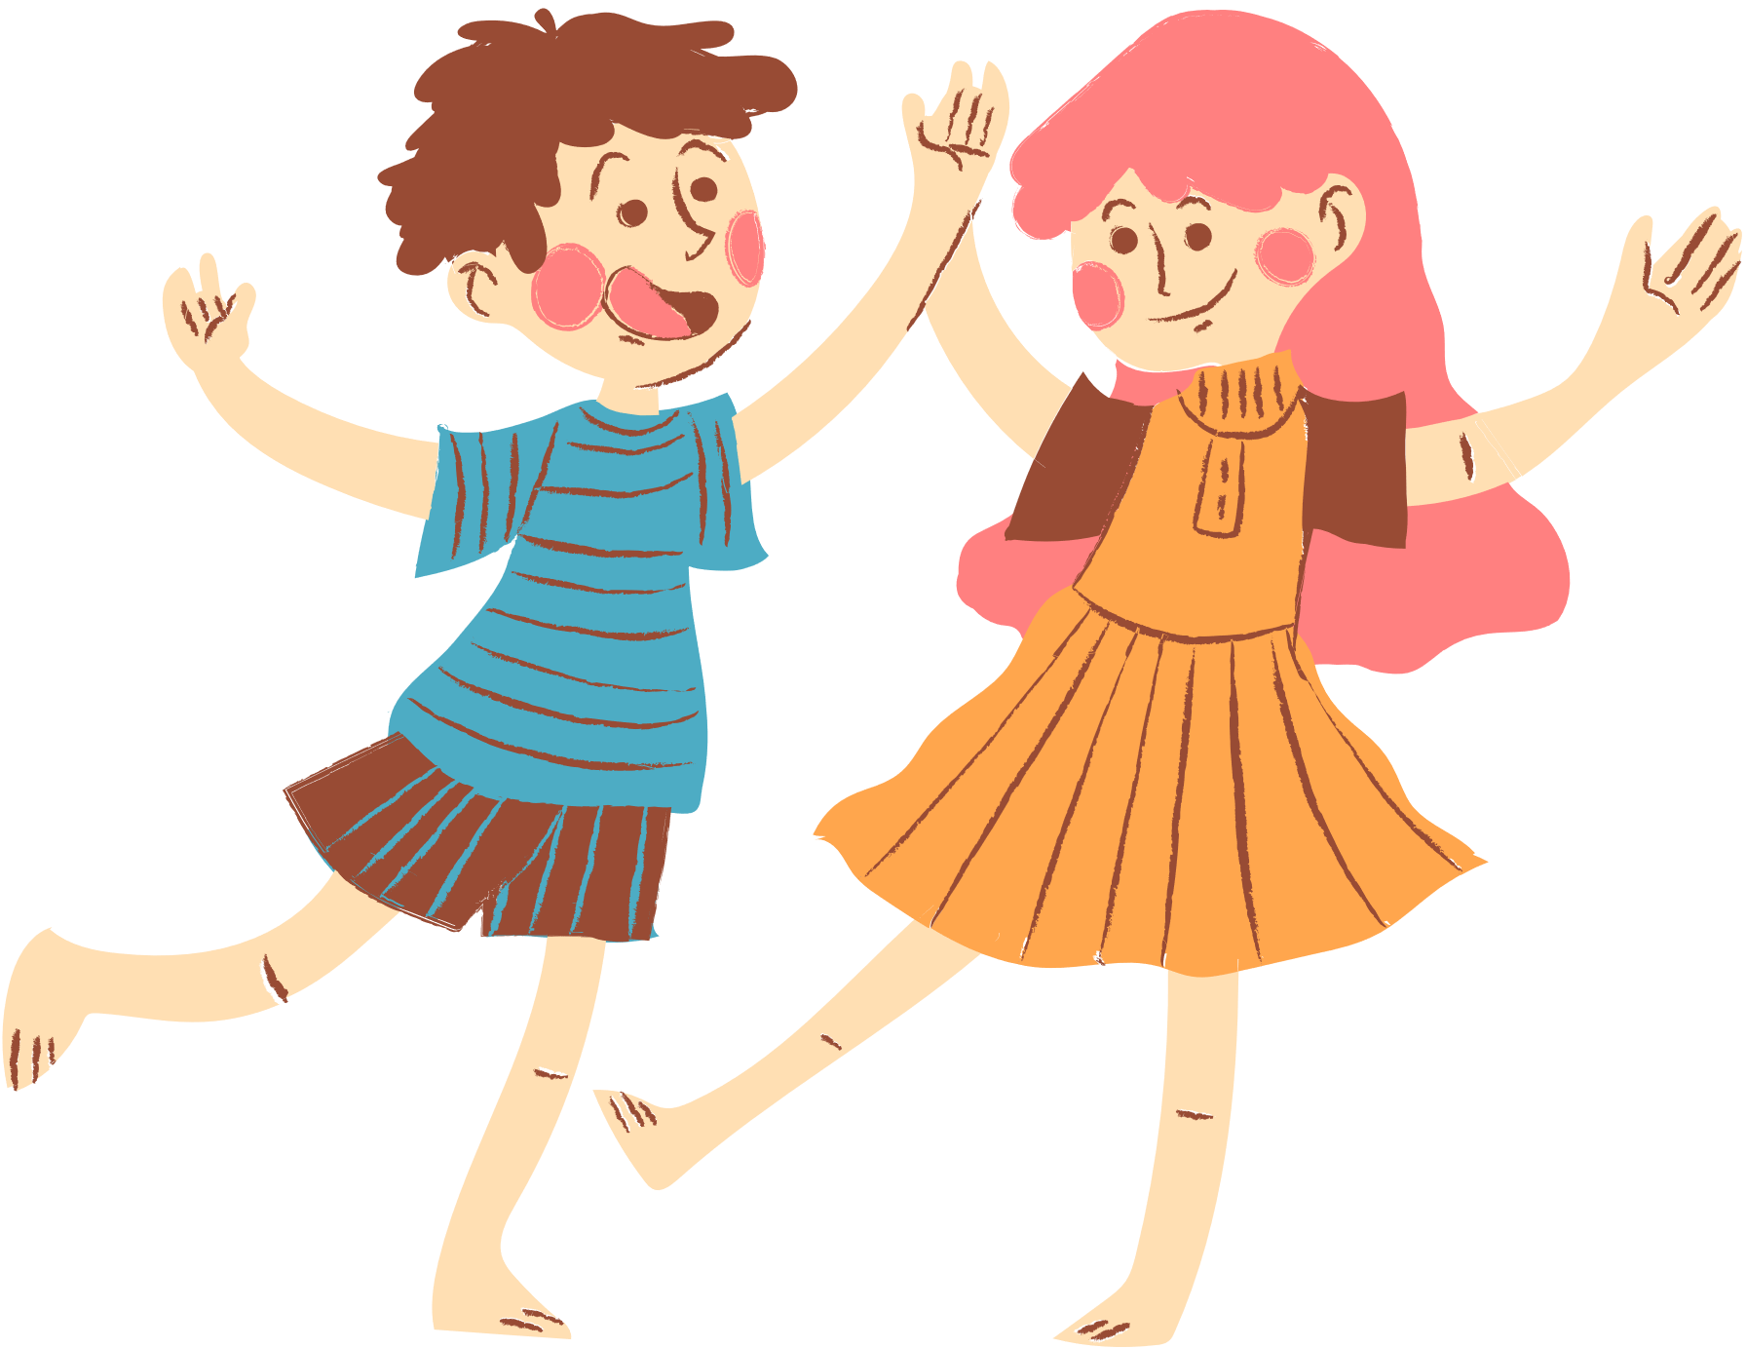
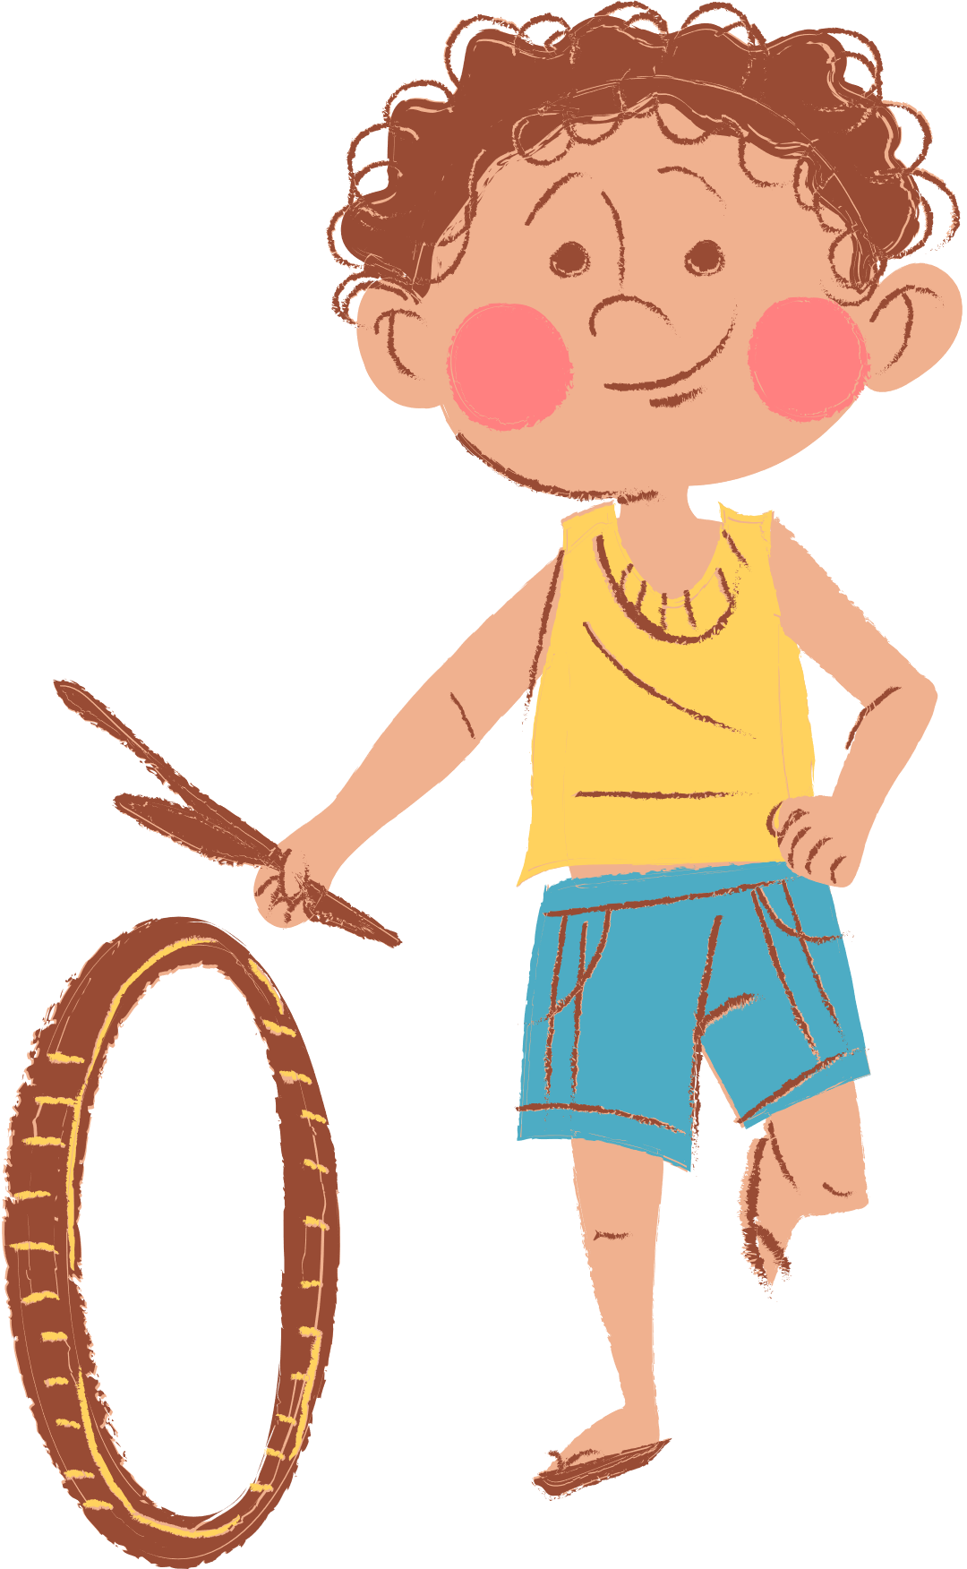
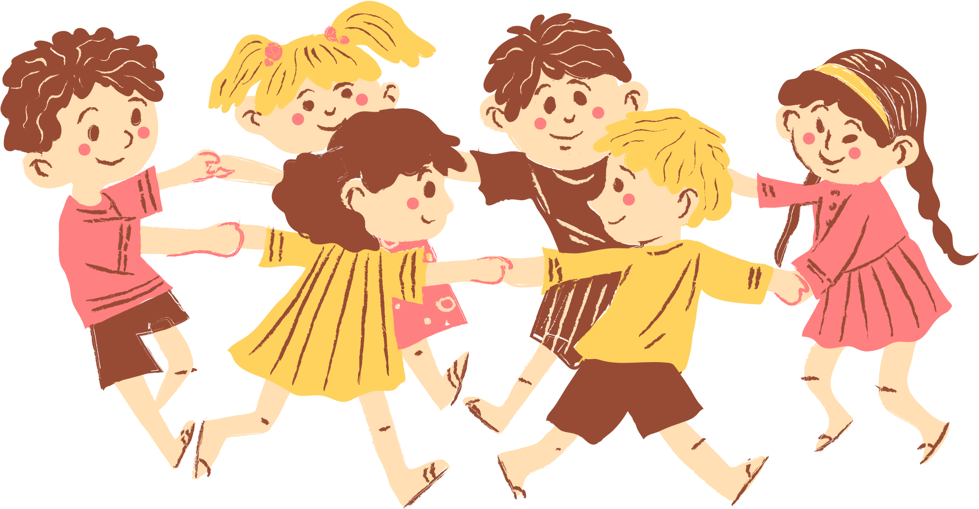

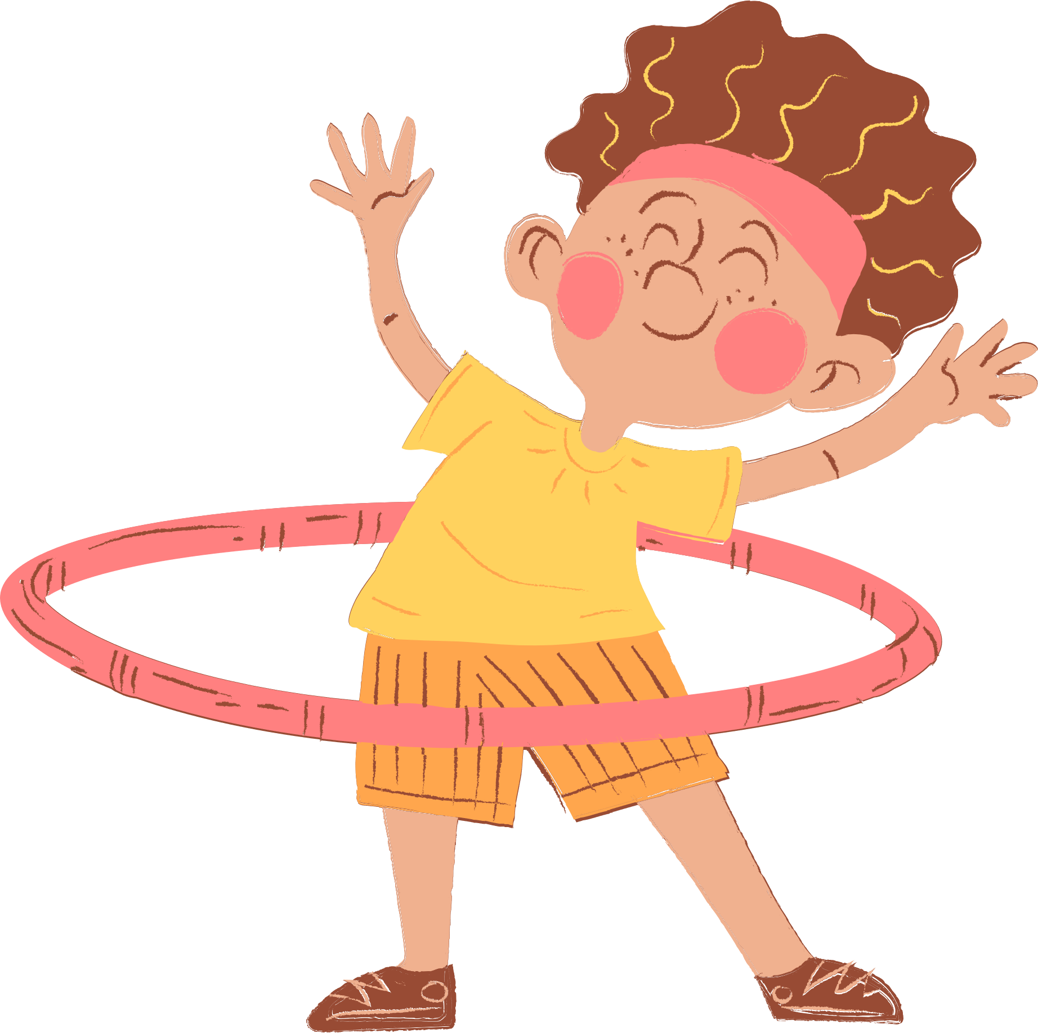
4
Our free-time activities

Slide 3







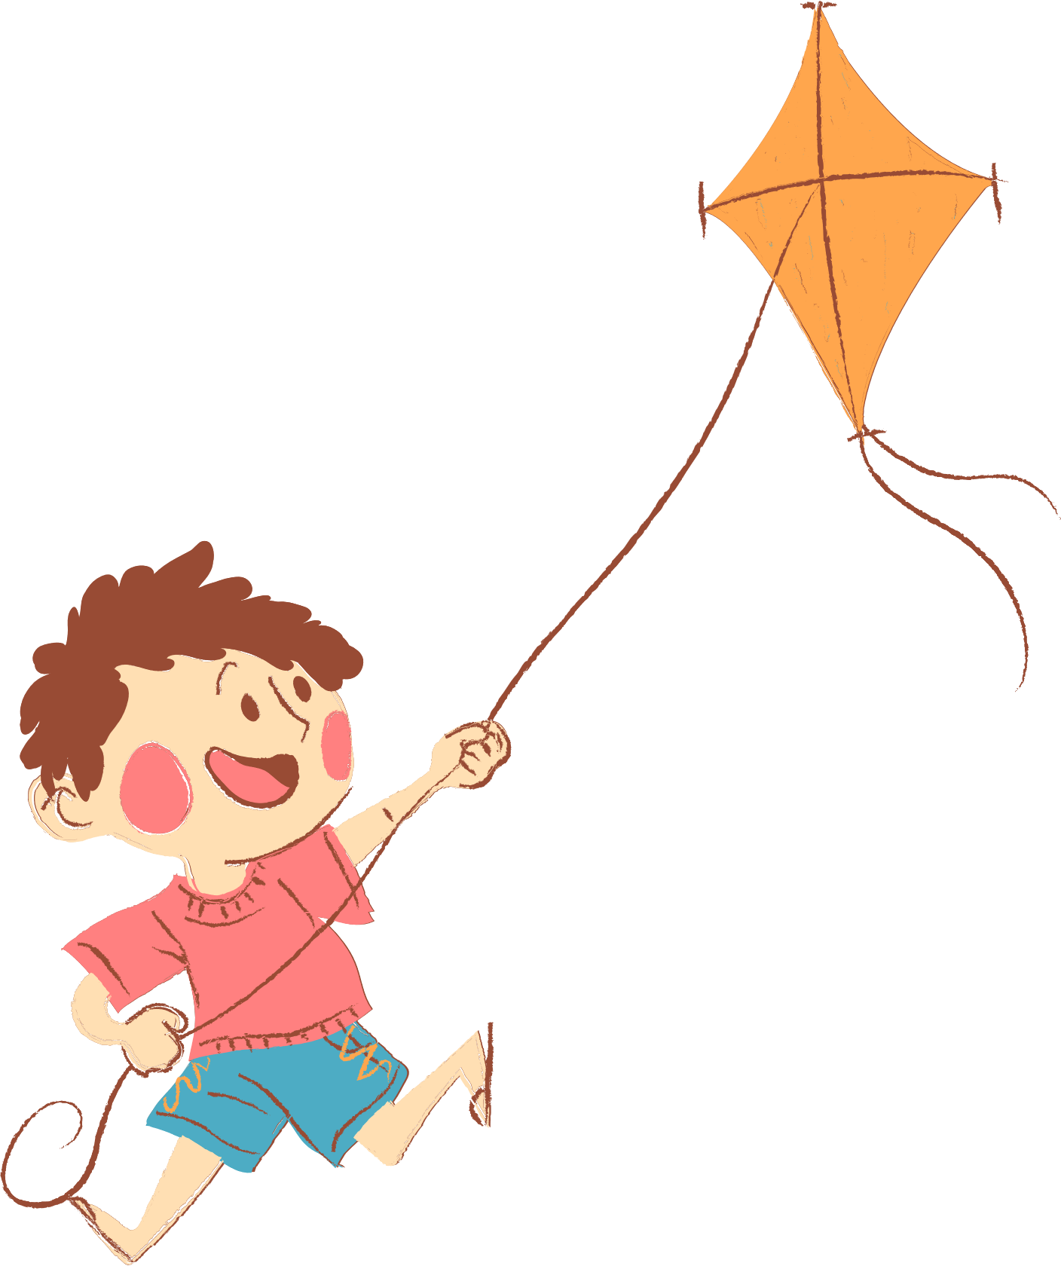
01. Warm-up and R eview
02. Read and answer.
03. Let’s write.
04. Project
05. Fun corner and Wrap-up

Slide 4
01. Warm-up and Review

Slide 5

mystery box

Slide 6

The mystery box may be good or bad!
+100 pts
-100 pts

Slide 7
Choose to keep the box or give it to another team!

Slide 8













Next
->

Slide 9
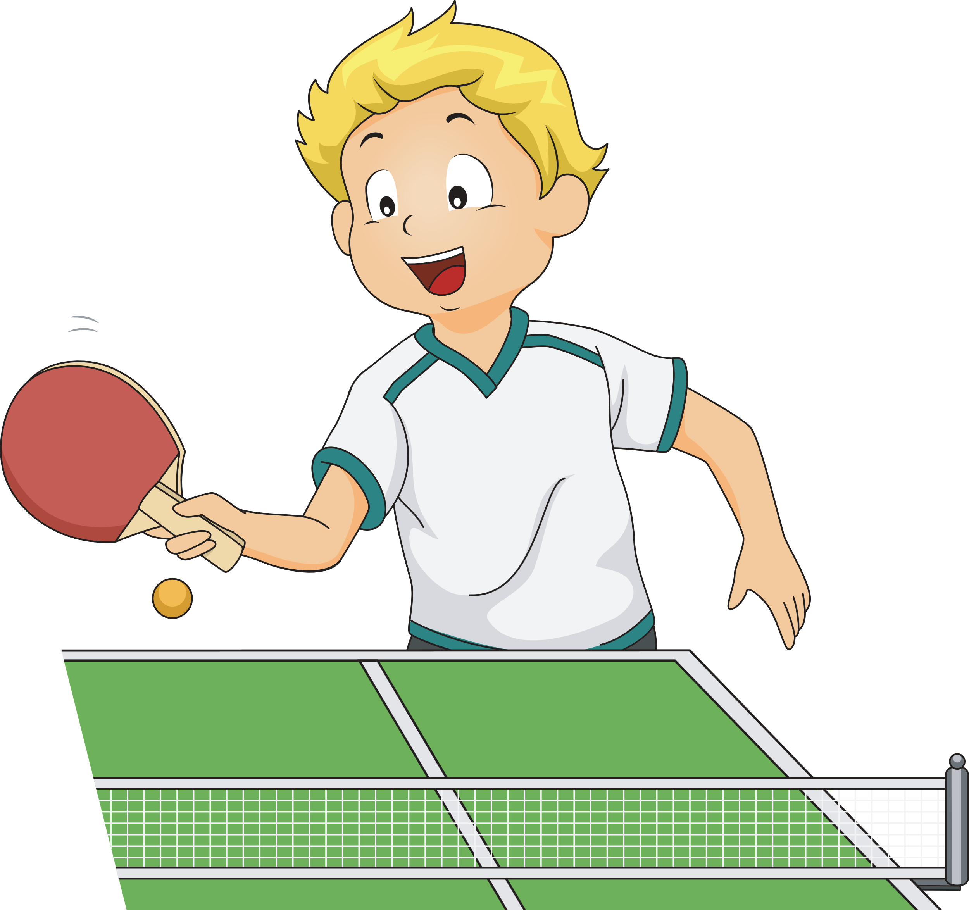

What do you do after school?
sometimes
I sometimes play table tennis.
Notes:
Press the spacebar or down arrow to reveal the answer.
Press the X to go back to the letter slide (wrong answer), press the question box to go the reward slide (correct answer).

Slide 10
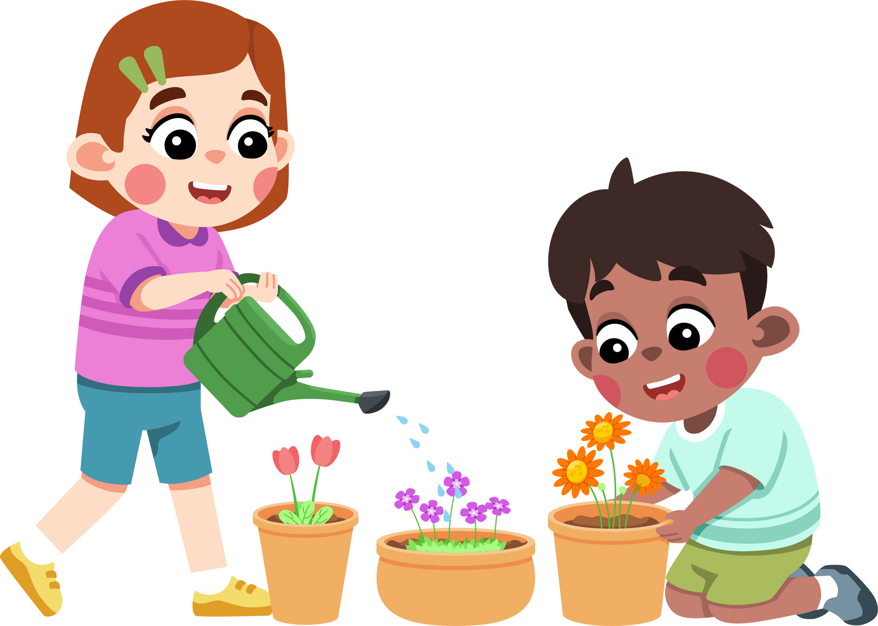
What do you like doing in your free time?
I/ We like watering the flowers.
Notes:
Press the spacebar or down arrow to reveal the answer.
Press the X to go back to the letter slide (wrong answer), press the question box to go the reward slide (correct answer).

Slide 11
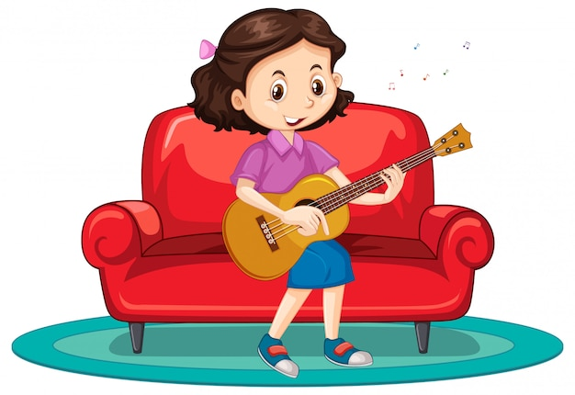
What do you like doing in your free time?
I like playing the guitar.
Notes:
Press the spacebar or down arrow to reveal the answer.
Press the X to go back to the letter slide (wrong answer), press the question box to go the reward slide (correct answer).

Slide 12

What do you like doing before going to bed?
I like reading stories (with my mum).
Notes:
Press the spacebar or down arrow to reveal the answer.
Press the X to go back to the letter slide (wrong answer), press the question box to go the reward slide (correct answer).

Slide 13

What do you do at the weekend?
always
I always go swimming.
Notes:
Press the spacebar or down arrow to reveal the answer.
Press the X to go back to the letter slide (wrong answer), press the question box to go the reward slide (correct answer).

Slide 14

What do you like doing in your free time?
I like surfing the Internet.
Notes:
Press the spacebar or down arrow to reveal the answer.
Press the X to go back to the letter slide (wrong answer), press the question box to go the reward slide (correct answer).

Slide 15

What do you do at the weekend?
always
I always ride my bike.
Notes:
Press the spacebar or down arrow to reveal the answer.
Press the X to go back to the letter slide (wrong answer), press the question box to go the reward slide (correct answer).

Slide 16

What do you like doing in your free time?
I like listening to music.
Notes:
Press the spacebar or down arrow to reveal the answer.
Press the X to go back to the letter slide (wrong answer), press the question box to go the reward slide (correct answer).

Slide 17
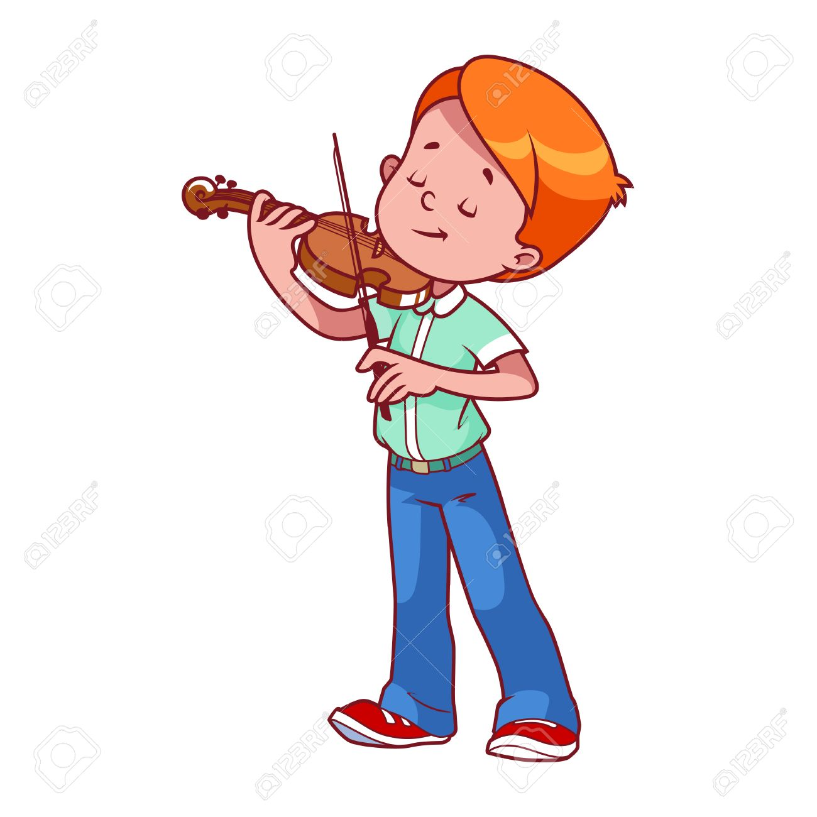
Do you like playing the violin in your free time?
Yes, I do.
Notes:
Press the spacebar or down arrow to reveal the answer.
Press the X to go back to the letter slide (wrong answer), press the question box to go the reward slide (correct answer).

Slide 18

Do you play basketball at the weekend?
No, I don’t. I never play basketball at the weekend.
Notes:
Press the spacebar or down arrow to reveal the answer.
Press the X to go back to the letter slide (wrong answer), press the question box to go the reward slide (correct answer).

Slide 19
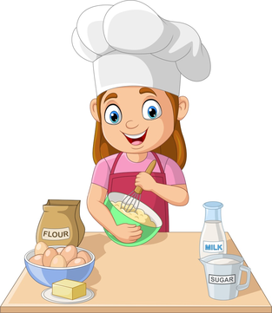
What do you do on Sundays?
often
I often cook (on Sundays).
Notes:
Press the spacebar or down arrow to reveal the answer.
Press the X to go back to the letter slide (wrong answer), press the question box to go the reward slide (correct answer).

Slide 20

What do you like doing in your free time?
I like walking.
Notes:
Press the spacebar or down arrow to reveal the answer.
Press the X to go back to the letter slide (wrong answer), press the question box to go the reward slide (correct answer).

Slide 21



+100 pts
Keep or give the
mystery box?
Notes:
Ask the student(s) if they want to keep the box or give it to another student/team.
Click the question block to reveal the reward/punishment.
Press the Mario icon in the corner to go back to the letter slide.

Slide 22
+200 pts
Keep or give the
mystery box?
Notes:
Ask the student(s) if they want to keep the box or give it to another student/team.
Click the question block to reveal the reward/punishment.
Press the Mario icon in the corner to go back to the letter slide.

Slide 23
+300 pts
Keep or give the
mystery box?
Notes:
Ask the student(s) if they want to keep the box or give it to another student/team.
Click the question block to reveal the reward/punishment.
Press the Mario icon in the corner to go back to the letter slide.

Slide 24
+400 pts
Keep or give the
mystery box?
Notes:
Ask the student(s) if they want to keep the box or give it to another student/team.
Click the question block to reveal the reward/punishment.
Press the Mario icon in the corner to go back to the letter slide.

Slide 25
+500 pts
Keep or give the
mystery box?
Notes:
Ask the student(s) if they want to keep the box or give it to another student/team.
Click the question block to reveal the reward/punishment.
Press the Mario icon in the corner to go back to the letter slide.

Slide 26

-100 pts
Keep or give the
mystery box?
Notes:
Ask the student(s) if they want to keep the box or give it to another student/team.
Click the question block to reveal the reward/punishment.
Press the Mario icon in the corner to go back to the letter slide.

Slide 27
-100 pts
Keep or give the
mystery box?
Notes:
Ask the student(s) if they want to keep the box or give it to another student/team.
Click the question block to reveal the reward/punishment.
Press the Mario icon in the corner to go back to the letter slide.

Slide 28
-200 pts
Keep or give the
mystery box?
Notes:
Ask the student(s) if they want to keep the box or give it to another student/team.
Click the question block to reveal the reward/punishment.
Press the Mario icon in the corner to go back to the letter slide.

Slide 29


Change pts!
Keep or give the
mystery box?
Notes:
Ask the student(s) if they want to keep the box or give it to another student/team.
Click the question block to reveal the reward/punishment.
Press the Mario icon in the corner to go back to the letter slide.

Slide 30


Steal 200 pts!
Keep or give the
mystery box?
Notes:
Ask the student(s) if they want to keep the box or give it to another student/team.
Click the question block to reveal the reward/punishment.
Press the Mario icon in the corner to go back to the letter slide.

Slide 31


Lose all pts!
Keep or give the
mystery box?
Notes:
Ask the student(s) if they want to keep the box or give it to another student/team.
Click the question block to reveal the reward/punishment.
Press the Mario icon in the corner to go back to the letter slide.

Slide 32

+1000 pts!
Keep or give the
mystery box?
Notes:
Ask the student(s) if they want to keep the box or give it to another student/team.
Click the question block to reveal the reward/punishment.
Press the Mario icon in the corner to go back to the letter slide.

Slide 33
02. Read and answer

Slide 34
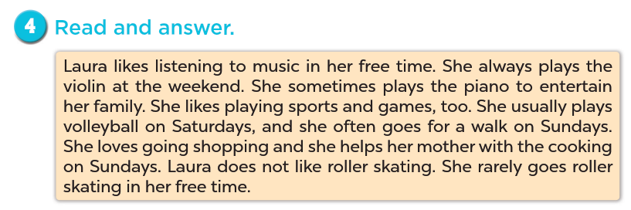

Slide 35
- She always plays the violin (at the weekend).

Slide 36
- She usually plays volleyball (on Saturdays).

Slide 37
V
- She often goes for a walk on Sundays.

Slide 38
- She helps her mother with the cooking.

Slide 39
03. Let’s write.

Slide 40
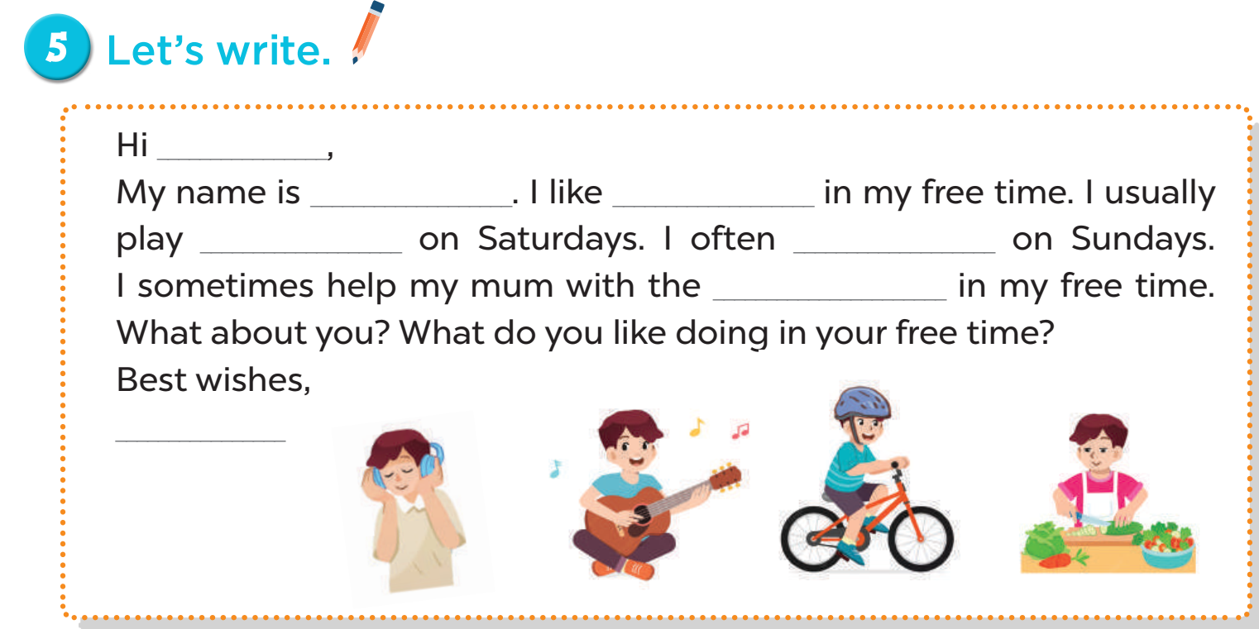
Now you write!

Slide 41
04. Project

Slide 42
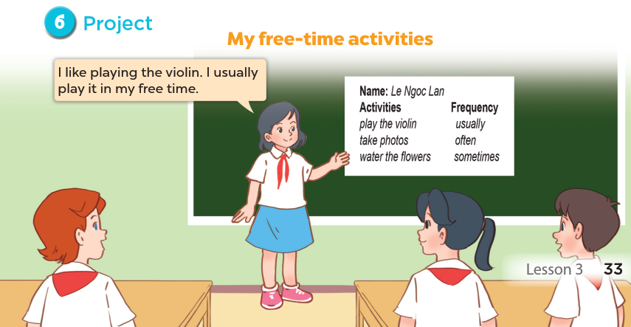

Slide 43
05. Fun corner and Wrap-up

Slide 44
Website: hoclieu.vn
Fanpage: https://www.facebook.com/tienganhglobalsuccess.vn/

