Slide 2








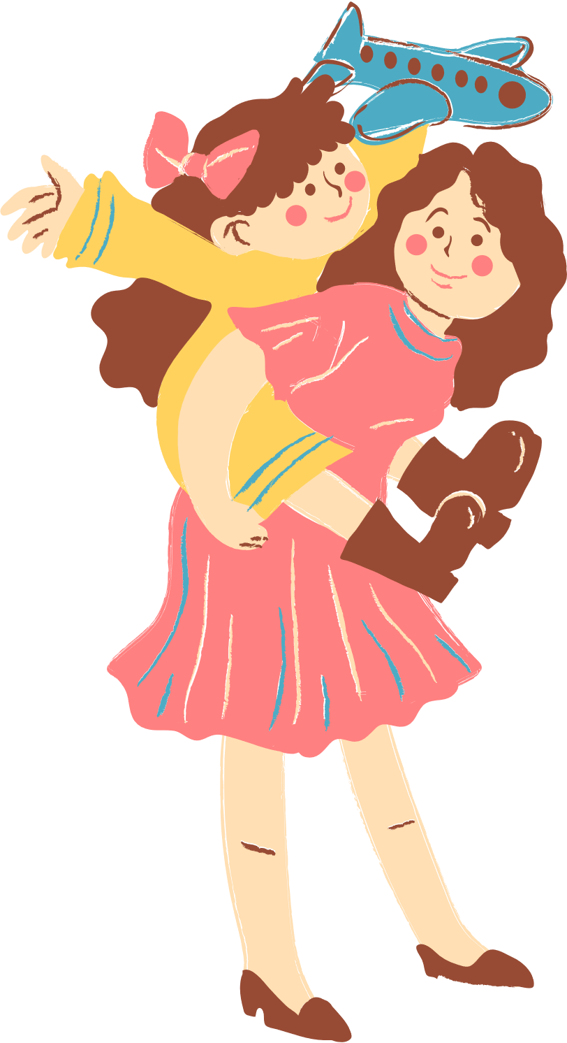
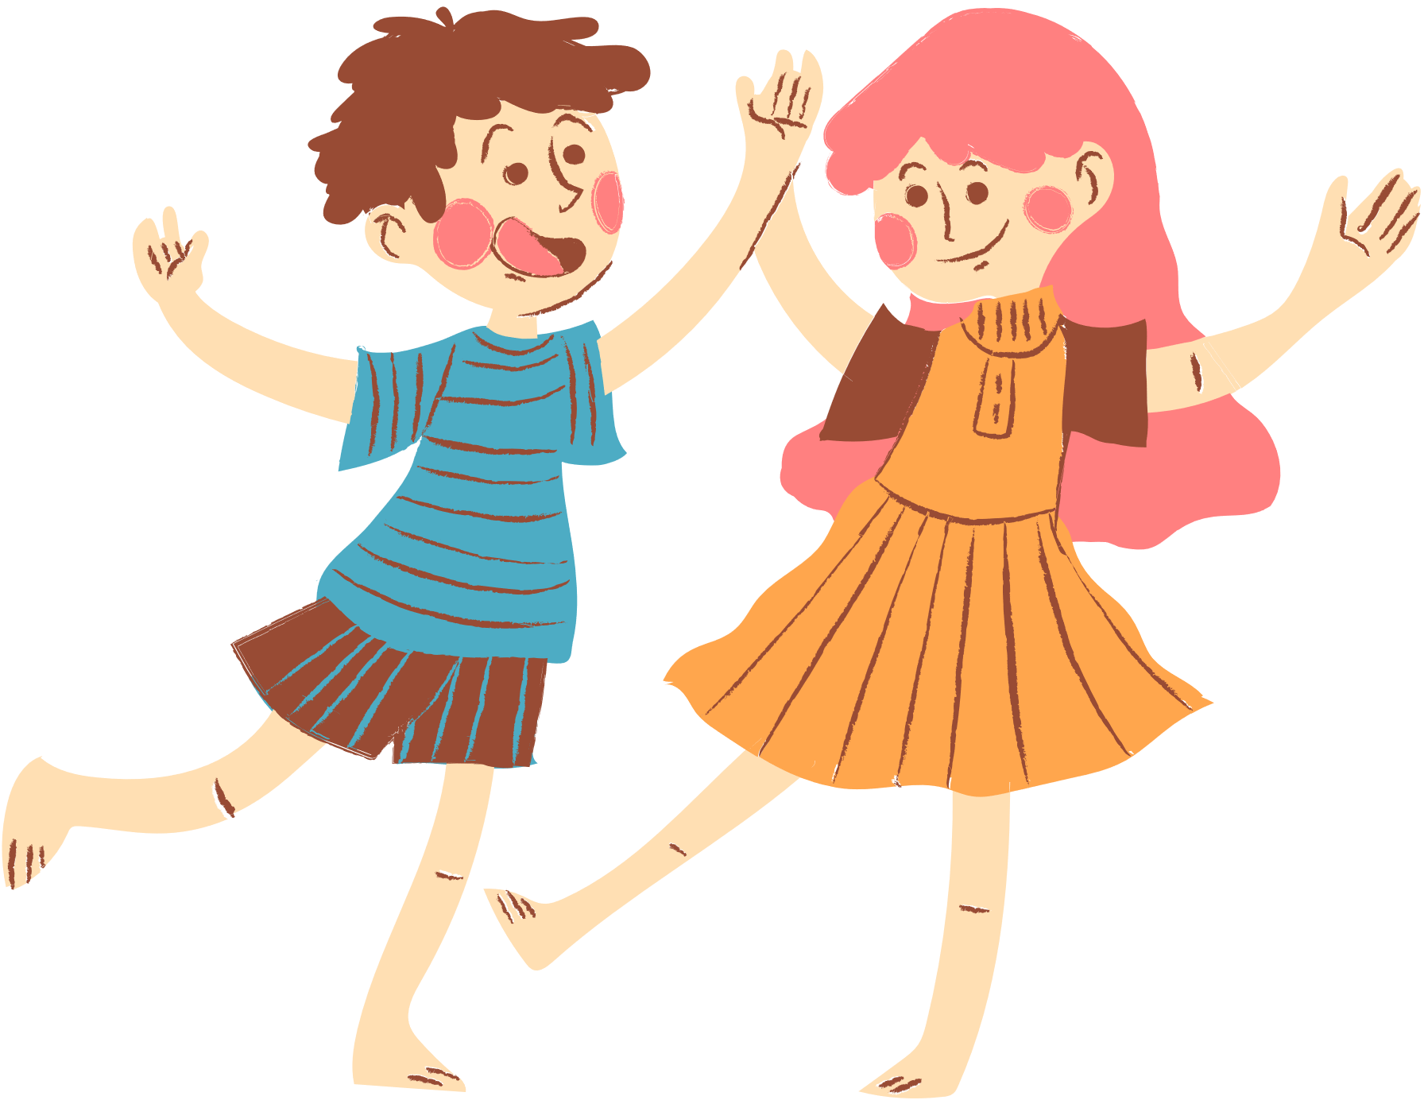
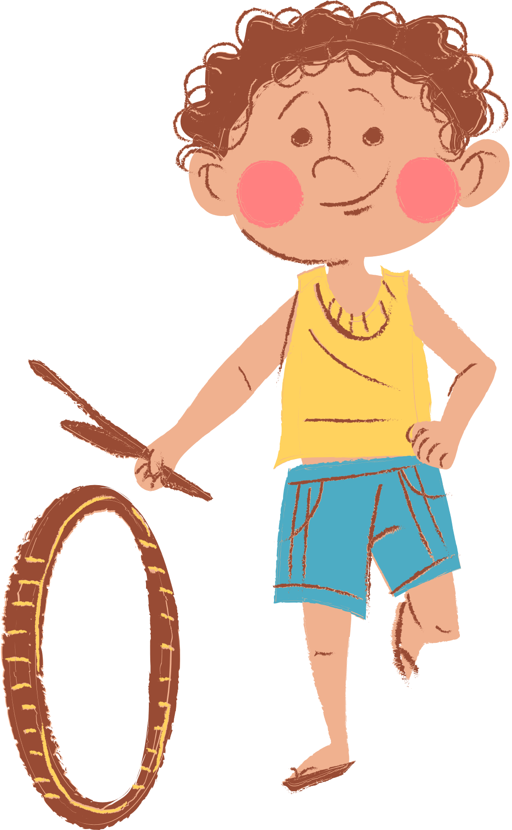
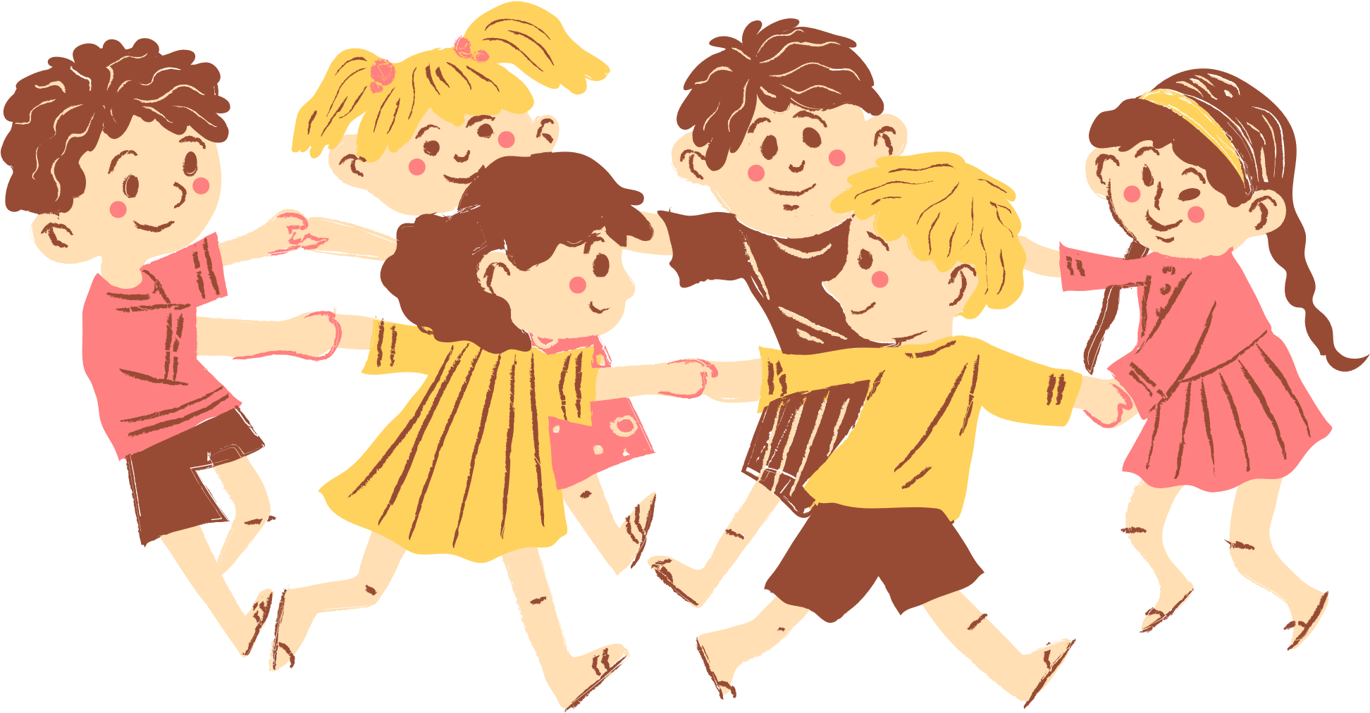
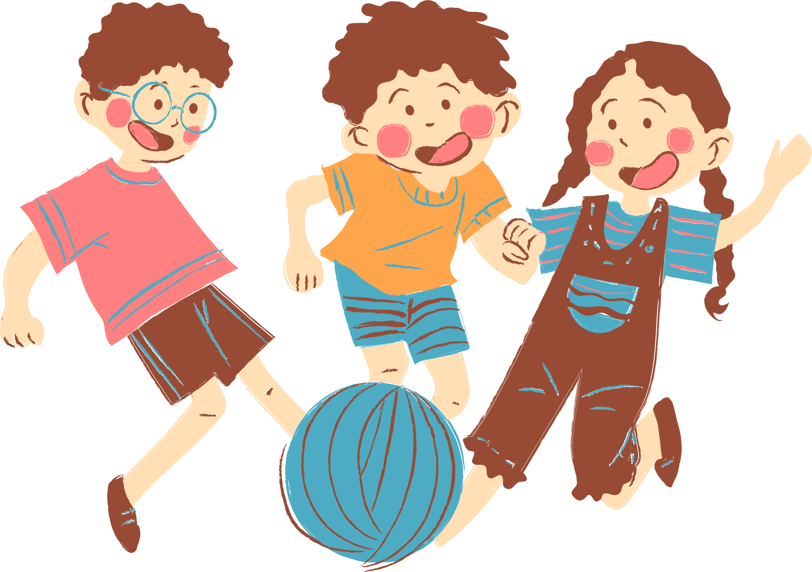
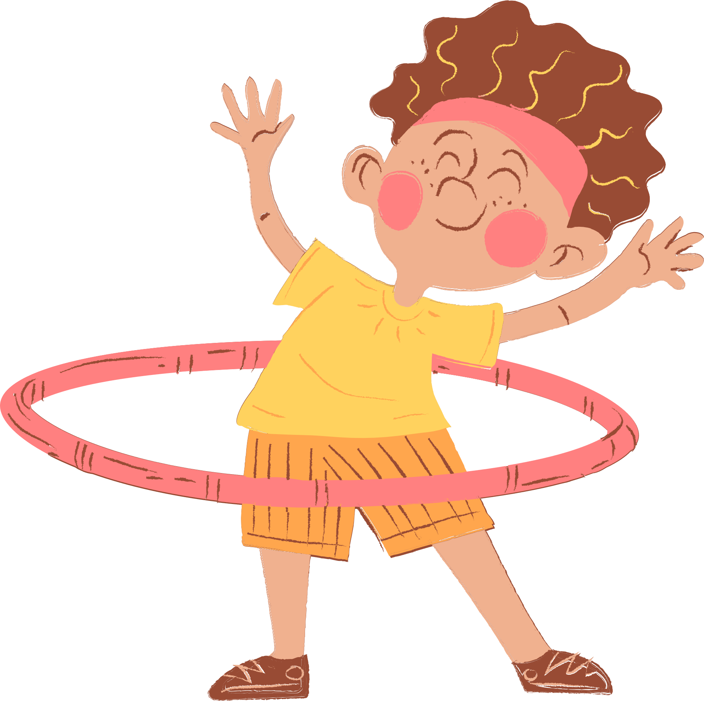
4
Our free-time activities

Slide 3






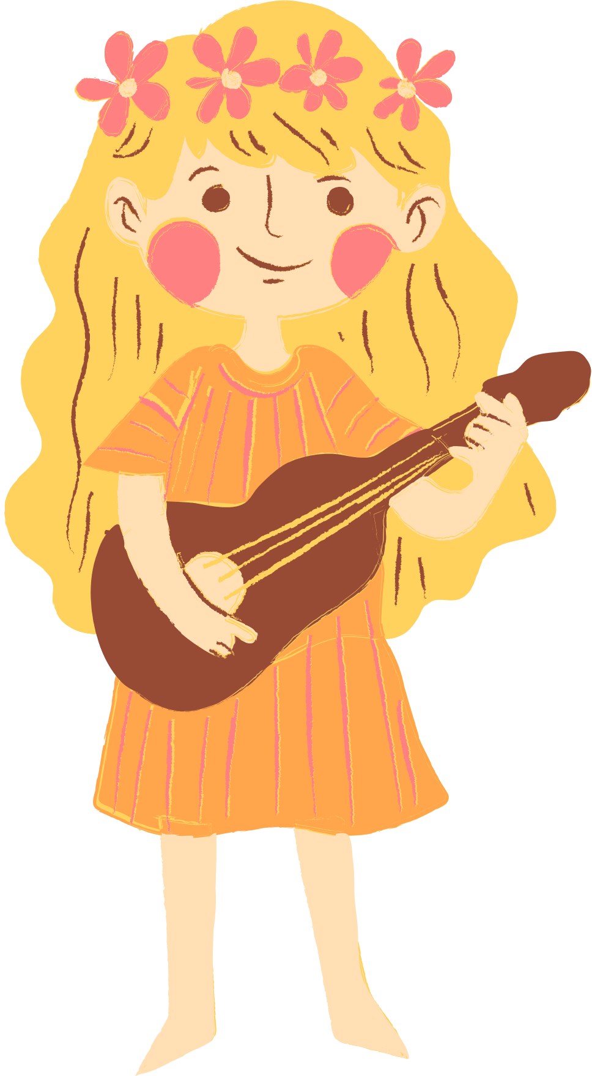
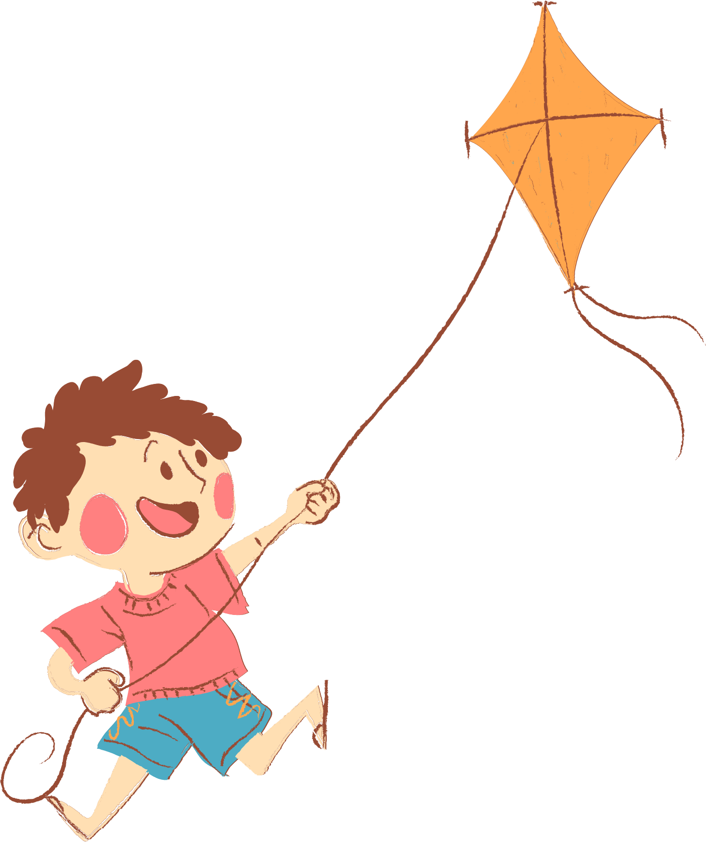
01. Warm-up and Review
02. Look, listen and repeat.
03. Listen, point and say.
04. Let’s talk.
05. Fun corner and Wrap-up

Slide 4
01. Warm-up and Review

Slide 5

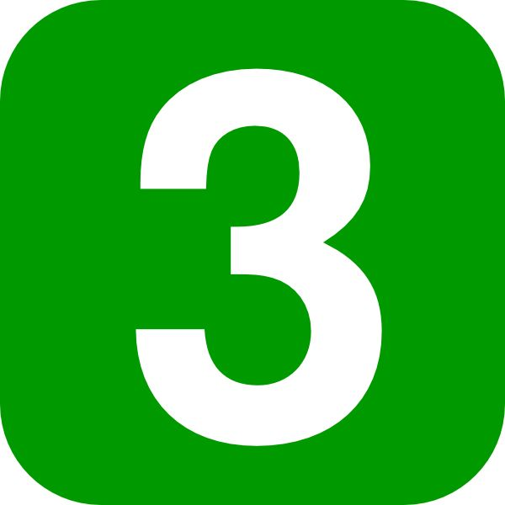



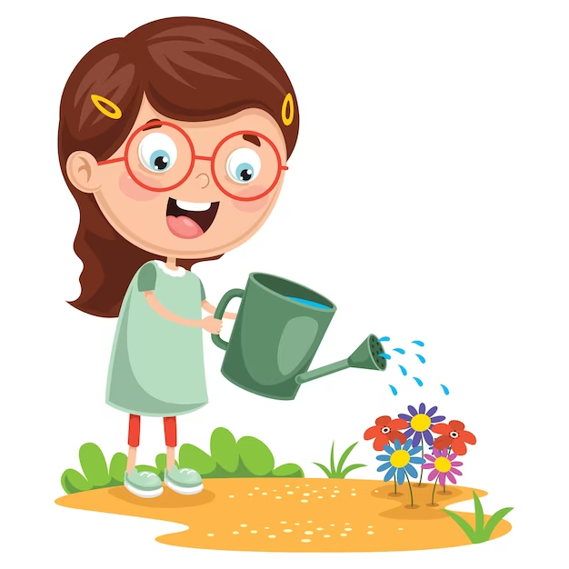
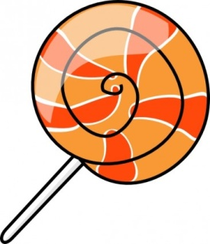
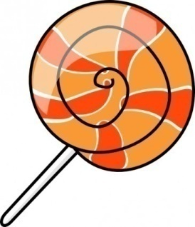

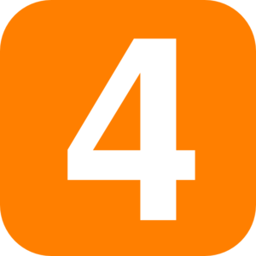

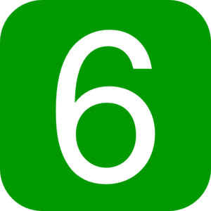
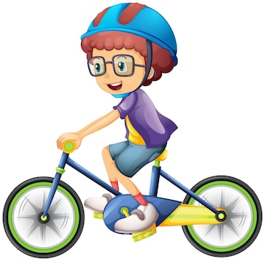
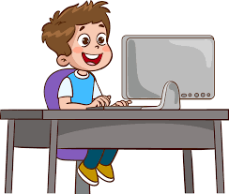
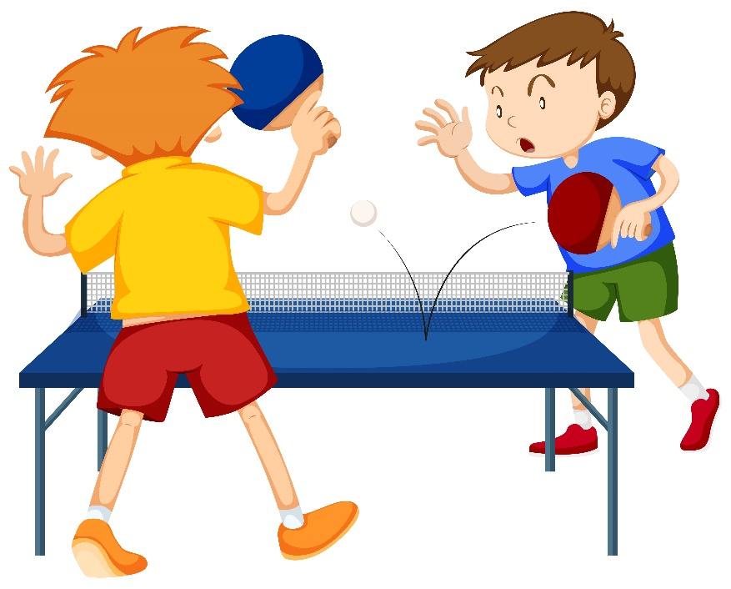
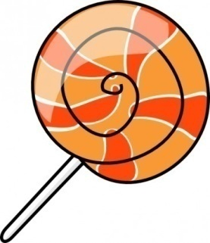

Slide 6
02. Look, listen and repeat.

Slide 7

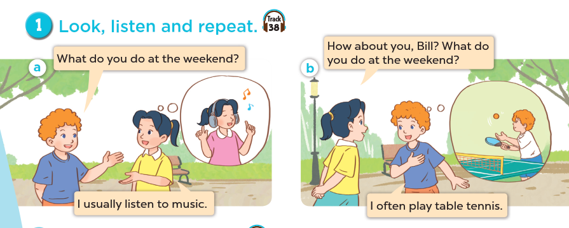
Who are they?
What are they doing?
Where are they?

Slide 8
03. Listen, point and say.

Slide 9
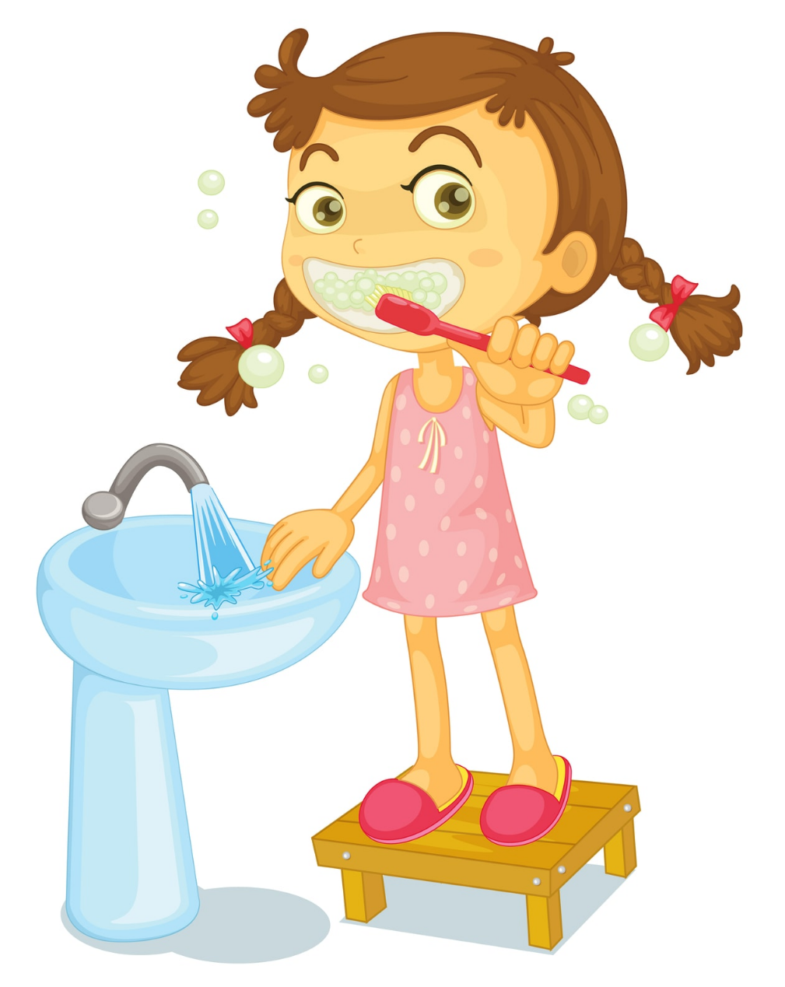

Sun
Mon
Tue
Wed
Thu
Fri
Sat
We always brush my teeth in the morning.

Slide 10

Sun
Mon
Tue
Wed
Thu
Fri
Sat
She usually go to school by bus.

Slide 11
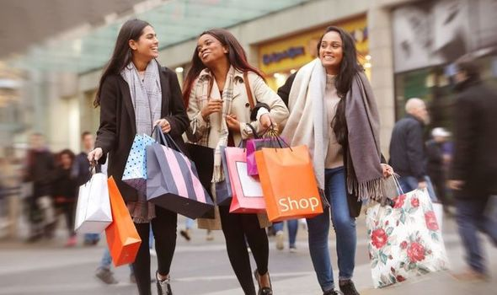
Mon | Tue | Wed | Thu | Fri | Sat | Sun
 | 1 | 2 | 3 | 4 | 5 | 6
7 | 8 | 9 | 10 | 11 | 12 | 13
14 | 15 | 16 | 17 | 18 | 19 | 20
21 | 22 | 23 | 24 | 25 | 26 | 27
28 | 29 | 30 | 31
We often go shopping on Sundays.

Slide 12
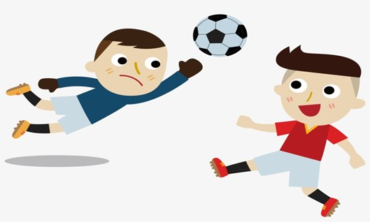
Sun
Mon
Tue
Wed
Thu
Fri
Sat
He sometimes plays football in his free time.

Slide 13

Remember:
always
usually
often
sometimes
0 %
100 %
90 %
70 %
50 %

Slide 14
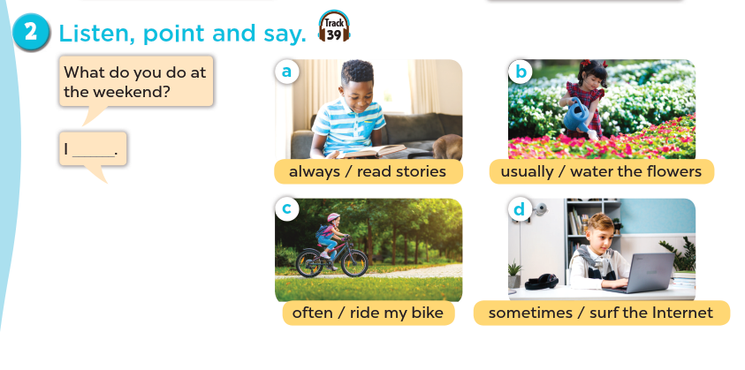

Slide 15
Extension

Slide 16
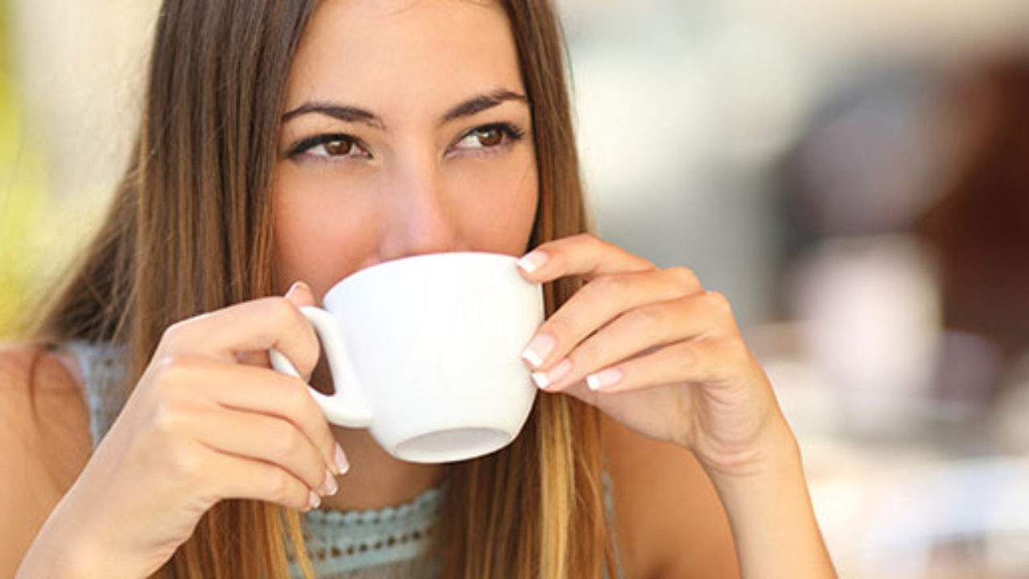
Mon | Tue | Wed | Thu | Fri | Sat | Sun
 | 1 | 2 | 3 | 4 | 5 | 6
7 | 8 | 9 | 10 | 11 | 12 | 13
14 | 15 | 16 | 17 | 18 | 19 | 20
21 | 22 | 23 | 24 | 25 | 26 | 27
28 | 29 | 30 | 31
My mother rarely drinks tea.

Slide 17
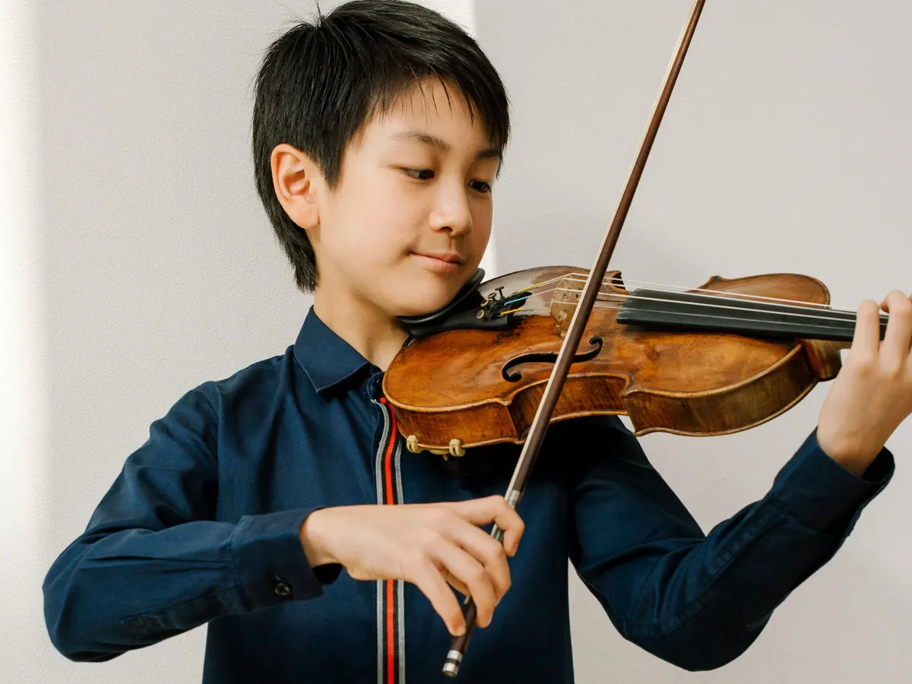
Mon | Tue | Wed | Thu | Fri | Sat | Sun
 | 1 | 2 | 3 | 4 | 5 | 6
7 | 8 | 9 | 10 | 11 | 12 | 13
14 | 15 | 16 | 17 | 18 | 19 | 20
21 | 22 | 23 | 24 | 25 | 26 | 27
28 | 29 | 30 | 31
My brother never plays the violin.

Slide 18
Remember:
always
usually
often
sometimes
rarely
never
100 %
90 %
70 %
50 %
5 %
0 %

Slide 19
04. Let’s talk

Slide 20
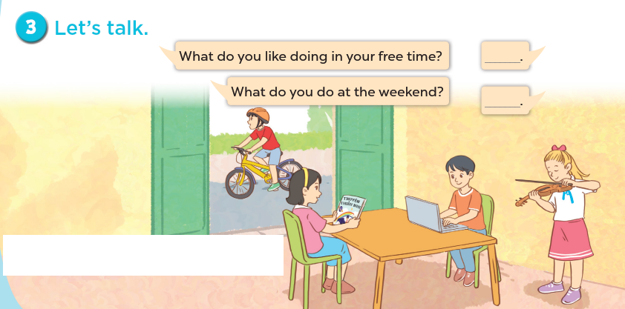

Slide 21
05. Fun corner and Wrap-up
Game: Who has more correct answers?

Slide 22
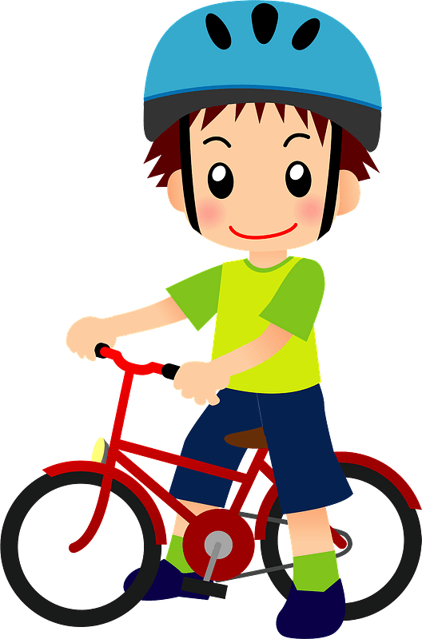
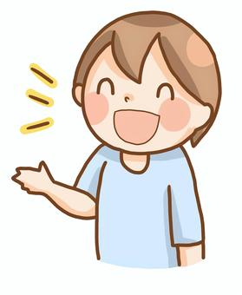
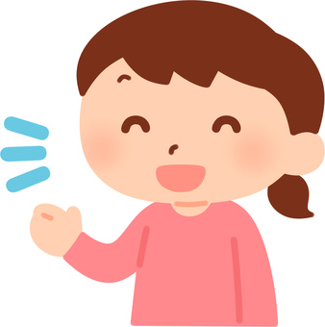
1. What do you do at the weekend?
100 %
I ……………… ride my bike.
A. always
B. never
C. usually

Slide 23

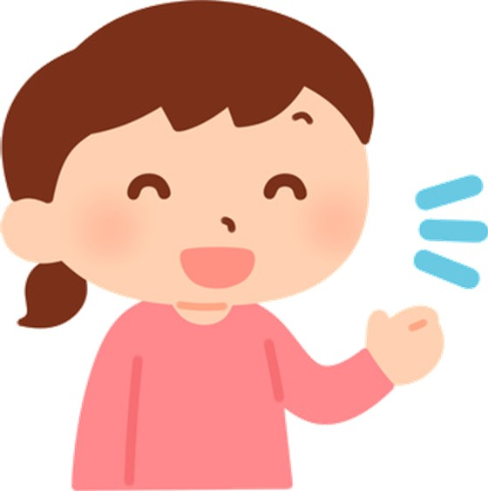
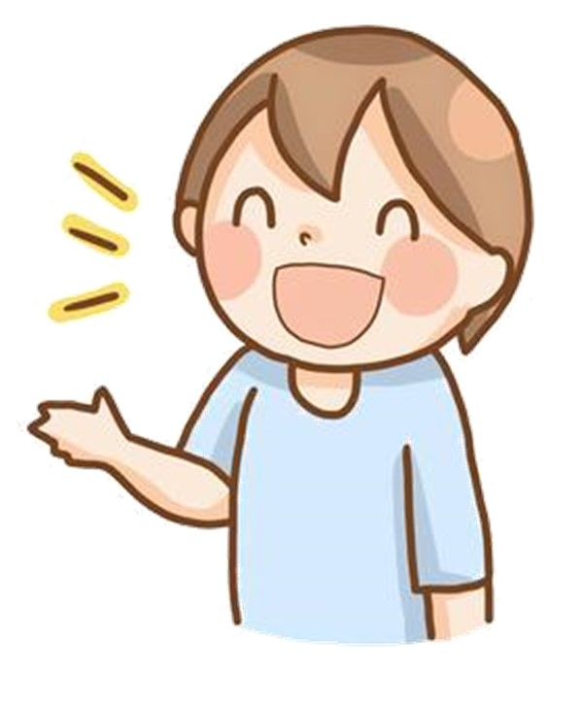
2. What do you do at the weekend?
50 %
I …………………… surf the Internet.
A. often
B. rarely
C. sometimes

Slide 24
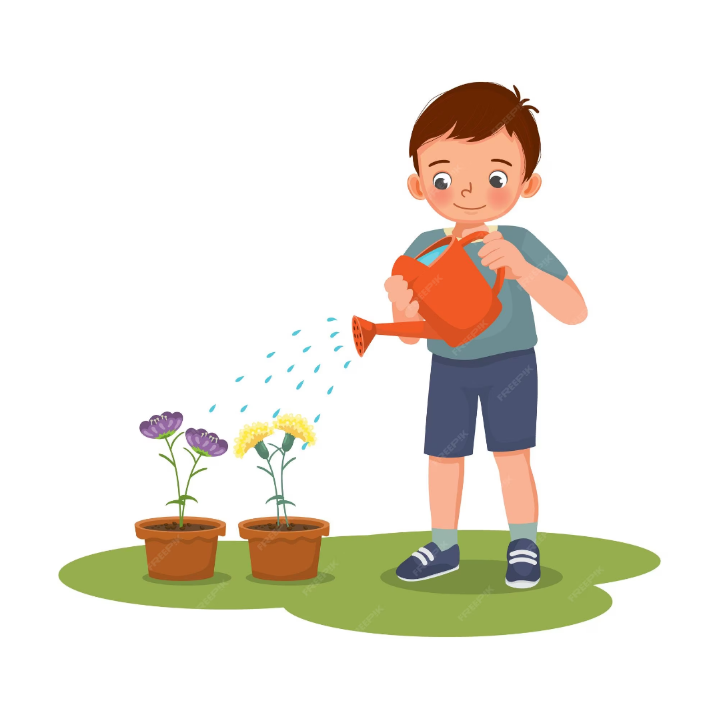
5 %
3. What do you do at the weekend?
I ……………. water the flowers.
A. always
B. rarely
C. often

Slide 25

4. What do you do at the weekend?
90 %
I …………………. read stories.
A. sometimes
B. never
C. usually

Slide 26
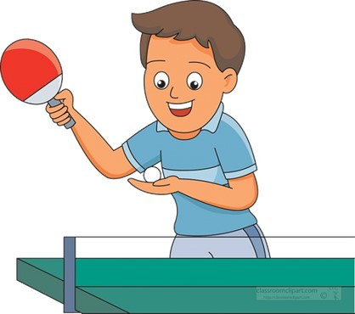
5. What do you do at the weekend?
0 %
I ……………… play table tennis.
A. never
B. often
C. usually

Slide 27
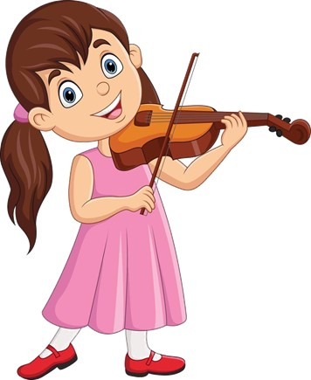
6. What do you do at the weekend?
70 %
I …………………… play the violin.
A. always
B. sometimes
C. often

Slide 28

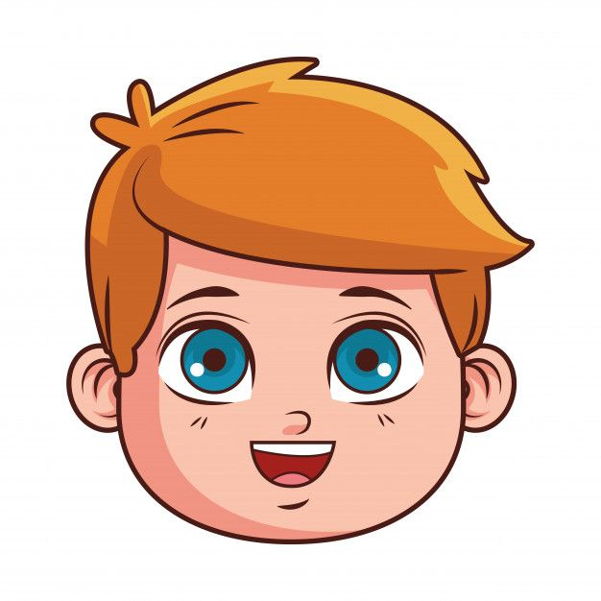
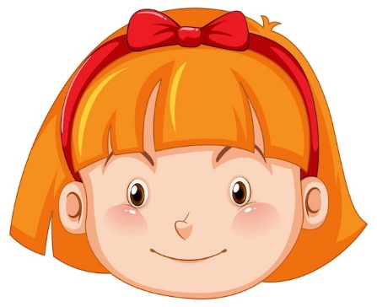
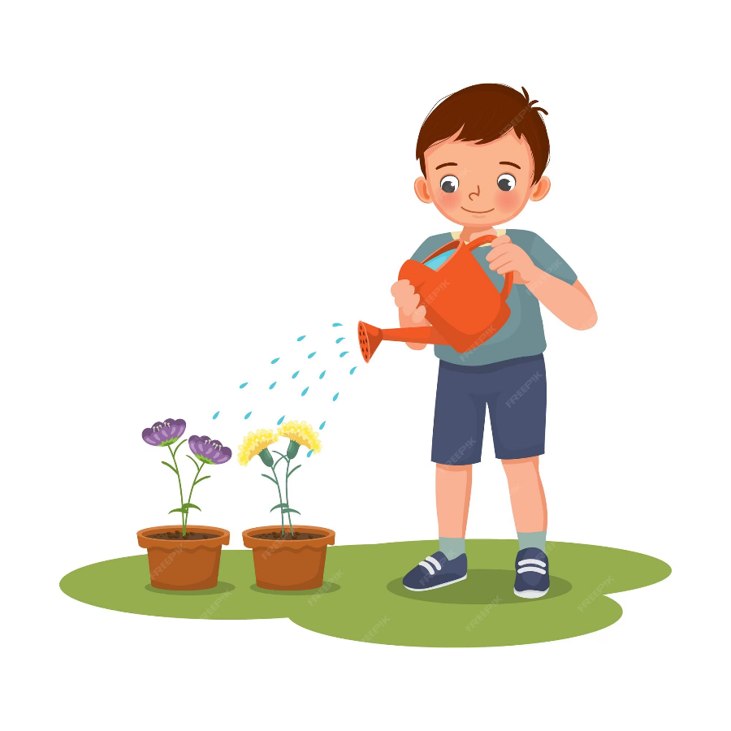


Pair work
What do you do at the weekend?
I …….. ……….

Slide 29
Website: hoclieu.vn
Fanpage: https://www.facebook.com/tienganhglobalsuccess.vn/

