Slide 2









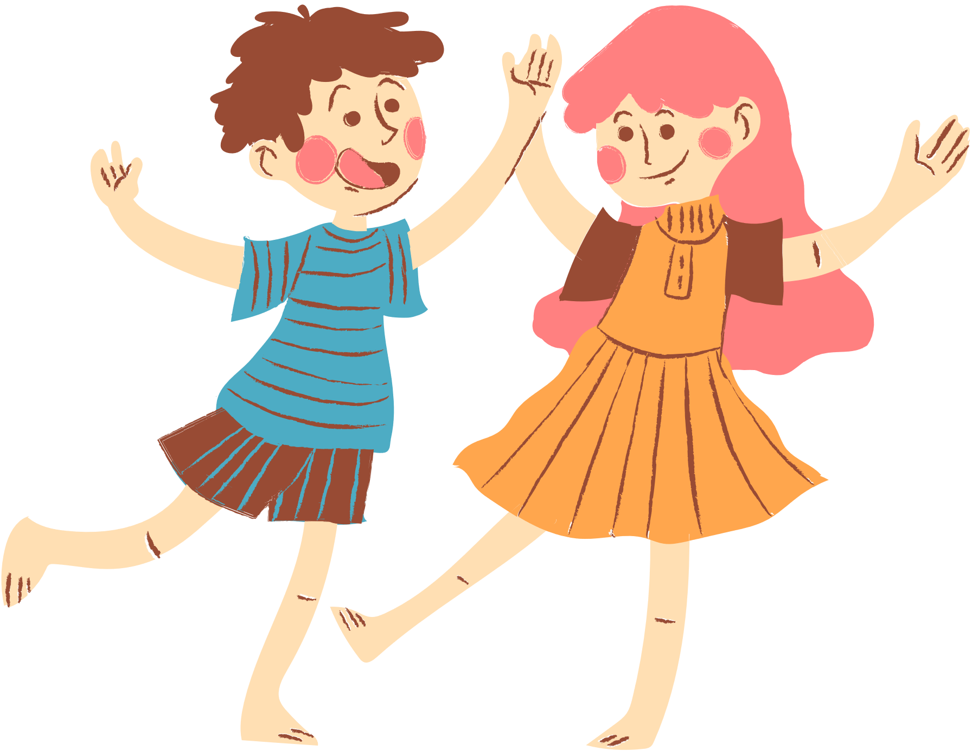
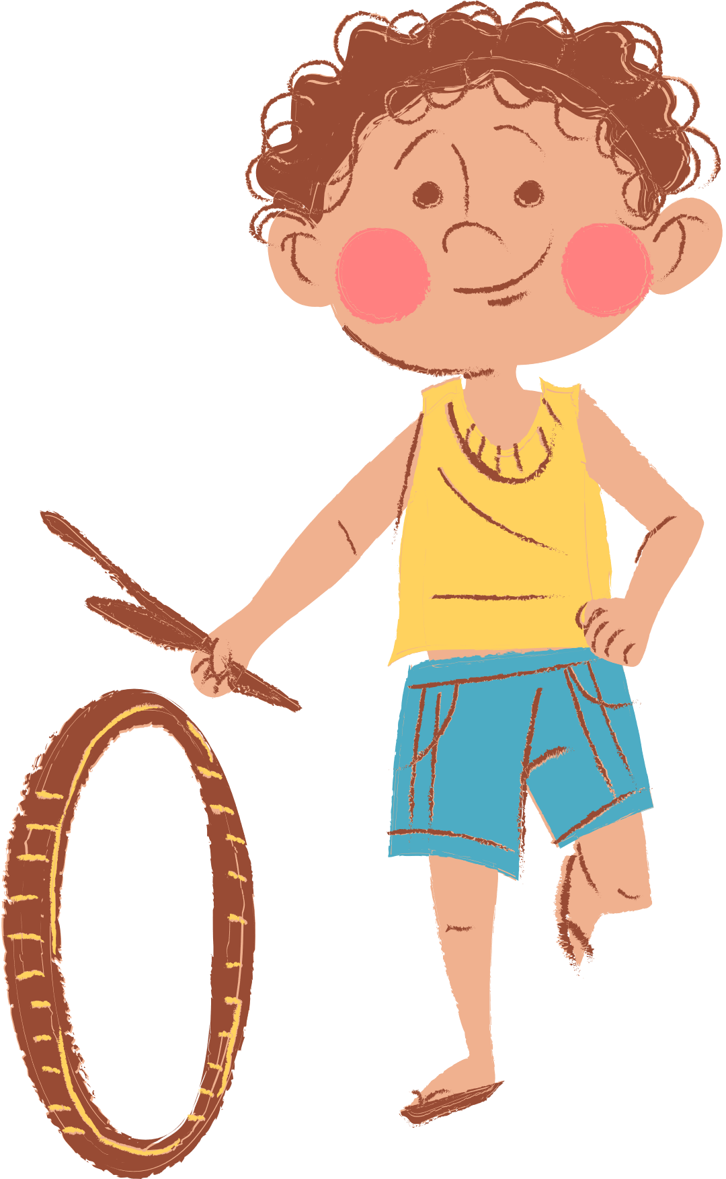
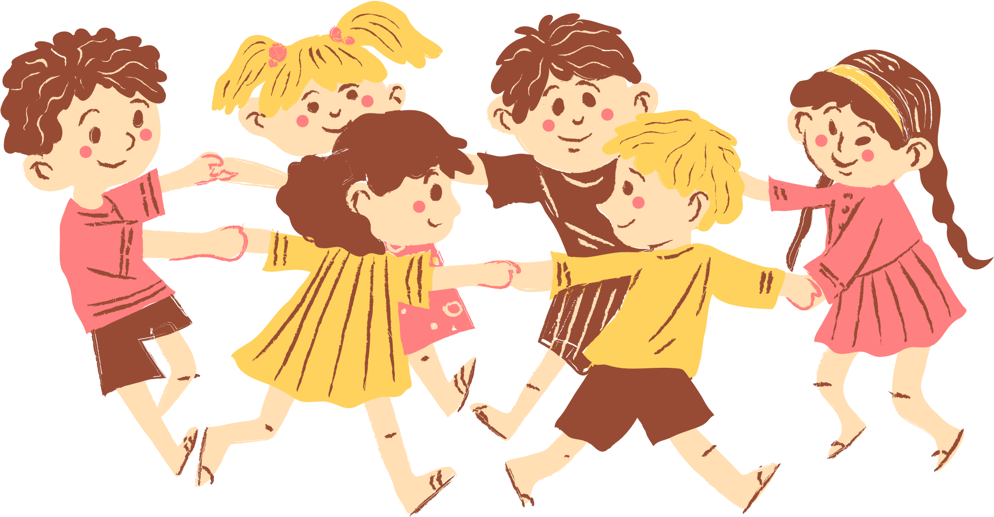
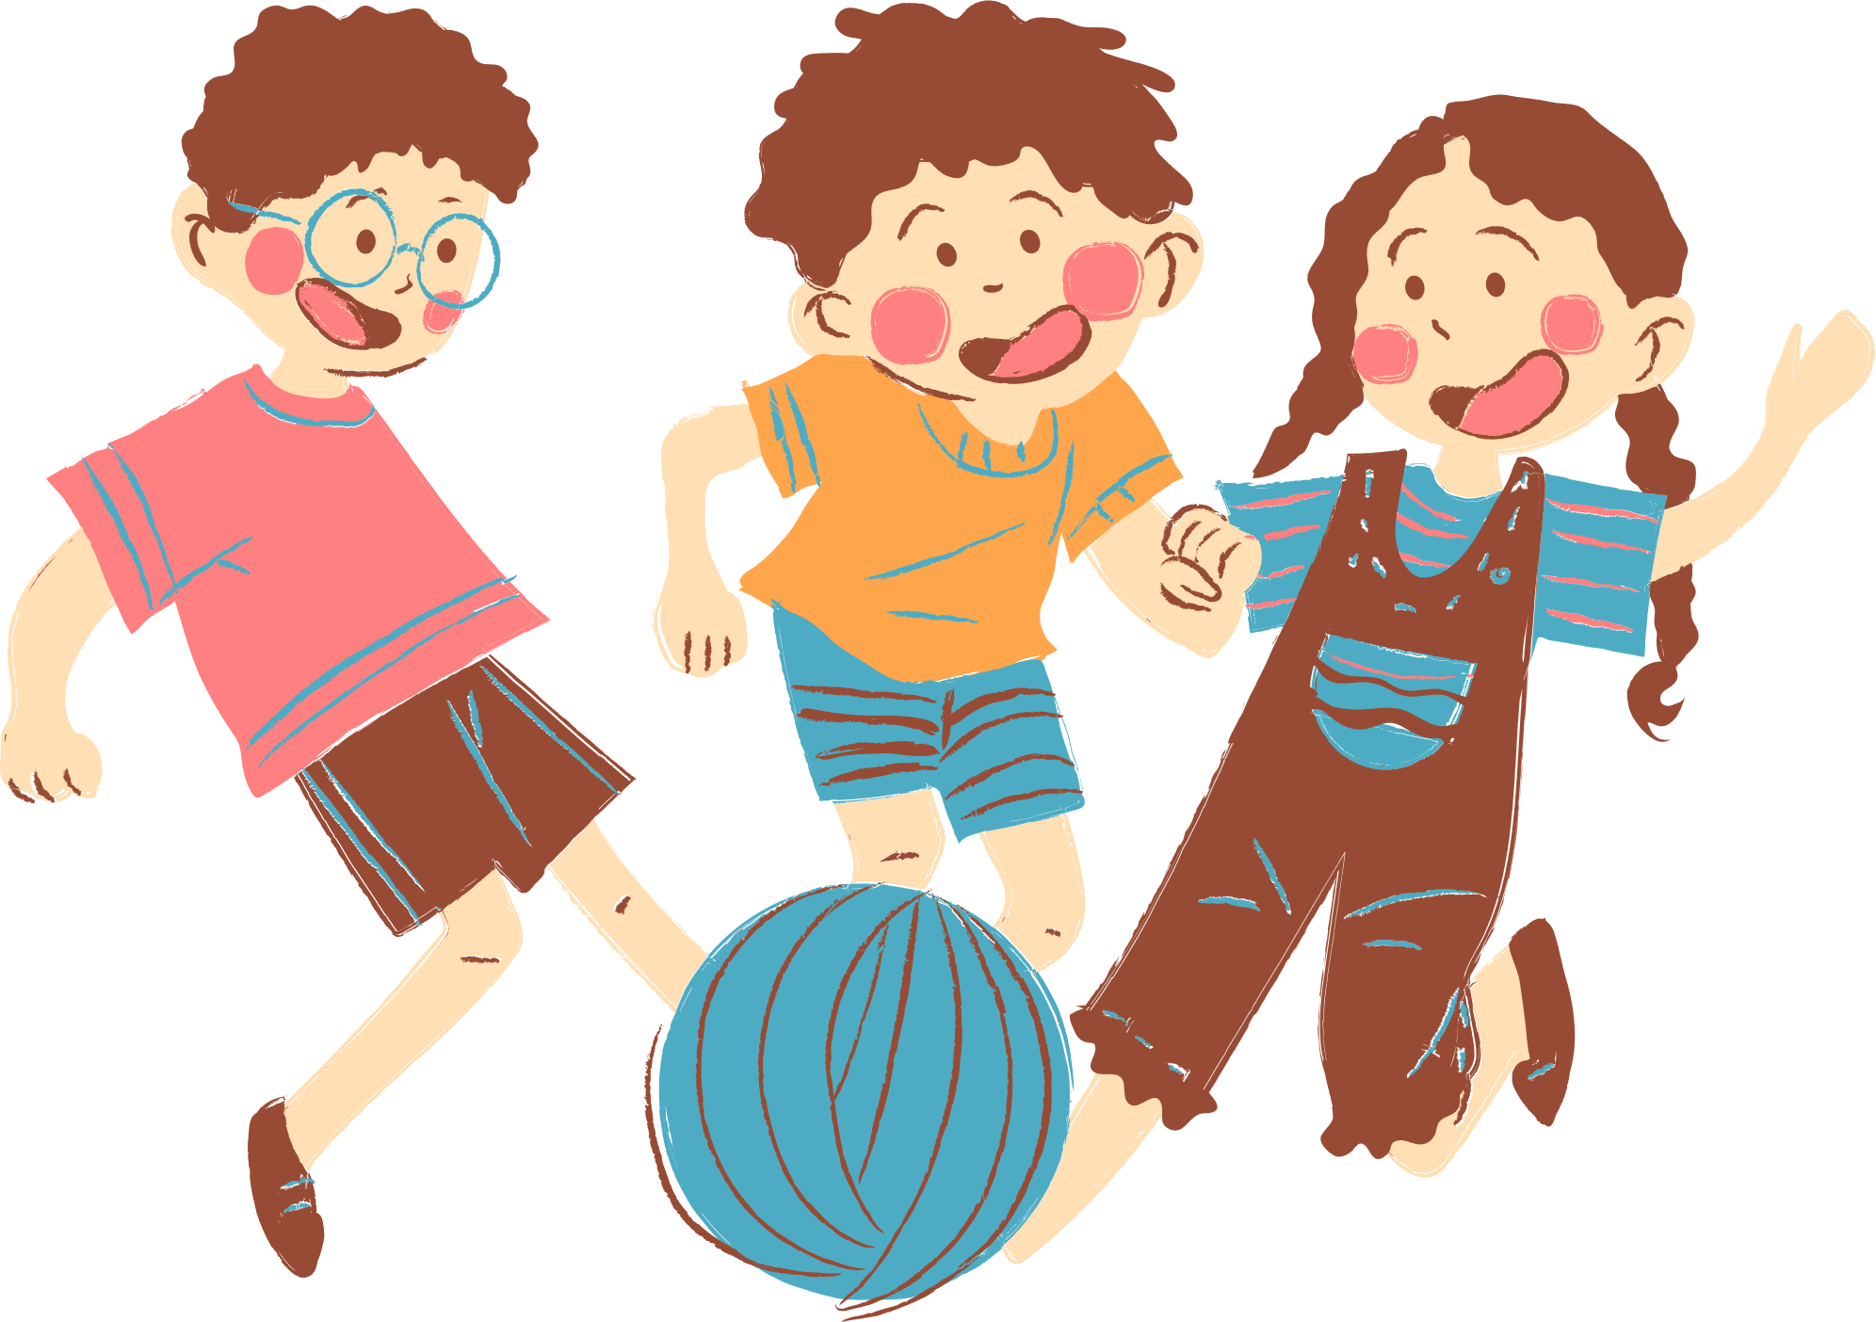
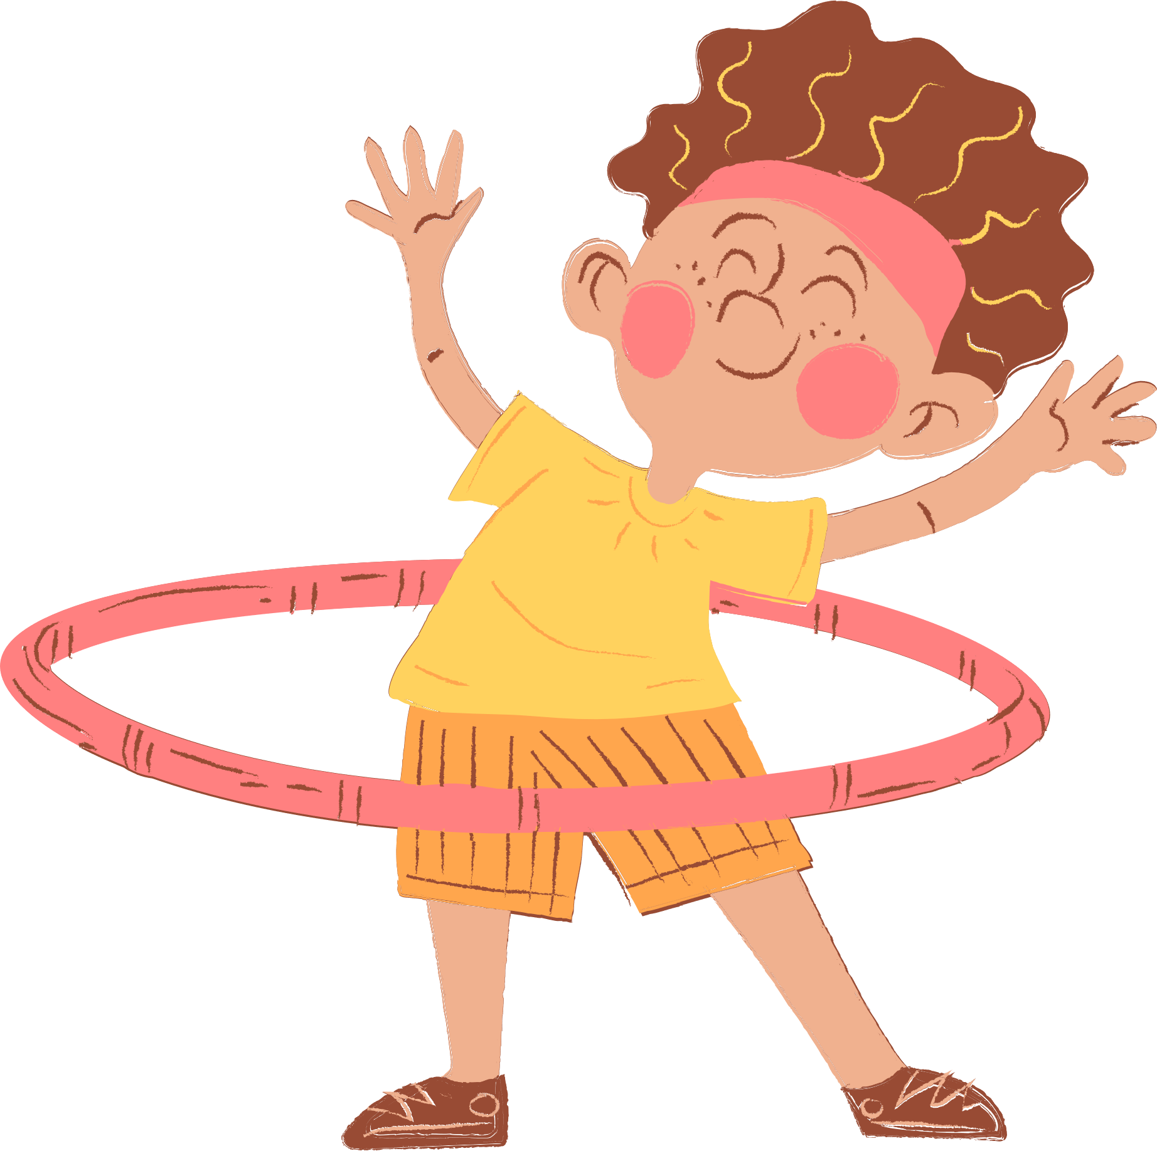
4
Our free-time activities

Slide 3






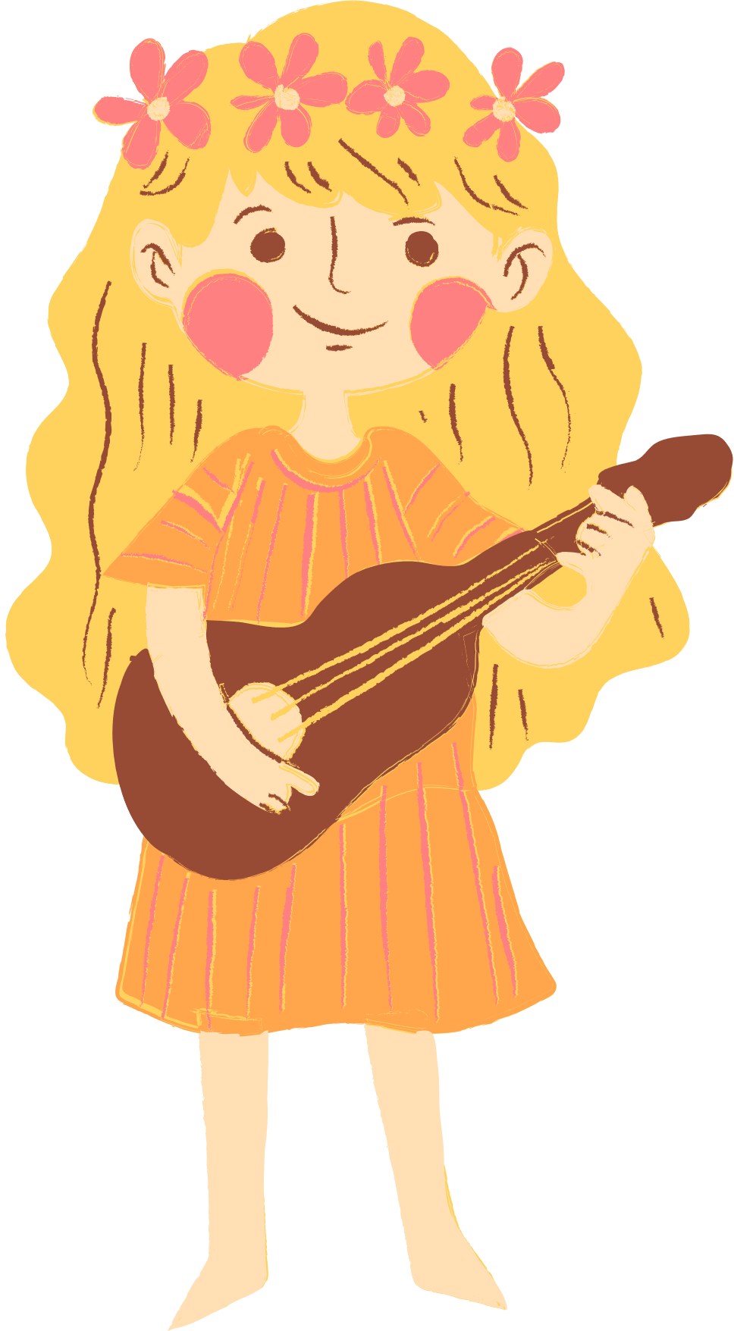
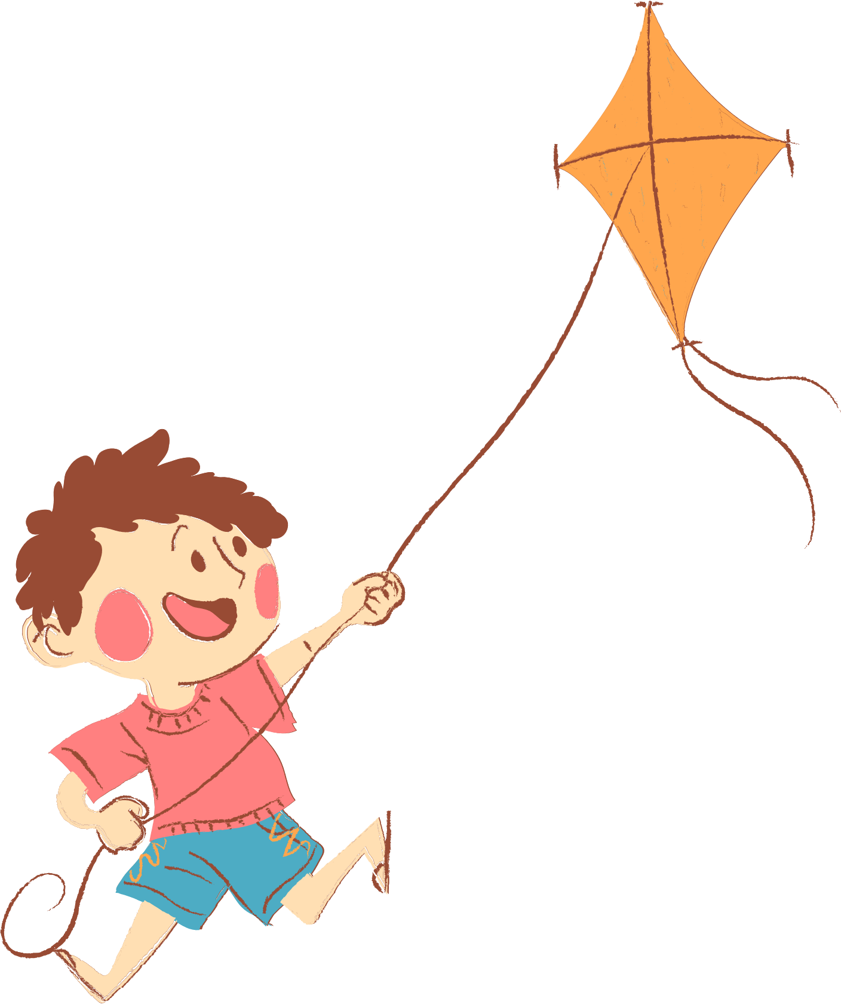
01. Review
02. Listen and number.
03. Read and complete.
04. Let’s play.
05. Fun corner and
Wrap-up

Slide 4
01. Review

Slide 5

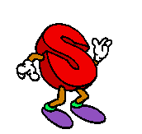
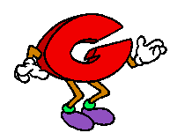
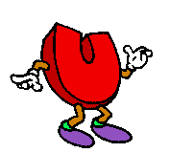
Can you

Slide 6
Look and guess what word is it.
1-open picture: 3 points
2-open pictures: 2 points
Picture left: 1 point

Slide 7

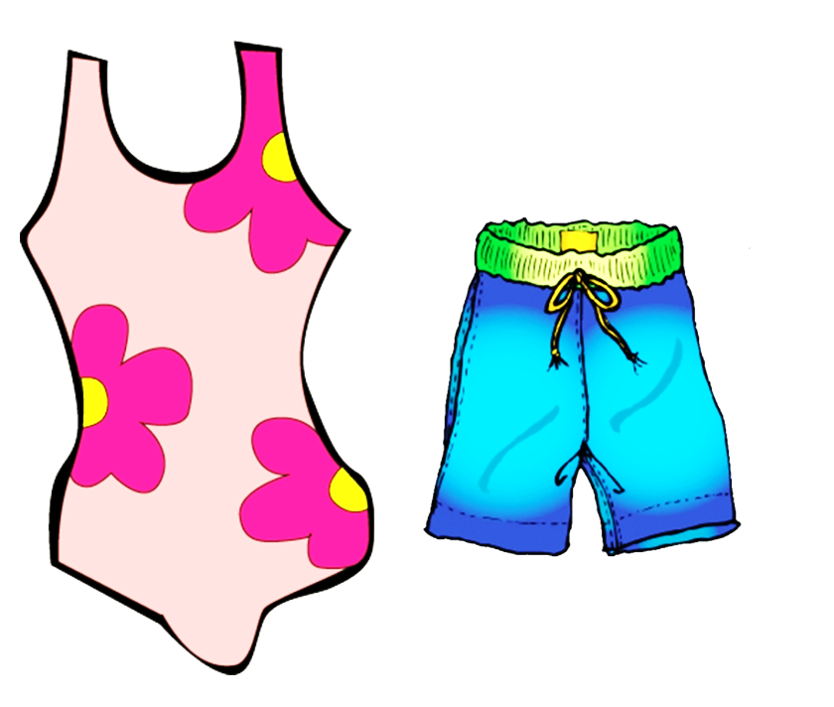
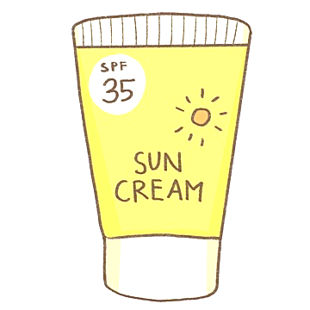

swim

Slide 8


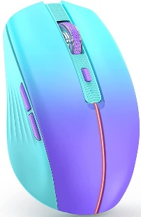
surf the Internet

Slide 9
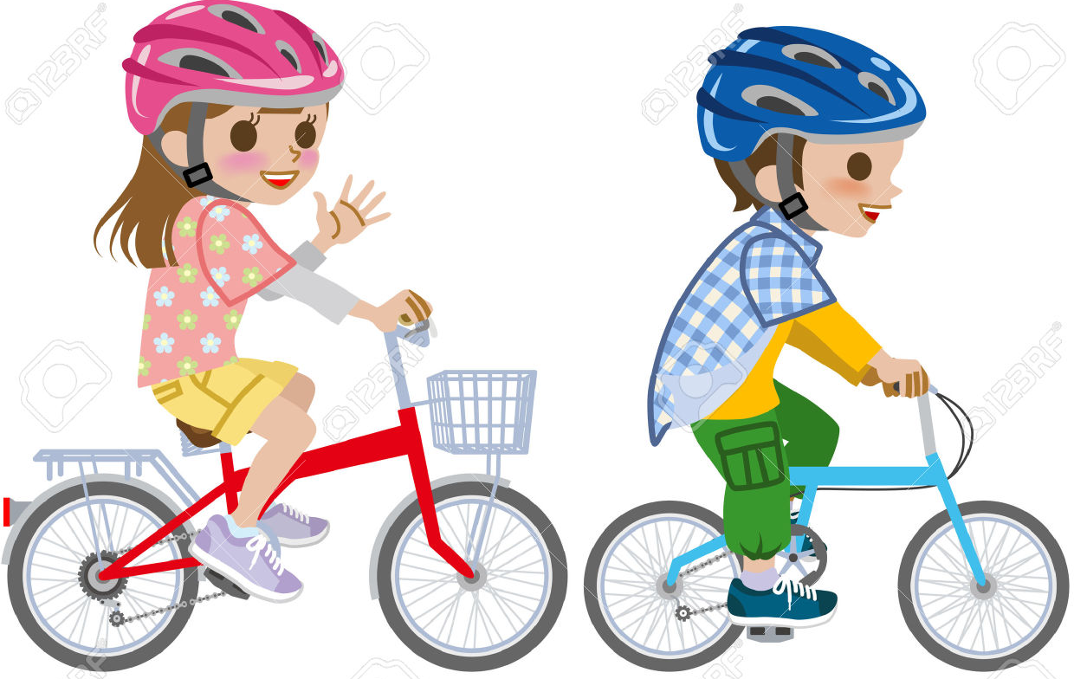
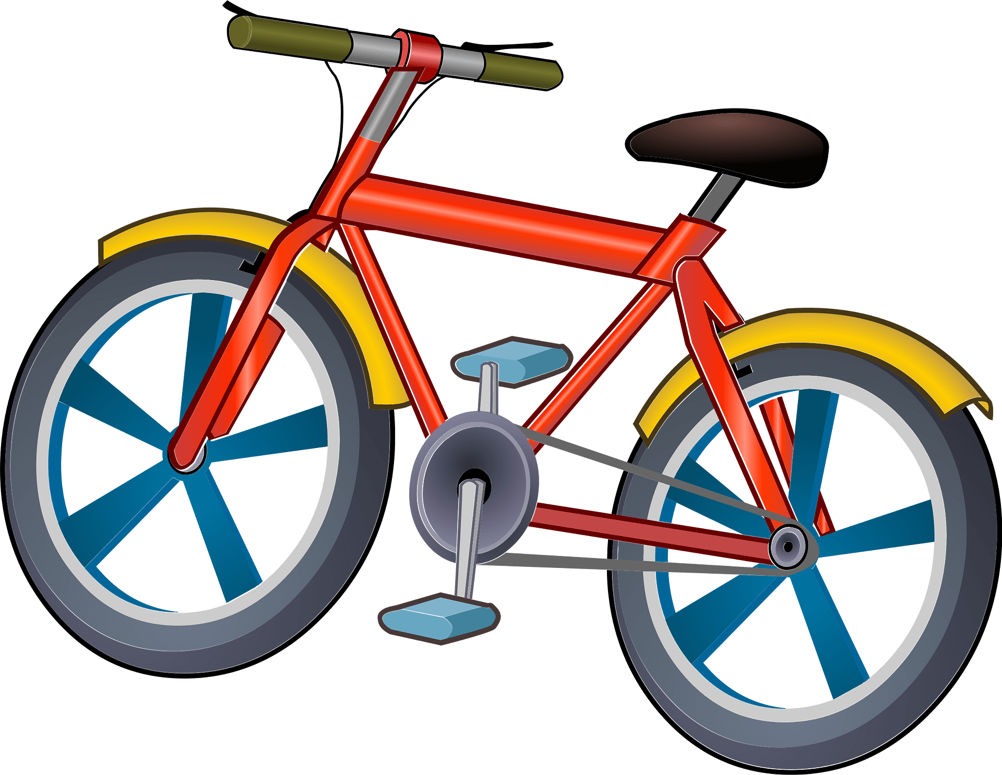

ride a bike

Slide 10
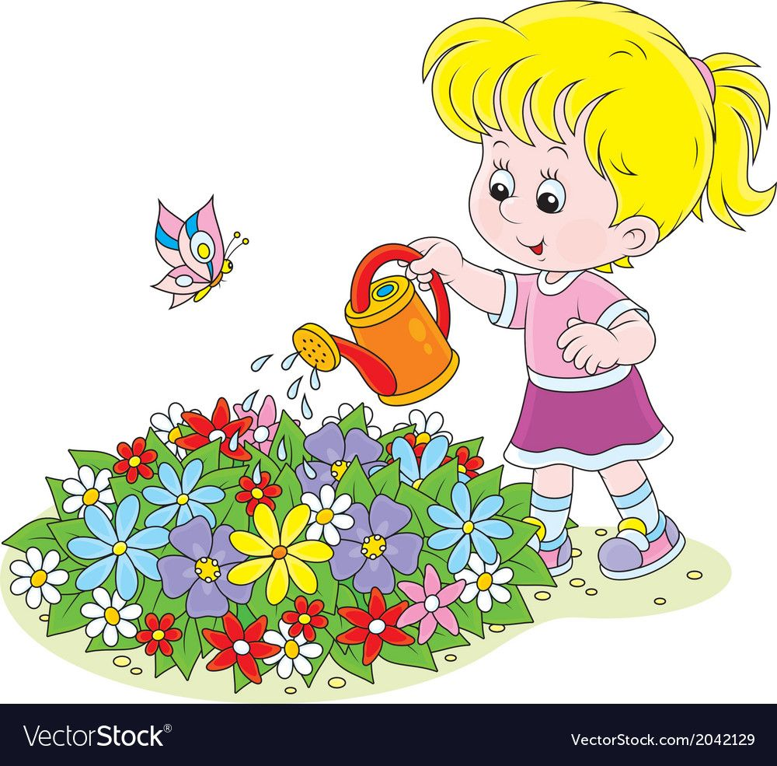


water the flowers

Slide 11
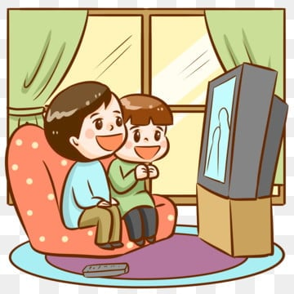


watch TV

Slide 12
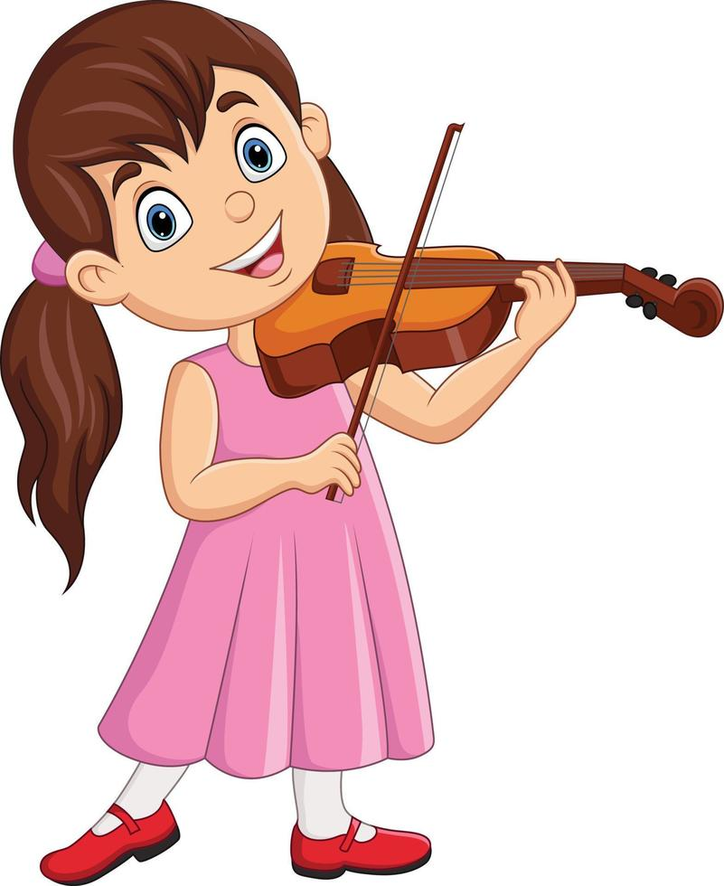

play the violin

Slide 13
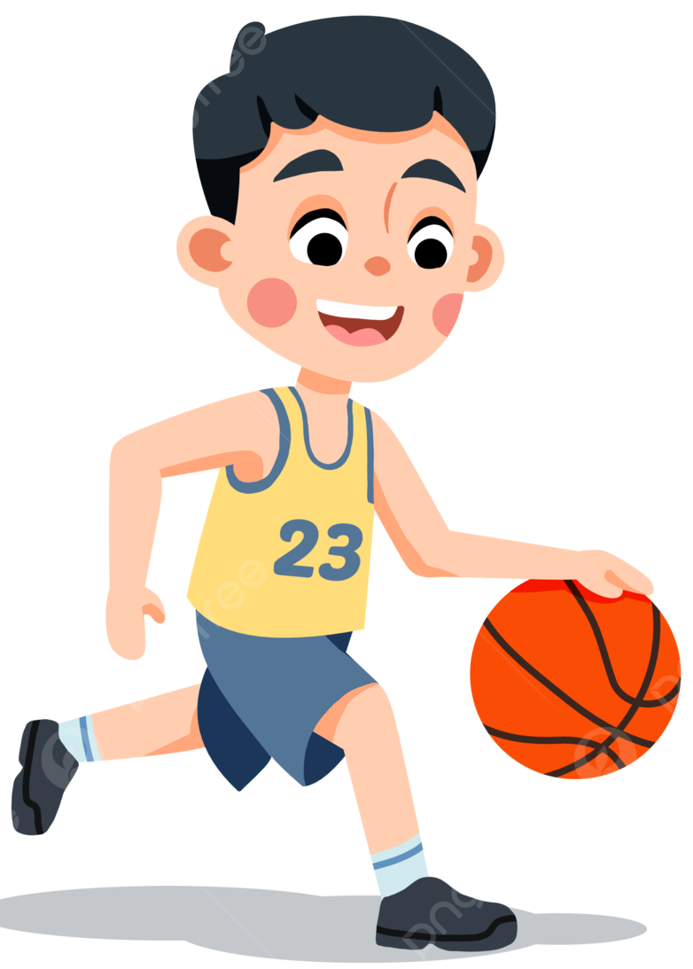
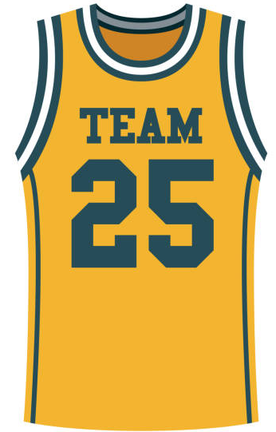

play basketball

Slide 14


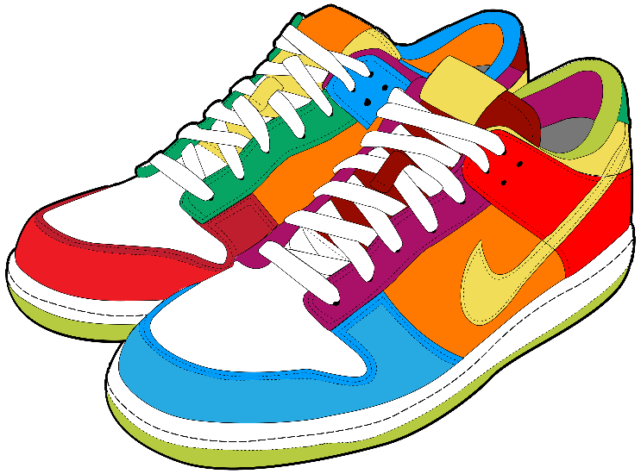
go for a walk

Slide 15
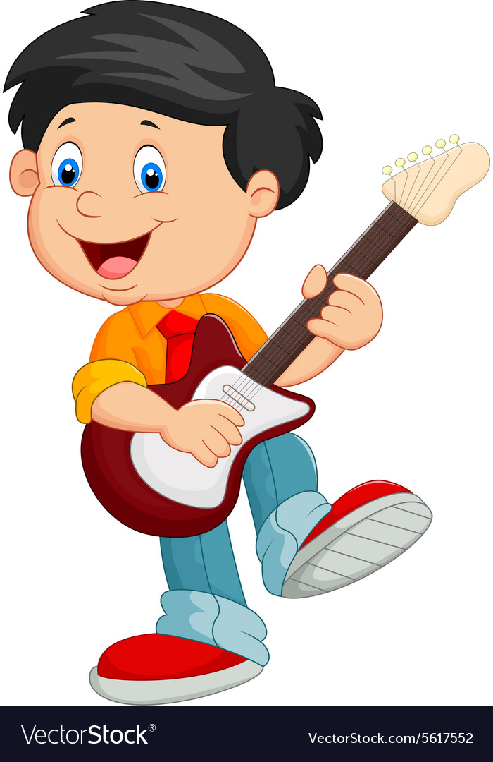
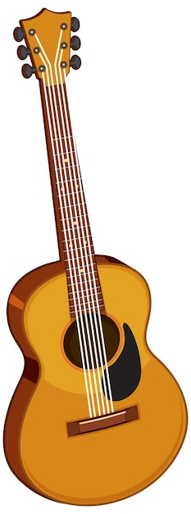

play the guitar

Slide 16
Let’s meet
my friends.
What do / don’t they like doing?

Slide 17



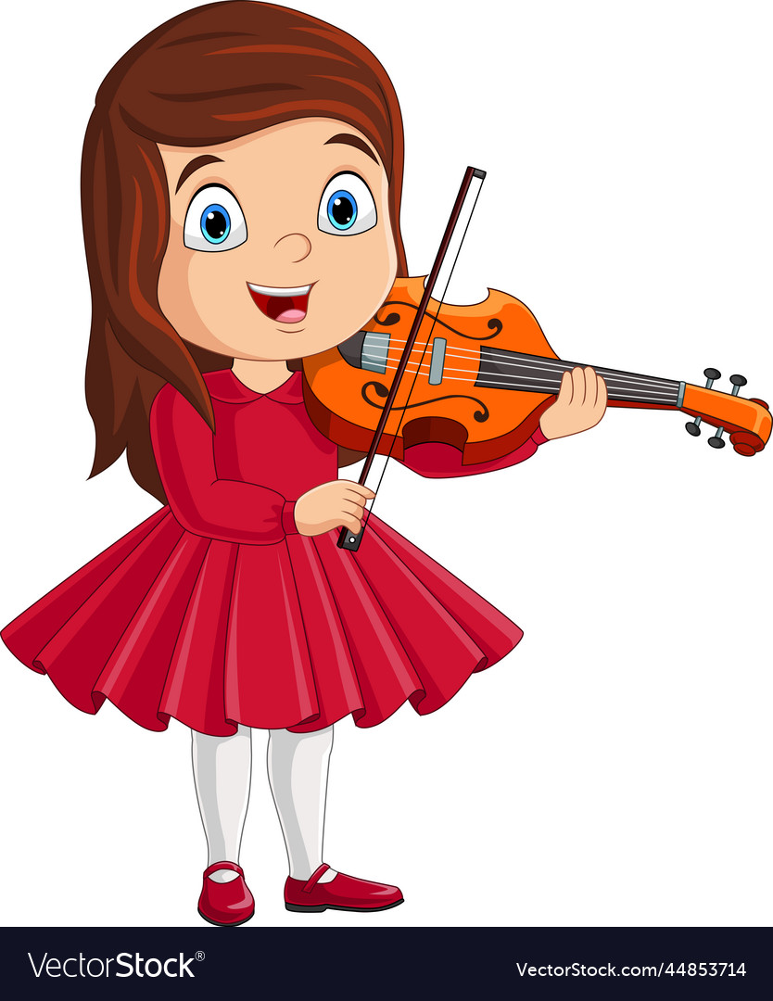
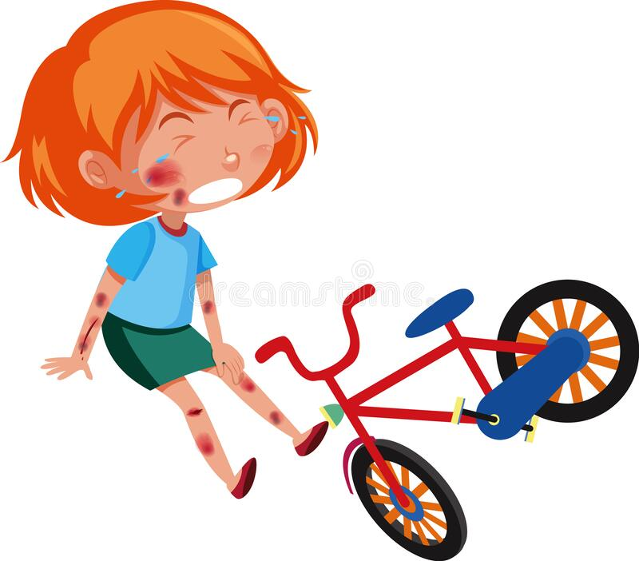


Do you like ………………. in your free time?
No, I don’t.
Yes, I do.
No, I don’t.

Slide 18


What do you like doing
in your free time?
I like ……………….

Slide 19
02. Listen and number.

Slide 20
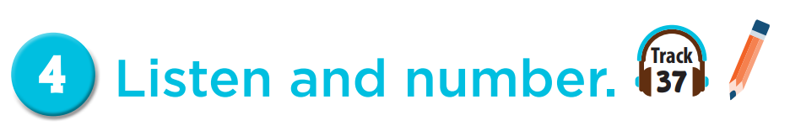


4
3
2
1

Slide 21
03. Read and complete.

Slide 22
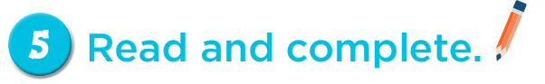
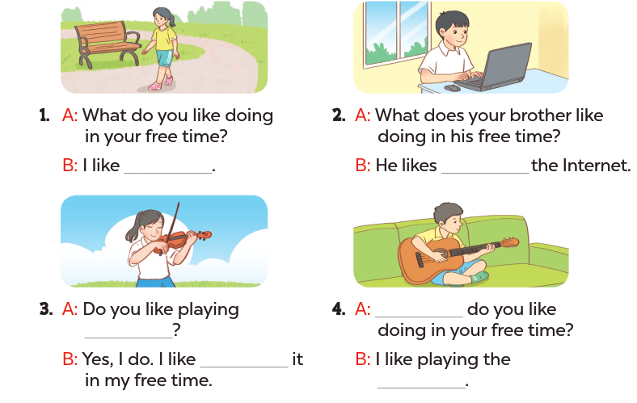
going for a walk
surfing
What
the violin
playing
guitar

Slide 23
04. Let’s play.

Slide 24
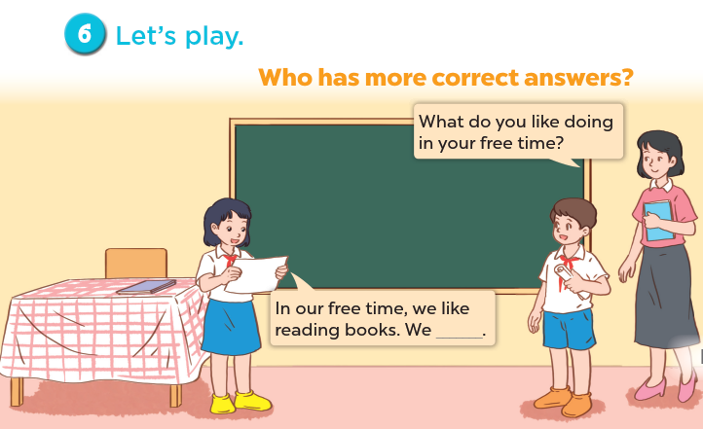

Slide 25
Share with friends.

Slide 26
05. Fun corner and Wrap-up
Game: SPIN THE WHEEL

Slide 27



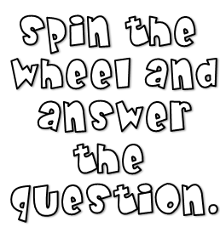




Slide 36

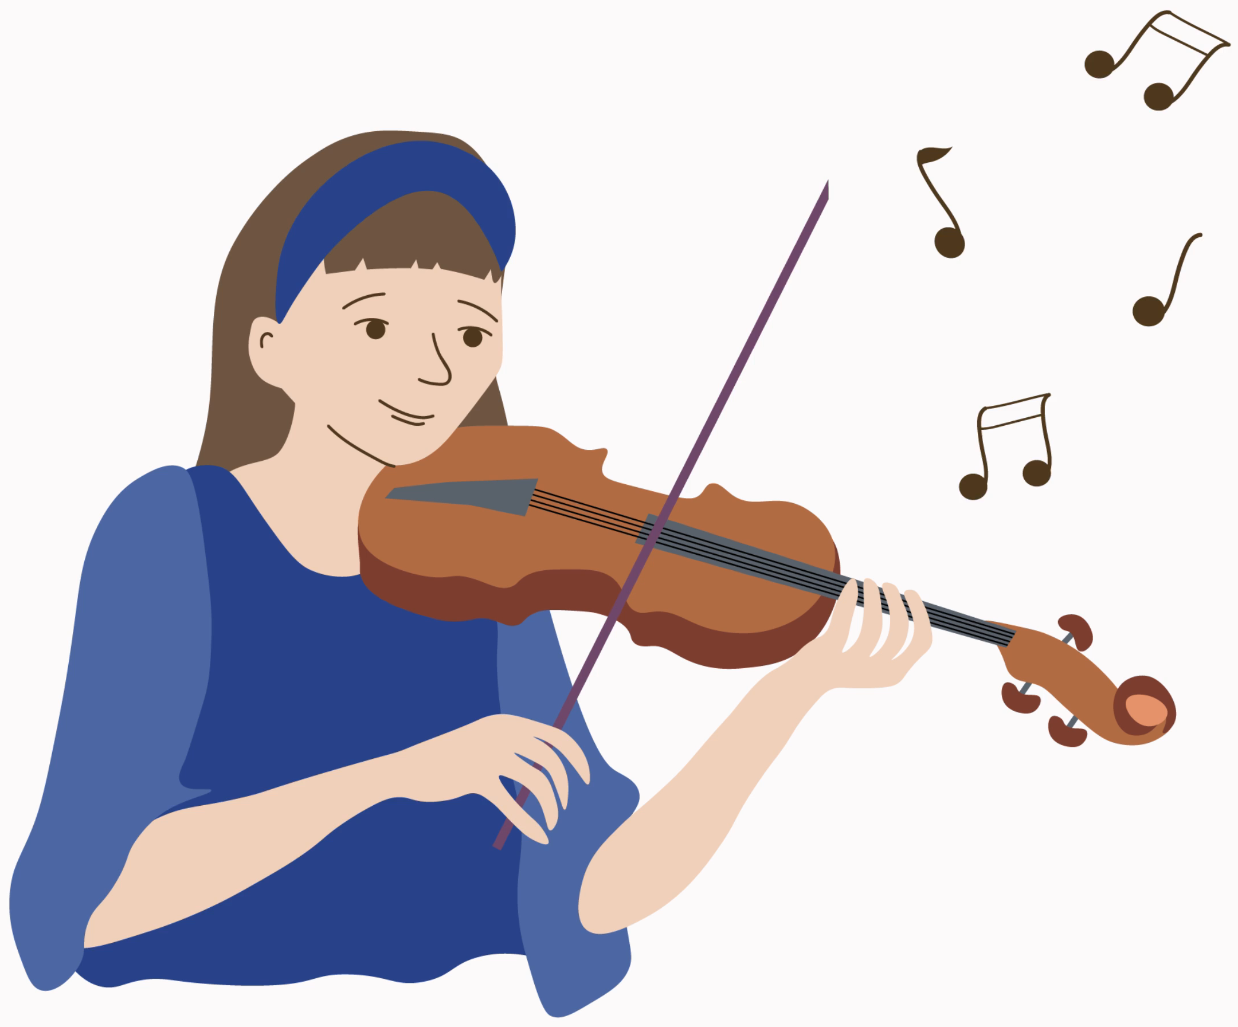

What do you like doing
in your free time?
I like playing the violin.

Slide 37
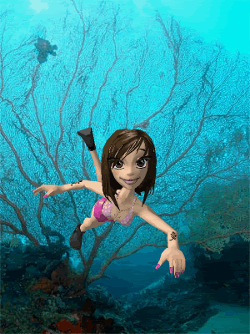
What do you like doing
in your free time?
I like swimming.

Slide 38
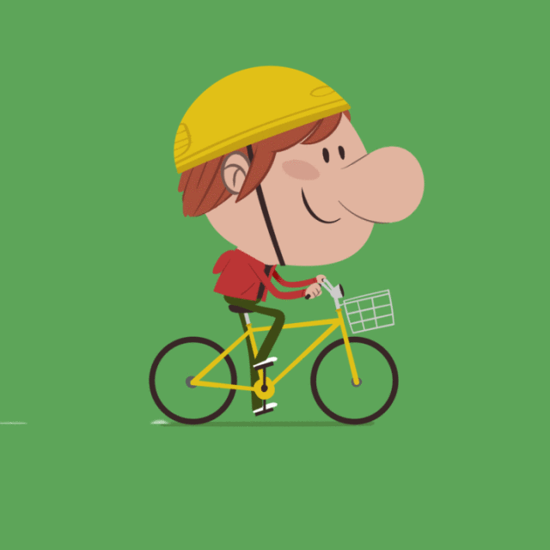
What do you like doing
in your free time?
I like riding a bike.

Slide 39


Slide 40
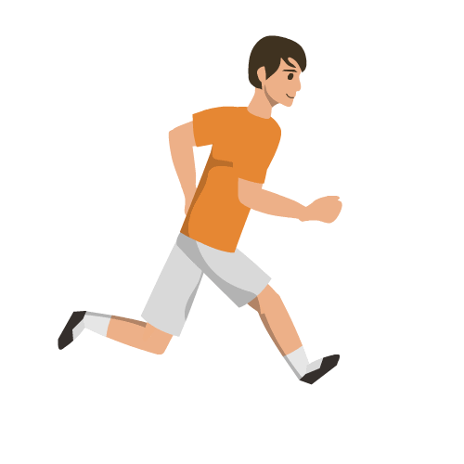
What do you like doing
in your free time?
I like running.

Slide 41

- 3 stars

Slide 42

What do you like doing
in your free time?
I like surfing the Internet.

Slide 43
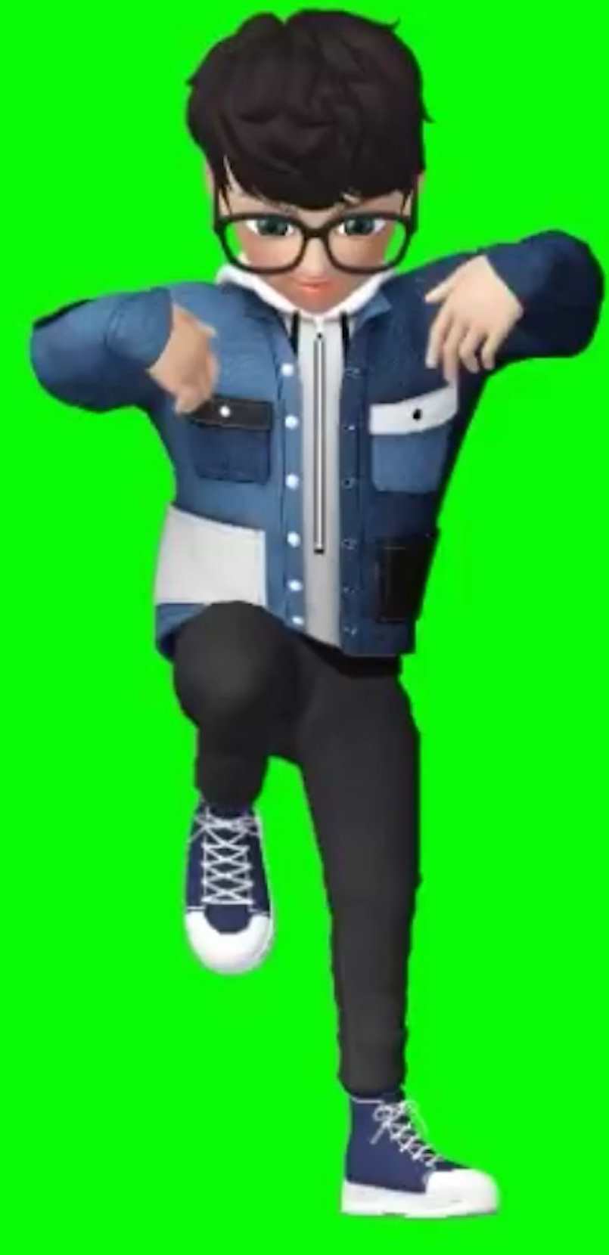

What do you like doing
in your free time?
I like dancing.

Slide 44
Website: hoclieu.vn
Fanpage: https://www.facebook.com/tienganhglobalsuccess.vn/

