Slide 2





My foreign friends
Unit 3
Lesson 3 – Period 6

Slide 3
Table of contents
01
Warm up and Review
02
Read and complete.
03
Let’s write.
05
Fun corner and Wrap-up
04
Project

Slide 4


01
Warm-up and Review

Slide 5






LISTEN, SING AND CLAP.
My friends
Notes:
Link video hoạt hình: https://hoclieu.vn/hop-phan-bo-tro/video-hoat-hinh/203?gidzl=zOIHFJEOs53ncvauCu7VN_2QdJKkXTuBw9gNP7hKXGZloSLdBjo43hl9nJLorOnSiydFDZFmBN1VDvdPKm

Slide 6







LET’S SING IN THE FRONT.

Slide 7





Slide 8
02
Read and complete.

Slide 9


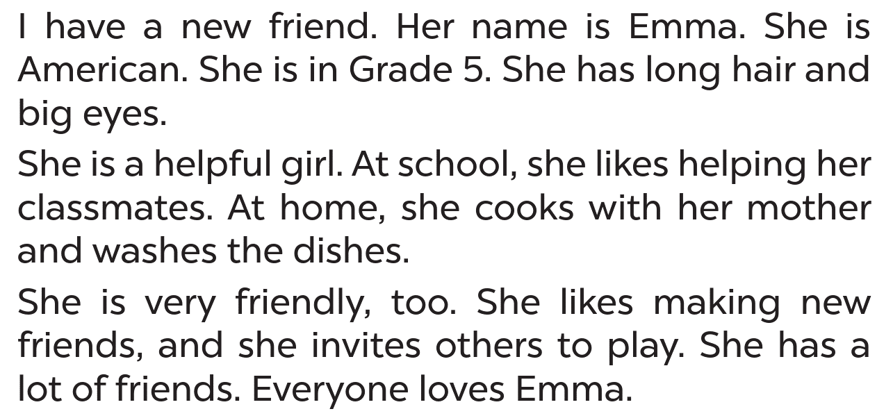


LISTEN AND READ
Emma

Slide 10



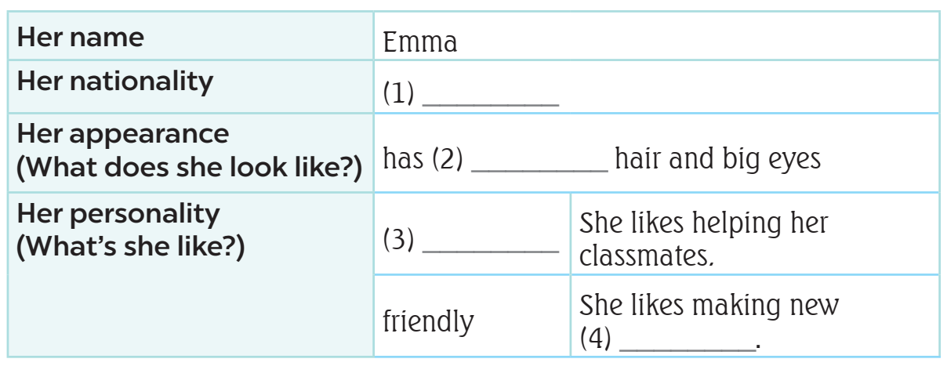

LISTEN AND READ
What’s
the information?
main
information

Slide 11

READ AND ANSWER.

Slide 12
READ AND ANSWER.
nationality
Emma

Slide 13

READ AND ANSWER.
American

Slide 14

SWAP YOUR BOOKS.

Slide 15


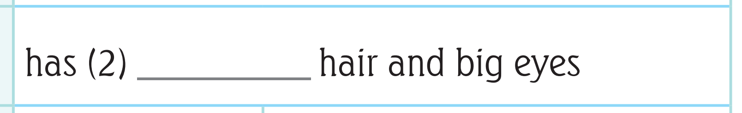


LET’S CHECK!
long

Slide 16
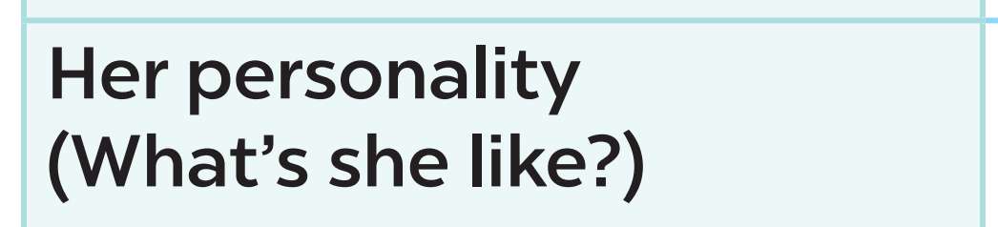

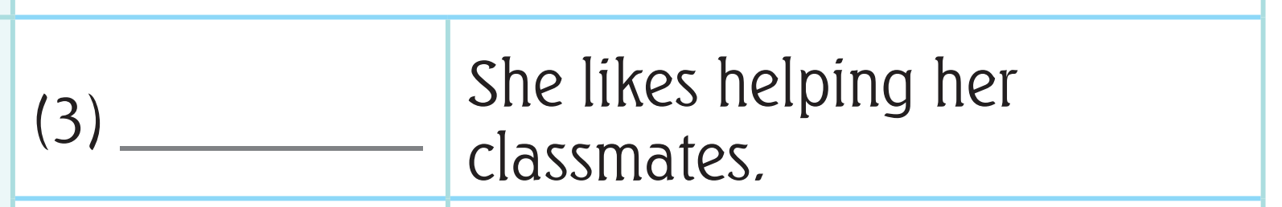



LET’S CHECK!
helpful

Slide 17




LET’S CHECK!
friends

Slide 18
ASK AND ANSWER ABOUT EMMA.
American
dishes
hair
friendly
classmate

Slide 20
03
Let’s write.

Slide 21

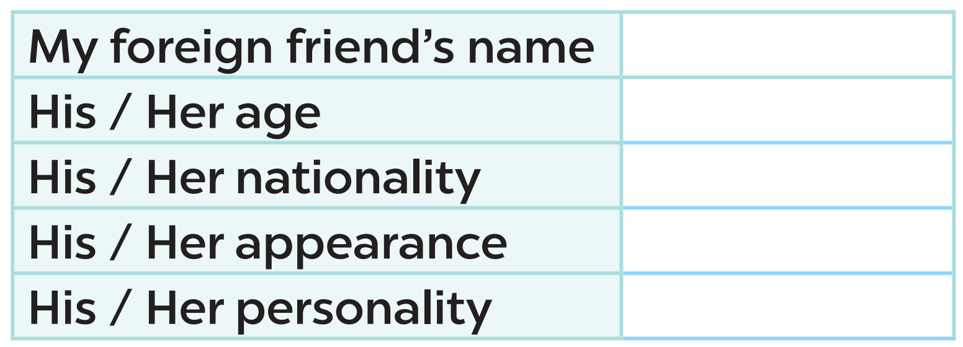

READ AND ANSWER

Slide 22
READ AND ANSWER
Lisa

Slide 24
04
Project

Slide 25
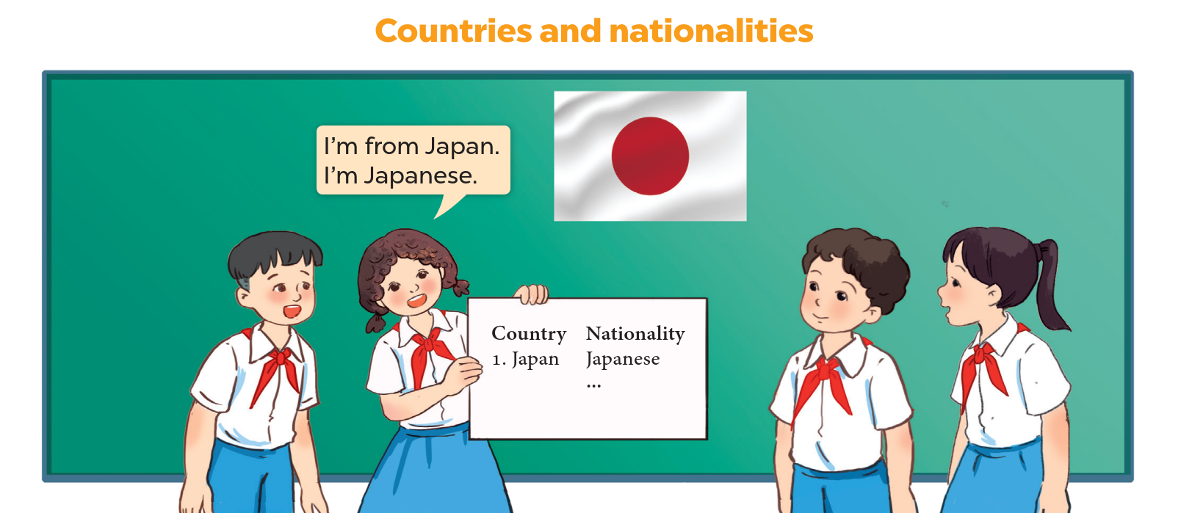
LET’S CHECK YOUR POSTERS!
5 countries
nationalities

Slide 26


WORK IN GROUPS.
Talk about your poster!!!!

Slide 27


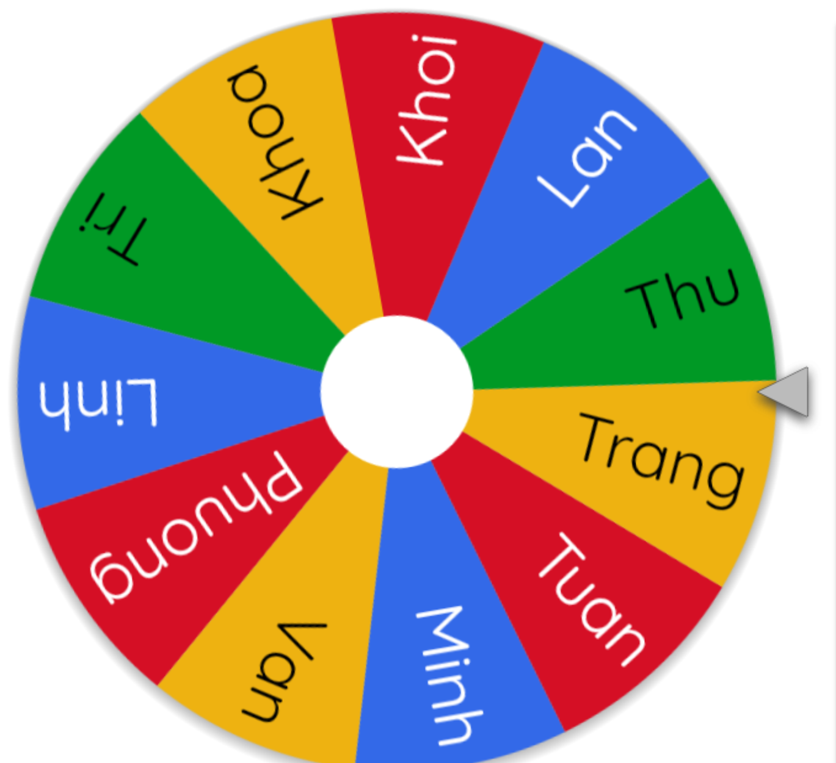


LET’S SPIN!
Notes:
Use this link https://wheelofnames.com/ to choose pupils in random.

Slide 29
05
Fun corner
and Wrap-up

Slide 30




Game
WHO’S FASTER?
friendly
helpful
active
clever

Slide 31




TEAM 1 and TEAM 2
friendly
clever
active
helpful

Slide 33
Website: hoclieu.vn
Fanpage: https://www.facebook.com/tienganhglobalsuccess.vn/

