Slide 2





My foreign friends
Unit 3
Lesson 3 – Period 5

Slide 3
Table of contents
01
Warm up and Review
02
Listen and repeat.
03
Circle, listen and check.
05
Fun corner and Wrap-up
04
Let’s chant.

Slide 4


01
Warm-up and Review

Slide 5


Describing people's
APPEARANCE
and
PERSONALITY

Slide 6


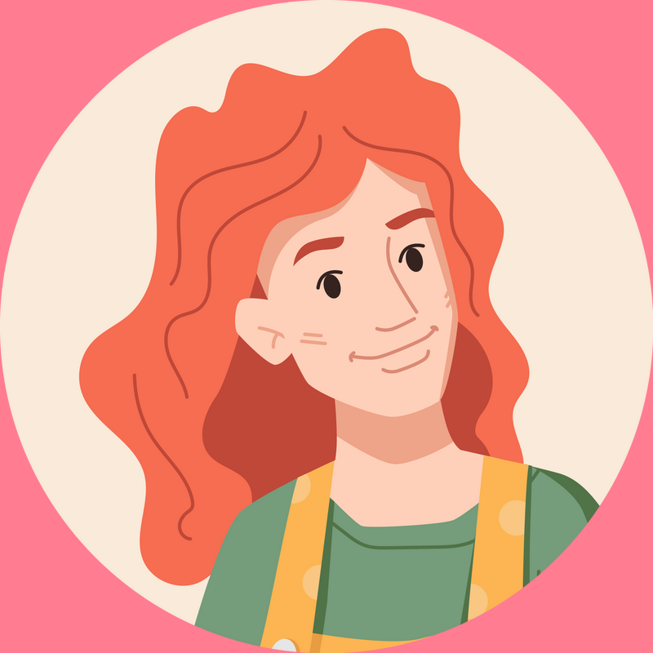

She has long and red hair.

Slide 7

She has long and red hair.

Slide 8

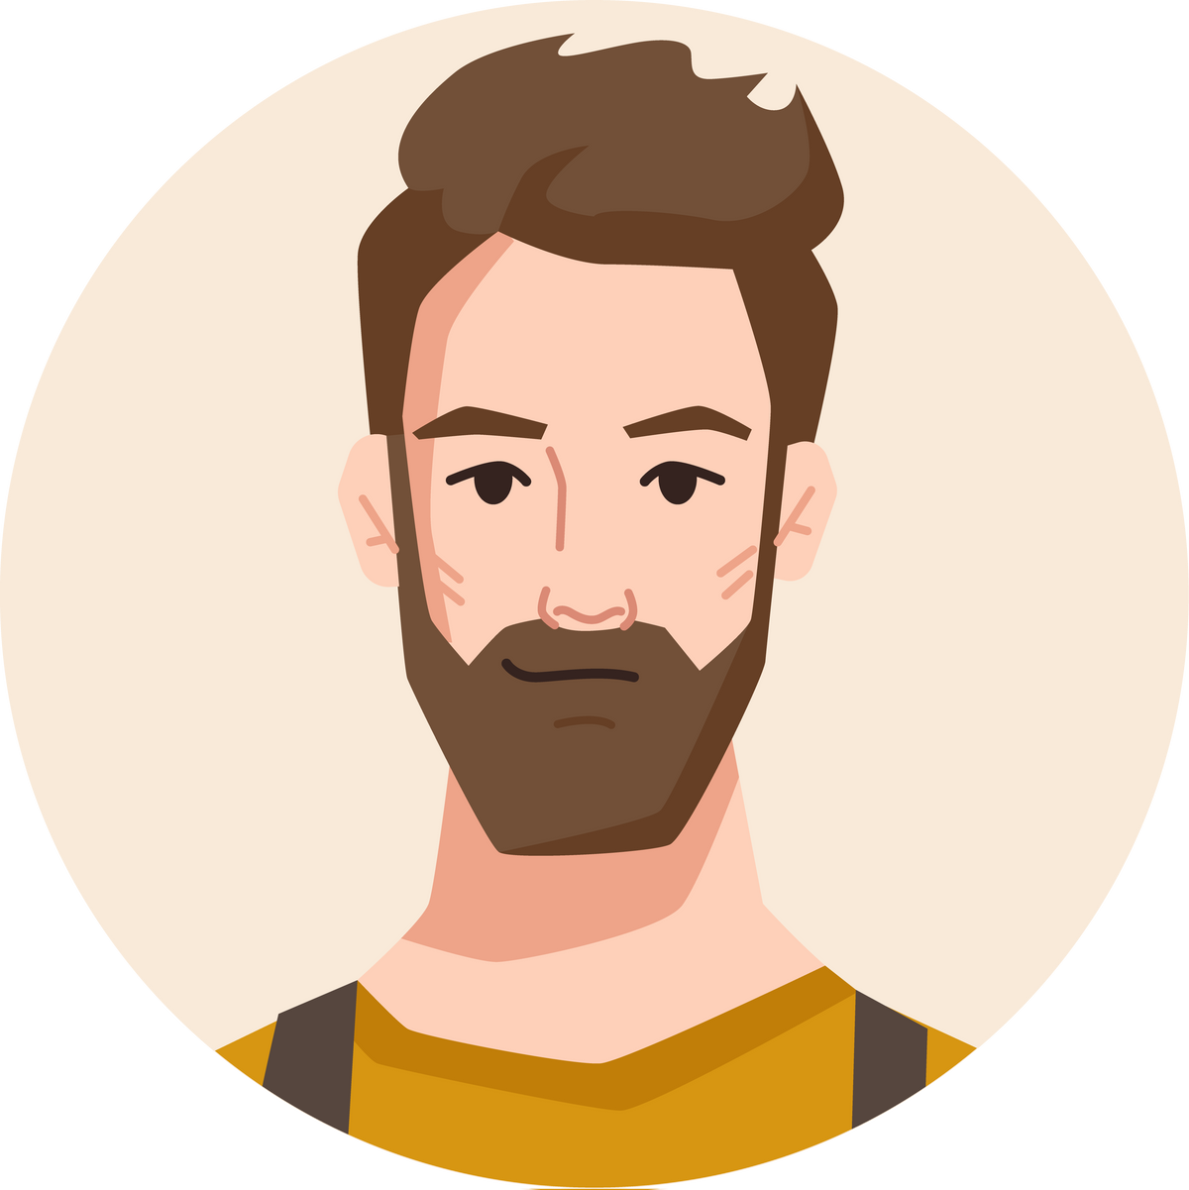
He has long and brown hair.
He is big and fat.
He has short and brown hair.

Slide 9
He has long and brown hair.
He is big and fat.
He has short and brown hair.

Slide 10
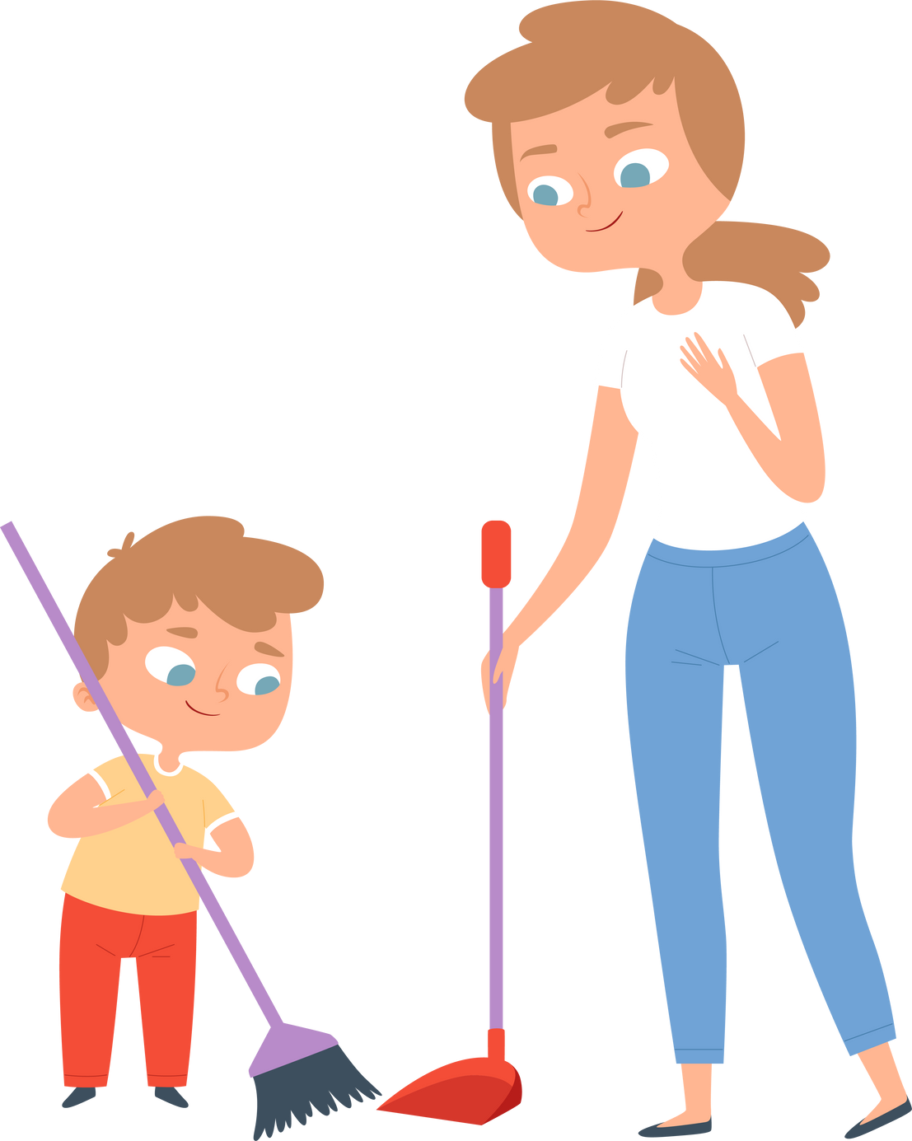
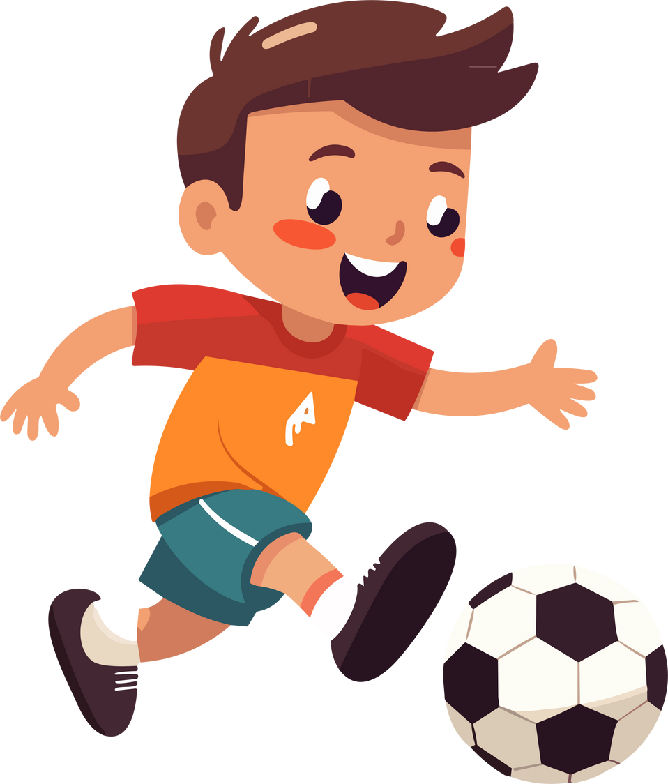
He is very active.

Slide 11
He is very active.

Slide 12

My sister has eyes.

Slide 13
big
My sister has eyes.

Slide 14


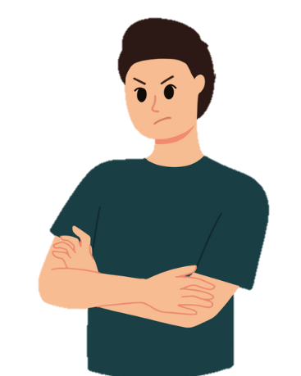
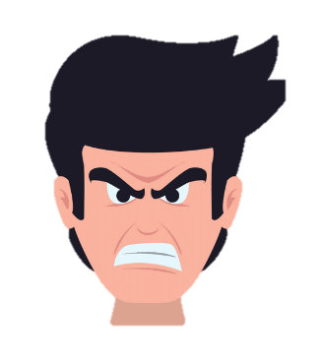
My brother is friendly.

Slide 15
My brother is friendly.

Slide 16


My little brother is helpful.
My little brother is clever.
My little brother is active.

Slide 17
My little brother is helpful.
My little brother is clever.
My little brother is active.

Slide 18
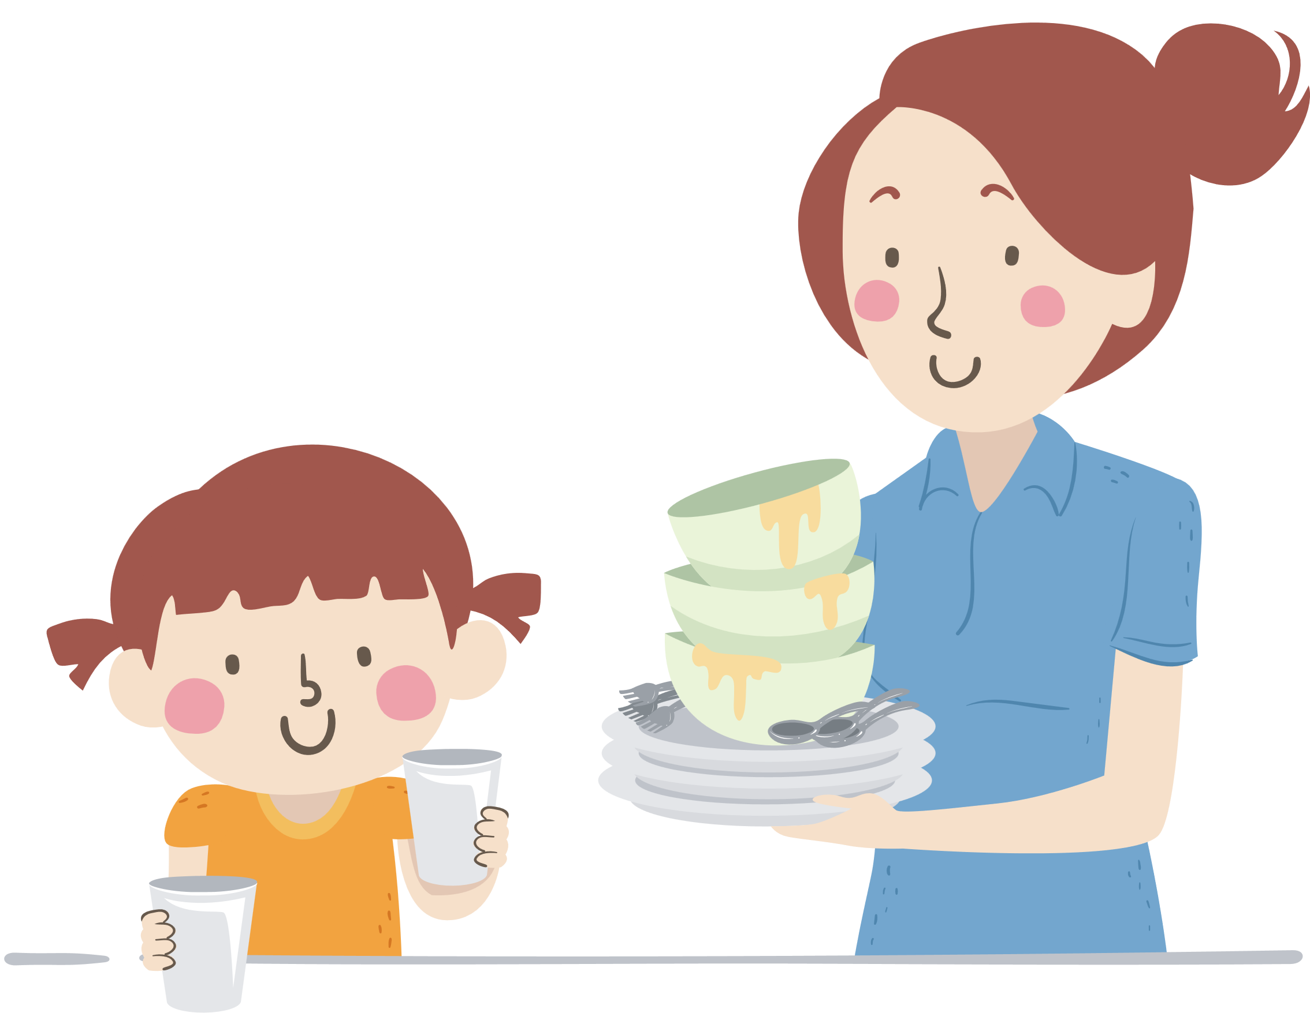
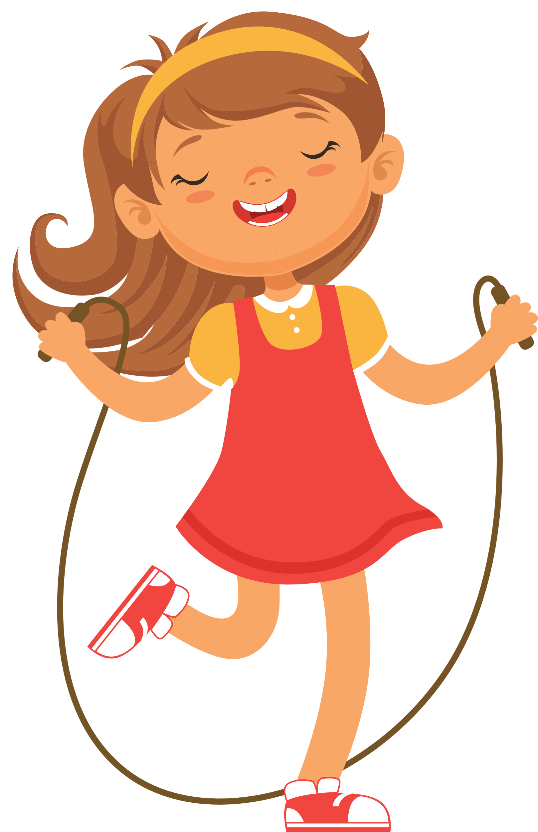
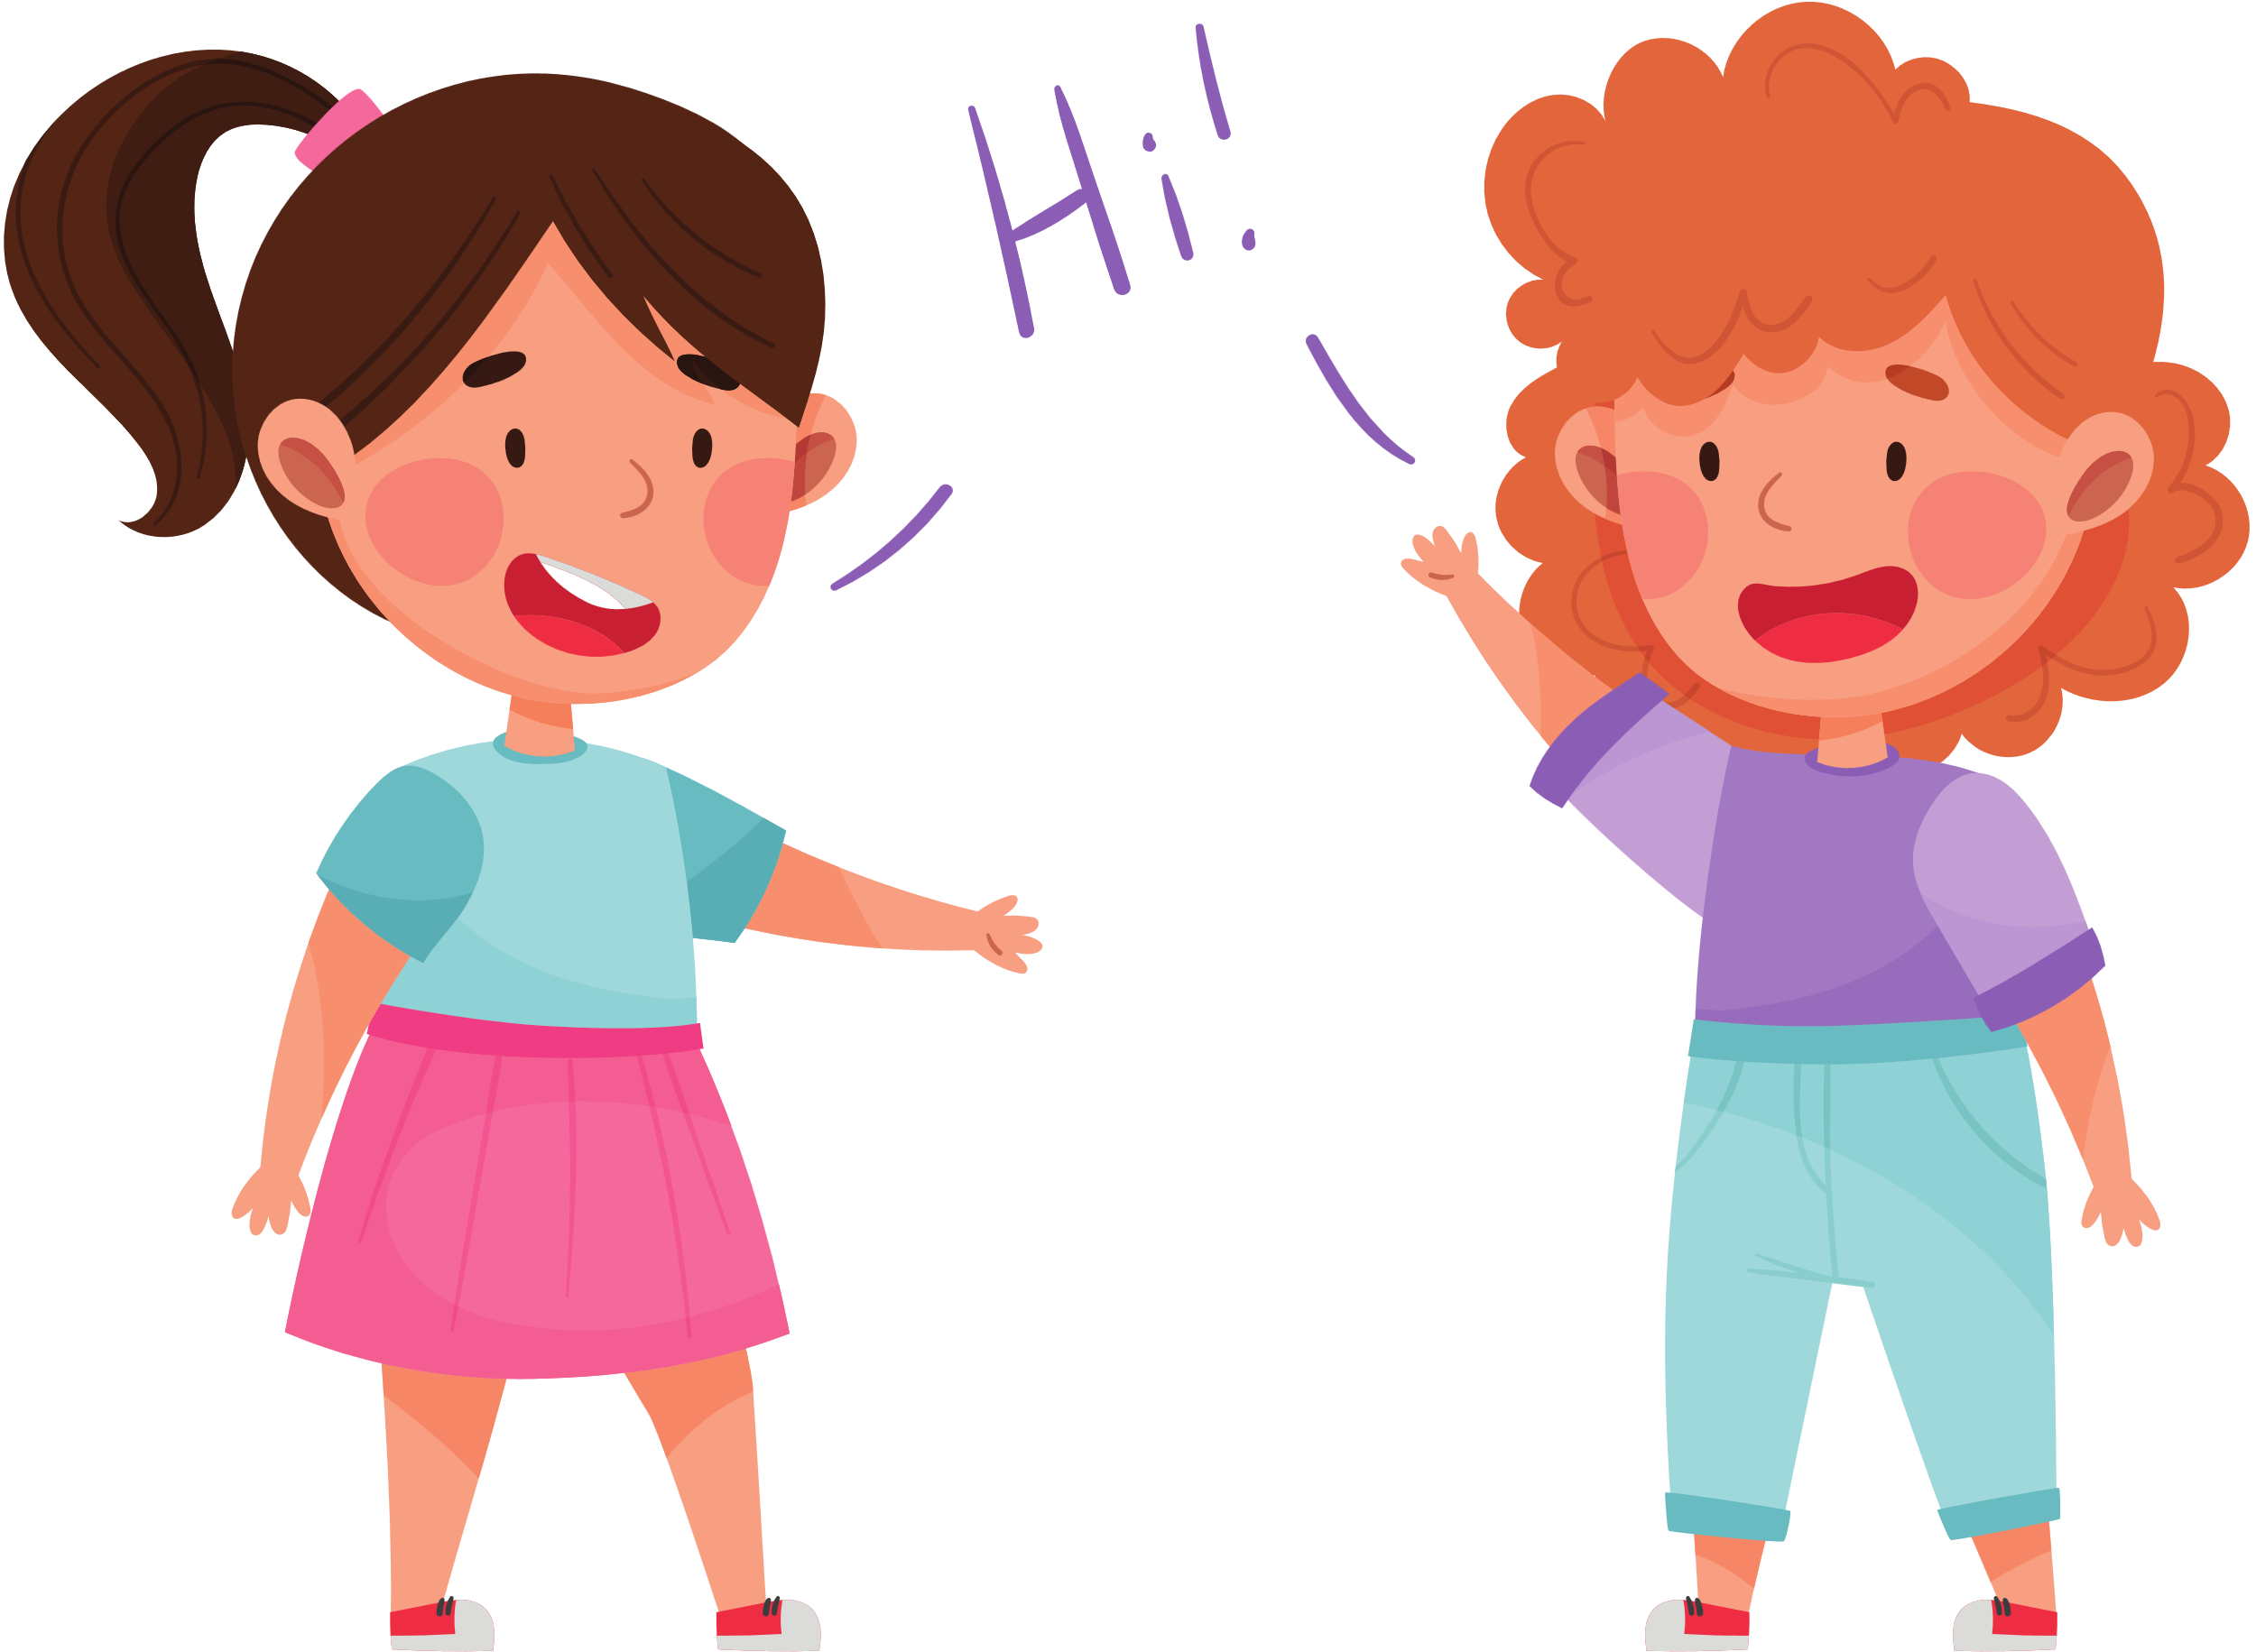
My younger sister is helpful.

Slide 19
My younger sister is helpful.

Slide 20





Slide 21
02
Listen and repeat.

Slide 22
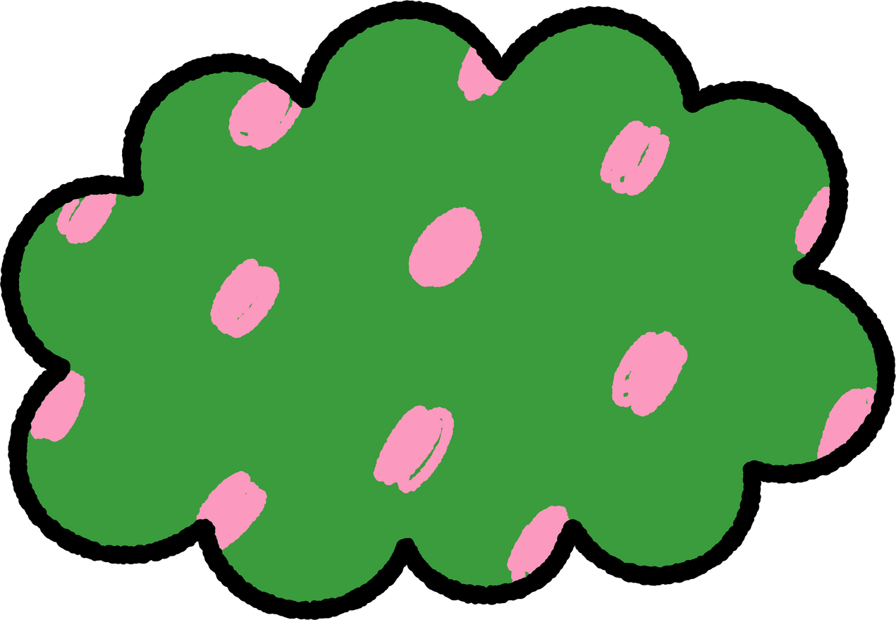




LISTEN, POINT AND REPEAT.
‘active
He’s ‘active.

Slide 23
LISTEN, POINT AND REPEAT.
‘friendly
She’s ‘friendly.

Slide 24



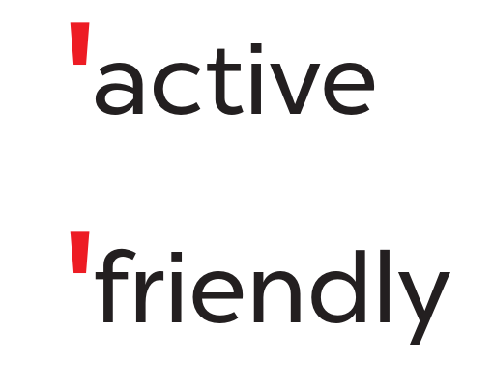
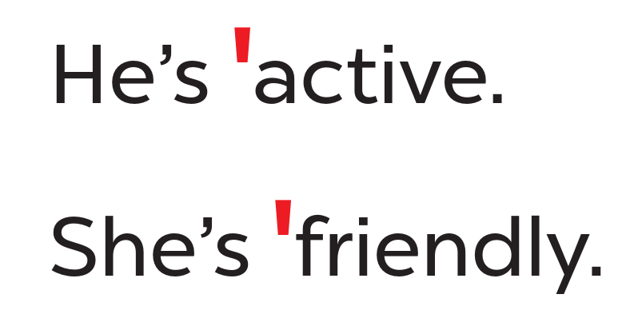


WORK IN PAIRS.

Slide 25
03
Circle, listen and check.

Slide 26




READ AND CIRCLE.
a. friendly
b. fifteen
c. active
a. sixteen
b. eighteen
c. clever
a. helpful
b. about
c. nineteen

Slide 27

SWAP YOUR BOOKS.

Slide 28
LISTEN AND CHECK.
a. friendly
b. fifteen
c. active
a. sixteen
b. eighteen
c. clever
a. helpful
b. about
c. nineteen

Slide 29



LOOK AND SAY ALOUD.
friendly
helpful
active
clever
She’s active.
He’s friendly.
He’s clever.
She’s helpful.

Slide 31
04
Let’s chant.

Slide 32
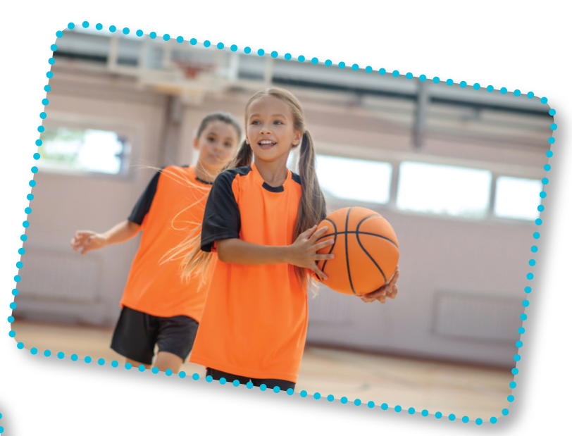
LOOK AND SAY.
play basketball
active

Slide 33
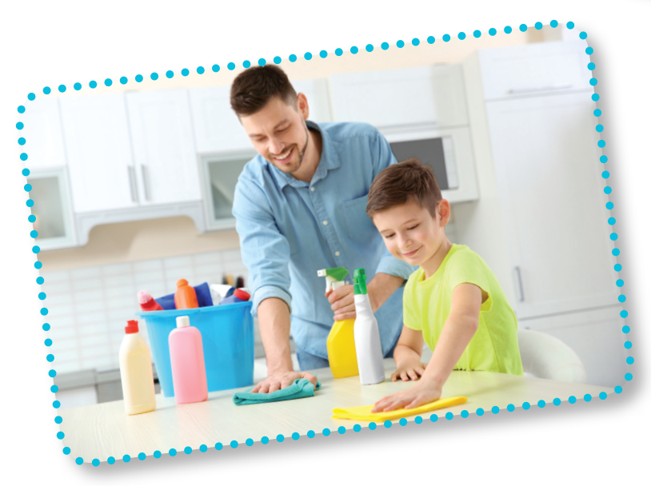
LOOK AND SAY.
clean the table
helpful

Slide 34
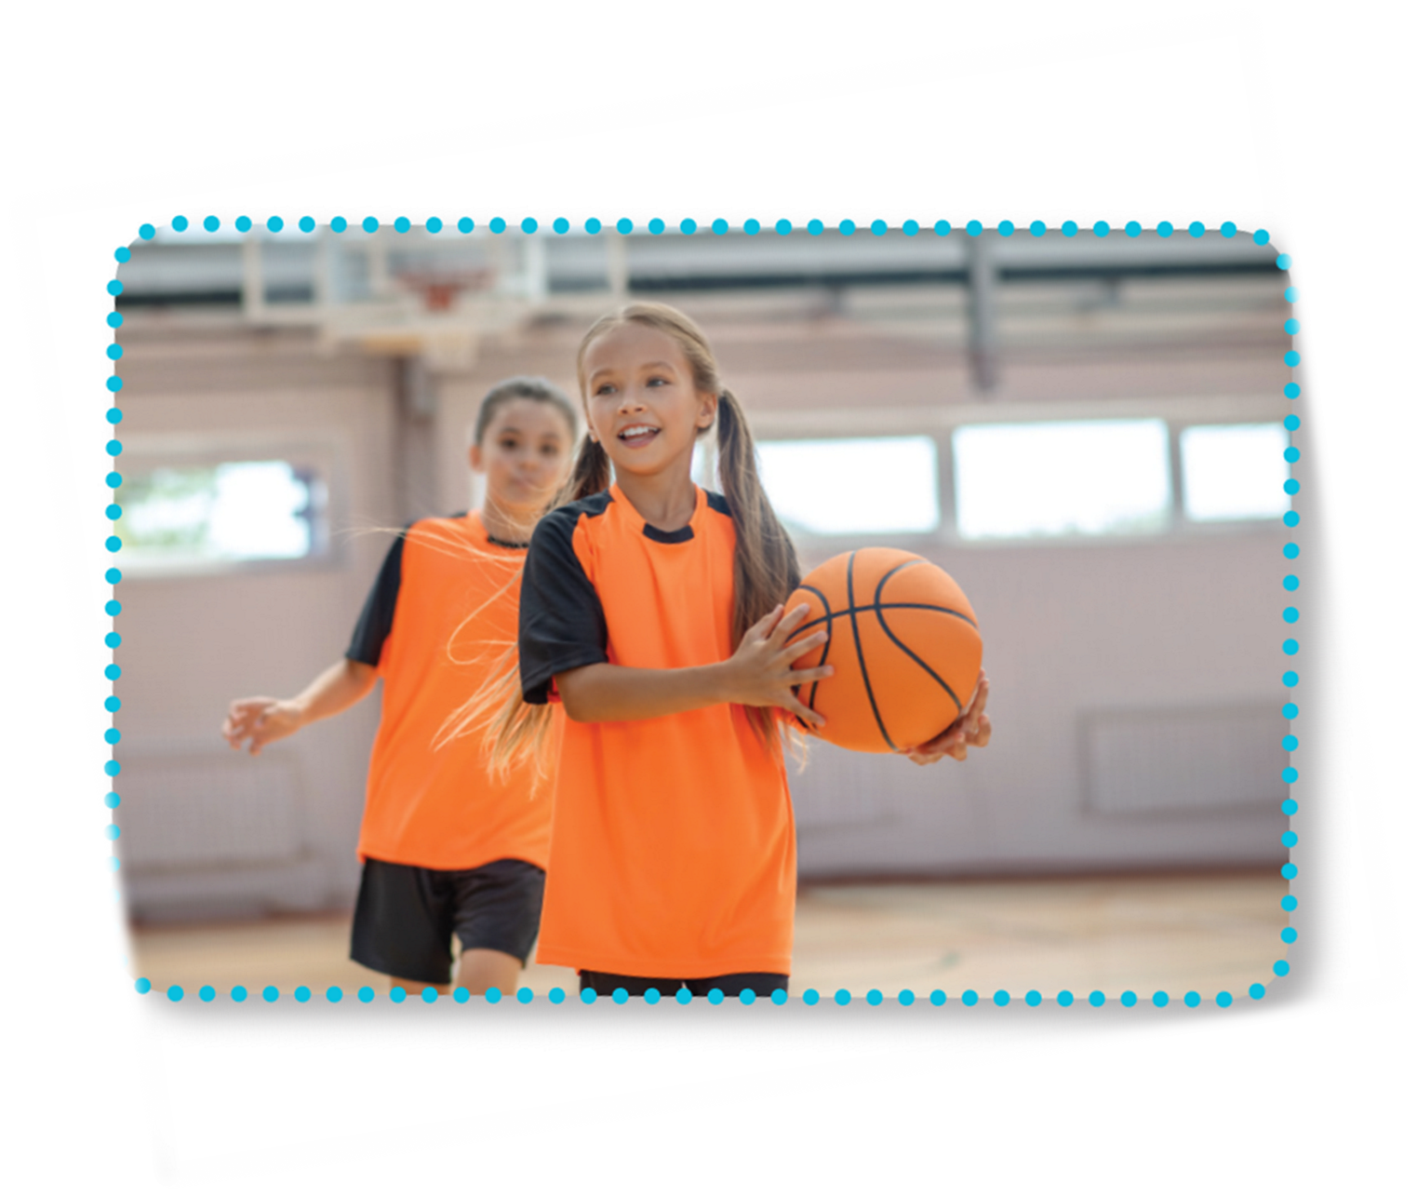

LOOK AND READ.
Is she active?
Yes, she is.
Is she friendly?
Yes, she is.
She’s active and friendly.

Slide 35
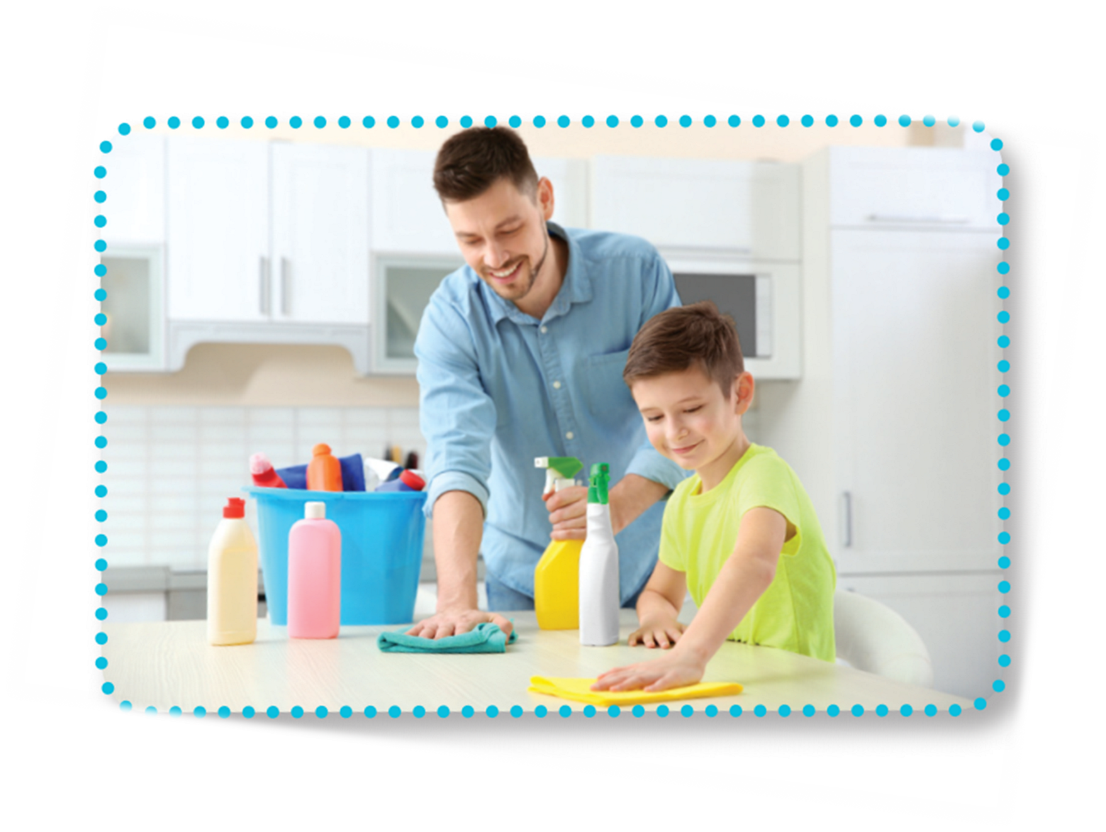
LOOK AND READ.
Is he helpful?
Yes, he is.
Is he clever?
Yes, he is.
He’s helpful and clever.

Slide 36

LISTEN AND POINT.
Is she active?
Yes, she is.
Is she friendly?
Yes, she is.
She’s active and friendly.

Slide 37

LISTEN AND POINT.
Is he helpful?
Yes, he is.
Is he clever?
Yes, he is.
He’s helpful and clever.

Slide 38

LISTEN AND REPEAT.
Is she active?
Yes, she is.
Is she friendly?
Yes, she is.
She’s active and friendly.

Slide 39

LISTEN AND REPEAT.
Is he helpful?
Yes, he is.
Is he clever?
Yes, he is.
He’s helpful and clever.

Slide 40

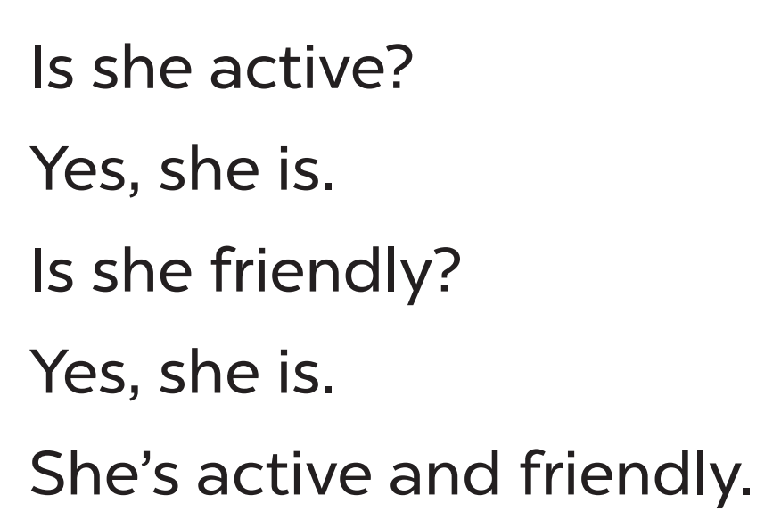
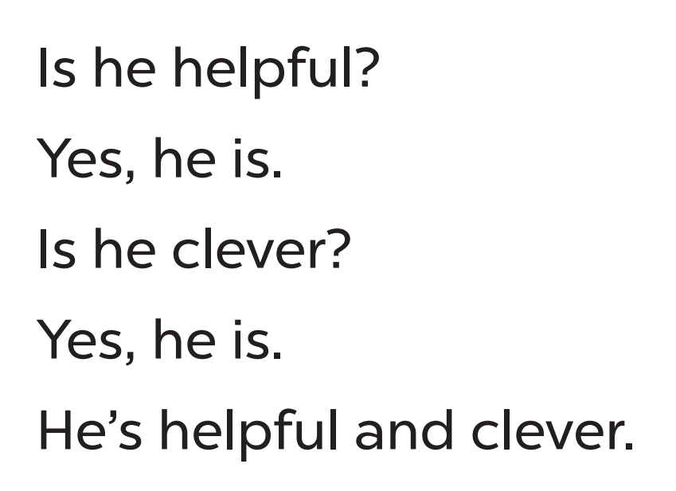
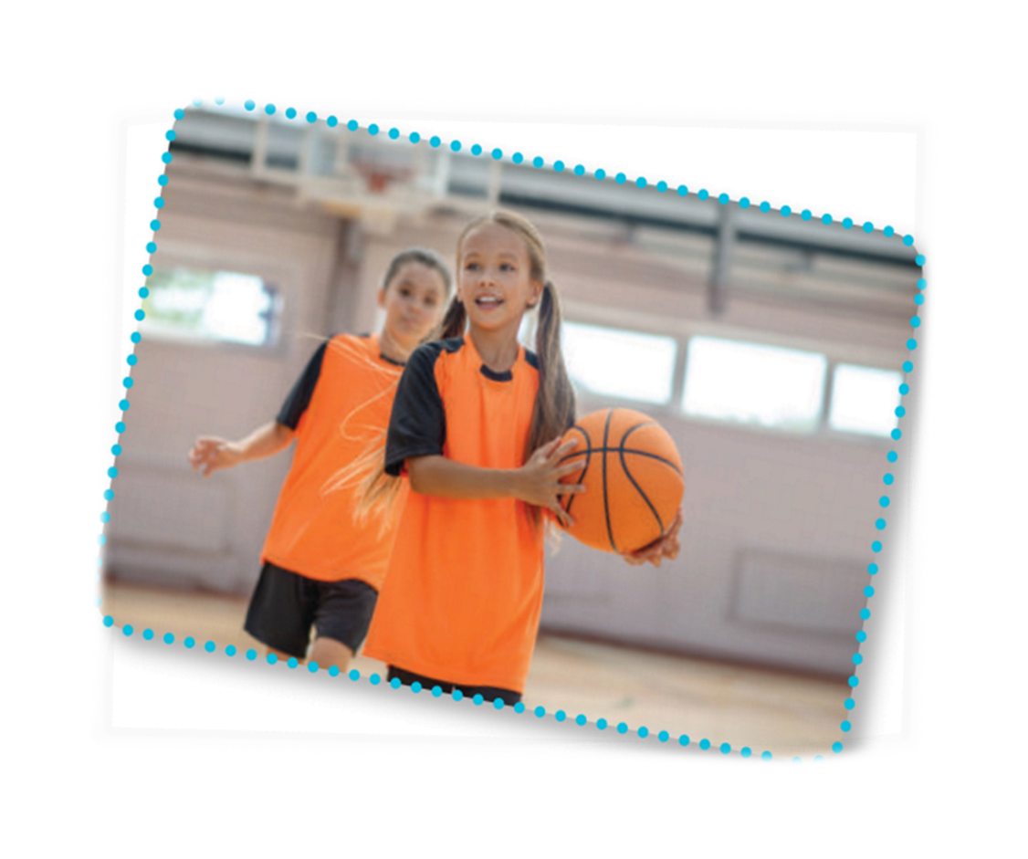
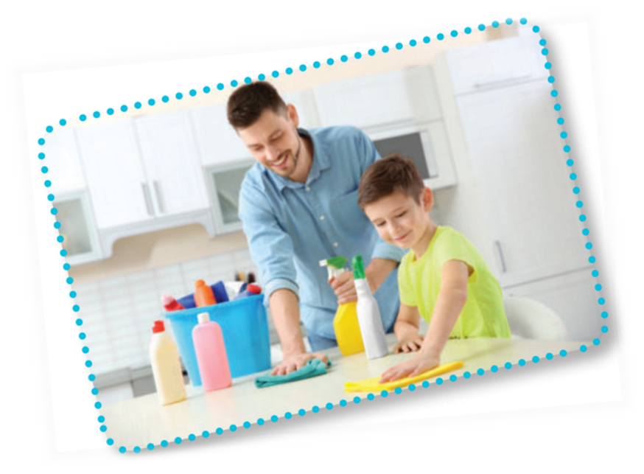
CHANT AND CLAP

Slide 41




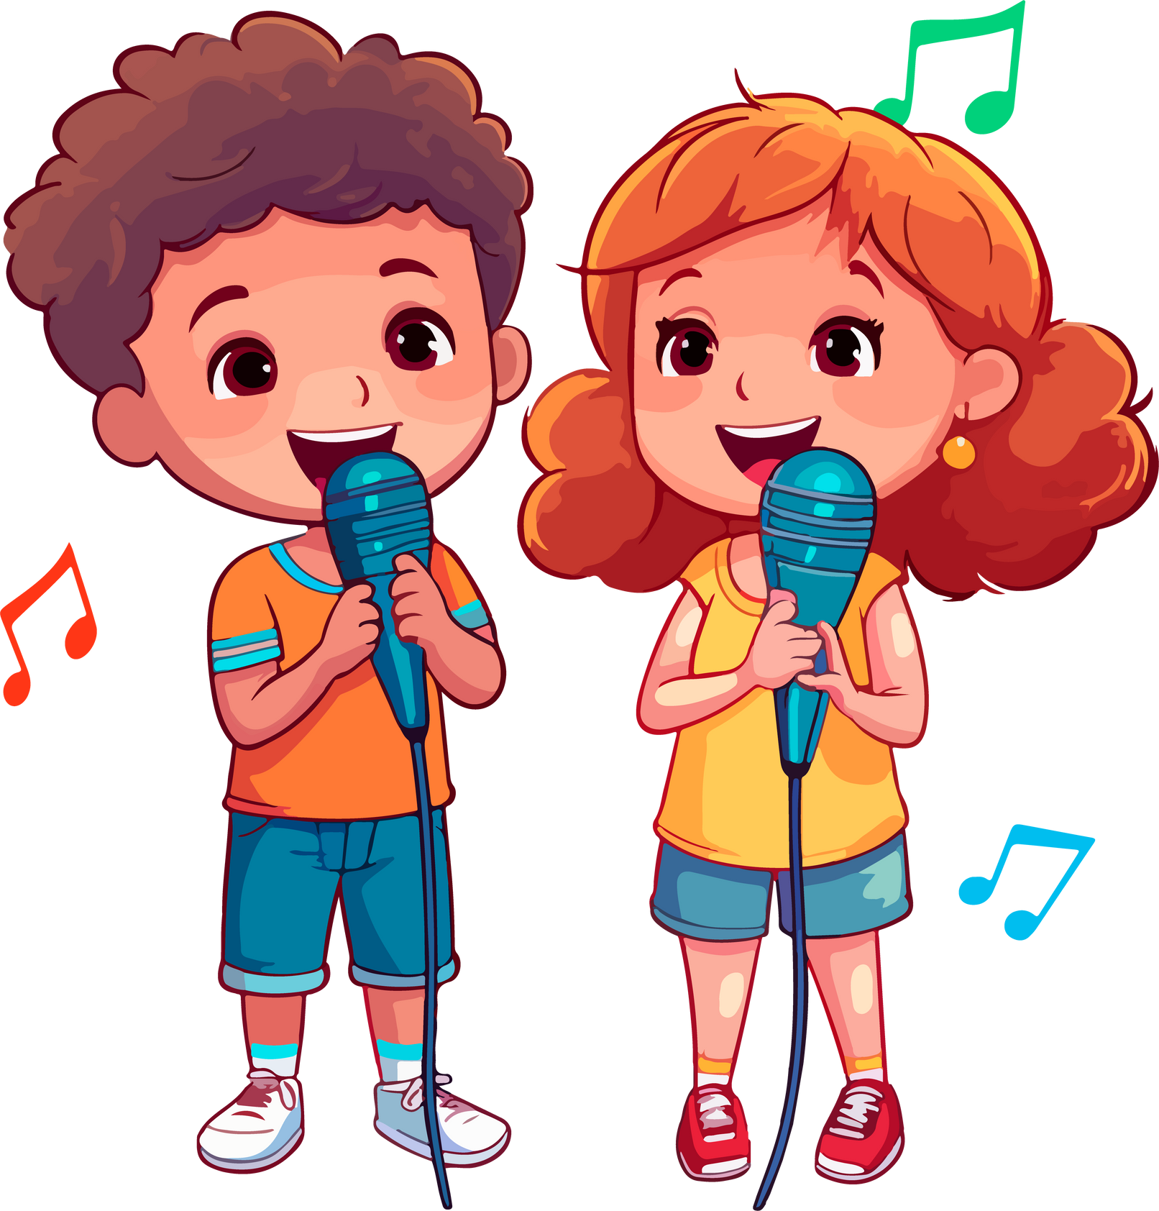


LET’S CHANT IN THE FRONT.
Notes:
Link video hoạt hình: https://hoclieu.vn/hop-phan-bo-tro/video-hoat-hinh/203?gidzl=92okFGyK4JiWCwOu3mqMD24oe3WI2HLjEJAgQKPOJcu-OVXg4b1FQ6fX-3XEMKSwOc7oEpCT2OOq2nKGE0

Slide 42
PRACTISE THE NEW CHANT.
happy
busy
quiet
tidy
gentle
Is she active?
Is he helpful?
Yes, she is.
Yes, he is.
Is she friendly?
Is he clever?
Yes, she is.
Yes, he is.
She’s active and friendly.
He’s helpful and clever.
Notes:
Extension (For consolidation): Replace two adjectives in the chant with other adjectives which have the stress on the first syllable for example, happy, busy, quiet, tidy, gentle. Have pupils practice the new chant.

Slide 44
05
Fun corner
and Wrap-up

Slide 45








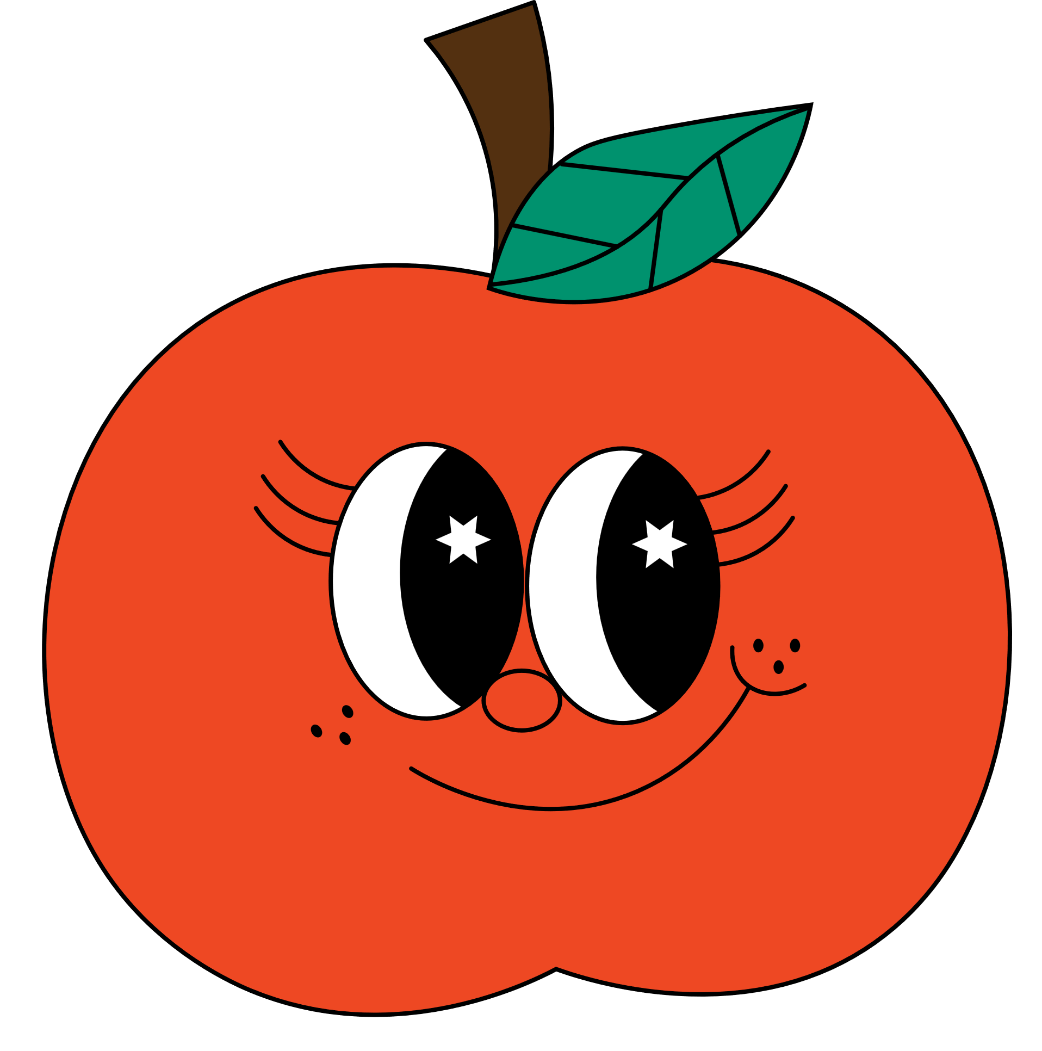


Let’s talk about your beloved ones!
Have fun!

Slide 46








What is like?
Let’s talk about the friend sitting at your left.

Slide 47






What is like?
Let’s talk about the friend sitting at your right.

Slide 48



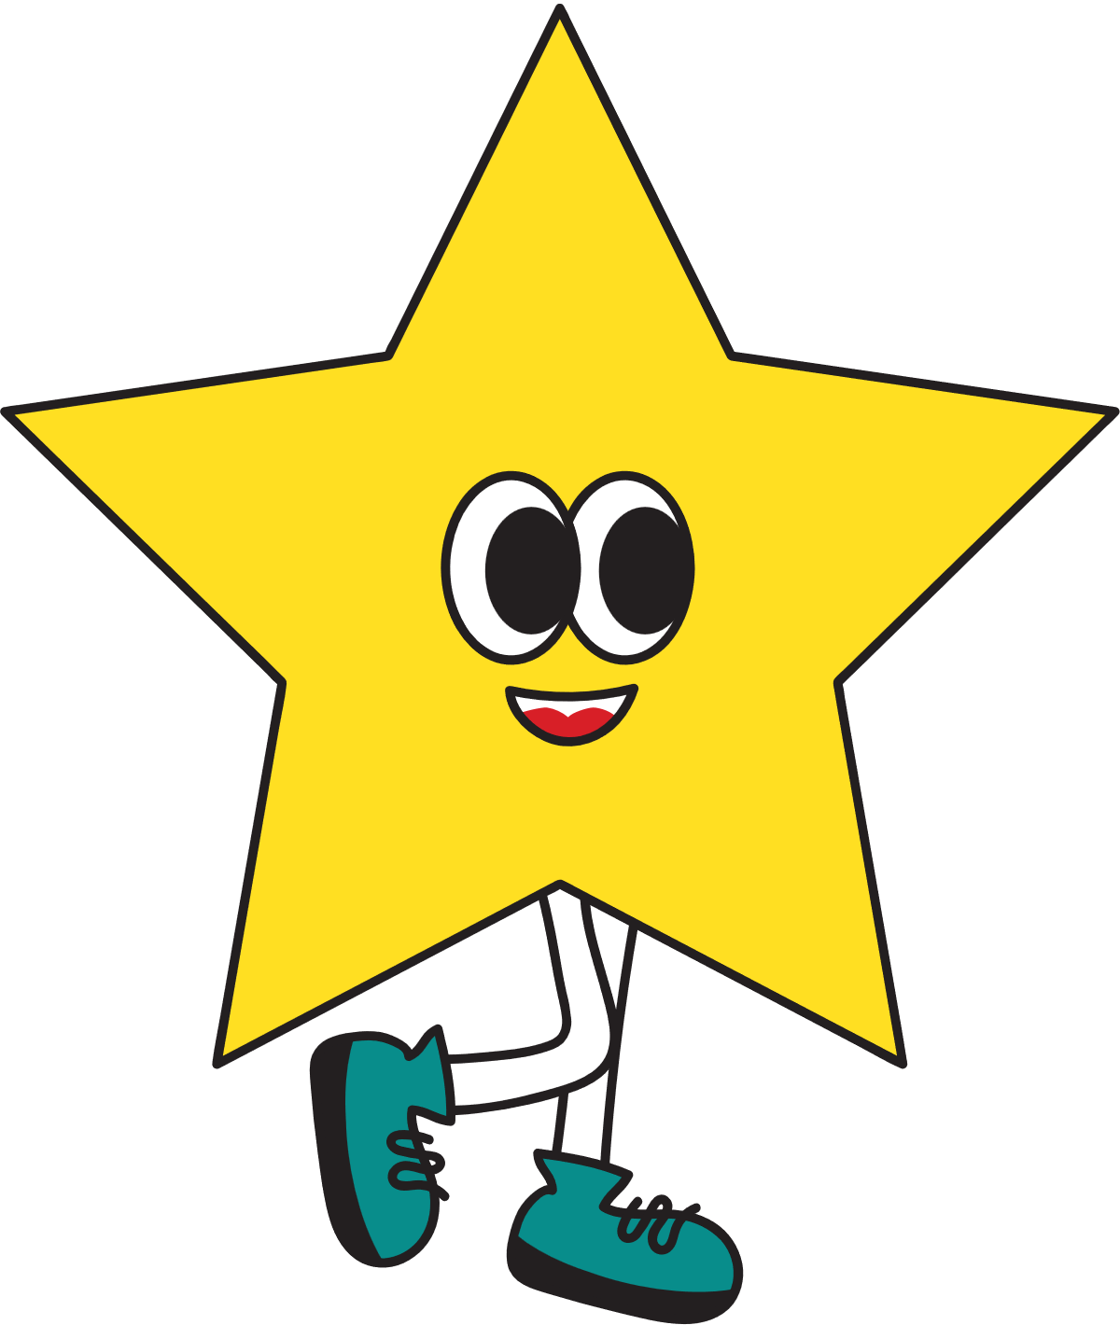


What is like?
Let’s talk about the friend behind you.

Slide 49


What is like?
Let’s talk about the friend in front of you.

Slide 50

What is like?
Let’s talk about your favourite teacher.

Slide 51


Good job!

Slide 52
Website: hoclieu.vn
Fanpage: https://www.facebook.com/tienganhglobalsuccess.vn/

