Slide 2





My foreign friends
Unit 3
Lesson 2 – Period 4

Slide 3
Table of contents
01
Warm up and Review
02
Listen and number.
03
Read and complete.
05
Fun corner and Wrap-up
04
Let’s play.

Slide 4


01
Warm-up and review

Slide 5





Game
WHAT IS THE WORD?

Slide 6
Do you know these words?
Will 10 seconds be enough for you
to solve the puzzle?

Slide 7
Are you ready?

Slide 8


WHAT IS THE WORD?
E
F
I
N
D
L
R
Y

Slide 9


friendly

Slide 10

WHAT IS THE WORD?
I
M
S
L

Slide 11
slim

Slide 12

WHAT IS THE WORD?
R
V
E
E
L
C

Slide 13
clever

Slide 14

WHAT IS THE WORD?
R
H
T
S
O

Slide 15
short

Slide 16

WHAT IS THE WORD?
I
C
V
T
E
A

Slide 17
active

Slide 18
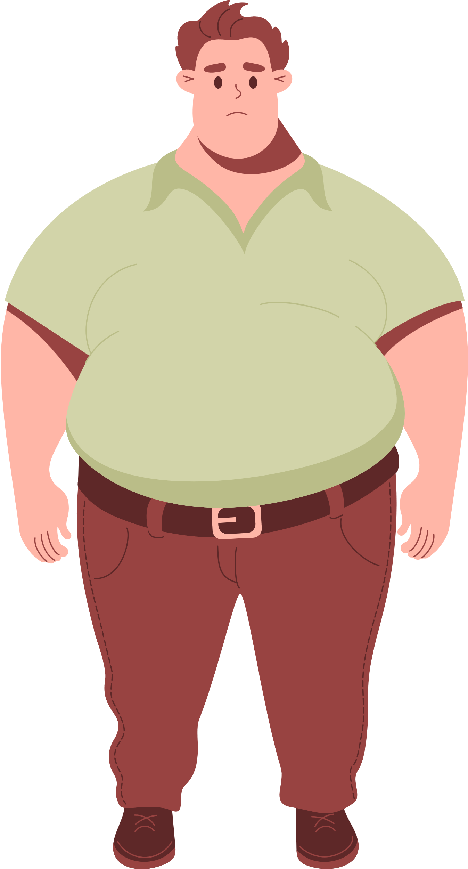
WHAT IS THE WORD?
G
I
B

Slide 19
big

Slide 20
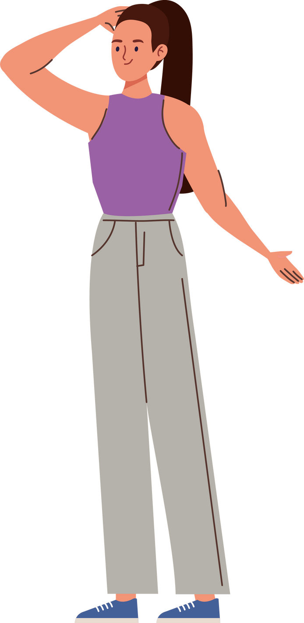
WHAT IS THE WORD?
A
L
T
L

Slide 21
tall

Slide 22
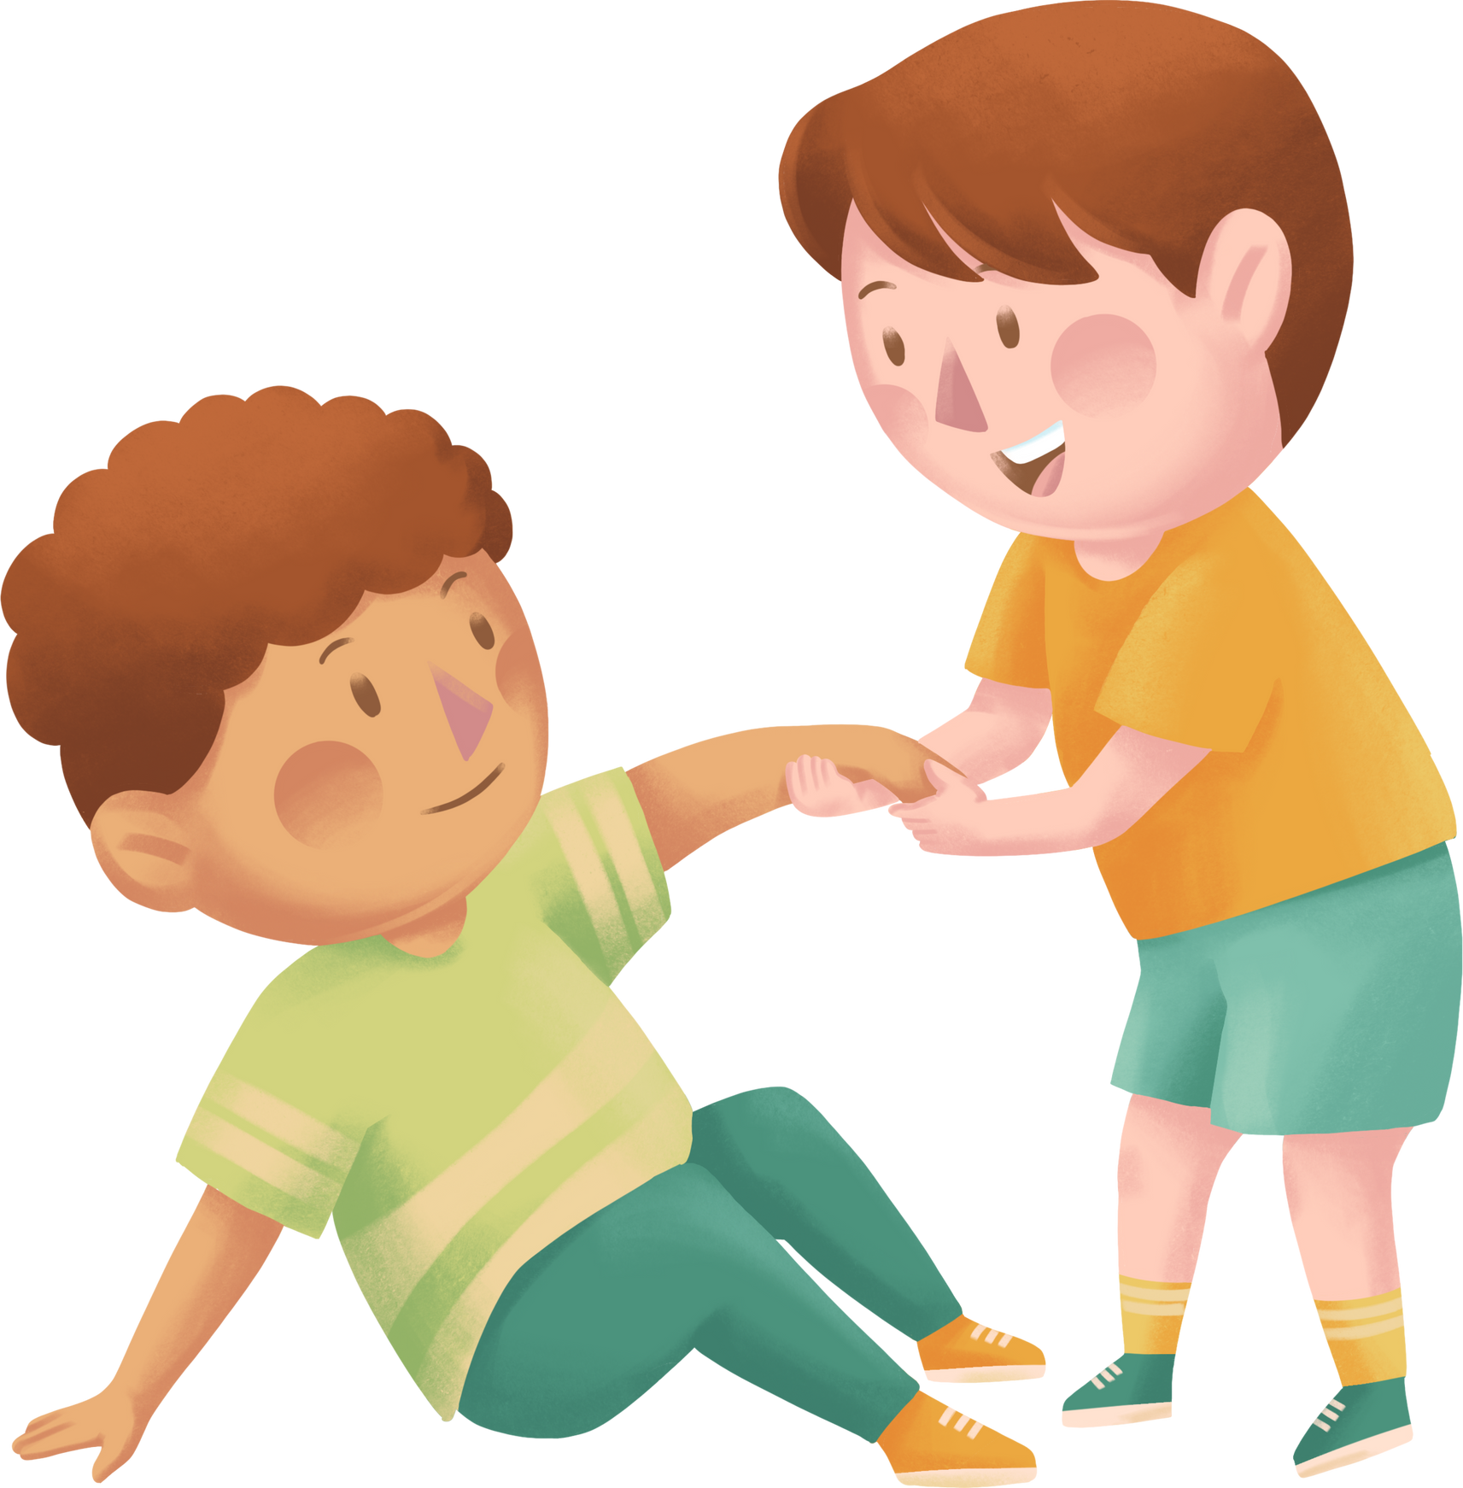
WHAT IS THE WORD?
F
H
E
U
L
P
L
c

Slide 23
helpful
c

Slide 24

Good job!!

Slide 25
02
Listen and number.

Slide 26







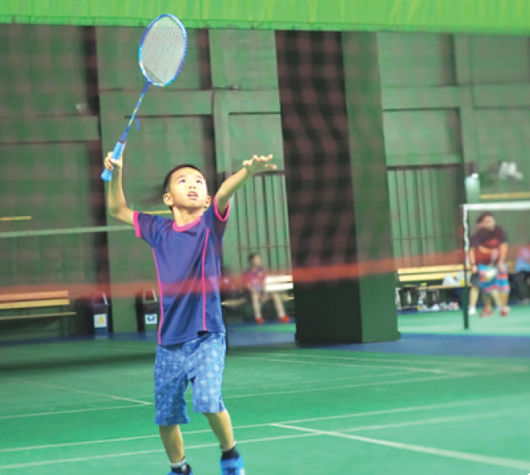


ASK AND ANSWER.

Slide 27








LISTEN AND NUMBER.
1

Slide 28

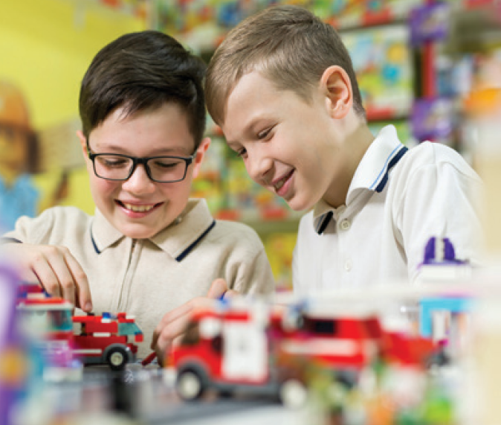
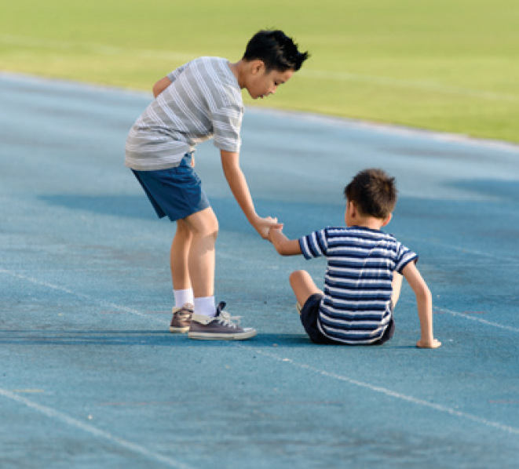

LISTEN AND NUMBER.
1

Slide 29






SWAP YOUR BOOKS

Slide 30
LISTEN AND CHECK.
2
1
4
3

Slide 31
03
Read and complete.

Slide 32
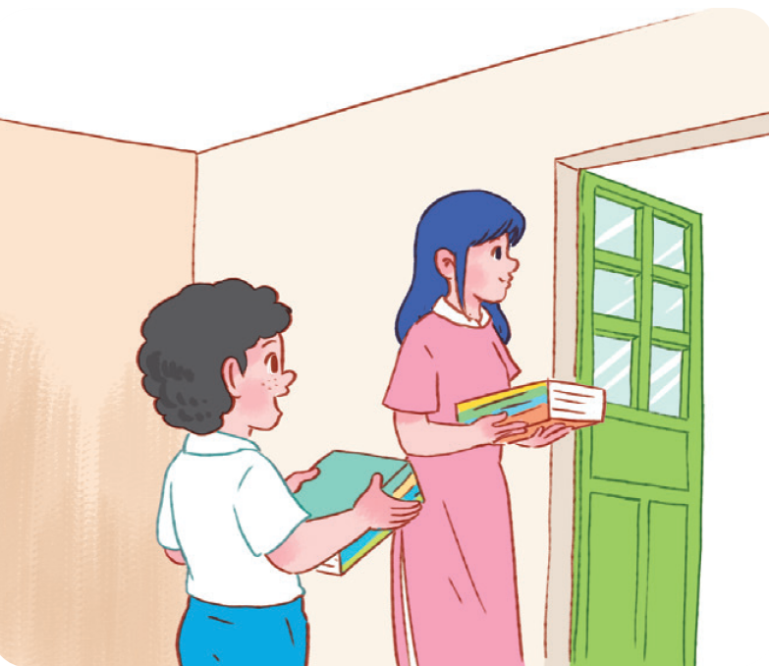

READ AND GUESS.
1. A: I have a new friend at school.
He’s Malaysian.
B: Really? I also have a friend from _____________. Is he from Kuala Lumpur?
A: Yes, he is.
B: What’s he like?
A: He’s _________. He likes helping others.
Malaysia
helpful

Slide 33




READ AND GUESS.
2. A: Do you have a new English teacher?
B: Yes, I do.
A: What nationality is she?
B: She’s ____________.
A: What’s she _____?
B: She’s friendly.

Slide 34
SWAP YOUR BOOKS

Slide 35
LET’S CHECK.
2. A: Do you have a new English teacher?
B: Yes, I do.
A: What nationality is she?
B: She’s ____________ .
A: What’s she _____?
B: She’s friendly.
American
like

Slide 36


True or False

Slide 37


The new friend is from America.
False
True

Slide 38
False
The new friend is from Malaysia.

Slide 39


The new friend is helpful. He likes helping others.
False
True

Slide 40
True
The new friend is helpful.
He likes helping others.

Slide 41


The new English teacher
is from America.
False
True

Slide 42
True
The new English teacher is from America. She’s American.

Slide 43

The new English teacher
is not friendly.
False
True

Slide 44
False
The new English teacher is friendly.

Slide 45

Great Job!

Slide 46
04
Let’s play.

Slide 47




WORK IN GROUPS
Group 1
Group 6
Group 2
Group 7
Group 3
Group 8
Group 4
Group 9
Group 5
Group 10

Slide 48

LOOK AND WRITE.
friendly

Slide 49
LOOK and WRITE.
active

Slide 50
LOOK and WRITE.
helpful

Slide 51
LOOK and WRITE.
clever

Slide 52



Slide 53
05
Fun corner
and Wrap-up

Slide 54

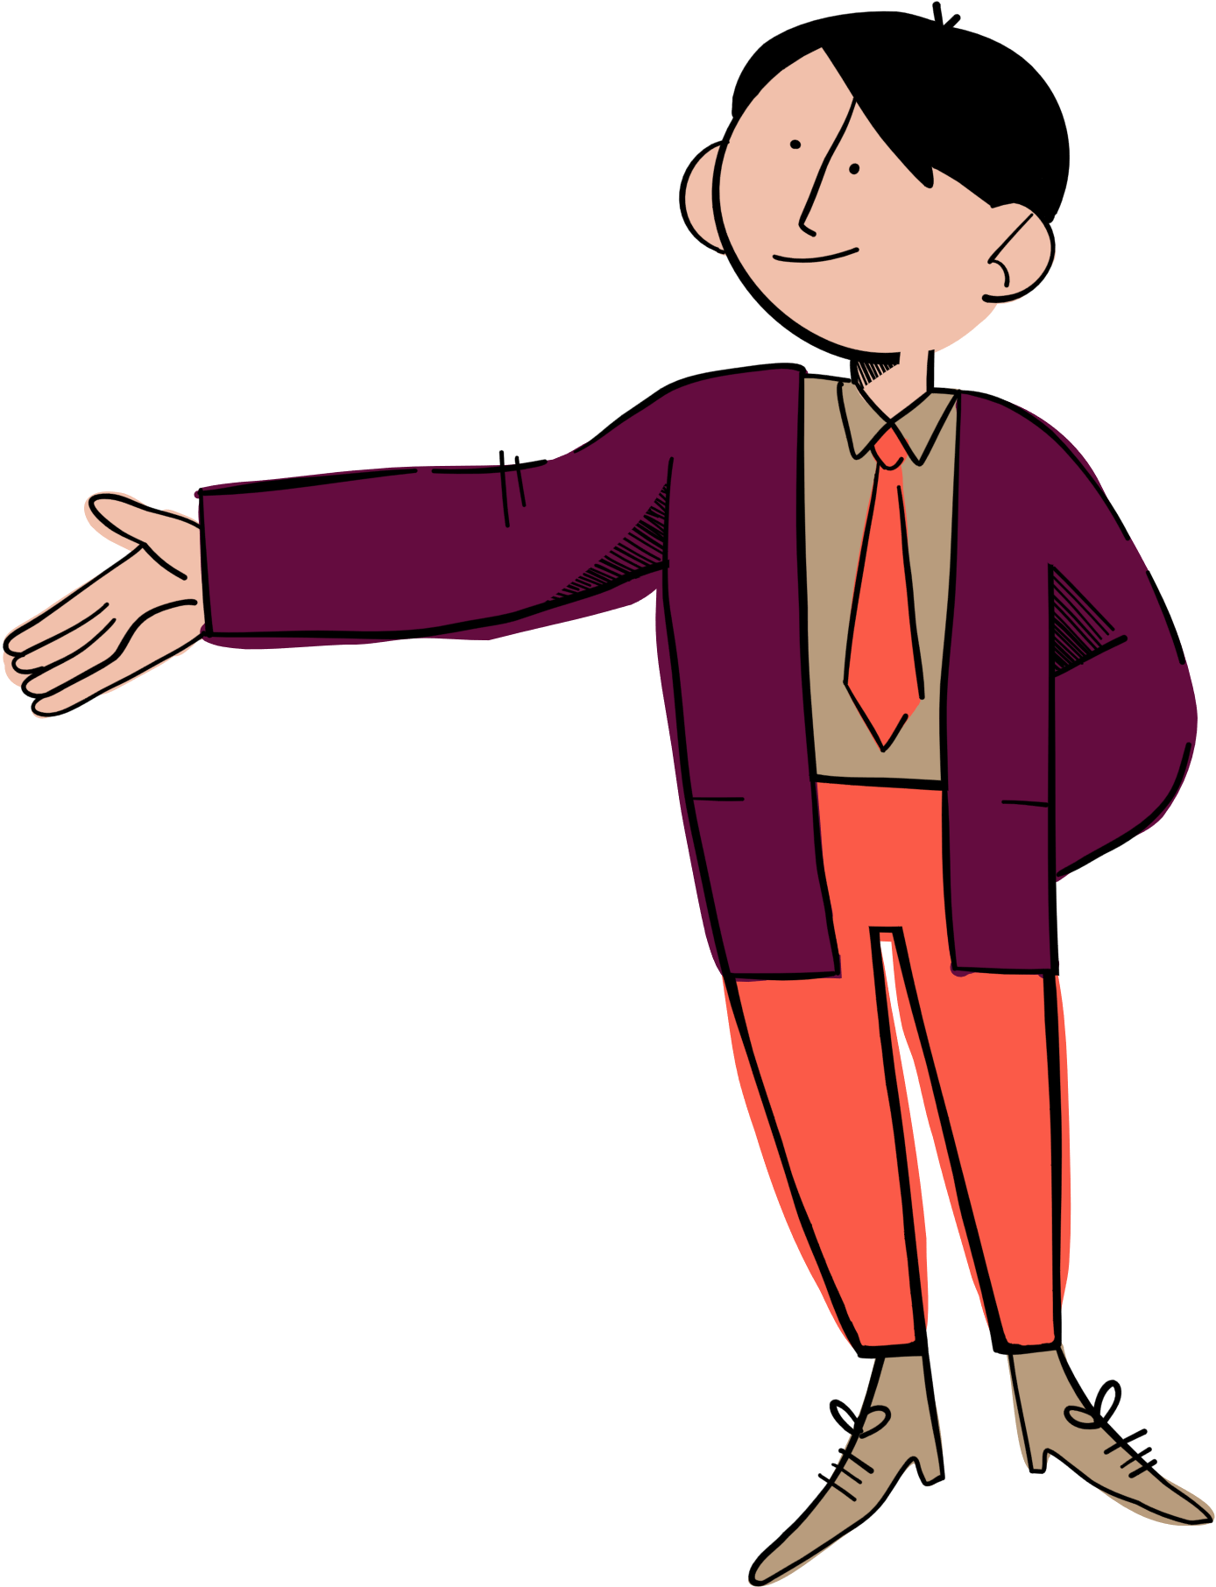


Let’s
spin the wheel!
big
friendly
clever
slim
tall
active
helpful
short

Slide 55

big
friendly
clever
slim
tall
active
helpful
short

Slide 57
Website: hoclieu.vn
Fanpage: https://www.facebook.com/tienganhglobalsuccess.vn/

