Slide 2
My foreign friends
Unit 3
Lesson 1 – Period 2

Slide 3
Table of contents
01
Warm-up and Review
02
Listen and tick.
03
Read and circle.
05
Fun corner and wrap-up
04
Let’s sing.

Slide 4
01
Warm-up and Review

Slide 5
Match the flags to the countries and tell the nationalities.
Australia
Singapore
Thailand
Malaysia
Viet Nam
Britain
Japan
America

Slide 6
Match the flags to the countries and tell the nationalities.
Britain
Australia
Viet Nam
Malaysia
Australia
Singapore
Thailand
Malaysia
Viet Nam
Britain
Japan
America
Thailand
Singapore
America
Japan

Slide 7
What about you?
WHERE ARE YOU FROM?

Slide 9
Let's play.
LUCKY STARS
GAME

Slide 10
1
2
3
4
5
6
7
8
FINISH
Notes:
Click the middle of the number to move to the Question slide.
Click the white circle to disappear the whole number card.
Click FINISH to end the game.

Slide 11
Look and Say.
He’s from Australia. He’s Australian.
Notes:
Click to show the answer sentences.
Click the sentences to show the lucky scores.
Click the yellow star to back to the Number Slide.

Slide 12
Look and Say.
He’s from America. He’s American.

Slide 13
Look and Say.
He’s from Britain. He’s British.

Slide 14
Look and Say.
She’s from Japan. She’s Japanese.

Slide 15
Look and Say.
He’s from Viet Nam. She’s Vietnamese.

Slide 16
Look and Say.
They’re from Thailand. They’re Thai.

Slide 17
Look and Say.
They’re from Singapore. They’re Singaporean.

Slide 18
Look and Say.
They’re from Malaysia. They’re Malaysian.

Slide 19
THANKS
FOR PLAYING!
See you next time!

Slide 20
02
Listen and tick.

Slide 21
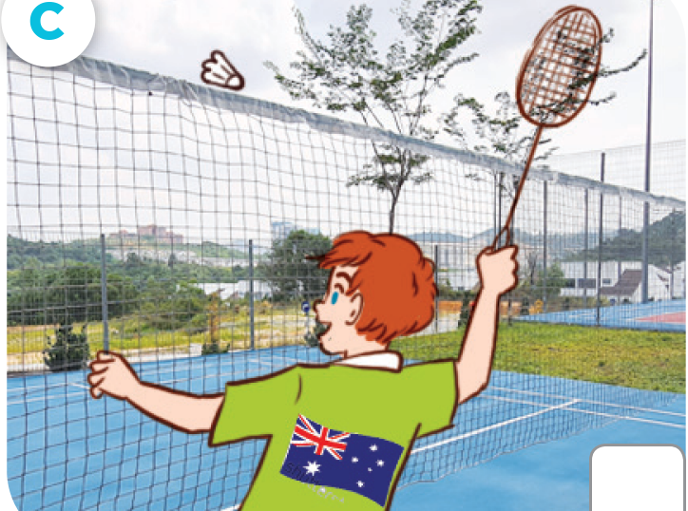
LOOK AND ANSWER.
Japanese
American
Australian

Slide 22
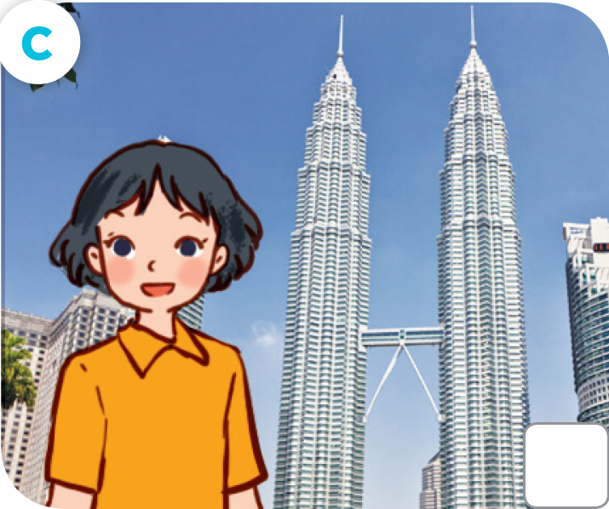
LOOK AND ANSWER.
British
Australian
Malaysian

Slide 23
LISTEN AND TICK.

Slide 24
CHECK YOUR ANSWERS.

Slide 25
Let's play!
sit down

Slide 27
03
Read and circle.

Slide 28
READ AND CIRCLE.
1. This is Sally. She’s from Britain / America.

Slide 29
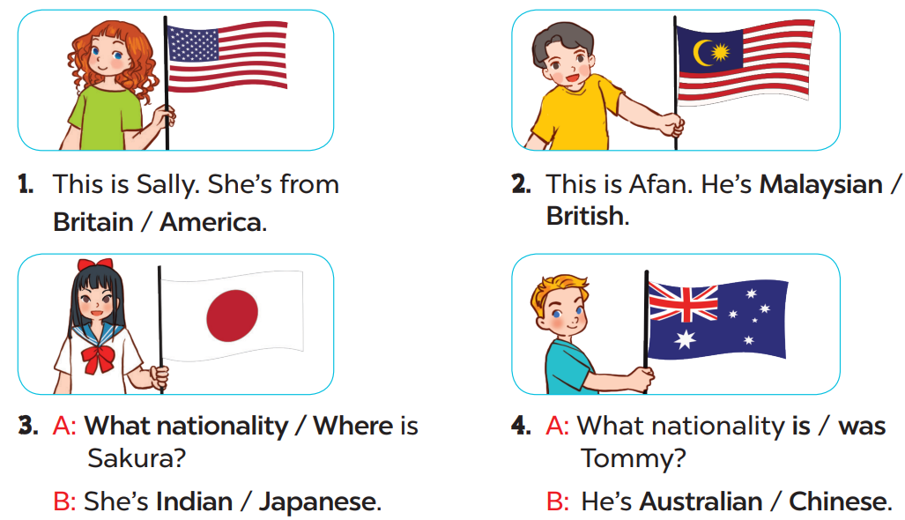
READ AND CIRCLE.
Page
23

Slide 30
SWAP YOUR BOOKS.

Slide 31
LET’S CHECK YOUR ANSWERS.
2. This is Afen. He’s Malaysian / British.

Slide 32
LET’S CHECK YOUR ANSWERS.
3. A: What nationality / Where is Sakura?
B: She’s Indian / Japanese.

Slide 33
LET’S CHECK YOUR ANSWERS.
4. A: What nationality is / was Tommy?
B: He’s Australian / Chinese.

Slide 34
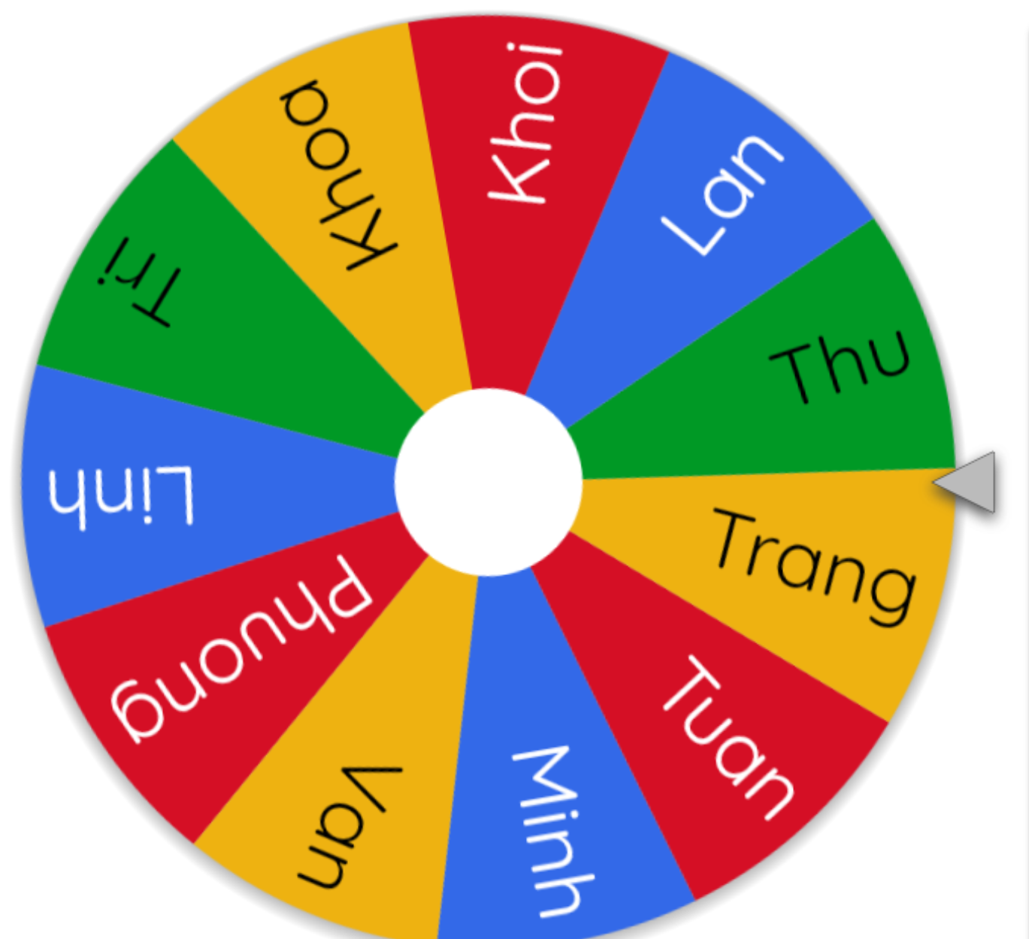
LET’S SPIN!
Notes:
Use this link to choose pupils in random: https://wheelofnames.com/

Slide 36
04
Let’s sing.

Slide 37
LOOK AND SAY.
My friends

Slide 38
LISTEN AND POINT.
My friends
Notes:
Link video hoạt hình: https://hoclieu.vn/hop-phan-bo-tro/video-hoat-hinh/203?gidzl=zOIHFJEOs53ncvauCu7VN_2QdJKkXTuBw9gNP7hKXGZloSLdBjo43hl9nJLorOnSiydFDZFmBN1VDvdPKm

Slide 39
LISTEN and REPEAT.
My friends
She’s British.
She’s from Britain.
It’s a land of lakes and parks.
You can see the River Thames there.

Slide 40
LISTEN AND REPEAT.
My friends
He’s Australian.
He’s from Australia.
It’s a land of sun and fun.
You can see kangaroos there.

Slide 41
SING AND CLAP.
My friends
She’s British.
She’s from Britain.
It’s a land of lakes and parks.
You can see the River Thames there.

Slide 42
LISTEN AND REPEAT.
My friends
He’s Australian.
He’s from Australia.
It’s a land of sun and fun.
You can see kangaroos there.

Slide 43
LISTEN, SING AND CLAP.
My friends

Slide 44
Let’s SING in the front.

Slide 46
05
Fun corner
and wrap-up

Slide 47
Yes or No Game
Let’s play!

Slide 48
The
Rules
Answer the questions within limit time.
If the answer is correct, the player will get 1 point.
If the answer is wrong, the player will lose 1 point.
Have fun!

Slide 49
Question
Is he Japanese?
You have 15 seconds.

Slide 50
Answer
Yes

Slide 51
Question
Is she American?
You have 15 seconds.

Slide 52
Answer
No
She’s Thai.
She’s from Thailand.

Slide 53
Question
Are they Australian?
You have 15 seconds.

Slide 54
Answer
Yes

Slide 55
Question
Is she Malaysian?
You have 15 seconds.

Slide 56
Answer
No
She’s Singaporean.
She’s from Singapore.

Slide 57
Question
Is he British?
You have 15 seconds.

Slide 58
Answer
No
He’s Vietnamese.
He’s from Viet Nam.

Slide 60
Website: hoclieu.vn
Fanpage: https://www.facebook.com/tienganhglobalsuccess.vn/

