Slide 4
Britain

Slide 6
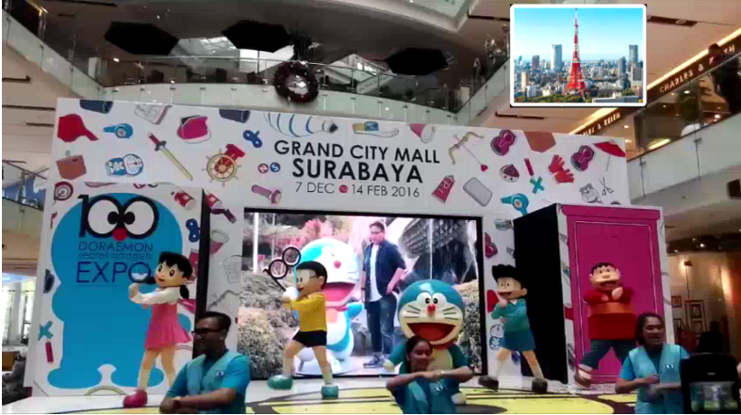
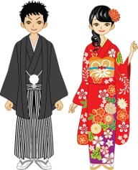
Japan

Slide 8
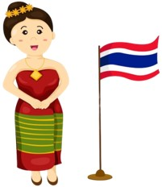
Thailand

Slide 10
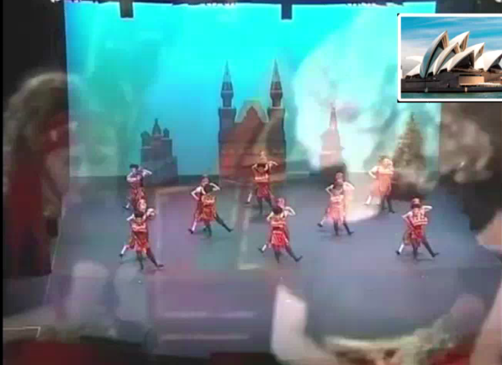
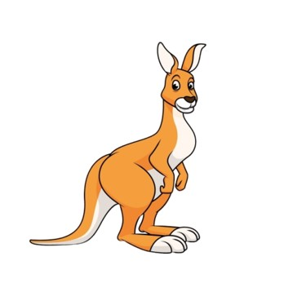
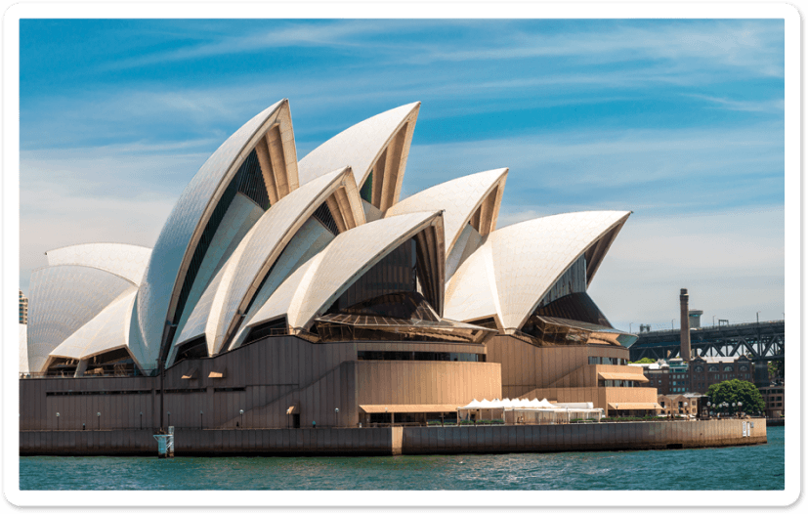
Australia

Slide 12
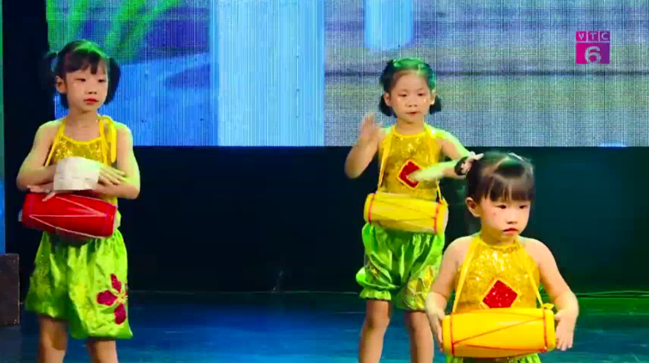
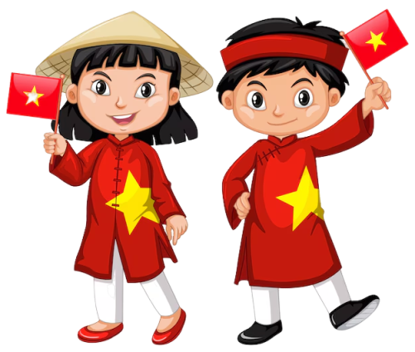
Viet Nam

Slide 13
Our summer holidays
10
Lesson 2 (1, 2, 3)

Slide 14
3 PARTS
Look, listen and repeat.
01
Listen, point and say.
02
03
Let’s talk.

Slide 15
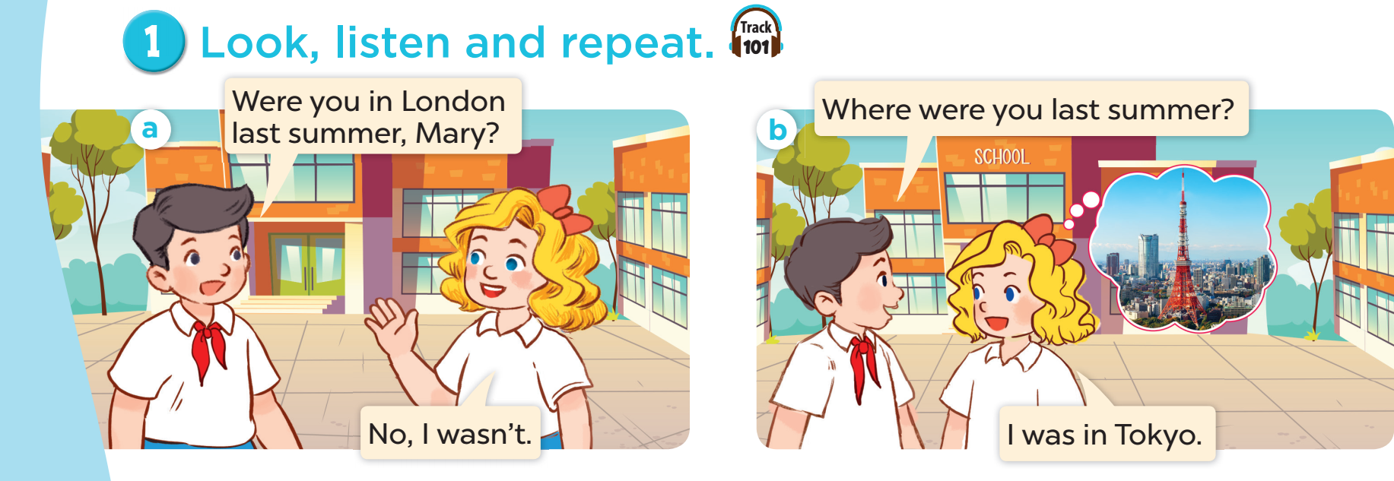

Slide 16
Quiz Time
B
A
or

Slide 17
It’s a city in Thailand.
Bangkok
Sydney
A
B
A

Slide 18
The “Shell” Opera House is here.
Sydney
London
A
B

Slide 19
It’s in England.
Bangkok
London
A
B

Slide 20
This city is in Japan.
London
Tokyo
A
B
finish

Slide 21
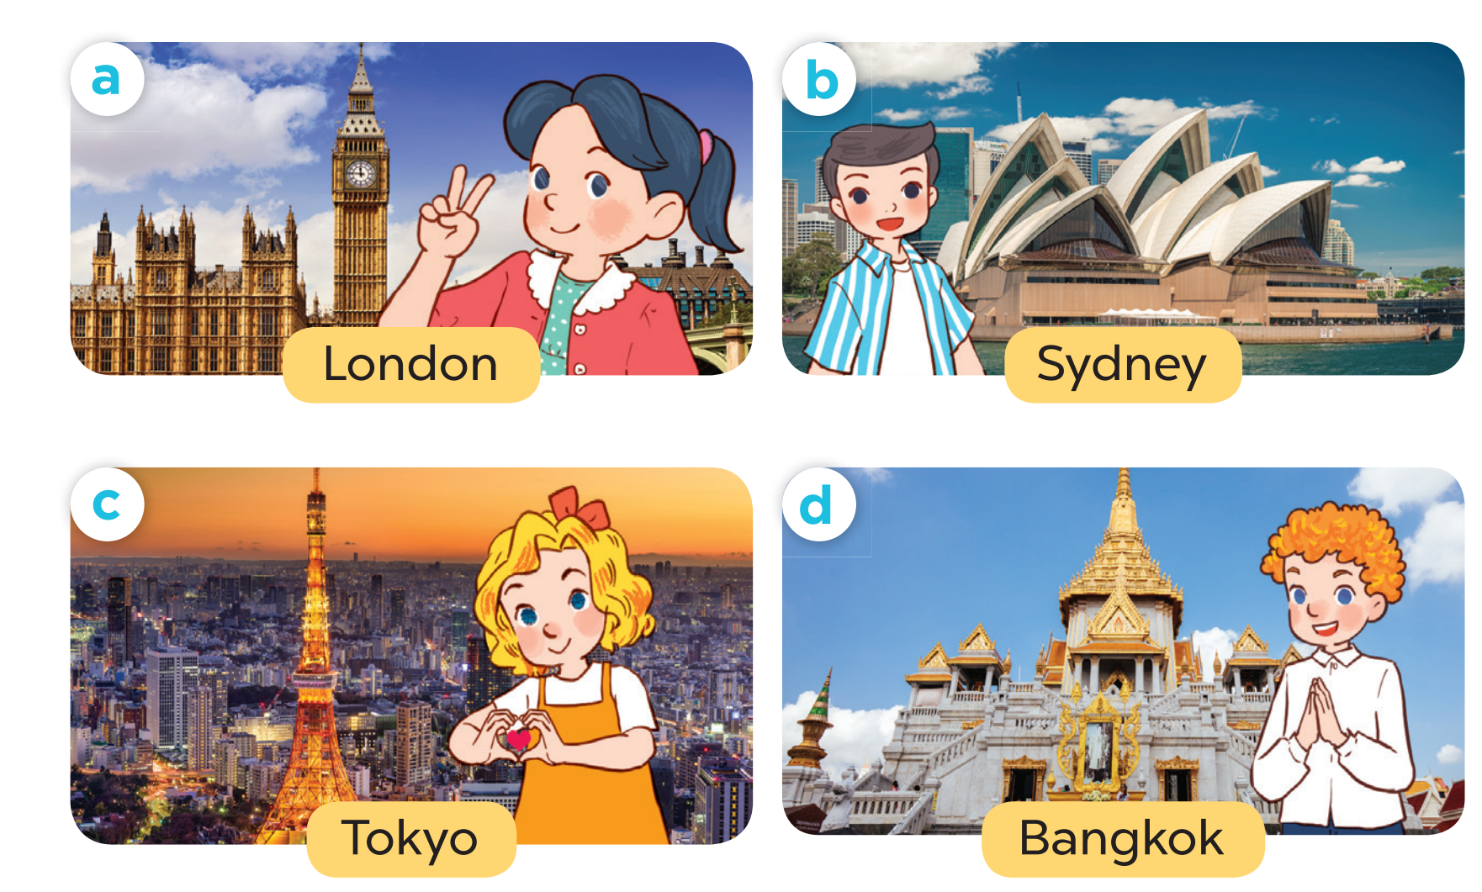

Slide 23
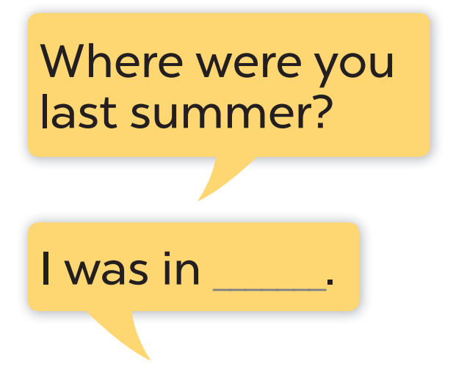

Slide 24
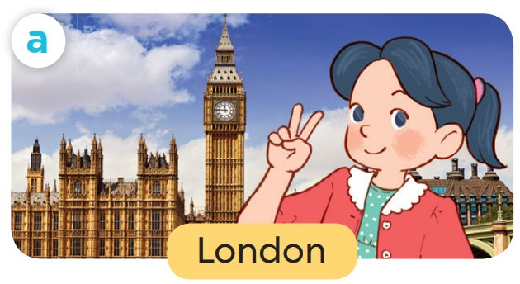

Slide 25
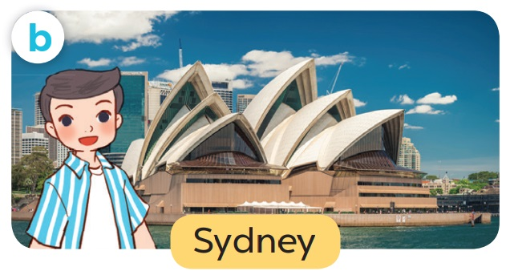

Slide 26
2
4
3
1
LUCKY STAR
Exit

Slide 27
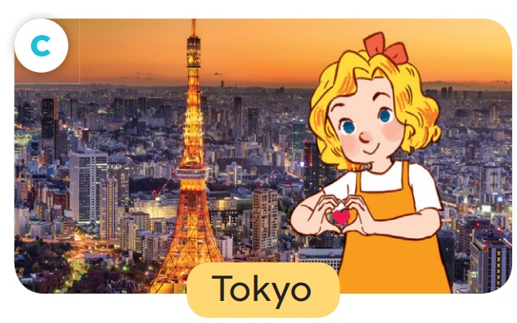
You are given 3 smileys.
GO HOME

Slide 28
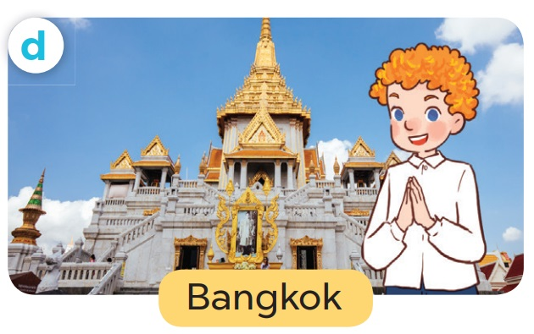
You are given 1 smiley.
GO HOME

Slide 29
You are given 2 smileys
GO HOME

Slide 30
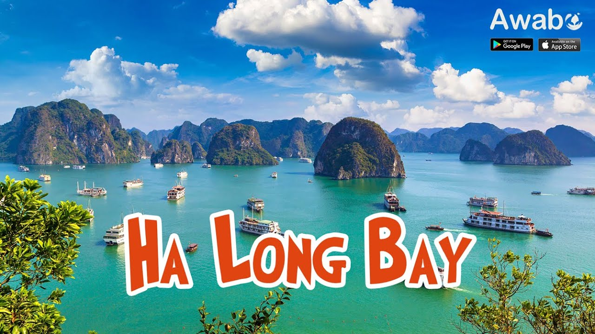
You are given 1 smileys
GO HOME

Slide 32
Name | Where were you last summer?
Mai | Phu Quoc

Slide 33
TALK SHOW
Talk about where you and your friends were last summer.

Slide 34
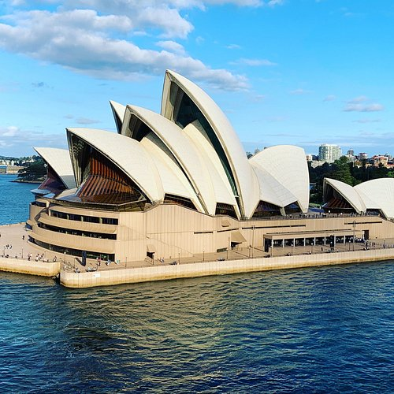

Slide 35
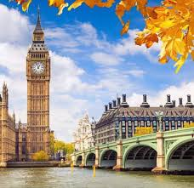

Slide 36
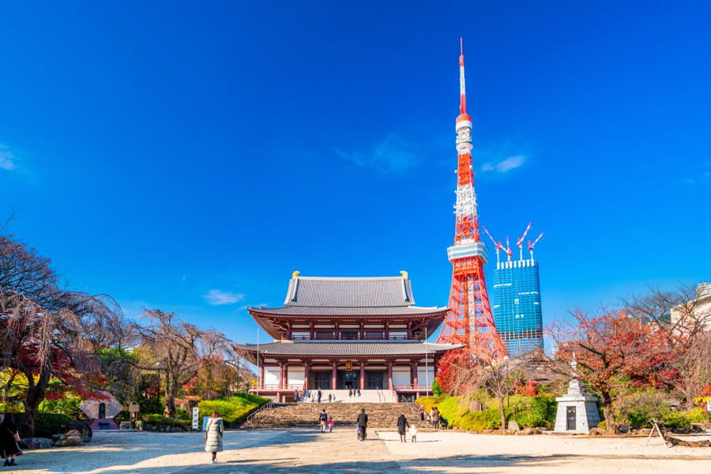

Slide 37
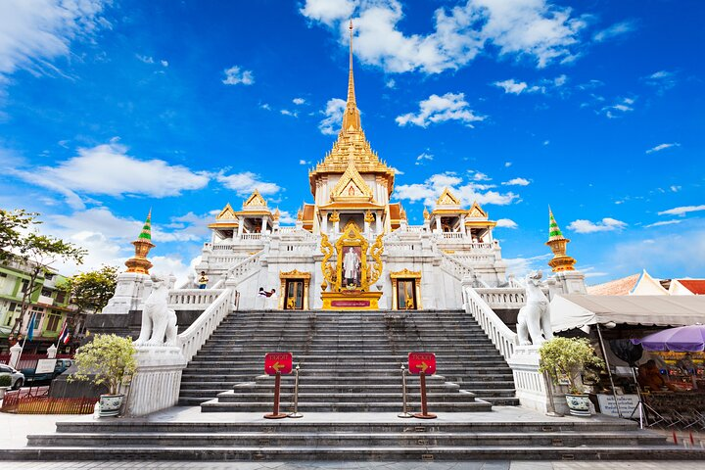

Slide 39
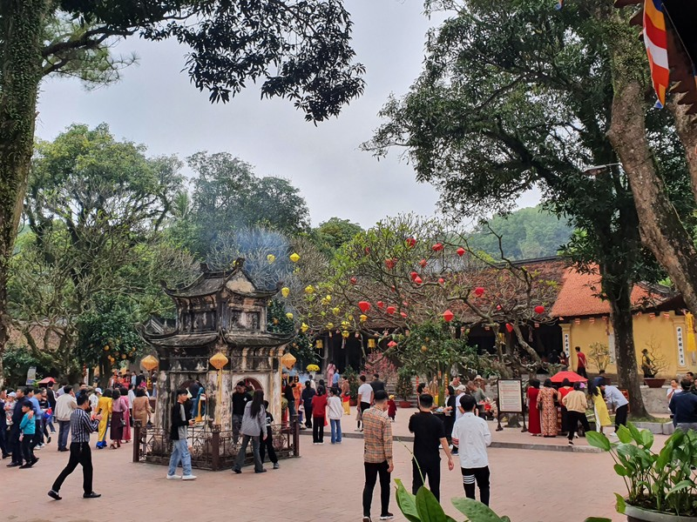
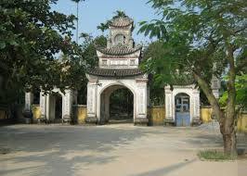
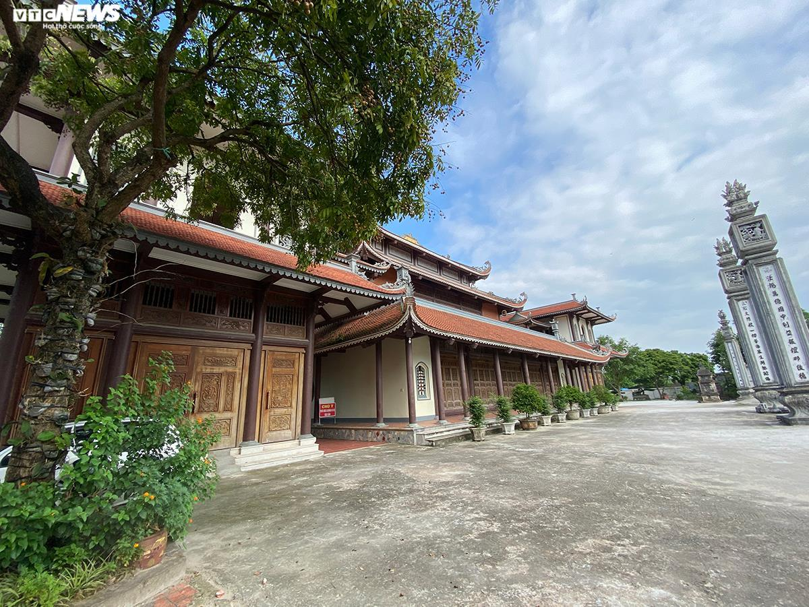
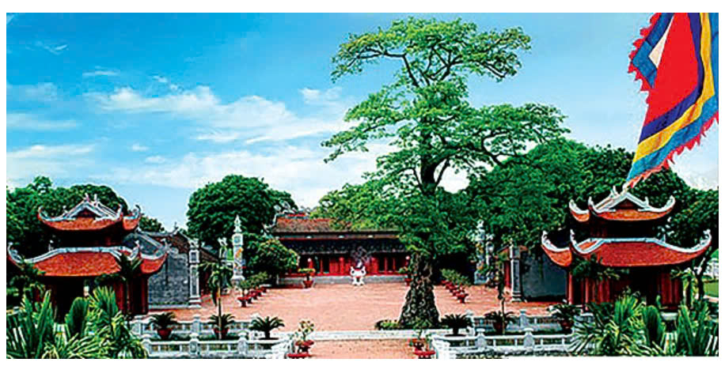
Con Son Pagoda
Canh Linh Pagoda
Hai Duong Province
Muong Pagoda
Mao Dien Temple of Literature

Slide 40
Website: hoclieu.vn
Fanpage: facebook.com/www.tienganhglobalsuccess.vn

