Slide 1
Unit 3: Our friends
Lesson 1: Part 4,5,6
Class 3G
Teacher: Pham Ngoc Kien

Slide 2
CONTENTS
* Warm-up and review
4. Listen and tick.
5. Look, complete and read.
6. Let’s sing.

Slide 3
Warm-up and review
Notes:
The Telephone Game
- Divide the class into 2 groups: Boys and Girls
- Play Rock, Paper, Scissors to determine which group goes first.
- Spread out the cards randomly. One group asks the questions and the other groupanswers. Teacher sets time to start.
- In turn, pupils in each group read out what their cards say to match questions with the answers.
- Then, they have to decide whether the question and answer match. If so, they get 1 point. If not, they will turn the cards face down.
- The winner is the group which correctly matched all the sentences in the shortest time.

Slide 5
Game: Pass the ball
Boys
Girls
* Luật chơi:
- Khi nghe tiếng nhạc các em phải chuyền bóng sang cho bạn nhanh chóng. Khi nhạc dừng bạn nào đang có bóng phải đặt được một câu giới thiệu “This/That is + tên bạn.” trong lớp học. Nếu đặt được câu đội đó sẽ nhận được 1 mặt cười (smiley) cho đội mình.
- Đội chiến thắng sẽ là đội có nhiều mặt cười hơn.

Slide 7
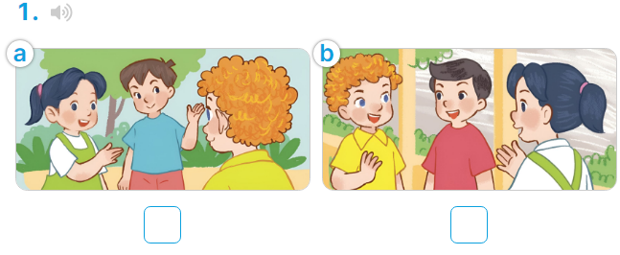
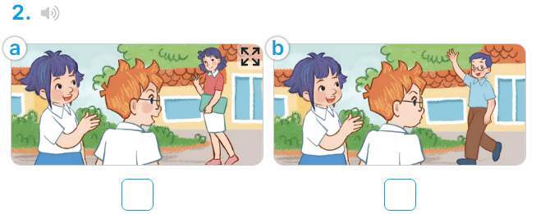
Wednesday, October 9th 2024
UNIT 3: OUR FRIENDS
Lesson 1: Part 4,5,6 (Page 23)

Slide 8
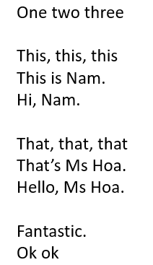
Let’s chant with me.

Slide 10
game
Chase of catching words
Just 3 seconds for you to raise your hands for reading.

Slide 11
game
Time’s up!
chase of catching words
Read
this
dialogue.

Slide 12
game
Time’s up!
chase of catching words
Read
this
dialogue.

Slide 13
game
Time’s up!
chase of catching words
Read
this
dialogue.

Slide 14
game
Time’s up!
chase of catching words
Read
this
dialogue.

Slide 16
Wednesday, October 9th 2024
UNIT 3: OUR FRIENDS
Lesson 1: Part 4,5,6 (Page 23)
4. Listen and tick.
5. Look, complete and read.
6. Let’s sing.

Slide 19
REMEMBER
* Mẫu giới thiệu nhân vật ở gần (This is) và ở xa (That is):
This is + name.
That’s + name.
* Một số nhân vật trong bài học.
Ben Mary Nam
Mai Linh Mr Long
Lucy Minh Ms Hoa

Slide 20
Thanks for your attendance!

