Slide 1
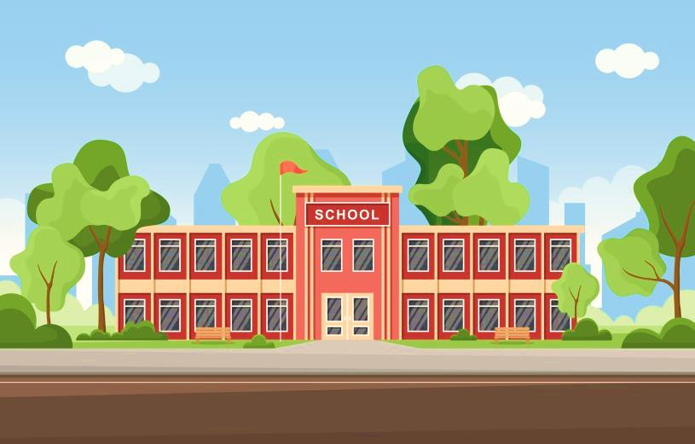
Unit
6
Our school facilities
Lesson 1 (1+2+3)

Slide 2
Contents
Look, listen and repeat.
Listen, point and say.
Let’s talk.

Slide 3
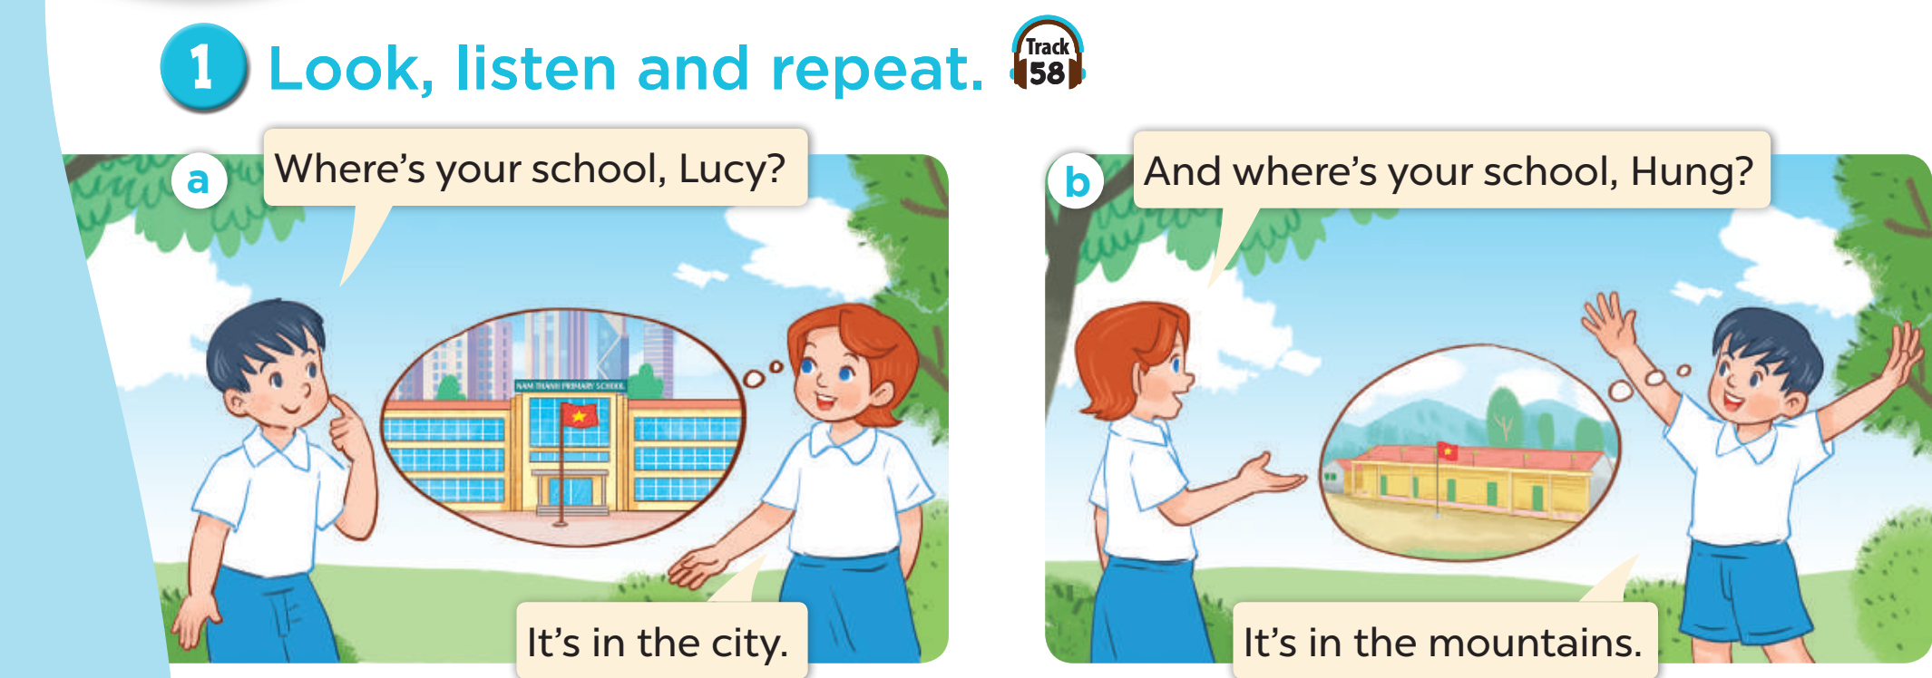

Slide 4
Where’s your school, Lucy?
And where’s your school, Hung?
It’s in the city.
It’s in the mountains.

Slide 5
mountains
/ˈmaʊntənz/

Slide 6
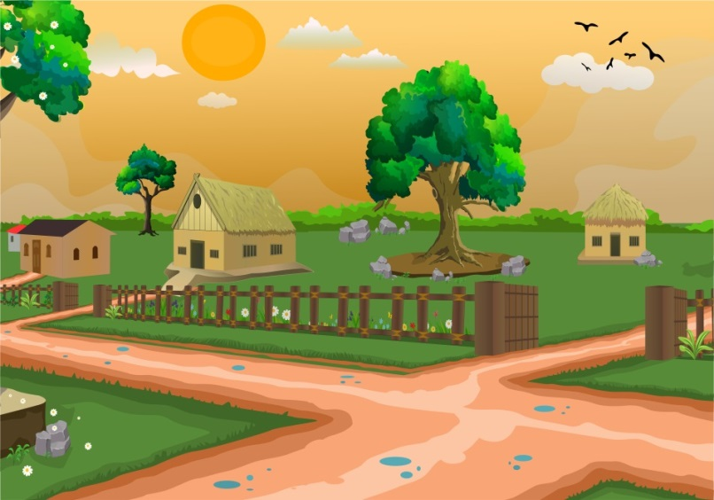
village
/ˈvɪlɪdʒ/

Slide 7
city
/ˈsɪti/

Slide 8
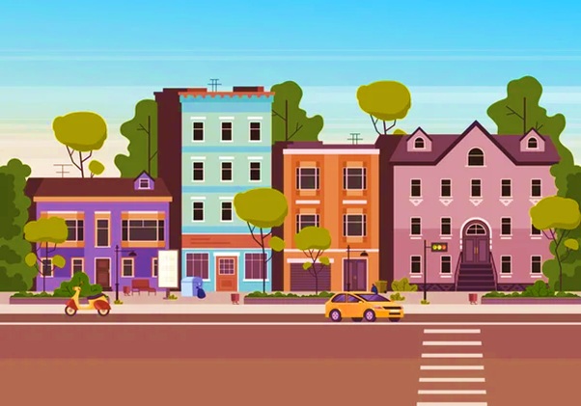
town
/taʊn/

Slide 9
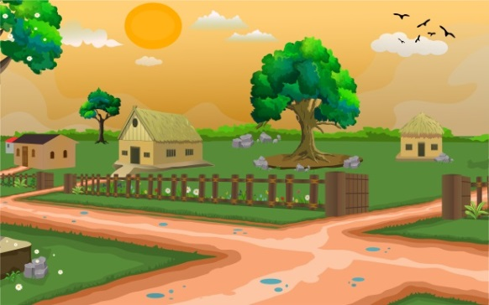
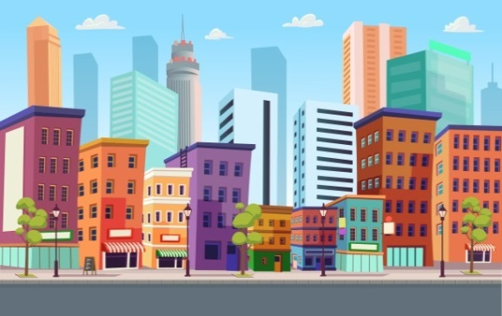
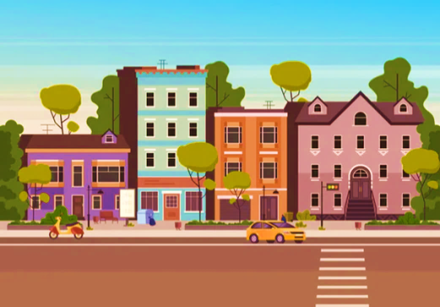
mountains
village
city
town

Slide 10
Checking vocabulary
Guessing game

Slide 11
mountains

Slide 12
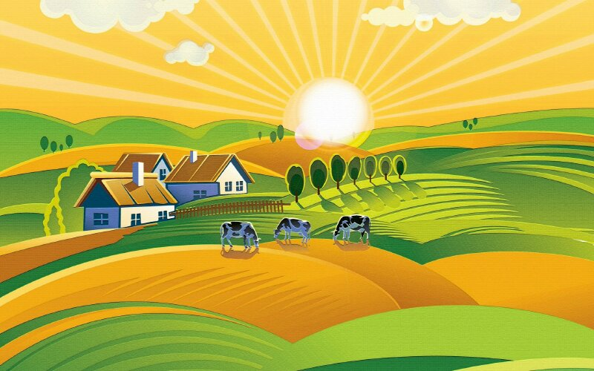
village

Slide 13
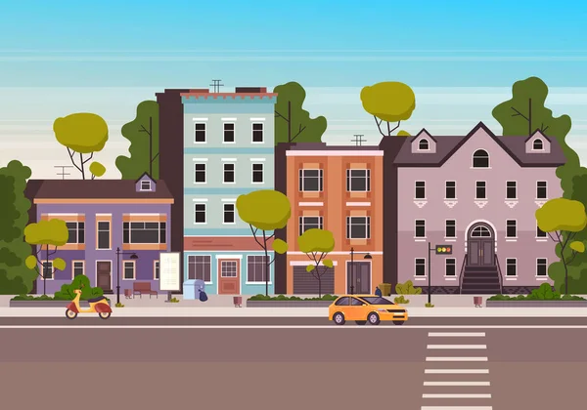
town

Slide 14
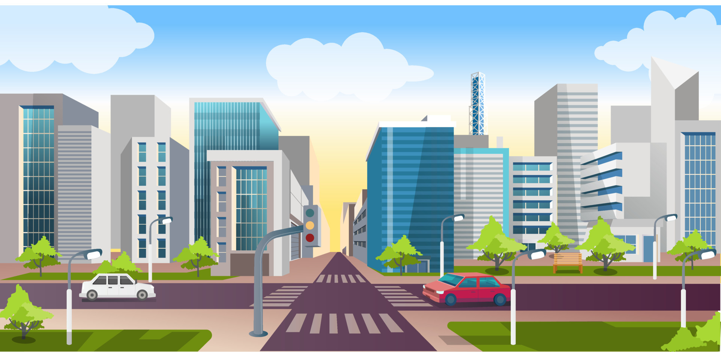
city

Slide 15
Structures

Slide 16
Where’s your school, Lucy?
It’s in the city.

Slide 18
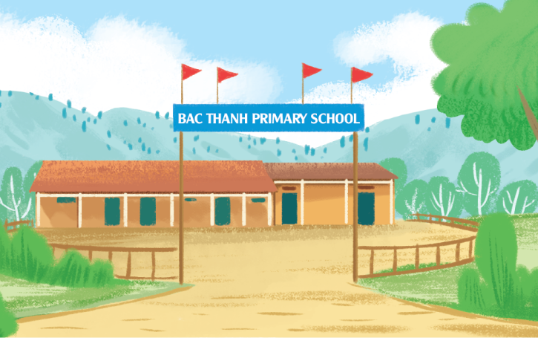
mountains
Where’s your school?
It’s in the mountains.

Slide 19
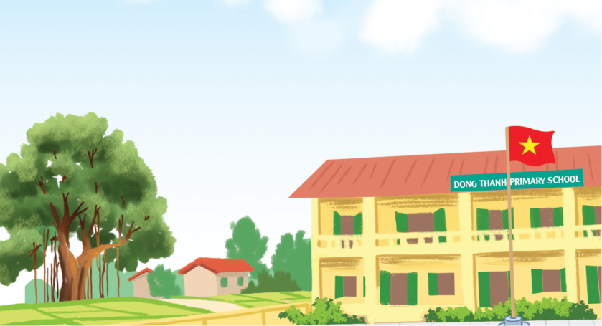
village
Where’s your school?
It’s in the village.

Slide 20
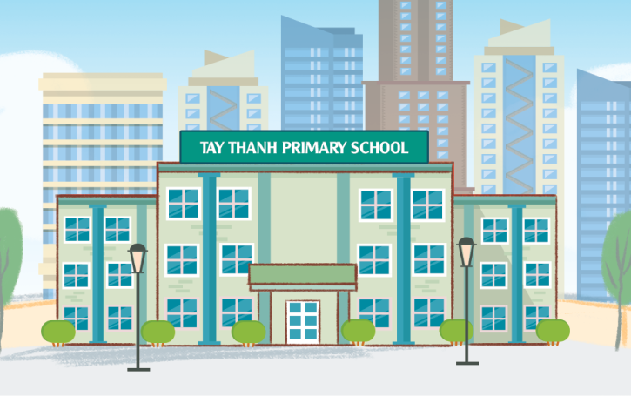
city
Where’s your school?
It’s in the city.

Slide 21
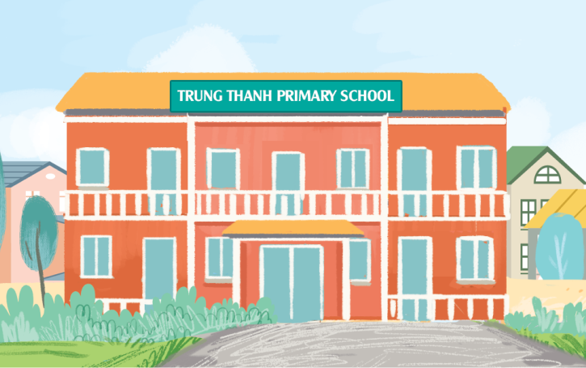
town
Where’s your school?
It’s in the town.

Slide 22
Where’s your school?
It’s in the ______.
it’s = it is
town
mountains
village
city

Slide 24
