Slide 2


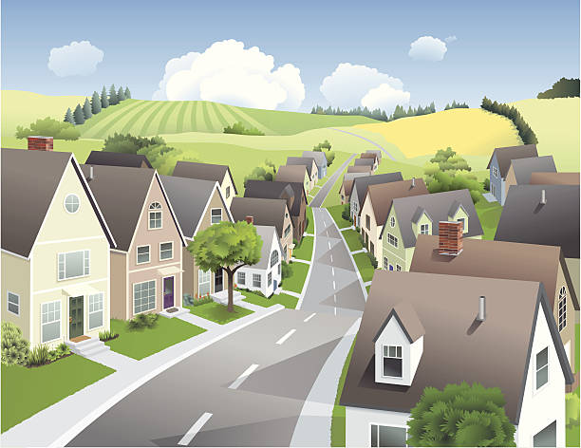
Unit
1
LOCAL COMMUNITY
LESSON 7: LOOKING BACK & PROJECT
1

Slide 3
LESSON 7: LOOKING BACK & PROJECT
LESSON 1: GETTING STARTED
WARM-UP
Brainstorming
Task 1: Write a word or phrase for each description below.
Task 2: Circle the correct word or phrase to complete each sentence.
VOCABULARY
Task 3: Choose the correct answer A, B, C, or D.
Task 4: Rewrite each sentence so that it contains the phrasal verb in brackets. You may have to change the form of the verb.
GRAMMAR
PROJECT
What to change in our community
CONCOLIDATION
Wrap-up
Homework

Slide 4

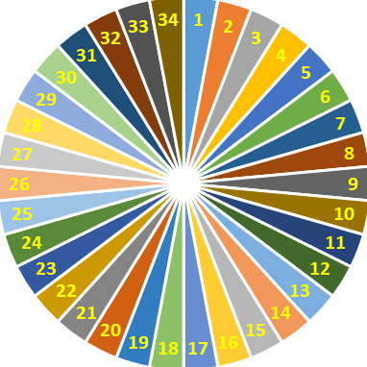
Check out the old lesson by spinning the wheel to call out the name
SPIN

Slide 5
VOCABULARY
1
Write a word or phrase for each description below.
1. This person delivers goods to your house.
2. This person stops fires from burning.
3. People visit this place for pleasure usually while they are on holiday.
4. People make these objects out of clay.
5. This person makes things with his / her hands.
→ delivery person
→ firefighter
→ tourist attraction
→ pottery
→ artisan

Slide 6
VOCABULARY
2
Circle the correct word or phrase to complete each sentence.
1. The villagers (preserve / shorten) their traditional weaving techniques.
2. Com Lang Vong has a special (fragrance / function), so it is very popular.
3. Our (firefighters / police officers) help keep law and order in our community.
4. Bun cha is the (speciality / fast food) I like best.
5. My home town is famous for (handicrafts / objects), such as paper fans and lanterns.

Slide 7
GRAMMAR
3
Choose the correct answer A, B, C, or D.
1. You should decide ______ to move to the new house. A. while B. when C. where D. who 2. Do you know ______ to sort rubbish? A. who B. which C. how D. what 3. She didn’t tell me ______ to meet, in the library or in the lab. A. how B. when C. what D. where 4. Could you tell me ______ to do in this situation? A. what B. when C. where D. who 5. I wonder ______ to ask for advice, my teacher or my parents. A. where B. when C. who D. what

Slide 8
GRAMMAR
4
Rewrite each sentence so that it contains the phrasal verb in brackets. You may have to change the form of the verb.
1. In some villages, people reduce the number of steps to make the
handicraft. (cut down on)
2. My grandparents gave the skills to my parents. (hand down)
In some villages, people cut down on the number of steps to make the handicraft.
My grandparents handed down the skills to my parents.

Slide 9
GRAMMAR
4
Rewrite each sentence so that it contains the phrasal verb in brackets. You may have to change the form of the verb.
3. In their community, the eldest child is usually responsible for his or her parents. (take care of)
4. Before we go to a new place, we always get information about it. (find out)
5. They have a good relationship with all neighbours. (get on with)
In their community, the eldest child usually takes care of his or her parents.
Before we go to a new place, we always find out about it.
They get on with all neighbours.

Slide 10
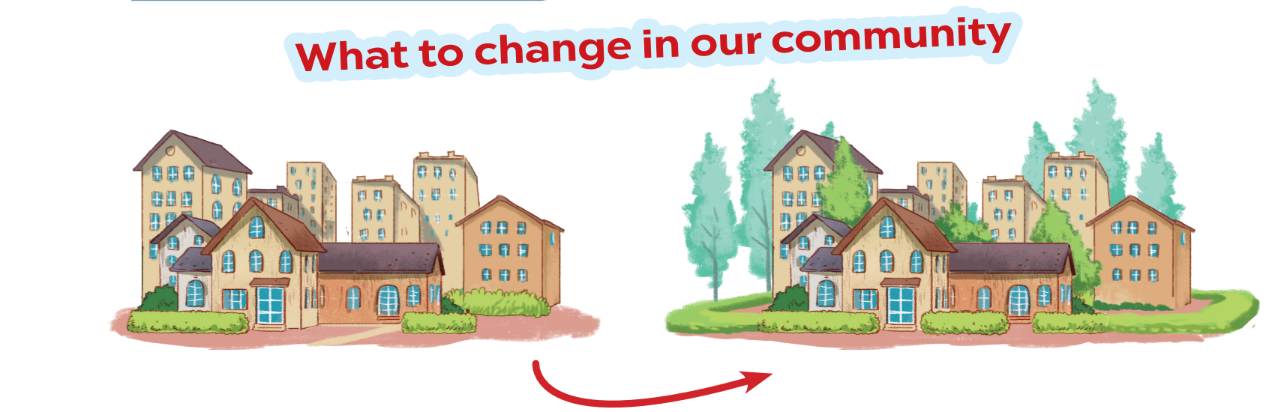
PROJECT

Slide 11
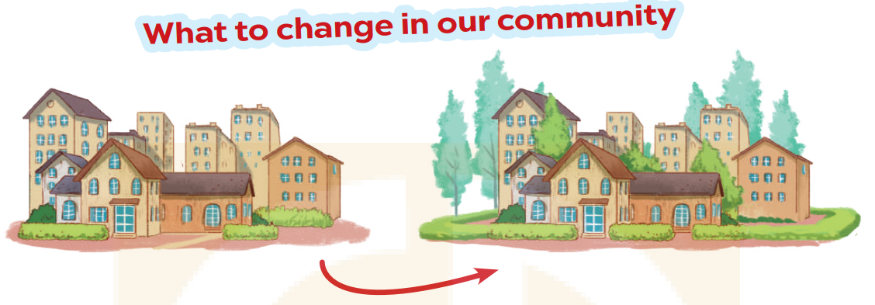
* PROJECT
1. Interview some students from your class or from other classes about the changes they want to make in their community. Use the questions below
1. Where do you live?
2. What is good about your community?
3. What is not good about your community?
4. What changes do you want to make to improve your community?

Slide 12
* PROJECT
1. Interview some students from your class or from other classes about the changes they want to make in their community. Use the questions below
1. Where do you live?
2. What is good about your community?
3. What is not good about your community?
4. What changes do you want to make to improve your community?
→ I live in …..
→ People in my community tend to be ….
→ One drawback/disadvantage is …..
→ I would like to see improvements in …..

Slide 13

* PROJECT
2. Collect the answers.
Use the table below.
Students | Question 1 | Question 2 | Question 3 | Question 4
Huong | small town | Friendly neighbors,… | Lack of public parks , outdoor space | more public spaces, parks, cinemas and entertainment centres.
Thu | ……… | …………. | ……….. | …………..

Slide 14

3. Report your group's findings to your class. Use the following questions to guide your report
1. How many students did you interview?
2. What is good about their community?
3. What is not good about their community?
4. What changes do they want to make?
We interviewed 4 students.
Their community has several good aspects: friendly neighbors, peaceful and very cool
he drawbacks of their community are: lack of public parks and outdoor space, limited public transportation options and limited access to quality healthcare
They want their community to have more green spaces and recreational areas, implementing traffic management measures, better public transportation services and more accessible healthcare options.

Slide 15

* CONSOLIDATION
What have we learnt in this lesson?
Review the vocabulary and grammar of Unit 1.
Apply what they have learnt (vocabulary and grammar) into practice through a project.

Slide 16

CONSOLIDATION
2
Homework
- Do exercises in the Workbook.
- Prepare for the next lesson.

Slide 17
Website: hoclieu.vn
Fanpage: facebook.com/www.tienganhglobalsuccess.vn/

