Slide 2


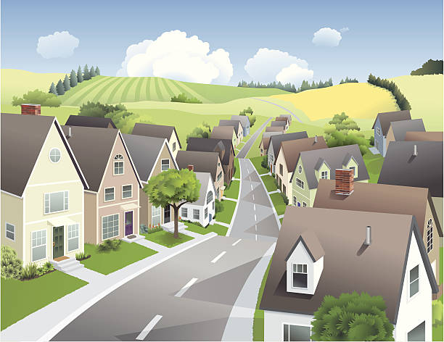
Unit
1
LOCAL COMMUNITY
LESSON 6: SKILLS 2
1

Slide 3
LESSON 6: SKILLS 2
LESSON 1: GETTING STARTED
WARM-UP
Brainstorming
Task 1: Work in pairs. Discuss the questions.
Task 2: Listen and fill in each blank with no more than two words.
Task 3: Listen again and tick T (True) or F (False).
LISTENING
Task 4: Work in pairs. Choose a community helper you like and answer the following questions.
Task 5: Write a paragraph (about 100 words) about your favourite community helper. Use the answers to the questions in 4 to help you.
WRITING
CONSOLIDATION
Wrap-up
Homework

Slide 4
WARM-UP
Who is your favourite community helper?
Why?
BRAINSTORMING

Slide 5
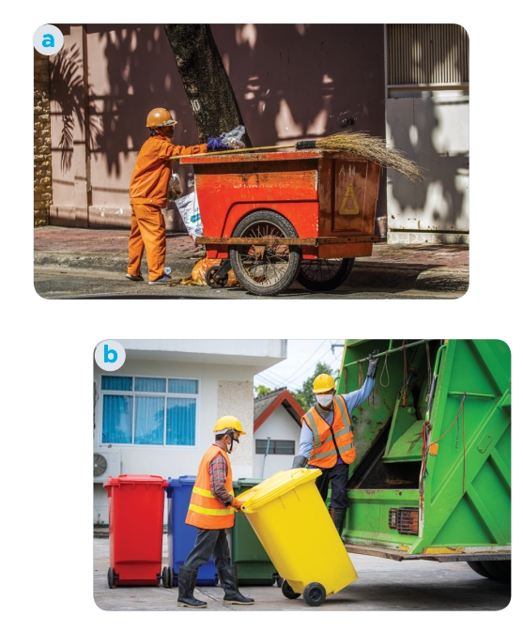
LISTENING
1
Work in pairs. Discuss the questions.
1. Who can you see in the pictures?
2. What are they doing?
We can see garbage collectors.
They are taking the garbage away.

Slide 6

LISTENING
2
Listen and fill in each blank with no more than TWO words.
1. The name of the writing contest is “My Favourite
________________”.
2. Mr Vinh is a _______________.
3. He is tall and ______.
4. He is hard-working, responsible, and ________.
Community Helper
garbage collector
slim
friendly

Slide 7
LISTENING TRANSCRIPT
2
Listen and fill in each blank with no more than TWO words.
This is An Binh commune radio station. In today's special programme, we will share with you a piece of writing which won first prize in our writing contest test called “My favourite community helper”. This was written by Mi, a grade nine student. There are many great community helpers in our neighbourhood. But my favourite one is Mr. Vinh, the garbage collector. Mr. Vinh is a tall and slim man. He usually wears a green uniform with reflective stripes. He is hardworking and responsible. Every day he goes to our neighbourhood at 06:00 p.m with a garbage cart. He instructs everyone to put garbage in the correct bin, recyclable and nonrecyclable, and then goes to the next neighbourhood at about 09:00 p.m. He comes back and empties all the bins carefully. Mr Vinh is also friendly. He usually keeps a smile on his face. He talks with the people in our community cheerfully about his work and the importance of sorting rubbish. We all love him.
1
2
3
4

Slide 8

LISTENING
3
Listen again and tick T (True) or F (False).
 | T | F
1. Mr Vinh wears an orange uniform.
2. He arrives at Mi’s neighbourhoodat 9 p.m. every day.
3. He instructs people to putrubbish in two types of bins.
4. He shares information about his work and the importance of sorting rubbish.

Slide 9
LISTENING TRANSCRIPT
2
Listen and fill in each blank with no more than TWO words.
This is An Binh commune radio station. In today's special programme, we will share with you a piece of writing which won first prize in our writing contest test called “My favourite community helper”. This was written by Mi, a grade nine student. There are many great community helpers in our neighbourhood. But my favourite one is Mr. Vinh, the garbage collector. Mr. Vinh is a tall and slim man. He usually wears a green uniform with reflective stripes. He is hardworking and responsible. Every day he goes to our neighbourhood at 06:00 p.m with a garbage cart. He instructs everyone to put garbage in the correct bin, recyclable and nonrecyclable, and then goes to the next neighbourhood at about 09:00 p.m. He comes back and empties all the bins carefully. Mr Vinh is also friendly. He usually keeps a smile on his face. He talks with the people in our community cheerfully about his work and the importance of sorting rubbish. We all love him.
1
2
3
4

Slide 10
WRITING
4
Work in pairs. Choose a community helper you like and answer the following questions.
- What is his / her job? -
– What does he / she look like?
– What is he / she like?
– What does he / she do for the community?
– How do you feel about him / her?
- He/She is a + name of job
– He/She is + adj of appearance
– He/She + adj of personality
– He/She usually + V and V
– I … her/him

Slide 11
WRITING
5
Write a paragraph (about 100 words) about your favourite community helper. Use the answers to the questions in 4 to help you.
My favourite community helper is ….
- He/She is a + name of job
– He/She is + adj of appearance
– He/She + adj of personality
– He/She usually + V and V
– I … her/him

Slide 12
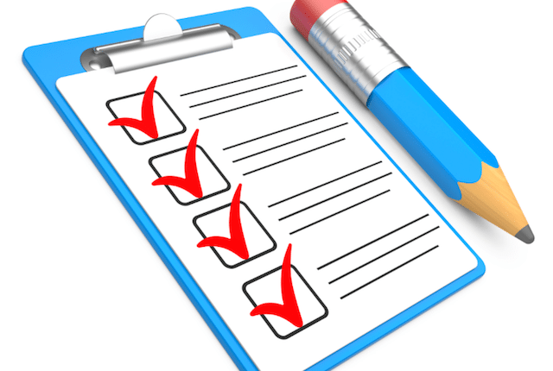
CONSOLIDATION
1
Wrap-up
What have we learnt in this lesson?
Listen for specific information about a community helper.
Write a paragraph about a community helper.

Slide 13

CONSOLIDATION
2
Homework
- Rewrite the paragraph in the notebooks.
- Do exercises in the workbook.

Slide 14
WRITING
5
Write a paragraph (about 100 words) about your favourite community helper. Use the answers to the questions in 4 to help you.
My favourite community helper is Mr Nam. He is a delivery person in my neighbourhood. He is a friendly person. Whenever he delivers something to us, he smiles happily. He sometimes asks me about my study. In addition, he is hard-working and responsible. He delivers goods to my family and other families in the neighbourhood despite the weather. Sometimes he has to return twice to deliver us a parcel because we are not at home. I really appreciate his manner. In general, Mr Nam is a very dedicated community helper who makes our life easy and comfortable.

Slide 15
Website: hoclieu.vn
Fanpage: facebook.com/www.tienganhglobalsuccess.vn/

