Slide 2



Unit
1
LOCAL COMMUNITY
LESSON 5: SKILLS 1
1

Slide 3
LESSON 5: SKILLS 1
LESSON 1: GETTING STARTED
WARM-UP
Video watching
Task 1: Work in pairs. Answer the questions.
Vocabulary teaching
Task 2: Read the brochure introducing different places with special products. Match each highlighted word with its definition.
Task 3: Read the brochure again. Decide which place each detail below belongs to.
READING
Task 4: Work in pairs. Ask and answer about a speciality in your neighbourhood, your home town, or the area you know. Use the questions below.
Task 5: Work in groups. Give a short presentation about the speciality you discussed in 4.
SPEAKING
CONSOLIDATION
Wrap-up
Homework

Slide 4
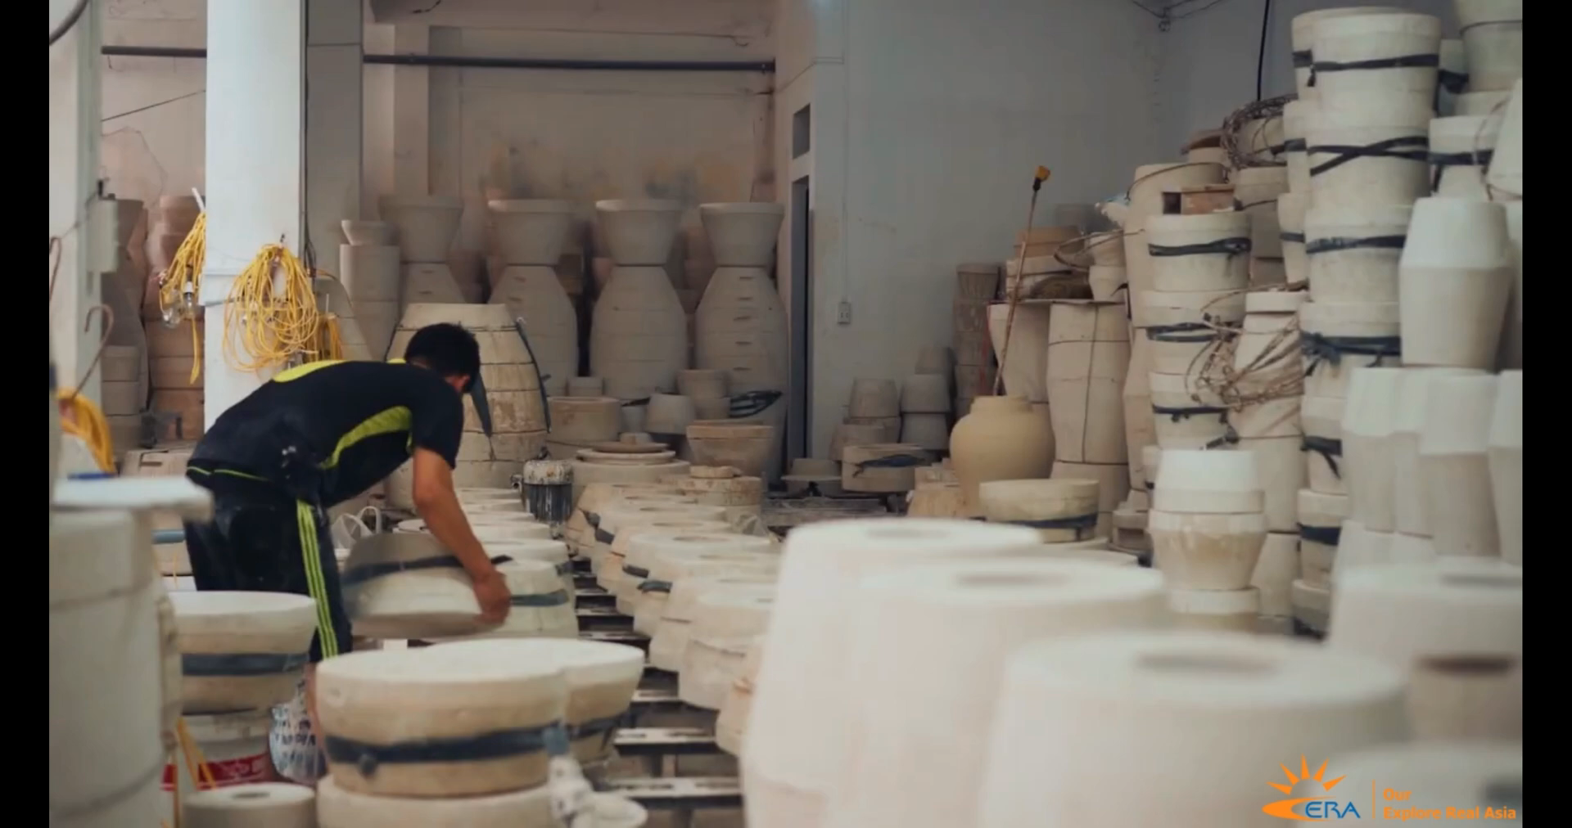
WARM-UP
WATCH THE VIDEO
VIDEO
WATCHING
Notes:
Video link: https://www.youtube.com/watch?v=bkWHK0_OmJM

Slide 5
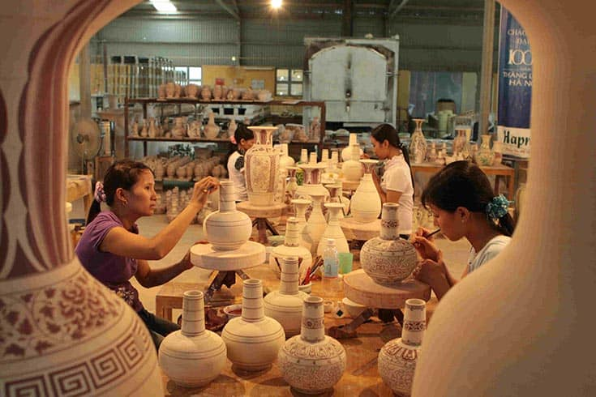
WARM-UP
BAT TRANG POTTERY VILLAGE

Slide 6
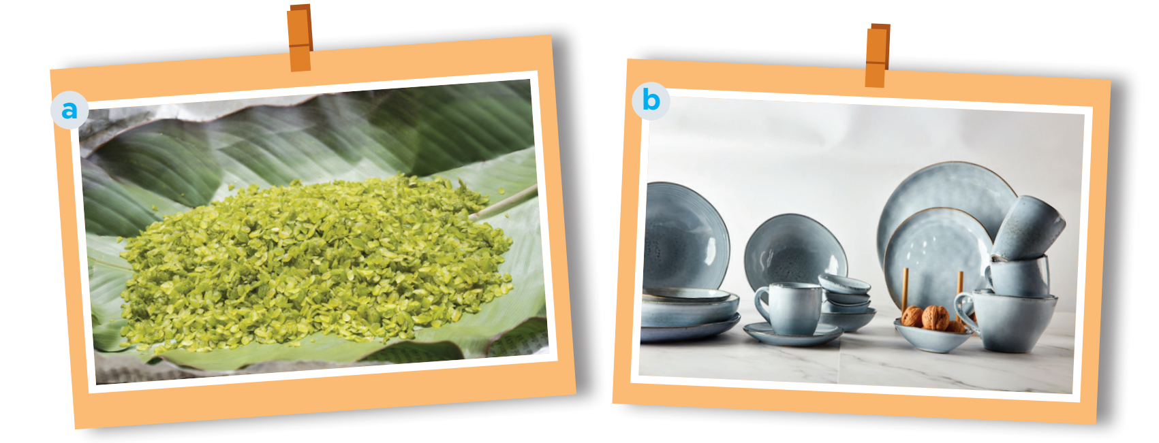
READING
1
Work in pairs. Answer the questions.
1. What can you see in each picture?
2. Do you know any place(s) where people make the thing(s) in each picture?

Slide 7
READING
1
Work in pairs. Answer the questions.
Picture a: cốm (young sticky rice) - from Vong Village, Ha Noi
Another place which makes com: Tu Le Commune in Yen Bai Province

Slide 8
READING
1
Work in pairs. Answer the questions.
Picture b: pottery – from Denby, England.
In Viet Nam, there are some pottery villages: Bat Trang, Bau Truc, Phu Lang, …

Slide 9

VOCABULARY
1. preserve (v)
maintain (something) in its original or existing state
/prɪˈzɜːv/
bảo tồn

Slide 10

READING
2. technique (n)
/tekˈniːk/
kĩ thuật

Slide 11

READING
3. shorten the process (v)
Rút ngắn quy trình

Slide 12

READING
4. layer (n)
/ˈleɪ.ər/
Lớp, tầng

Slide 13

READING
5. fragrance (n)
/ˈfreɪɡrəns/
hương thơm

Slide 14

READING
6. clay (n)
/kleɪ/
Đất sét

Slide 15

READING
7. original (adj)
/əˈrɪdʒ.ən.əl/
Nguyên bản, nguyên gốc

Slide 16

READING
8. function (n)
/ˈfʌŋk.ʃən/
công dụng/chức năng

Slide 17
READING
WORDS | PRONUNCIATION | MEANING
1. preserve (v) | /prɪˈzɜːv/ | Bảo tồn
2. technique (n) | /tekˈniːk/ | Kĩ thuật
3. shorten the process (v) |  | Rút ngắn quy trình
4. layer (n) | /ˈleɪ.ər/ | Lớp, tầng
5. fragrance (n) | /ˈfreɪɡrəns/ | Hương thơm
6. clay (n) | /kleɪ/ | Đất sét
7. original (adj) | /əˈrɪdʒ.ən.əl/ | Nguyên bản, nguyên gốc
8. function (n) | /ˈfʌŋk.ʃən/ | Công dụng/chức năng

Slide 18
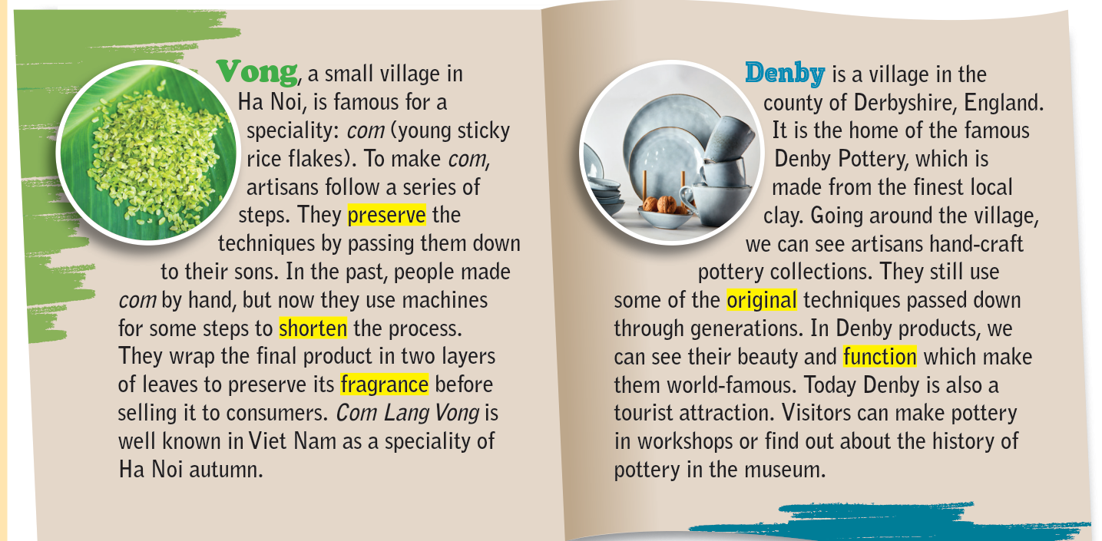
READING
2
Read the brochure introducing different places with special products. Match each highlighted word with its definition.

Slide 19
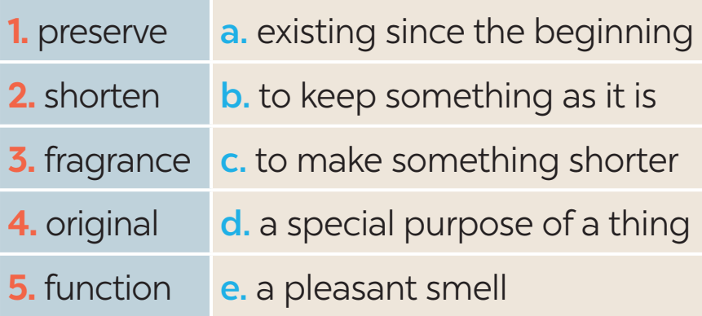
READING
2
Read the brochure introducing different places with special products. Match each highlighted word with its definition.

Slide 20

READING
3
Read the brochure again. Decide which place each detail below belongs to
In which place …? | Vong | Denby
1. people make the speciality from local material
2. people make the product from plants
3. people make the product with some traditional techniques
4. the product is famous worldwide
5. the product symbolises a season

Slide 21
SPEAKING
4
Work in pairs. Ask and answer about a speciality in your neighbourhood, your home town, or the area you know. Use the questions below.
1. What speciality is it?
2. What do people make it from?
3. Do people make it in the traditional way?
4. What can people do with it?
5. Is it well known in only your country or around the world?

Slide 22

SPEAKING
5
Work in groups. Give a short presentation about the speciality you discussed in 4.
I live in Tay Ho Village, 12 kilometres from Hue City. My village is famous for its conical hats. We make conical hats from goi leaves. We still follow 15 traditional steps to make a hat. A conical hat protects us from the sun and the rain as well as makes us more graceful. What is special about our conical hats is that each of them carries a poem. Tay Ho conical hats are not only famous in Hue but all over Viet Nam.

Slide 23

CONSOLIDATION
1
Wrap-up
What have we learnt in this lesson?
Read for specific information about special products in some areas.
Give a short presentation about a speciality.

Slide 24

CONSOLIDATION
2
Homework
- Do exercises in the Workbook.
- Write down a speciality in their notebooks.

Slide 25
Website: hoclieu.vn
Fanpage: facebook.com/www.tienganhglobalsuccess.vn/

