Slide 1
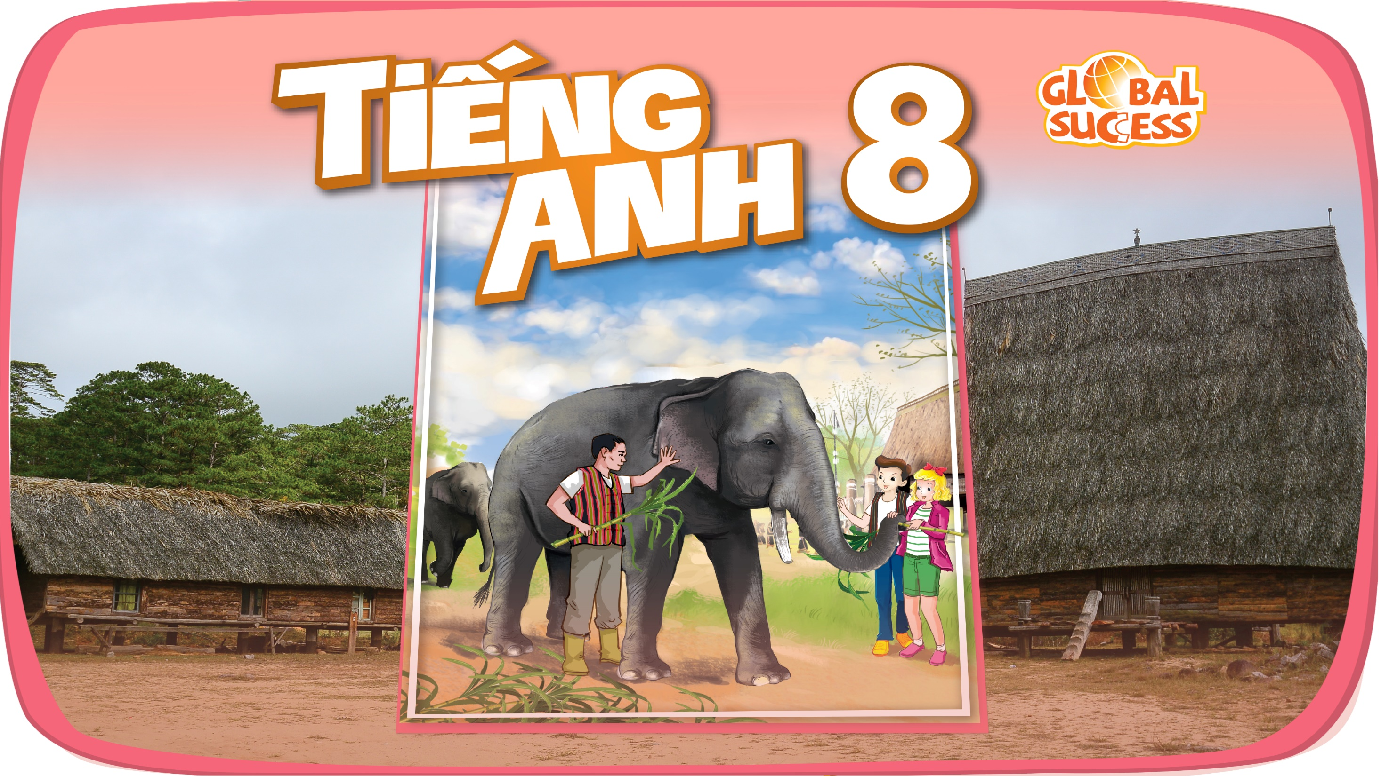

Slide 2

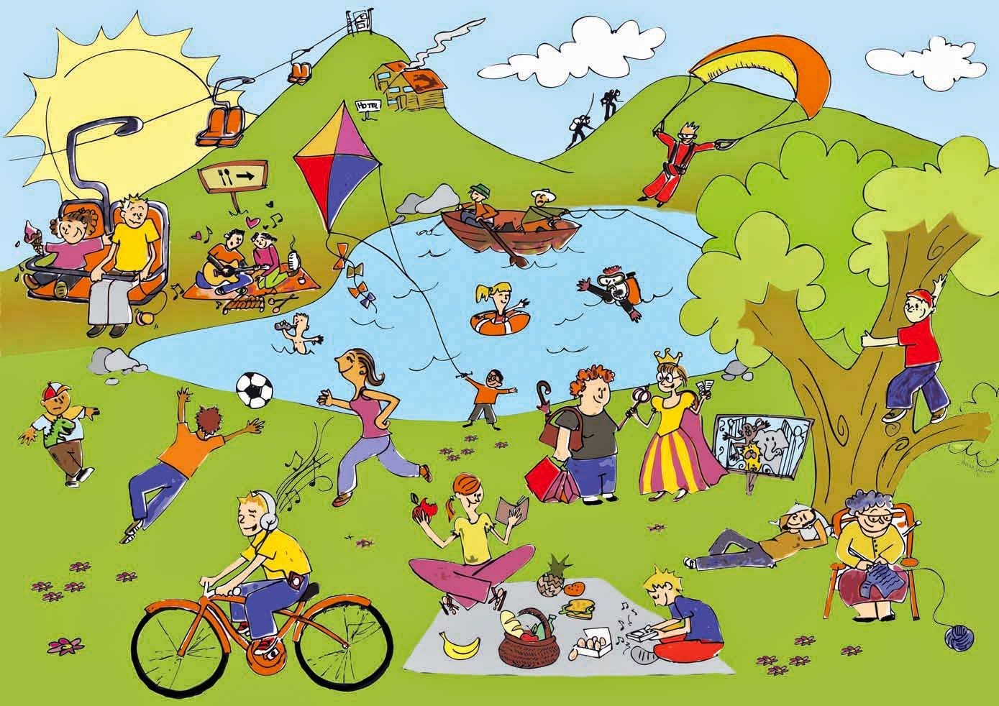
Unit
1
LEISURE TIME
LESSON 5: SKILL 1
1

Slide 3
LESSON 5: SKILLS 1
WARM-UP
Task 1: Look at the pictures. What activities can you see?
Vocabulary
Task 2: Read about Trang’s leisure activities. Choose the correct answer.
Task 3: Read the text again and answer the questions.
READING
Task 4: Work in groups. Take turns to ask and answer the questions.
Task 5: Report your group members’ answers to the class. What activities are the most common?
SPEAKING
CONSOLIDATION
Wrap-up
Homework

Slide 4
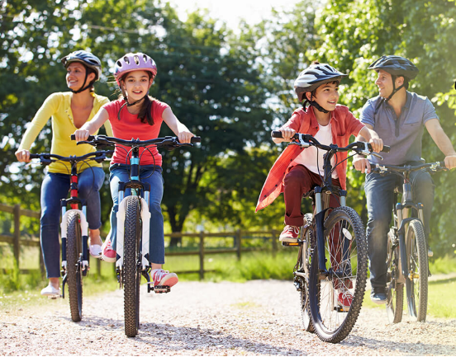
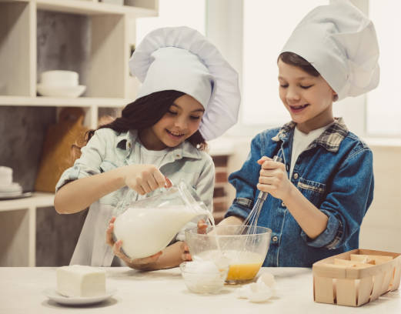
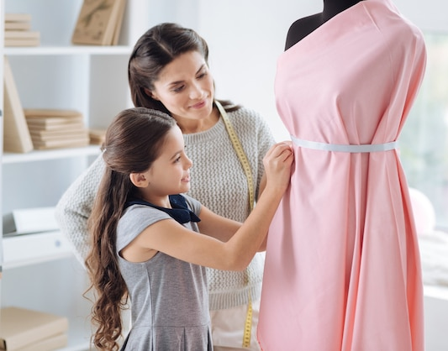
WARM-UP
1
Look at the pictures. What activities can you see?
riding a bike/ cycling
LEISURE ACTIVITIES
cooking
making a dress

Slide 5
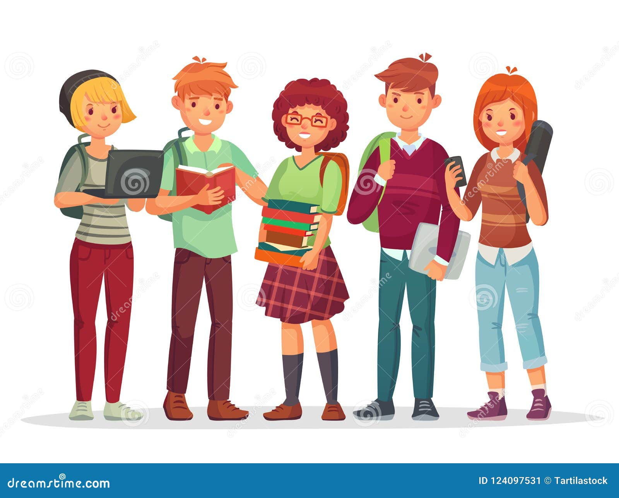

PRESENTATION
teenager (n)
/ˈtiːnˌeɪ.dʒər/
thiếu niên

Slide 6
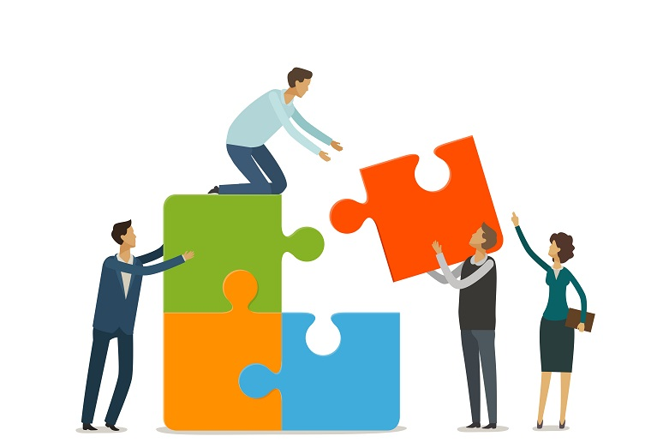
PRESENTATION
connect (v)
/kəˈnekt/
kết nối

Slide 7
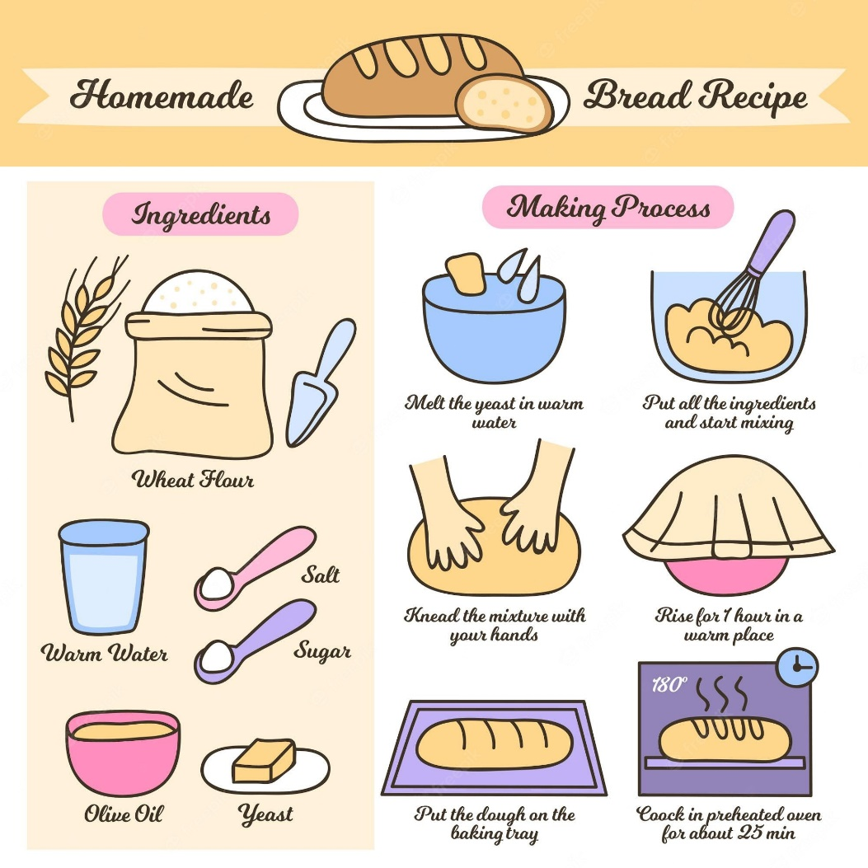
PRESENTATION
recipe (n)
/ˈresɪpi/
công thức

Slide 8
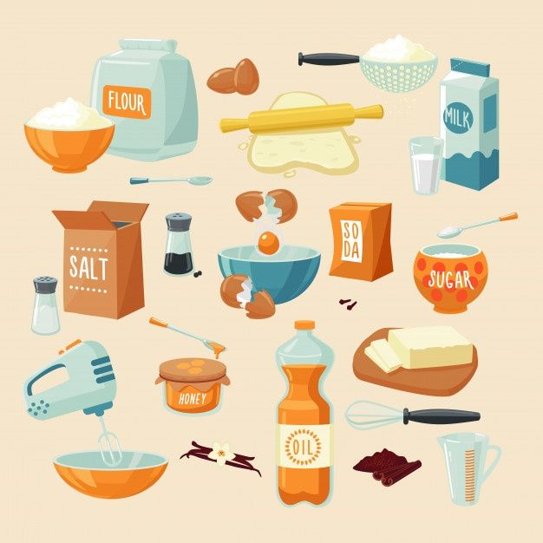
PRESENTATION
ingredient (n)
/ɪnˈɡriːdiənt/
nguyên liệu

Slide 9
PRESENTATION
prepare (v)
/prɪˈpeər/
chuẩn bị

Slide 10
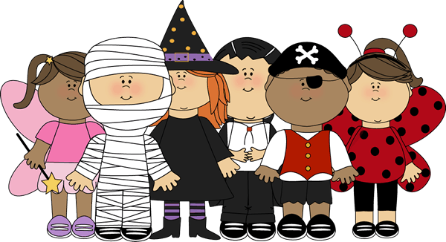
PRESENTATION
costume contest (n)
/ˈkɒstʃuːm ˈkɒn.test/
Cuộc thi hóa trang

Slide 11
PRESENTATION
New words | Pronunciation | Meaning
1. teenager (n) | /ˈtiːnˌeɪ.dʒər/ | thiếu niên
2. connect (v) | /kəˈnekt/ | kết nối
3. recipe (n) | /ˈresɪpi/ | công thức
4. ingredient (n) | /ɪnˈɡriːdiənt/ | nguyên liệu
5. prepare (v) | /prɪˈpeər/ | chuẩn bị
6. costume contest (n) | /ˈkɒstʃuːm ˈkɒn.test/ | Cuộc thi hóa trang

Slide 12
READING
2
Read about Trang’s leisure activities. Choose the correct answer.
Some teenagers enjoy spending free time with their friends. Others prefer doing leisure activities with their family members. I love spending time with my family because it's a great way to connect with them.
At the weekend, we usually go for a bike ride. We cycle to some nearby villages to enjoy the fresh air. We take photos and look at them later. My big brother and I are also into cooking. My brother looks for easy recipes. After that, we prepare the ingredients and cook. Sometimes the food is good, but sometimes it isn't; nevertheless, we love whatever we cook. The leisure activity I like the most is doing DIY projects with my mum. She teaches me to make my own dresses and doll clothes. On special occasions, we make special dresses together. Once I won the first prize in a costume contest at my school.

Slide 13
READING
2
Read about Trang’s leisure activities. Choose the correct answer.
Some teenagers enjoy spending free time with their friends. Others prefer doing leisure activities with their family members. I love spending time with my family because it's a great way to connect with them.
At the weekend, we usually go for a bike ride. We cycle to some nearby villages to enjoy the fresh air. We take photos and look at them later. My big brother and I are also into cooking. My brother looks for easy recipes. After that, we prepare the ingredients and cook. Sometimes the food is good, but sometimes it isn't; nevertheless, we love whatever we cook. The leisure activity I like the most is doing DIY projects with my mum. She teaches me to make my own dresses and doll clothes. On special occasions, we make special dresses together. Once I won the first prize in a costume contest at my school.

Slide 14
READING
2
Read about Trang’s leisure activities. Choose the correct answer.
1. The text is about Trang’s leisure activities ______.
A. in the past B. with her friends C. with her family
2. The word “connect” is closest in meaning to ______.
A. join with something
B. better understand someone
C. speak to someone by phone

Slide 15
READING
3
Read the text again and answer the questions.
Questions
Answers
1. What does Trang do with her family members at the weekend?
2. Who looks for recipes when Trang and her brother cook?
3. Which leisure activity does she love the most?
4. What does Trang’s mum teach her to do?
5. What did she win?
1. She goes for a bike ride, takes photos, cooks, and does DIY projects.
2. Her brother does.
3. She loves doing DIY projects with her mum the most.
4. Her mum teaches her to make her own dresses and doll clothes.
5. She won the first prize in a costume contest at her school.

Slide 16
SPEAKING
4
Work in groups. Take turns to ask and answer the questions. Record your friends’ answer in the table below.
Friends’ name | Questions 1: What leisure activities do you usually do with your family? | Questions 2: Which one do you like the most? Why? | Questions 3: How do you feel when you spend time with your family members?
Tâm | She usually cooks with her family | She likes cooking the most because cooking helps her to connect with family members. | She feels happy and relaxed.
B
C

Slide 17

SPEAKING
5
Report your group members’ answers to the class. What activities are the most common?
The most common activities is …

Slide 18
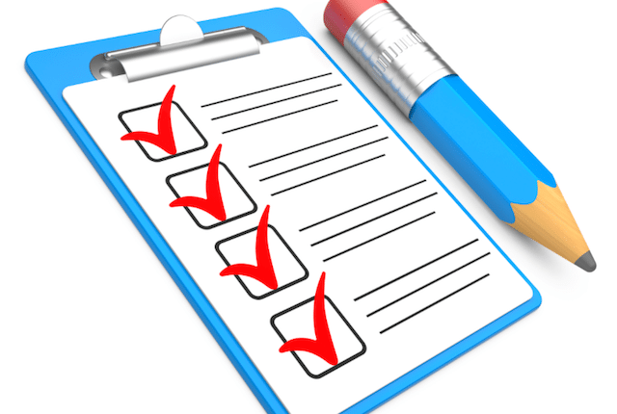
CONSOLIDATION
1
Wrap-up
What have we learnt in this lesson?
read about teen’s leisure activities
talk about friends’ leisure activities

Slide 19
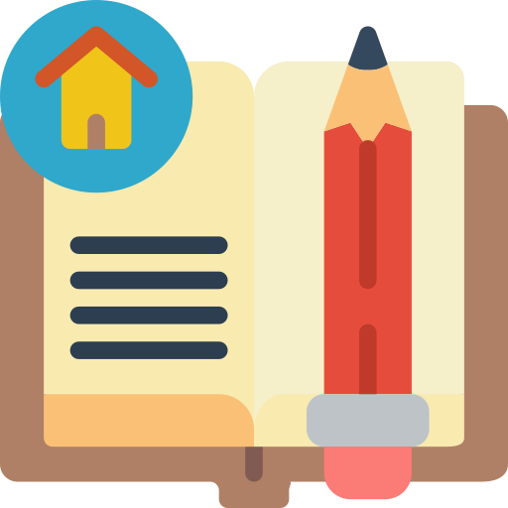
CONSOLIDATION
2
Homework
Do exercises in the workbook.

Slide 20

Website: hoclieu.vn
Fanpage: facebook.com/www.tienganhglobalsuccess.vn/

