Slide 2



Unit
1
LOCAL COMMUNITY
LESSON 3: A CLOSER LOOK 2
1

Slide 3
LESSON 3: A CLOSER LOOK 2
LESSON 1: GETTING STARTED
WARM-UP
Warm up: Brainstorming.
PRESENTATION
Question words with to-infinitives
Phrasal verbs
Task 1: Fill in each blank with a suitable question word.
Task 2: Rewrite the sentences using question words + to-infinitives.
Task 3: Match each phrasal verb with its meaning.
Task 4: Complete each sentence using the correct form of a phrasal verb in 3.
Task 5: Find someone who … Ask as many friends as you can the following questions. Then write their names in the table if they say “yes”.
PRACTICE
CONSOLIDATION
Wrap-up
Homework

Slide 4
QUESTION WORDS BEFORE TO-INFINITIVES
Wh-questions + to V
WARM-UP
BRAINSTORMING
Ann: Hi, Mi. Long time no see. How’re you doing?
Mi: I’m fine, thanks. By the way, we moved to a new house in a suburb last month.
Ann: Oh, that’s why I haven’t seen you in the Reading Club very often.
Mi: Yes. We’re still busy moving in, you know.
Ann: How’s your new neighbourhood?
Mi: It’s much bigger than our old one. The streets are wider, and there are fewer people.
Ann: What about the facilities?
Mi: It has all the things we need: shopping malls, parks, and hospitals. And there’s a craft village near our house.
Ann: Great! How’re your new neighbours?
Mi: They’re nice. Last Sunday when I was looking for the way to the bus station, a lady came and showed me the way. I think we will get on with them.
Ann: That reminds me of the time our family moved to Viet Nam. We didn’t know where to buy stuff for our
house, and the new neighbours in the community gave us useful advice. I guess you like your new place.
Mi: Sure. I really love where I live now.

Slide 5
PRESENTATION
Question words before to-infinitives
– We use a question word such as who, what, where, when, or how before a to-infinitive to express an indirect question about what we should do. – We often use a verb such as ask, wonder, (not) decide, (not) tell, or (not) know before the question word + to-infinitive.
S + | VERB + QUESTION WORDS + TO INFINITIVES
S + | ask wonder (not) be sure have no idea (not) know (not) decide (not) tell explain understand | who what where when how | to infinitives

Slide 6
PRESENTATION
Question words before to-infinitives
Example:
- We don’t know what to do to help the community.
- She asked how to get to the nearest shopping mall.

Slide 7
PRACTICE
1
Fill in each blank with a suitable question word.
1. I don’t know ______ to deal with this problem.
2. My sister wondered ______ to buy the best cakes.
3. Could you tell me ______ to do to get on well with my new neighbours?
4. They asked ______ to take out the rubbish, at 5 or 6 p.m.
5. He can’t decide ______ to give his books to.
how
where
what
when
who

Slide 8
PRACTICE
2
Rewrite the sentences using question words + to-infinitives.
1. I don’t know how I can get to the swimming pool.
2. They are wondering where they can buy traditional handicrafts.
3. She asked what she should give to her new neighbour at his house-warming party?
→ I don’t know how to get to the swimming pool.
→ They are wondering where to buy traditional handicrafts.
→ She asked what to give to her new neighbour at his house-warming party.

Slide 9
PRACTICE
2
Rewrite the sentences using question words + to-infinitives.
4. I can’t decide who I should ask for advice.
5. Could you tell me when I have to pay the water bill?
→ I can’t decide who to ask for advice.
Could you tell me when to pay the water bill?

Slide 10
PRESENTATION
Phrasal verbs
– A phrasal verb consists of a verb and one or two particles, such as up, down, back, on, round, …
– A phrasal verb usually has a special meaning.
Example:
go out = leave your house to go to a social event
pass down = give or teach something to your children
cut down on = reduce the amount or number of something
run out of = have no more of

Slide 11
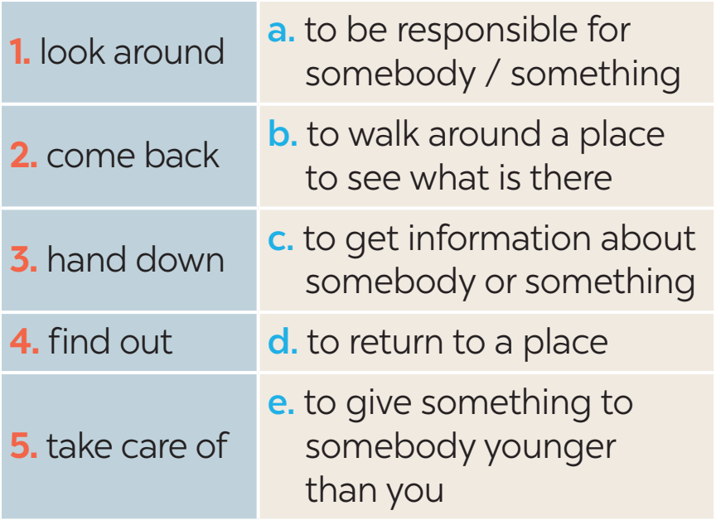
PRACTICE
3
Match each phrasal verb with its meaning.

Slide 12
PRACTICE
4
Complete each sentence using the correct form of a phrasal verb in 3.
came back
1. We __________ from our home town last Saturday.
2. The artisans in my village usually ___________ their skills to their eldest children.
3. If you want to ________ about our community, you can go to the local museum.
4. When we aren’t at home, our neighbour ____________ our cats.
5. Whenever I go to a new place, I spend time _____________.
hand down
find out
takes care of
looking around

Slide 13
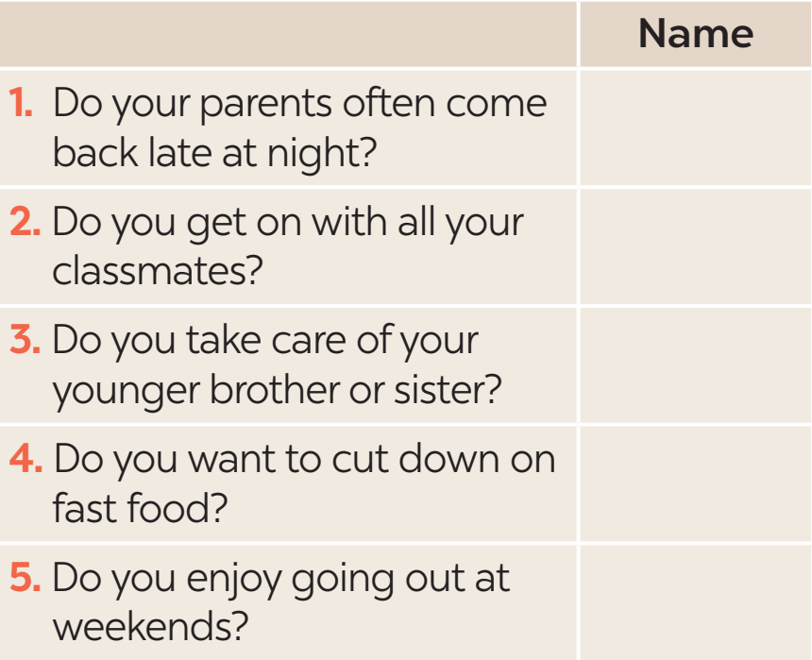

PRACTICE
5
Find someone who … Ask as many friends as you can the following questions. Then write their names in the table if they say “yes”.

Slide 14

CONSOLIDATION
1
Wrap-up
What have we learnt in this lesson?
Use questions words before to-infinitives and some phrasal verbs.

Slide 15

CONSOLIDATION
2
Homework
- Do exercises in the Workbook.
- Make 5 sentences using phrasal verbs.

Slide 16
Website: hoclieu.vn
Fanpage: facebook.com/www.tienganhglobalsuccess.vn/

