Slide 1

ENGLISH 9
Hello everyone !!!

Slide 2
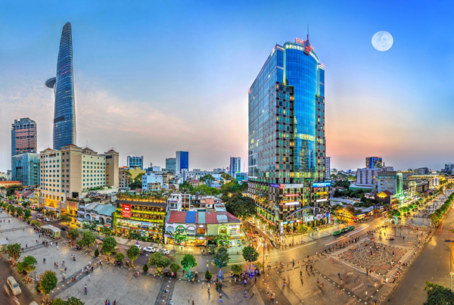


Unit
2
CITY LIFE
LESSON 1: GETTING STARTED
How is your city?

Slide 3
* WARM-UP
* Answer the questions:
OPTION 1
1/ Can you name some big cities in Viet Nam and in the world?
2/ Can you describe something you know about these cities?
3/ Do you want to live there?
4/ Can you describe where you live? Is it a city or town?
5/ Do you like living there?
THINK!

Slide 4

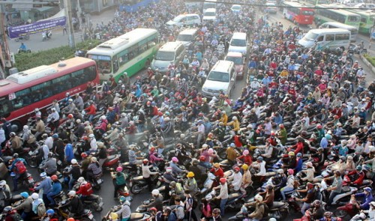
* VOCABULARY
a large number of vehicles close together and unable to move or moving very slowly.
traffic jam (n)
/ˈtræf.ɪk ˌdʒæm/
kẹt xe

Slide 5
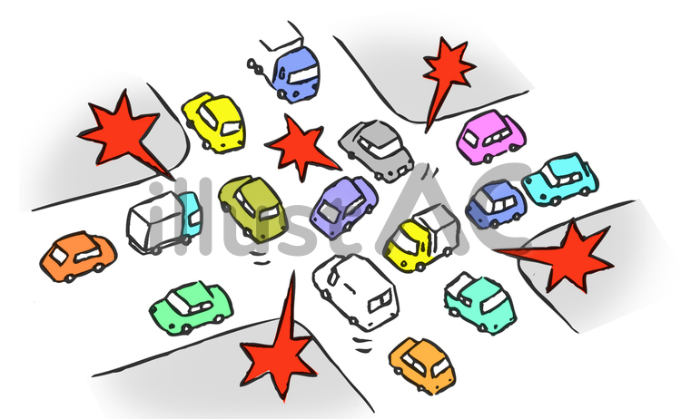
* VOCABULARY
a situation in which a place is too blocked or crowded, causing difficulties.
congested (adj)
/kənˈdʒes.tɪd/
tắc nghẽn (giao thông)

Slide 6

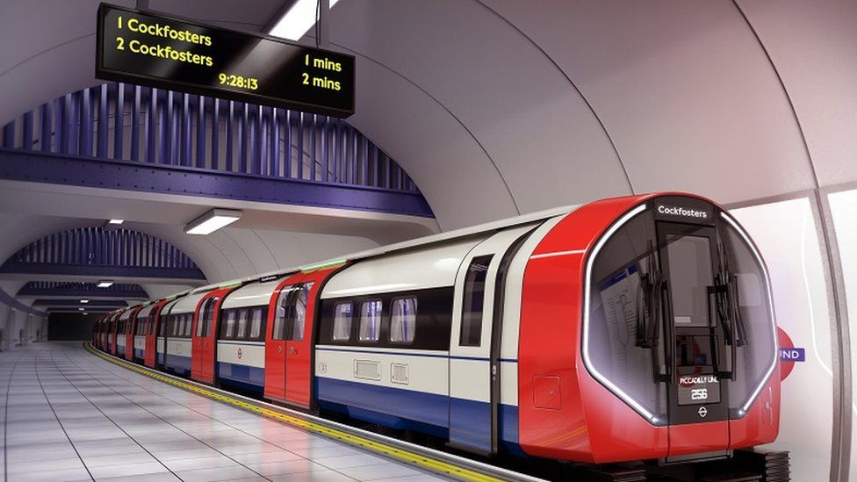
* VOCABULARY
an area or piece of land where construction work is taking place
construction site (n)
/kənˈstrʌkʃn saɪt/
công trường xây dựng

Slide 7
* VOCABULARY
A railway system in which electric trains travel through tunnels below ground.
underground (n)
/ˌʌndəˈɡraʊnd/
hệ thống tàu điện ngầm

Slide 8
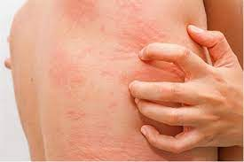
* VOCABULARY
itchy (adj)
having or causing an itch
/ˈɪtʃi/
ngứa, gây ngứa

Slide 9
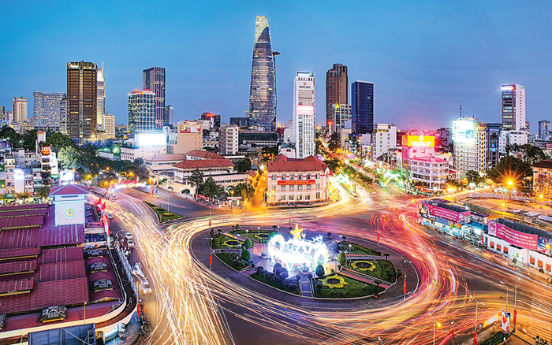
* VOCABULARY
in or to the central part of a city
downtown (n)
/ˌdaʊnˈtaʊn/
khu trung tâm tp, thị trấn

Slide 10
* VOCABULARY
unreliable (adj)
not able to be trusted
/ˌʌn.rɪˈlaɪə.bəl/
không đáng tin

Slide 11
* VOCABULARY
grand (adj)
important and large in degree
/ɡrænd/
hoành tráng

Slide 12
* VOCABULARY
pricey (adj)
expensive
/ˈpraɪ.si/
đắt đỏ

Slide 13
* VOCABULARY
New words | Pronunciation | Meaning
1. traffic jam (n) | /ˈtræf.ɪk ˌdʒæm/ | kẹt xe
2. congested (adj) | /kənˈdʒes.tɪd/ | tắc nghẽn (giao thông)
3. construction site (n) | /kənˈstrʌkʃn saɪt/ | công trường xây dựng
4. underground (n) | /ˌʌndəˈɡraʊnd/ | hệ thống tàu điện ngầm

Slide 14
New words | Pronunciation | Meaning
5. downtown (n) | /ˌdaʊnˈtaʊn/ | khu trung tâm tp, thị trấn
6. unreliable (adj) | /ˌʌn.rɪˈlaɪə.bəl/ | không đáng tin
7. grand (adj) | /ɡrænd/ | hoành tráng
8. pricey (adj) | /ˈpraɪ.si/ | đắt đỏ

Slide 15
* Checking vocab
New words | Meaning
 | đắt đỏ
 | hoành tráng
 | tắc nghẽn (giao thông)
 | không đáng tin
 | khu trung tâm tp, thị trấn
 | hệ thống tàu điện ngầm
 | công trường xây dựng
pricey (adj)
grand (adj)
congested (adj)
unreliable (adj)
downtown (n)
underground (n)
construction site (n)
traffic jam (n)
 | kẹt xe

Slide 16
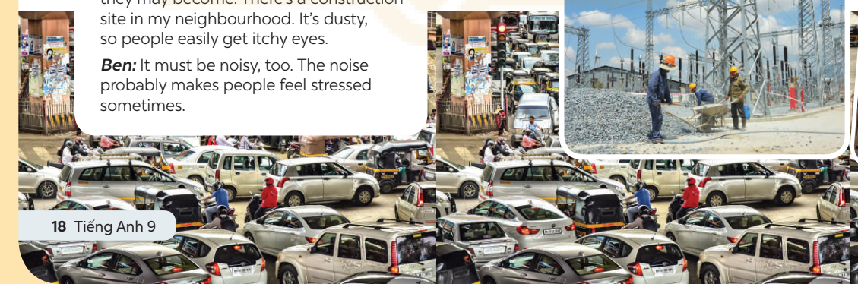
* PRACTICE
Look at pictures on p.28
1. What do you see in each picture?
traffic jam / traffic congestion, construction site …..
2. Are the things in the pictures common in your home town?

Slide 17









1
Listen and read.
Trang: Hi, Ben. Sorry I couldn’t get online earlier. I got stuck in a traffic jam and came home late.
Ben: No problem, Trang. Did you go by bus?
Trang: No. My dad picked me up. I rarely use the bus. It’s slow and packed with people.
Ben: I mostly get around by underground. It’s more reliable than the bus.
Trang: That’s great.
Ben: But traffic congestion is terrible in London. You know, the more crowded the city gets, the more congested the streets are.
Trang: Yeah … and the more polluted they may become. There’s a construction site in my neighbourhood. It’s dusty, so people easily get itchy eyes.
Ben: It must be noisy, too. The noise probably makes people feel stressed sometimes.

Slide 18
1
Listen and read.
Trang: That’s right. But new buildings make the city look modern and attractive.
Do you remember the grand building downtown?
Ben: Of course. How’s it now? When I left Viet Nam, they nearly finished it.
Trang: Well, it’s now a shopping mall. Teens like it because it’s modern and fun.
Ben: Do you often go there?
Trang: Sometimes. I watch movies there with my sister. I want to go there more often, but it’s a bit pricey.
Ben: It’s expensive here in London, too …
Say the words in the text that you think are related to the topic City life.

Slide 19
2
Read the conversation again and tick T (true) or F (False).
 | T | F
1. The bus in Trang’s city is slow and crowded.
2. The underground system in Ben’s city is unreliable.
3. There is a dusty and noisy construction site near Trang’s house.
√
√
“get around by underground. It’s more reliable than the bus.”
√

Slide 20
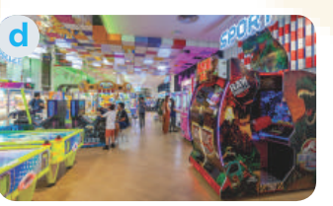
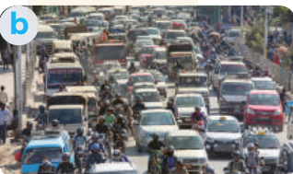
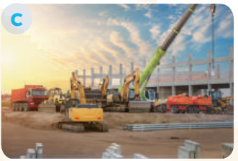

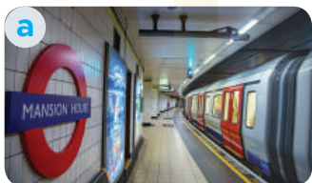
2
Read the conversation again and tick T (true) or F (False).
 | T | F
4. Trang thinks new buildings make the city look ugly.
5. . Both Trang and Ben find shopping malls expensive.
“ But new buildings make the city look modern and attractive”
√
√

Slide 21
3
Match the words/phrases with their pictures.
1. congested road
2. construction site
3. the underground
4. itchy eyes
5. entertainment centre

Slide 22
3
Match the words/phrases with their pictures.
3. the underground
1. congested road
2. construction site
5. entertainment centre
4. itchy eyes

Slide 23
4
Choose the correct answer A, B, C, or D
1. I like getting around by _______ I hate the smell of car exhaust.
A. Underground B. private car C. taxi D. bus
2. Road dust may badly affect our _______.
A. Stomach B. back C. eyes D. leg
3. There's a _______ in my neighbourhood. It's noisy and dusty.
A. Building B. construction site C. hospital D. lake
4. The road is narrow, so _______ often occurs at rush hour.
A. traffic light B. traffic flow C. traffic congestion D.traffic safety
5. Many teens fancy spending their weekends in an entertainment _______.
A. Industry B. value C. business D. centre
Game

Slide 24


Tom
Lucky Numbers
Jerry
40
1
2
3
4
60
70
30
10
40
20
30
60
70
80
10
50
50
20
5
6
7
8

Slide 25

LUCKY NUMBER!

Slide 26
LUCKY NUMBER!

Slide 27
LUCKY NUMBER!

Slide 28
4
Choose the correct answer A, B, C, or D
1. I like getting around by ______. I hate the smell of car exhaust.
A. underground | B. private car
C. taxi | D. bus

Slide 29
4
Choose the correct answer A, B, C, or D
2. Road dust may badly affect our ______.
A. stomach | B. back
C. eyes | D. leg

Slide 30
4
Choose the correct answer A, B, C, or D
3. There’s a ______ in my neighbourhood. It’s noisy and dusty.
A. building | B. construction site
C. hospital | D. lake

Slide 31
4
Choose the correct answer A, B, C, or D
4. The road is narrow, so ______ often occurs at rush hour.
A. traffic light | B. traffic flow
C. traffic congestion | D. traffic safety

Slide 32
4
Choose the correct answer A, B, C, or D
5. Many teens fancy spending their weekends in an entertainment ______.
A. industry | B. value
C. business | D. centre

Slide 33
4
Choose the correct answer A, B, C, or D
1. I like getting around by _______ I hate the smell of car exhaust.
A. underground B. private car C. taxi D. bus
2. Road dust may badly affect our _______.
A. stomach B. back C. eyes D. leg
3. There's a _______ in my neighbourhood. It's noisy and dusty.
A. building B. construction site C. hospital D. lake
4. The road is narrow, so _______ often occurs at rush hour.
A. traffic light B. traffic flow C. traffic congestion D.traffic safety
5. Many teens fancy spending their weekends in an entertainment _______.
A. industry B. value C. business D. centre

Slide 34
PRODUCTION
5
Quiz: A lifestyle survey: City life or Village life?
Complete the quiz. Then compare your choices with your friends’ and the teacher’s explanation. Which suits you more, life in the city or in a village?
You have 4 minutes to do this activity individually.

Slide 35
Compare your choices with your partner.
PRODUCTION
1. What kind of house do you want to live in? | 2. How do you like to get around?
A. A small and modern apartment. B. A house with a garden | A. By public transport. B. By motorbike or bicycle.
3. Where do you frequently enjoy visiting? | 4. How do you describe your favourite neighbourhood?
A. Shops, restaurants, cinemas, and art galleries. B. Local farmers’ markets. | A. Crowded and busy. B. Quiet and green.
5. How do you like to spend time outdoors?
A. Going for a walk or running in the park. B. Doing gardening or visiting next-door neighbours.

Slide 36
Compare your choices with your partner.
If you choose lots of A.
You will fit in the city.
If you choose lots of B.
The village is your better choice.

Slide 37
PRODUCTION
EXTRA ACTIVITY
Show me more ideas about:
City Life | Village Life
A small and modern apartment
By public transport.
Shops, restaurants, cinemas, and
art galleries.
Crowded and busy.
Going for a walk or running in
the park
- noisy, expensive, pollution
A house with a garden
By motorbike or bicycle
Quiet and green.
Local farmers’ markets.
Doing gardening or visiting next-door
neighbours.
- simple, friendly, cheap,cool,…

Slide 38
PRODUCTION
EXTRA ACTIVITY
 | LIVING IN THE CITY | LIVING IN THE COUNTRYSIDE
Accommodation
Means of transport
Facilities
Neighbourhood
Outdoor activities

Slide 39

* CONSOLIDATION
What have we learnt in this lesson?
Gain an overview about the topic City life
Gain vocabulary to talk about life in the city

Slide 40

* Homework
Do exercises in the workbook.
Prepair lesson 2: A closer look 1

Slide 41
* Homework
Name of the future city:
The population of the future city:
The type of houses people will live in:
The means of transportation that people will use:
The kinds of school and number of schools in the city:
The kinds and/or places of entertainment in the city:

Slide 42
* Homework
- Prepare for the Project of the unit
- Open book p.27
- Work in groups to brainstorm about the features of a city you want to live in the future and draw a picture of it.
- You will show and present in Lesson 7 – Looking back and Project.

