Slide 2
Unit
9
WORLD ENGLISHES
LESSON 2: A CLOSER LOOK 1

Slide 3
LESSON 2: A CLOSER LOOK 1
LESSON 2: A CLOSER LOOK 1
WARM-UP
Option 1: Brainstorming
Option 2: “Bin it or Keep it” quiz
Vocabulary
Task 1: Match a word or phrase in A with its meaning in B.
Task 2: Match a verb in A with a phrase in B to make a meaningful expression.
Task 3: Choose the correct word to complete each sentence.
VOCABULARY
Task 4: Listen and repeat the words. Pay attention to the word stress.
Task 5: Listen and repeat the sentences. Mark the stress in the underlined words.
PRONUNCIATION
CONSOLIDATION
Wrap-up
Homework

Slide 4
WARM-UP
OPTION 1
Brainstorming

Slide 5
WARM-UP
OPTION 1
- There are some pictures.
- You need to say the words in British English and American English.
HOI AN

Slide 6
WARM-UP
OPTION 1
UK: chips US: French Fries

Slide 7
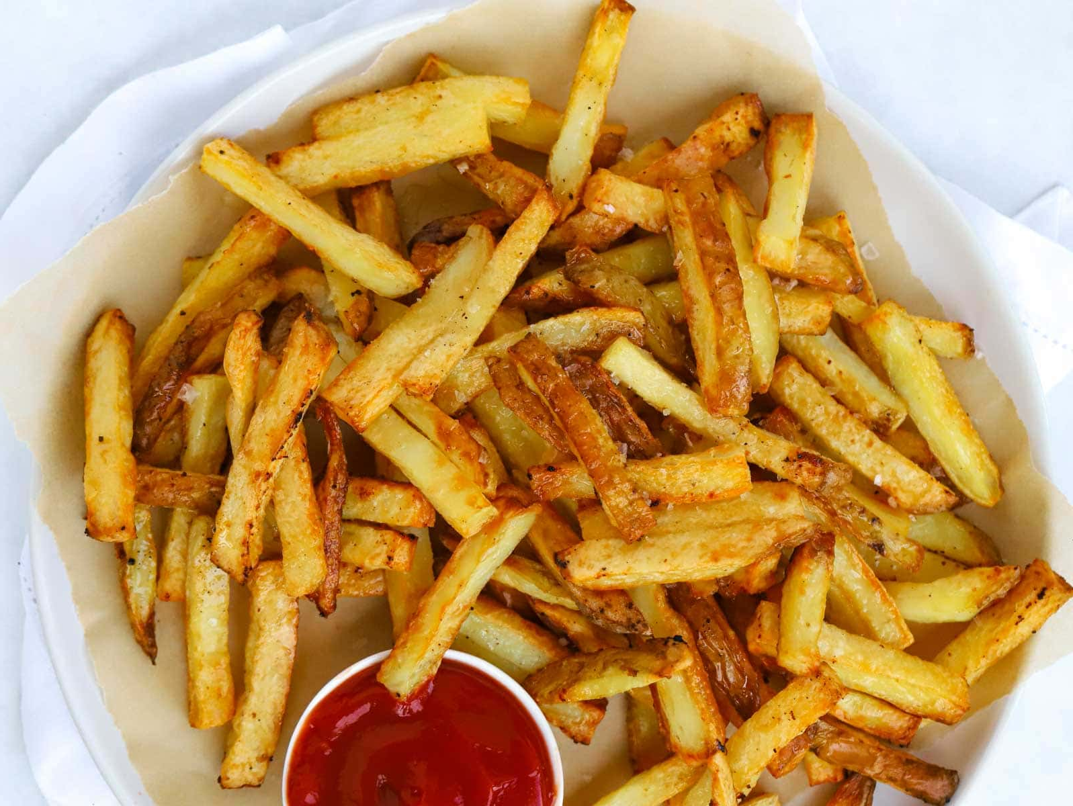
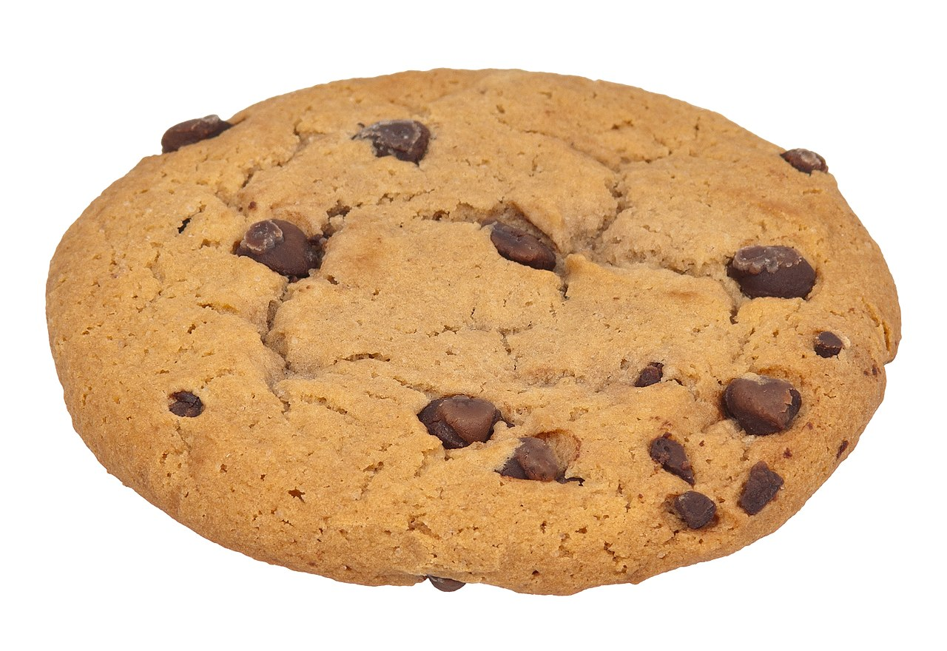
WARM-UP
OPTION 1
UK: flat US: apartment

Slide 8
WARM-UP
OPTION 1
UK: biscuit US: cookie

Slide 9
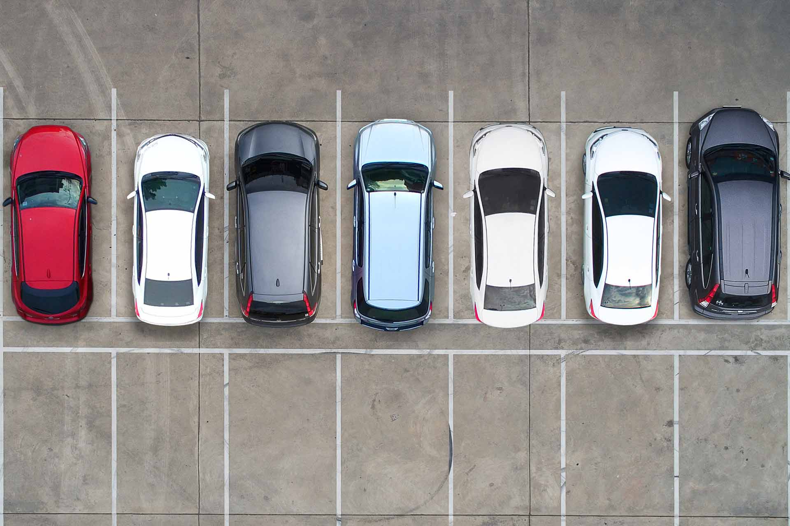
WARM-UP
OPTION 1
UK: dustbin
US: garbage can

Slide 10
WARM-UP
OPTION 1
UK: car park US: parking lot

Slide 11
WARM-UP
OPTION 2
Bin it or Keep it

Slide 12
WARM-UP
OPTION 2
- Work in teams.
- There are signs or flashcards labeled "Bin it" and "Keep it."
- There is some sentences.
- You hold up the sign corresponding to your answer: "Bin it" if the sentence is not American English, "Keep it" if it is.

Slide 13
WARM-UP
OPTION 2
The sidewalk is cracked.
Keep it.

Slide 14
WARM-UP
OPTION 2
Please turn off the tap when you're finished.
Bin it.
tap (UK) faucet (US)

Slide 15
WARM-UP
OPTION 2
Can you pass me the rubber?
Bin it.
rubber (UK) eraser (US)

Slide 16
WARM-UP
OPTION 2
Let's grab some chips after school.
Bin it.
chips (UK) French fries (US)

Slide 17
VOCABULARY
bilingual (adj)
able to use two languages equally well
/baɪˈlɪŋɡwəl/
sử dụng được hai ngôn ngữ

Slide 18
VOCABULARY
a different type of something
variety (n)
/vəˈraɪəti/
biến thể/ đa dạng

Slide 19
VOCABULARY
fluent (adj)
able to speak a language easily and well
/ˈfluːənt/
E.g. He's a fluent English speaker.
trôi chảy,
thành thạo

Slide 20
VOCABULARY
concentric (adj)
(of circles and rings) being one inside another and having the same centre
/kənˈsentrɪk/
đồng tâm

Slide 21
VOCABULARY
go over
to study something again
/ɡəʊ ˈəʊvə/
E.g. I always go over my notes just before I go into an exam.
ôn tập lại

Slide 22
VOCABULARY
pick up
to learn a new skill or language by practising it rather than being taught it
/pɪk ʌp/
E.g. When you live in a country, you soon pick up the language.
học (ngôn ngữ tự nhiên)
A | B
1. variety | a. a language which has legal status in a country. | 1.
2. bilingual | b. a different type of something | 2.
3. fluent | c. (of circles) having the same centre | 3.
4. concentric | d. able to speak two languages equally well | 4.
5. official language | e. able to speak, read, or write a language, especially a foreign language, easily and well | 5.

Slide 23
VOCABULARY
New words | Pronunciation | Meaning
1. bilingual (adj) | /baɪˈlɪŋɡwəl/ | sử dụng được hai ngôn ngữ
2. variety (n) | /vəˈraɪəti/ | biến thể/ đa dạng
3. fluent (adj) | /ˈfluːənt/ | trôi chảy, thành thạo
4. concentric (adj) | /kənˈsentrɪk/ | đồng tâm
5. go over | /ɡəʊ ˈəʊvə/ | ôn tập lại
6. pick up | /pɪk ʌp/ | học (ngôn ngữ tự nhiên)
A | B
1. variety | a. a language which has legal status in a country. | 1.
2. bilingual | b. a different type of something | 2.
3. fluent | c. (of circles) having the same centre | 3.
4. concentric | d. able to speak two languages equally well | 4.
5. official language | e. able to speak, read, or write a language, especially a foreign language, easily and well | 5.

Slide 24
VOCABULARY
1
Match a word or phrase in A with its meaning in B.
A | B
1. variety | a. a language which has legal status in a country. | 1.
2. bilingual | b. a different type of something | 2.
3. fluent | c. (of circles) having the same centre | 3.
4. concentric | d. able to speak two languages equally well | 4.
5. official language | e. able to speak, read, or write a language, especially a foreign language, easily and well | 5.
b
d
e
c
a

Slide 25
VOCABULARY
2
Match a verb in A with a phrase in B to make a meaningful expression.
A | B
1. translate | a. over the grammatical points | 1.
2. copy | b. up a new language | 2.
3. pick | c. up new words in an English-English dictionary | 3.
4. look | d. from Vietnamese into English | 4.
5. go | e. words into a notebook | 5.
d
e
b
c
a

Slide 26
VOCABULARY
3
Choose the correct word to complete each sentence.
1. English is a(n) official / first language in Singapore besides Malay, Mandarin, and Tamil.
2. Although he was born in Britain, he is fluent / bilingual in Vietnamese.
3. After you pick / look up a word in the dictionary, remember to make an example with it.

Slide 27
VOCABULARY
3
Choose the correct word to complete each sentence.
4. How many books have you picked / translated from English into Vietnamese?
5. Remember to go / copy over the words you have learnt in class.

Slide 28
PRONUNCIATION
4
Listen and repeat the words. Pay attention to the word stress.
-ion | -ity
relation | charity
decision | quality
position | clarity
education | ability
operation | obesity
Words ending in -ion and -ity have stress on the syllable immediately before them.

Slide 29
PRONUNCIATION
5
Listen and repeat the sentences. Mark the stress in the underlined words.
1. They had a discussion about the quality of the courses at their language centre.
2. Pay attention to her ability to express herself in English.
3. I have an intention of organising an English class for the community.
4. Let’s do a revision activity before the exam.
5. What is the function of the word ‘identity’ in this sentence?

Slide 30
EXTRA ACTITIVTY
- Work in groups. Ask groups to write as many words ending in –ion and –ity as possible in ............. minutes.
- The group with the most words writes the words on the board.
- Other students from other groups go to the board and put stress on the correct syllable in each word written.
Notes:
wish → wish
know → knowledge
decide → decision
damage → damage

Slide 31
CONSOLIDATION
1
Wrap-up
What have we learnt in this lesson?
Use the lexical items related to the topic World Englishes;
Pronounce the words ending in –ion and –ity with correct stress.

Slide 32
CONSOLIDATION
2
Homework
- Do exercises in the workbook.
- Find 3 more words ending in –ion and –ity and put the stress on the appropriate syllable in each of them.

Slide 33
Website: hoclieu.vn
Fanpage: facebook.com/tienganhglobalsuccess.vn/

