Slide 2



Unit
9
CITIES OF THE WORLD
LESSON 7: LOOKING BACK & PROJECT
1

Slide 3
LESSON 7: LOOKING BACK & PROJECT
LESSON 1: GETTING STARTED
Brainstorming
WARM-UP
Task 1: Choose the best two options to complete the sentences.
Task 2: Write the words / phrases in the box under their pictures.
Task 3: Complete the sentences with the correct possessive pronouns in the box.
Task 4: Read the sentences and correct the underlined words.
LOOKING BACK
PROJECT
My journey around the world!
CONSOLIDATION
Wrap-up
Homework

Slide 4




WARM UP
BRAINSTORM
1.
Work in 6-8 groups to list out all the suitable adjectives for the given topics.
2.
1 minute/ topic
3.
The team with the most suitable words wins
CITY
WEATHER
PEOPLE
FOOD

Slide 5
LOOKING BACK
1
Choose the best two options to complete the sentences.
1.
The city is .
A.
exciting
B.
amazing
C.
long
2.
The weather is .
A.
cold
B.
quiet
C.
sunny
3.
The people are .
A.
friendly
B.
expensive
C.
helpful

Slide 6
LOOKING BACK
1
Choose the best two options to complete the sentences.
4.
The buildings are .
A.
tall
B.
beautiful
C.
fast
5.
The food is .
A.
cute
B.
delicious
C.
good

Slide 7
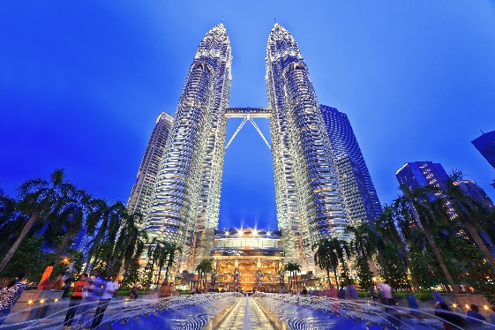
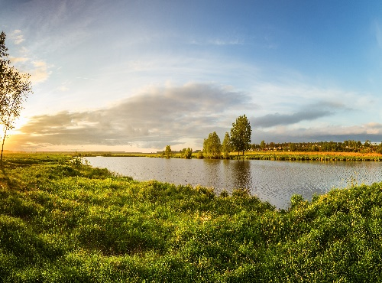
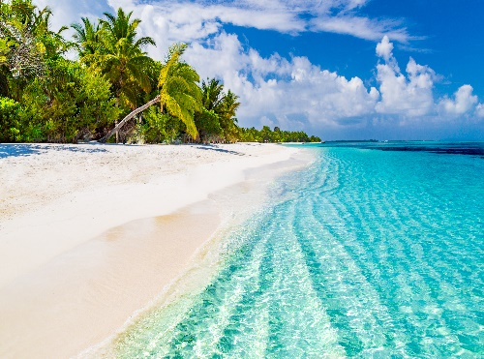
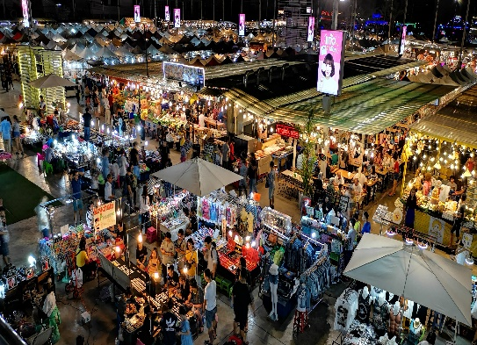
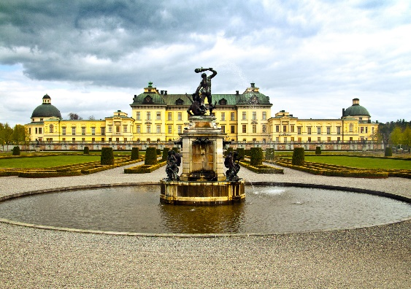

LOOKING BACK
2
Write the words / phrases in the box under their pictures.
towers
postcard
beach
1.
towers
2.
river bank
beach
3.
palace
river bank
night market
4.
night market
palace
postcard
5.
6.

Slide 8
LOOKING BACK
3
Complete the sentences with the correct possessive pronouns in the box.
theirs
hers
yours
mine
ours
1.
Hey Phong. You’re wearing my hat. It’s not .
yours
2.
We’re looking for Mr and Mrs Smith’s house. Is that ?
theirs
3.
mine
This is my drawing. It’s .
4.
This is your room. is next door. So call us if you need anything.
Ours
5.
Sue doesn’t need to borrow my pen. She’s got .
hers

Slide 9
LOOKING BACK
4
Read the sentences and correct the underlined words.
1.
Bangkok is an exciting city. I love it’s people
its
2.
We are watching the sunrise at Angkor Wat with ours local friends.
our
3.
Discover Beijing and Shanghai through theirs food tours.
their
4.
Visit Hue and try your food.
its
5.
Venice is your city and Jakarta is our.
ours

Slide 10




Slide 11

CONSOLIDATION
1
Wrap-up
What have we learnt in this lesson?
Review the vocabulary and grammar of Unit 9
Apply what they have learnt (vocabulary and grammar) into practice through a project

Slide 12

CONSOLIDATION
2
Homework
Prepare for the next lesson: Read Unit 10.

Slide 13






Website: hoclieu.vn
Fanpage: facebook.com/www.tienganhglobalsuccess.vn/

