Slide 2
Unit
9
CITIES OF THE WORLD
LESSON 5: SKILLS 1
Reading
Speaking

Slide 3
LESSON 5: SKILLS 1
LESSON 1: GETTING STARTED
WARM-UP
Discussion (Task 1)
Vocabulary pre-teaching
Task 2: Read the postcard and choose the correct answer to each of the questions.
Task 3: Read the text and match the places with the things they have.
READING
Task 4: Work in groups. Choose a city you know. Discuss and answer the questions below.
Task 5: Share the information you have collected in 4 with your class.
SPEAKING
CONSOLIDATION
Wrap-up
Homework

Slide 4
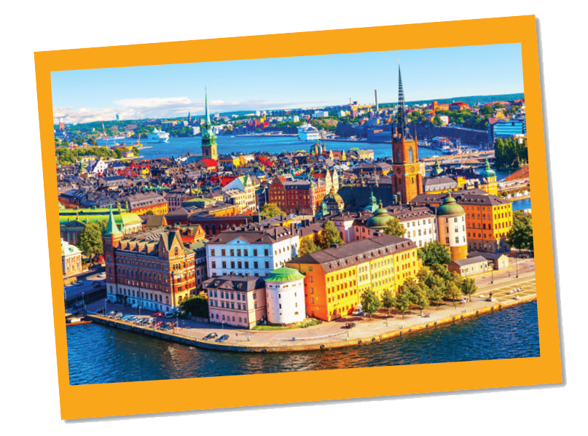
WARM-UP
Where is it?
What do they often write on a postcard?
When do people write a postcard?
Sweden

Slide 5
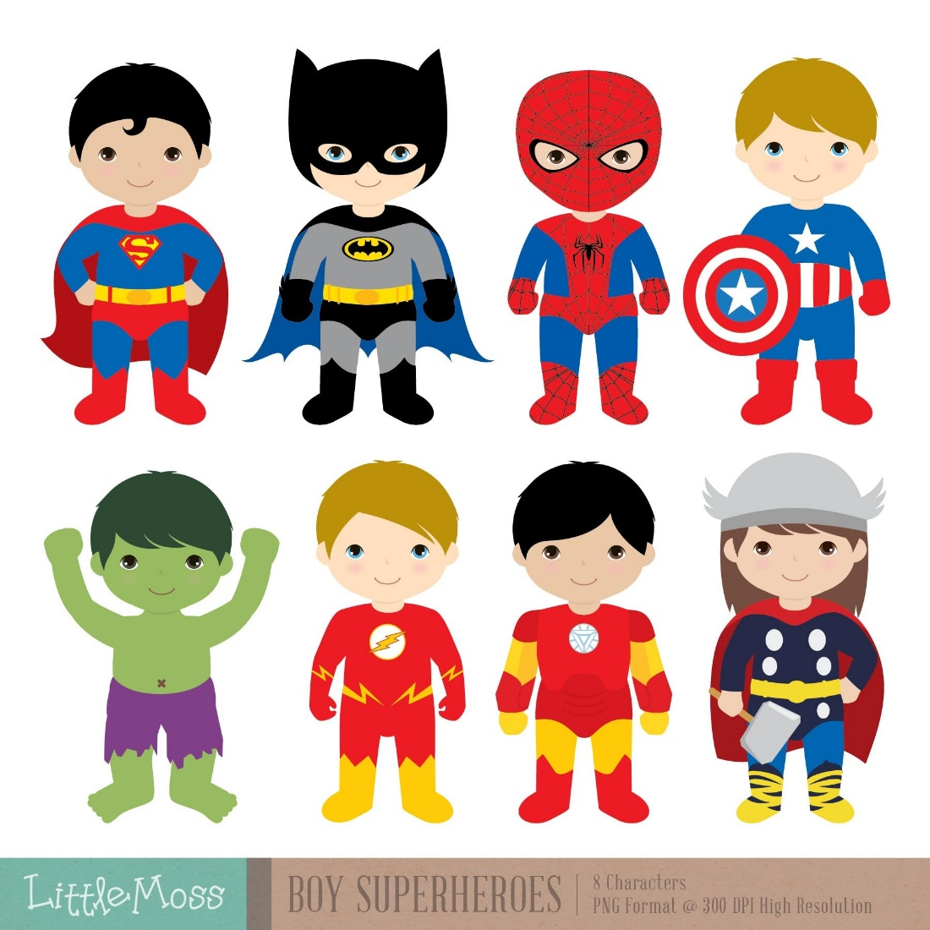
READING
fantastic (adj)
/fænˈtæstɪk/
phi thường, tuyệt vời

Slide 6
READING
perfect (adj)
/ˈpɜːfɪkt/
hoàn hảo

Slide 7
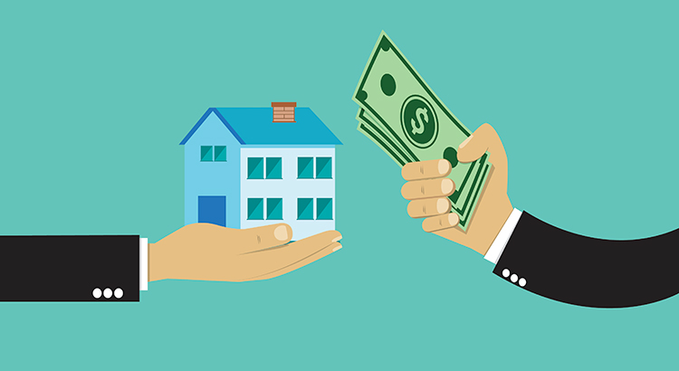
READING
rent (v)
/rent/
thuê, mướn

Slide 8
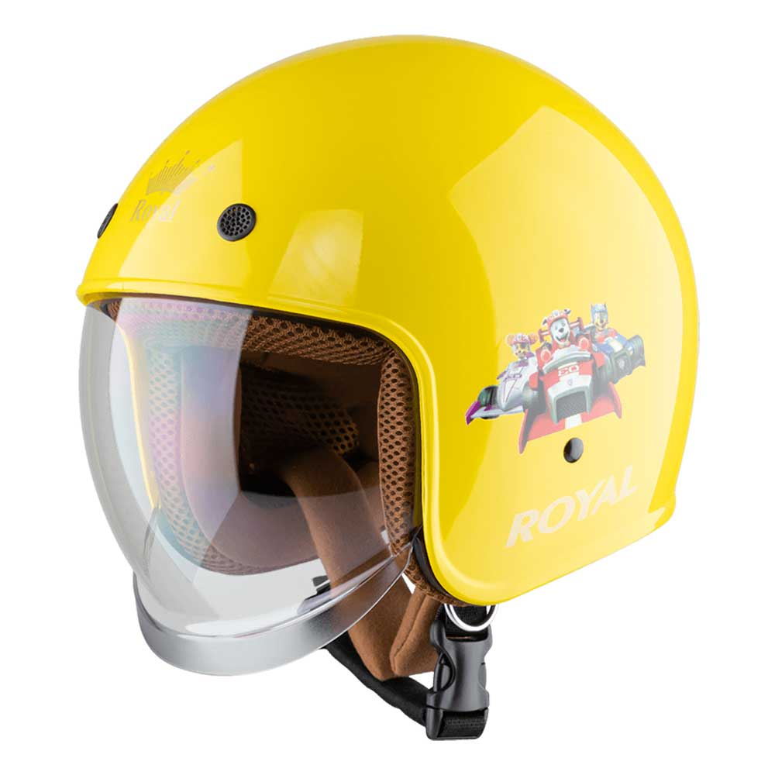
READING
helmet (n)
/ˈhelmɪt/
mũ bảo hiểm

Slide 9
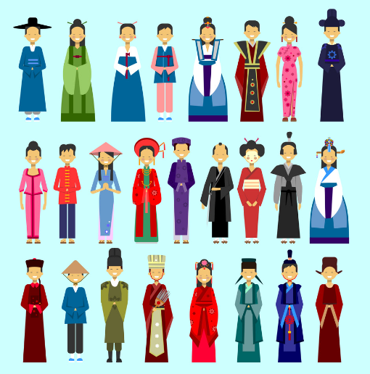
READING
traditional (n)
/trəˈdɪʃənl/
thuộc về truyền thống

Slide 10
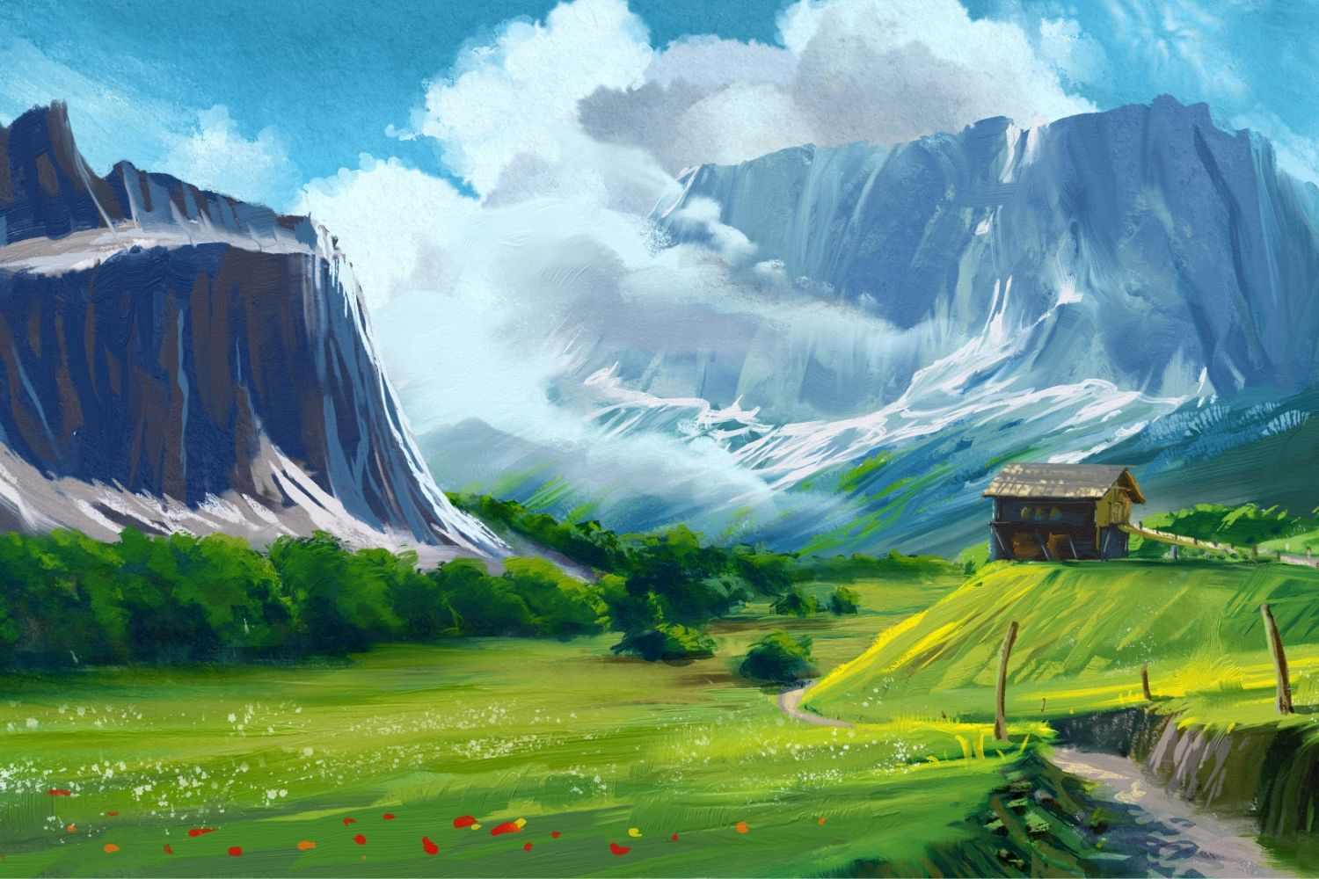
READING
landscape (n)
/ˈlændskeɪp/
phong cảnh

Slide 11
VOCABULARY
New words | Pronunciation | Meaning
1. fantastic (adj) | /fænˈtæstɪk/ | phi thường, tuyệt vời
2. perfect (adj) | /ˈpɜːfɪkt/ | hoàn hảo
3. rent (v) | /rent/ | thuê, mướn
4. helmet (n) | /ˈhelmɪt/ | mũ bảo hiểm
5. traditional (adj) | /trəˈdɪʃənl/ | thuộc về truyền thống
6. landscape (n) | /ˈlændskeɪp/ | phong cảnh

Slide 12
READING
2
Read the postcard and answer the questions.
1.
This postcard is about ______ in Stockholm.
A.
the weather
B.
a holiday
C.
landscapes
To: Grandpa & Grandma
Hoan Kiem, Ha Noi, Viet Nam
2.
Guests can ______ in the hotel.
A.
exercise
B.
cycle
C.
See Swedish art
3.
Mai and her parents rented bikes to ______.
B.
C.
go shopping
A.
cycle around the hotel
visit the old town
4.
“Fika” is a ______.
A.
traditional café
B.
palace
C.
coffee break

Slide 13
READING
3
Read the text and match the places with the things they have.
a.
the Royal Palace
1.
The hotel in Stockholm
b.
delicious breakfast
c.
Swimming pool
2.
The Old Town
d.
‘fika’
e.
Swedish art

Slide 14
READING
3
Read the text and match the places with the things they have.
b.
delicious breakfast
c.
Swimming pool
a.
the Royal Palace
d.
‘fika’
Swedish art
e.
1.
The hotel in Stockholm
2.
The Old Town
b.
delicious breakfast
a.
the Royal Palace
c.
Swimming pool
d.
‘fika’
e.
Swedish art

Slide 15
SPEAKING
4
Work in groups. Choose a city you know. Discuss and answer the questions below.
What city is it?
What is it like? (the weather, the food…)
What can you see and do there?
How do you feel about it?

Slide 16
SPEAKING
5
Share the information you have collected in 4 with your class.
You may start your talk with:
We’re going to tell you about …

Slide 17
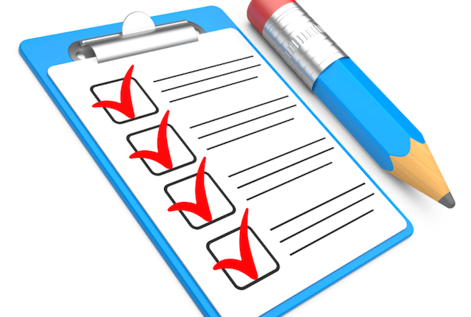
CONSOLIDATION
1
Wrap-up
What have we learnt in this lesson?
Read for specific information about Sweden
Talk about a city;

Slide 18
CONSOLIDATION
2
Homework
- Do exercises in the workbook
- Search for information about Bangkok

Slide 19
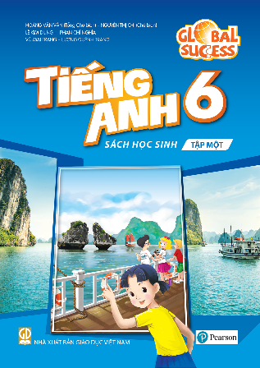
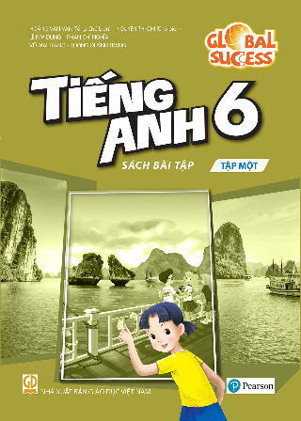
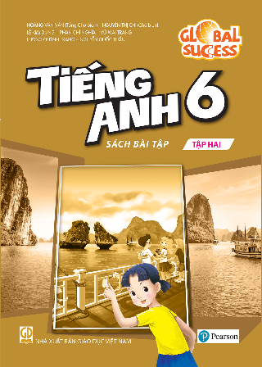
Website: hoclieu.vn
Fanpage: facebook.com/www.tienganhglobalsuccess.vn/

