Slide 2
WARM-UP
OPTION 1
- Look at two bowls of spicy noodles.
- Which bowl of noodles do you prefer?
=> I like the second bowl more than the first bowl.
√
√
√

Slide 3
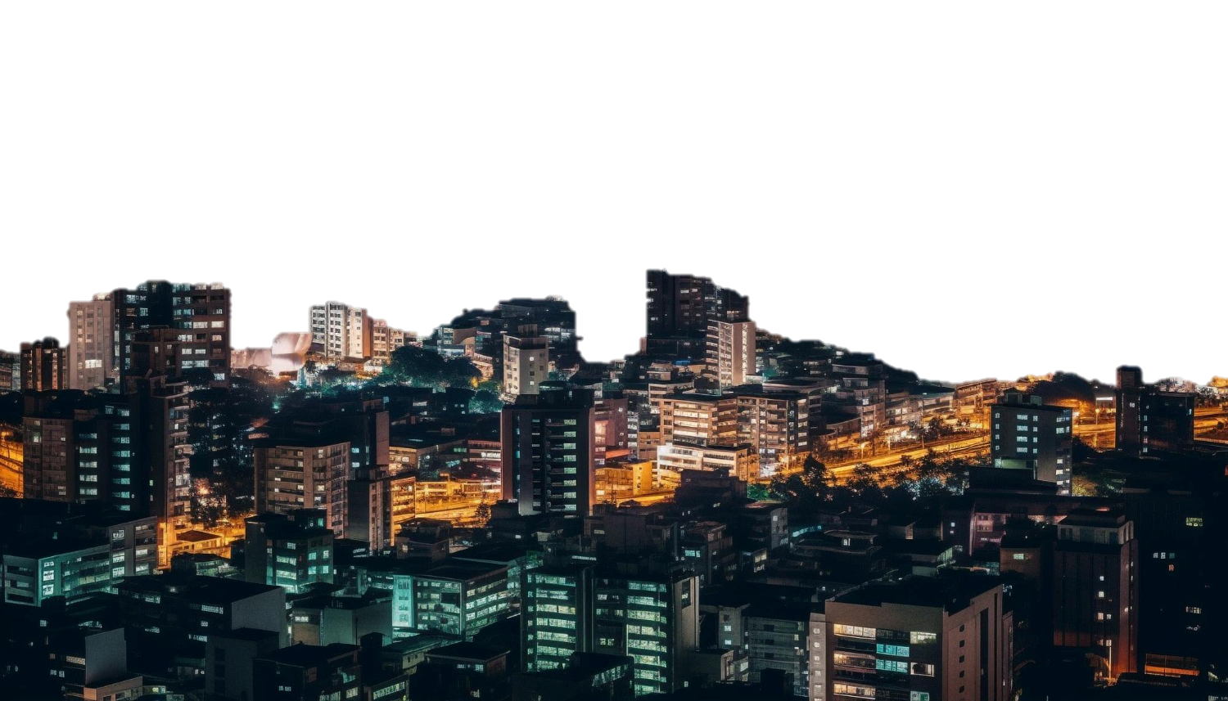
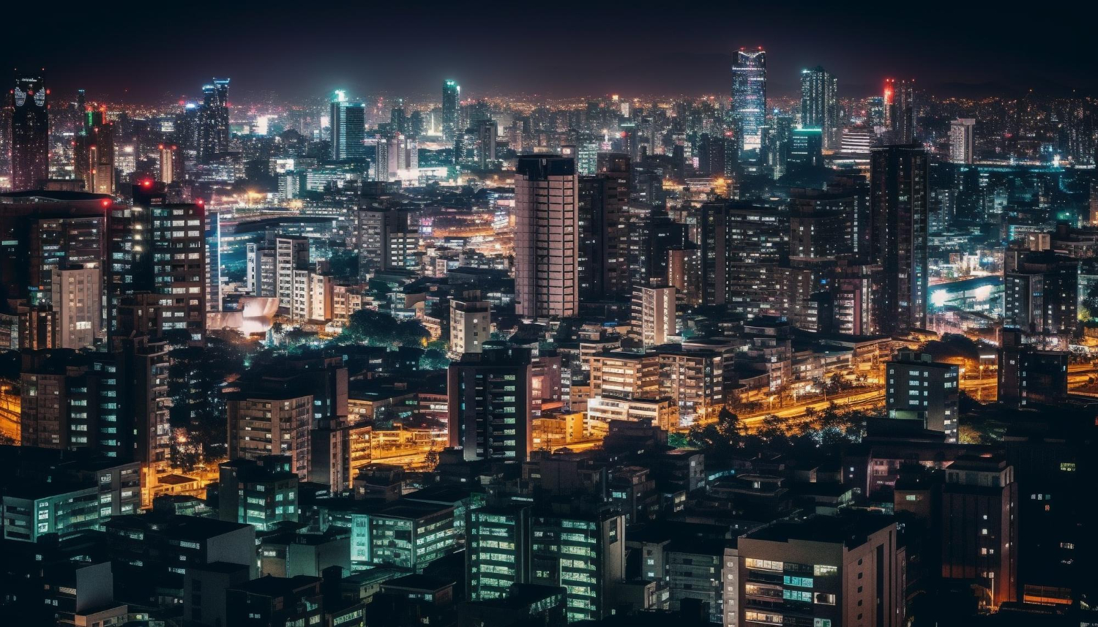
Unit
2
CITY LIFE
LESSON 3: A CLOSER LOOK 2

Slide 4
DOUBLE COMPARATIVES
Look at the sentences:
1.The more crowded the city is, the more polluted it is.
2. The hotter the noodles are , the more delicious they get.
You can use “the” with comparative adjectives to emphasize that one thing depends on another.
The + comparative adj 1 + clause 1, the + comparative adj 2 + clause 2.

Slide 5
DOUBLE COMPARATIVES
Look at Remember! box (p. 21):

Slide 6
DOUBLE COMPARATIVES
1
Choose the correct option to complete each sentence.
1. Lan isn’t home yet. The later / more late it gets, the more worried I get about her.
2. He wants a new house. The larger the house is, the comfortable / more comfortable he feels.
3. She thinks the bigger the city is, higher / the higher the cost of living gets.

Slide 7
DOUBLE COMPARATIVES
1
Choose the correct option to complete each sentence.
4. The famouser / more famous the city is, the higher number of tourists it can attract.
5. The larger population the town has, more difficult / the more difficult it is to find a job.

Slide 8
DOUBLE COMPARATIVES
2
Find a mistake in the underlined parts in each sentence below and correct it.
The hotter
1. I love the spicy food in this city. The hottest the food is, the more I like it.
A
B
C
D
2. I got stuck in a traffic jam yesterday. The more congested the road, the tired I became.
A
B
more tired
C
D

Slide 9
DOUBLE COMPARATIVES
2
Find a mistake in the underlined parts in each sentence below and correct it.
3. The modern the library is, the more attractive it is to teenagers.
more modern
A
B
C
D
4. The streets are getting dirtier. The more crowded this city is,
more polluted it becomes.
A
B
C
the more polluted
D

Slide 10
DOUBLE COMPARATIVES
2
Find a mistake in the underlined parts in each sentence below and correct it.
uglier
5. The denser the buildings are, the more ugly the city becomes. It’ll soon look like a concrete jungle.
A
B
C
D

Slide 11
PHRASAL VERBS
PHRASAL VERBS | MEANING
get around
carry out
come down with
hang out with
cut down on
move from place to place
/ go to a lot of different places
conduct
catch (a disease)
spend time a lot of time with sb
reduce

Slide 12
PHRASAL VERBS
3
Match a phrasal verb in column A with a suitable word / phrase in column B.
A | B
1. get around | a. noise pollution | 1.
2. carry out | b. friends | 2.
3. come down with | c. a project | 3.
4. hang out with | d. the city | 4.
5. cut down on | e. the flu | 5.
d
c
e
b
a

Slide 13
PHRASAL VERBS
4
Complete each sentence with a phrasal verb in 3. You can change the form of the verb when necessary.
coming down with
1. I’m a cold. I have a runny nose and a sore throat.
cut down on
2. We all need to using our cars and ride our bikes more to reduce air pollution.
get around
3. When I was in town, I chose to by bus.
hang out with
4. Where do teenagers in your neighbourhood often each other?
carrying out
5. The authority is a plan to solve traffic congestion in the downtown area.

Slide 14
PRODUCTION
5
Work in pairs. Tell each other whether you agree or disagree with the following ideas.
1. The busier the city is, the more unhappy its people are.
2. The older the city becomes, the less attractive it is to immigrants.
3. Your home town should cut down on noise pollution.

Slide 15
PRODUCTION
Some suggested ideas:
 | Agree | Disagree
1. The busier the city is, the more unhappy its people are. | Busy cities: high living costs, congested roads, long travelling time, etc. | Busy cities: lots of entertainment facilities, parks, playgrounds, etc.

Slide 16
PRODUCTION
Some suggested ideas:
 | Agree | Disagree
2. The older the city becomes, the less attractive it is to tourists. | Old cities: not many entertainment facilities, lack of public amenities, inconvenient public transportation. | Old cities: lots of cultural places, historical value, quiet and safe.

Slide 17
PRODUCTION
Some suggested ideas:
 | Agree | Disagree
3. Your home town should cut down on noise pollution. | My home town: lots of trucks and heavy lorries running on roads, construction sites everywhere, people playing music very loud at night. | My home town: a small and peaceful town, people mostly riding bikes, no big events happening in the town no noise pollution.

Slide 18
CONSOLIDATION
1
Wrap-up
What have we learnt in this lesson?
Recognise and use comparison of adjectives and some phrasal verbs.

Slide 19
CONSOLIDATION
2
Homework
- Do exercises in the workbook.
- Make 5 sentences by using double comparatives and phrasal verbs that you have learnt.

Slide 20
Website: hoclieu.vn
Fanpage: facebook.com/www.tienganhglobalsuccess.vn/

