Slide 1

TRƯỜNG TIỂU HỌC TÂN HỘI
TIẾNG ANH LỚP 2
GV: HOÀNG THỊ THÙY NHIÊN

Slide 2
Unit 9: Classroom Activities
Lesson 2
Page 60, 61

Slide 3

WARM UP

Slide 4
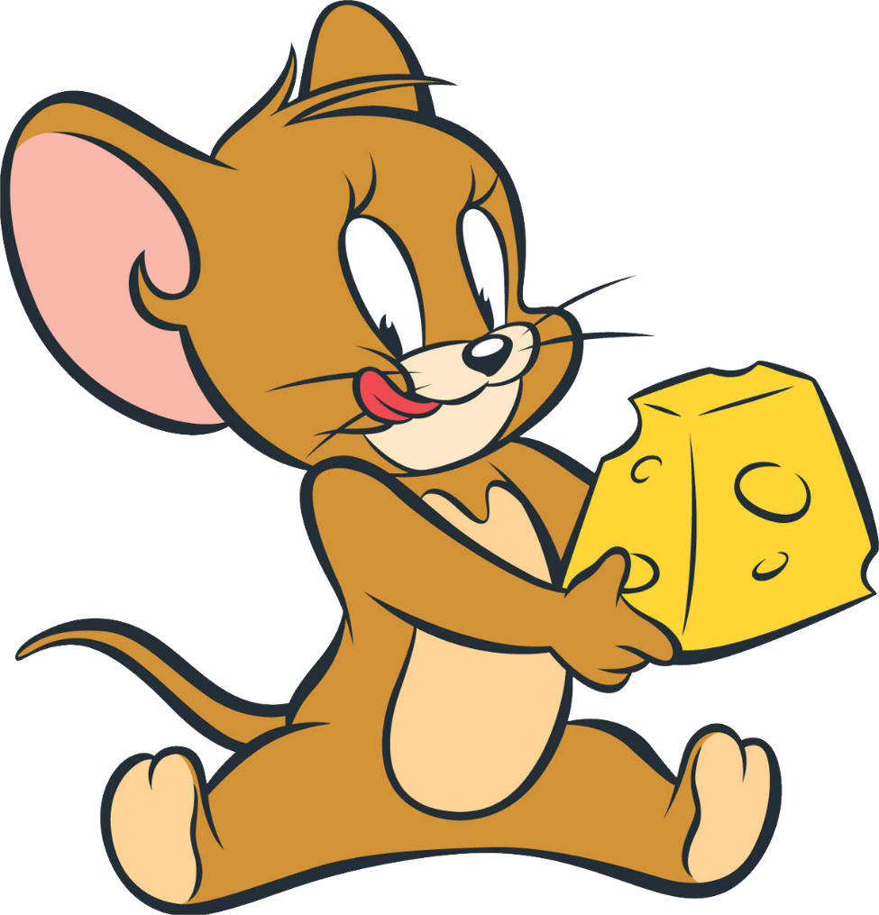
JERRY’S
DOOR
START

Slide 5


What is this?
CHECK
It is a crayon.

Slide 6

What is this?
CHECK
It is an eraser.

Slide 7

What is this?
CHECK
It is a pencil case.

Slide 8
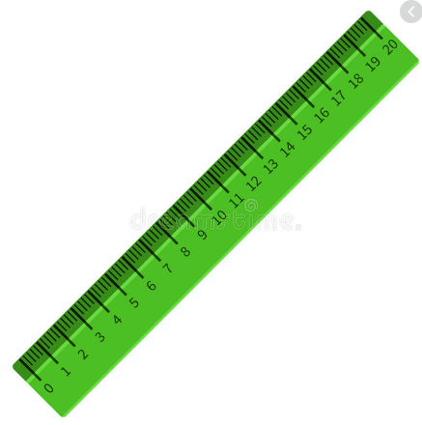
What is this?
CHECK
It is a ruler.

Slide 9
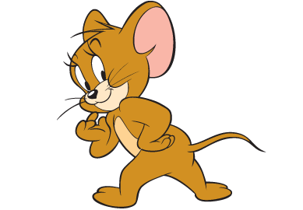
Well done!

Slide 10

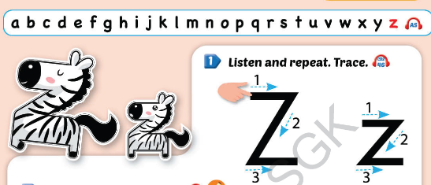

Slide 11


B. Listen and repeat. Write.
….ebra.
….oo.

Slide 12

e
z
?
z
e
b
r
a

Slide 13

z
i
?
z
o
o

Slide 14

C. Sing

Slide 15

E. Listen and repeat.
F. Listen and point

Slide 16
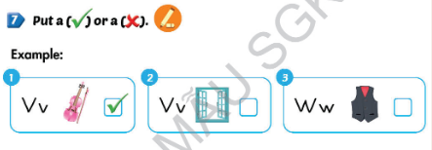
G. Put a (V) or a (X)

Slide 17
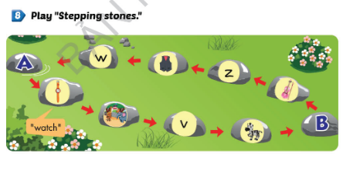

Slide 18

Enjoy your day!

