Slide 1

TRƯỜNG TIỂU HỌC TÂN HỘI
TIẾNG ANH LỚP 1
GV: HOÀNG THỊ THÙY NHIÊN

Slide 2

Unit 3: Colors
Lesson 1.
Page: 20, 21

Slide 3
Objectives
By the end of this lesson, students will be able to
- identify and use vocabulary for colors, using ….
- say what color it is, using …..
Vocabulary:
red, yellow, blue
Sentence pattern:
It’s (red).

Slide 4










FEEDING GOLDFISH
Mỗi câu trả lời đúng là
CÂU THẦN CHÚ giúp cá Vàng
ngoi lên mặt nước nhận thức ăn.
Nào chúng mình cùng giúp
bạn nhỏ cho cá Vàng ăn nhé!
START

Slide 5




What's it?
Next
It's a dog.
It's a bag.
It's a cat.
Notes:
YOUTUBE: MsPham.
Facebook: Dạy và học cùng công nghệ.

Slide 6


What's it?
Next
It's a book.
It's a bag.
It's a door.
Notes:
YOUTUBE: MsPham.
Facebook: Dạy và học cùng công nghệ.

Slide 7



What's it?
Next
It's a door.
It's a cap.
It's a bag.
Notes:
YOUTUBE: MsPham.
Facebook: Dạy và học cùng công nghệ.

Slide 8

What's it?
Next
It's a book.
It's a bag.
It's a door.
Notes:
YOUTUBE: MsPham.
Facebook: Dạy và học cùng công nghệ.

Slide 9

It’s time to learn …

Slide 10







Click A to hear the sound
/red/
màu đỏ
/ˈjeloʊ/
màu vàng
/bluː/
màu xanh dương
Notes:
Click vào hình A. 1. Listen and point. Repeat để cho cả audio full chạy

Slide 11

/red/
màu đỏ
Notes:
Click vào hình A. 1. Listen and point. Repeat để cho cả audio full chạy

Slide 12

/ˈjeloʊ/
màu vàng

Slide 13

/bluː/
màu xanh dương

Slide 14

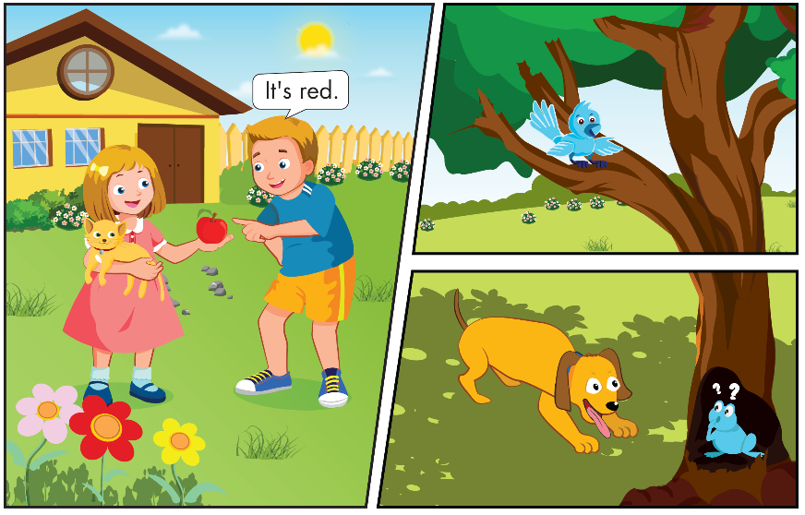
Notes:
B. Listen and point. Repeat. Role-play. (CD1 Track 03)
Have students call out the things they can see in each picture.
Play the audio and have them point to the characters.
Play the audio again and have them repeat the new words.
Divide the class into pairs to role-play the dialogue.
Swap roles and repeat.
Invite some pairs to demonstrate the activity in front of the whole class.
Go around the class and support them if necessary.

Slide 15


It's red.
It's red.
It's red.
It's red.
It's yellow.
It's yellow.
It's yellow.
It's yellow.
It's blue.
It's blue.
It's blue.
It's blue.
Notes:
B. Listen and point. Repeat. Role-play. (CD1 Track 03)
Have students call out the things they can see in each picture.
Play the audio and have them point to the characters.
Play the audio again and have them repeat the new words.
Divide the class into pairs to role-play the dialogue.
Swap roles and repeat.
Invite some pairs to demonstrate the activity in front of the whole class.
Go around the class and support them if necessary.

Slide 16

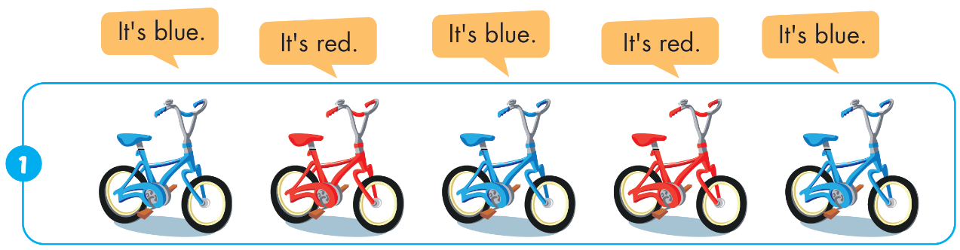
Notes:
Click vào hình A. 1. Listen and point. Repeat để cho cả audio full chạy

Slide 17


It's red.
It's yellow.
It's red.
It's yellow.
It's red.
Notes:
Click vào hình A. 1. Listen and point. Repeat để cho cả audio full chạy

Slide 18

It's yellow.
It's yellow.
It's blue.
It's yellow.
It's yellow.
Notes:
Click vào hình A. 1. Listen and point. Repeat để cho cả audio full chạy

Slide 19
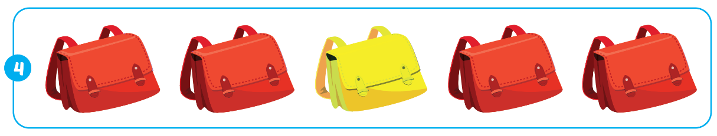
It's red.
It's red.
It's yellow.
It's red.
It's red.
Notes:
Click vào hình A. 1. Listen and point. Repeat để cho cả audio full chạy

Slide 20


Notes:
B. Listen and point. Repeat. Role-play. (CD1 Track 03)
Have students call out the things they can see in each picture.
Play the audio and have them point to the characters.
Play the audio again and have them repeat the new words.
Divide the class into pairs to role-play the dialogue.
Swap roles and repeat.
Invite some pairs to demonstrate the activity in front of the whole class.
Go around the class and support them if necessary.

Slide 21

Enjoy your day!

