Slide 1

WARM UP

Slide 2
Look quickly and say aloud the word.

Slide 3
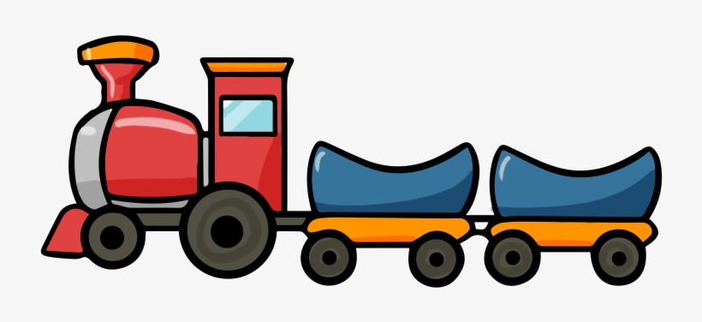
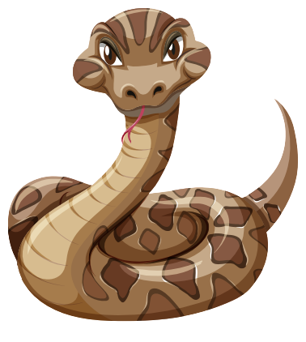

Slide 4
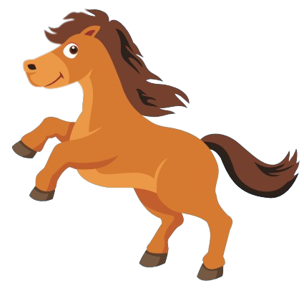

Slide 5


Slide 6
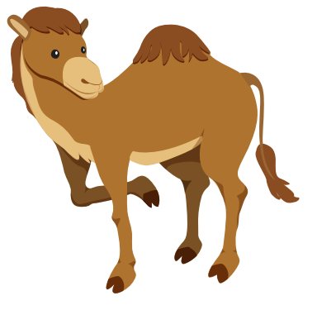

Slide 7
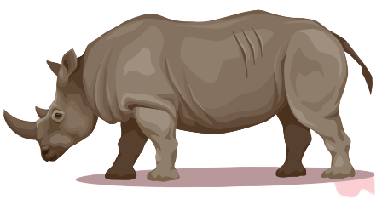

Slide 8


Slide 9
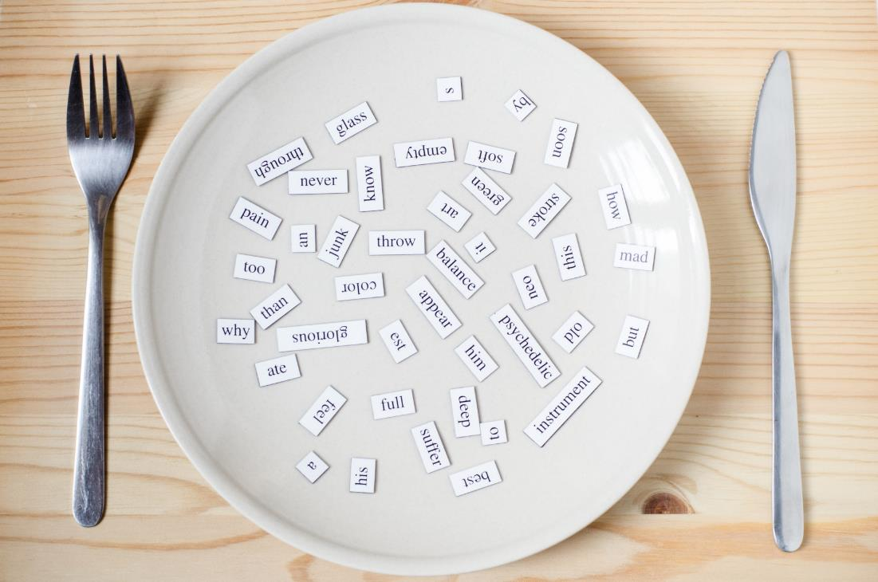
New words
panda, giraffe, lion,
dolphin, tiger, zebra

Slide 10


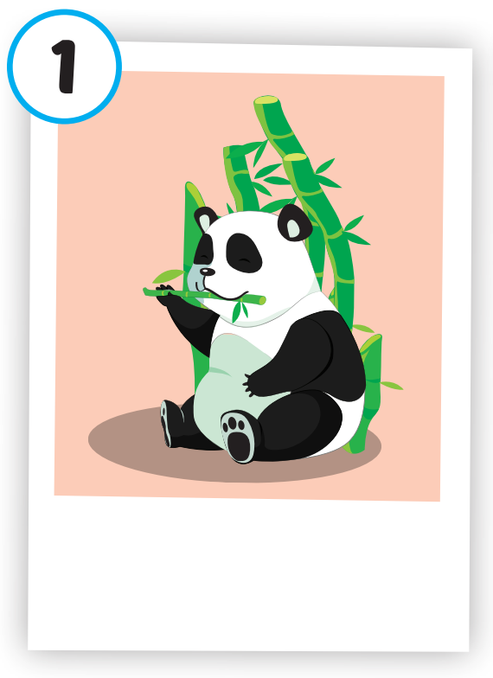
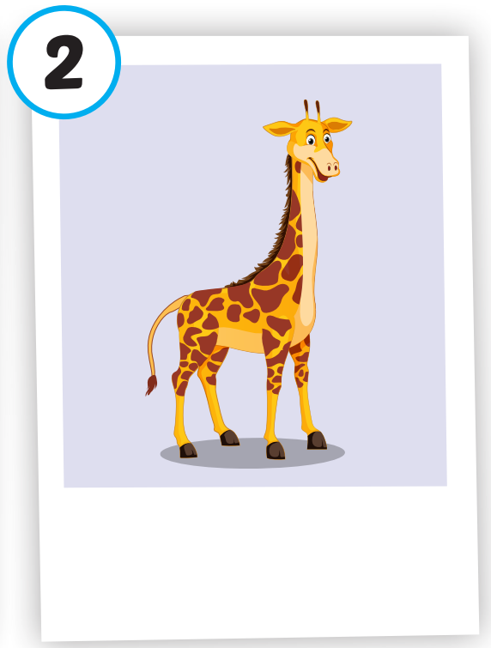
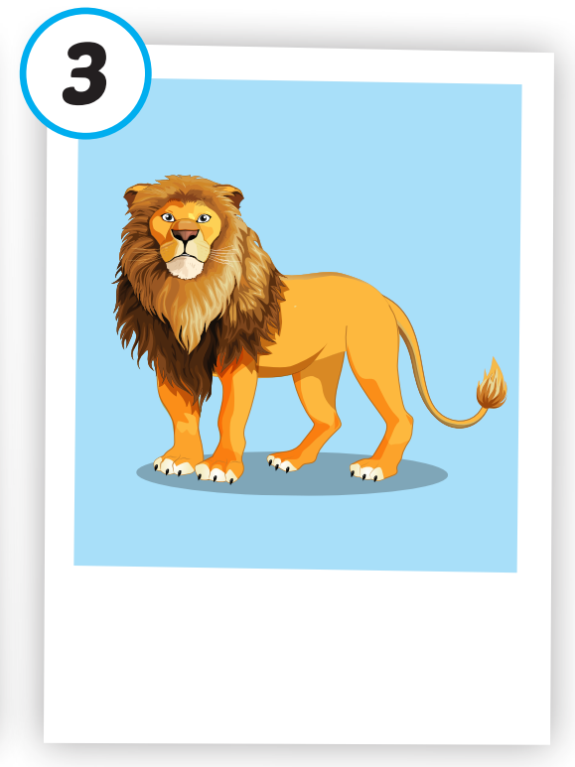
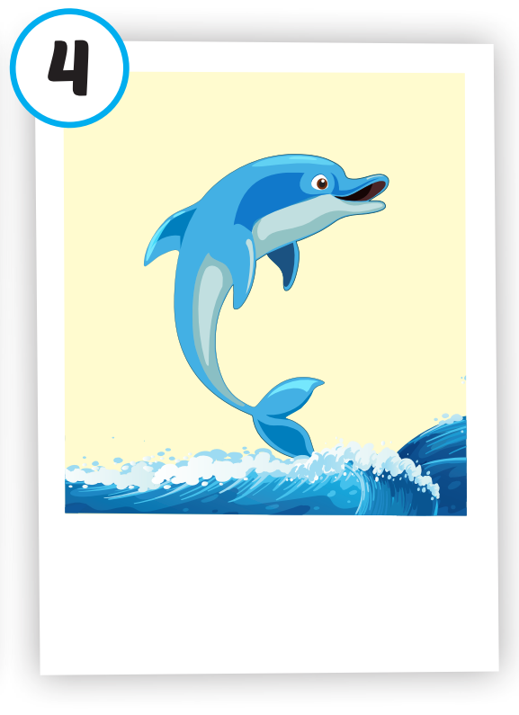
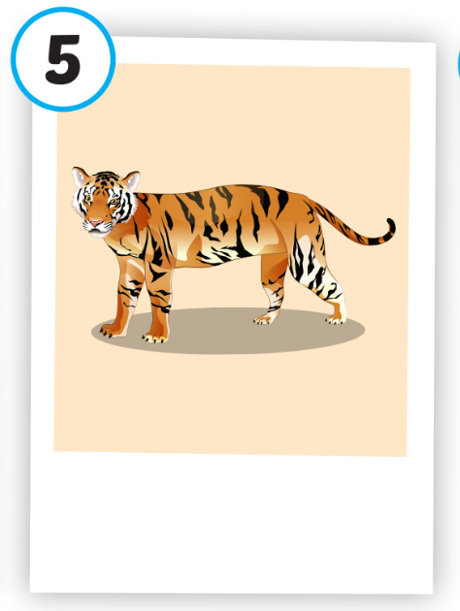
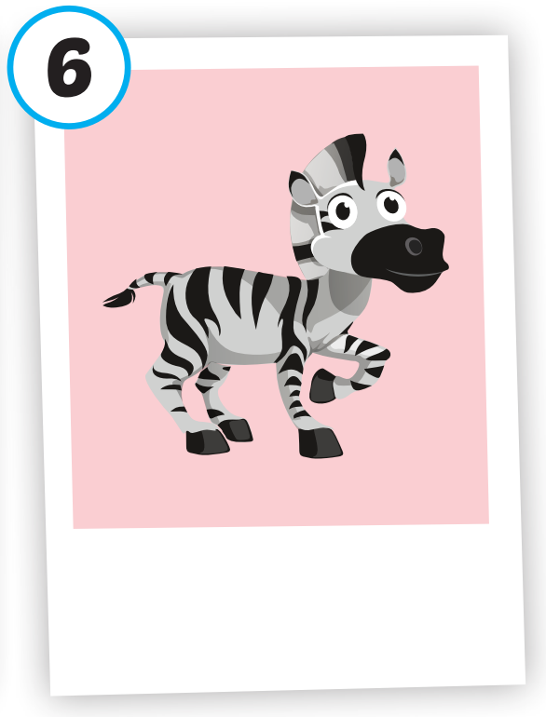






/ˈpændə/
con gấu trúc
/ˈlaɪən/
con sư tử
/ˈdɑːlfɪn/
cá heo
/ˈtaɪɡər/
con hổ
/ˈziːbrə/
con ngựa vằn
/dʒɪˈræf/
con hươu cao cổ

Slide 11

Click on each picture to hear the sound.
/ˈpændə/
con gấu trúc
Notes:
Click vào hình A. 1. Listen and point. Repeat để cho cả audio full chạy

Slide 13
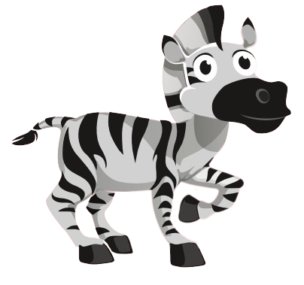
Click on each picture to hear the sound.
/ˈziːbrə/
con ngựa vằn

Slide 14
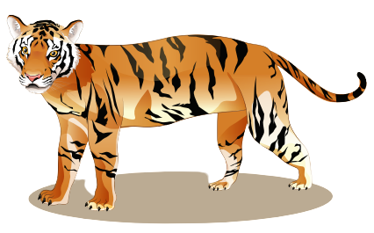
Click on each picture to hear the sound.
/ˈtaɪɡər/
con hổ

Slide 15

Click on each picture to hear the sound.
/ˈdɑːlfɪn/
cá heo
Notes:
Click vào hình A. 1. Listen and point. Repeat để cho cả audio full chạy

Slide 16
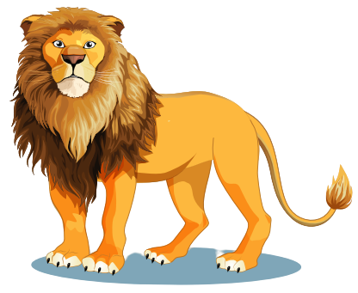
Click on each picture to hear the sound.
/ˈlaɪən/
con sư tử

Slide 17
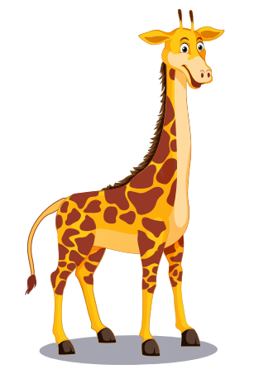
Click on each picture to hear the sound.
/dʒɪˈræf/
con hươu cao cổ
Notes:
Click vào hình A. 1. Listen and point. Repeat để cho cả audio full chạy

Slide 18

Practice

Slide 19
Check your memory

Slide 20



A. tiger
B. lion
C. panda

Slide 21
A. lion
B. tiger
C. zebra

Slide 22
A. camel
B. tiger
C. giraffe

Slide 23
A. dolphin
B. tiger
C. lion

Slide 24
A. monkey
B. lion
C. tiger

Slide 25
A. dolphin
B. giraffe
C. duck

Slide 26
Structure
What's this? - It's a panda.
What's that? - It's a dolphin.

Slide 27
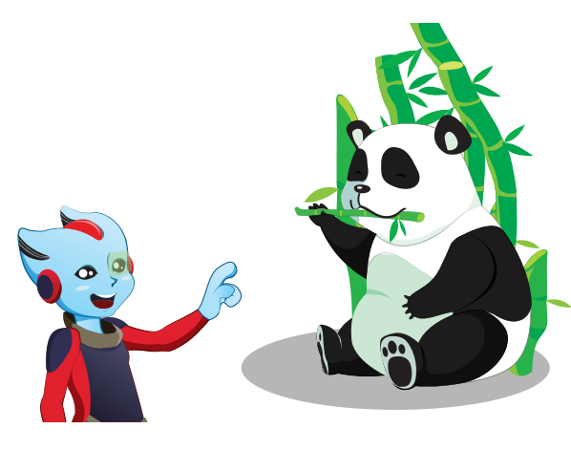



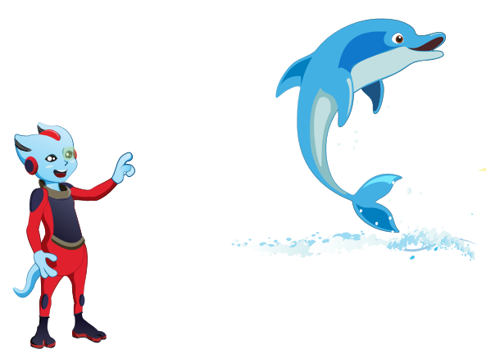

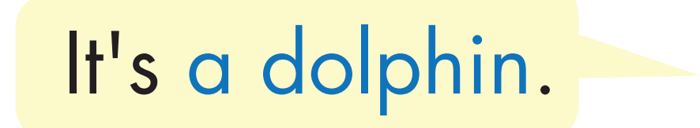

Structure

Slide 28


Slide 29

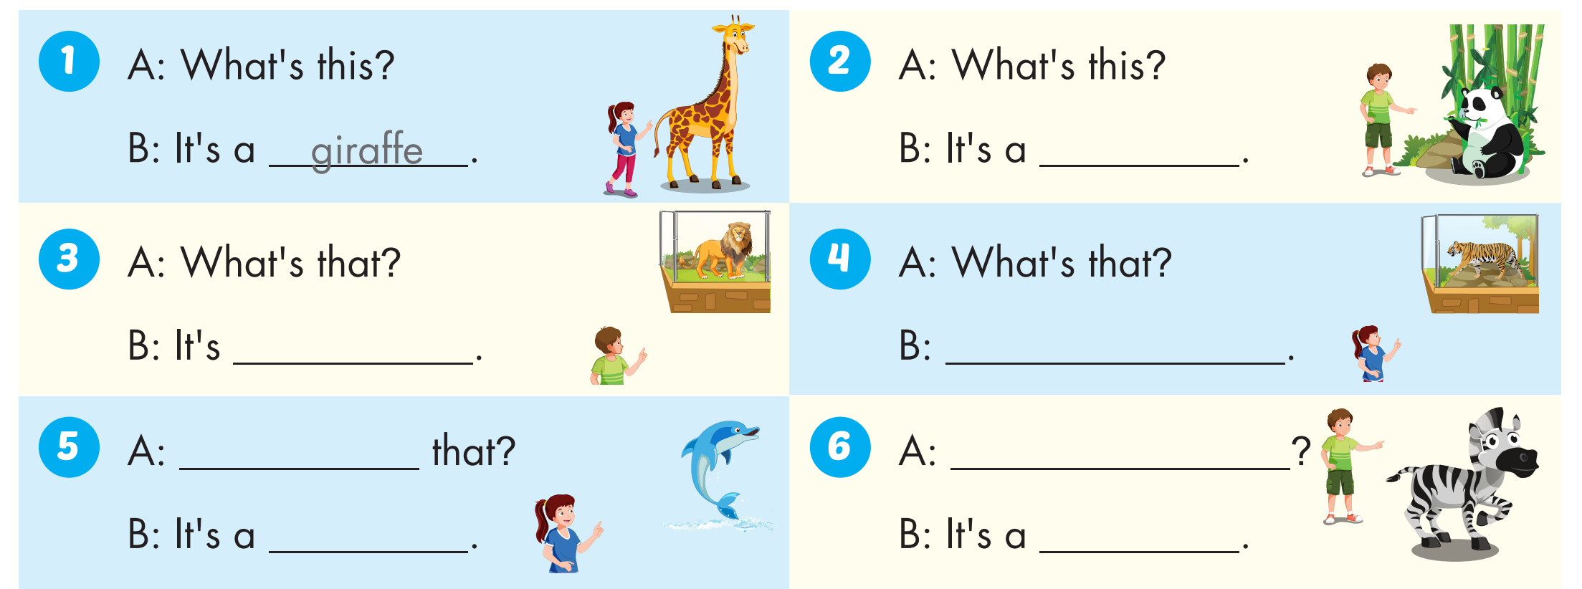
panda
a lion
It's a tiger
What's
What's this?
dolphin
zebra

Slide 30


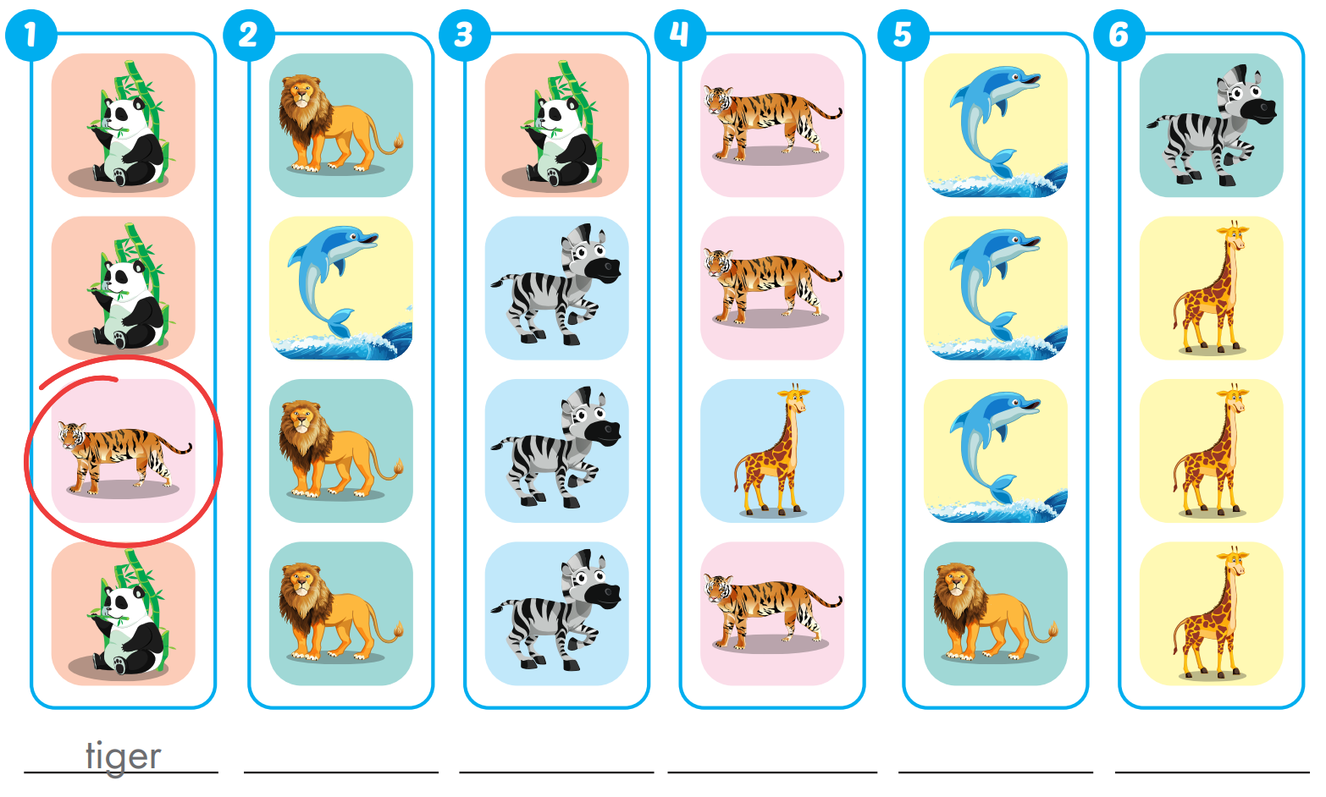
Extra Practice
WB, page 4
dolphin
panda
giraffe
lion
zebra

Slide 31

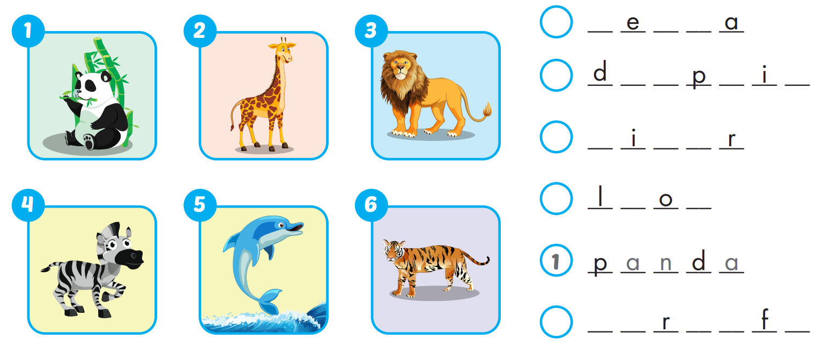
Extra Practice
WB, page 4
4
z b r
5
o l h n
6
t g e
3
i n
2
g i a f e

Slide 32
Homework
Practice the vocabularies and structure; and make sentences using them.
Do the exercises in Tiếng Anh 4 i-Learn Smart Start WB (page 4)
Do the exercises in Tiếng Anh 4 i-Learn Smart Start Notebook (page 7)
Prepare the next lesson (page 10 SB)
Play the consolidation games in Tiếng Anh 4 i-Learn Smart Start DHA App on www.eduhome.com.vn

