Slide 1
UNIT 5:
FREE TIME ACTIVITIES
Lesson 1
Page 34, 35

Slide 2
Objectives
By the end of this lesson, students will be able to suggest activities.
Vocabulary:
- soccer, tag, hopscotch, hide and seek.
Structure:
- Let’s play (soccer).
OK.
Skills:
- Talk about activities, using the vocab in the lesson

Slide 3
WARM UP

Slide 4
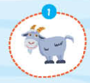
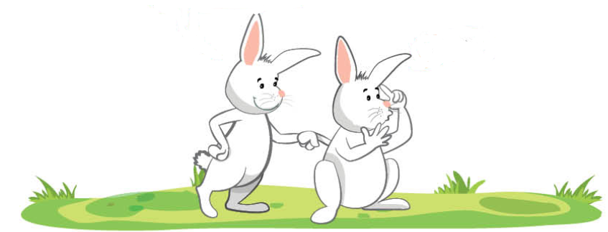
What’s that?
It’s a goat.

Slide 5
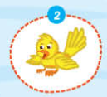
What’s that?
It’s a bird.

Slide 6
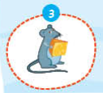
What’s that?
It’s a mouse.

Slide 7
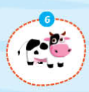
What’s that?
It’s a cow.

Slide 8
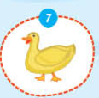
What’s that?
It’s a duck.

Slide 9
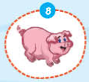
What’s that?
It’s a pig.

Slide 10
It’s time to learn …

Slide 11
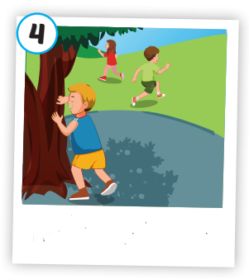
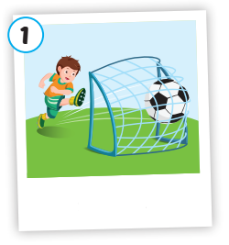
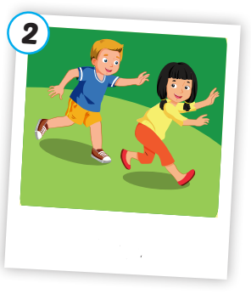
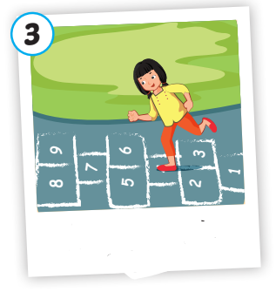
Click the pictures to hear the sound.

Slide 12
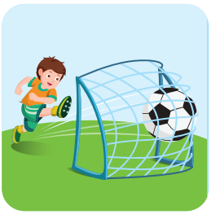
soccer
/ˈsɒkər/
bóng đá

Slide 13
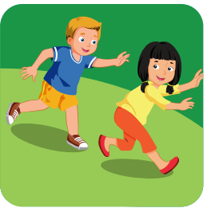
tag
/tæɡ/
trò đuổi bắt

Slide 14
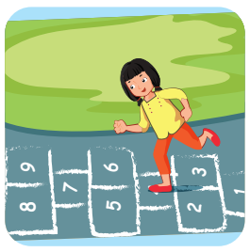
hopscotch
/ˈhɒpskɒtʃ/
trò nhảy lò cò

Slide 15
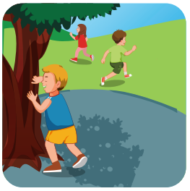
hide and seek
/ˌhaɪd ən ˈsiːk/
trò chơi trốn tìm

Slide 16
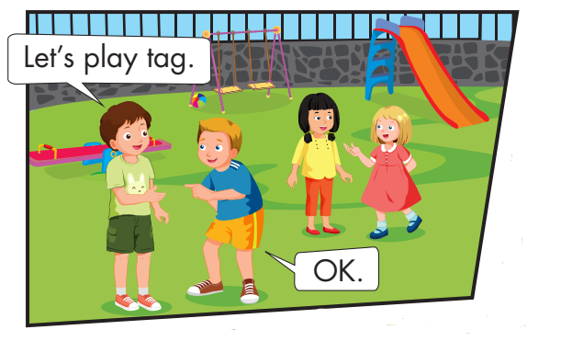

Slide 17
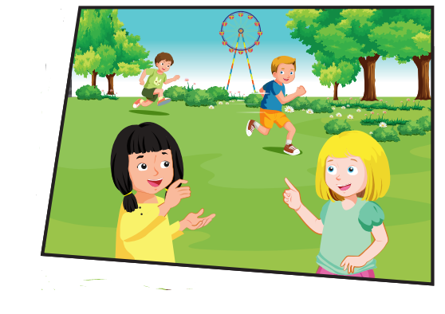
Hey Bill.
Let’s play tag.
OK.

Slide 18
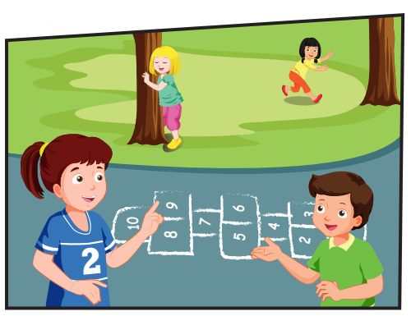
Lola. Let’s play hide and seek.
OK.

Slide 19
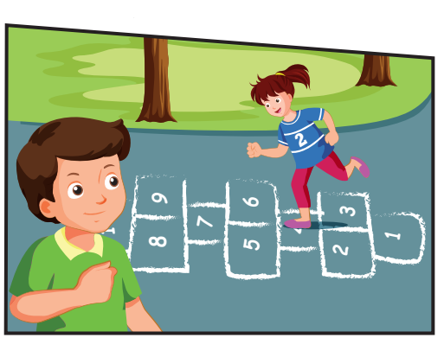
Yeah, OK.
Let’s play hopscotch, Lucy.

Slide 20
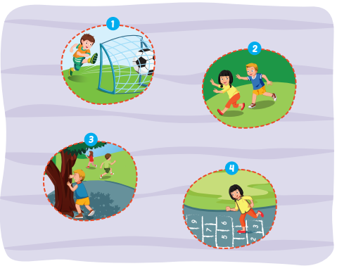
Let’s play soccer.
OK.

Slide 21
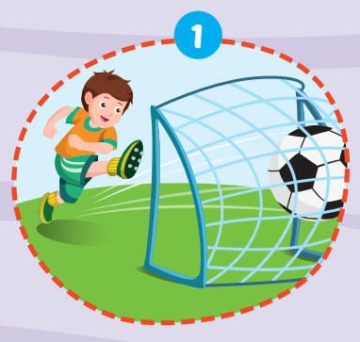
Let’s play soccer.
OK.

Slide 22
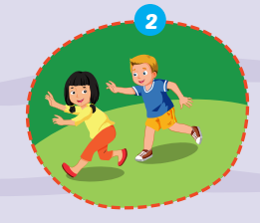
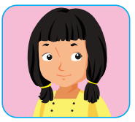
OK.
Let’s play tag.

Slide 23
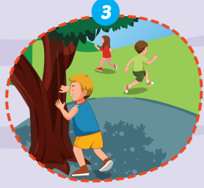
Let’s play
hide and seek.
OK.

Slide 24
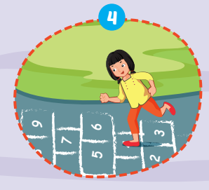
OK.
Let’s play hopscotch.

Slide 25
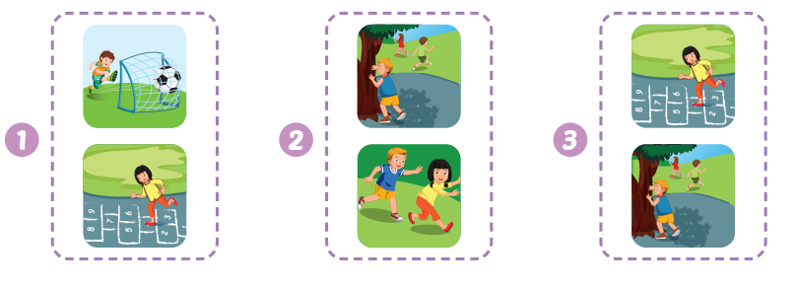

Slide 26
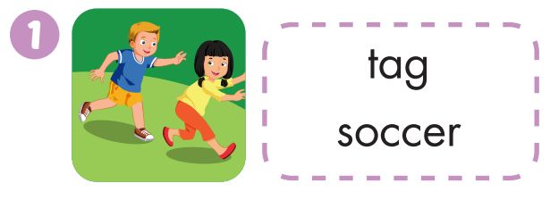
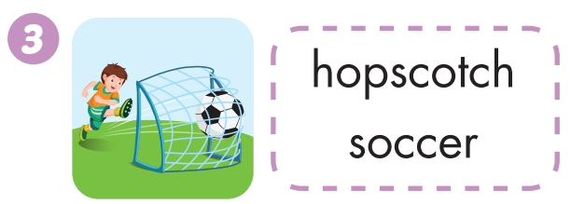
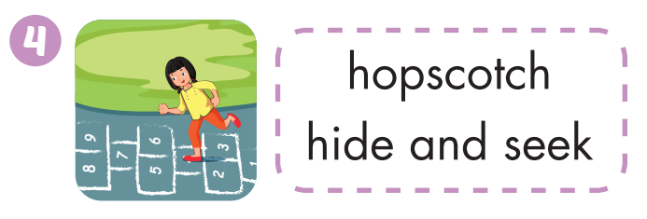

Slide 27
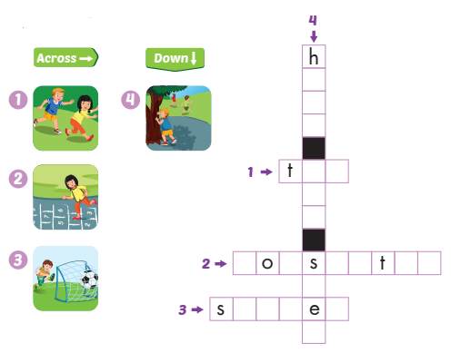
i
d
e
n
d
a g
h p c o c h
e
k
o c c r

