Slide 1
Table of contents
02
01
03
Warm Up
Speaking
Class Activities

Slide 2
01
Warm Up

Slide 3
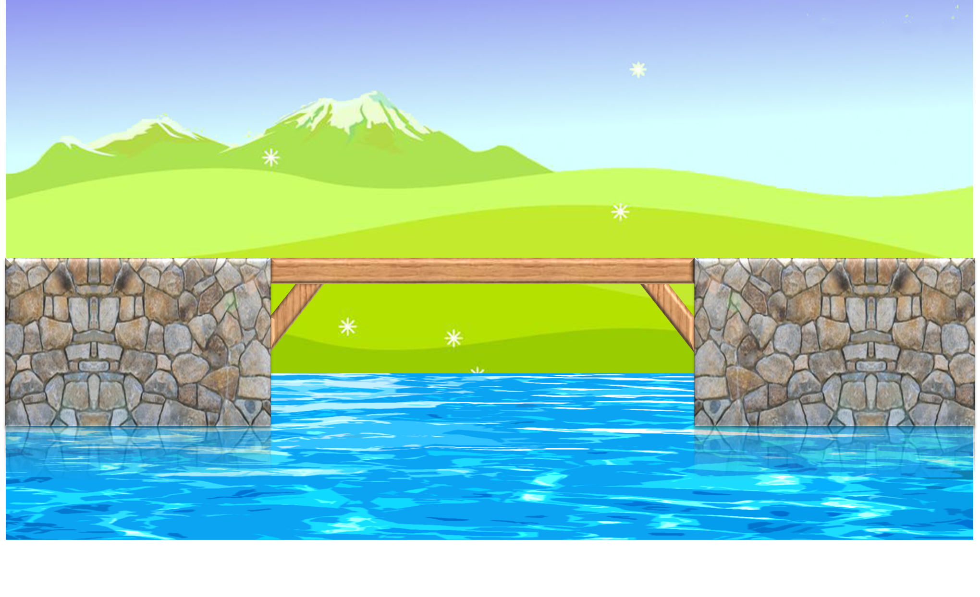
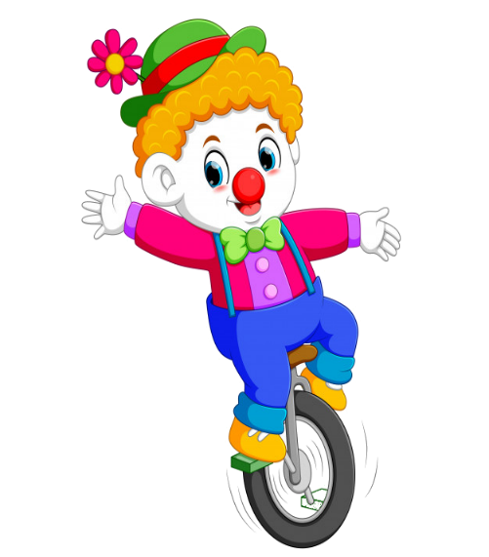



PLAY
Notes:
Thanh Yến Trần 0967 255 149 zalo/ FB https://www.facebook.com/thanhyentrananhngutaymy

Slide 4
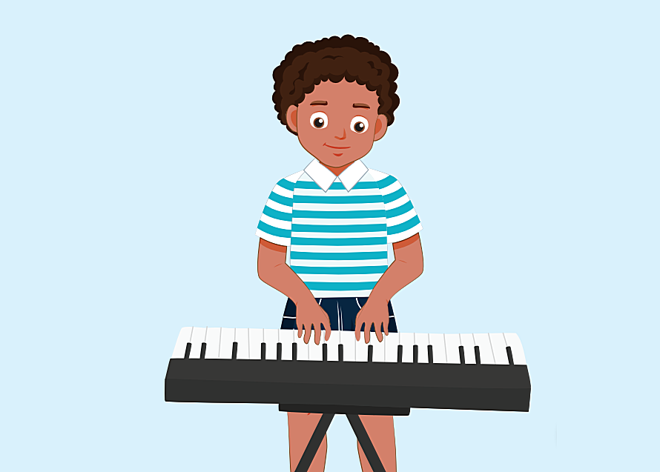



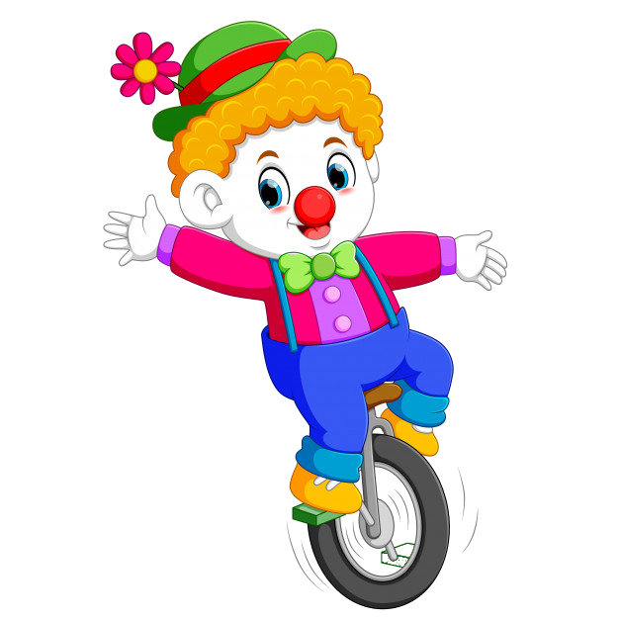
I can………..
A. sing
B. act
C. paint
D. play the keyboard
Notes:
Thanh Yến Trần 0967 255 149 zalo/ FB https://www.facebook.com/thanhyentrananhngutaymy

Slide 5
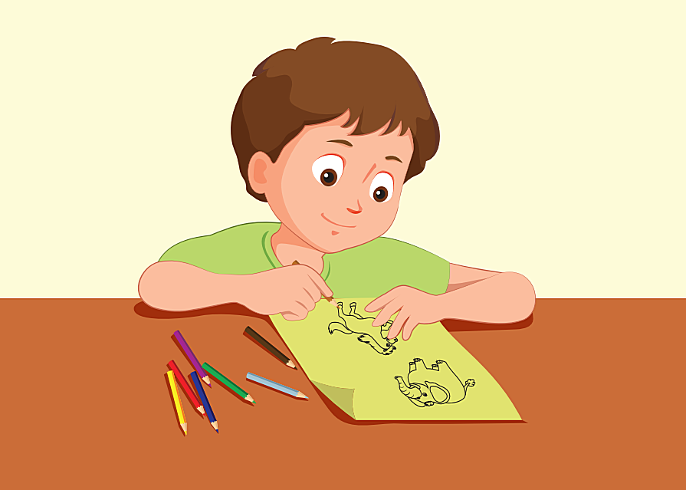
I can………
A. draw
B. sing
C. paint
D. dance
Notes:
Thanh Yến Trần 0967 255 149 zalo/ FB https://www.facebook.com/thanhyentrananhngutaymy

Slide 6

I can………and…………..
A. sing-paint
B. dance- paint
C. sing-draw
D. dance-draw
Notes:
Thanh Yến Trần 0967 255 149 zalo/ FB https://www.facebook.com/thanhyentrananhngutaymy

Slide 7
: tìm
I can’t……
A. draw
B. paint
C. act
D. sing
Notes:
Thanh Yến Trần 0967 255 149 zalo/ FB https://www.facebook.com/thanhyentrananhngutaymy

Slide 8

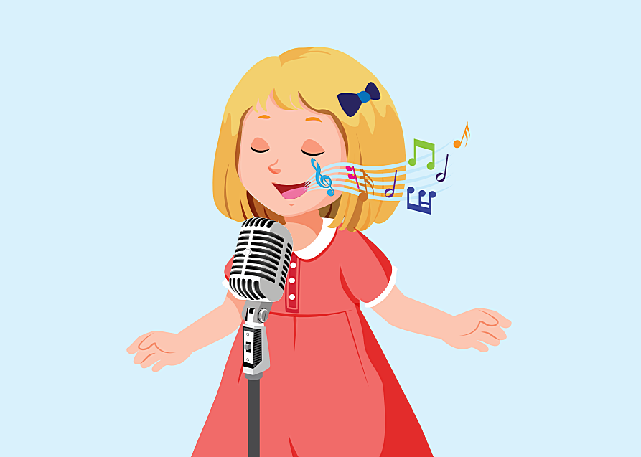
I can and
A. draw-sing
B. paint- act
C. paint- sing
D. draw-act

Slide 9

I can’t and sing.
A. draw
B. play the keyboard
C. sing
D. dance

Slide 10
Listen and choose the correct answer
A. draw and paint
B. draw and sing
C. draw and act
D. draw and dance

Slide 11
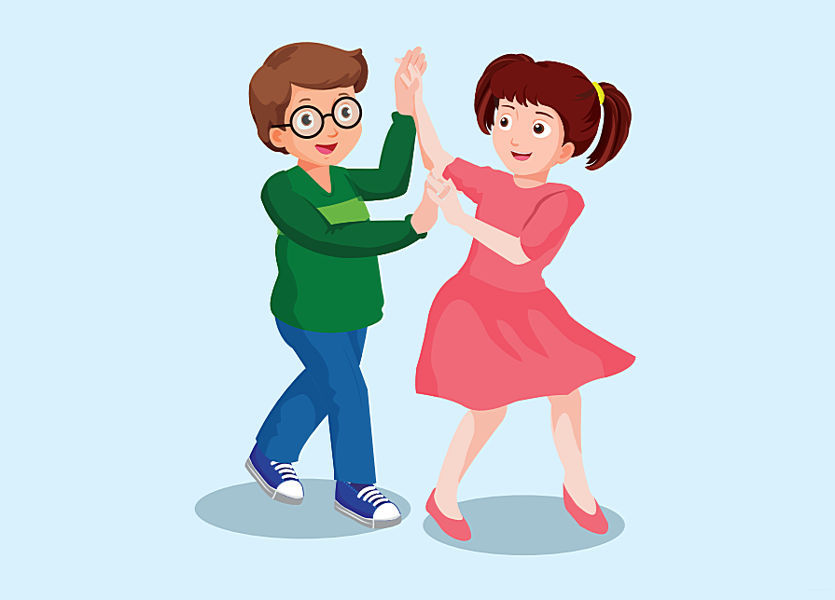
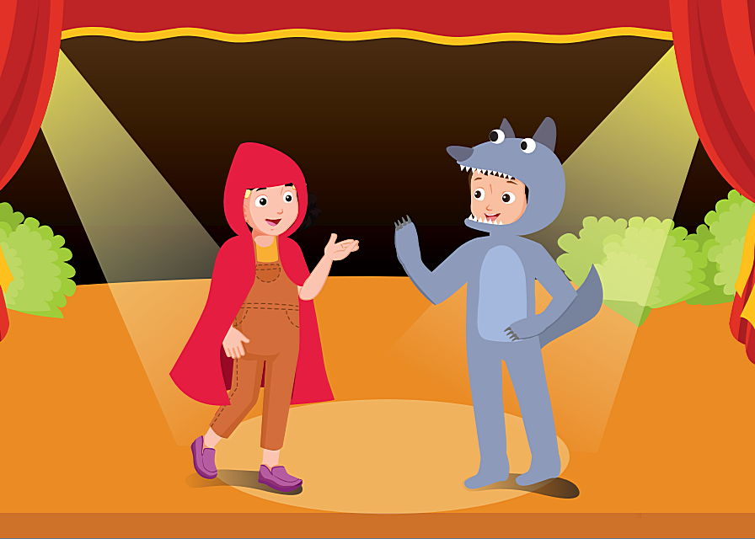
Listen and choose the correct picture
A
B
C
D
Notes:
Thanh Yến Trần 0967 255 149 zalo/ FB https://www.facebook.com/thanhyentrananhngutaymy

Slide 12


EXIT
Notes:
Thanh Yến Trần 0967 255 149 zalo/ FB https://www.facebook.com/thanhyentrananhngutaymy

Slide 13
02
SPEAKING

Slide 14

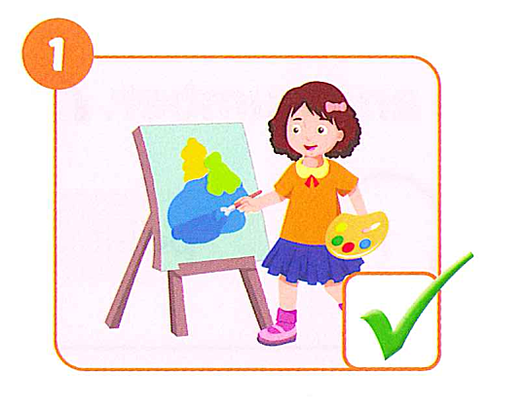
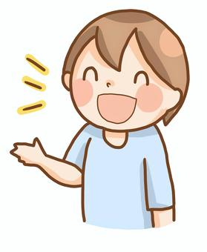
I can paint

Slide 15
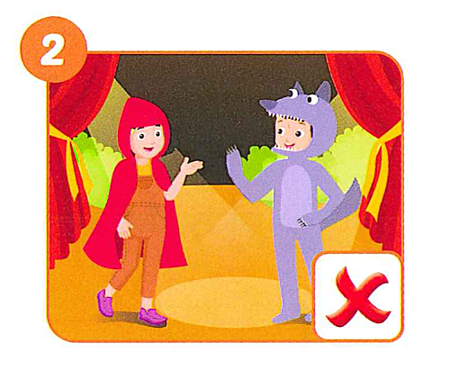
I can act

Slide 16
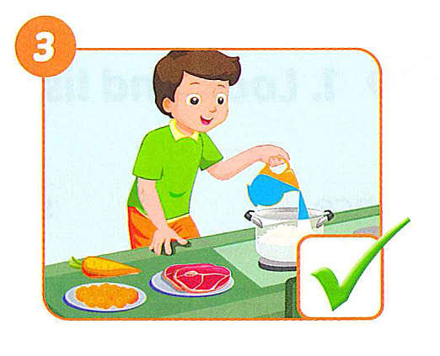
I can cook

Slide 17
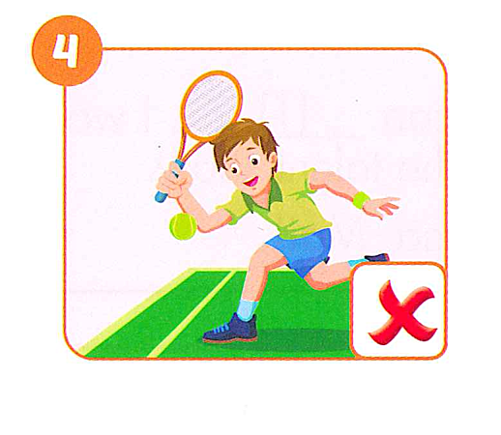
I can’t tennis

Slide 18
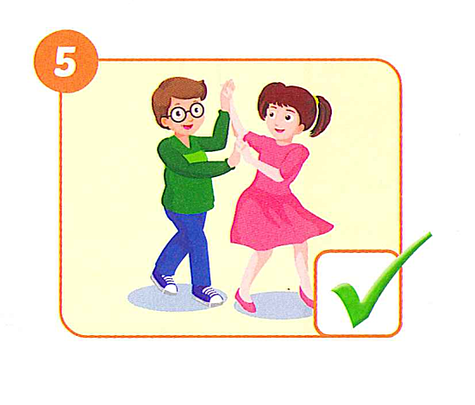
I can dance

Slide 19
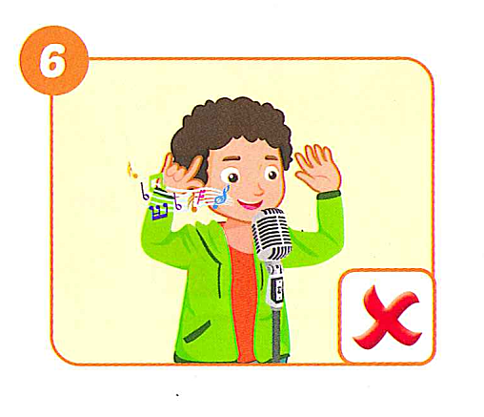
I can’t sing

Slide 20
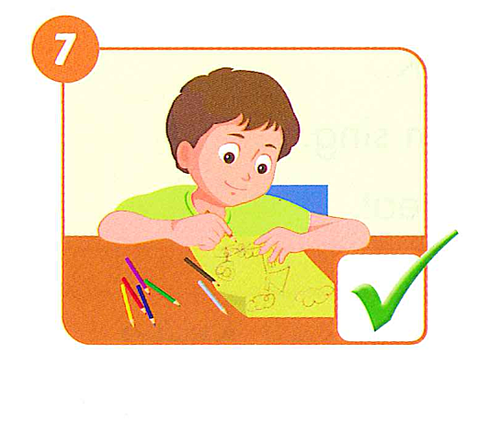
I can draw

Slide 21
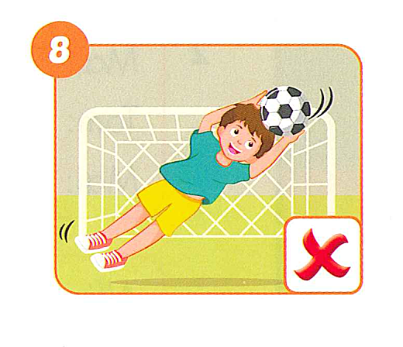
I can’t
play soccer

Slide 22
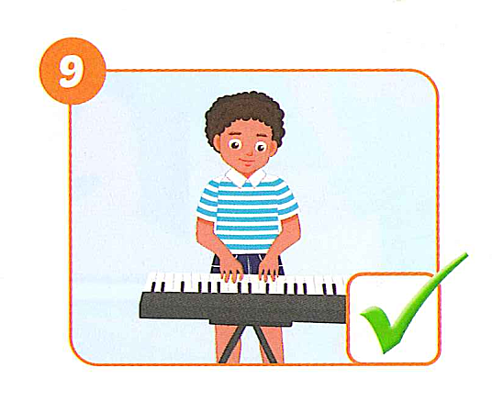
I can
play the keyboard

Slide 23
Class Activity

Slide 24
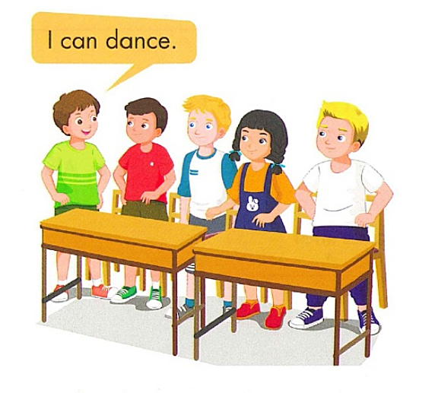

Slide 25
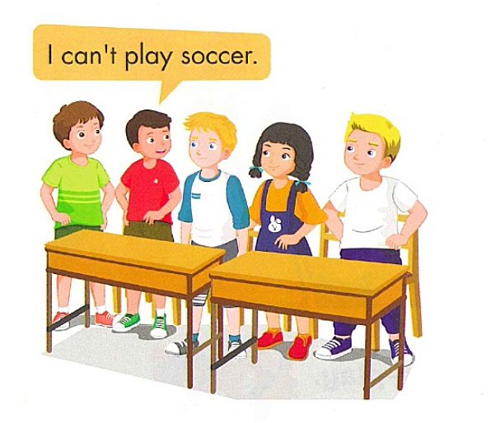

Slide 26
GOOD BYE

