Slide 1
Thursday, December 5 ^{th} 2024
Unit 4 Home
Lesson 1.1

Slide 2

WARM UP

Slide 3




Make up sentences, using suggested pictures. pictures
Make up sentences, using pictures
I have
a green ruler.
a blue pencil.
I have

Slide 4

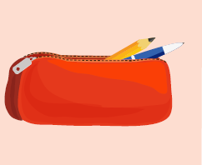
Make up sentences, using suggested pictures. pictures
I have
a yellow book.
I have
a red pencil case.

Slide 5

It’s time to learn …

Slide 6
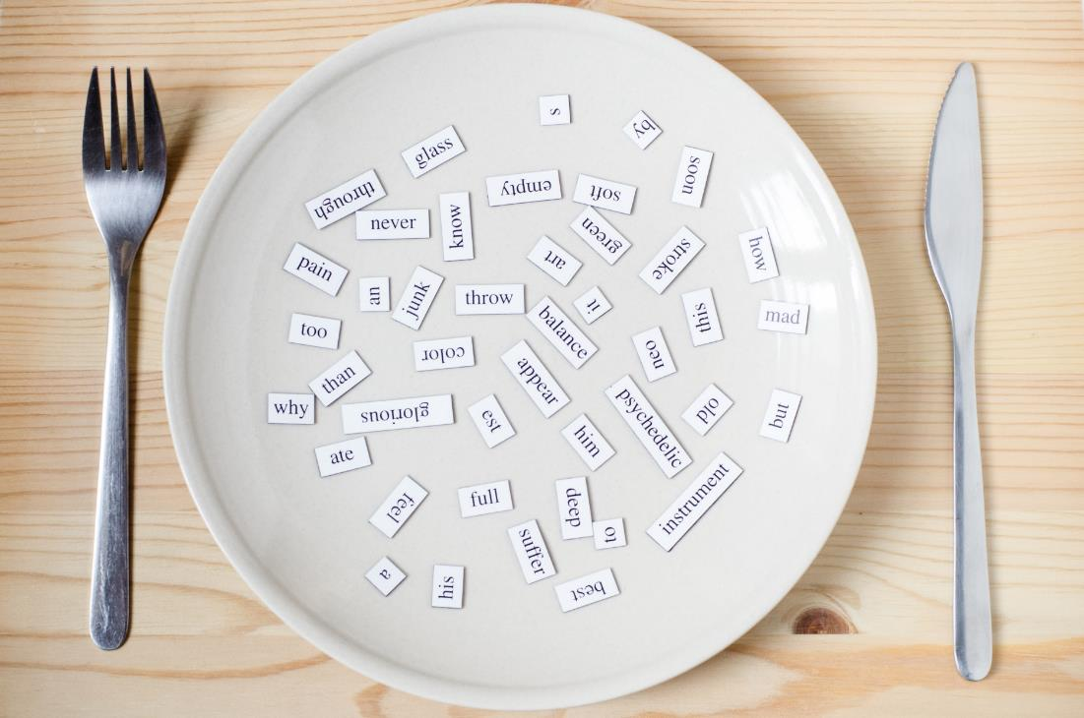
New words
living room
bedroom
kitchen
bathroom
yard

Slide 7

Presentation

Slide 8


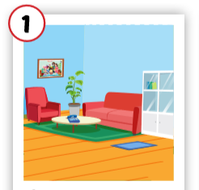
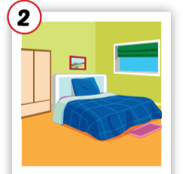
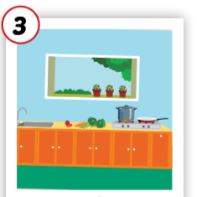
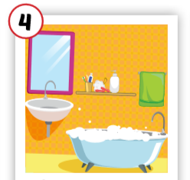
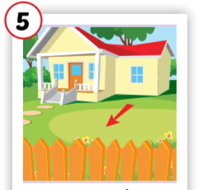
Click each English word to hear the sound.
living room
bedroom
kitchen
bathroom
yard
/ˈlɪvɪŋ ruːm/
phòng khách
/ˈbedruːm/ phòng ngủ
/ˈkɪtʃɪn/
nhà bếp
/ˈbæθruːm/ phòng tắm
/jɑːrd/
sân

Slide 9
Click each English word to hear the sound.
living room
/ˈlɪvɪŋ ruːm/
phòng khách

Slide 10
Click each English word to hear the sound.
bedroom
/ˈbedruːm/ phòng ngủ

Slide 11
Click each English word to hear the sound.
kitchen
/ˈkɪtʃɪn/
nhà bếp

Slide 12
Click each English word to hear the sound.
bathroom
/ˈbæθruːm/ phòng tắm

Slide 13
Click each English word to hear the sound.
yard
/jɑːrd/
sân

Slide 14

Practice

Slide 15
In pairs, 01 points to the picture, other says the word.
living room
bedroom
kitchen
bathroom
yard
/ˈlɪvɪŋ ruːm/
phòng khách
/ˈbedruːm/ phòng ngủ
/ˈkɪtʃɪn/
nhà bếp
/ˈbæθruːm/ phòng tắm
/jɑːrd/
sân

Slide 16
Game: Slap the board

Slide 17
Game: Decode the pictures.

Slide 18

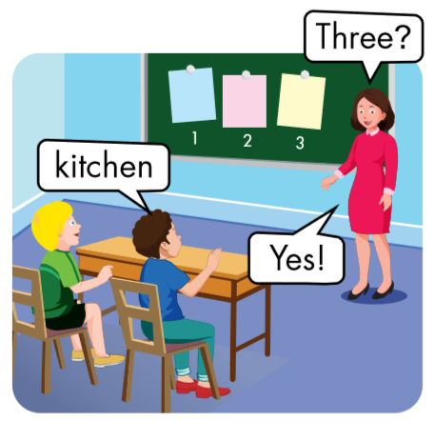
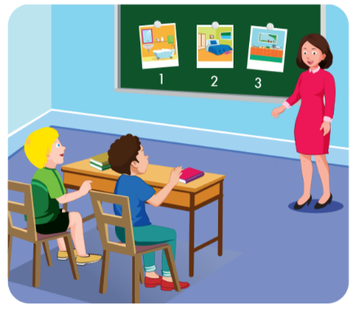
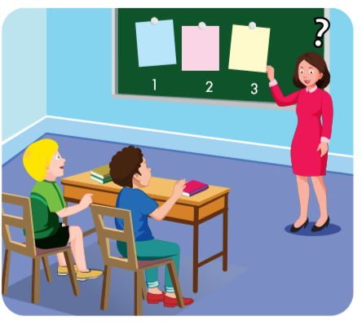


Slide 19

One?
bedroom
No

Slide 20
Two?
bedroom

Slide 21
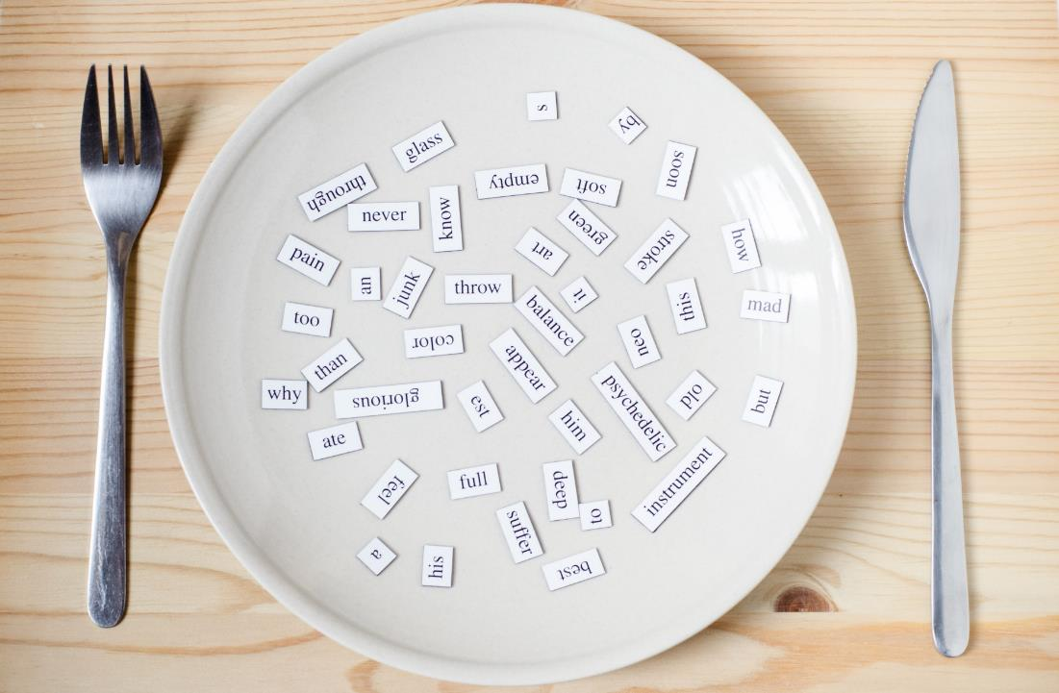
Structures
Where’s Dad?
He’s in the yard.
Where’s Grandma?
She’s in the kitchen.

Slide 22
Presentation

Slide 23


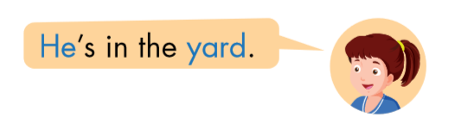

Click each English word to hear the sound.

Slide 24
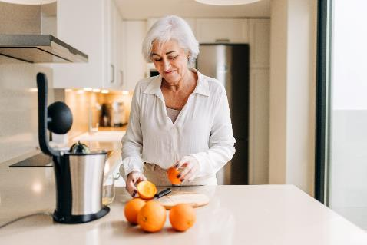


Click each English word to hear the sound.

Slide 25
Practice

Slide 26

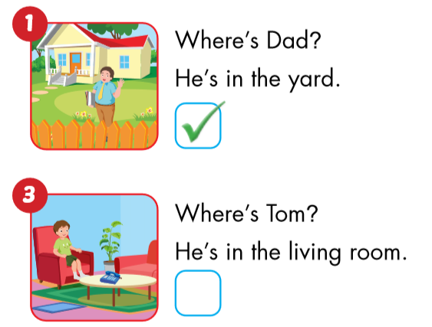
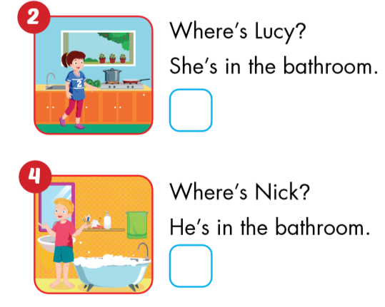

Slide 27
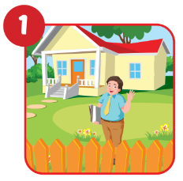
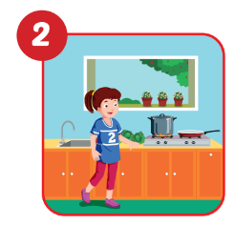
Circle the correct answers.
- Where’s Dad?
- He’s in the yard/
living room.
- Where’s Lucy?
- She’s in the kitchen/ bedroom.

Slide 28
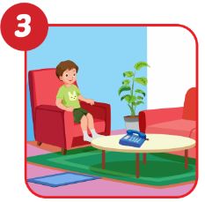
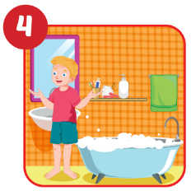
Circle the correct answers.
- Where’s Tom?
- Where’s Nick?
- He’s in the
living room/kitchen.
- He’s in the bathroom/ yard.
4

Slide 29

Workbook
p. 38

Slide 30

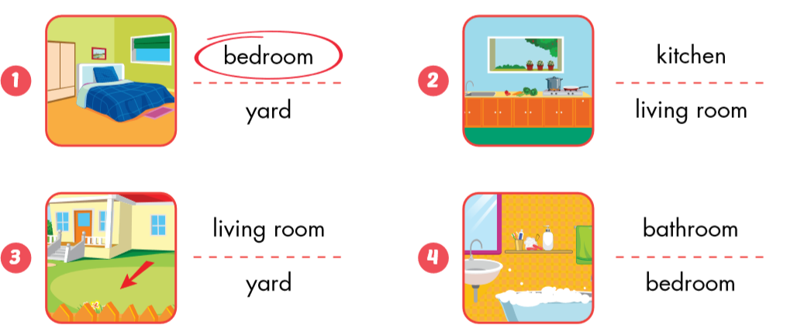

Slide 31

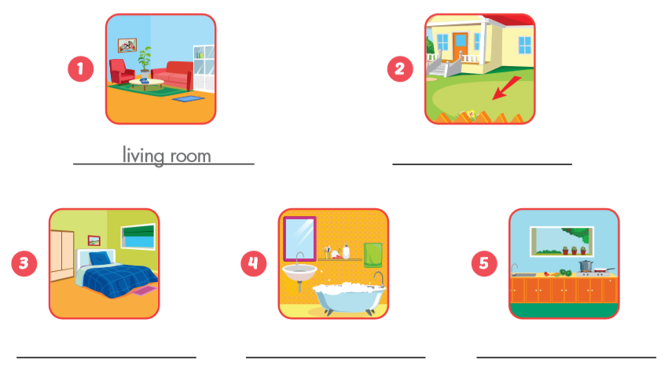
living room
yard
bedroom
bathroom
kitchen

Slide 32

Production
Production

Slide 33
3
1
Nick
4
1
4
Tom
SPIN
3
2
2
Ben
2
5
5
Lucy
Alex

Slide 34

CONSOLIDATION

Slide 35
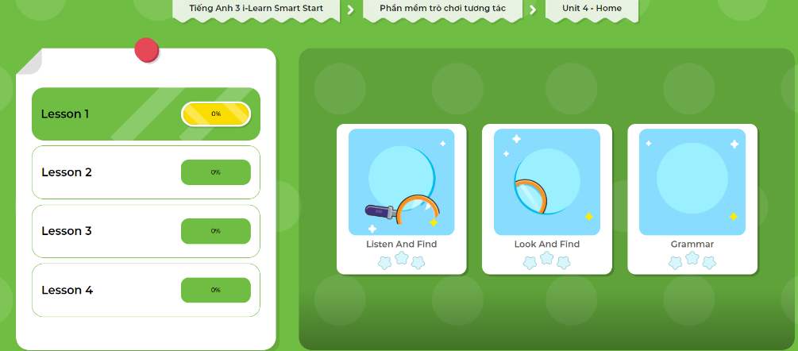
Extra Practice
DHA App
Let’s play!
Click here to play the game

Slide 36

WRAP-UP

Slide 37
Lesson 3
Today’s lesson
Vocabularies
living room
bedroom
kitchen
bathroom
yard
Structures/ Sentence patterns
Where’s Dad?
He’s in the yard.
Where’s Grandma?
She’s in the kitchen.

Slide 38
Homework
Review the vocabularies and sentence patterns. Make sentences using them.
Do the exercises on page 38 (WB)
Prepare the next lesson (page 53 SB)
Play the consolidation games in Tiếng Anh 3 i-Learn Smart Start DHA App on www.eduhome.com.vn
Do the exercises in Tiếng Anh 3 i-Learn Smart Start Notebook (page 28)

Slide 39

Enjoy your day!

Slide 40

Have a nice day!

