Slide 1
Wednesday De cember 25 ^{th} 2024
Unit 4
Lesson 4.3

Slide 2
Reading

Slide 8
Writing

Slide 9
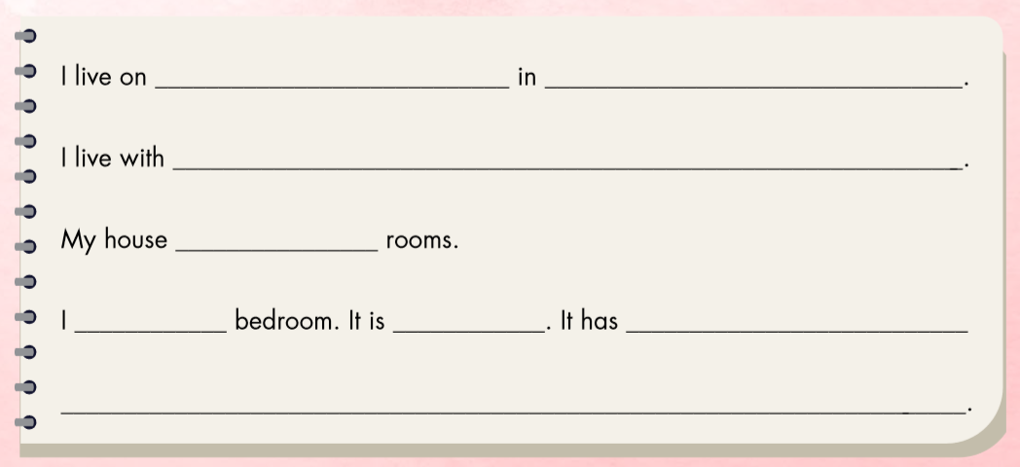

Slide 10
Dương Tự Minh Street
Thái Nguyên
my mother and father.
has six
love my
blue
a bed, a desk, and a closet.

Slide 11
Workbook
p. 43

Slide 12
E. Write about your home. Write 10–20 words.

Slide 13
Use the suggested words to complete the task.
I/Hàng Bài Street/Hanoi.
I/live/my mother/my father/my sister.
My house/ five/ rooms.
I/love/my living room. It/blue. It/TV/picture/sofa.

Slide 14
Use the suggested words to complete the task.
I live on Hàng Bài Street in Hanoi.
I live with my mother, my father, and my sister.
My house has five rooms.
I love my living room. It is blue. It has a TV, a picture, and a sofa.

Slide 15
CONSOLIDATION

Slide 16
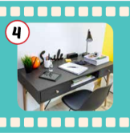
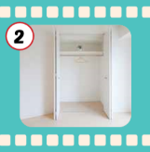
1
3
3
1
4
SPIN
5
2
2
4
3
5

Slide 17
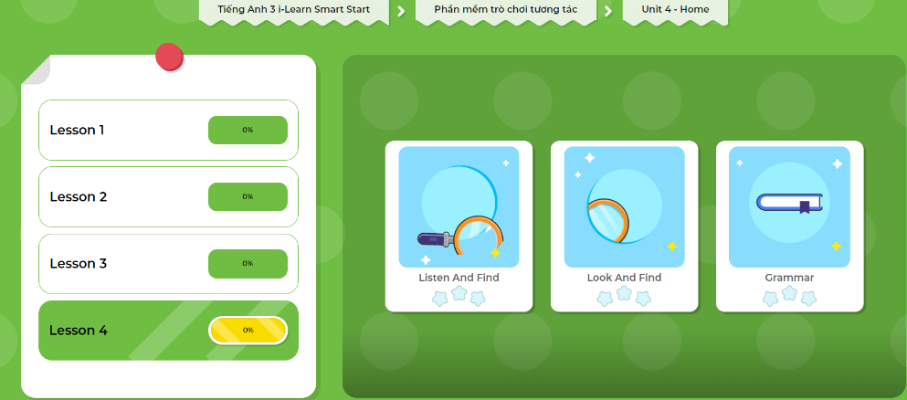
LET’S PLAY!
Click here to play the games!

Slide 18
Go around and ask 3 friends about their living room.
Name | color | a TV | a sofa
An
blue


Hoa
Nam
Notes:
GV giới thiệu hoạt động HS sẽ đi vòng quanh lớp và hỏi ý kiến của 3 bạn về các loại động vật bạn yêu mến, thích, và không thích. GV chuẩn bị handout cho HS.

Slide 19
WRAP-UP

Slide 20
Homework
Review the vocabularies and sentence patterns. Make sentences using them.
Do the exercises on page 45 (WB)
Prepare the next lesson (page 64 SB)
Play the consolidation games in Tiếng Anh 3 i-Learn Smart Start DHA App on www.eduhome.com.vn
Do the exercises in Tiếng Anh 3 i-Learn Smart Start Notebook on page 31.

Slide 21
Enjoy your day!

Slide 22
Have a nice day!

