Slide 1
Unit 5: HEALTH
Lesson 3.1
Page 70

Slide 2
WARM UP
https://youtu.be/tVlcKp3bWH8?si=17S11h4xwG8MXhIu

Slide 3
Tuesday, February 25th, 2025
Unit 5: HEALTH
Lesson 3.1

Slide 4
Presentation

Slide 5
Click on A to hear the sound.
đi khám nha sĩ
uống thuốc
nghỉ ngơi
thức khuya
đi tắm
bỏ bữa sáng
Notes:
Click vào hình A. 1. Listen and point. Repeat để cho cả audio full chạy

Slide 6
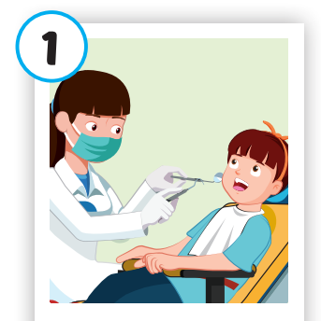
Click on the picture to hear the sound.
see a dentist

Slide 7
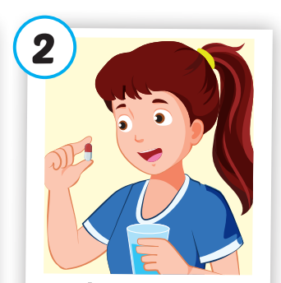
Click on the picture to hear the sound.
take some medicine

Slide 8
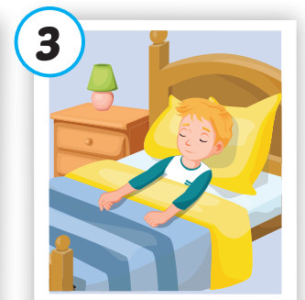
Click on the picture to hear the sound.
get some rest

Slide 9
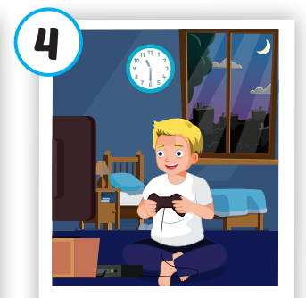
Click on the picture to hear the sound.
stay up late

Slide 10
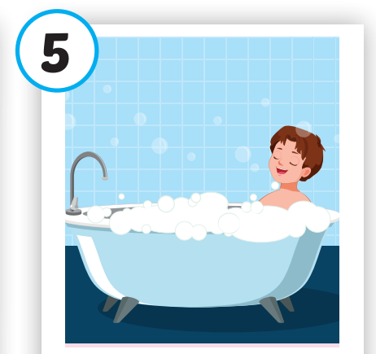
Click on the picture to hear the sound.
take a bath

Slide 11
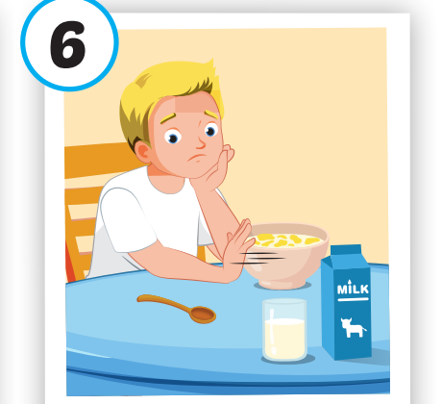
Click on the picture to hear the sound.
skip breakfast

Slide 12
Click on A to hear the sound.
Notes:
Click vào hình A. 1. Listen and point. Repeat để cho cả audio full chạy

Slide 13
Practice

Slide 14
Look, read and choose

Slide 15
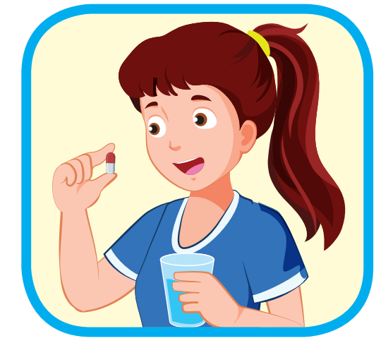
Look, read and choose
A
B
C
stay up late

Slide 16
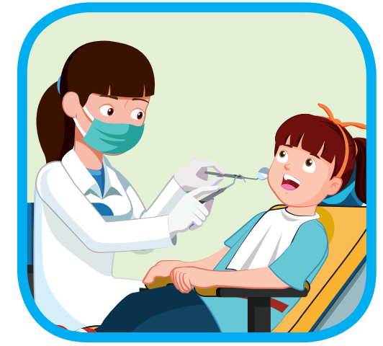
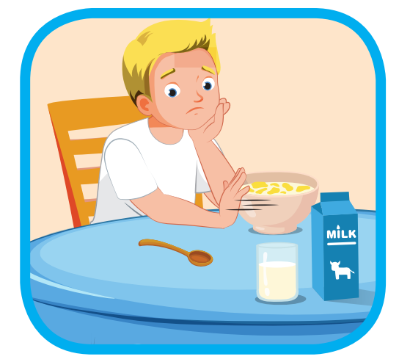
Look, read and choose
A
B
C
skip breakfast

Slide 17
Look, read and choose
A
B
C
take a bath

Slide 18
Look, read and choose
A
B
C
see a dentist

Slide 19
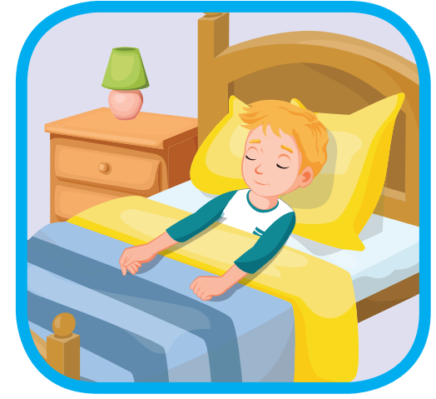
Look, read and choose
A
B
C
get some rest

Slide 20
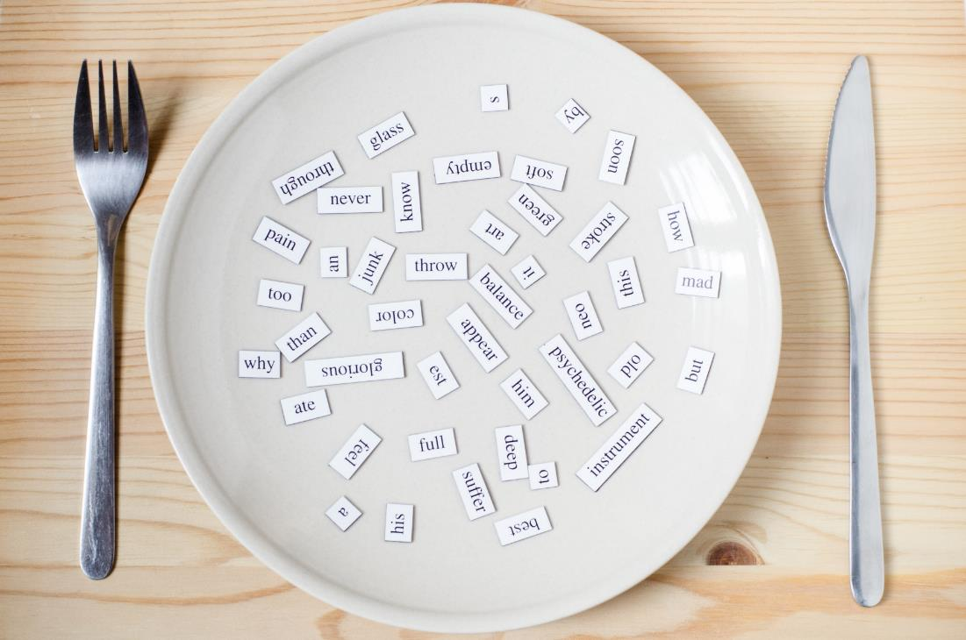
Structure
You should see a dentist.
You shouldn't stay up late.

Slide 21
Presentation

Slide 22
VIDEO 3.1

Slide 23
* Watch the video and complete the sentences:
shouldn’t
1. Sore throat
-A. You …………………drink too much cold water.
should
2. fever
-B. You…………….. get some rest and ……………… work too much.
shouldn’t
should
3. stomachache
-C. You………………. take some medicine and get some rest.
shouldn’t
4. headache
-D. You ……………….. watch TV too much.

Slide 24
Practice

Slide 25
Click on B to hear the sound.
You should see a dentist.
You shouldn’t stay up late.
You should /shouldn’t……………………..

Slide 26
Let’s make sentences.
SHOULD
1
2
1. You should take some medicine.
3
2. You should see a dentist.
3. You should get some rest.

Slide 27
1
SHOULDN’T
1. You shouldn’t stay up late.
2
2. You shouldn’t skip breakfast.

Slide 28
Let’s give advice
.
3
5
1
2
4

Slide 29
Production

Slide 30
Role play
the flu
sick
Patient: I have…………………./I feel………………….
Doctor: You should/ shouldn’t………………………

Slide 31
CONSOLIDATION

Slide 32
Look, read and choose
A
B
stay up late

Slide 33
A
B
skip breakfast

Slide 34
A
B
take a bath

Slide 35
A
B
see a dentist

Slide 36
A
B
get some rest

Slide 37
WRAP-UP

Slide 38
Today’s lesson
Vocabularies
see a dentist, take some medicine, get some rest, stay up late, take a bath, skip breakfast.
Structures/ Sentence patterns
You should see a dentist.
You shouldn't stay up late.

Slide 39
Homework
Practice the vocabularies and structure, and make sentences using them.
Do the exercises in Tiếng Anh 5 i-Learn Smart Start WB (page 47).
Do the exercises in Tiếng Anh 5 i-Learn Smart Start Notebook.
Prepare the next lesson (page 71 SB).
Play the consolidation games in Tiếng Anh 5 i-Learn Smart Start DHA App on www.eduhome.com.vn

Slide 40
Enjoy your day!

Slide 41
Lesson 3
Stay positive and have a nice day!

