Slide 1
Thursday, February 25 ^{th} 2025 Unit 5 Health Lesson 3.3

Slide 2
1. Warm up

Slide 3
A. How
B. Why
C. What
Key: C

Slide 4
A: ___ do you feel?
B: I feel sick.
A: That’s too bad.
A. What
B. Why
C. How
Key: C

Slide 5
A: What’s matter with you?
B: _________
A. He has chickenpox.
B. I have stomachache.
C. She has the flu
Key: B

Slide 6
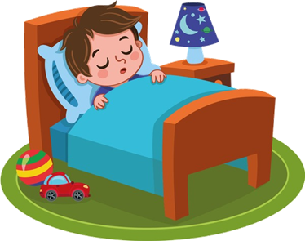
He____ get some rest.
A. should
B. shouldn’t
C. could
Key: A

Slide 7
shouldn’t/late./up/You/stay
A. Shouldn’t up stay late you.
B. You shouldn’t stay up late.
C. You stay up shouldn’t late.
Key: B

Slide 8
2. Speaking

Slide 9
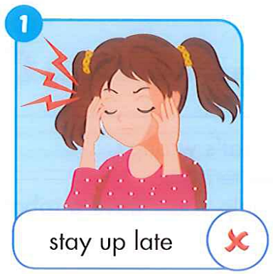
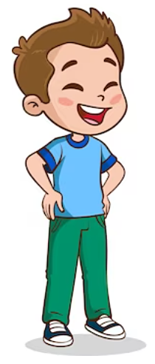
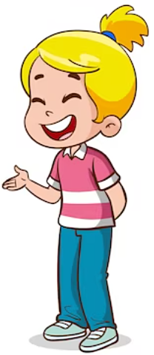
D
1. Point, say and respond.
I have a headache.
You shouldn’t stay up late.

Slide 10
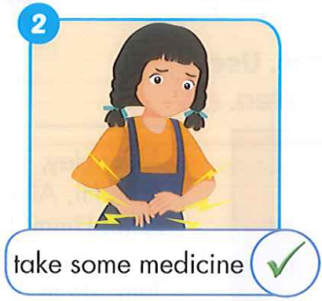
D
1. Point, say and respond.
I have a stomachache.
You should take some medicine.

Slide 11
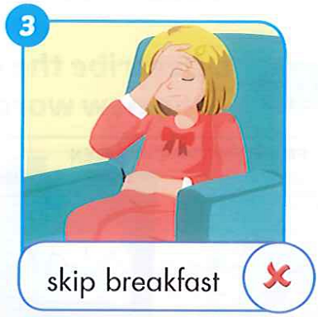
D
1. Point, say and respond.
I feel terrible.
You shouldn’t skip breakfast.

Slide 12
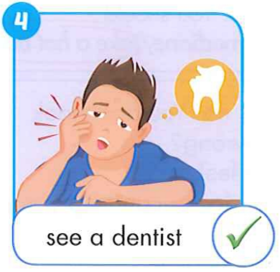
D
1. Point, say and respond.
I have a toothache.
You should see a dentist.

Slide 13
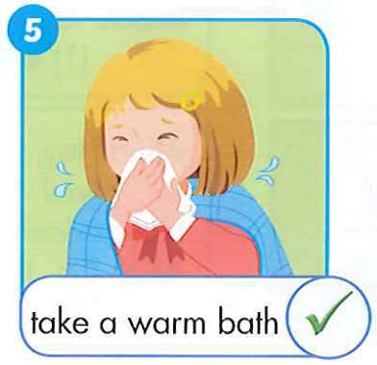
D
1. Point, say and respond.
I feel stuffed up.
You should take a warm bath.

Slide 14
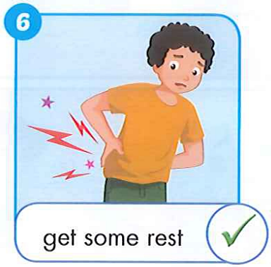
D
1. Point, say and respond.
I feel sore.
You should get some rest.

Slide 16
Watch video and tick Yes or No
Linh’s mother has a sore throat……
The doctor said “Linh’s father shouldn’t get some rest.”……
“Linh shouldn’t eat too much candies”The doctor said …….
Mai has a stomachache……..
Yes
No
No
Yes

Slide 18
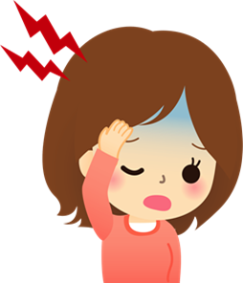
2. List other health advice you know. Practice again.
Should do exercise every day/ play outside/ wash your hands before meals…..
Shouldn’t play video game all the time/ eat fast food too much…….

Slide 19
Role play

Slide 20
GOODBYE

