Slide 1
WARM-UP

Slide 2
Unit 7: JOBS
Lesson 2.1
Page 95

Slide 3
Let’s watch video and answer:
What jobs are they talking about?
What will he be in the future?

Slide 4
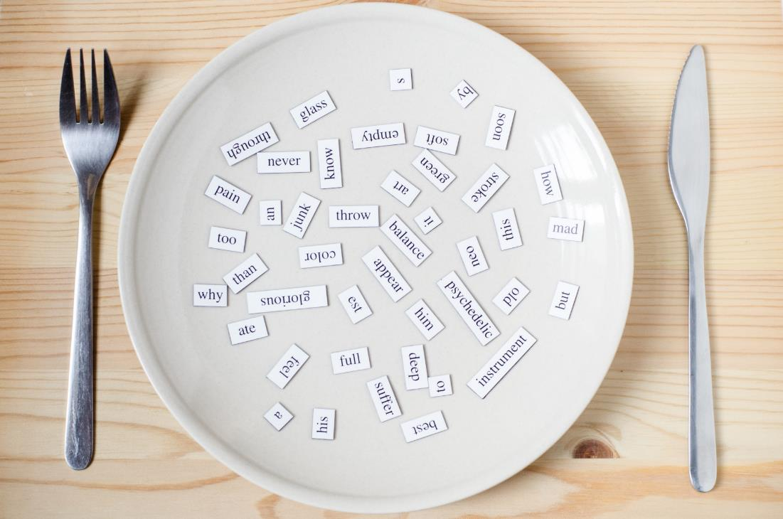
New words
soccer player,
singer,
nurse,
driver,
police officer,
actor.

Slide 5
Presentation

Slide 6
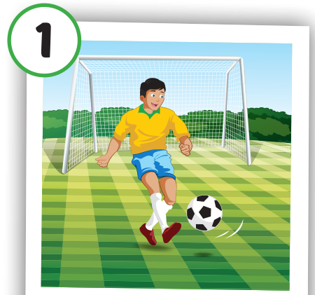
Click on the picture to hear the sound.
soccer player
cầu thủ

Slide 7
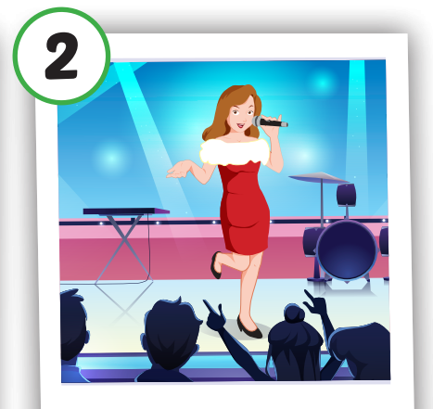
Click on the picture to hear the sound.
singer
ca sĩ

Slide 8
Click on the picture to hear the sound.
nurse
y tá

Slide 9
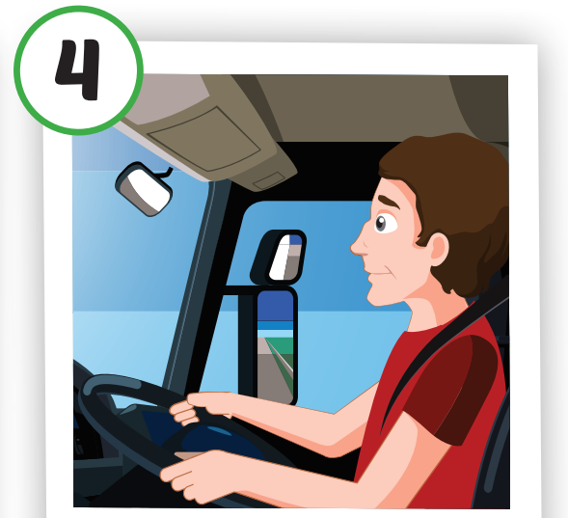
Click on the picture to hear the sound.
driver
tài xế

Slide 10
Click on the picture to hear the sound.
police officer
cảnh sát

Slide 11
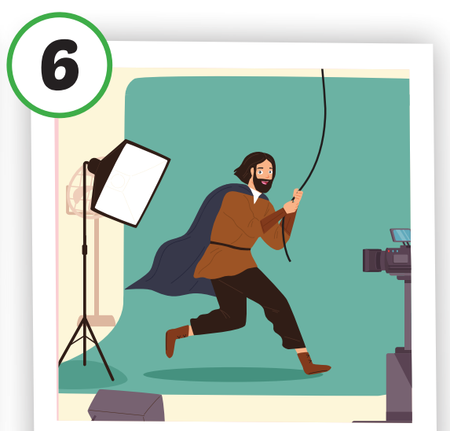
Click on the picture to hear the sound.
actor
diễn viên

Slide 12
← Click on the title to hear the sound.
cầu thủ
ca sĩ
y tá
tài xế
cảnh sát
diễn viên

Slide 13
Review vocabulary

Slide 14
GAME: FLASHCARD PEEK.

Slide 15
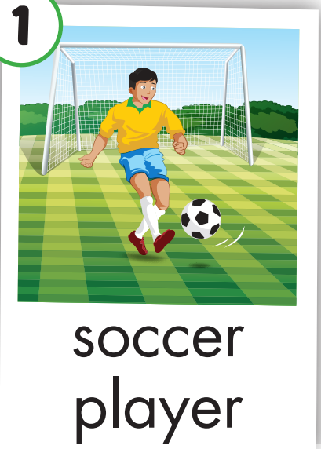

Slide 18
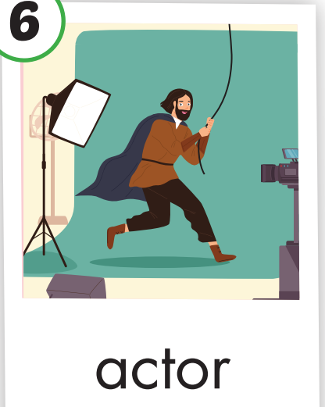

Slide 19
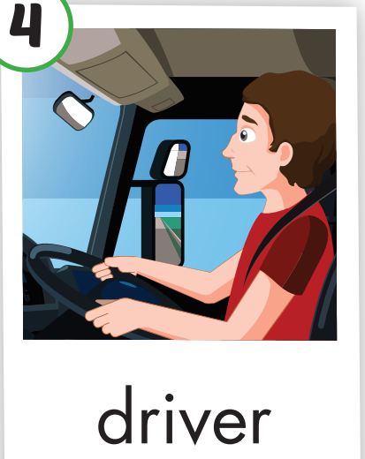

Slide 20
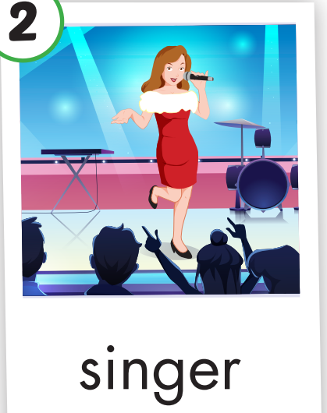

Slide 21
Structure
Tom likes sports. I think he’ll
be a soccer player

Slide 22
Presentation

Slide 23
He likes sports
He likes running.
He likes playing with a ball.
What will he be in the future?
I think he’ll be a soccer player.

Slide 24
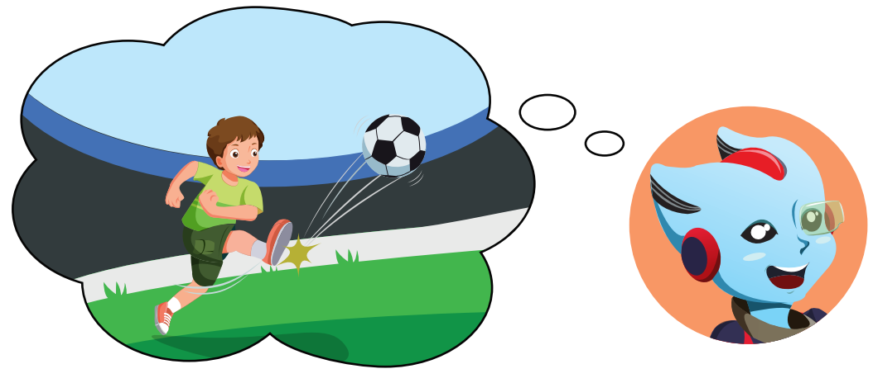
Click on the picture to hear the sound.

Slide 25
he’ll be a pilot
He likes planes. I think…………………….

Slide 26
He likes beautiful places.
I think .....................................
he’ll be a tour guide.

Slide 27
Practice

Slide 28
Matching
I think he’ll be a driver.
1.
A.
You like music.
She likes helping
B.
2.
I think you’ll be a singer.
sick people.
3.You like animals.
C.
I think you’ll be a vet.
4.
D.
He likes cars.
I think she’ll be a nurse.
D
C
A
1 - 2 - 3 - 4 -
B

Slide 29
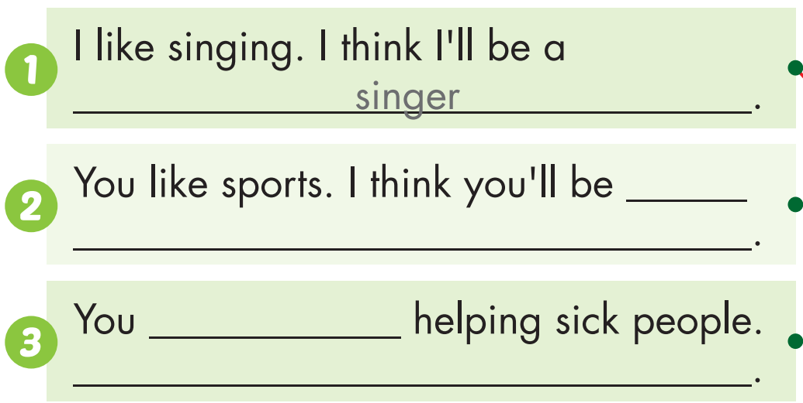
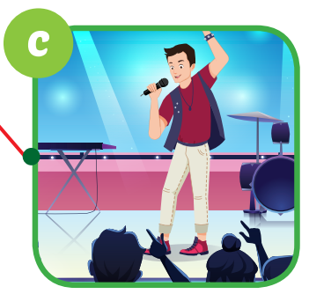
a soccer player
like
I think you’ll be a nurse

Slide 30
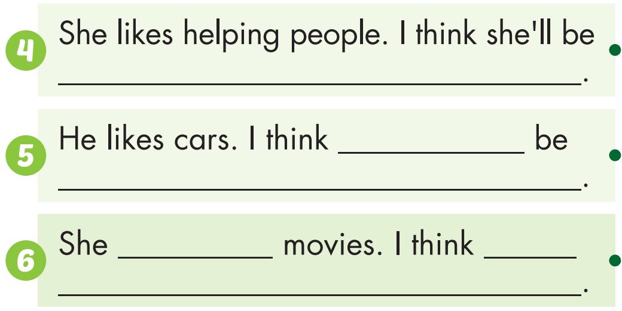
a police officer
he’ll
a driver
likes
She’ll be an actor

Slide 31
Production

Slide 32
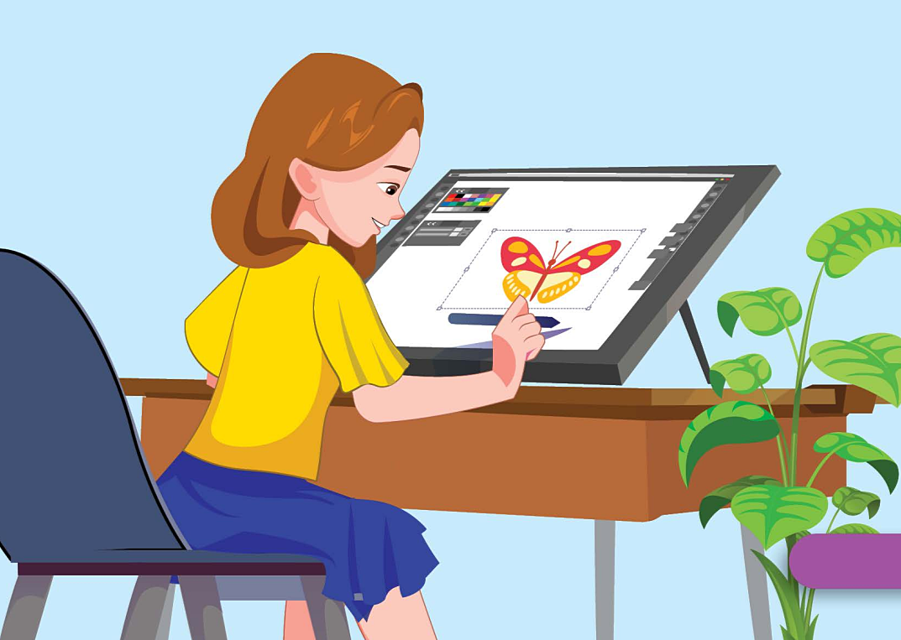
ROLE – PLAY
I like drawing and painting.
I think you’ll be a designer.
What do you like doing?

Slide 33
Today’s lesson
Vocabularies
soccer player, singer, nurse, driver, police officer, actor.
Structures/ Sentence patterns
Tom likes sports. I think he’ll be a soccer player.

Slide 34
Homework
Practice the vocabularies and structure, and make sentences using them.
Do the exercises in Tiếng Anh 5 i-Learn Smart Start WB (page 64).
Do the exercises in Tiếng Anh 5 i-Learn Smart Start Notebook.
Prepare the next lesson (page 96 SB).
Play the consolidation games in Tiếng Anh 5 i-Learn Smart Start DHA App on www.eduhome.com.vn

Slide 35
Enjoy your day!

Slide 36
Lesson 3
Stay positive and have a nice day!

