Slide 2
Unit
11
ELECTRONIC DEVICES
LESSON 1: GETTING STARTED
In an electronic shop.
1

Slide 3
LESSON 1: GETTING STARTED
LESSON 1: GETTING STARTED
WARM-UP
Games: Pass the chalk.
Vocabulary
PRESENTATION
Task 1: Listen and read.
Task 2: Read the conversation again and answer the following questions.
Task 3: Match the following words with their definitions.
Task 4: Complete the sentences with the words from 3.
PRACTICE
Task 5: Work in pairs. Think of an electronic device and describe it to your partner. Can your partner guess what you are describing?
PRODUCTION
Wrap-up
Homework
CONSOLIDATION

Slide 4
WARM-UP
WHAT ARE ELECTRONIC DEVICES?
PASS
THE CHALK

Slide 5
PRESENTATION
portable (adj)
/ˈpɔːr.t̬ə.bəl/
vùng ngoại ô

Slide 6
PRESENTATION
aluminium (n)
ˌæl.jəˈmɪn.i.əm/
cơ sở vật chất

Slide 7
PRESENTATION
virtual (adj)
/ˈvɝː.tʃu.əl/
cơ sở vật chất

Slide 8
PRESENTATION
New words | Pronunciation | Meaning
1. portable (adj) | /ˈpɔːr.t̬ə.bəl/ | có thể bỏ túi
2. aluminium (n) | ˌæl.jəˈmɪn.i.əm/ | hợp kim nhôm
3. virtual (adj) | /ˈvɝː.tʃu.əl/ | ảo

Slide 9
PRACTICE
1
Listen and read.
Shop assistant: Good morning! What can I do for you?
Customer: Good morning! I’d like to buy a computer for my son.
Shop assistant: We have desktops, laptops, and tablets. Which one are you interested in?
Customer: I want to buy one for my son that is portable and can be used for studying and entertainment.
Shop assistant: Ah, in this case I suggest you should buy a tablet. Look at this grey tablet. It can work as effectively as a laptop. But it’s the size of a book. And it’s much lighter than a laptop because it’s smaller. It also has a lightweight aluminium case.
Customer: Sounds good.
Shop assistant: It also has two cameras to take photos, shoot videos, and scan documents. It has a touchscreen, so you can do everything with your fingers.
Customer: Is it easy to type on?
Shop assistant: Yes, it is. There is a virtual keyboard. If you don’t want to use it, you can use the wireless hardware keyboard.
Customer: Can I write and draw on it?
Shop assistant: You can use its pencil to take notes, draw pictures or diagrams, and make 3D designs.

Slide 10
PRACTICE
2
Read the conversation again and answer the following questions.
1. What does the customer want to buy?
2. What kind of electronic device does the shop assistant suggest the customer should buy?
The customer wants to an electronic device for her son.
The shop assistant suggests the customer should buy a tablet.

Slide 11
PRACTICE
2
Read the conversation again and answer the following questions.
3. What is the tablet’s case made of?
4. What is the tablet’s pencil used for?
It is made of aluminum.
It is used for taking notes, drawing, and making 3D designs.

Slide 12
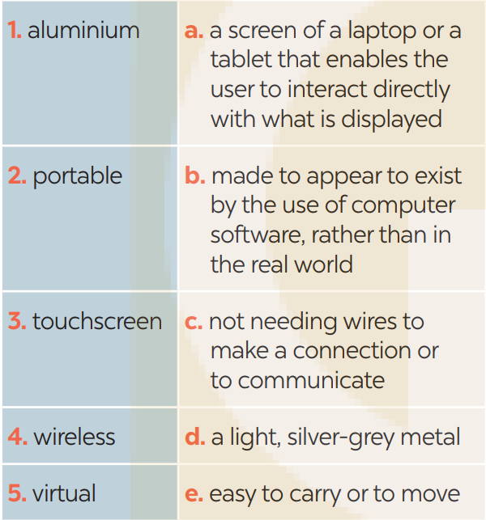
PRACTICE
3
Match each word or phrase with its definition.
1. d
2. e 3. a
4. c 5. b

Slide 13
PRACTICE
4
Complete each sentence with a word or phrase from 3.
1. The website allows you to take a ___________ tour of the art gallery.
2. You can carry your _____________ laptop with you from class to class because it’s small and light.
3. Nowadays we often use _____________ keyboards because they are portable.
4. We often use _____________ to make vehicles like aircraft or cars because of its strength and lightweight.
5. Most smartphones today have a ______________ which allows us to navigate, type, and interact with apps and games easily.
virtual
portable
wireless
aluminium
touchscreen

Slide 14
PRODUCTION
5
Work in pairs. Think of an electronic device and describe it to your partner. Can your partner guess what you are describing?
Example: A: It’s a small, flat computer. We can control it by touching its screen or by using a special pen. B: Is that a portable music player? A: No. Try again

Slide 15
CONSOLIDATION
1
Wrap-up
What have we learnt in this lesson?
identify the topic of the unit
use lexical items related to local community
identify the language features that are covered in the unit

Slide 16
CONSOLIDATION
2
Homework
- Do exercises in the Workbook.
- Start preparing for the Project of the unit by working in groups of 5 to brainstorm about your community.

Slide 17
Website: hoclieu.vn
Fanpage: facebook.com/www.tienganhglobalsuccess.vn/

