Slide 2
Unit
11
SCIENCE AND TECHNOLOGY
LESSON 1: GETTING STARTED
Great news for students
1

Slide 3
LESSON 1: GETTING STARTED
WARM-UP
Game: Hidden words
PRESENTATION
Vocabulary
Task 1: Listen and read.
Task 2: Read the conversation again and tick T (True) or F (False)
Task 3: Label each picture with a phrase from the box.
Task 4: Complete the sentences, using the phrases in 3.
PRACTICE
Task 5: Quiz: Do you know what things were invented in these years? Work in pairs and find out.
PRODUCTION
CONSOLIDATION
Wrap-up
Homework

Slide 4
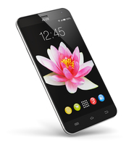
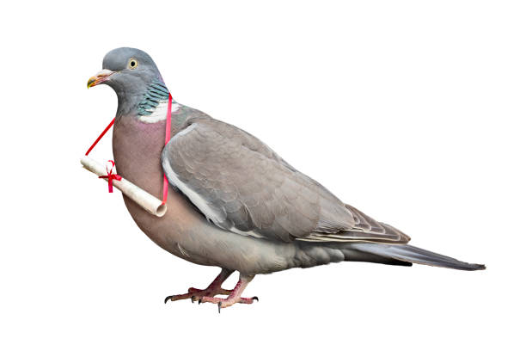
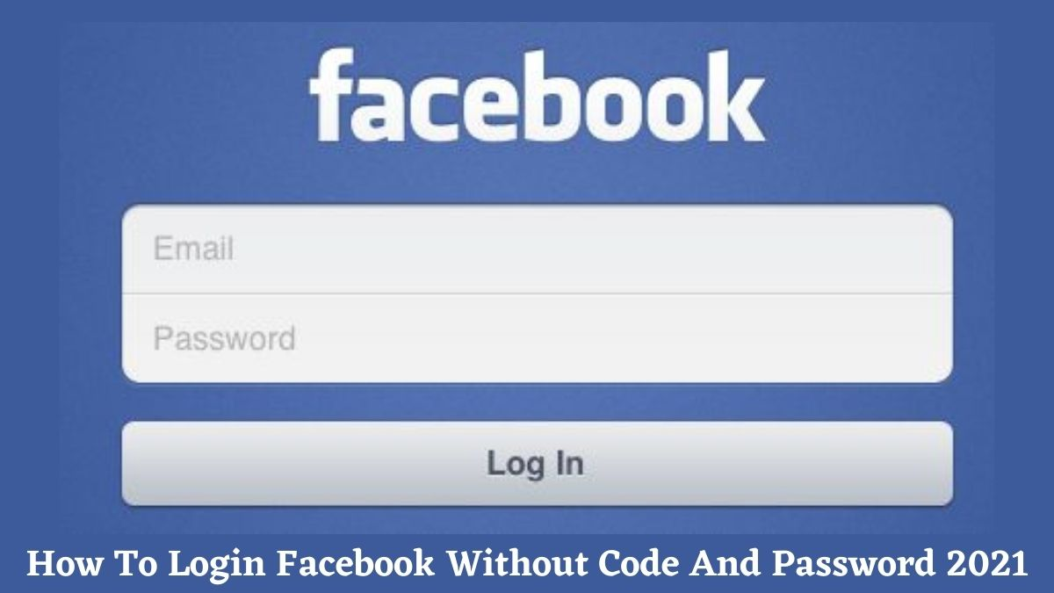
WARM-UP
1. What is this?
The hidden word:
SEIENCC
SMARTPHONE
_ _ _ _ _ _ _ _ _ _
PIGEON
2. My favourite bird is _ _ _ _ _ _ .
ACCOUNT
3. I don't have a Facebook _ _ _ _ _ _ _ .”

Slide 5
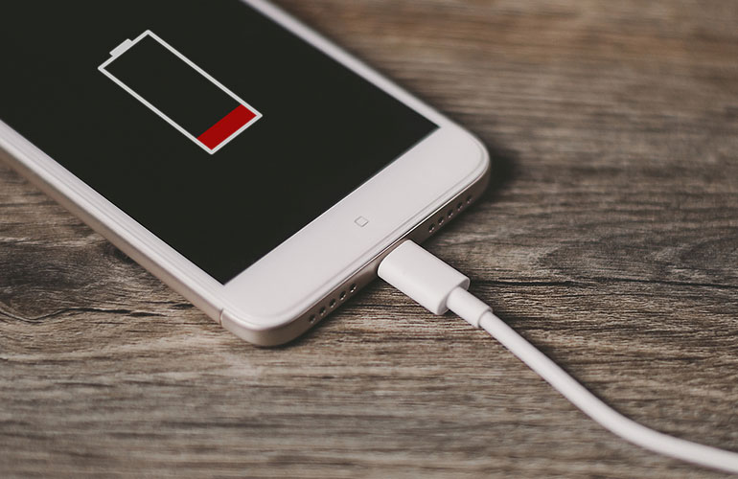
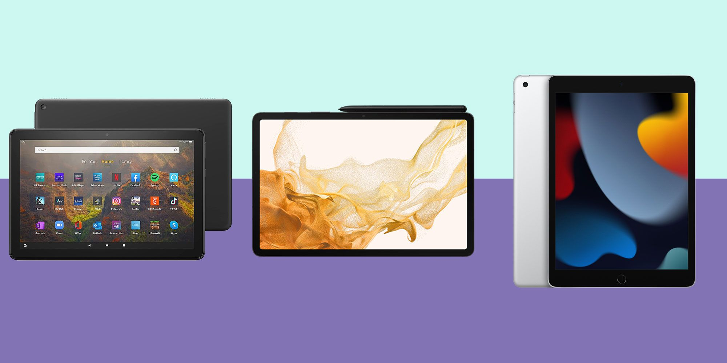
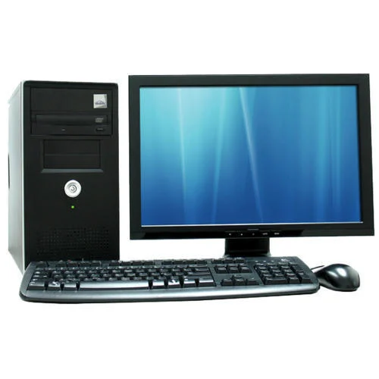
WARM-UP
The hidden word:
EOTLHYGNCO
4. What are they?
7. Don't unplug my phone.
It's _ _ _ _ _ _ _ _ .
CHARGING
EMOJIS
_ _ _ _ _ _
TABLETS
5. I prefer using _ _ _ _ _ _ _ to smartphones .
8. What is this?
It's a _ _ _ _ _ _ _ _ .
TELEPATHY
6. _ _ _ _ _ _ _ _ _ the direct communication of thoughts or feelings from one person to another without using speech, writing, or any other normal method.
COMPUTER

Slide 6
WARM-UP
The hidden words:
SEIENCC
EOTLHYGNCO
SCIENCE
TECHNOLOGY
_ _ _ _ _ _ _
_ _ _ _ _ _ _ _ _ _

Slide 7
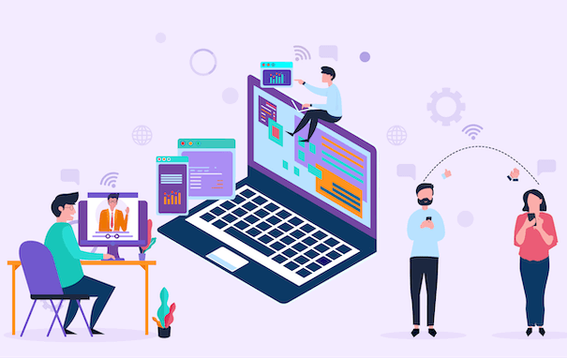
PRESENTATION
technology (n)
/tekˈnɒlədʒi/
công nghệ

Slide 8
PRESENTATION
face to face (adj)
/ˌfeɪs tə ˈfeɪs/
trực tiếp,
mặt đối mặt

Slide 9
PRESENTATION
epidemic (n)
/ˌepɪˈdemɪk/
đại dịch

Slide 10
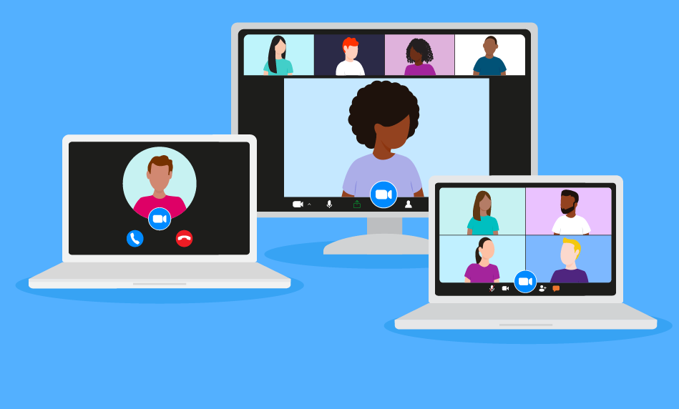
PRESENTATION
breakout room (n)
/ˈbreɪkaʊt rʊm /
phòng học chia nhỏ, chia nhóm

Slide 11
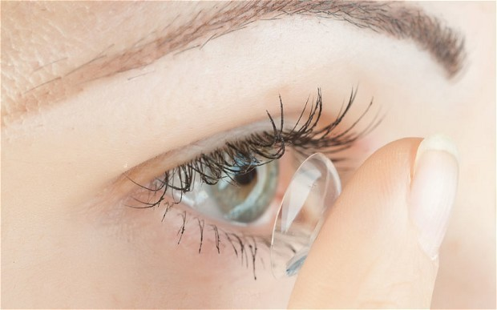
PRESENTATION
contact lens (n)
/ˈkɒntækt lenz/
kính áp tròng

Slide 12
PRESENTATION
invention (n)
/ɪnˈvenʃn/
phát minh

Slide 13
PRESENTATION
New words | Pronunciation | Meaning
1. technology (n) | /tekˈnɒlədʒi/ | công nghệ
2. face-to-face | /ˌfeɪs tə ˈfeɪs/ | trực tiếp, mặt đối mặt
3. epidemic (n) | /ˌepɪˈdemɪk/ | đại dịch
4. breakout room (n) | /ˈbreɪkaʊt ruːm/ | phòng học chia nhỏ
5. contact lens (v) | /ˈkɒntækt lenz/ | kính áp tròng
6. invention (n) | /ɪnˈvenʃn/ | phát minh

Slide 14
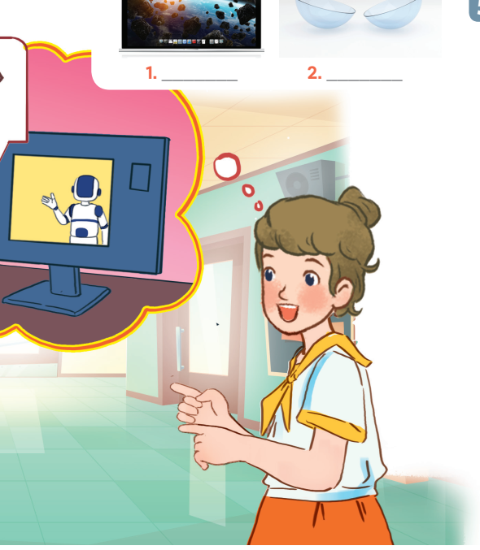
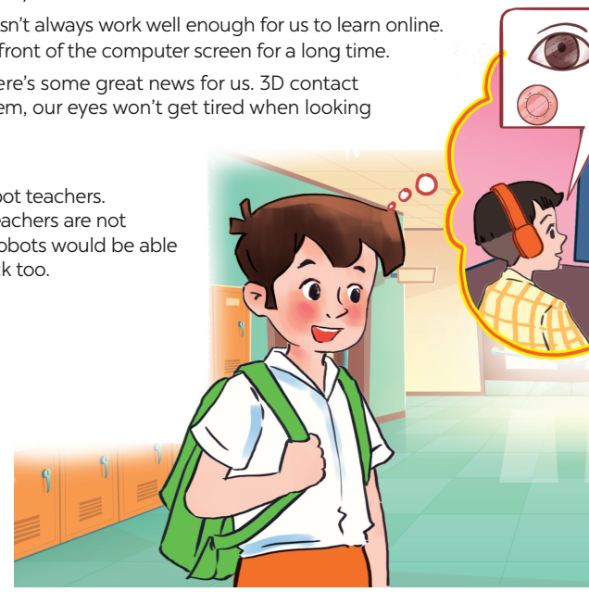
PRACTICE
1. Who are the girl and the boy? 3. What might they be talking about?
2. Where do you think they are? 4. What can you see in the bubble?

Slide 15
PRACTICE
1
Listen and read.
Minh: I really liked yesterday’s online lesson. What about you, Ann?
Ann: I prefer having face-to-face classes. I like to interact with my classmates during the lessons.
Minh: I think online classes are convenient during bad weather or epidemics. Also, students can still interact when they are in breakout rooms.
Ann: But the Internet connection doesn’t always work well enough to learn online. And my eyes get tired when I work in front of the computer screen for a long time.
Minh: I know what you mean. But there’s some great news for us. 3D contact lenses will soon be available. With them, our eyes won’t get tired when looking at a computer screen all day long.
Ann: Wow, that’s brilliant!
Minh: Another helpful invention is robot teachers. They will teach us when our human teachers are not available or get ill. My uncle said the robots would be able to mark our work and give us feedback too.
Ann: Fantastic! I can’t wait.

Slide 16
PRACTICE
2
Read the conversation again and tick T (True) or F (False).
Statements | T | F
1. Ann and Minh had a face-to-face class yesterday.
2. Ann likes face-to-face classes because she can interact with her classmates.
3. Minh finds online classes inconvenient.
4. When students use 3D contact lenses, their eyes will not get tired.
5. Robot teachers will be able to mark papers and comment on students’ work.

Slide 17
PRACTICE
3
Label each picture with a phrase from the box.
computer screen
3D contact lenses
1. ______________
2. _______________

Slide 18
PRACTICE
3
Label each picture with a phrase from the box.
online class
3. ______________
4. _______________
robot teacher

Slide 19
PRACTICE
3
Label each picture with a phrase from the box.
breakout rooms
5. ______________
6. _________________
Internet connection

Slide 20
PRACTICE
4
Complete the sentences, using the phrases in 3.
1. I can’t see the documents on the computer very clearly. I need a larger ______________.
2. During our lessons, our teacher puts us into ______________ for group discussions.
3. A ____________ in Korea teaches English to primary students.
4. We had a(n) ____________ yesterday with a teacher in the US.
5. Can I wear ________________ and watch a movie too?
computer screen
breakout rooms
robot teacher
online class
3D contact lenses

Slide 21
PRODUCTION
5
Do you know what things were invented in these years?
1. 1822: Charles Babbage invented it. Students use it to type essays and to learn online.
The first computer

Slide 22
PRODUCTION
5
Do you know what things were invented in these years?
2. 1876: Alexander Graham Bell invented it. We use it to communicate with our friends and families.
The telephone

Slide 23
PRODUCTION
5
Do you know what things were invented in these years?
3. 1928: Sir Alexander Fleming discovered it. It was the world’s first antibiotic.
Penicillin

Slide 24
PRODUCTION
5
Do you know what things were invented in these years?
4. 1989: Tim Berner-Lee invented it. It links information sources so everyone can access them.
The WWW - World Wide Web

Slide 25
PRODUCTION
5
Do you know what things were invented in these years?
5. 2000: Honda developed it. It can run, jump, and work as a bartender.
Robot ASIMO

Slide 26
CONSOLIDATION
1
Wrap-up
What have we learnt in this lesson?
identify the topic of the unit
use lexical items related to science and technology
identify the language features that are covered in the unit

Slide 27
CONSOLIDATION
2
Homework
- Name technologies and inventions they have learnt about in the lesson.
- Learn new words and phrases by heart.
- Do Exercise in the Workbook
- Start preparing for the Project of the unit

Slide 28
Website: hoclieu.vn
Fanpage: facebook.com/tienganhglobalsuccess.vn/

