Slide 2
Unit 9: NATURAL DISASTERS
Lesson 7.
LOOKING BACK AND PROJECT

Slide 3
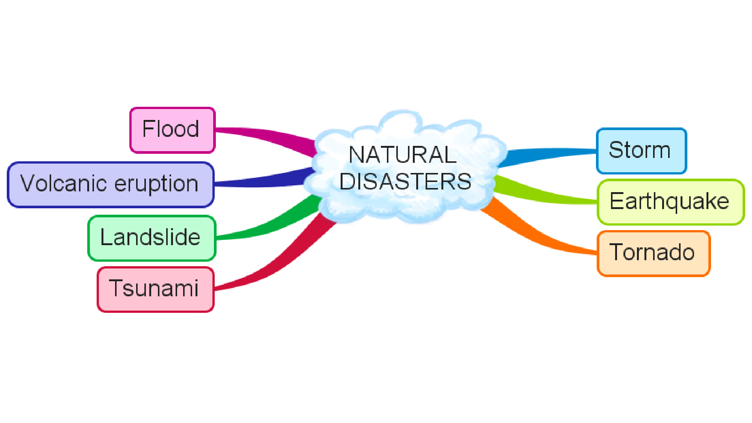

Slide 4
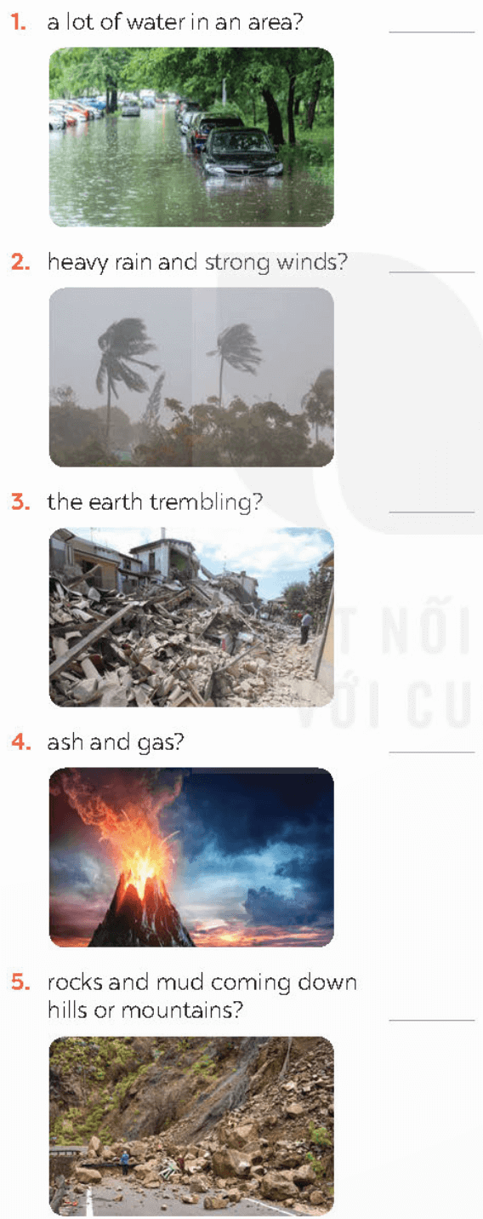

Slide 5
1
2
3
4
5
6
7
8
9

Slide 6
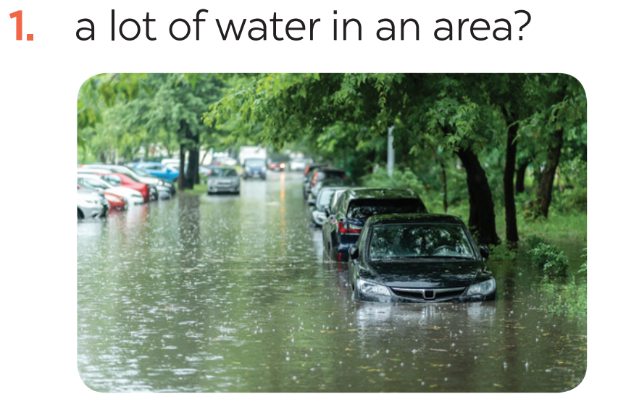
VOCABULARY
1
Write the name of a natural disaster in each blank.
flood

Slide 8
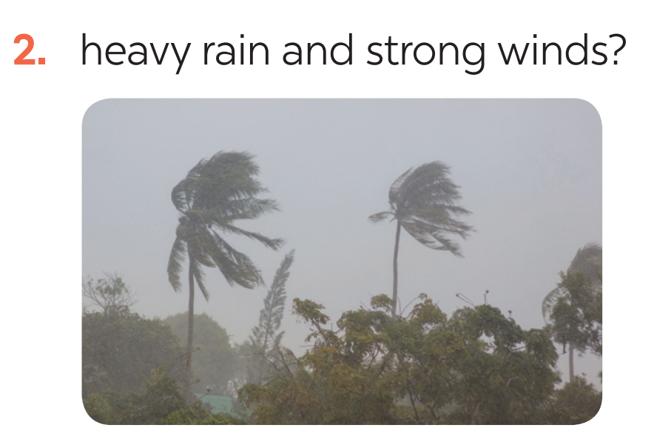
VOCABULARY
1
Write the name of a natural disaster in each blank.
storm

Slide 10
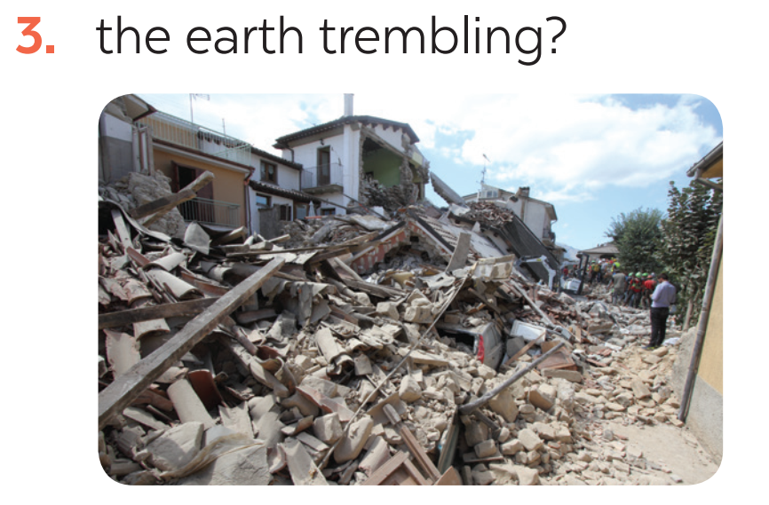
VOCABULARY
1
Write the name of a natural disaster in each blank.
earthquake

Slide 12
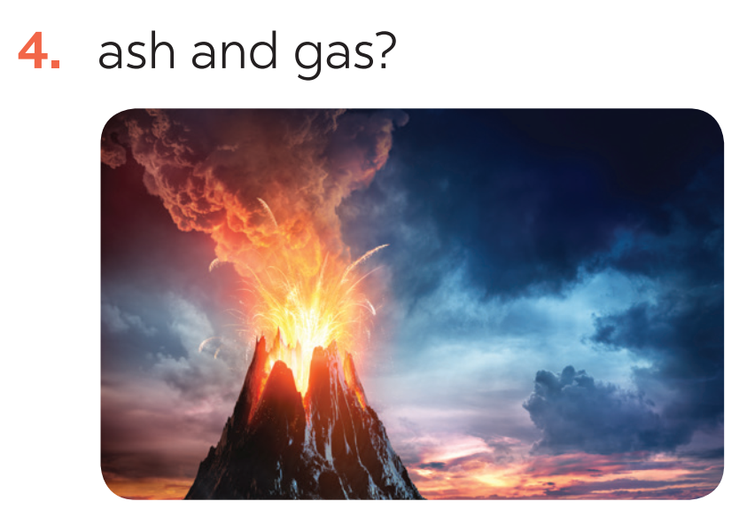
VOCABULARY
1
Write the name of a natural disaster in each blank.
volcanic eruption

Slide 13
VOCABULARY
1
Write the name of a natural disaster in each blank.
landslide

Slide 15
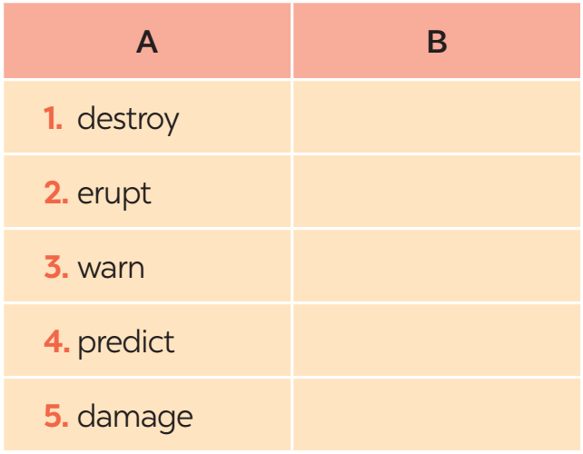
S (n) + V + n (o)
The + n
Adj + n
destruction
eruption
warning
prediction
damage

Slide 16
VOCABULARY
2
Fill in each blank with the correct form of the word in brackets.
1. The tsunami brought __________ to cities and towns near the sea. (destroy)
2. The government has developed some systems to help make __________ about natural disasters. (predict)
3. We are donating money and food to help the ______ of the landslide. (victim)
4. The local authorities _______ the villagers about a landslide yesterday. (warning)
5. Rescue _______ are trying hard to save people in the flooded area. (work)

Slide 18
VOCABULARY
2
Fill in each blank with the correct form of the word in brackets.
1. The tsunami brought __________ to cities and towns near the sea. (destroy)
2. The government has developed some systems to help make __________ about natural disasters. (predict)
3. We are donating money and food to help the ______ of the landslide. (victim)
4. The local authorities _______ the villagers about a landslide yesterday. (warning)
5. Rescue _______ are trying hard to save people in the flooded area. (work)
destruction
predictions
victims
warned
workers

Slide 19
The past continuous
Affirmative sentences: S + was/ were + V- ing…
Negative sentences: S + was/ were not + V- ing…
Questions: Was/ were + S + V- ing…?
* notes: - an action that was happening at a particular time in the past.
- a past action that was happening when another action interrupted it.

Slide 20
GRAMMAR
3
Put the verbs into the correct tense: the past simple or past continuous.
1. What _____ you (do) _____ at 8 o’clock yesterday morning?
2. Last year, earthquakes (destroy) _________ a lot of houses in Japan.
3. He (water) ____________ the flowers in his garden when the tornado (come) _____.
4. While they (call) __________ for help, the rescue workers (appear) ________.
5. _______ you (listen) ________ to music at 9 o’clock yesterday evening?

Slide 22
GRAMMAR
3
Put the verbs into the correct tense: the past simple or past continuous.
1. What _____ you (do) _____ at 8 o’clock yesterday morning?
2. Last year, earthquakes (destroy) _________ a lot of houses in Japan.
3. He (water) ____________ the flowers in his garden when the tornado (come) _____.
4. While they (call) __________ for help, the rescue workers (appear) ________.
5. _______ you (listen) ________ to music at 9 o’clock yesterday evening?
were
doing
destroyed
was watering
came
were calling
appeared
Were
listening

Slide 23
GRAMMAR
4
Complete the sentences about you and your family members.
At 7 p.m. yesterday, …
1. I was ________________________________.
2. my grandmother / grandfather ____________.
3. my mother ____________________________.
4. my father _____________________________.
5. my sister / brother ______________________.

Slide 24
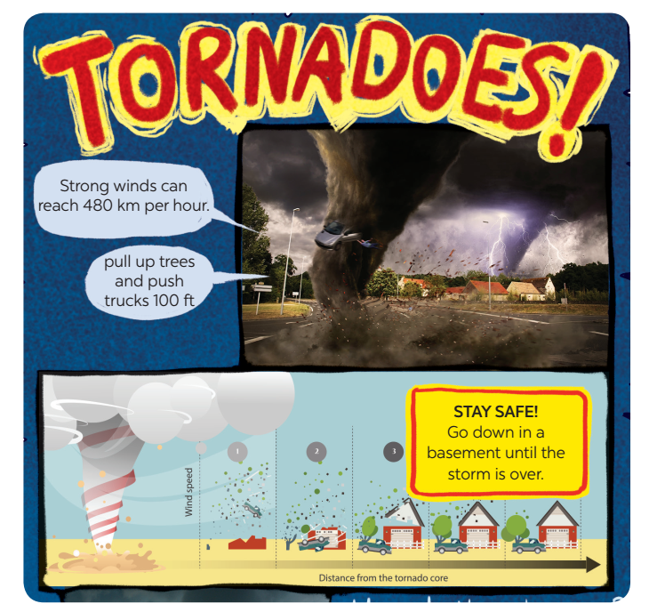
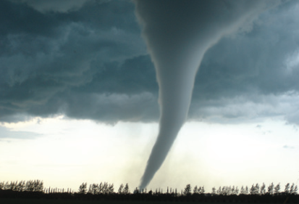
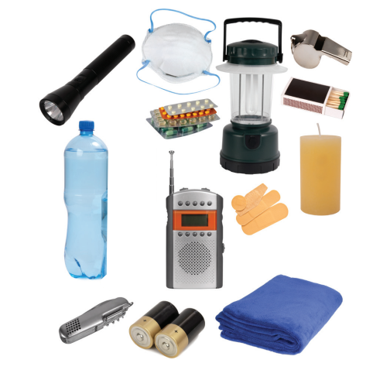
PROJECT

Slide 25
GROUP 4

Slide 26
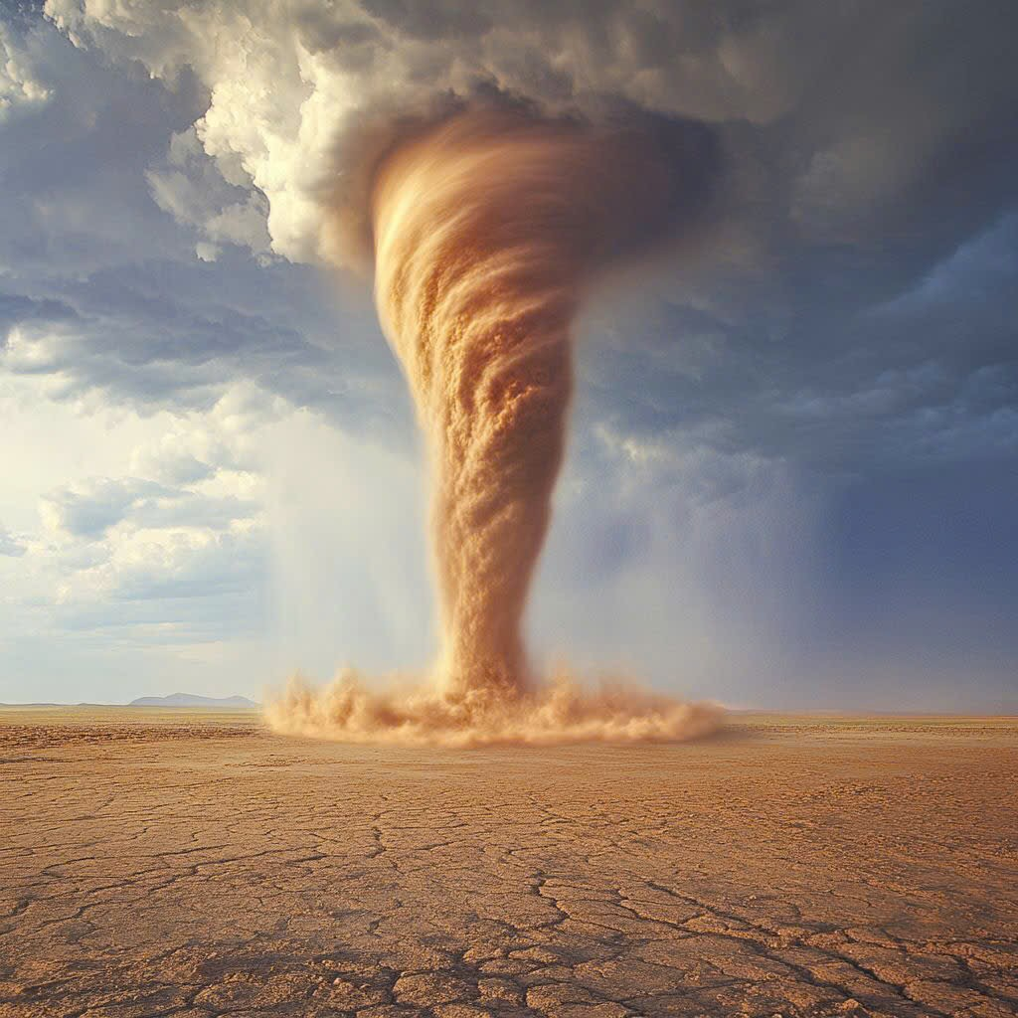
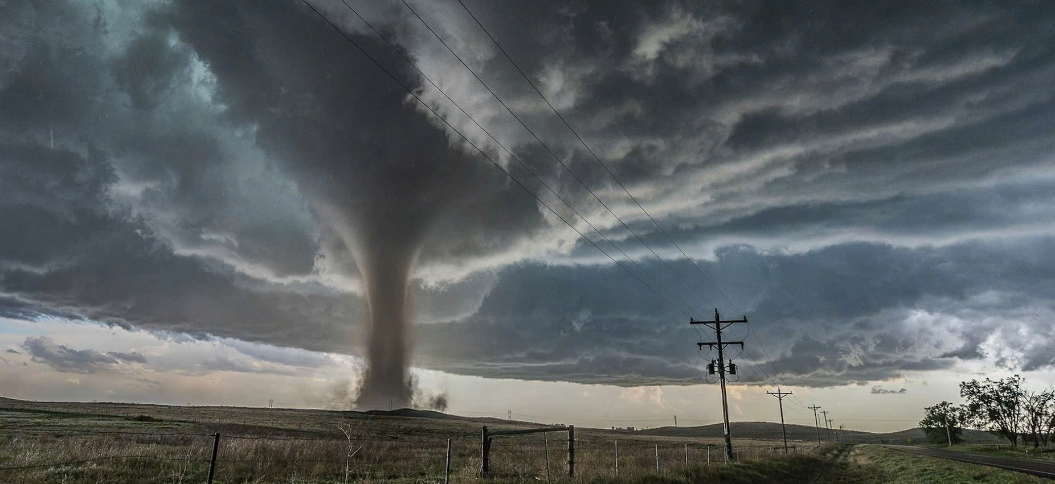
TORANADOES

Slide 27
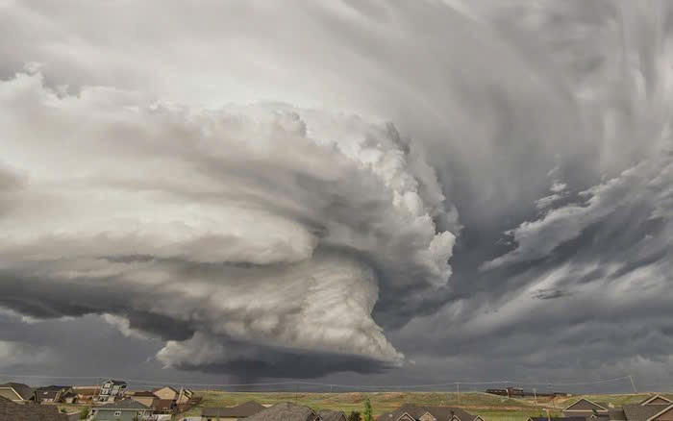
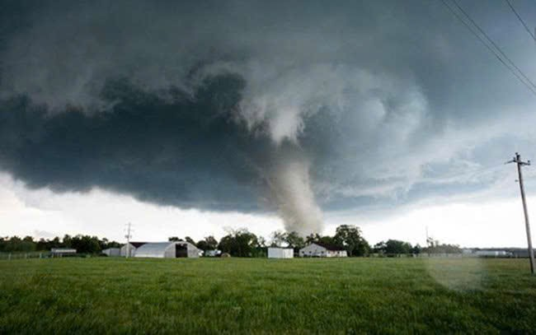
A tornado forms from a thunderstorm or large storm.
Tornadoes are common in the USA. According to ABC, an average of 132 tornadoes occur in Texas each year, mostly from April to June

Slide 28
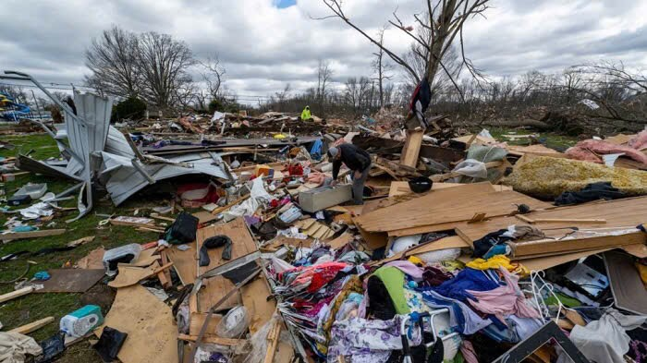
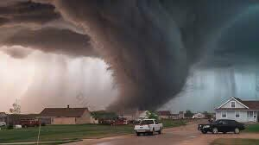
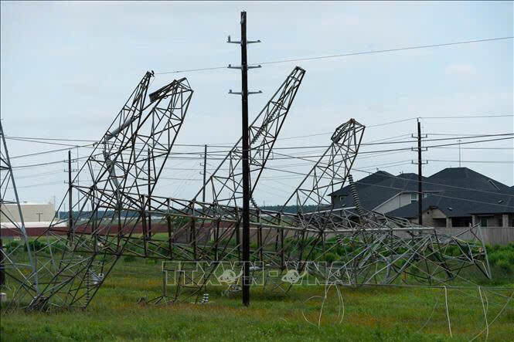
Effects of tornado
Tornadoes usually occur suddenly, last for a short time, and cause great destruction in a small area. They can sweep away houses, objects, and people. They appear suddenly and without warning, so they can cause death, injury, and damage to both people and property. They destroy homes and crops.

Slide 29
Before it happens
- Know the signs of a tornado
- Practice getting to safety with your parents
- If you can't get to a safer place, lie down and cover your head with your hands.
- Wear sturdy shoes. Wear a helmet to protect your head.
While it happens
- Get to a safe place immediately.
- Follow the instructions of your parent or teacher.
- Protect yourself by covering your head or neck with your arms.
- Stay away from windows.
- If you are in a car, get out and into a sturdy building.

Slide 30
After it happens
- If there is damage, stay away and follow adult instructions.
- Do not touch exposed electrical wires such as power lines.
- Tell your parents if you smell gas.

Slide 33
CONSOLIDATION
1
Wrap-up
In this lesson, you have:
revised more vocabulary items you have learnt in the unit.
revised the differences between the past simple and past continuous.
revised the past continuous.
researched more deeply into a natural disaster.

Slide 34
CONSOLIDATION
2
Homework
Do exercises in the workbook.
Prepare for Unit 10 – Getting started

Slide 35
Website: hoclieu.vn
Fanpage: facebook.com/tienganhglobalsuccess.vn/

