Slide 1
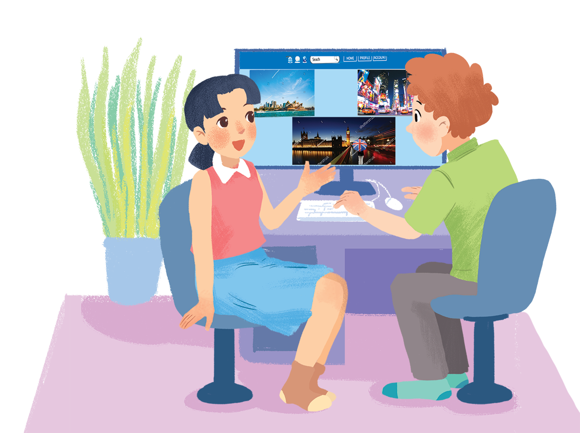
WELCOME TO OUR CLASS!

Slide 3
What city is it?

Slide 4
Friday, March 14th , 2025
UNIT 9: CITIES OF THE WORLD
Lesson 6: Skills 2

Slide 5
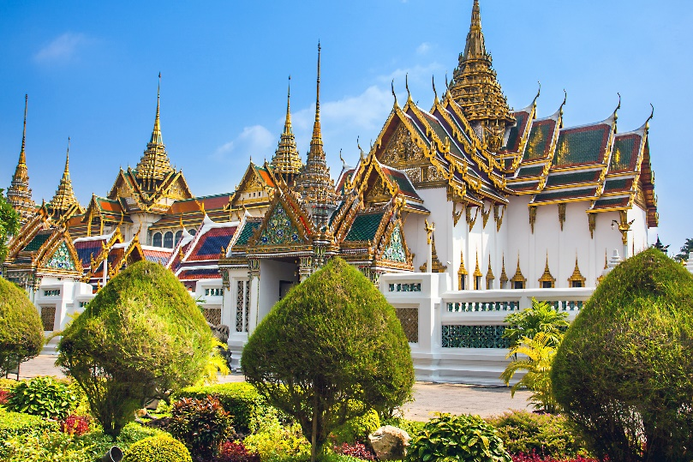
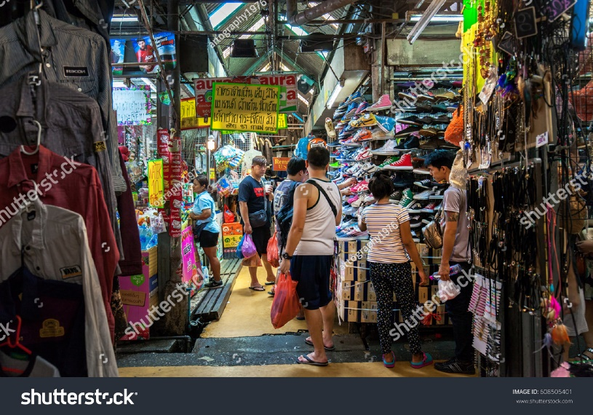
Work in groups. Discuss and answer the questions.
1.
Where is Bangkok?
It’s the capital of Thailand
2.
What is Bangkok famous for?
It’s famous for pagodas, markets, food….

Slide 6
Listen and tick () T (True) or F (False).
 |  | T | F
1. | Bangkok is famous for palace.
2. | Things at Chatuchak market are expensive.
3. | The floating market is on the sea.
4. | You can find food stalls all around Bangkok.

Slide 7
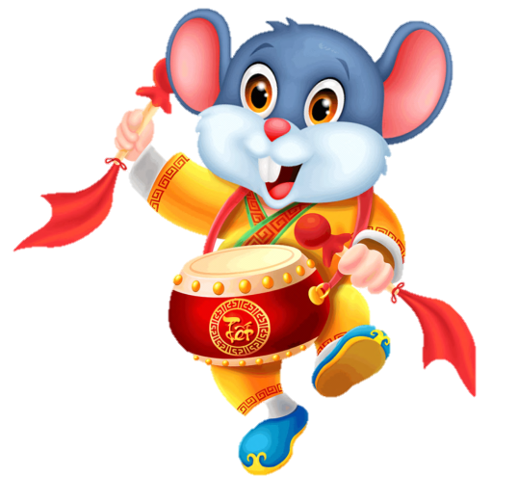
GETTING LUCKY MONEY

Slide 8
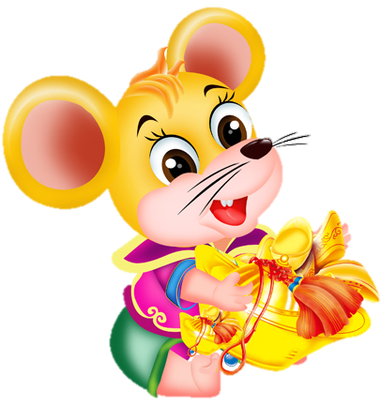
START
1. Bangkok is famous for palaces.
10
3
8
5
True
False
?

Slide 9
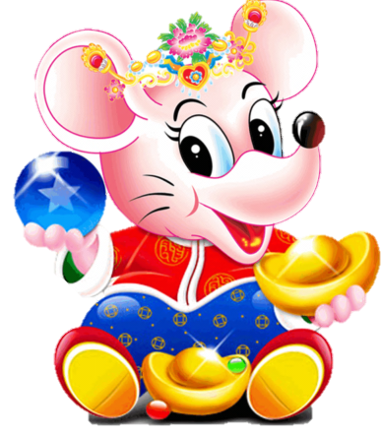
START
10
2. Things at Chatuchak market are expensive.
3
8
5
stop
True
False
?

Slide 10
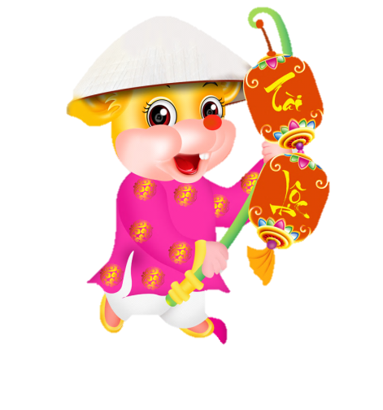
START
3. The floating market is on the sea.
10
3
8
5
stop
True
False
?

Slide 11
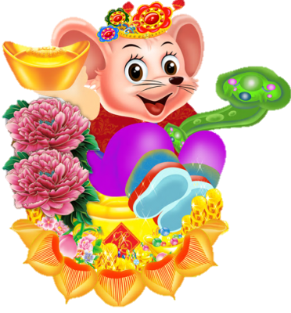
START
4. You can find food stalls all around Bangkok.
10
3
8
5
stop
True
False
?

Slide 12
SUGGEST
Bangkok is famous for its markets and street food. Visit the Chatuchak, the largest weekend market in the world. There are over 15,000 stalls selling nearly everything, at cheap prices. It’s only five minutes’ walk from the station. When you visit this market, you can see part of Thai people’s life.
Another interesting type of market is the floating market on the river. Don’t forget to try street food in Bangkok. It’s easy to find food stalls all around Bangkok, serving different Thai dishes. They are really delicious.

Slide 13
SUGGEST
Bangkok is famous for its markets and street food. Visit the Chatuchak, the largest weekend market in the world. There are over 15,000 stalls selling nearly everything, at cheap prices. It’s only five minutes’ walk from the station. When you visit this market, you can see part of Thai people’s life.
Another interesting type of market is the floating market on the river. Don’t forget to try street food in Bangkok. It’s easy to find food stalls all around Bangkok, serving different Thai dishes. They are really delicious.

Slide 14
SUGGEST
Bangkok is famous for its markets and street food. Visit the Chatuchak, the largest weekend market in the world. There are over 15,000 stalls selling nearly everything, at cheap prices. It’s only five minutes’ walk from the station. When you visit this market, you can see part of Thai people’s life.
Another interesting type of market is the floating market on the river. Don’t forget to try street food in Bangkok. It’s easy to find food stalls all around Bangkok, serving different Thai dishes. They are really delicious.

Slide 15
SUGGEST
Bangkok is famous for its markets and street food. Visit the Chatuchak, the largest weekend market in the world. There are over 15,000 stalls selling nearly everything, at cheap prices. It’s only five minutes’ walk from the station. When you visit this market, you can see part of Thai people’s life.
Another interesting type of market is the floating market on the river. Don’t forget to try street food in Bangkok. It’s easy to find food stalls all around Bangkok, serving different Thai dishes. They are really delicious.

Slide 16
Listen and tick () T (True) or F (False).
 |  | T | F
1. | Bangkok is famous for palace.
2. | Things at Chatuchak market are expensive.
3. | The floating market is on the sea.
4. | You can find food stalls all around Bangkok.
✓
✓
✓
✓

Slide 17
Listen again and fill each gap with one word / number.
1.
Chatuchak market has over stalls.
2.
Chatuchak market is about minutes’ walk from the station.
3.
You can see part of Thai people’ s at a market.
4.
Street food in Bangkok is .

Slide 18
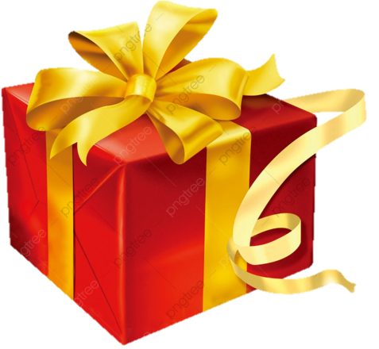
90 marks
80 marks
100 marks
70 marks
MYSTERY PRESENTS

Slide 19
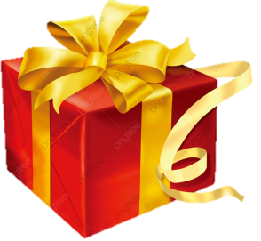
START
1. Chatuchak market has over ……………..stalls.
12
9
3
6
stop
A.15.000
Great
B. 14.000
C. 13.000
?

Slide 20
START
2. Chatuchak market is about …….. minutes’ walk from the station.
12
9
3
6
stop
A. 4
B. 5
Good job
C. 6
?

Slide 21
START
3. You can see part of Thai people’s ……..at a market.
12
9
3
6
stop
A. sale
B. shops
C. life
Wonderful
?

Slide 22
START
4. Street food in Bangkok is……………
12
9
3
6
stop
A. delicious
Very well
B. bad
C. very bad
?

Slide 23
SUGGEST
Bangkok is famous for its markets and street food. Visit the Chatuchak, the largest weekend market in the world. There are over 15,000 stalls selling nearly everything, at cheap prices. It’s only five minutes’ walk from the station. When you visit this market, you can see part of Thai people’s life.
Another interesting type of market is the floating market on the river. Don’t forget to try street food in Bangkok. It’s easy to find food stalls all around Bangkok, serving different Thai dishes. They are really delicious.

Slide 24
SUGGEST
Bangkok is famous for its markets and street food. Visit the Chatuchak, the largest weekend market in the world. There are over 15,000 stalls selling nearly everything, at cheap prices. It’s only five minutes’ walk from the station. When you visit this market, you can see part of Thai people’s life.
Another interesting type of market is the floating market on the river. Don’t forget to try street food in Bangkok. It’s easy to find food stalls all around Bangkok, serving different Thai dishes. They are really delicious.

Slide 25
SUGGEST
Bangkok is famous for its markets and street food. Visit the Chatuchak, the largest weekend market in the world. There are over 15,000 stalls selling nearly everything, at cheap prices. It’s only five minutes’ walk from the station. When you visit this market, you can see part of Thai people’s life.
Another interesting type of market is the floating market on the river. Don’t forget to try street food in Bangkok. It’s easy to find food stalls all around Bangkok, serving different Thai dishes. They are really delicious.

Slide 26
SUGGEST
Bangkok is famous for its markets and street food. Visit the Chatuchak, the largest weekend market in the world. There are over 15,000 stalls selling nearly everything, at cheap prices. It’s only five minutes’ walk from the station. When you visit this market, you can see part of Thai people’s life.
Another interesting type of market is the floating market on the river. Don’t forget to try street food in Bangkok. It’s easy to find food stalls all around Bangkok, serving different Thai dishes. They are really delicious.

Slide 27
Listen again and fill each gap with one word / number.
1.
15,000
Chatuchak market has over stalls.
2.
5
Chatuchak market is about minutes’ walk from the station.
3.
life
You can see part of Thai people’s at a market.
4.
Street food in Bangkok is .
delicious

Slide 28
Work in groups. Talk about a city in your country, using the questions below as a guide.
What can you see there?
What is it like?
What can you do there?

Slide 29
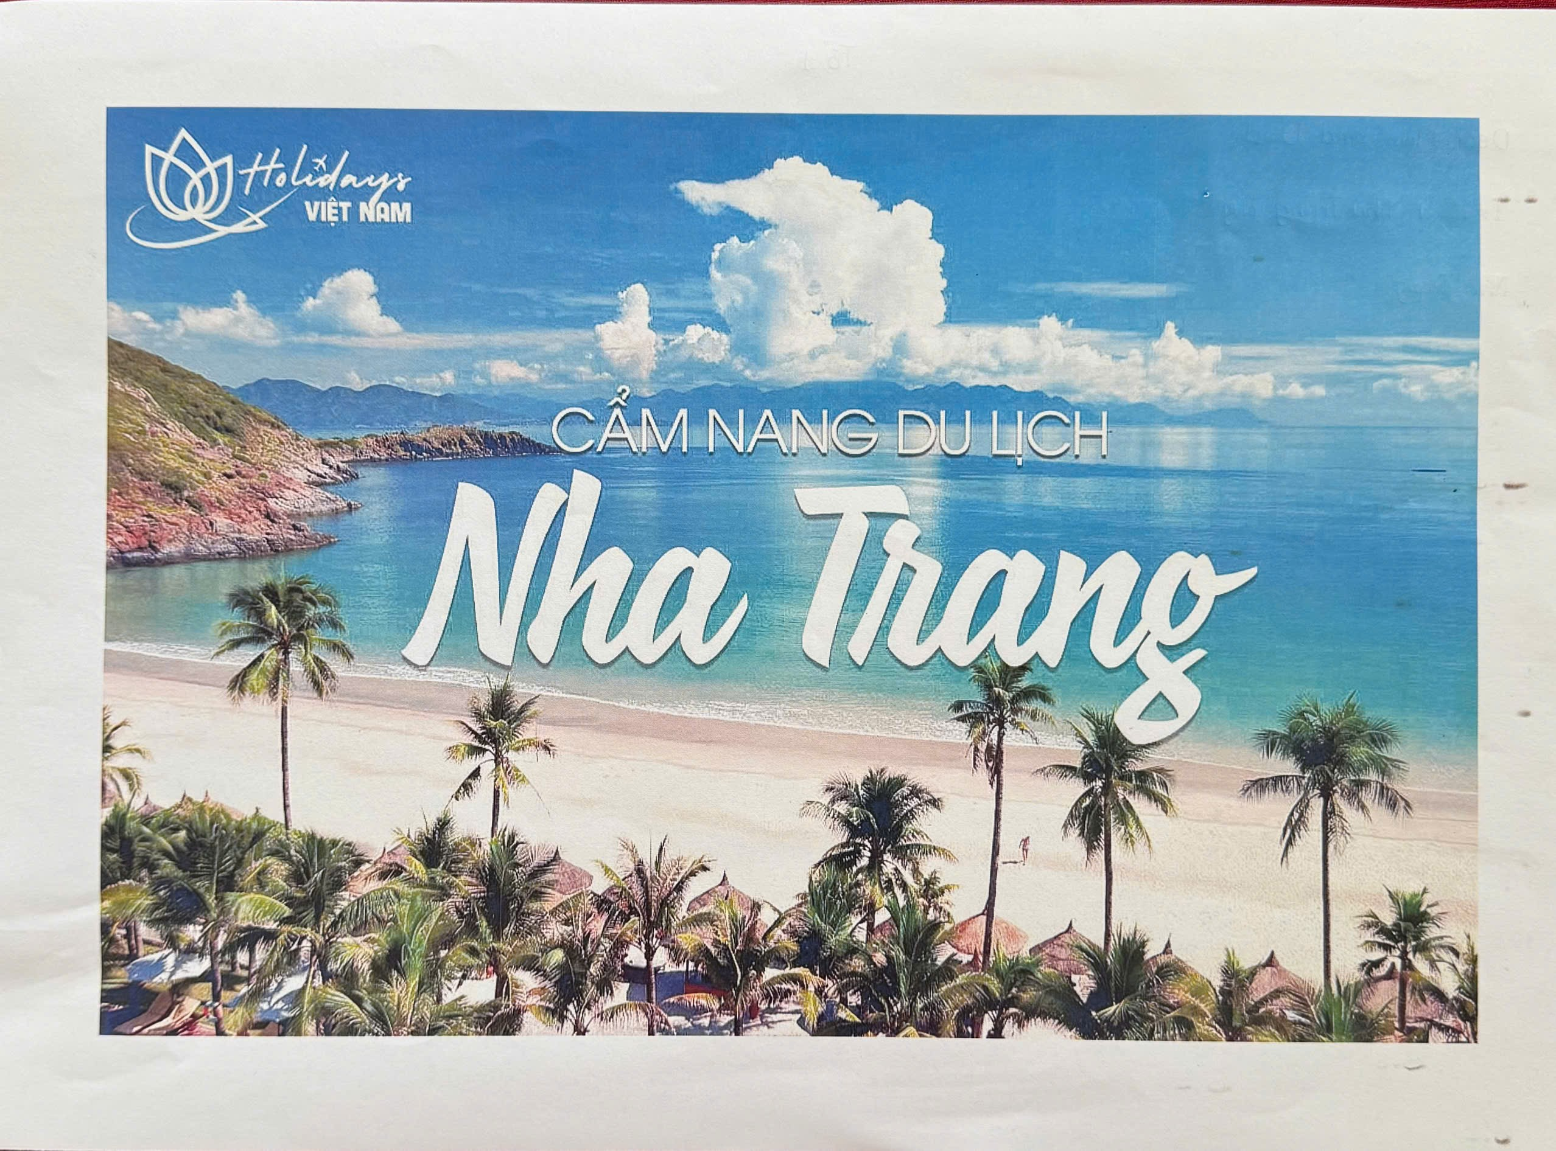
Group 1

Slide 30
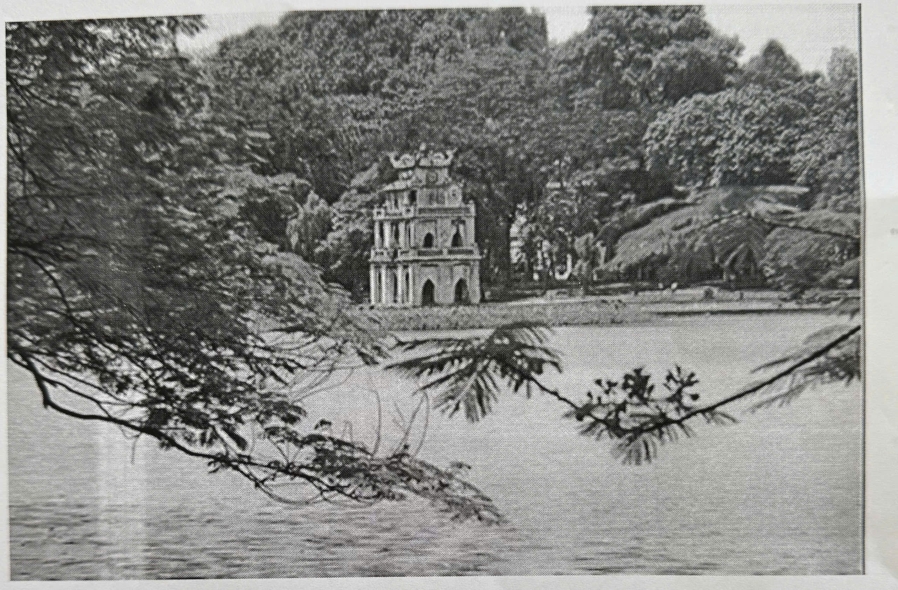
Group 2

Slide 31
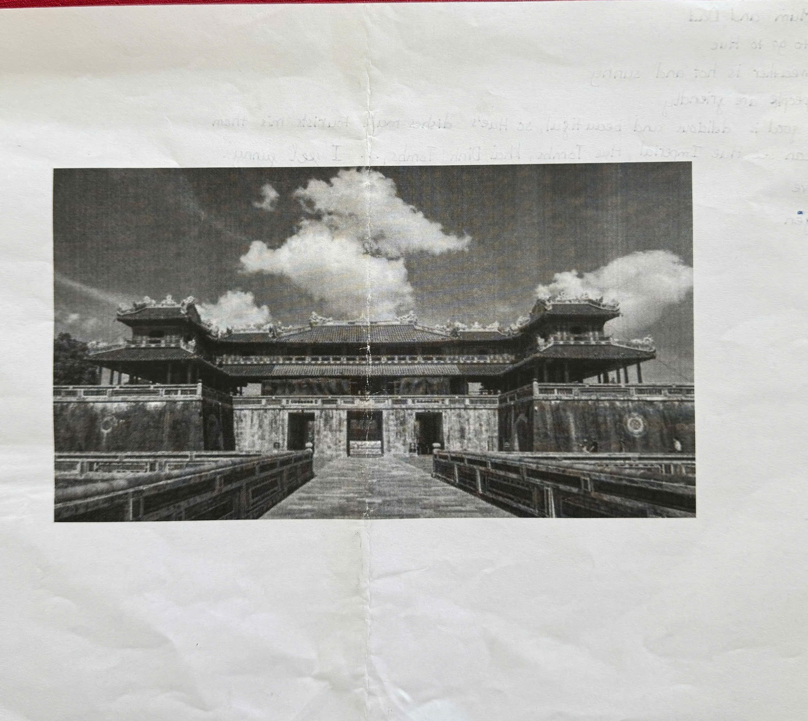
Group 3

Slide 32
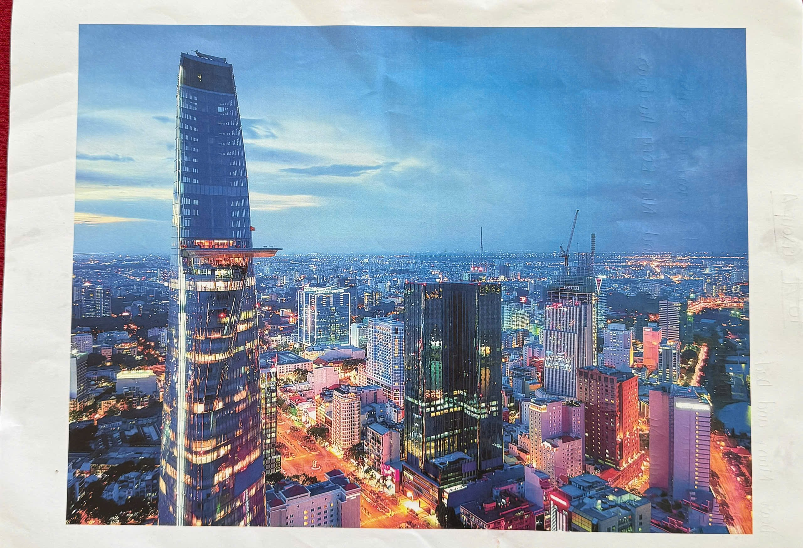
Group 4

Slide 33
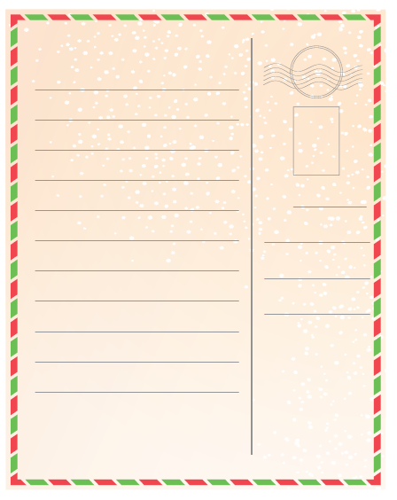
Write a postcard of about 50 words about your holiday in a city. Use the information in 4.
Dear Mum and Dad,
Dalat is very nice
The weather is cold and sunny.
The people are friendly and helpful.
The food is delicious such as jam, strawberries, fresh food…
I can see flowers and beautiful places.
I feel very happy there.
Wish you were here.
Love,
Trang
To:
Love,
Trang

Slide 34
HOMEWORK
Write a postcard about your holiday in the city
Do exercises E in workbook
Prepare: Looking back and Project

Slide 35
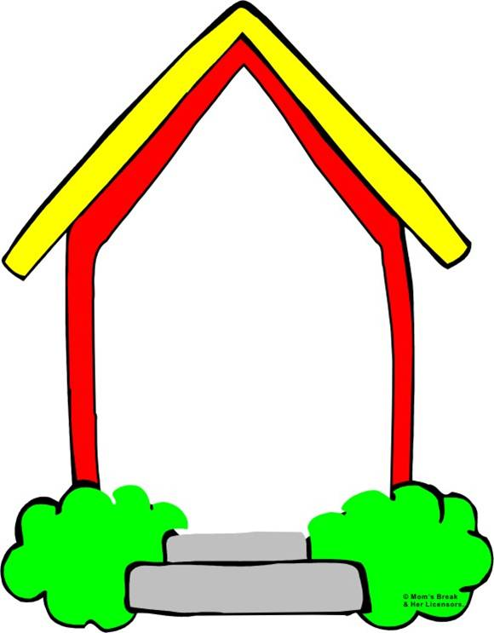
Good bye

