Slide 2
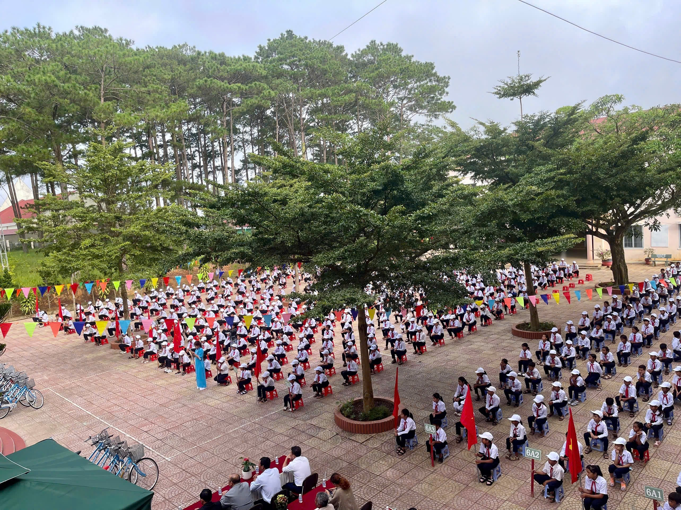
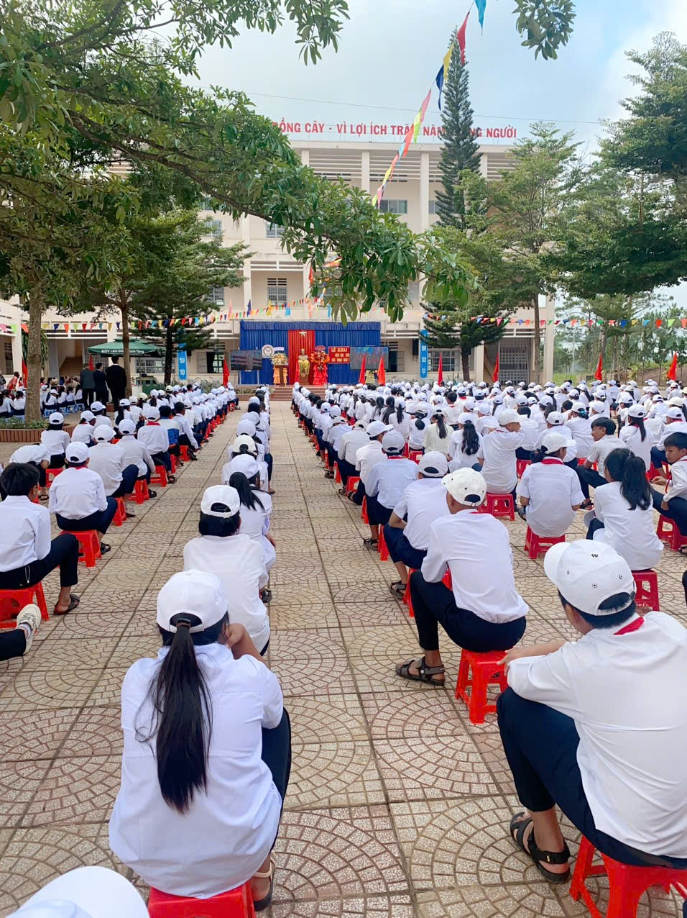
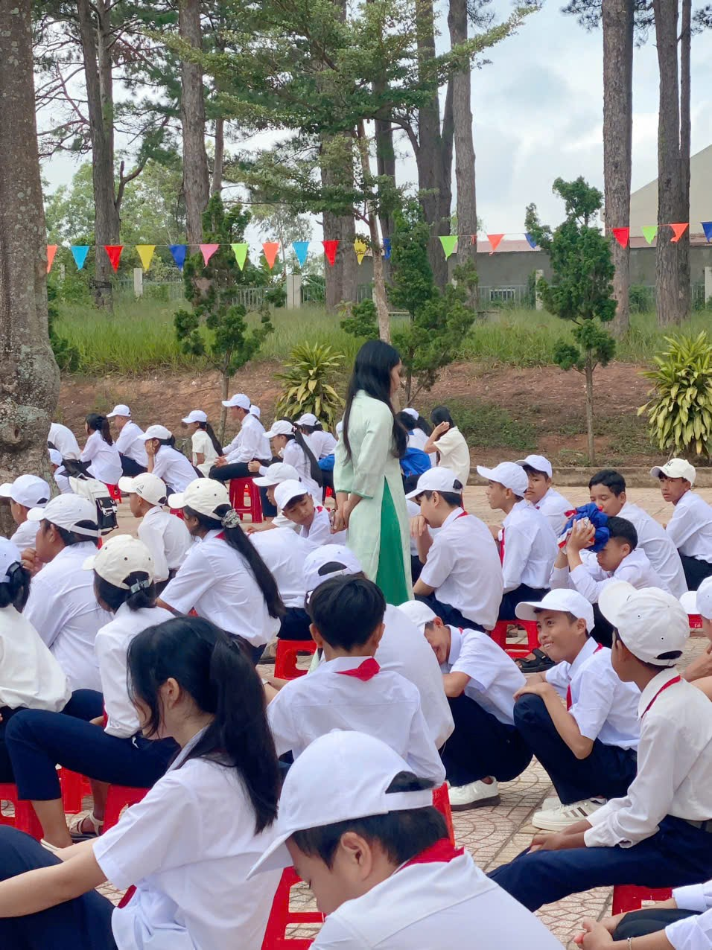
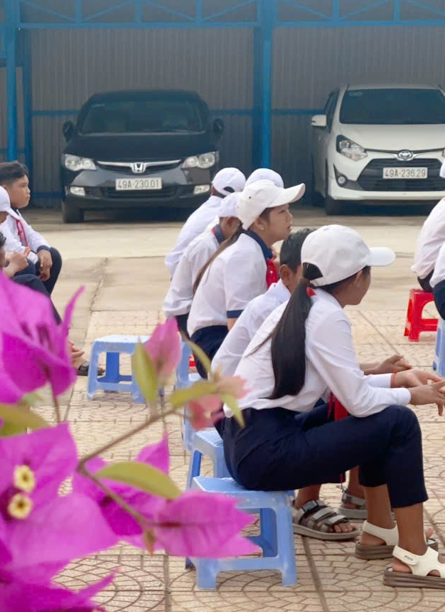
new school
Unit 1: My …………

Slide 3
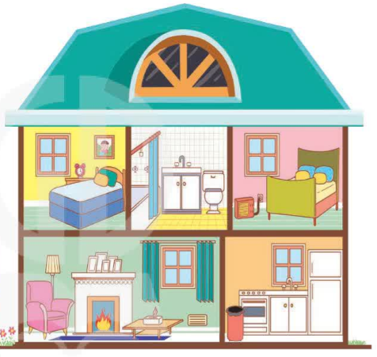

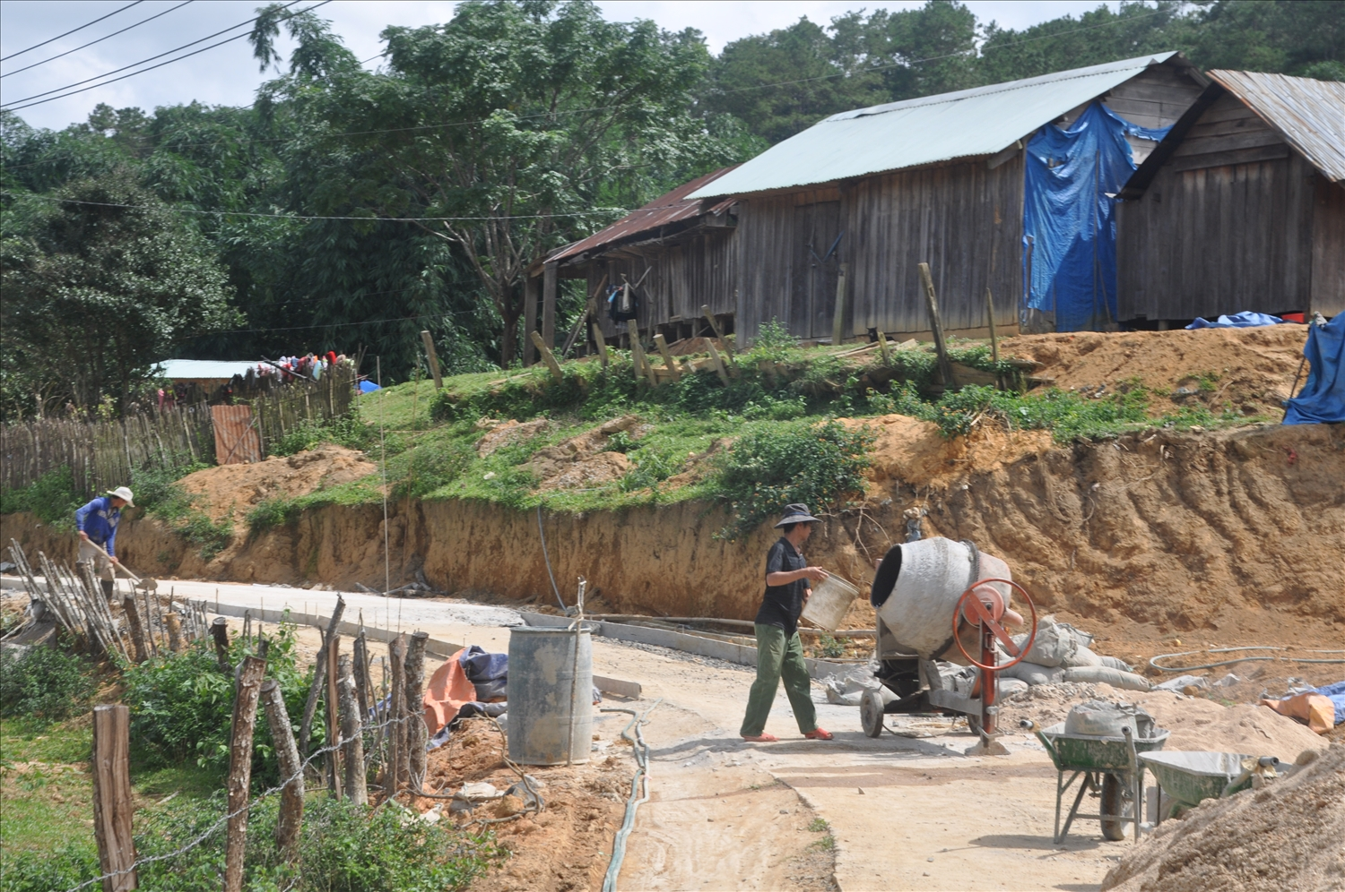
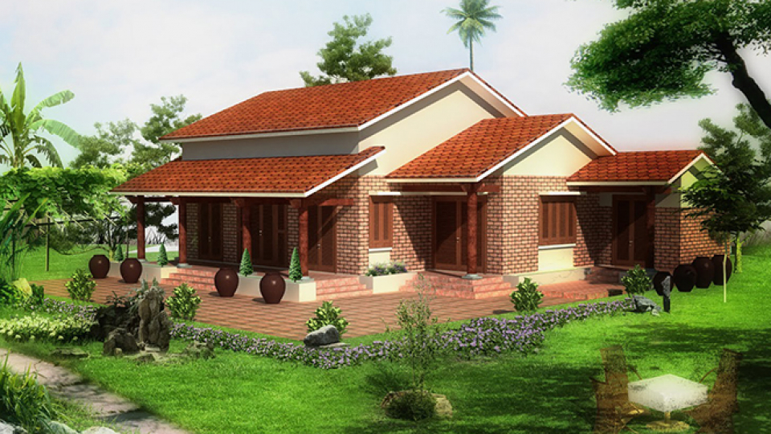
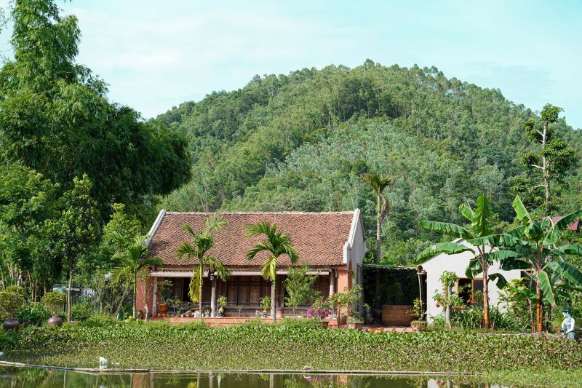
house
Unit 2: My …………..

Slide 4
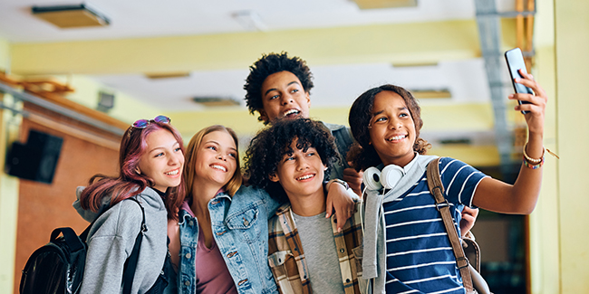
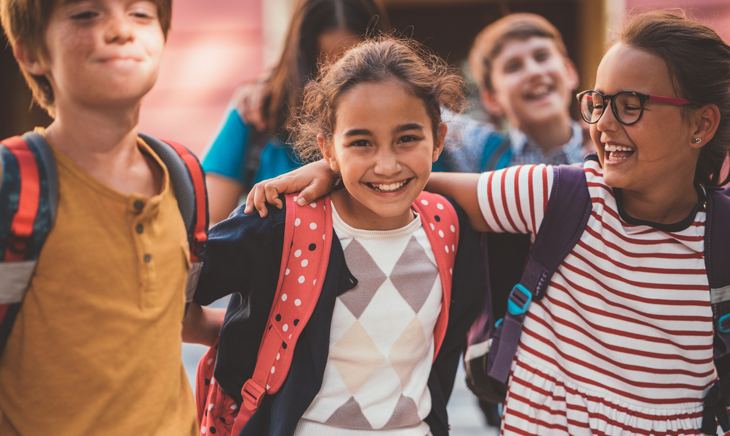
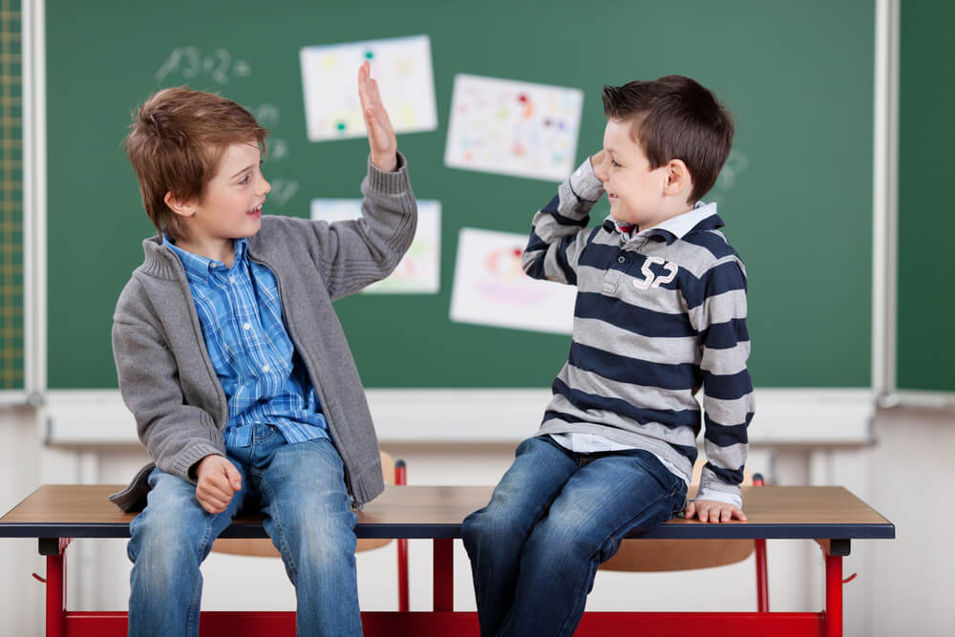
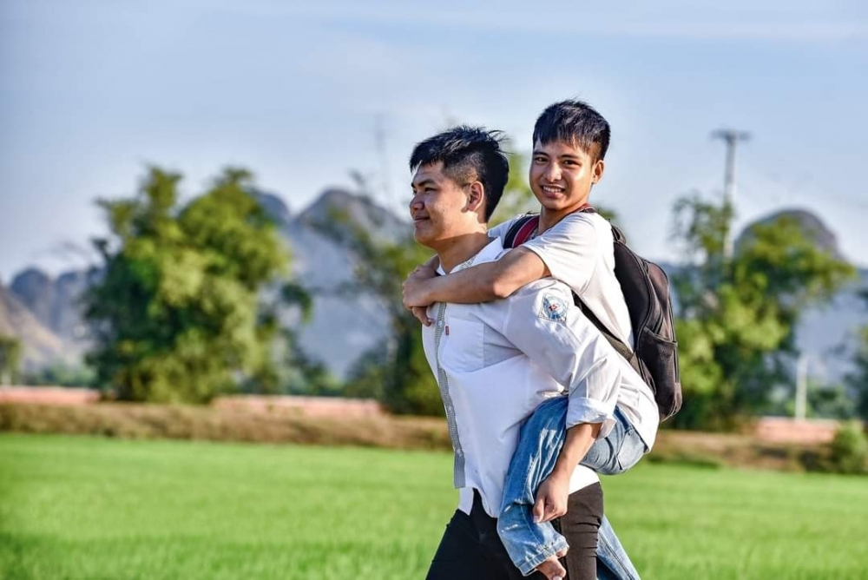
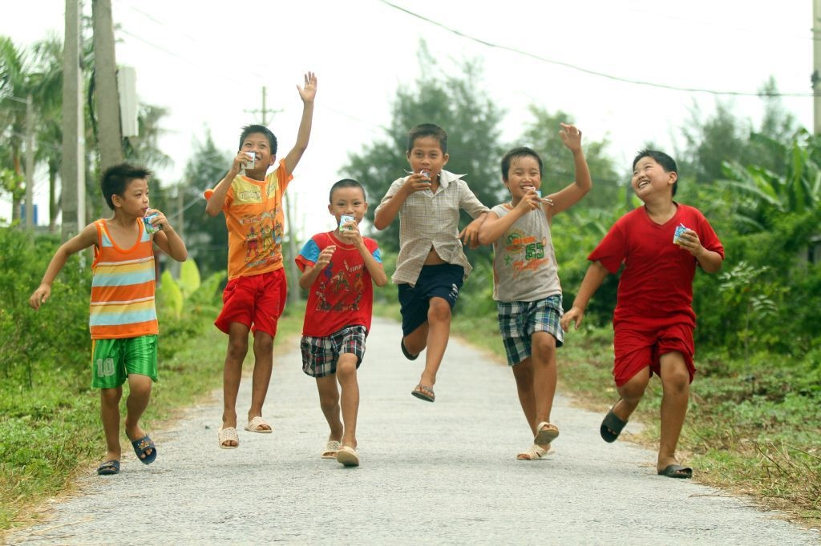
friends
Unit 3: My …………

Slide 5


Unit
3
MY FRIENDS
LESSON 1: GETTING STARTED
A surprise guest
1

Slide 6
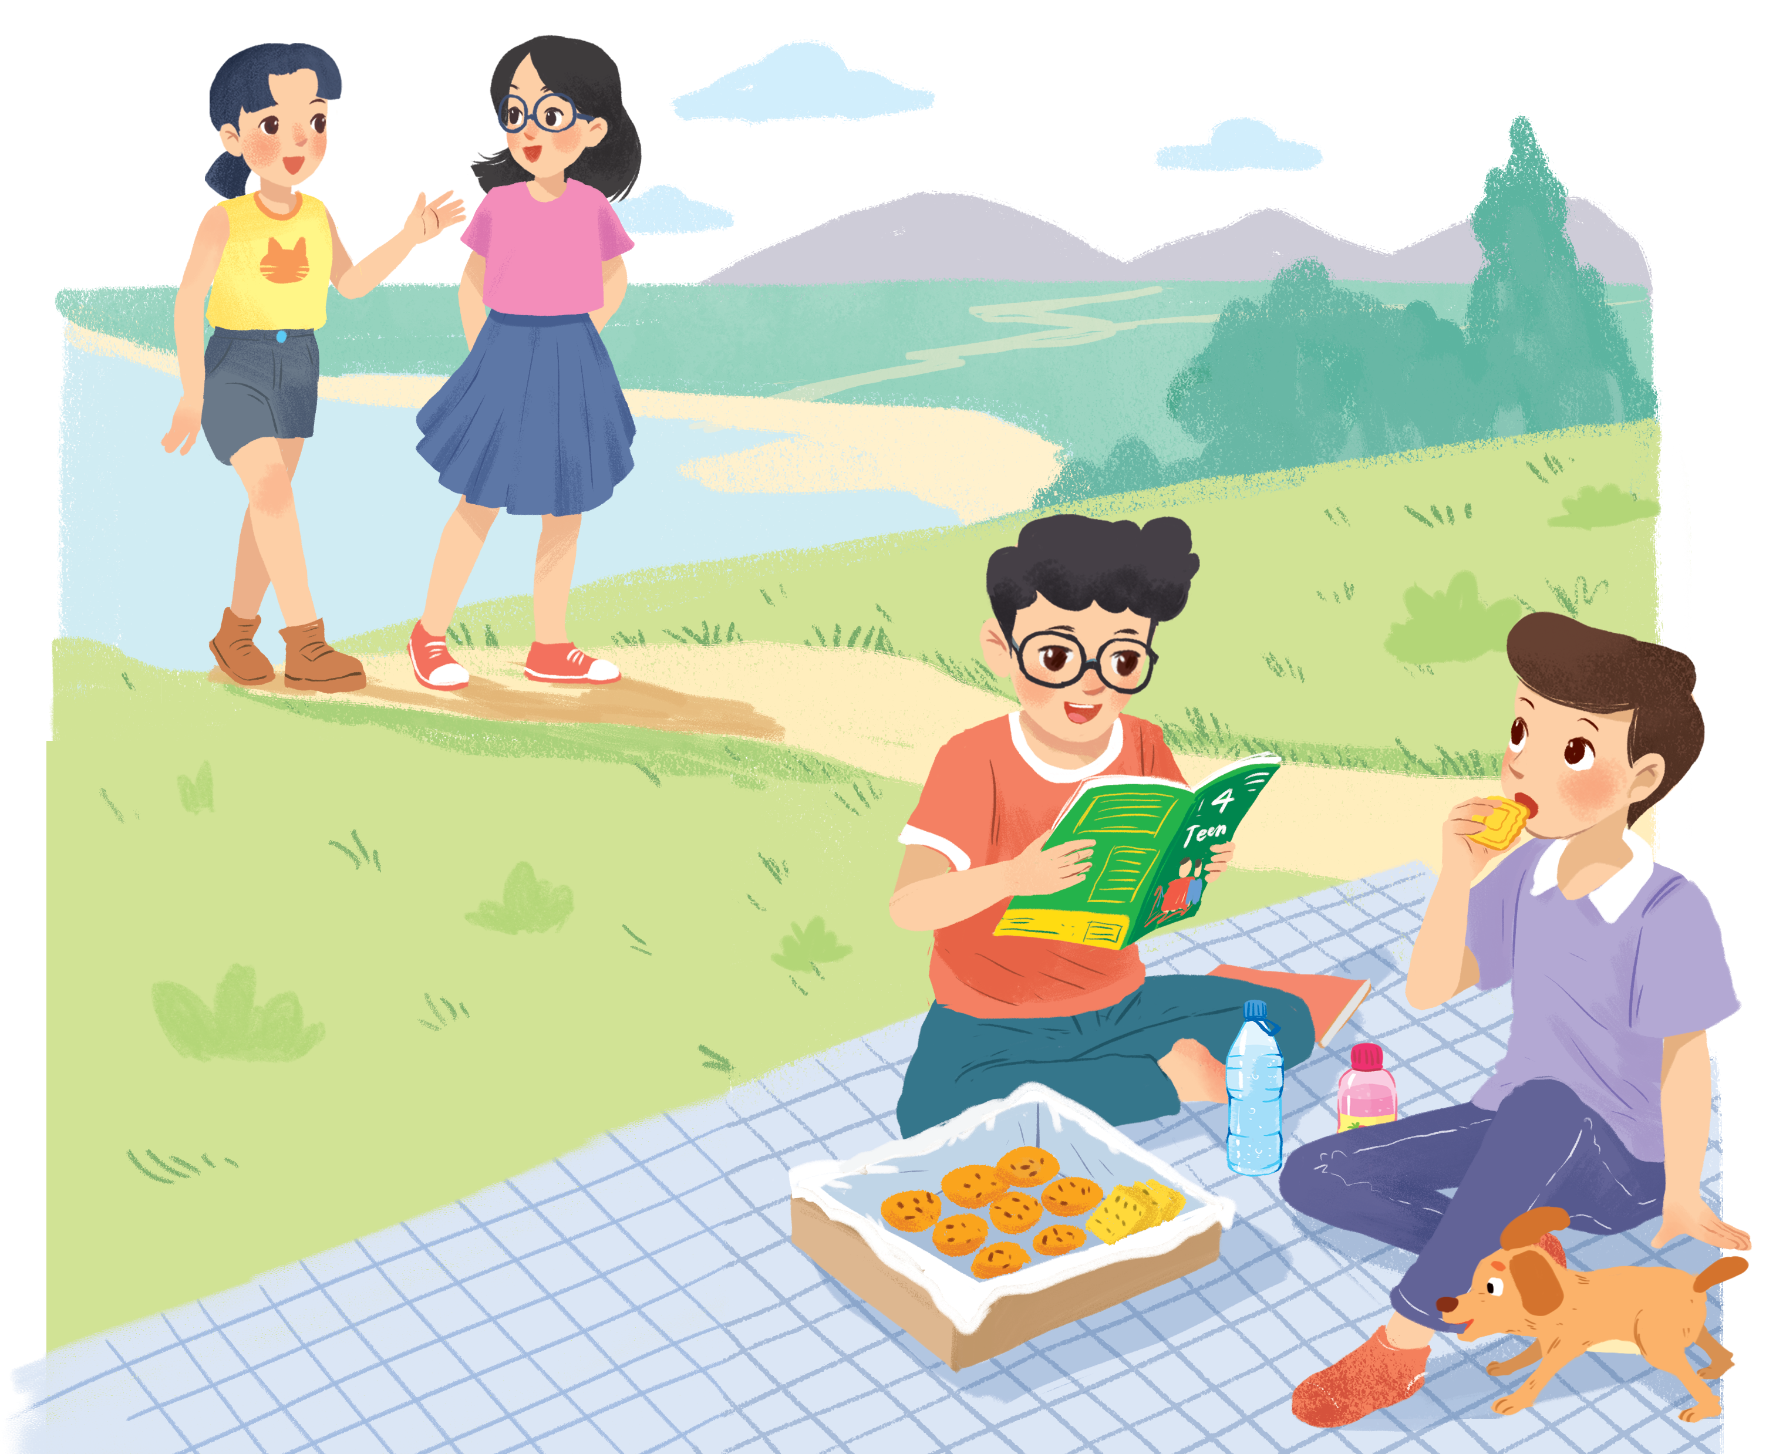
Mai
Chau
Nam
a magazine
Phong
biscuits

Slide 7
Mai
A surprise guest
Chau
* Answer the questions
1. What are Phong and Nam doing?
2. What is Phong’s favourite magazine?
3. Who do Phong and Nam see?
4. Where are the two girls going?
Phong
Nam

Slide 8

Listen and read. (P.26)
Phong: That was a great idea, Nam. I love picnics!
Nam: Please pass me the biscuits.
Phong: Sure. Here you are.
Nam: Thanks. What are you reading, Phong?
Phong: 4Teen. It's my favourite magazine!
Nam: Look! It's Mai. And she is with someone.
Phong: Oh, who's that? She has glasses and long black hair.
Nam: I don't know. They're coming over.
Mai: Hi there. This is my friend Chau.
Phong & Nam: Hi, Chau. Nice to meet you.
Chau: Nice to meet you, too.
Nam: Would you like to sit down? We have lots of food.
Mai: Oh, sorry, we can't. We're going to the bookshop.
Chau: Bye for now.
Phong & Nam: Bye bye.

Slide 9
Monday, October 12th, 2025
Unit 3: MY FRIENDS – P. 26
- Having a picnic
- Có 1 buổi dã ngoại
- Pass me some biscuits
- Đưa tôi 1 ít bánh quy
- My favourite magazine
- tạp chí yêu thích của tôi
- She has glasses
- Cô ấy đeo kính
- She has long black hair
- Cô ấy có tóc dài
- We are going to the bookshop
- Chúng tôi đang đi đến hiệu sách

Slide 10
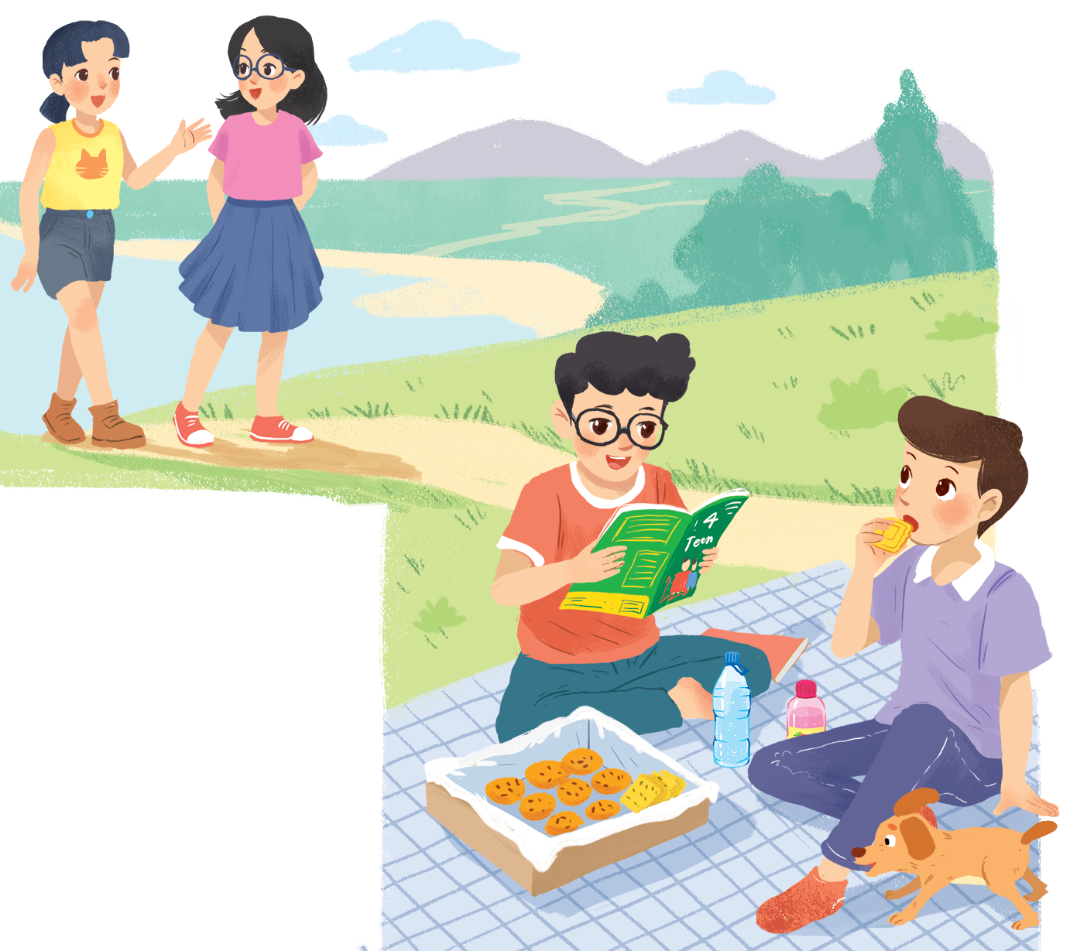
PRACTICE
What are Phong and Nam doing?
2. What is Phong’s favourite magazine?
3. Who do Phong and Nam see?
4. Where are the two girls going?
They are having a picnic.
It’s 4Teen.
They see their friends. (Châu and Mai)
They are going to the bookstore.
Notes:
Suggested answers:
They are having a picnic.
It’s …
They see …
They are going to …

Slide 11
PRACTICE
2
Fill the blanks with the words from the conversation.
1. Phong and Nam are having a _______.
2. 4Teen is Phong’s __________________.
3. Phong and Nam see _____ and ______.
4. Chau has _________ and _______________.
5. Mai and Chau _____________ the bookshop.
picnic
favourite magazine
Mai
Chau
glasses
long black hair
are going to

Slide 12
Let’s check!
1. Phuc and Nam are having a ____________.
picnics
Phong: That was a great idea, Nam. I love picnics!
Nam: Please pass me the biscuits.
2. 4Teen is Phong's __________________.
favourite magazine
Nam: Thanks. What are you reading, Phong?
Phong: 4Teen. It's my favourite magazine!

Slide 13
Let’s check!
3. Phong and Nam see ___________ and ___________.
Mai
Chau
Nam: Look! It's Mai. And she is with someone.
Phong: Oh, who's that? She has glasses and long black hair.
Nam: I don't know. They're coming over.
Mai: Hi there. This is my friend Chau.
Phong & Nam: Hi, Chau. Nice to meet you.

Slide 14
Let’s check!
4. Chau has _____________, and _________________.
glasses
long black hair
Nam: Look! It's Mai. And she is with someone.
Phong: Oh, who's that? She has glasses and long black hair.
Nam: I don't know. They're coming over.
Mai: Hi there. This is my friend Chau.
Phong & Nam: Hi, Chau. Nice to meet you.

Slide 15
Let’s check!
5. Mai and Chau _____________ the bookshop.
are going to
Phong & Nam: Hi, Chau. Nice to meet you.
Chau: Nice to meet you, too.
Nam: Would you like to sit down? We have lots of food.
Mai: Oh, sorry, we can't. We're going to the bookshop.

Slide 16
Who is “A surprise guest”?
Nam: Look! It's Mai. And she is with someone.
Phong: Oh, who's that? She has glasses and long black hair.
Nam: I don't know. They're coming over.
Mai: Hi there. This is my friend Chau.
Phong & Nam: Hi, Chau. Nice to meet you.
Chau: Nice to meet you, too.
Chau

Slide 17

Watch and write as many body parts as you can

Slide 18
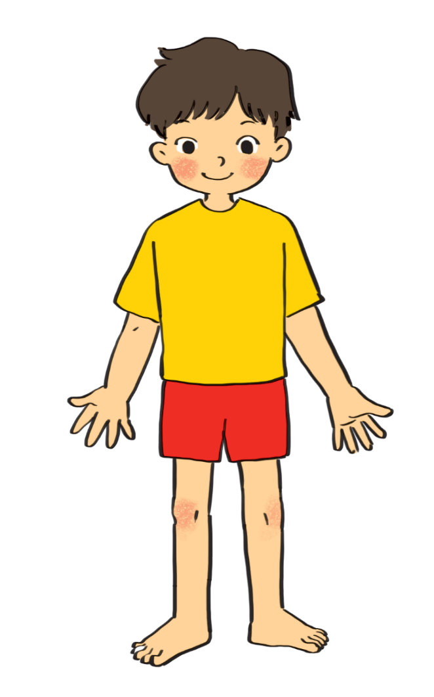
PRACTICE
3
cheek
eye
hand
arm
mouth
cheek
eye
hand
arm
mouth
ears
leg
nose
hair
shoulder
foot
leg
nose
hair
shoulder
foot
head
Do you know any other words for body parts?
eye
forehead
1.
hair
10.
neck
2.
nose
9.
cheek
belly
shoulder
8.
mouth
3.
back
arm
butt
7.
4.
hand
knee
5.
leg
foot
fingers
6.

Slide 19
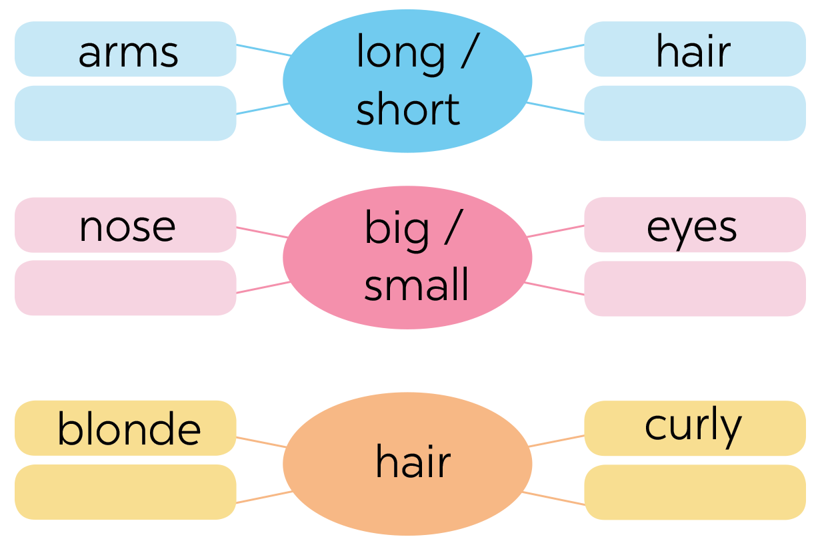
4. Work in group of four. Complete the word webs.
legs
feet
hands
ears
black
straight

Slide 20
PRACTICE
4
Work in groups. Complete the word webs.
Example:
nose
eyes
big / small
head
feet
hand
ears

Slide 21
PRACTICE
4
Work in groups. Complete the word webs.
Example:
blonde
curly
long/ short
black
hair
wavy
straight
fair

Slide 22
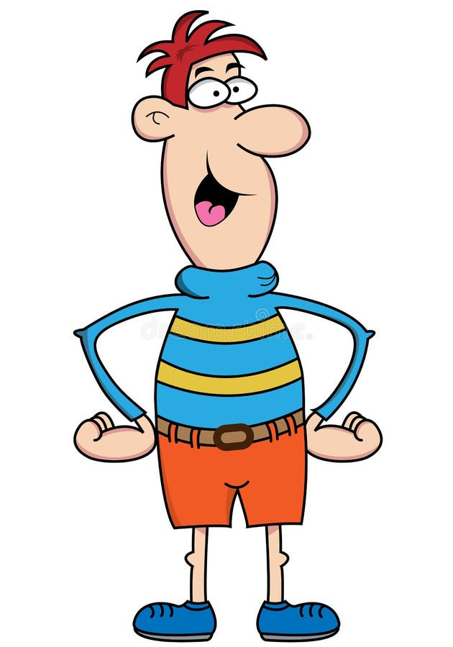
Yes or No
→ The boy has a big nose
→ He has black hair
→ He has big hands
→ He has small feet

Slide 23
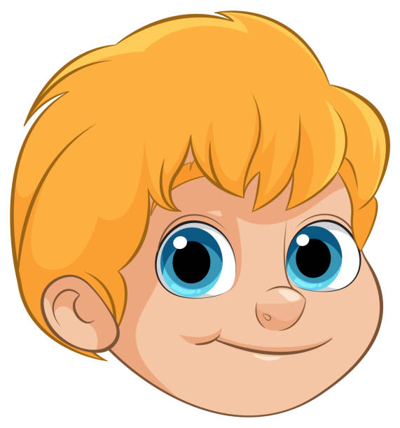
Yes or No
→ The boy has blonde hair
→ The boy has long hair
→ He has big brown eyes
→ He has short hair and blue eyes

Slide 24
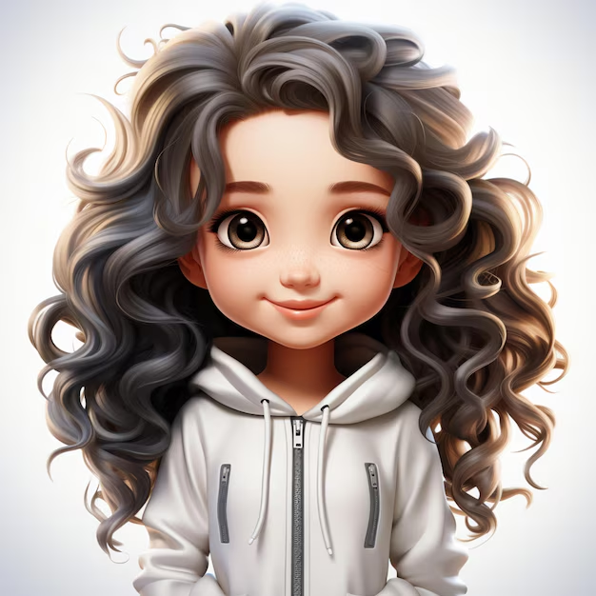
Yes or No
→ The girl has long / curly hair
→ She has long / curly hair
→ The girl has a small nose
→ She has a small nose
→ The girl has long / curly hair and a small nose

Slide 25
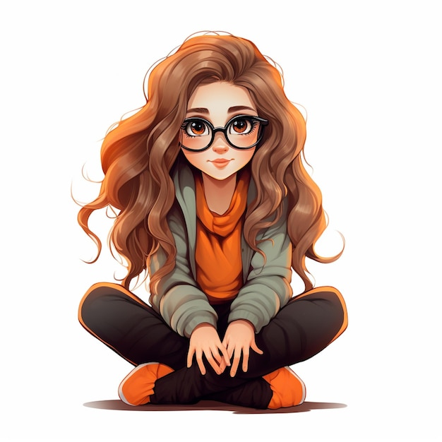
Yes or No
→ The girl has glasses
→ She is wearing glasses

Slide 26
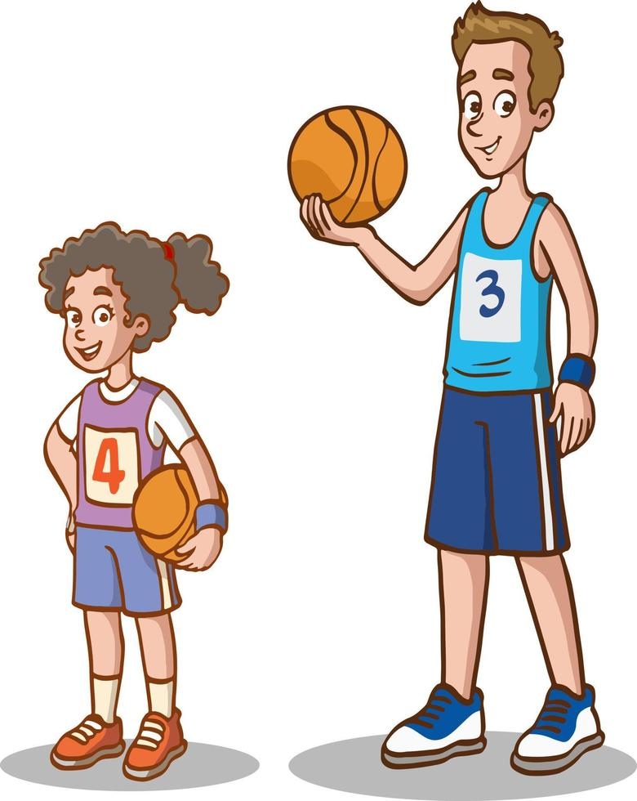
Yes or No
The boy is tall
The girl is short

Slide 27
Which picture?
He / She has ………
3
2
He / She is ………
1
4
5

Slide 28
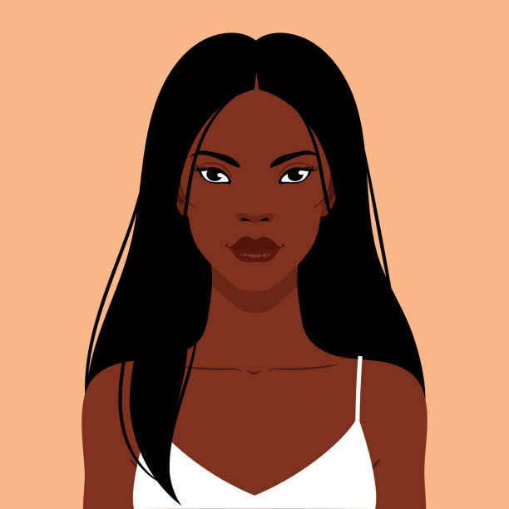
RECAP
What adjectives do we use to describe hair?
01


long
curly
small

blonde
big

straight
Which are correct?
02
She is black long hair.

She has long black hair.
She has straight long hair.

Slide 29
Monday, October 12th, 2025
Unit 3: MY FRIENDS – P. 26
- Having a picnic
- Có 1 buổi dã ngoại
- Pass me some biscuits
- Đưa tôi 1 ít bánh quy
- My favourite magazine
- tạp chí yêu thích của tôi
- She has glasses
- Cô ấy đeo kính
- She has long black hair
- Cô ấy có tóc dài
- We are going to the bookshop
- Chúng tôi đang đi đến hiệu sách

Slide 30
Thanks!
Do you have any questions?

Slide 31






Website: hoclieu.vn
Fanpage: facebook.com/www.tienganhglobalsuccess.vn/

