Slide 1


Slide 2

GAME: record your voice
GAME: Watch video and list all the school words in this video. (individual)

Slide 3
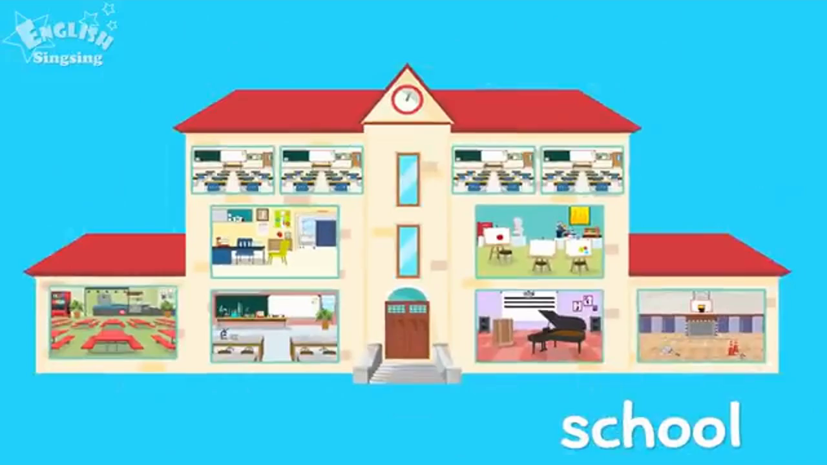

Slide 4

Work in group of 6, share your answers. (1 min)

Slide 5

2 teams go to the board and record all your answers. (2 mins).

Slide 6
Answer:
gym
art room
music room
science room
nurse’s office
cafeteria
classroom
blackboard
chalk
desk
chair
bulletin board
teacher
student
classmate

Slide 7
Guess the topic today:
My favourite book
A visit to a school
My classroom

Slide 8



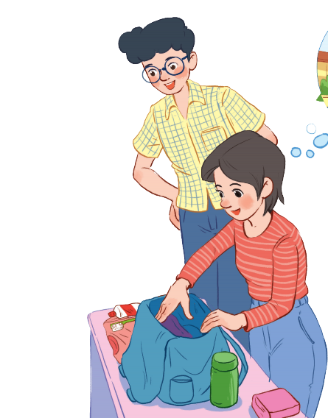
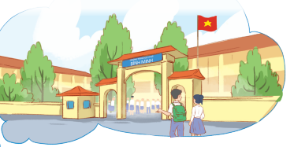
Unit
6
A VISIT TO A SCHOOL
LESSON 1: GETTING STARTED
A visit to Binh Minh Lower Secondary School
Unit
HOBBIES

Slide 9


PRESENTATION
lower secondary school
/ˈləʊər ˈsekəndrɪ skuːl/
trường trung học cơ sở

Slide 10

PRESENTATION
classmate (n)
/ˈklɑːsmeɪt/
bạn cùng lớp

Slide 11
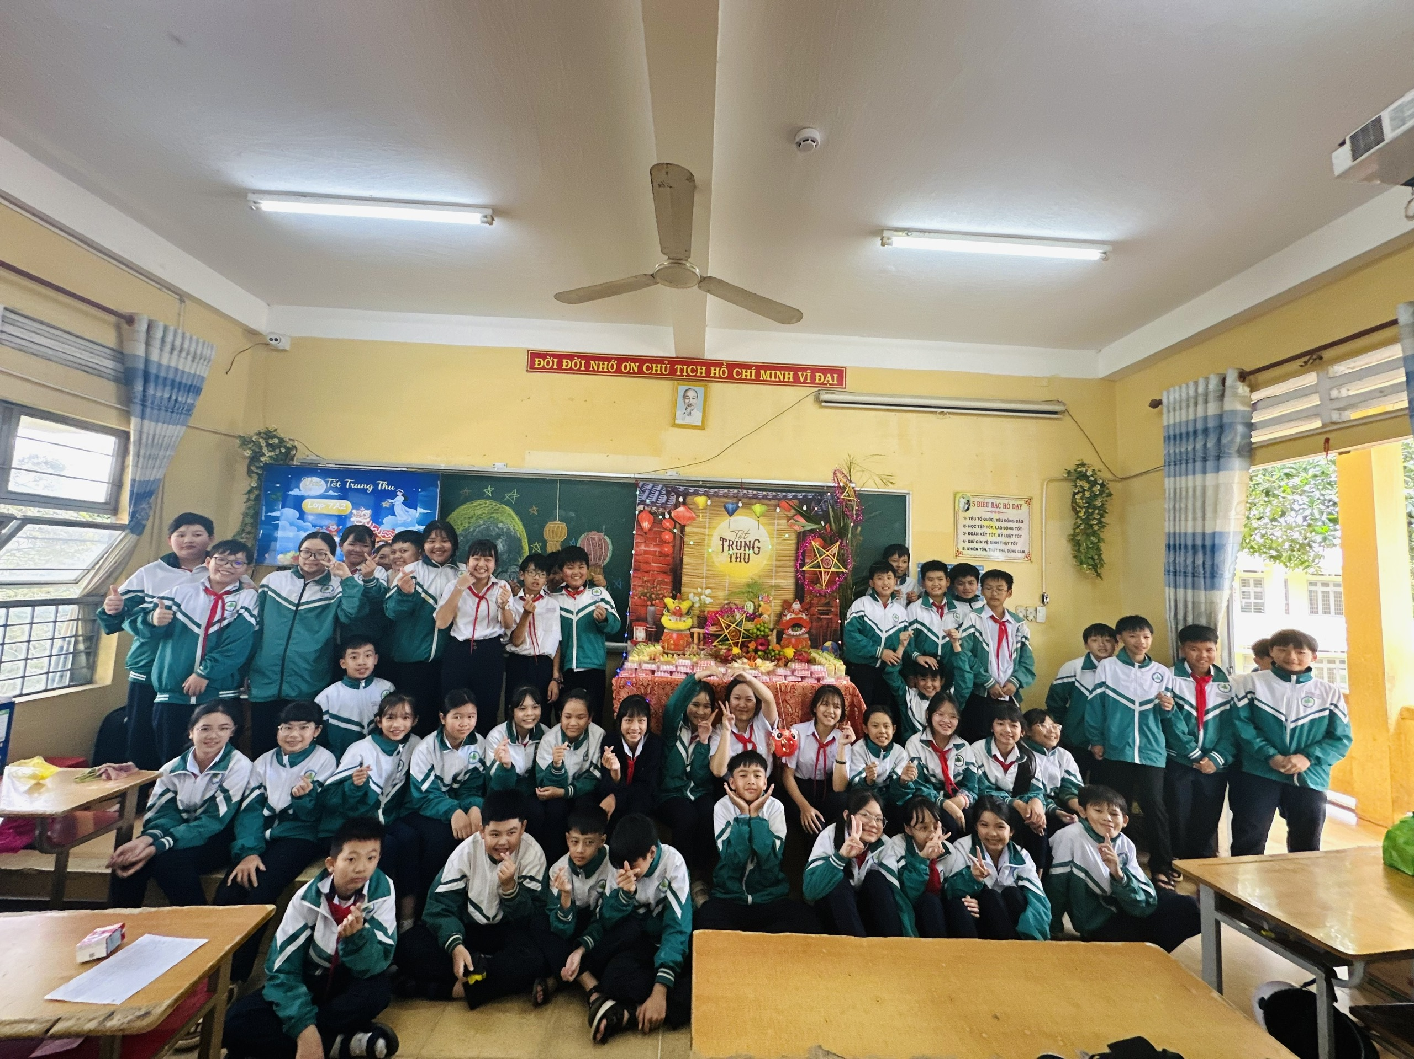
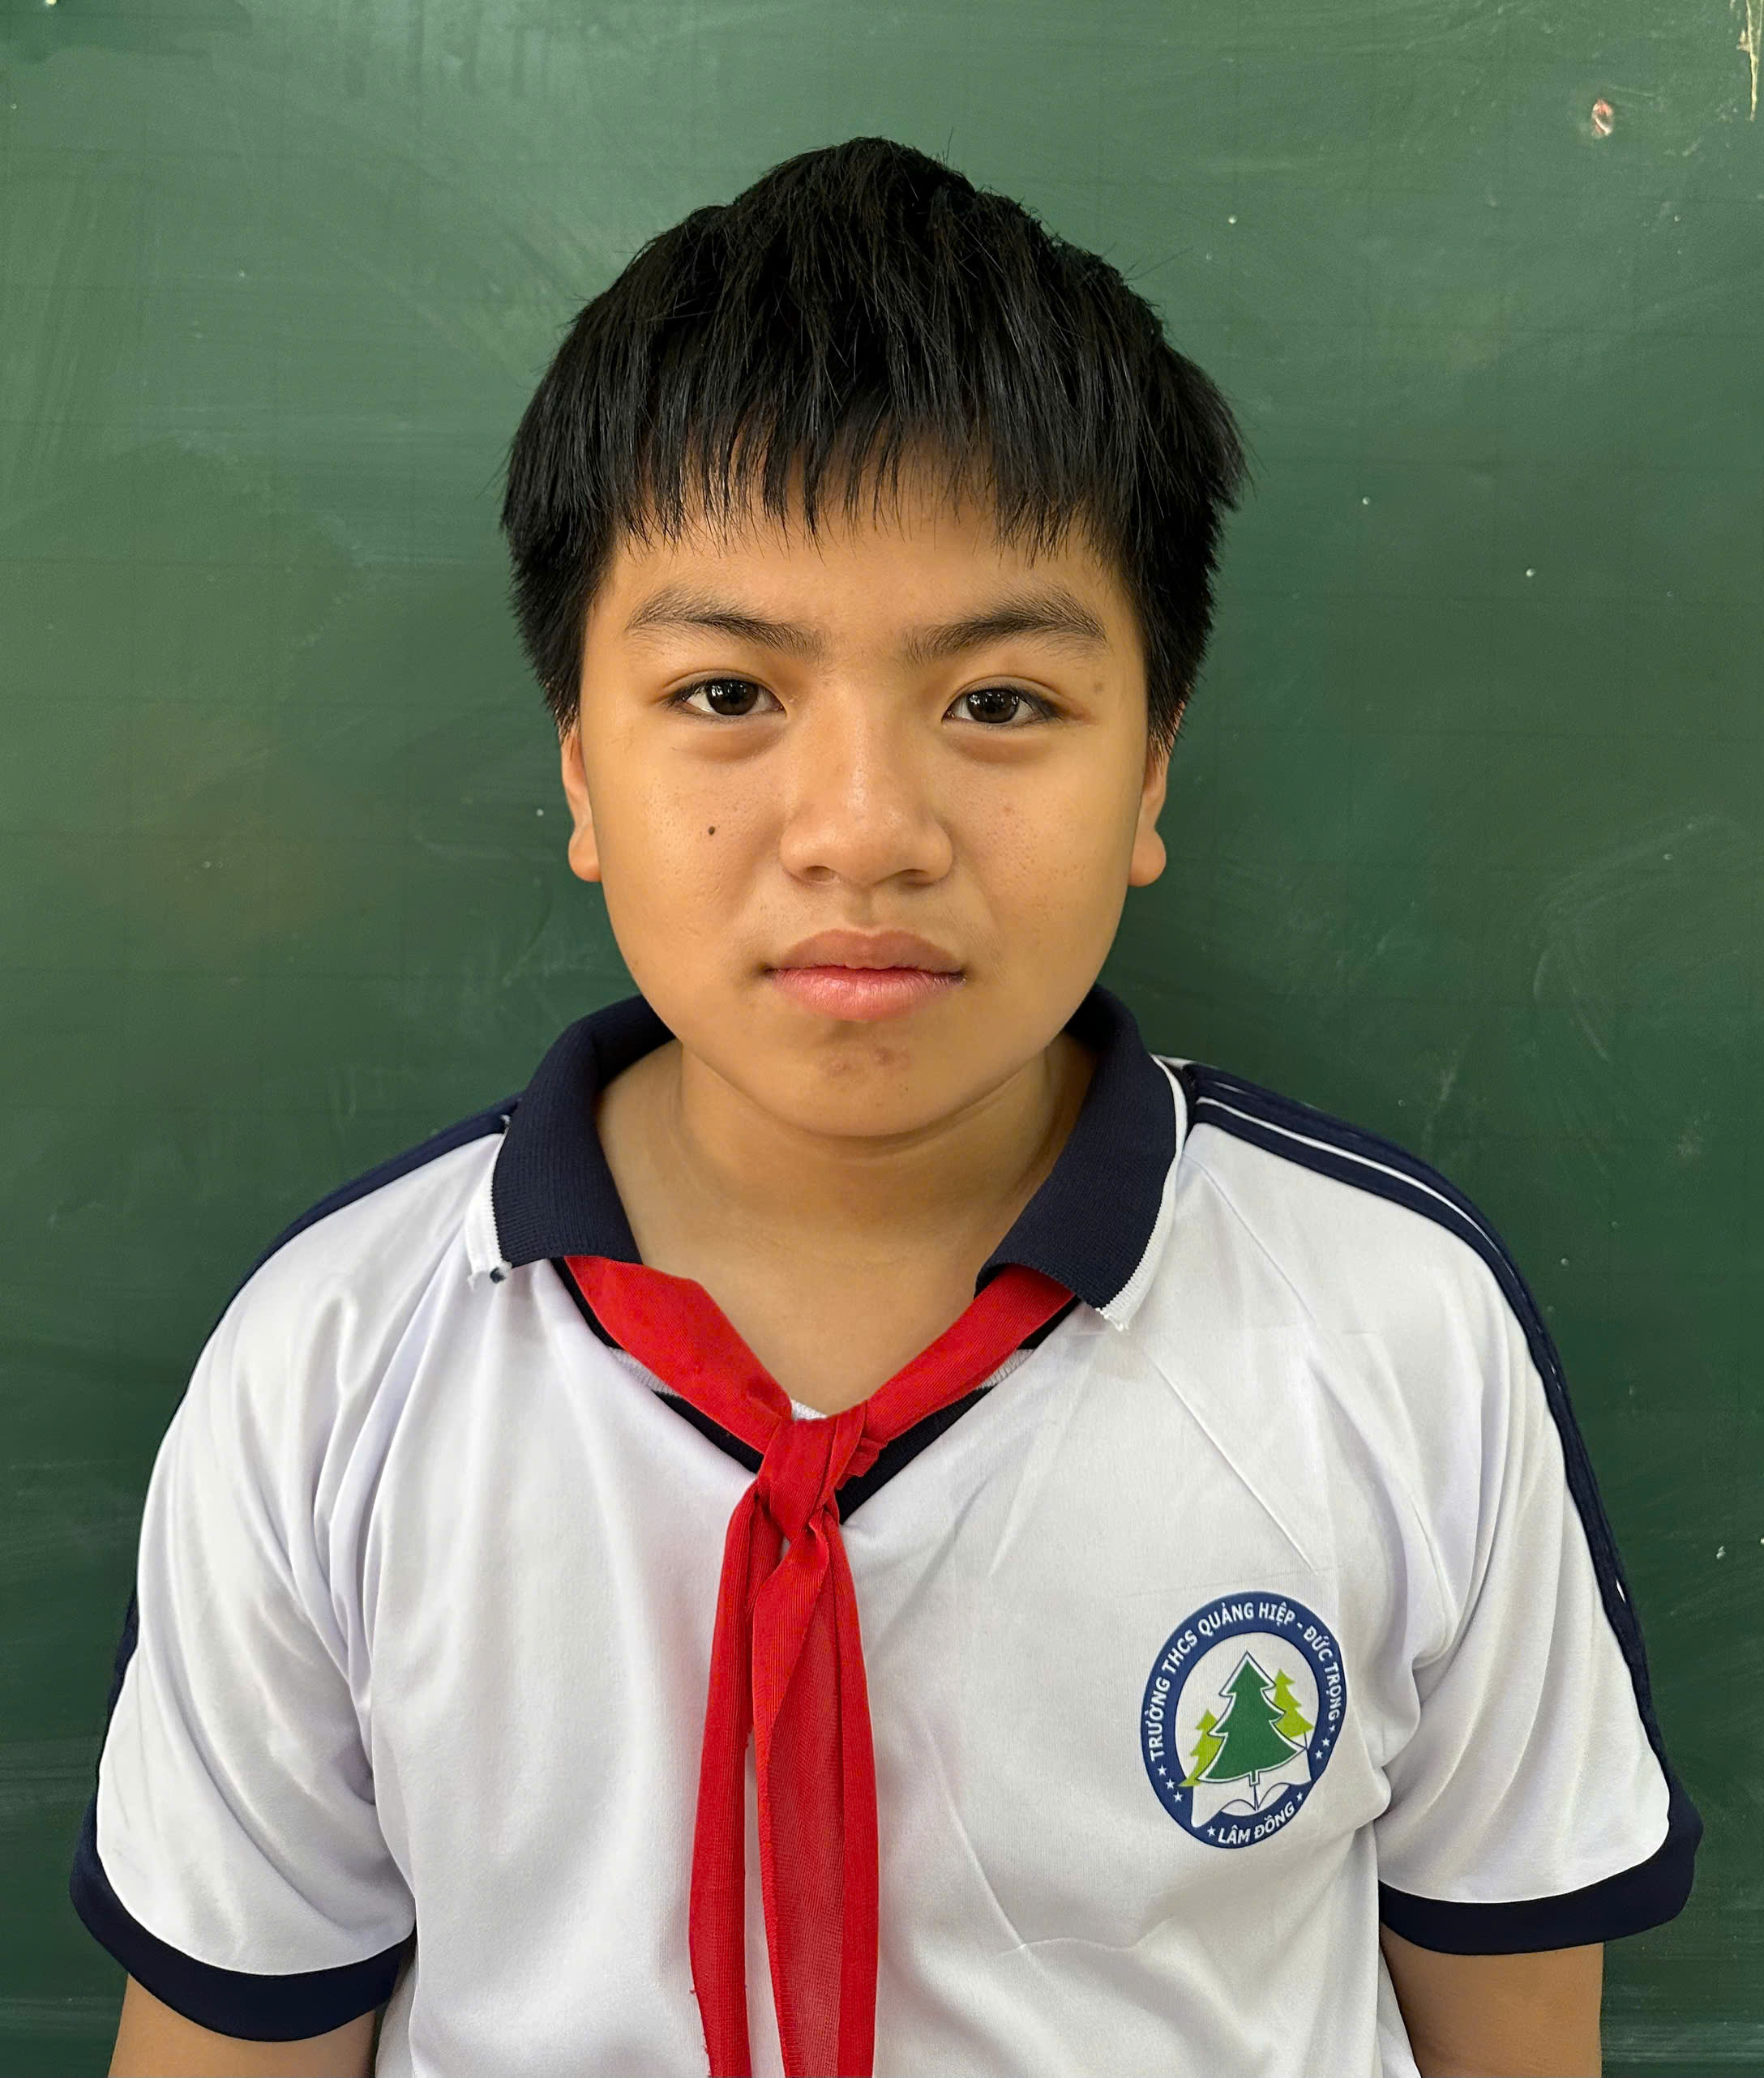
PRESENTATION
member (n)
/ˈmembər/
thành viên
Minh Tien is a member of class 7A2.

Slide 12


PRESENTATION
remind (v)
/rɪˈmaɪnd/
gợi nhớ, nhắc nhở

Slide 13
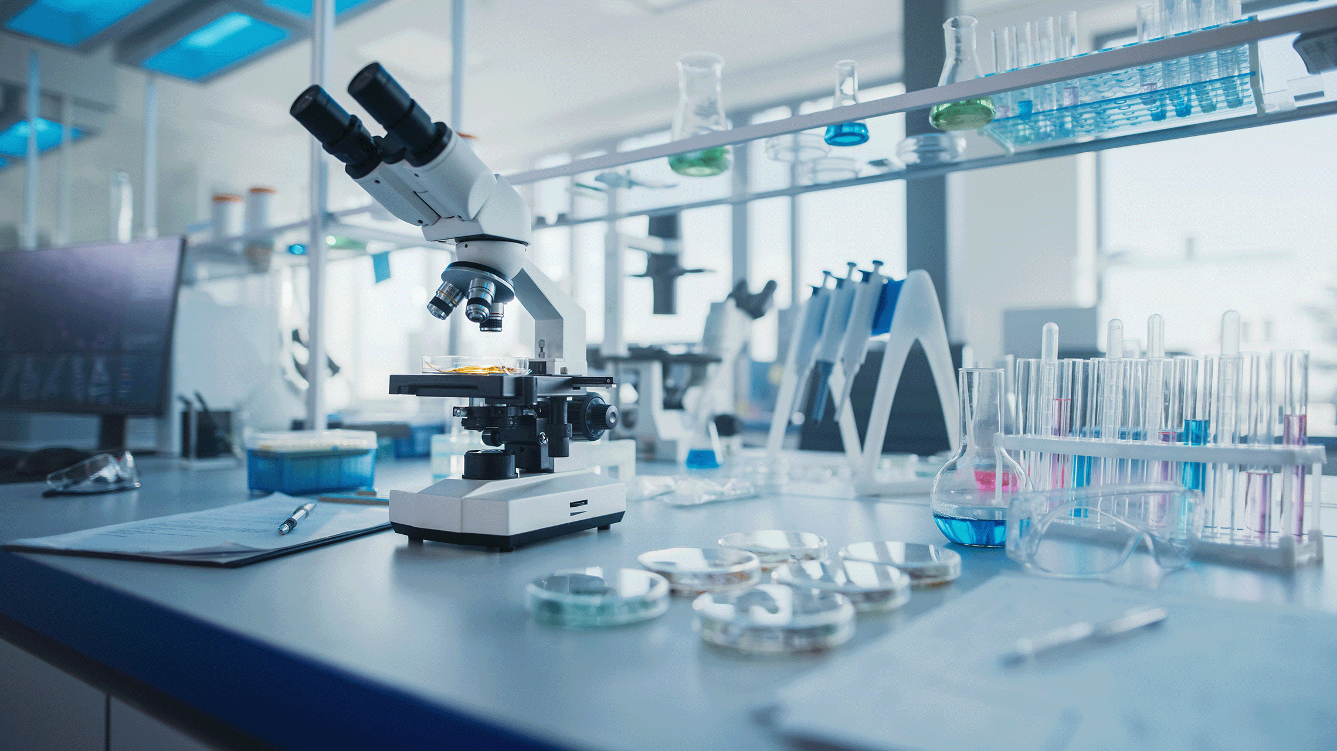
PRESENTATION
science lab
/ˈsaɪəns læb/
science laboratory
phòng thí nghiệm khoa học

Slide 14
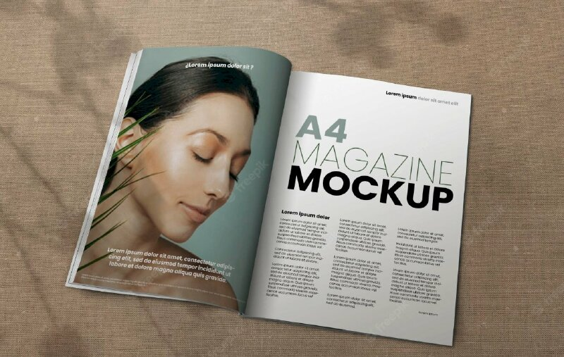
PRESENTATION
magazine (n)
/ˌmæɡəˈziːn/
tạp chí

Slide 15
PRESENTATION
New words | Pronunciation | Meaning
lower secondary school | /ˈləʊər ˈsekəndrɪ skuːl/ | trường trung học cơ sở
classmate | /ˈklɑːsmeɪt/ | bạn cùng lớp
member | /ˈmembər/ | thành viên
remind | /rɪˈmaɪnd/ | gợi nhớ/ nhắc nhở
science lab | /ˈsaɪəns læb/ | phòng thí nghiệm khoa học
magazine (n) | /ˌmæɡəˈziːn/ | tạp chí

Slide 16
PRESENTATION
lower secondary school
A. Thư viện
B. Bạn cùng lớp.
C. Dự án
D. trường trung học cơ sở

Slide 17
PRESENTATION
Bạn cùng lớp
A. Project
B. Classroom.
C. Biology
D.Classmate.

Slide 18
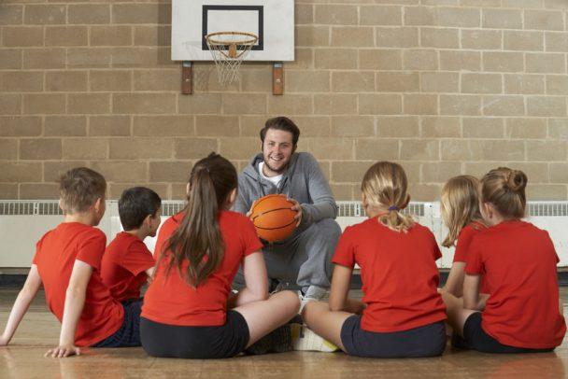
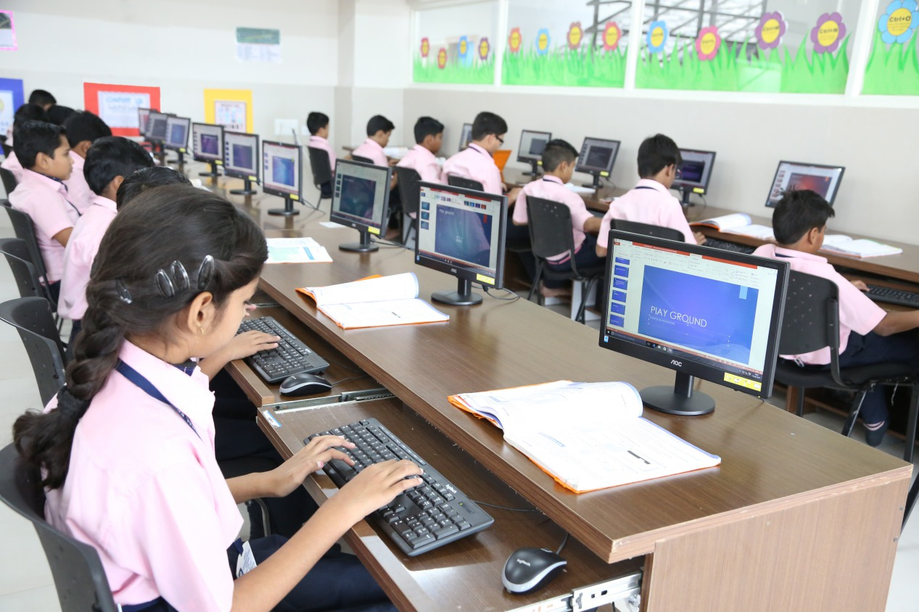
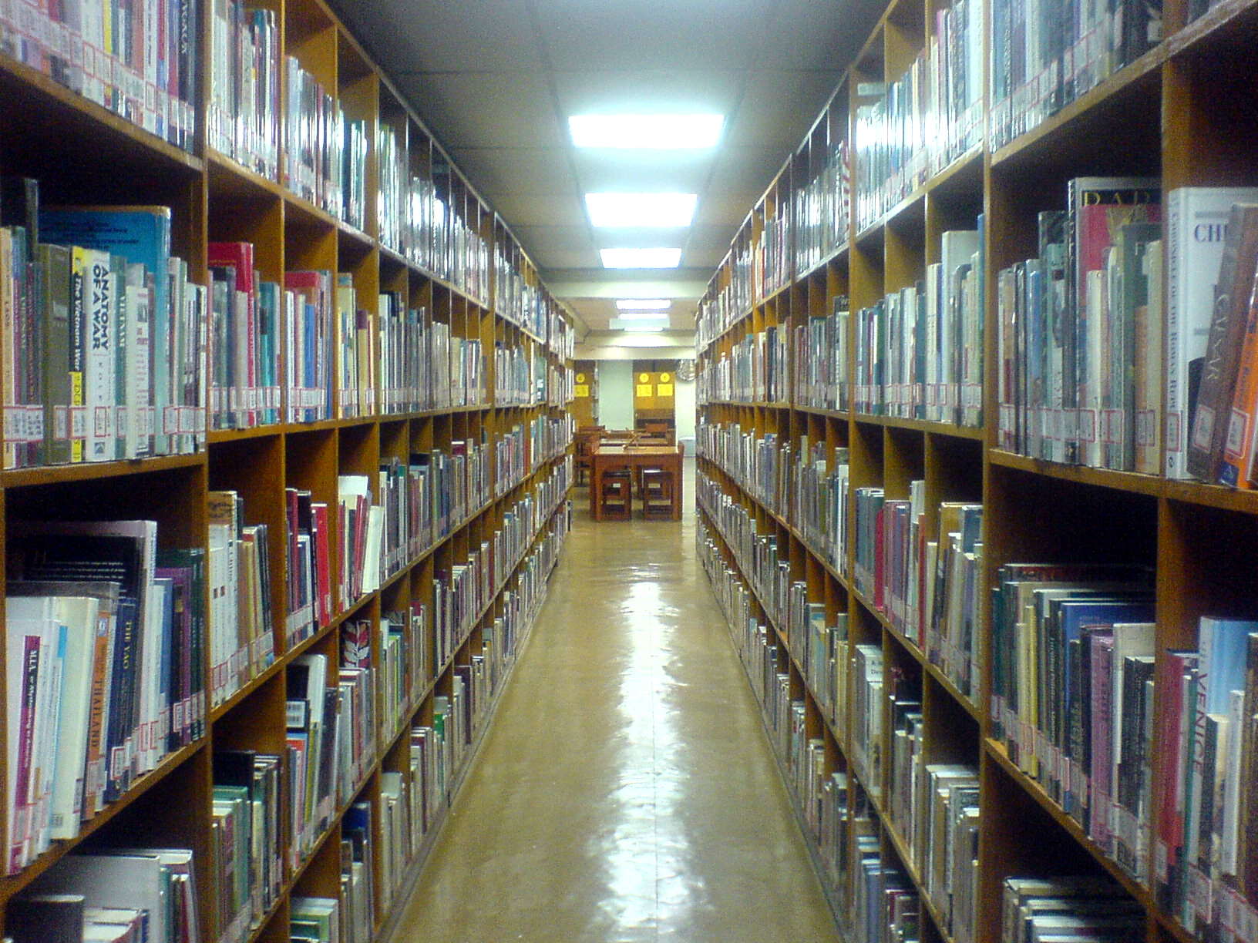
PRESENTATION
Science Lab
1.
2.
3.
4.

Slide 19
PRESENTATION
A. Thành viên
B. Tạp chí.
C. Tin học
D. Dự án.

Slide 20
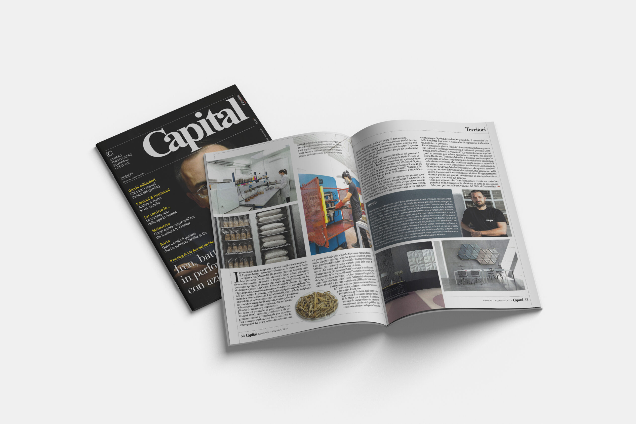
PRESENTATION
A. History
B. Newspaper.
C. Magazine
D.Classmate.

Slide 21
PRESENTATION
A. Thư viện
B. Nhắc nhở.
C. Sinh học
D.Vườn trường.

Slide 22
PRE-READING
What is the girl doing?
What are they talking about?

Slide 23
PRACTICE
1
Listen and read.
Phong: What are you doing, Mi? Mi: I’m preparing to visit Binh Minh Lower Secondary School. Phong: Sounds great! I think that’s one of the best schools in my neighbourhood. Who is going with you and when? Mi: My teacher and my classmates. We’re going in the afternoon. Phong: I see. What will you do there? Mi: Well, I think we’ll visit the school library, the computer room, and the gym. We’ll meet the students and share ideas for a project in our English class. Phong: That’s interesting. What else will you do there? Mi: We’ll meet the members of their Go Green Club and take photos of the school. Phong: Fantastic! so don’t forget to take your camera. Mi: I almost forgot. Thanks for reminding me.
Work in pairs:
1. What are they talking about?
2. What will they do there?

Slide 24
PRACTICE
2
Work in pairs. Read the conversation again and answer the questions by circling A, B, or C.
1. What are they talking about?
A. A visit to a computer room. B. A visit to a school. C. A visit to a school library.

Slide 25
PRACTICE
2
Read the conversation again and answer the questions by circling A, B, or C.
Phong: What are you doing, Mi? Mi: I’m preparing to visit Binh Minh Lower Secondary School. Phong: Sounds great! I think that’s one of the best schools in my neighbourhood. Who is going with you and when? Mi: My teacher and my classmates. We’re going in the afternoon. Phong: I see. What will you do there? Mi: Well, I think we’ll visit the school library, the computer room, and the gym. We’ll meet the students and share ideas for a project in our English class. Phong: That’s interesting. What else will you do there? Mi: We’ll meet the members of their Go Green Club and take photos of the school. Phong: Fantastic! so don’t forget to take your camera. Mi: I almost forgot. Thanks for reminding me.
2. Who is going to visit the school? A. Mi and her teacher. B. Mi and her classmates. C. Mi, her teacher and her classmates.

Slide 26
PRACTICE
2
Read the conversation again and answer the questions by circling A, B, or C.
Phong: What are you doing, Mi? Mi: I’m preparing to visit Binh Minh Lower Secondary School. Phong: Sounds great! I think that’s one of the best schools in my neighbourhood. Who is going with you and when? Mi: My teacher and my classmates. We’re going in the afternoon. Phong: I see. What will you do there? Mi: Well, I think we’ll visit the school library, the computer room, and the gym. We’ll meet the students and share ideas for a project in our English class. Phong: That’s interesting. What else will you do there? Mi: We’ll meet the members of their Go Green Club and take photos of the school. Phong: Fantastic! so don’t forget to take your camera. Mi: I almost forgot. Thanks for reminding me.
3. Where is the school? A. In the city. B. In the countryside. C. In Phong’s neighbourhood.

Slide 27
PRACTICE
2
Read the conversation again and answer the questions by circling A, B, or C.
Phong: What are you doing, Mi? Mi: I’m preparing to visit Binh Minh Lower Secondary School. Phong: Sounds great! I think that’s one of the best schools in my neighbourhood. Who is going with you and when? Mi: My teacher and my classmates. We’re going in the afternoon. Phong: I see. What will you do there? Mi: Well, I think we’ll visit the school library, the computer room, and the gym. We’ll meet the students and share ideas for a project in our English class. Phong: That’s interesting. What else will you do there? Mi: We’ll meet the members of their Go Green Club and take photos of the school. Phong: Fantastic! so don’t forget to take your camera. Mi: I almost forgot. Thanks for reminding me.
4. When are they going?
A. In the morning. B. In the afternoon. C. At noon.

Slide 28
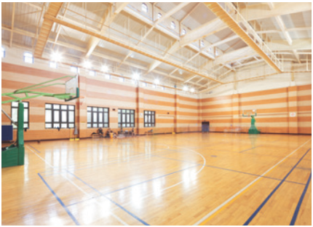
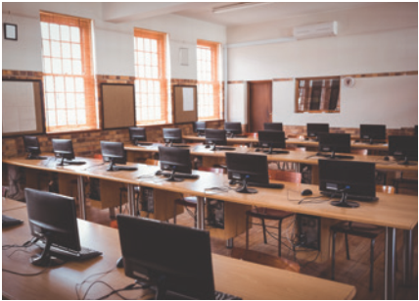
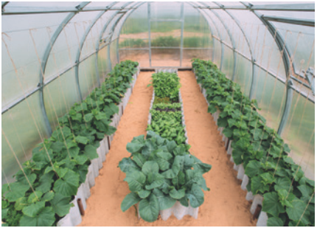
PRACTICE
3
Work individually. Name these places, using the words and phrases from the box.
gym
computer room
school garden
1. ____________
2. ________________
3. ________________

Slide 29
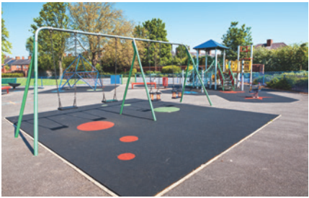
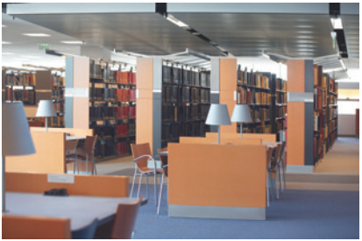
PRACTICE
3
Name these places, using the words and phrases from the box.
playground
4. ____________
school library
5. ______________

Slide 30
PRACTICE
4
Complete the following sentences with the words in the box.
computer room
school library
school garden
playground
gym
1. The school _______________ is very small, so not many children can play in it.
2. We learn how to use the Internet in the _______________ twice a week.
3. They have school meetings in the _______________ when it rains.
4. There are a lot of books, magazines, and newspapers in the _______________.
5. Our class usually waters the vegetables in the _______________ on Friday afternoons.
playground
computer room
gym
school library
school garden

Slide 31
PRODUCTION
5
Work in pairs. Ask and answer questions about Nick’s timetable, using when and where.
Subject | Time (at + time) (on + day) | Place (in + place)
Maths | 8 a.m. Monday, Tuesday, Friday | Classroom (room 302)
Biology | 9 a.m. Thursday | Science lab
Information Technology | 2 p.m. Wednesday | Computer room
Physical Education | 3 p.m. Monday, Thursday | School gym
History | 3:30 p.m. Tuesday | School library
Example: A: When does Nick have Biology? B: At 9 a.m. on Thursday. A: And where does he have it? B: In his science lab.

Slide 32
PRODUCTION
5
Work in pairs. Ask and answer questions about Nick’s timetable, using when and where.
Subject | Time (at + time) (on + day) | Place (in + place)
English
P.E
Information Technology
Example: A: When do you have? B: At ............ on ...................... A: And where do you have it? B: In ..........................

Slide 33
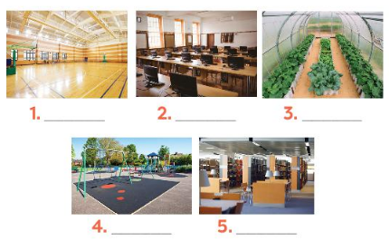
CONSOLIDATION
1
WRAP-UP
Topic of the unit
A visit to a school
Binh Minh Lower Secondary School
Vocabulary
School facilities

Slide 34

CONSOLIDATION
2
HOMEWORK
Exercises in Workbook:
6/ page 45

Slide 35

Website: hoclieu.vn
Fanpage: facebook.com/www.tienganhglobalsuccess.vn/

