Slide 1


Slide 2
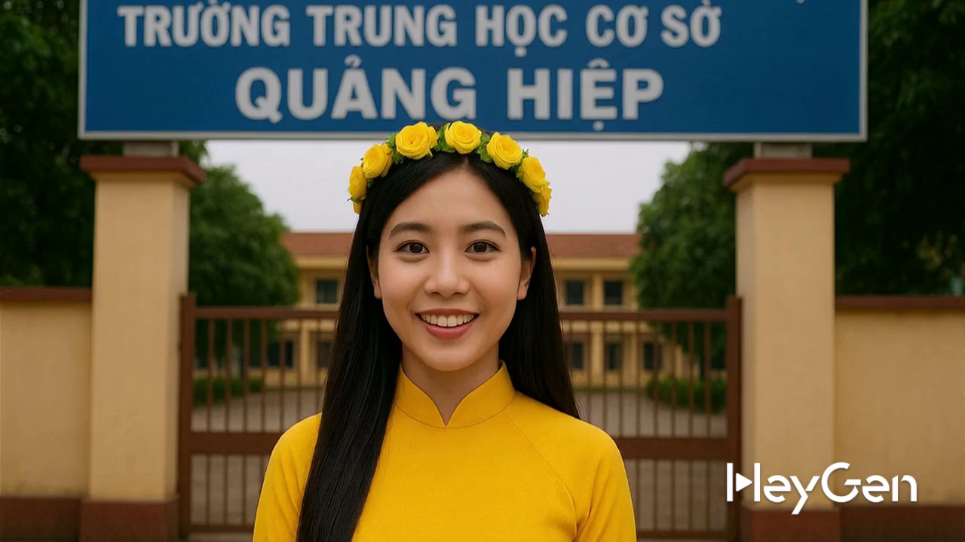

Slide 3
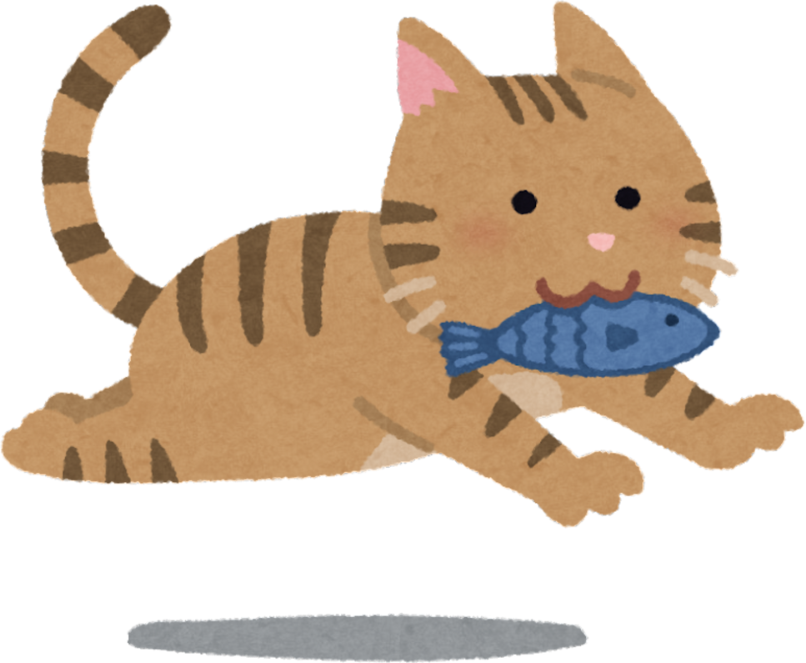
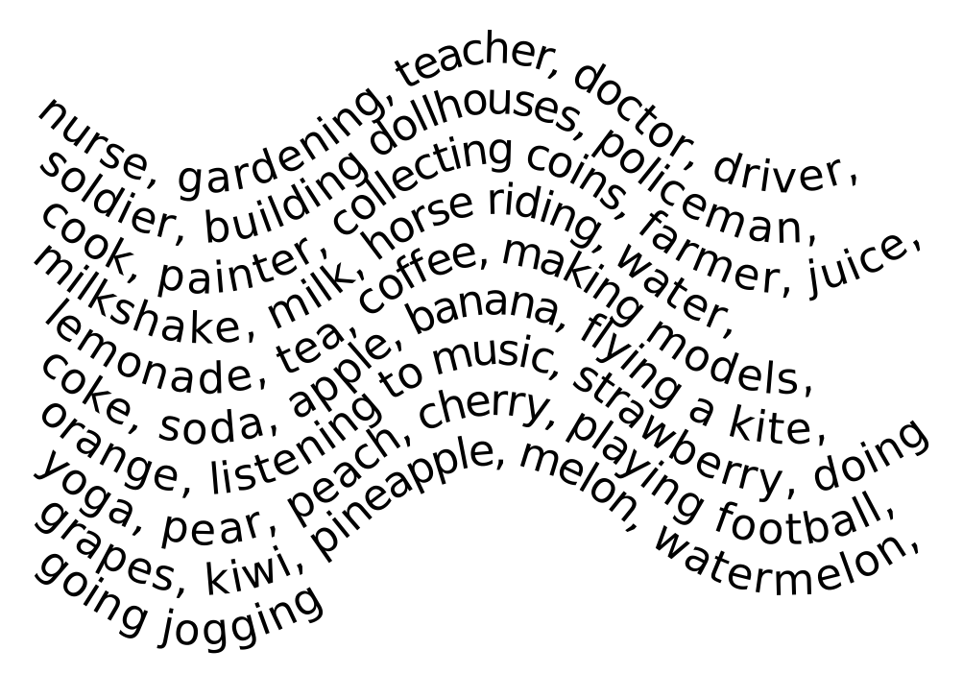

WARM-UP
Circle the “hobby” words.
gardening
building dollhouses
collecting coins
horse riding
making models
flying a kite
listening to music
doing yoga
playing football
going jogging

Slide 4



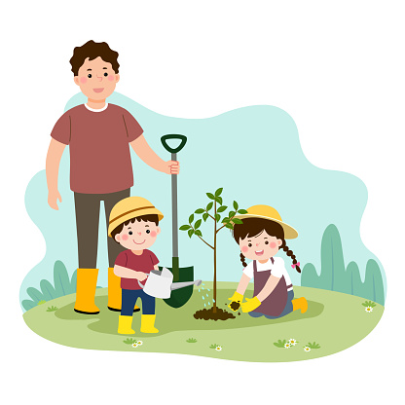
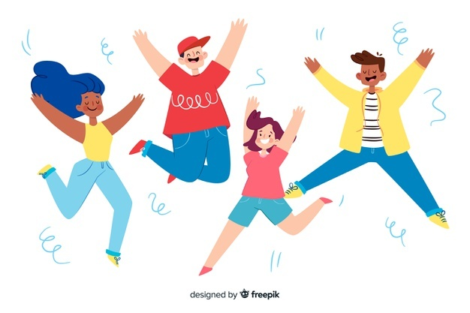
Unit
1
HOBBIES
LESSON 5: SKILLS 1
READING
Gardening as a hobby
Benefits of hobbies
SPEAKING

Slide 5
Unit
1
HOBBIES
LESSON 5: SKILLS 1
READING
SPEAKING
Unit
Gardening as a hobby
Benefits of hobbies

Slide 6
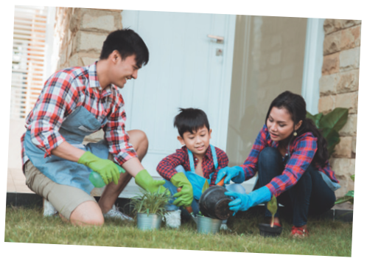
PRE-READING
1
Work in pairs. Look at the picture and discuss the questions below.
1. What can you see in the picture? 2. In your opinion, what is good about gardening?
1. In the picture, I can see 3 people, they are gardening. They are smiling.
2. I think that gardening helps us relax.
- I think that gardening helps me love nature.

Slide 7
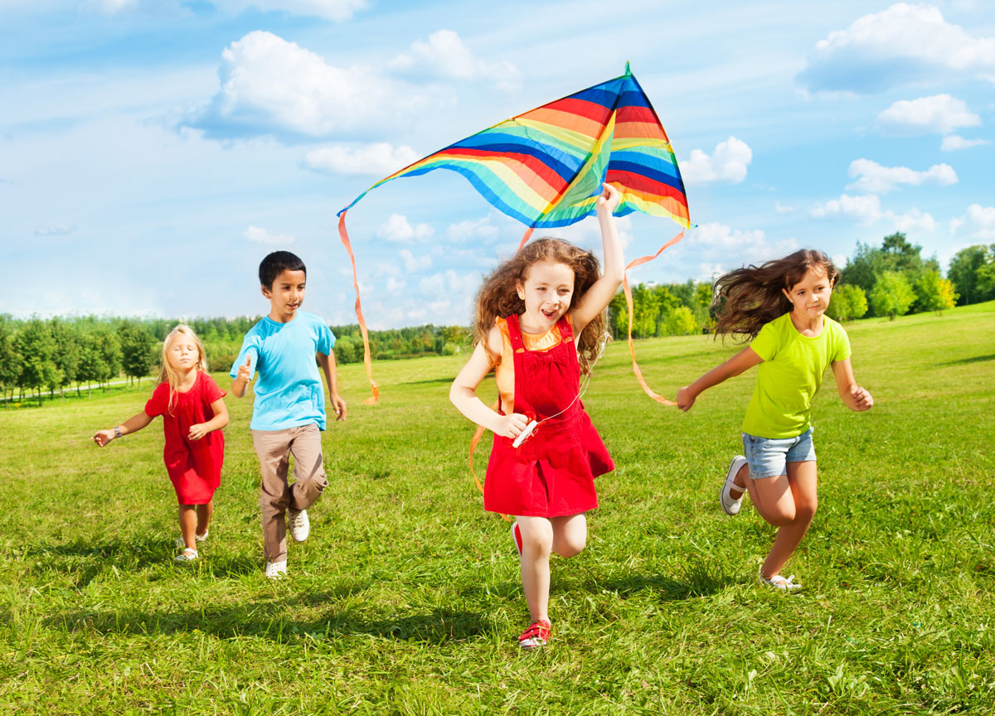

Vocabulary
outdoor (adj)
/ˈaʊtdɔː(r)/
ngoài trời
Flying a kite is an outdoor activity.

Slide 8
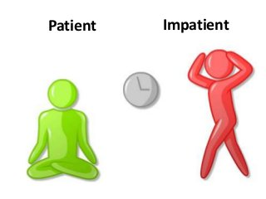
Vocabulary
patient (adj)
/ˈpeɪʃnt/
kiên nhẫn
Doing yoga is a patient hobby

Slide 9
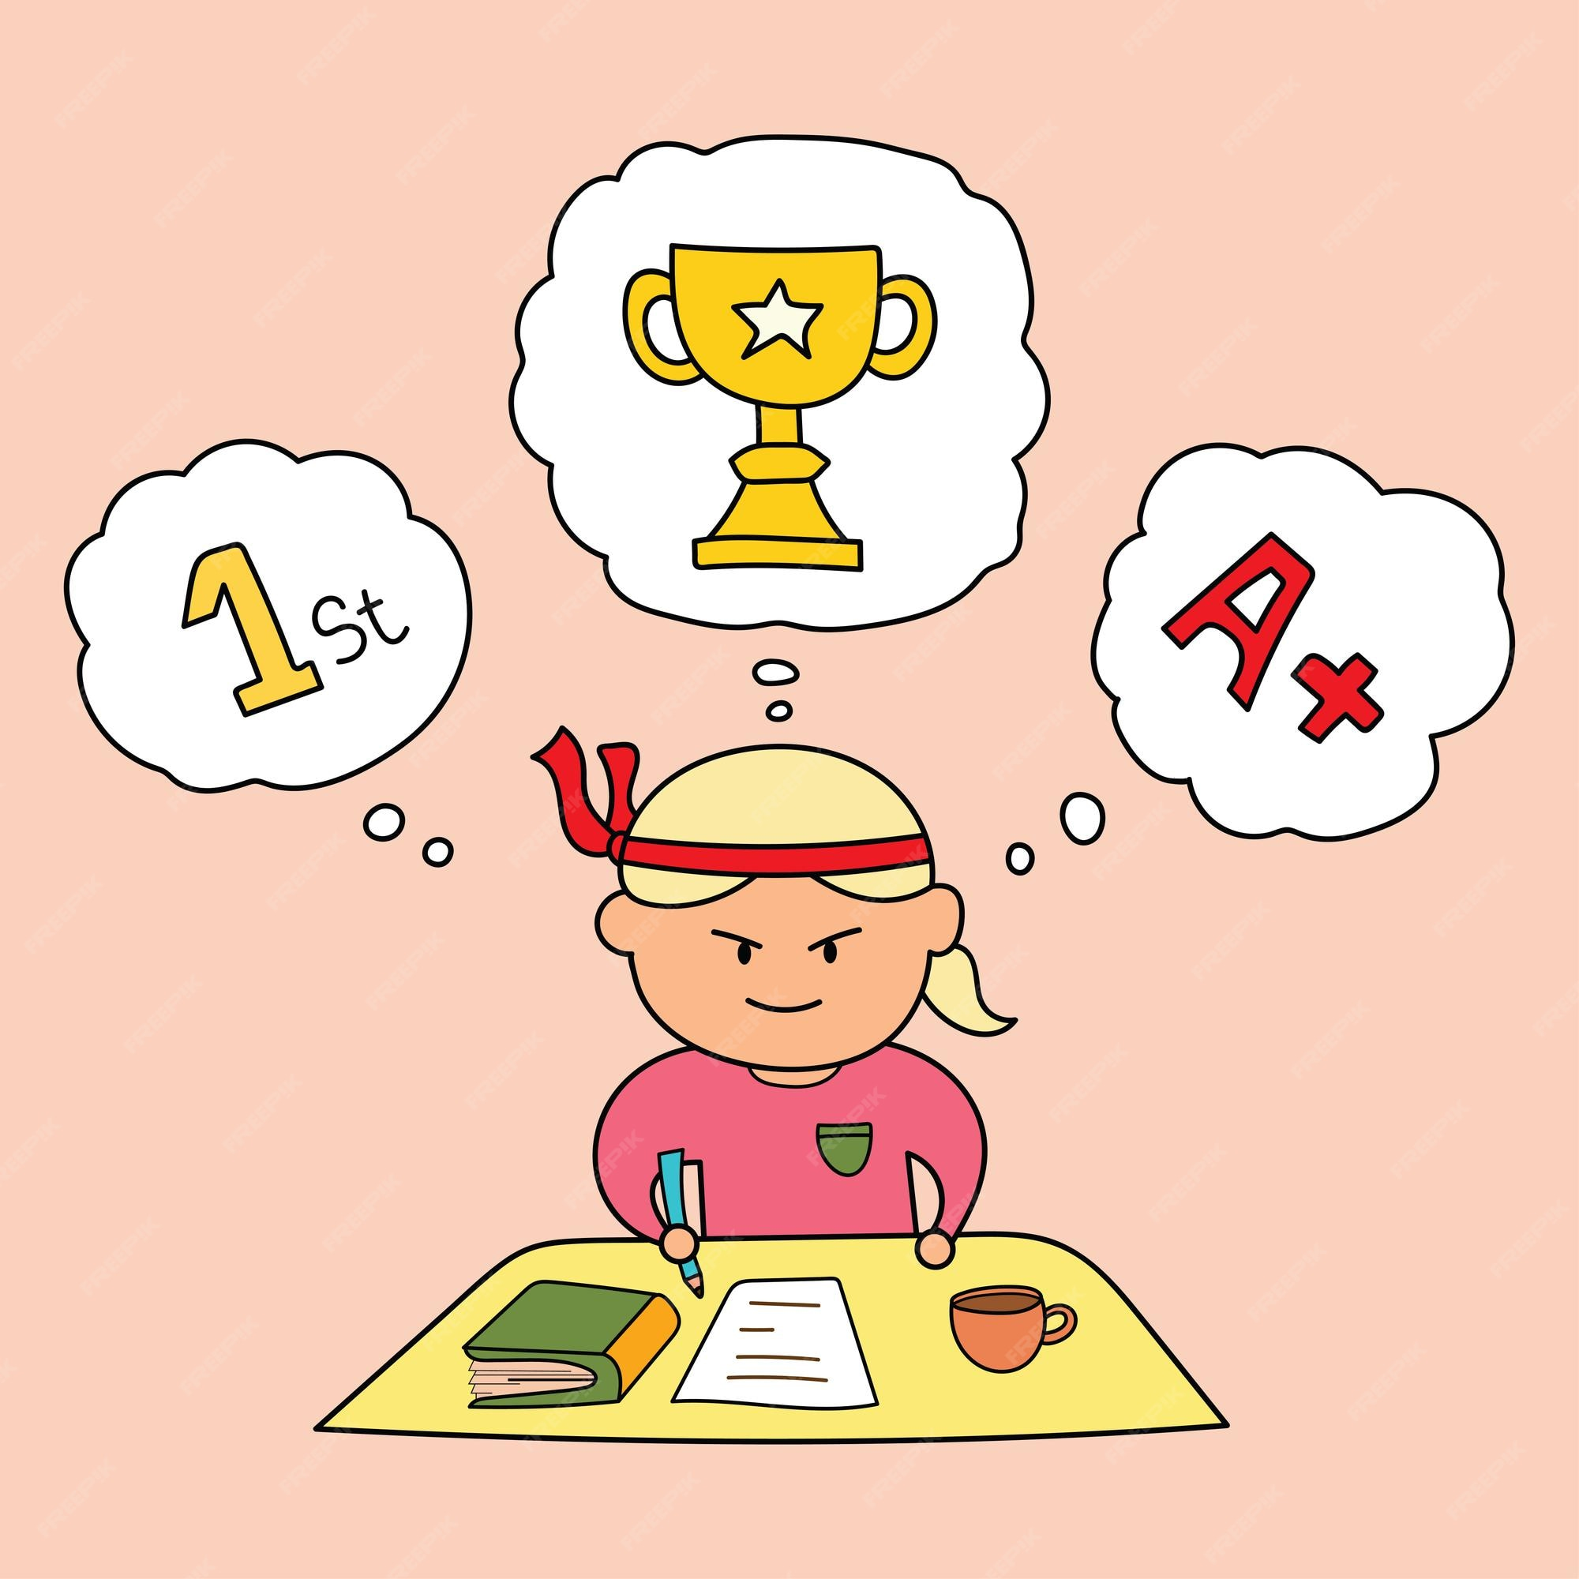
Vocabulary
responsibility (n)
/rɪˌspɒnsəˈbɪləti/
trách nhiệm
- responsible (adj): có trách nhiệm
- take on responsibility: chịu trách nhiệm.
She takes responsibility for her studying.

Slide 10
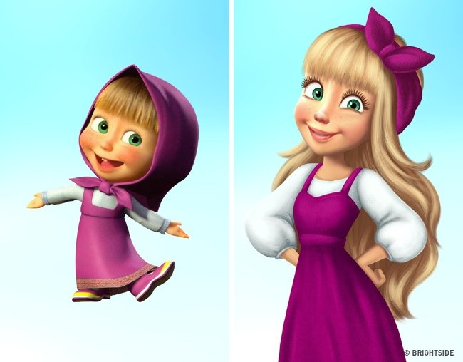
Vocabulary
maturity (n)
/məˈtjʊərəti/
sự trưởng thành

Slide 11

Vocabulary
valuable (adj)
/ˈvæljuəbl/
quý giá, quan trọng, hữu ích
valuable lesson: bài học quý giá.
These are valuable things.

Slide 12

Vocabulary
benefit (n)
[ˈbenɪfɪt]
lợi ích

Slide 13
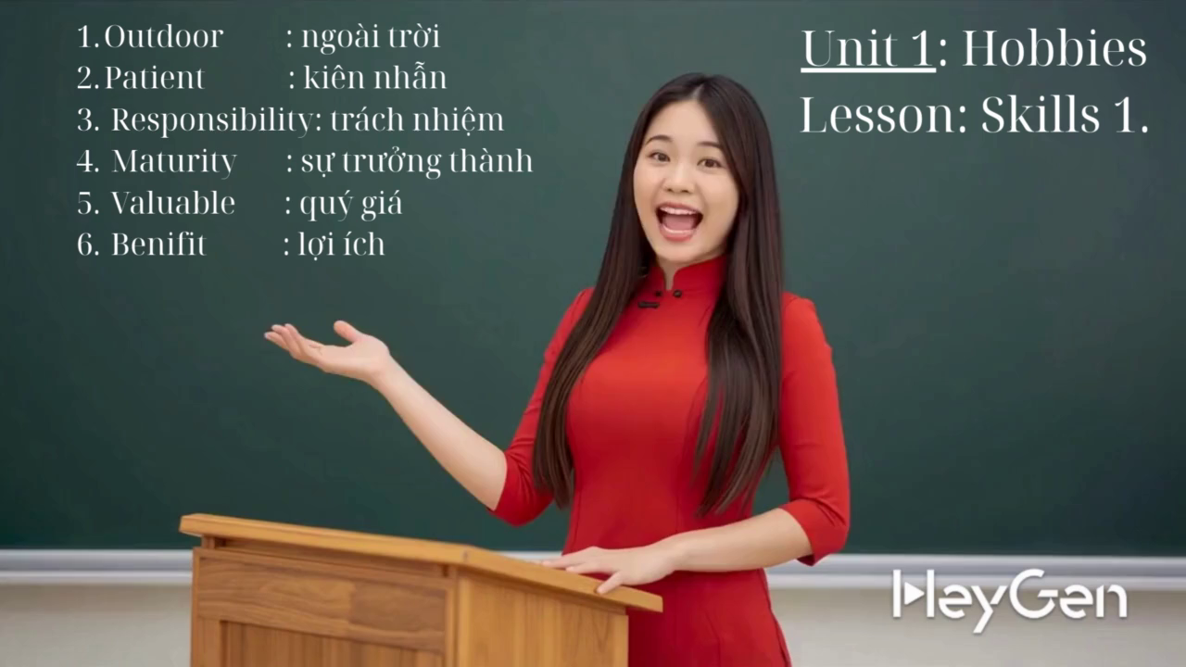
Vocabulary

Slide 14
Vocabulary
ngoài trời
kiên nhẫn
trách nhiệm
sự trưởng thành
quý giá
lợi ích

Slide 15
Vocabulary
ngoài trời
kiên nhẫn
trách nhiệm
sự trưởng thành
quý giá
lợi ích

Slide 16
Vocabulary
ngoài trời
kiên nhẫn
trách nhiệm
sự trưởng thành
quý giá
lợi ích

Slide 17
Vocabulary
ngoài trời
kiên nhẫn
trách nhiệm
sự trưởng thành
quý giá
lợi ích

Slide 18
Vocabulary
ngoài trời
kiên nhẫn
trách nhiệm
sự trưởng thành
quý giá
lợi ích

Slide 19
Vocabulary
ngoài trời
kiên nhẫn
trách nhiệm
sự trưởng thành
quý giá
lợi ích

Slide 20
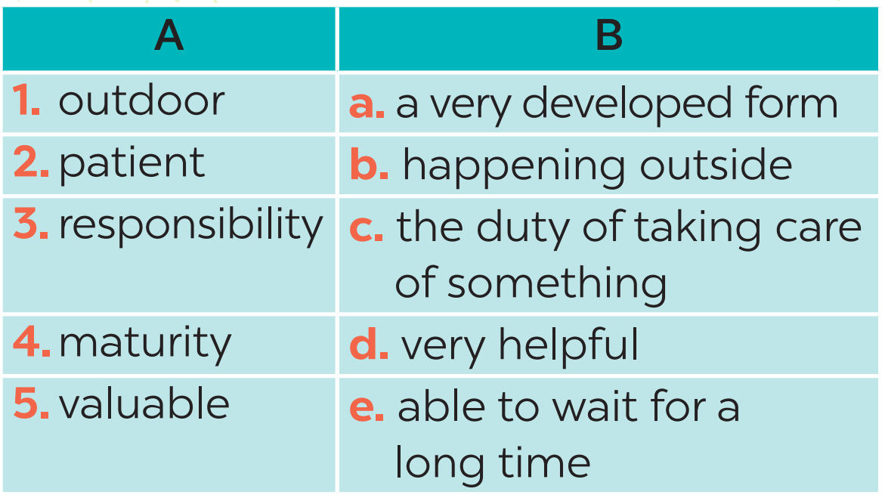
WHILE-READING
2
Read the text about gardening. Match each word in column A with its definition in column B.
1. b
2. e
3. c
4. a
5. d

Slide 21
WHILE-READING
People divide hobbies into four big groups: doing things, making things, collecting things, and learning things. Gardening belongs to the most popular group - doing things.
Gardening is one of the oldest outdoor activities. It has something for everyone, even for children. Gardening teaches children about flowers, fruits, and vegetables. They can also learn about insects and bugs. When gardening, children learn to be patient and take on responsibility. They learn to wait for the plants to grow to maturity. And if they don’t water their plants, their plants will die. This teaches them valuable lessons about responsibility.
Gardening is also good because everyone in the family can join in and do something together. My mum and I love gardening. We usually spend an hour a day in our garden. It really makes us happy, and we love spending time together.
Group of Gardening:
Benefits of Gardening:

Slide 22
WHILE-READING
3
Read the text again. Complete each sentence with no more than THREE words.
3
People divide hobbies into four big groups: doing things, making things, collecting things, and learning things. Gardening belongs to the most popular group - doing things.
1. Gardening belongs to the group of
_______________.
doing things

Slide 23
WHILE-READING
3
Read the text again. Complete each sentence with no more than THREE words.
Gardening is one of the oldest outdoor activities. It has something for everyone, even for children. Gardening teaches children about flowers, fruits, and vegetables. They can also learn about insects and bugs.
2. Gardening teaches children about flowers, fruits, vegetables,
_______________. .
insects and bugs

Slide 24
WHILE-READING
3
Read the text again. Complete each sentence with no more than THREE words.
When gardening, children learn to be patient and take on responsibility. They learn to wait for the plants to grow to maturity. And if they don’t water their plants, their plants will die. This teaches them valuable lessons about responsibility.
3. Gardening makes children become ______________ and responsible.
patient

Slide 25
WHILE-READING
3
Read the text again. Complete each sentence with no more than THREE words.
Gardening is also good because everyone in the family can join in and do something together. My mum and I love gardening. We usually spend an hour a day in our garden. It really makes us happy, and we love spending time together.
4. It is an activity that everyone in the family can ______________. 5. The author and her mother usually garden for ______________ a day.
join in
an hour

Slide 26
PRE-SPEAKING
- develop + sth: phát triển...
- make sb + adj: khiến...
- reduce sth: giảm...
- help sb / sth do sth: giúp...
a. develops your creativity.
b. makes you strong
c. reduces stress
d. helps you be more patient.
e. helps your hands and eyes work well together.

Slide 27
PRE-SPEAKING
Work in pairs. Arrange each hobby with its benefit(s).
One hobby may have more than one benefit.
4
a. develops your creativity. b. makes you strong c. reduces stress d. helps you be more patient. e. helps your hands and eyes work well together.
1. collecting stamps | 2. riding a horse | 3. making models
c. reduces stress
d. helps you be more patient.
-- helps you relax.
b. makes you strong
c. reduces stress
- helps you love animal.
a. develops your creativity.
c. reduces stress
d. helps you be more patient.
e. helps your hands and eyes work well together.
- Ex: Collecting stamps helps you be more patient.
- Ex: Riding a horse makes you strong.
- Ex: Making models develops my creativity.

Slide 28
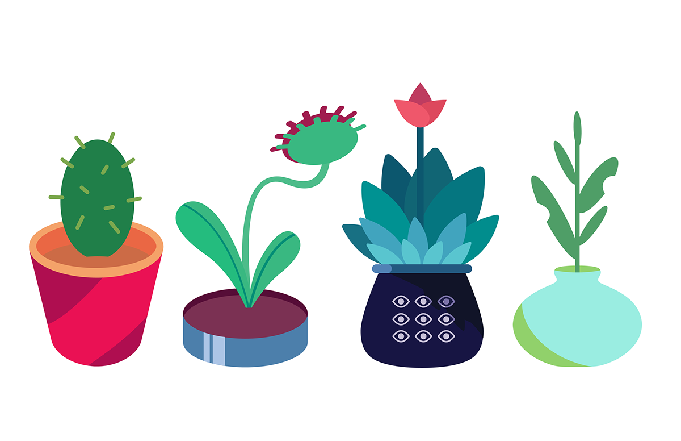
WHILE-SPEAKING
Work in groups. Ask one another the following questions.
Then present your partners’ answers to the class.
You: What is your favourite hobby?
Nam: My favourite hobby is playing football.
You: What are its benefits?
Nam: Playing football makes me strong and reduces stress. Example: My friend Nam’s favourite hobby is playing football. It makes him strong and reduces stress.

Slide 29
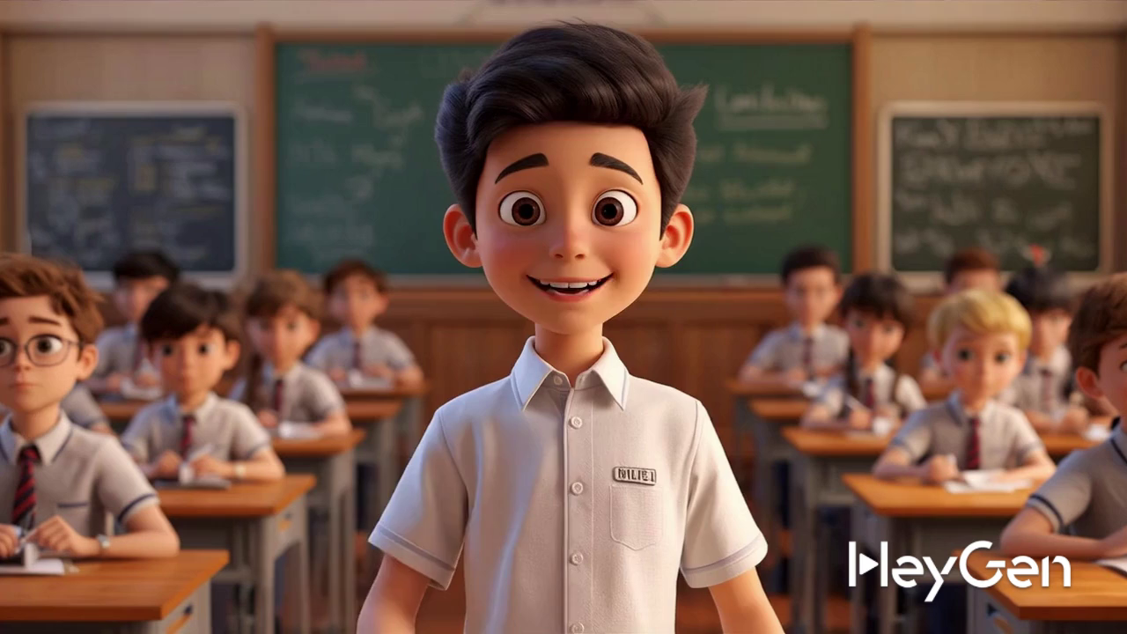

Slide 30
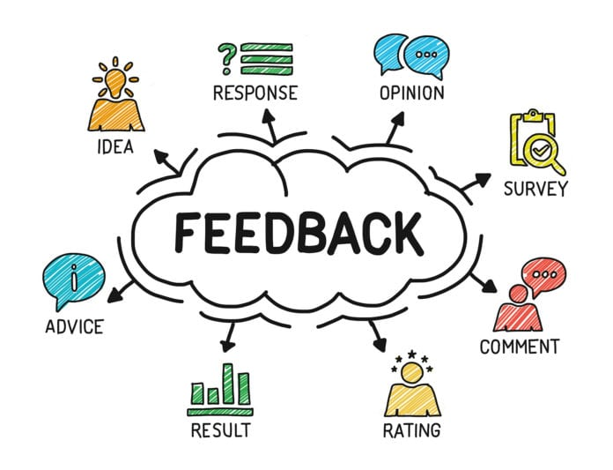
POST-READING & SPEAKING
Let’s give comments for your friends and vote for the most interesting and informative presentation.

Slide 31
CONSOLIDATION
1
WRAP-UP
READING
SPEAKING
Gardening as a hobby
Benefits of hobbies

Slide 32

CONSOLIDATION
2
HOMEWORK
Practice talking about your own hobby.
Prepare lesson 6 (Skills 2).
Do exercises D1,2/P7(WORKBOOK)

Slide 33

Website: hoclieu.vn
Fanpage: facebook.com/www.tienganhglobalsuccess.vn/

