Slide 1
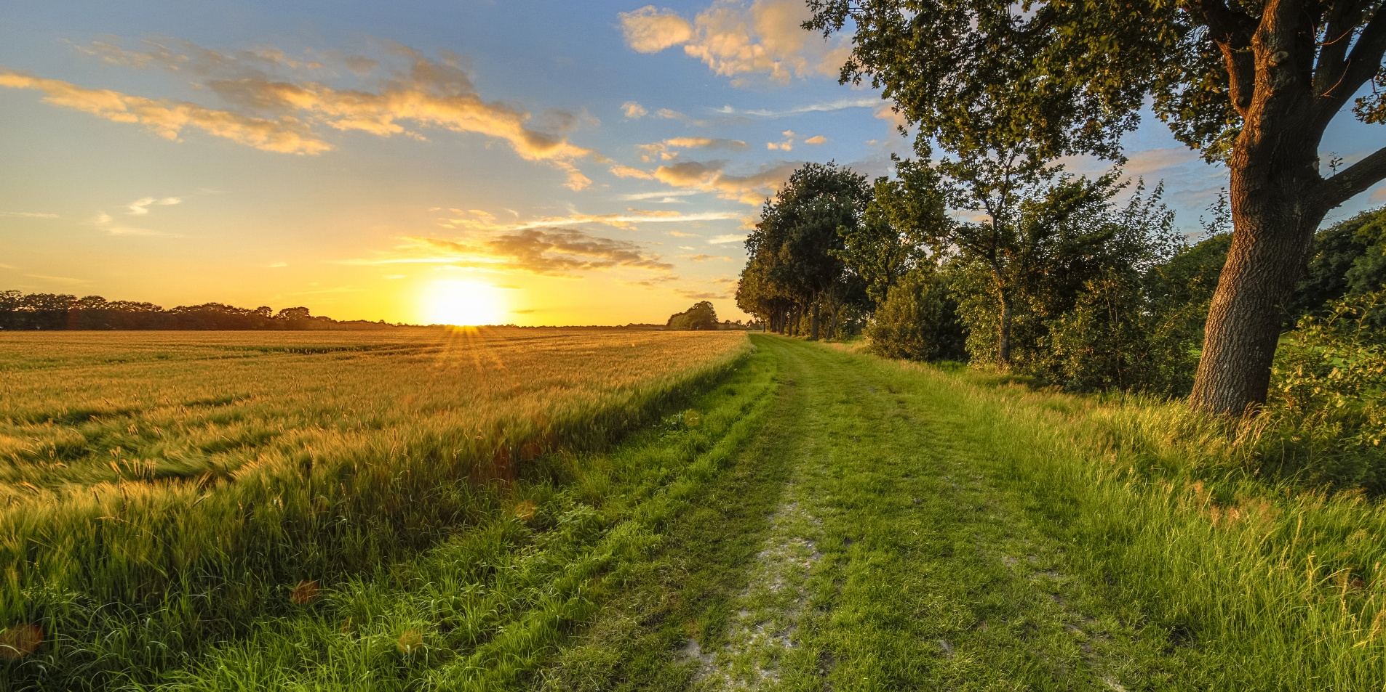
Unit
2
LIFE IN THE COUNTRYSIDE
LESSON 5: SKILLS 1

Slide 2
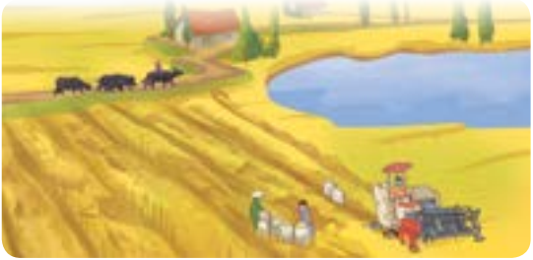

WARM-UP
1
Work in pairs. Look at the picture and discuss the following questions.
Which of the following adjectives describe the picture?

Slide 3
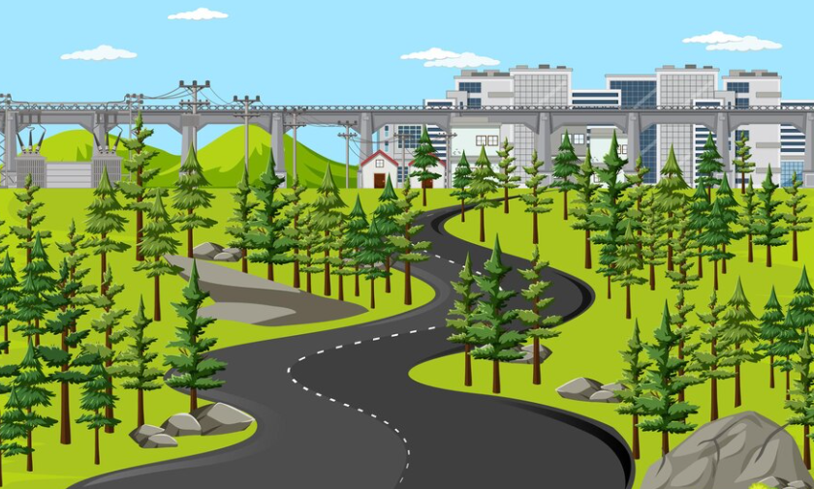

READING
stretch (v)
/stretʃ/
trải dài

Slide 4
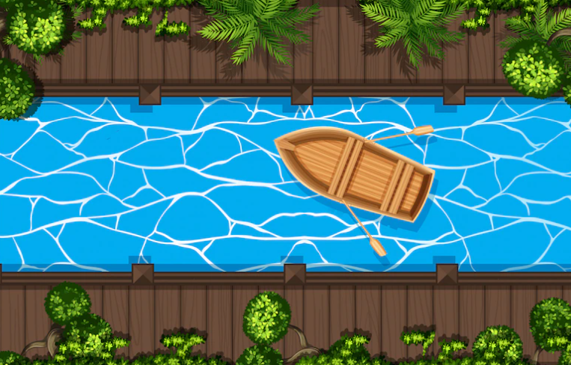
READING
canal (n)
/kəˈnæl/
kênh đào

Slide 5
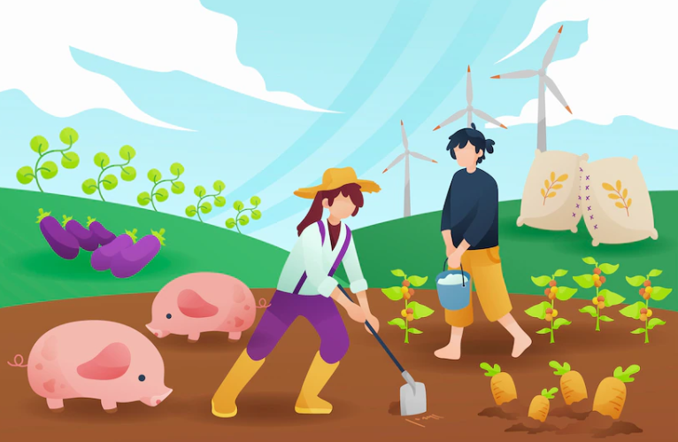
READING
cultivate (v)
/ˈkʌltɪveɪt/
canh tác

Slide 6
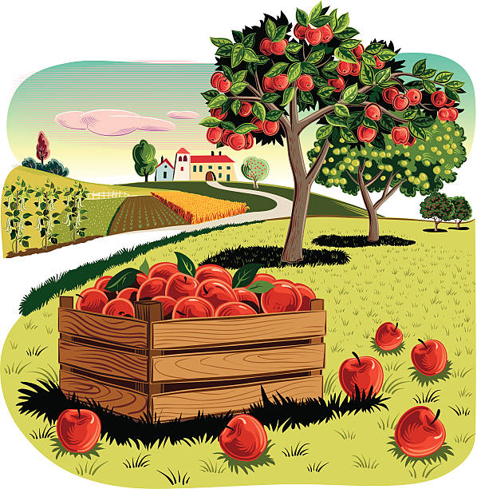
READING
orchard (n)
/ˈɔːtʃəd/
vườn cây ăn quả

Slide 7
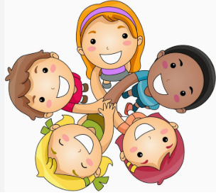
READING
get along
/get/
/ əˈlɒŋ/
hòa thuận, hòa hợp

Slide 8
READING
New words | Pronunciation | Vietnamese equivalent
1. stretch (v) | /stretʃ/ | trải dài
2. canal (n) | /kəˈnæl/ | kênh đào
3. cultivate (v) | /ˈkʌltɪveɪt/ | canh tác
4. orchard (n) | /ˈɔːtʃəd/ | vườn cây ăn quả
5. get along | /get/ /əˈlɒŋ/ | hòa thuận, hòa hợp

Slide 9
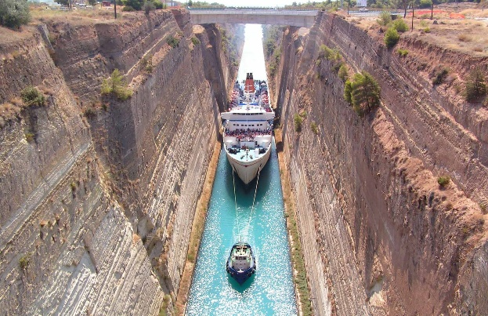
READING
Look at the picture and say the word
canal (n)

Slide 10
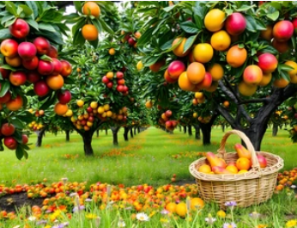
READING
Look at the picture and say the word
orchard (n)

Slide 11
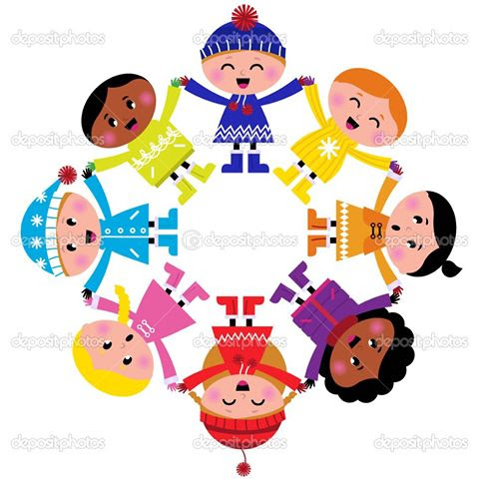
READING
Look at the picture and say the word
get along

Slide 12
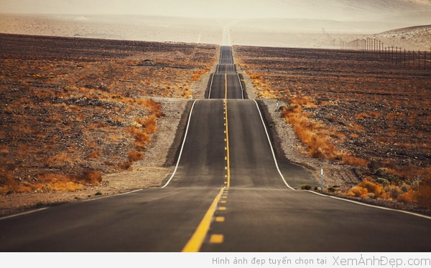
READING
Look at the picture and say the word
stretch (v)

Slide 13
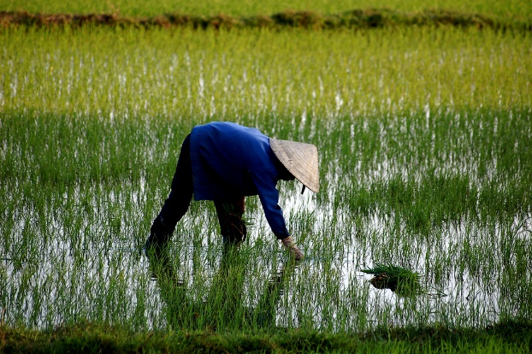
READING
Look at the picture and say the word
cultivate (v)

Slide 14
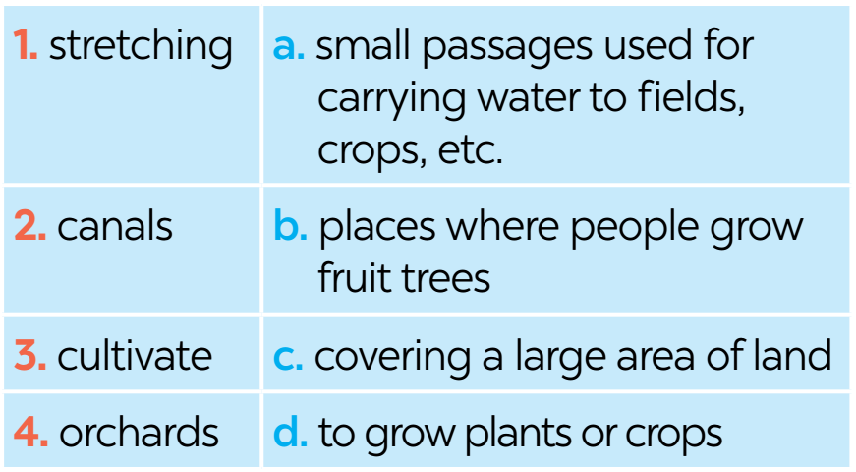
READING
2
Read the text about life in a village in Viet Nam. Match the highlighted words in the text with their meanings

Slide 15
READING
3
Read the text again and tick T (True) or F (False) for each sentence.
 | T | F
1. Life in the author’s village is very peaceful.
2. The people in the village work very hard.
3. Villagers live only by catching fish in lakes, ponds, and canals.
4. The children are always busy helping their parents.
5. The villagers get along well.

Slide 16

READING
3
Read the text again and tick T (True) or F (False) for each sentence.
T
1. Life in the author’s village is very peaceful.

Slide 17

READING
3
Read the text again and tick T (True) or F (False) for each sentence.
T
2. The people in the village work very hard.

Slide 18
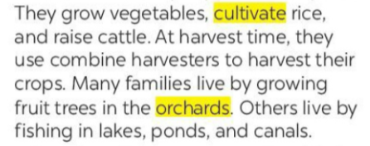
READING
3
Read the text again and tick T (True) or F (False) for each sentence.
F
3. Villagers live only by catching fish in lakes, ponds, and canals.
-> Villagers live by growing vegetables, cultivating rice, raising cattle, growing fruit trees, and fishing in lakes, ponds, and canals.

Slide 19
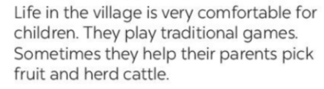
READING
3
Read the text again and tick T (True) or F (False) for each sentence.
4. The children are always busy helping their parents.
F
-> The children sometimes help their parents pick fruit and herd cattle.

Slide 20
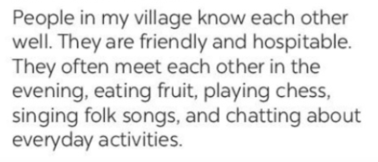
READING
3
Read the text again and tick T (True) or F (False) for each sentence.
T
5. The villagers get along well.

Slide 21

READING
3
Read the text again and tick T (True) or F (False) for each sentence.
 | T | F
1. Life in the author’s village is very peaceful.
2. The people in the village work very hard.
3. Villagers live only by catching fish in lakes, ponds, and canals.
4. The children are always busy helping their parents.
5. The villagers get along well.

Slide 22
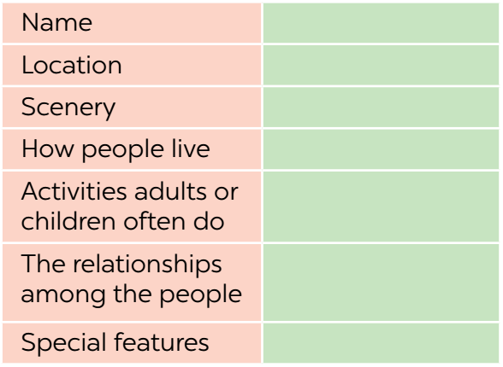
SPEAKING
4
Make notes about the village or town where you live or which you know.

Slide 23

SPEAKING
5
Work in groups. Take turns to talk about the village or town where you live or which you know. Use the information in 4.
Example

Slide 24


Slide 25
SPEAKING
4
Make notes about the village or town where you live or which you know.
Lam Dong
Central Highlands
beautiful, pine forests,
garden, mountains
close to nature, work hard
plant vegetables,
enjoy outdoor activities
warm, hospitable
cool climate, many flowers,
old French houses

Slide 26

CONSOLIDATION
1
Wrap-up
What have we learnt in this lesson?
read about different aspects of a Vietnamese village;
talk about a village or town where one lives or which one knows;

Slide 27

CONSOLIDATION
2
Homework
Do exercises in the workbook.

