Slide 1
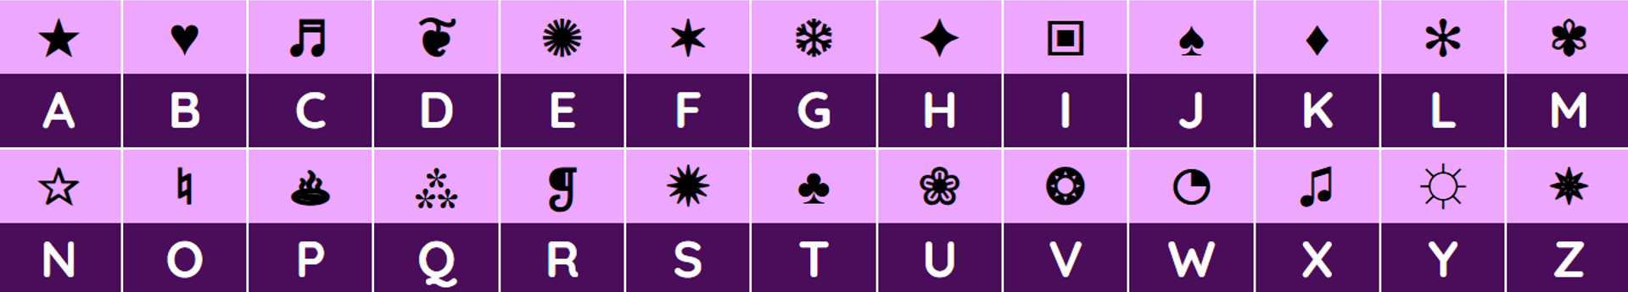
WARM-UP: BRAINSTORMING
Secret Code Game
Notes:
Secret Code Chart . Each symbol is a letter. Work in teams, decode the secret word. One team member will come to the board to write the answer

Slide 2
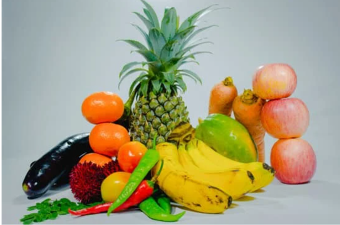
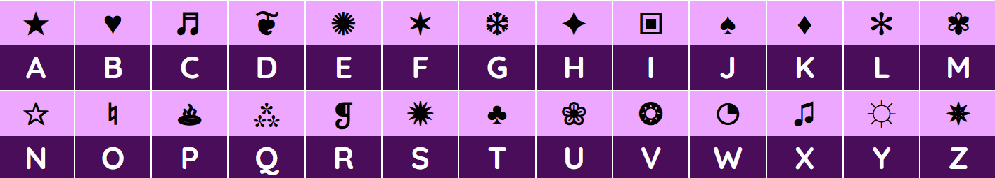
Secret Code Game
FRUIT

Slide 3
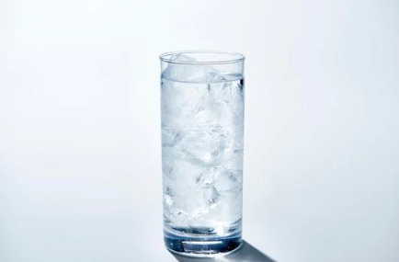
Secret Code Game
WATER

Slide 4
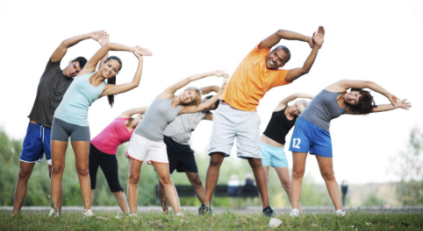

Secret Code Game
EXERCISE
Notes:
Verb phrase : do exercise

Slide 5
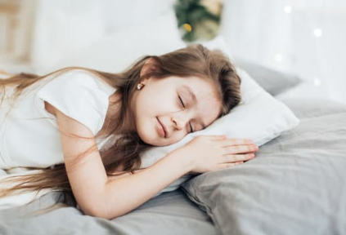
Secret Code Game
SLEEP
Notes:
Can you repeat 4 words?
Congrat winning team

Slide 6

WARM-UP: BRAINSTORMING
HEALTHY LIVING
Notes:
To stay strong and healthy, we need to eat fruit, drink water, do exercise, and sleep well. All of these are part of healthy living.
Today we are going to learn about healthy living.

Slide 7



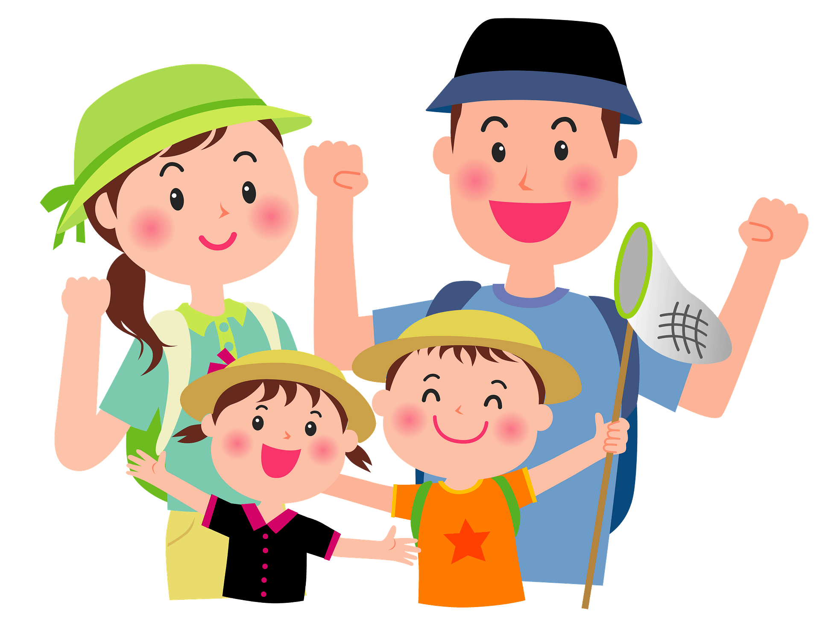
Unit
2
HEALTHY LIVING
LESSON 1: GETTING STARTED
Let’s go out!
Unit
HOBBIES

Slide 8
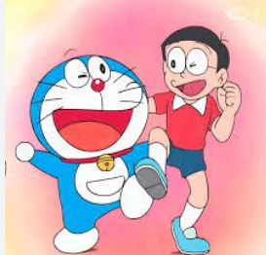

Vocabulary
popular (a)
/ˈpɒpjələ(r)/
phổ biến, nổi tiếng
Notes:
liked, enjoyed, or supported by many people

Slide 9

Vocabulary
fresh (a)
/freʃ/
tươi, mới
Fresh air is good for health.
Notes:
How are the vegetables?

Slide 10

Vocabulary
join (v)
/dʒɔɪn/
tham gia
Notes:
to become a member of an organization
to do something with or be with someone or something:

Slide 11

Vocabulary
Bring along
/brɪŋ/
/əˈlɒŋ/
mang theo, đem theo

Slide 12
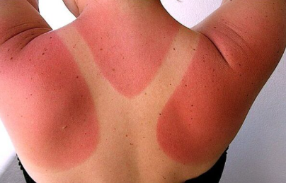
Vocabulary
sunburn (n)
/sʌn/
/bɜːn/
cháy nắng
Notes:
Get sunburn

Slide 13
Vocabulary
New words | Pronunciation | Meaning
popular (a) | /ˈpɒpjələr/ | phổ biến, nổi tiếng
fresh (a) | /freʃ/ | tươi, mới
join (v) | /dʒɔɪn/ | tham gia
bring along | /brɪŋ//əˈlɒŋ/ | mang theo, đem theo
sunburn (n) | /sʌn/ /bɜːn/ | cháy nắng
Notes:
Great! Now we’ve learned some useful words about healthy living. Let’s see how these words are used in a real conversation.

Slide 14
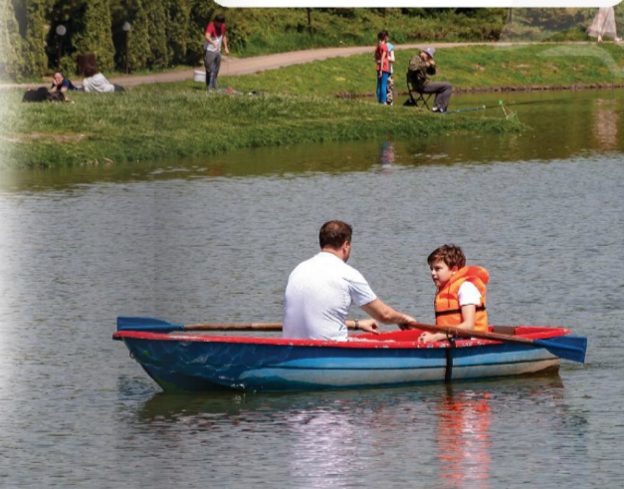
1. The people are in the park.
2. They are fishing.
3. The weather is rainy.
Notes:
Look at the picture. Read these sentences and decide Yes or No. We will check after reading

Slide 15
1
LISTEN AND READ.
Mi: This is a nice picture, Mark.
Mark: That’s my dad and I boating at Yen So Park.
Mi: It also see a lot of people exercise there.
Mark: Yes, it’s a popular place for people in my neighbourhood.
Mi: Outdoor activities are good for our health. My family often goes cycling in the countryside. It’s quiet and there’s a lot of fresh air.
Mark: It sounds interesting.
Mi: Yes, it’s lots of fun. We also bring fruit, water, and a lunch box with us.
Mark: I’d love to join you next time.
Mi: Sure. Bring along a hat and suncream.
Mark: Why suncream?
Mi: It’s really hot and sunny at noon so you might get sunburn.
Mark: I see.
Notes:
Ask ss to close their books, listen once, find the word, phrase related to the topic. -> play the audio-> ask the answer.
Ask ss open their books. Ask students to read the dialogue silently in their books Play the audio recording twice. Ask students to listen carefully and check the pronunciation.

Slide 16

LISTEN AND READ.
Mi: This is a nice picture, Mark.
Mark: That’s my dad and I boating at Yen So Park.
Mi: It also see a lot of people exercise there.
Mark: Yes, it’s a popular place for people in my neighbourhood.
Mi: Outdoor activities are good for our health. My family often goes cycling in the countryside. It’s quiet and there’s a lot of fresh air.
Mark: It sounds interesting.
Mi: Yes, it’s lots of fun. We also bring fruit, water, and a lunch box with us.
Mark: I’d love to join you next time.
Mi: Sure. Bring along a hat and suncream.
Mark: Why suncream?
Mi: It’s really hot and sunny at noon so you might get sunburn.
Mark: I see.
Notes:
Ask 2 ss read. Give fb. Check the word.

Slide 17
The people are in the park. Yes
2. They are fishing. No
3. The weather is rainy. No
Notes:
Now you have read the dialogue. Let’s see if you understand it. Read the sentences and choose the best answer.

Slide 18

PRACTICE
2
Circle the correct answer.
1
1. What are Mark and Mi talking about?
A. Health problems
B. Healthy activities
C. Sports and games
Mi: I also see a lot of people exercising there.
Mark: Yes, it’s a popular place for people in my neighbourhood.
Notes:
Good job! In the dialogue, we saw many activities and things people use outdoors. Now look at these pictures. Can you match the correct words or phrases under each picture?”

Slide 19
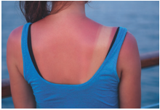

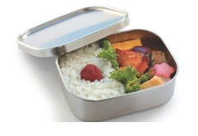
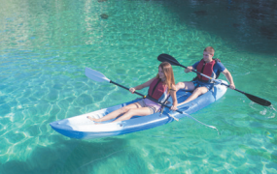
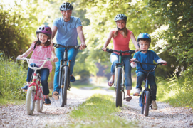
PRACTICE
3
Match a word or phrase from the box under its picture.
boating suncream lunch box sunburn cycling
1.
sunburn
2.
suncream
3.
lunch box
4.
boating
5.
cycling
Notes:
You know the words now. Let’s use them in sentences. Complete each sentence with a word from the conversation

Slide 20
PRACTICE
4
Complete each sentence with a word from the conversation.
1. In the picture, Mark and his father are __________.
boating
Mi: This is a nice picture, Mark.
Mark: That’s my dad and I boating at Yen So Park.
2. The people in Mark’s neighbourhood love to go to the _________ .
park
Mi: It also see a lot of people exercise there.
Mark: Yes, it’s a popular place for people in my neighbourhood.

Slide 21
PRACTICE
4
Complete each sentence with a word from the conversation.
3. Mi’s family often goes cycling in the ___________.
countryside
Mi: Outdoor activities are good for our health. My family often goes cycling in the countryside. It’s quiet and there’s a lot of fresh air.
4. - I don’t want to get sunburn.
- Wear a hat and use __________.
suncream
Mi: Sure. Bring along a hat and suncream.
Mark: Why suncream?
Mi: It’s really hot and sunny at noon so you might get sunburn.

Slide 22
PRACTICE
4
Complete each sentence with a word from the conversation.
5. Fruit and water are good for our _________ .
health
Mi: Yes, it’s lots of fun. We also bring fruit, water, and a lunch box with us.

Slide 23

PRODUCTION
4
Survey: Good or bad for health.
1. What daily activity do you usually do?
2. How often do you do this activity?
3. Is this activity good or bad for your health? Reason?
Notes:
Write down two daily activities you usually do. Then decide if they are good or bad for health

Slide 24


Slide 25
PRODUCTION
4
Survey: Good or bad for health.
Example:
Mai: Hi Hoa, what daily activity do you usually do?
Hoa: I usually read books in the evening.
Mai: How often do you do this activity?
Hoa: I read books every day.
Mai: Is this activity good or bad for your health? Why?
Hoa: It’s good for my health because it helps me relax and learn new things.
Mai: That sounds interesting!

Slide 26
PRODUCTION
4
Survey: Good or bad for health.
Name | Daily activities | How often | Good ( Reason) | Bad (Reason)
1. What daily activity do you usually do?
2. How often do you do this activity?
Is this activity good or bad for your health?
Reason?

Slide 27
PRODUCTION
4
Survey: Good or bad for health.
Name | Daily activities | How often | Good (Reason) | Bad (Reason)
Khanh | Walking to school | Every day | √ It keeps your body fit.
Nam | Eating breakfast | Rarely |  | √ You have no energy for studying.
Chi | Going swimming | Twice a week | √ It helps you stay healthy.
Ly | Sleeping | 12 hours per day |  | √ It makes you lazy.
Notes:
Some activities are good for health, such as walking, swimming, and eating breakfast. They give us energy, make our bodies strong, and help us stay active.
However, some activities can be bad if we do them too much or too little
The most important thing is balance. We should keep good habits every day and avoid unhealthy ones to stay healthy and happy

Slide 28
CONSOLIDATION
1
WRAP-UP
HEALTHY LIVING
Things to go out
Healthy activities
Topic of the unit
Vocabulary

Slide 29
CONSOLIDATION
2
HOMEWORK
- Do exercises in the workbook.
- Prepare the vocabulary for the next lesson: A closer look 1.
- Start preparing for the Project of the unit.

