Slide 2
QUANG HIEP SECONDARY SCHOOL
WELLCOME TO OUR CLASS !
Presented by: HỒ THỊ HỒNG THẮM

Slide 3
Crossword
LET’S DO
THIS CROSSWORD!
LET’S DANCE 1

Slide 5
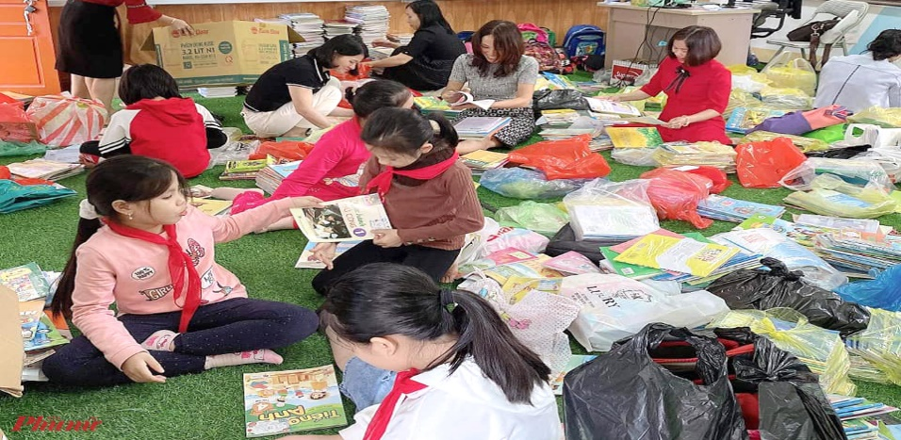
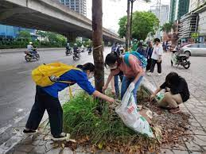
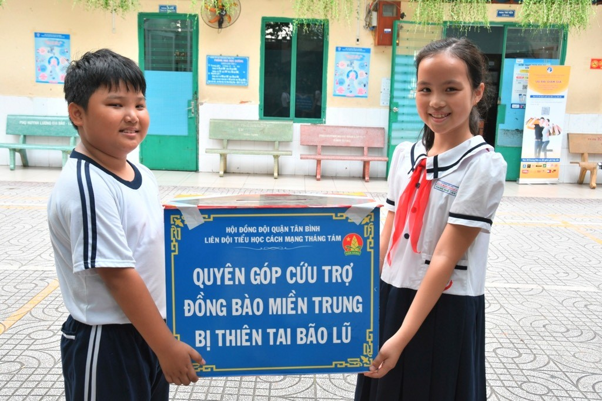
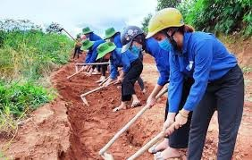
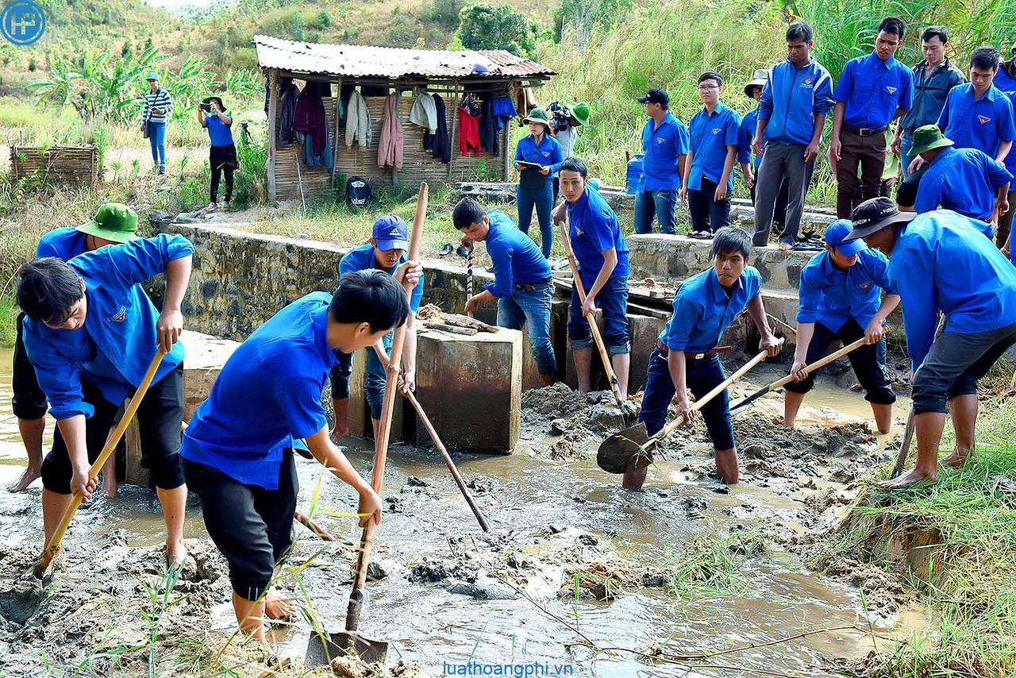
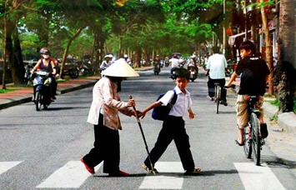
Community activities / services
Collecting old books to poor children
Collecting trash on the streets
Donating money for flooded area
Making roads in remote areas
Cleaning on the canals
Helping old people

Slide 6
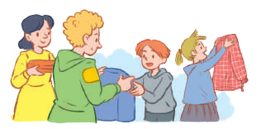
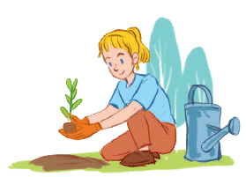
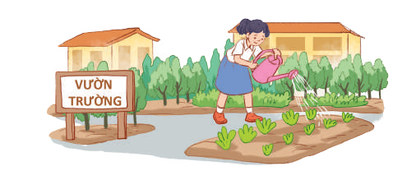
Unit 3 : Community services
PERIOD :16
Lesson 1: Getting started
Sounds like great work!

Slide 7
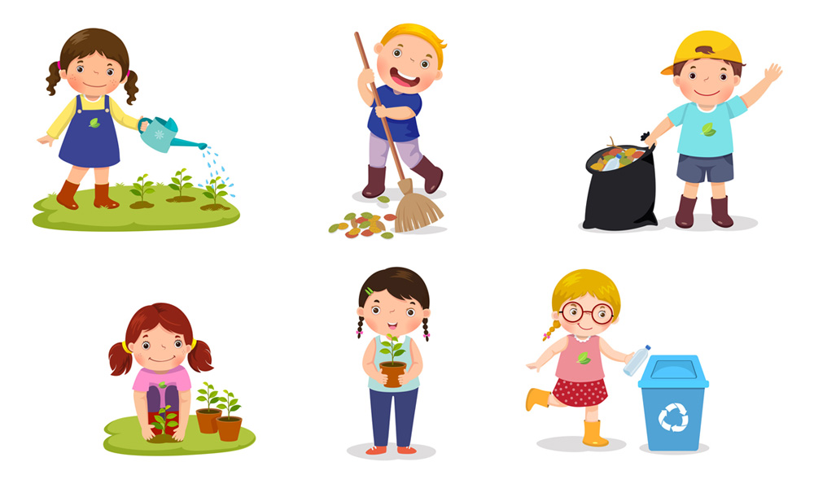
Vocabulary :
community activity (n.phr.)
/kəˈmjuːnɪti ækˈtɪvɪti/
hoạt động cộng đồng

Slide 8
Vocabulary
donate (v)
/dəʊˈneɪt/
We collect/ donate books to poor children
quyên góp, ủng hộ
blood
/clothes
/ money

Slide 9
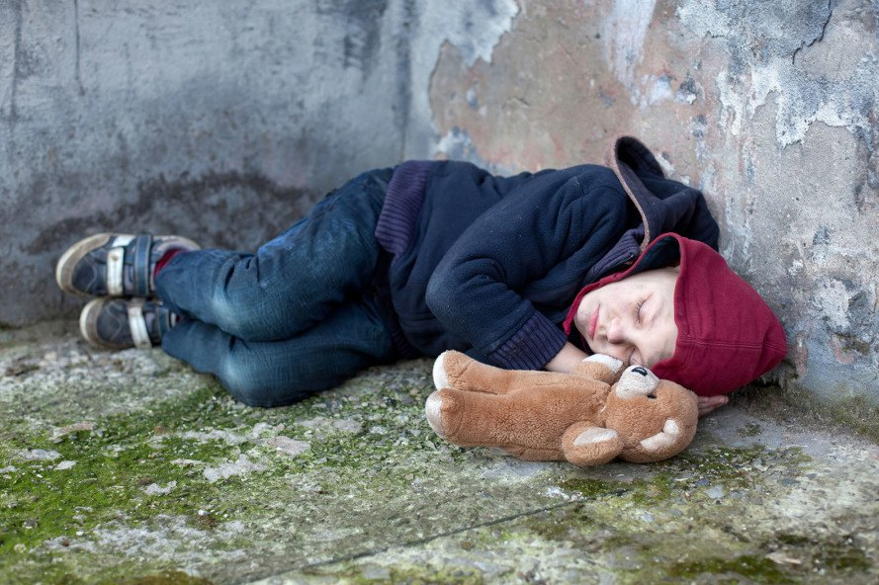
Vocabulary
homeless (adj)
/ˈhəʊmləs/
vô gia cư
He is poor, he doesn’t have a house.
He ‘s homeless

Slide 10
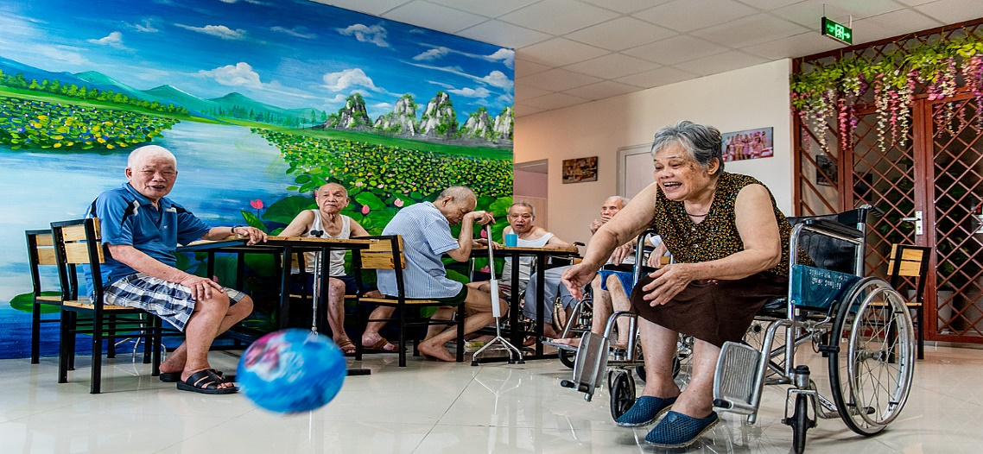
Vocabulary
nursing home (n.phr.)
/ˈnɜːsɪŋ həʊm/
viện dưỡng lão

Slide 11
Vocabulary
Pick up litter (v.ph)
/pɪk ʌp ˈliːtə/
Nhặt rác

Slide 12
Vocabulary
New words | Pronunciation | Meaning
community activity | /kəˈmjuːnɪti ækˈtɪvɪti/ | hoạt động cộng đồng
donate | /dəʊˈneɪt/ | quyên góp, ủng hộ
nursing home | /ˈnɜːsɪŋ həʊm/ | viện dưỡng lão
homeless | /ˈhəʊmləs/ | vô gia cư
pick up litter | /pɪk ʌp ˈliːtə/ | Nhặt rác

Slide 13
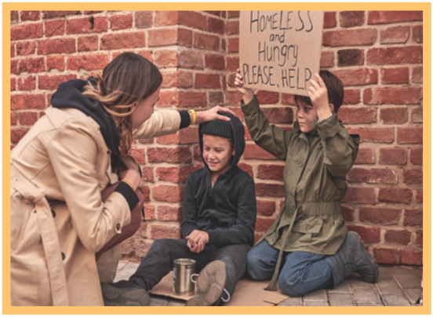
Name the activities
1
2
3
Homeless children
Picking up litter
Donating money
4
5
Community activity
Nursing home

Slide 14
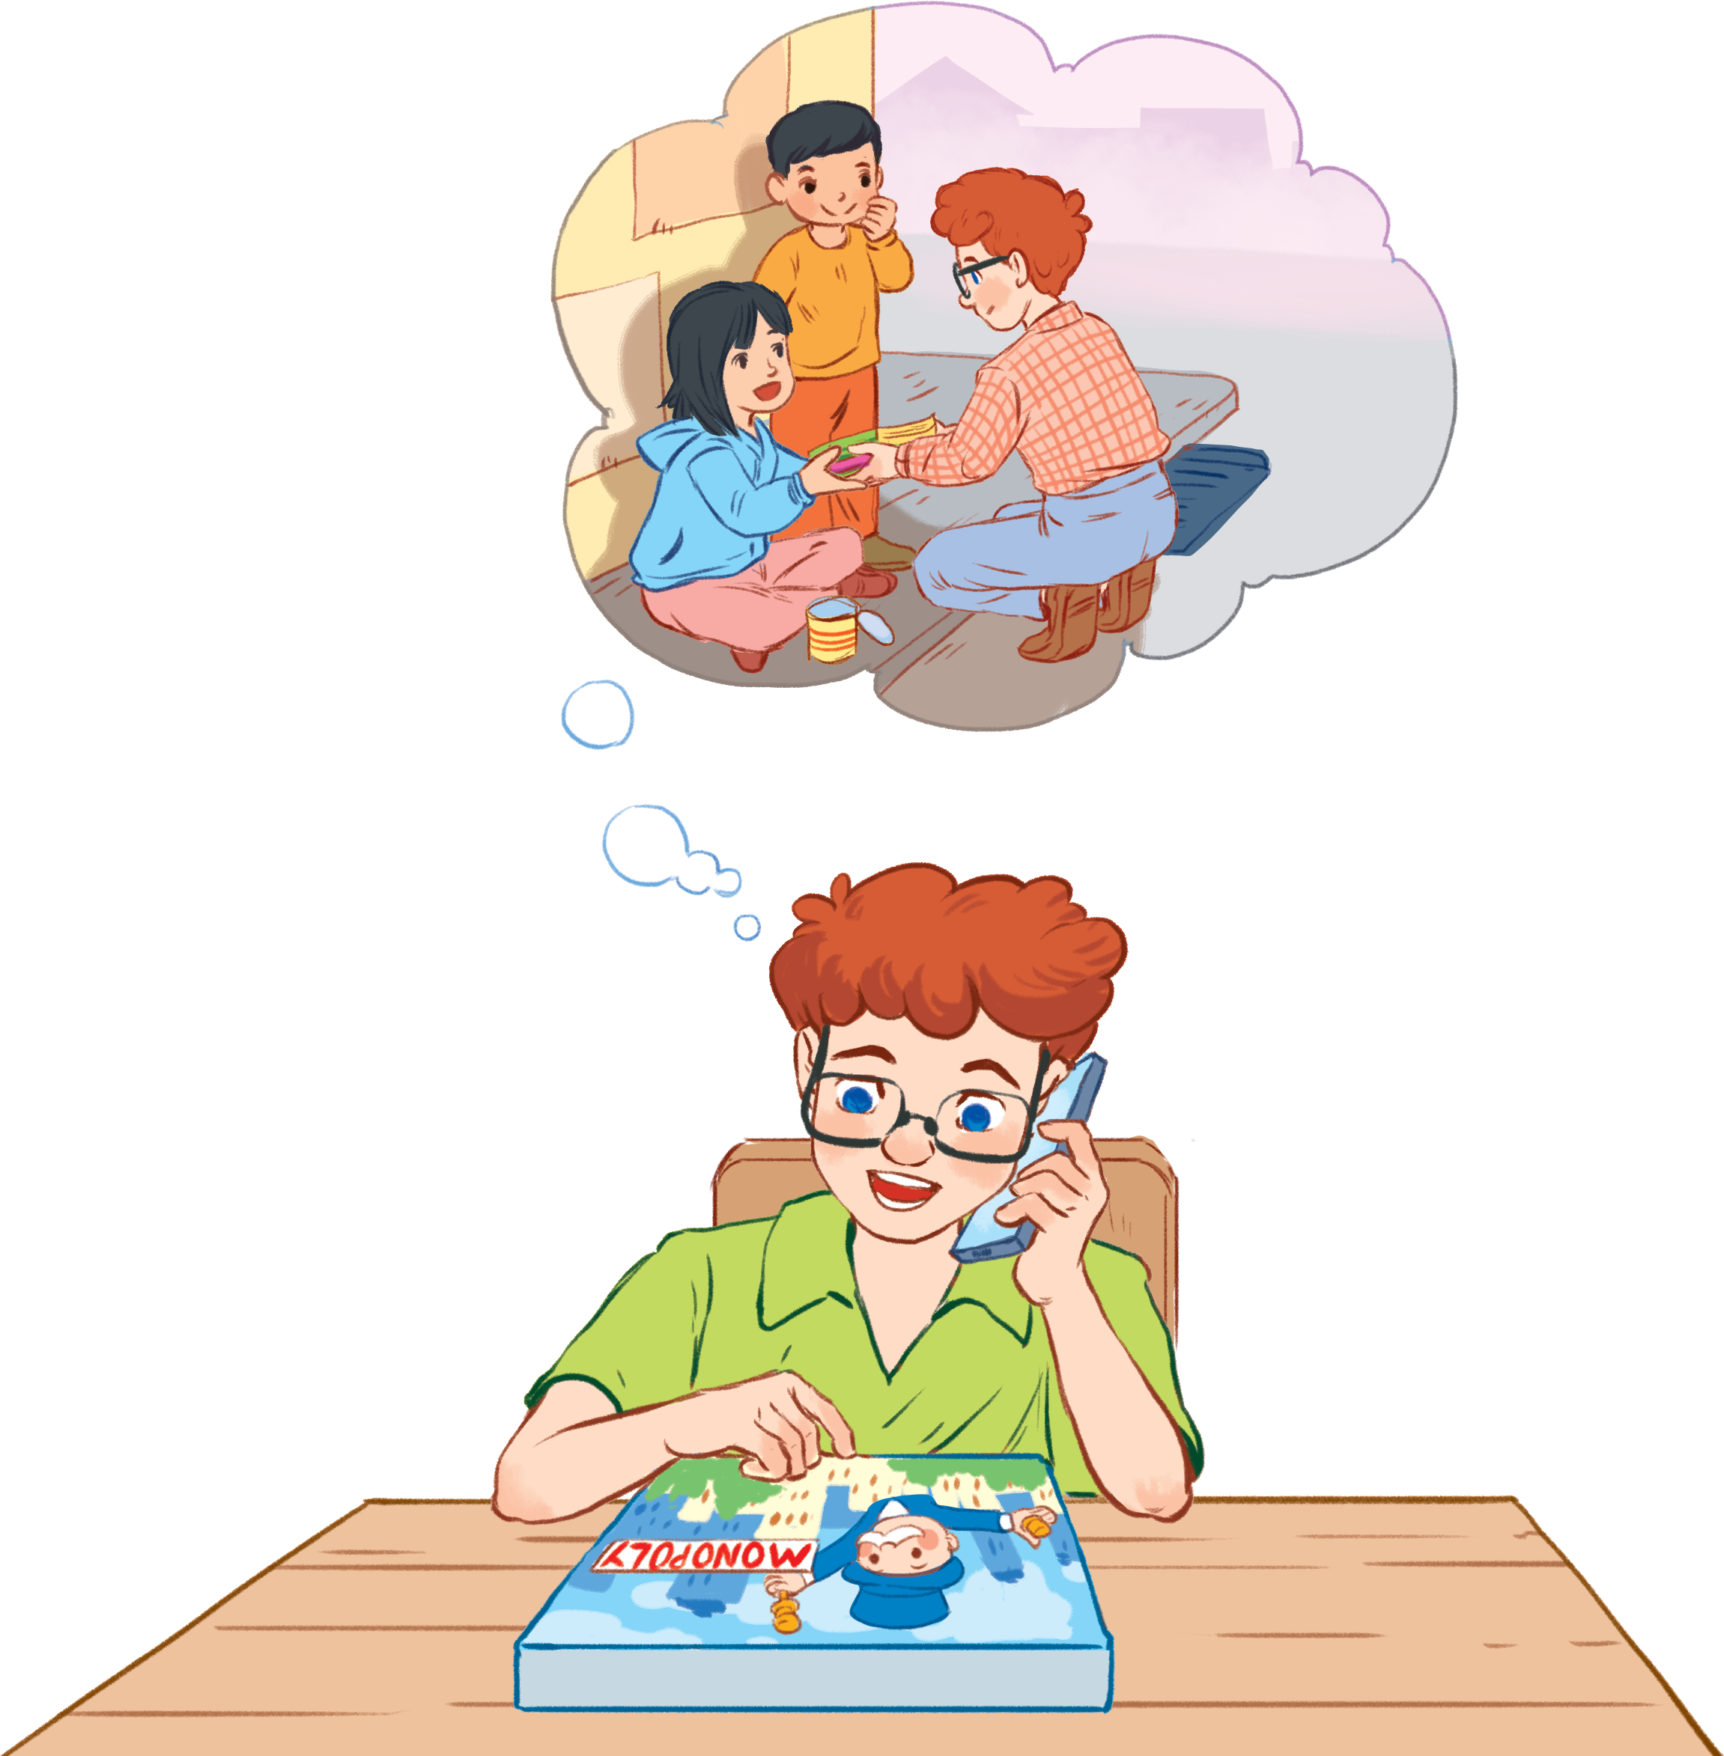
1. Listen and choose the best answer
Minh
What activities do Tom’s club and Minh’s club do
to help the community?
1. Minh’ club ………in the school garden.
a. plants trees.
b. plants flowers.
c. plants vegetables.
Tom
2. Tom’s club ………... for kids.
a. teaches Math
b. teaches English
c. teaches History.

Slide 15
PRACTICE
1
Listen and read.
Minh: Hi, Tom. Are you back in Ha Noi? Tom: Yes. I came back yesterday. Can we meet up this Sunday morning? I bought you a board game. Minh: Sure, I can’t wait! But our Green School Club will have some community activities on that morning. Tom: What activities does your club do? Minh: Well, we pick up litter around our school and plant vegetables in our school garden. Tom: School gardening? That’s fantastic! Minh: Yes. We donate the vegetables to a nursing home. Does your school have any activities like these? Tom: Yes. We donate books to homeless children. We also have English classes. Last summer, we taught English to 30 kids in the area. Minh: Sounds like great work! Tom: Thanks. Minh: ... So, let’s meet in the afternoon then.

Slide 16
1. Listen and choose the best answer
Minh
What activities do Tom’s club and Minh’s club do
to help the community?
1. Minh’ club ………in the school garden.
a. plants trees.
b. plants flowers.
c. plants vegetables.
Tom
C
2. Tom’s club ………... for kids.
a. teaches Math
b
b. teaches English
c. teaches History.

Slide 17
PRACTICE
1
Read.
Minh: Hi, Tom. Are you back in Ha Noi? Tom: Yes. I came back yesterday. Can we meet up this Sunday morning? I bought you a board game. Minh: Sure, I can’t wait! But our Green School Club will have some community activities on that morning. Tom: What activities does your club do? Minh: Well, we pick up litter around our school and plant vegetables in our school garden. Tom: School gardening? That’s fantastic! Minh: Yes. We donate the vegetables to a nursing home. Does your school have any activities like these? Tom: Yes. We donate books to homeless children. We also have English classes. Last summer, we taught English to 30 kids in the area. Minh: Sounds like great work! Tom: Thanks. Minh: ... So, let’s meet in the afternoon then.

Slide 18
1. Listen and choose the best answer
Minh
What activities do Tom’s club and Minh’s club do
to help the community?
1. Minh’ club ………in the school garden.
a. plants trees.
b. plants flowers.
c. plants vegetables.
Tom
C
2. Tom’s club ………... for kids.
a. teaches Math
b
b. teaches English
c. teaches History.

Slide 19
PRACTICE
2
Read the conversation again and tick the appropriate box.
Community activity | Minh’s club | Tom’s club
1. picking up litter
2. planting vegetables
3. donating books
4. donating vegetables
5. teaching English

Slide 20
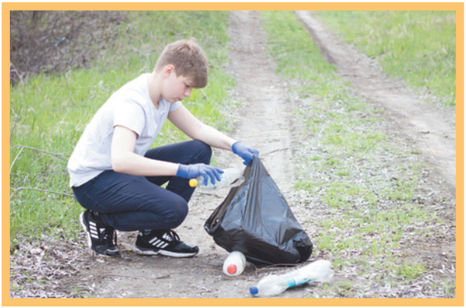
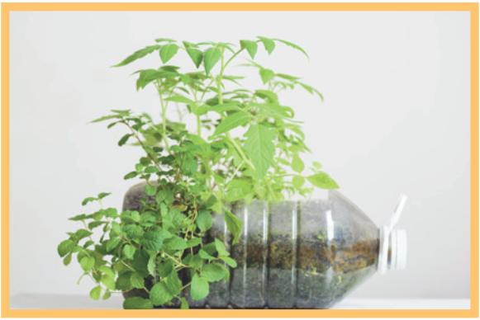
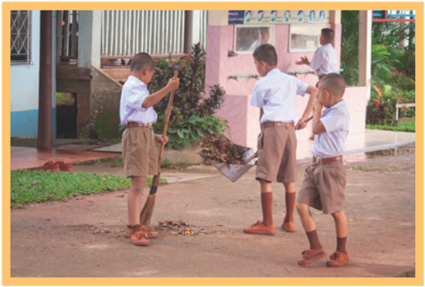
3
Complete the phrases under the pictures with the verbs below.
pick up clean donate recycle help
pick up
help
1. ________ litter
2. ______ homeless children
recycle
3. _______ plastic bottles
donate
4. _________ clothes
clean
5. ________ the playground

Slide 21
PRACTICE
4
Complete the sentences with the correct words or phrases below.
old people homeless children planted litter taught
1. We collected clothes and gave them to _________________. 2. Those students picked up all the __________ on the street. 3. We helped ____________ in the nursing home last Sunday. 4. The club members ________ maths to primary students during school holidays. 5. We __________ a lot of trees in the park last summer.
homeless children
litter
old people
TEACH
taught
planted

Slide 22
Making survey :
1.What activities do you often do to help the community ? If not
2. What activities do you want do help the community ? Why ?
3. How do you feel when you do these activities?
Names | Activities | Feeling

Slide 23
Making survey :
1.What activities do you often do to help the community ? If not
2. What activities do you want do help the community ? Why ?
3. How do you feel when you do these activities?
Names | Activities | Feeling
Miss Tham | Donate money to poor students | happy

Slide 24
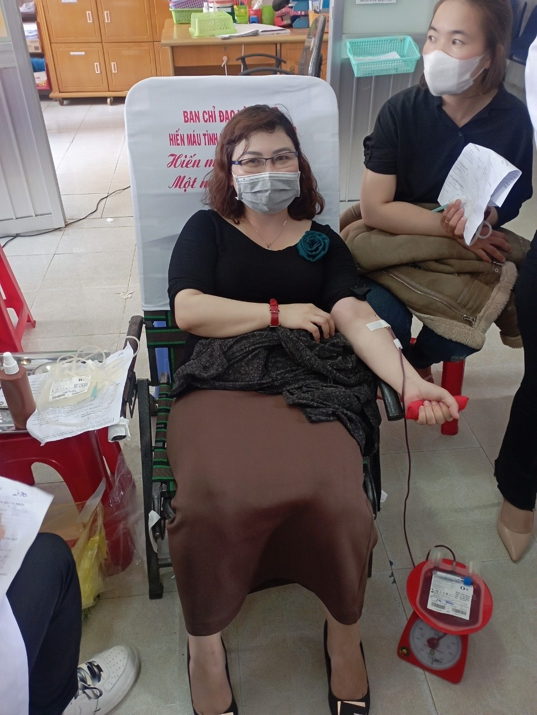
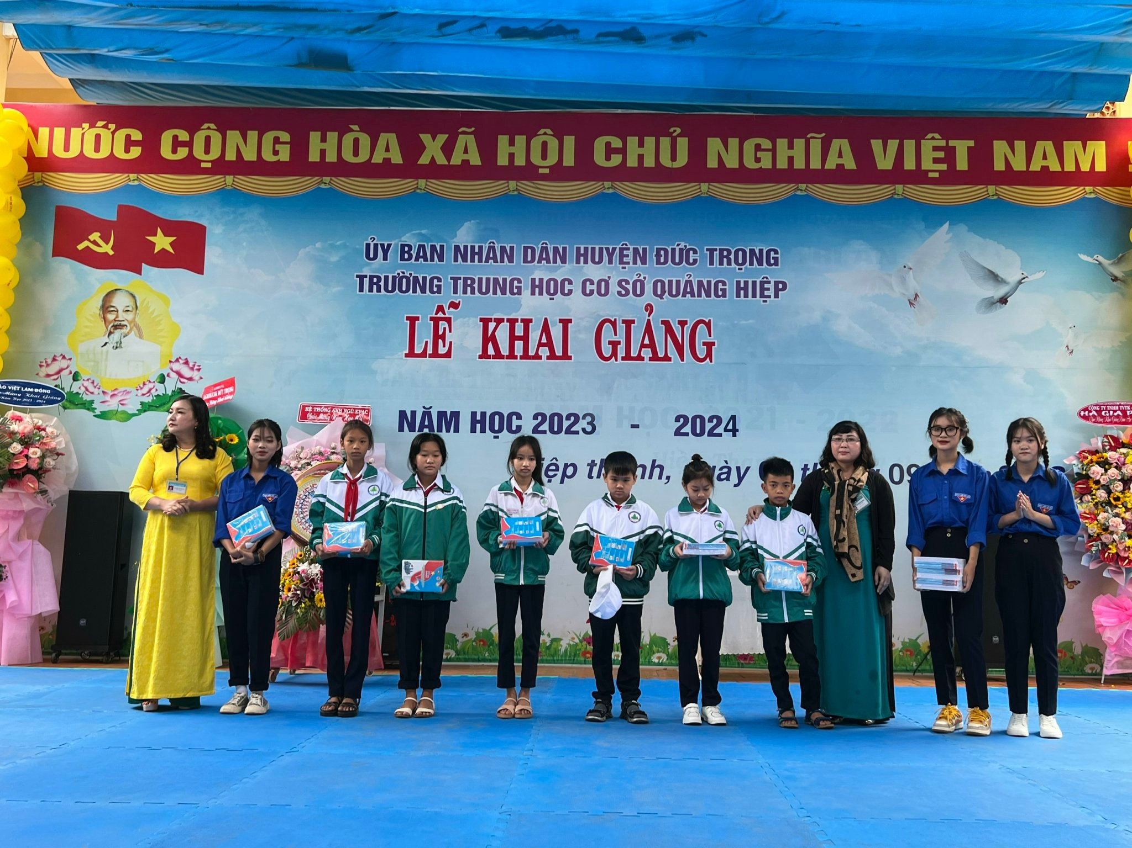
Retell about your community activities

Slide 25
Community activities / services
Collecting old books to poor children
Collecting trash on the streets
Donating money for flooded area
Making roads in remote areas
Cleaning on the canals
Helping old people

Slide 27
Homework
Learn by heart the new words.
List 3 community activities that students can do ( at least 3 activities)
Prepare projects: Think about some environmental problems in your neighborhood and the solutions to those problems.

Slide 28
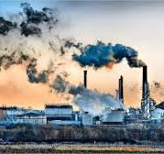
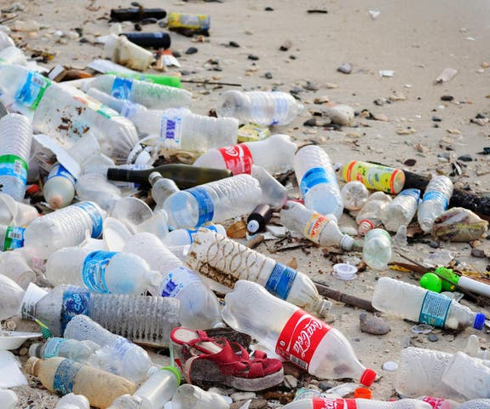
Projects
Give your environmental problems in your neighborhood – Give solutions .
Too much trash/ litter
Air pollution

Slide 29
PRACTICE
1
Listen and read.
Minh: Hi, Tom. Are you back in Ha Noi? Tom: Yes. I came back yesterday. Can we meet up this Sunday morning? I bought you a board game. Minh: Sure, I can’t wait! But our Green School Club will have some community activities on that morning. Tom: What activities does your club do? Minh: Well, we pick up litter around our school and plant vegetables in our school garden. Tom: School gardening? That’s fantastic! Minh: Yes. We donate the vegetables to a nursing home. Does your school have any activities like these? Tom: Yes. We donate books to homeless children. We also have English classes. Last summer, we taught English to 30 kids in the area. Minh: Sounds like great work! Tom: Thanks. Minh: ... So, let’s meet in the afternoon then.

Slide 30
PRACTICE
1
Listen and read.
Minh: Hi, Tom. Are you back in Ha Noi? Tom: Yes. I came back yesterday. Can we meet up this Sunday morning? I bought you a board game. Minh: Sure, I can’t wait! But our Green School Club will have some community activities on that morning. Tom: What activities does your club do? Minh: Well, we pick up litter around our school and plant vegetables in our school garden. Tom: School gardening? That’s fantastic! Minh: Yes. We donate the vegetables to a nursing home. Does your school have any activities like these? Tom: Yes. We donate books to homeless children. We also have English classes. Last summer, we taught English to 30 kids in the area. Minh: Sounds like great work! Tom: Thanks. Minh: ... So, let’s meet in the afternoon then.

